Slide 1
AlgoTrading

Slide 2
Takeaways from Version 1...
Important Points
Plot correlation between 10 tickers
60% stocks/ 30% bonds/ 10% gold
Equal weightage
MACD (12, 26, 9)
Weigh recent data higher
Daily resolution
No shorting
self.equities = ["AAPL", "PG", "AMGN", "EXC",
"LULU", "MNST", "TLT", "LQD",
"BNDX", "GLD"]
self.weight = 1.0/len(self.equities)
self.MACD(symbol, 12, 26, 9,
MovingAverageType.Exponential,
Resolution.Daily)

Slide 3
Correlation Table
Stocks | AAPL | PG | AMGN | EXC | LULU | MNST | TLT | LQD | BNDX | GLD
AAPL | 1
PG | 0.428281 | 1
AMGN | 0.490143 | 0.45775 | 1
EXC | 0.389153 | 0.548459 | 0.364004 | 1
LULU | 0.39427 | 0.222064 | 0.278597 | 0.304655 | 1
MNST | 0.428159 | 0.446115 | 0.365216 | 0.433684 | 0.309002 | 1
TLT | -0.29341 | -0.17932 | -0.28636 | -0.18298 | -0.14181 | -0.17929 | 1
LQD | 0.165152 | 0.175405 | 0.085664 | 0.238831 | 0.167088 | 0.181116 | 0.46424 | 1
BNDX | 0.042449 | 0.129161 | -0.02353 | 0.21625 | 0.083448 | 0.095015 | 0.538644 | 0.537164 | 1
GLD | -0.00938 | 0.049377 | -0.0325 | 0.124397 | 0.00339 | 0.05597 | 0.35139 | 0.338778 | 0.337529 | 1

Slide 4
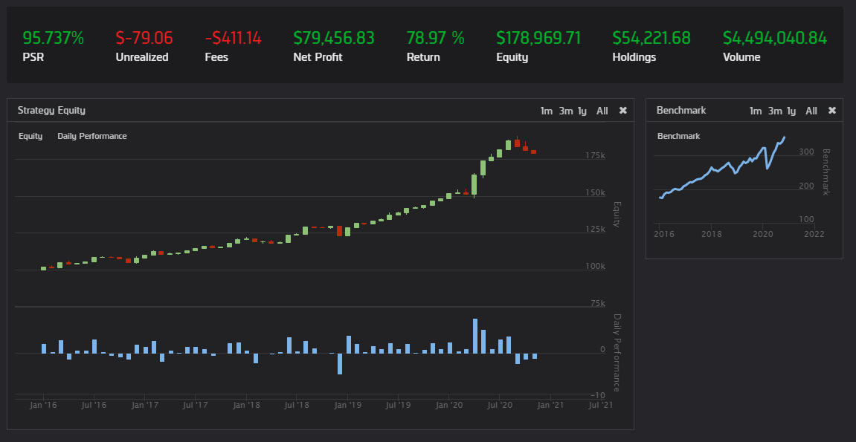

Slide 5
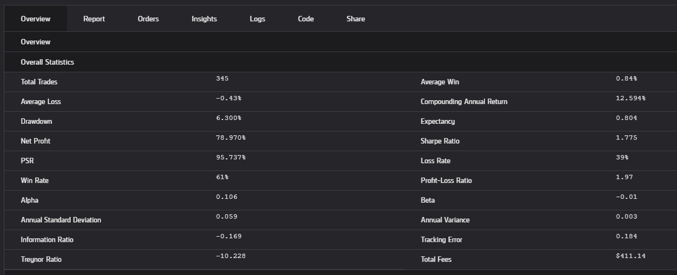
Overview- Version 1

Slide 6
Revised Strategy
Identify…
or rather
Re-identify
Re-identification of Potential Markets
Shift towards tech-focused portfolio;
"ADBE", "PG", "AMD", "NVDA", "LULU", "MSFT", "TSLA", "CDNS", "VGLT", "NEM"
What’s Next?
Try out the following strategies...
Simulate equal weightage (Cases 1 & 2)
Buy and hold strategy
MACD strategy (w/ liquidation)
Test MPT weightage (Case 3)
https://www.portfoliovisualizer.com/optimize-portfolio
Years 2017 - 2020
Maximum Sharpe Ratio
Monte Carlo Simulation

Slide 7
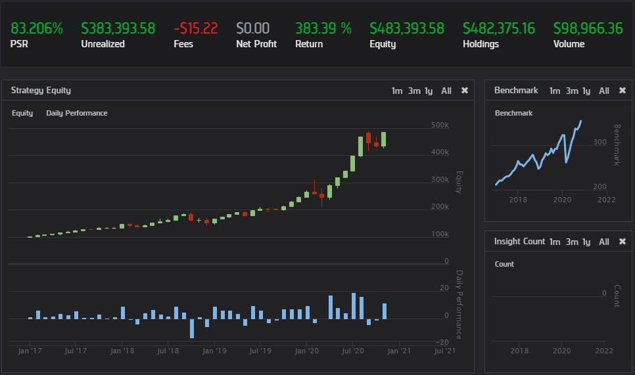
Case 1: Buy and Hold from Day 1

Slide 8
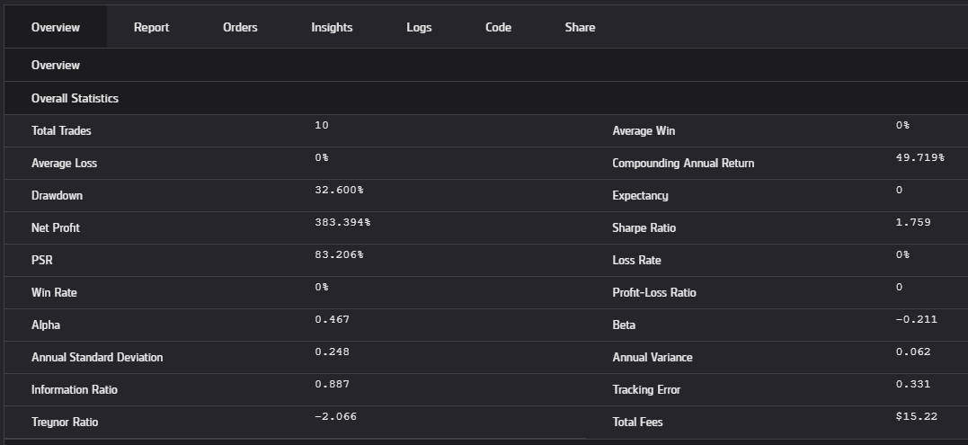
Case 1: Results

Slide 9
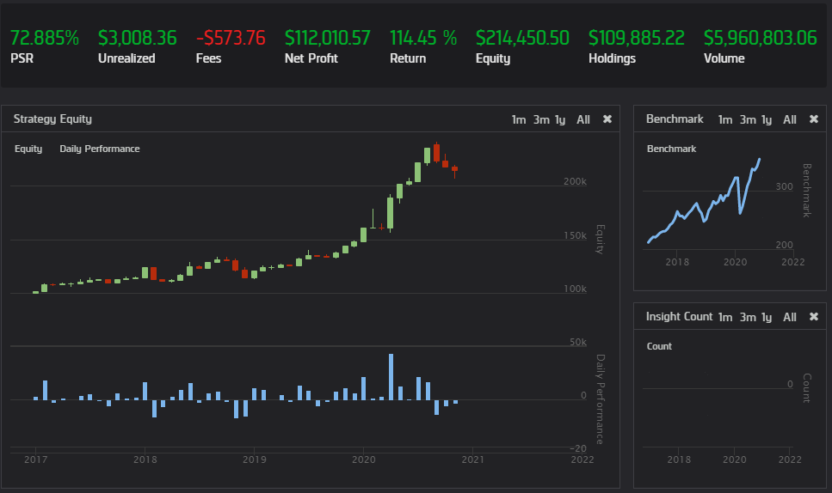
Case 2: MACD Strategy (with Liquidation)

Slide 10
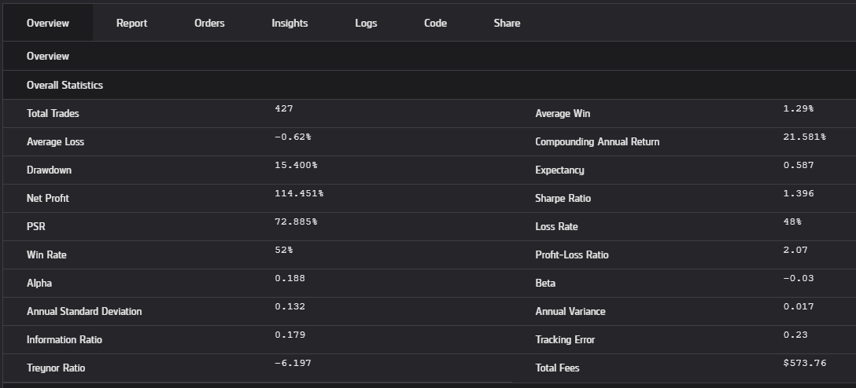
Case 2: Results

Slide 11
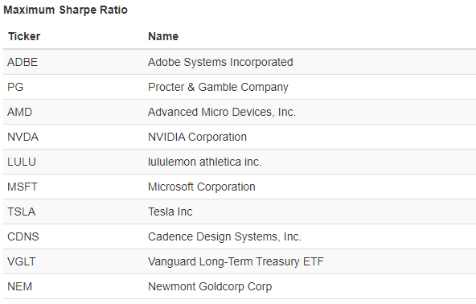
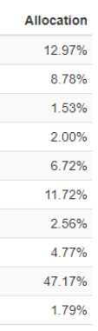
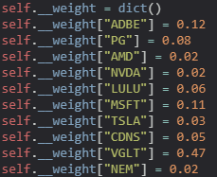
Case 3: Portfolio Optimisation
Data obtained from: https://www.portfoliovisualizer.com/optimize-portfolio#analysisResults

Slide 12
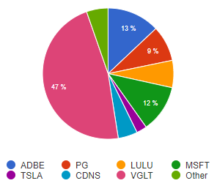
Case 3: Portfolio Performance Summary
Metric | Maximum Sharpe Ratio
Start Balance | $10,000
End Balance | $25,828
CAGR | 28.09%
Expected Return | 28.64%
Stdev | 9.55%
Best Year | 36.87%
Worst Year | 11.40%
Max. Drawdown | -6.27%
Sharpe Ratio (ex-ante) | 2.85
Sharpe Ratio (ex-post) | 2.51
Sortino Ratio | 6.59
US Stock Market Correlation | 0.66
VaR = -2.36%, CVaR = -3.91%
Data obtained from: https://www.portfoliovisualizer.com/optimize-portfolio#analysisResults

Slide 13
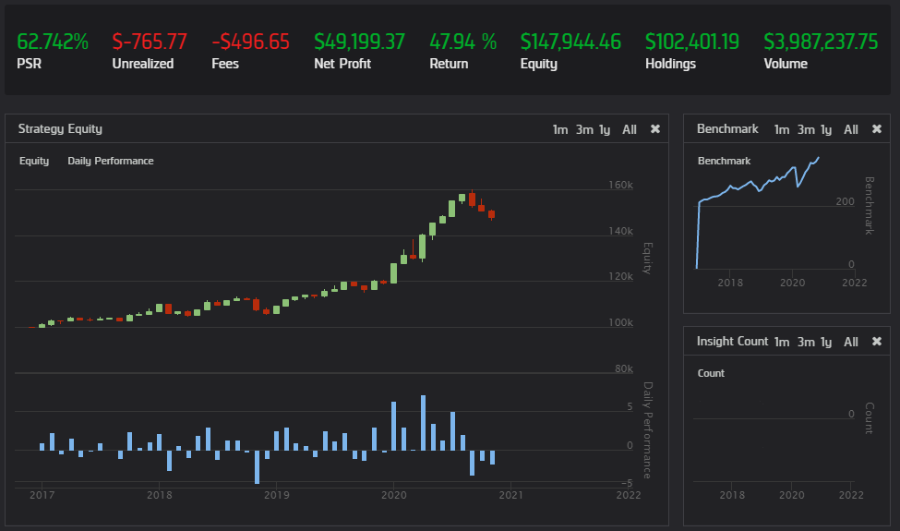
Case 3: MPT Weightage (Static)

Slide 14
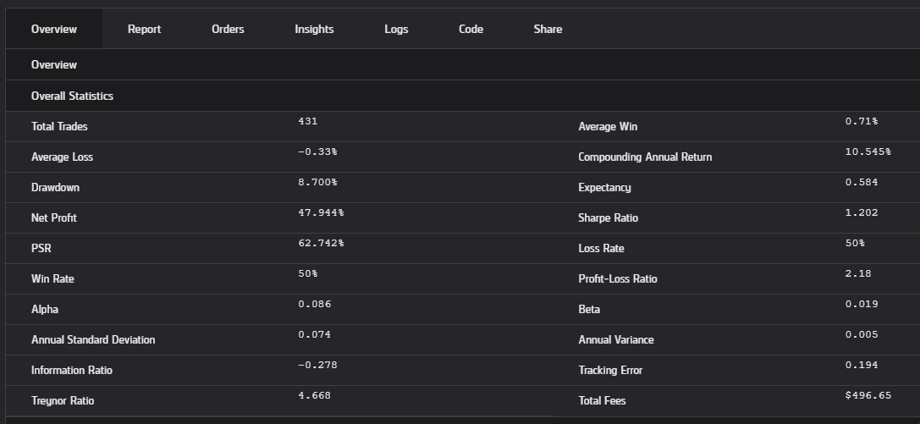
Case 3: Results

Slide 15
Observations for Case 3
Profit-loss for MPT actually increased.
Net Profits: ↓ as average win ↓
Win Rate: Unchanged
Sharpe Ratio: ↓ but still > 1
Beta: ≈ 0
Drawdown: reduced by ≈ 50%
Overall:
MPT win smaller, lose smaller but no. of trades stayed the same
Notable difference between portfoliovisualizer.com results & backtest results
 | Buy n Hold (Equal Weightage) | MACD (Equal Weightage) | MACD (MPT Weightage)
Returns | 383.39 | 114.45 | 47.94
Sharpe Ratio | 1.759 | 1.396 | 1.202
Beta | -0.211 | -0.03 | 0.019
Drawdown | 32.6 | 15.4 | 8.7

Slide 16
Other Commentary
Buying
When we tried to short the stock when the algo says to buy it perform exactly as we expected: the portfolio kept on losing money.
Thus, when the algo says to buy it, we set holdings according to the portfolio weightage (unchanged).
Selling
However, when we tried to short the stock when the algo says to sell it (currently it is liquidating), the portfolio returns are lower.
This indicates that we need to refine the criteria for liquidating or shorting.
We suspect that it is because the stocks are generally bullish and the current selling signals are false positives.

Slide 17
Our Strategy
2. Decide
Moving Forward
With Case 3
Decide
Moving Average Convergence Divergence (MACD):
a trend-following momentum indicator that shows the relationship between two moving averages of a security’s price
calculated by subtracting the 26-period Exponential Moving Average (EMA) from the 12-period EMA.
Confirm
Exponential Moving Average:
Calculated using past 200-day data
Familiarise with general movement of stocks
Act as a strong support/resistance

Slide 18

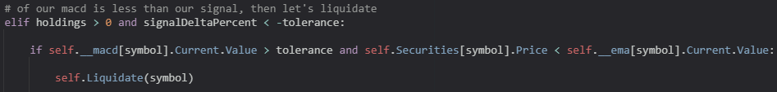
Confirming for Liquidation
Before:
After:

Slide 19
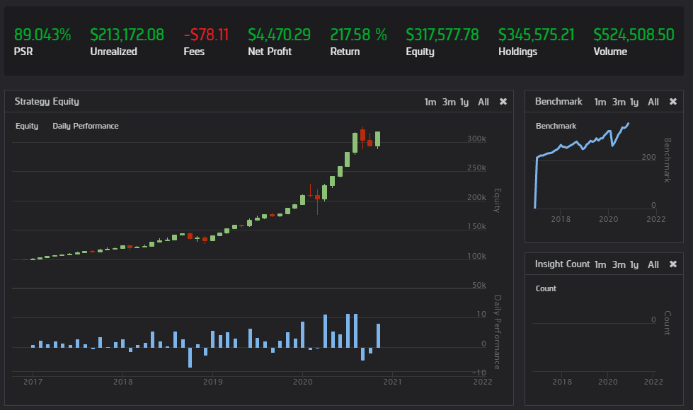
After Confirmation
500% increment

Slide 20

Results with Updated Selling Confirmation
Lower trades; likely due to less false signals
Drawdown increased to ride out temporary dip
Highest Sharpe Ratio in discussion so far
Beta bigger but remains low volatility (<1)

Slide 21
Revised Strategy
3. Manage
Trailing Stop Loss:
Tracks the highest peak
Sets stop loss according to that peak
Exit when price falls below stop loss
Diversify Portfolio:
Distribute the risks
More diversification across different sectors
Adjust the weightages according to individual performance

Slide 22
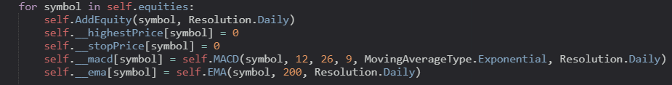
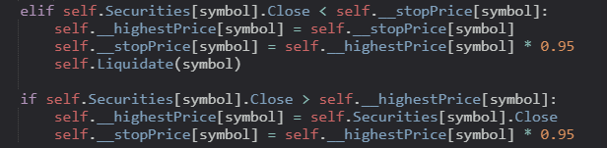
Stop Loss @ -5% from Previous Peak

Slide 23
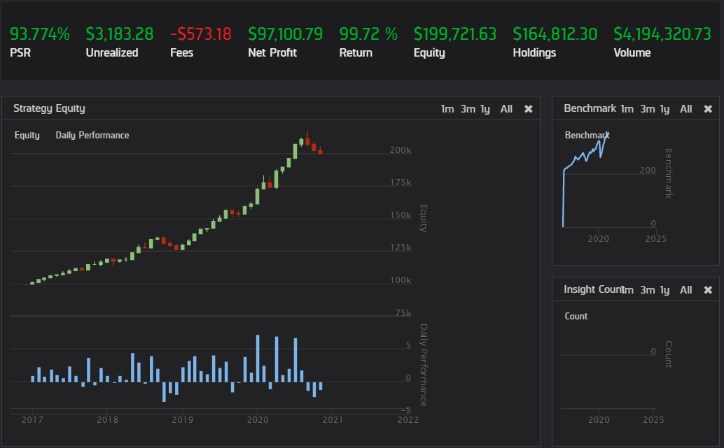
Trailing Stop Loss Effects
Stocks likely to dip much lower than 5%; algo instructed to not get back in until stock prices rise again, missing the gains.

Slide 24
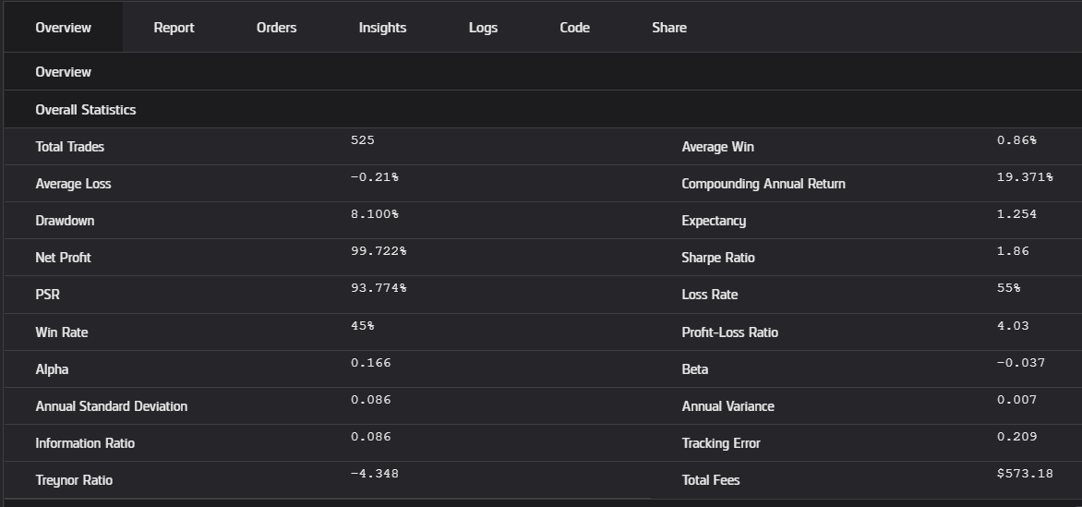
Results with Stop Loss Implemented
More trades from stop loss
Almost a quarter of previous drawdown
Even higher Sharpe Ratio
>100% increase in Profit-Loss Ratio
Lower win rates due to increased frequency of stop loss
Smaller beta

Slide 25
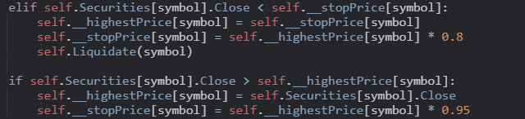
Buying at the Dip
Before:
Idea
Experimented with this value to allow the algo to come back into the market earlier after the initial dip. (Next entry price is lower after liquidating)
After:

Slide 26
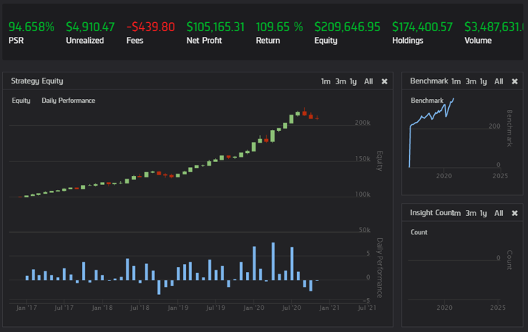
Re-entering the Market

Slide 27
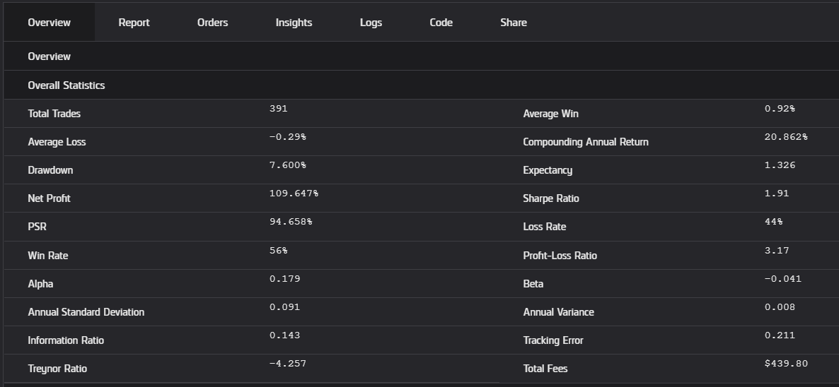
Results
Higher Sharpe Ratio

Slide 28
Comparison
 | Case 3: MACD (MPT Weightage) | MACD w/ EMA(200) & Stop Loss (MPT Weightage)
Returns | 47.94 | 109.65
Sharpe Ratio | 1.202 | 1.91
Alpha | 0.086 | 0.179
Beta | 0.019 | -0.041
Drawdown | 8.1 | 7.6

Slide 29
Revised Strategy
4. Rebalance
Rebalancing of Portfolio
Stop all trades upon a maximum of 15% loss
Liquidate at 85000
Reassess market conditions and reevaluate algorithms before entering the market again
Option for Automated or Manual depending on preference

Slide 30

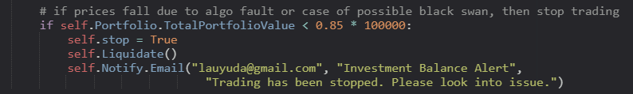
Rebalancing
Automate
When the entire value of the portfolio falls below a certain threshold, it automatically stops all trading.
Sends a notification to the investor.

Slide 31
Rebalancing
Manual
Triggers a notification for investor to look out for possible issues and to stop trade if necessary.
Portfolio can be rebalanced using MPT accordingly by removing or adding other ticker(s).

