Slide 1
MPEG-1
MPEG is short for the ‘Moving Picture Experts Group‘.
The official page: http://cselt.it/mpeg.
The 'official' title of the committee is ‘ISO/IEC JTC1 SC29 Working Group 11’.

Slide 2

MPEG-1 Encoding Flowchart
R
G
B
To Other
Color Space
(Optional)
DPCM
Huffman or
Arithmetic
Coding
Scan
I-Frame
DCT
Quant
Zig-Zag
Y
RLE
I
Q
01001...
IQuant
P B-Frame
Different Image
Motion
Estatimation
Motion
Vector
IDCT
Y
Reconstruct &
Update
I
Q
Forward Frame Buffer
Y
I
Q
Backward Frame Buffer

Slide 3
Motion Estimation
Motion Vector
Motion Estimation
Frame N
Frame N+1
88 84 83 84 85 86 83 82 86 82 82 83 82 83 83 81 82 82 84 87 87 87 81 84 81 86 87 89 82 82 84 87 81 84 83 87 85 89 80 81 81 85 85 86 81 89 81 85 82 81 86 83 86 89 81 84 88 88 90 84 85 88 88 81
84 82 83 81 85 86 83 81 82 82 81 83 82 83 83 81 83 82 84 87 87 87 81 88 81 85 86 88 82 82 84 87 81 84 85 87 85 89 84 81 82 85 81 84 81 89 81 83 81 87 86 83 86 89 81 84 88 82 87 84 87 89 84 81
-4 -2 0 -3 0 0 0 -1 -4 0 -1 0 0 0 0 0 1 0 0 0 0 0 0 4 0 -1 -1 -1 0 0 0 0 0 0 2 0 0 0 4 0 1 0 -4 -2 0 0 0 -2 -1 6 0 0 0 0 0 0 0 -6 -3 0 2 1 -4 0
-
=

Slide 4
Motion Compensation
Motion Compensation
  using motion vector between current frame and reference frame to reconstruct the prediction of current frame
Current frame
Reconstruct frame
Reference frame

Slide 5
Motion Compensation (conti.)
Coding Motion Vector by DPCM
Half pixel Motion Vector
A
B
a = A
a
b
b = (A+B+1)/2
c
d
c = (A+C+1)/2
d = (A+B+C+D+2)/4
C
D

Slide 6
P,B-Frames
The P-picture uses MC to de-correlate dependence between continuous frames
The B-picture is introduced for increasing the frame rate without increasing too much bitrate
Forward
prediction
Backward
prediction
I or P
B
I or P

Slide 7
Bitstream Structure
Sequence Layer
GOP Layer
Picture Layer
Slice Layer
Macroblock Layer (no header)
Block (no header)

Slide 8
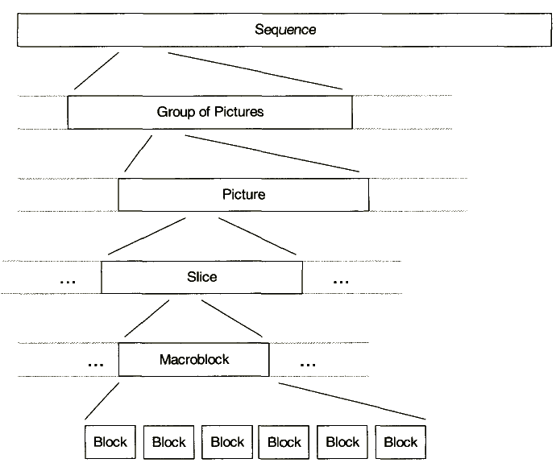
MPEG-1 Syntax hierarchy

Slide 9
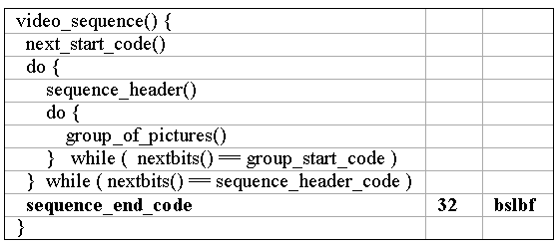
Video Sequence Layer

Slide 10
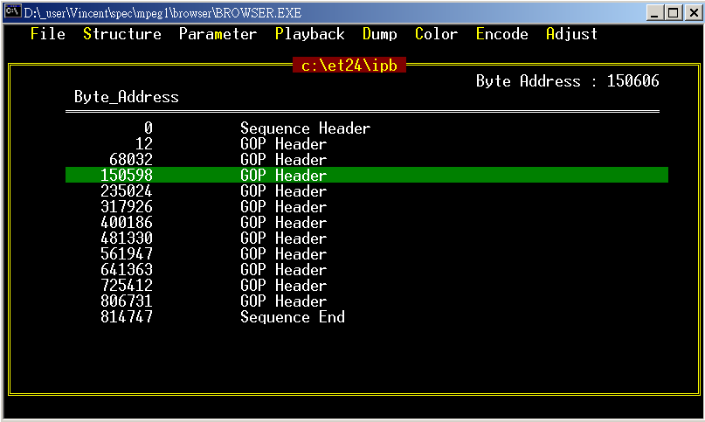

Slide 11
Sequence Layer
Information in the Sequence Header:
  horizontal and vertical size
  pel_aspect_ratio
  picture rate
  bit-rate
  buffer size
  Constrained Parameter Set Flag

Slide 12
GOP Layer
I,P,B three type of picture to consist a GOP(group of picture)
Temporal : 1 2 3 4 5 6 7 8 9 10 11 12 13
Picture type : I B B P B B P B B P B B P
Coding seq : 1 3 4 2 6 7 5 9 10 8 12 13 11

Slide 13
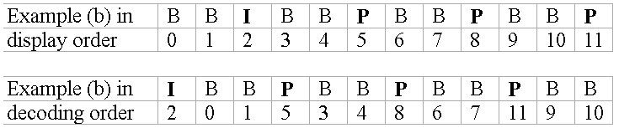
Picture Layer
Information in the Picture Header
  Temporal Reference
  Picture coding type
    001 : I Picture
    010 : P Picture
    011 : B Picture
  full_pel_vector
    zero for half pels
    one for integer pels
    only in the headers of P pictures and B pictures

Slide 14
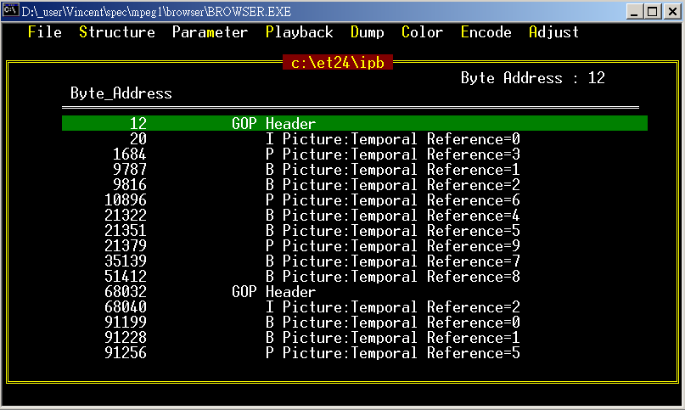

Slide 15
Decoding-Order v.s.
Display-Order
Display-Order
Decoding-Order
  I P B B P B B P B B P B B
I
B
B
P
B
B
P
B
B
P
B
B
P

Slide 16
3-Frame Buffers with Swapping
B
I,P
Forward
Buffer
Current
Buffer
Backward
Buffer
old I,P
DISPLAY
Queue one frame then display as the above depicts.

Slide 17
GOB Layer
Macroblock Line (Group Of Block)
Convenient to perform Error Concealment when transmission error occurs

Slide 18
Macroblock Layer
macroblock_address_increment
  the difference between macroblock_address and previous_macroblock_address
macroblock_type
  macroblock_quant
  macroblock_motion_forward
  macroblock_motion_backward
  macroblock_pattern
    coded_block_pattern
  macroblock_intra

Slide 19
coded_block_pattern
Macroblock
  consisted of
    16 x 16 Luminance block
    8 x 8 Chrominance block
  basic unit for Motion Estimation
Block : 8 pixels by 8 lines
  basic unit for DCT
1
2
5
3
4
Cb
6
Y
Cr

Slide 20
Macroblock Skip
In I-pictures, all macroblocks are coded and there are no skipped macroblocks
In P-pictures, the skipped macroblock is defined to be a macroblock with a reconstructed motion vector equal to zero and no DCT coefficients.
In B-pictures, the skipped macroblock is defined to have the same macroblock type as the prior macroblock, differential motion vectors equal to zero (use the motion vector predictor as its motion vector), and no DCT coefficients.

Slide 21
Block Layer
DC: Predictive coding
  dct_dc_size_luminance
  dct_dc_differential
AC: Run–Length coding
  dct_coeff_first
  dct_coeff_next

Slide 22
Motion
Forward F Code in Picture Layer
  forward_f_size
  forward_f
Integer pixels
Half-pel
  right_half_for
  down_half_for
  Bilinear filter
A
B
a = A
a
b
b = (A+B+1)/2
c
d
c = (A+C+1)/2
d = (A+B+C+D+2)/4
C
D

Slide 23
Motion Predictor Reset
The current macroblock is the first macroblock in the slice.
The last macroblock that was decoded contained no motion vector information.
  The last macroblock was skipped.
  The macroblock_motion_forward was zero.

Slide 24
Speed up
Picture Header
File I/O
  Memory Mapping
  Pre Buffer
Inverse Transform
  Assembly code
YUV to RGB
  Show YUV directly
  DirectX Support API
  http://www.microsoft.com/downloads/
Picture Header

Slide 25
The End
Any questions?
Thank you

