Slide 1
CODIMAGE
THE IMAGE PROCESSOR

Slide 2
Content
Introduction
Objective
Features
Demonstration
Implementation

Slide 3
Introduction
Basic Operations
Advanced Operations

Slide 4
Objectives
To implement an image processor.
To perform image transformations.
To perform some interesting and advanced operations on images like: Steganography.
To learn about Image structures (Header, Bit-Maps, Pixels arrangement).

Slide 5
Functional Features
Copy
Scale
Mirror
Rotate
Transpose
Crop
Blur
Stretch

Slide 6
Functional Features Contd…
Merge
Fill Color
Pattern Search
Steganography
Undo
Redo
Window (graphics).

Slide 7
Demonstration

Slide 8
IMPLEMENTATION

Slide 9
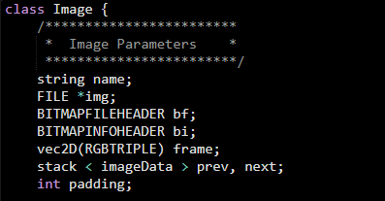

Slide 10
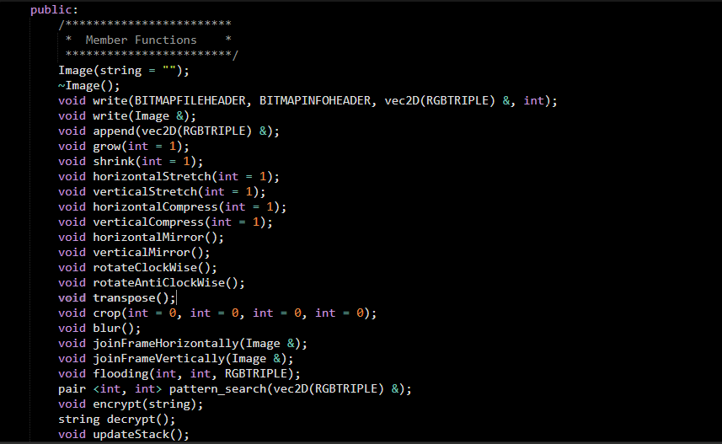

Slide 11
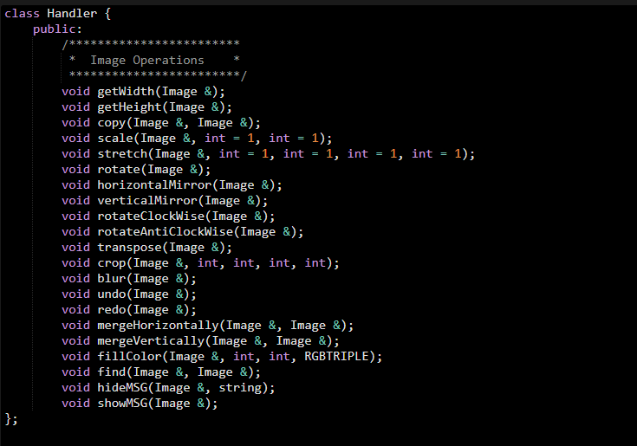

Slide 12
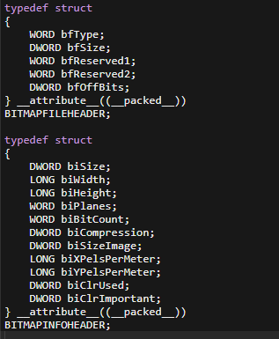

Slide 13
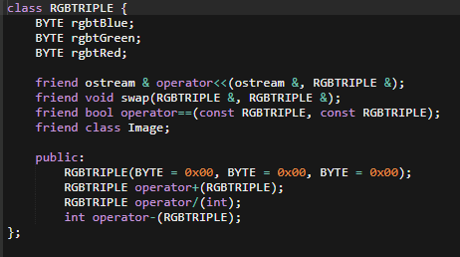

Slide 14
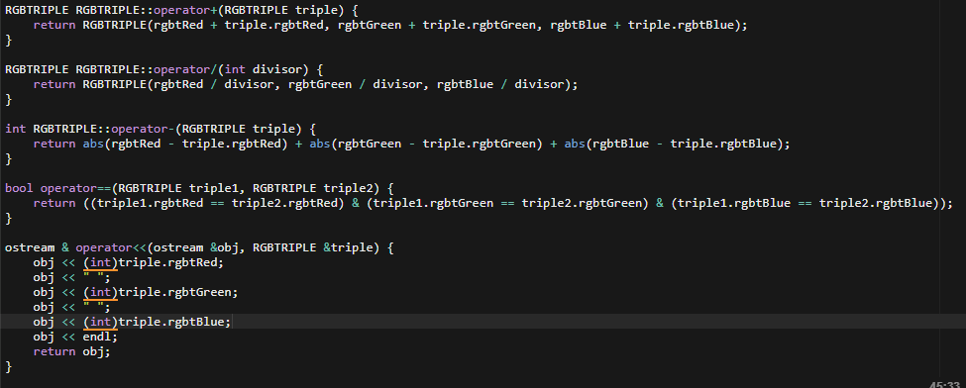

Slide 15
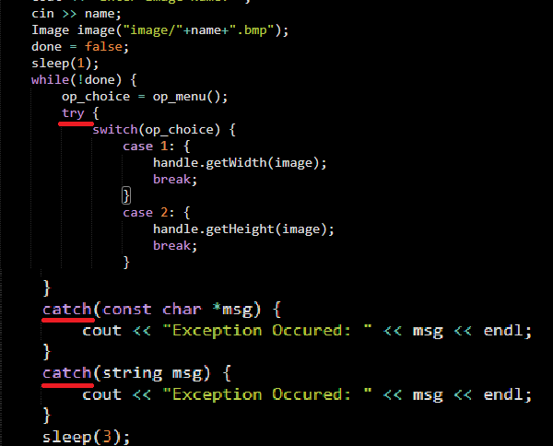

Slide 16
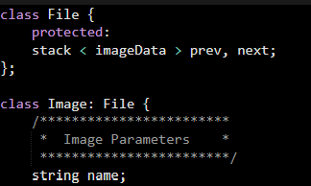

Slide 17
www.msdn.microsoft.com www.stackoverflow.com
References

Slide 18
Any Questions?
Suggestions are most welcome
Notes:
This is it from our side. Any questions or suggestions are most welcome.

Slide 19
Thank You

