Slide 1

Department of Computer Science and Engineering
CAPSTONE PROJECT - I
CIPHERTWIN: AN AUTONOMOUS CYBER DEFENSE FRAMEWORK FOR EXPLAINABLE ZERO-TRUST SECURITY USING DIGITAL TWIN, ADAPTIVE CYBER DECEPTION, AND QUANTUM-ASSISTED POLICY REOPTIMIZATION
Team Members:
RAJESWARI B (23TD0384)
DEEPIKA S (23TD0322)
THAARANI C (23TD0413)
LAVANYA P (23TD0376)
Under the Guidance of:
Dr. S. Pariselvam, M.E., PhD
HOD,
Department of Computer Science and Engineering.

Slide 2
AGENDA
Abstract
Problem Statement
Literature Review
Existing System
Proposed Solution
System Architecture
Tech Stack
References

Slide 3
DOMAIN
NETWORK AND SECURITY
• Focuses on protecting enterprise networks, devices, and data from unauthorized access and cyber threats.
• Involves network monitoring, identity management, access control, anomaly detection, and threat defense.
• Addresses limitations of traditional security using AI-driven adaptive defense, real-time monitoring, and automated threat response.
• Aims to build resilient, intelligent, and self-defending network systems.

Slide 4
ABSTRACT
Traditional cybersecurity relies on static rules and reactive defenses that require heavy human intervention. CipherTwin integrates Digital Twin modeling, Explainable Zero-Trust access control, Adaptive Cyber Deception, and Quantum-Assisted Policy Reoptimization. The executable MVP mirrors network state from synthetic telemetry, scores access requests with explainable risk factors, routes high-risk activity into simulated decoys, and uses a classical QAOA-inspired optimizer for policy reweighting. Random Forest and Isolation Forest add data-driven threat classification and anomaly scoring. The result is a proactive, explainable, and auditable cybersecurity research prototype.

Slide 5
LITERATURE REVIEW
PAPER TITLE | CONTRIBUTION | RESEARCH GAP
DeCusatis et al., arXiv:2606.09469 Quantum Optimization for Honeynet Traffic Partitioning | • Uses QAOA-based Max-Cut optimization for honeypot routing. • Tested on a 110-qubit IBM Quantum benchmark. | • Limited to static honeypot traffic partitioning. • No real-time Zero-Trust policy adaptation.
Al Ridhawi et al., 2023 — Decentralized Zero-Trust Framework for Digital Twin-enabled 6G | • Uses blockchain authentication for Digital Twin security.• Provides decentralized Zero-Trust access control. | • Rule-based decisions without explainable risk analysis. • No adaptive deception and live telemetry optimization.
Kumar et al., 2024 — Digital Twins-enabled Zero Touch Network: Smart Contract and Explainable AI Cybersecurity Framework | • Integrates Blockchain, Smart Contracts, and Explainable AI (XAI) for Digital Twin security. • Provides trusted authentication and access control. | • Focuses on trust management and detection. • No quantum optimization or adaptive cyber deception response.

Slide 6
PROBLEM STATEMENT
Existing Zero-Trust systems are static and rule-based, unable to adapt to evolving threats.
Current defenses lack explainable risk analysis and intelligent decision-making.
Traditional deception methods are non-adaptive and easily detectable by attackers.
Large-scale policy optimization becomes computationally expensive with increasing telemetry.
Need for an adaptive, explainable, and quantum-efficient closed-loop cyber defense framework.

Slide 7
EXISTING SYSTEM
Static firewalls & signature-based IDS detect only known attack patterns
Manually configured Zero-Trust policies fixed rules, no adaptive scoring
Static honeypots unchanged deception, easily fingerprinted by attackers
Periodic manual policy updates slow adaptation to new threats
No explainability access decisions lack clear justification
No real-time policy Reoptimization relies on classical, static methods
Limitations of Existing System
Static Detection: Uses fixed rules and signature-based detection, making it ineffective against new and evolving attacks.
Lack of Explainability: Zero Trust decisions provide little or no justification for access control actions.
Non-Adaptive Deception: Static honeypots are easily detected and bypassed by attackers.
Poor Scalability: Manual or traditional policy updates struggle to handle large-scale networks, leading to higher false positives and slower threat response.

Slide 8
PROPOSED SOLUTION
Digital Twin Construction: synthetic EDR-style telemetry is mirrored into a queryable SQLite-backed graph abstraction.
Explainable Zero-Trust Scoring (EZTE): each event is scored across identity, behaviour, device, location, and history factors, with human-readable reasons.
Adaptive Deception Trigger (ACDE): elevated-risk sessions activate simulated decoys and honeytokens, with activity logged for threat intelligence.
Threat Intelligence: suspicious activity is correlated with seeded MITRE ATT&CK techniques and adversary profiles.
Quantum-Assisted Policy Reoptimization (QAPRE): the MVP uses a classical QAOA-inspired simulation for policy reweighting and cost analysis. Literal PennyLane/QUBO execution is a future integration.
Explainable Feedback Loop: decisions, deception events, and optimization results are exposed through the React analyst dashboard and audit logs.

Slide 9
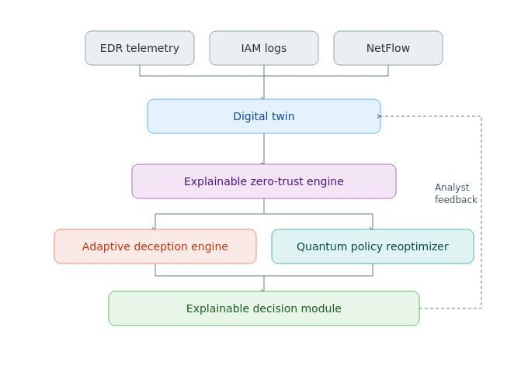
SYSTEM ARCHITECTURE
Telemetry drives explainable risk scoring and simulated adaptive deception; threat intelligence feeds a classical QAOA-inspired policy reoptimization loop with auditable outputs.

Slide 10
TECH STACK
🔹 Digital Twin & Risk Engine
Python — Core logic & orchestration
SQLite-backed GraphStore — Digital Twin graph model (Neo4j-ready abstraction) Weighted Zero-Trust Risk Function — Access risk scoring
Random Forest + Isolation Forest — ML threat/anomaly analysis
🔹 Telemetry & Data Sources
Python background worker — Synthetic EDR telemetry pipeline RabbitMQ — Integration-ready / future external telemetry broker
🔹 Deception Layer
Docker-ready decoy simulation — Risk-triggered deception sessions Honeytokens + threat activity logging — Attacker-behaviour capture Cowrie — Integration-ready / future live SSH/Telnet honeypot
🔹 Quantum-Assisted Policy Optimization
QAOA-inspired classical simulation — Policy reweighting and cost analysis
NumPy / Python — Optimization computation PennyLane + literal QUBO execution — Future quantum integration
🔹 Explainability & Feedback
Jinja2 — Human-readable risk explanations React / TypeScript dashboard — Analyst feedback and visualization Streamlit — Not used in the executable MVP
🔹 Deployment & Integration
FastAPI — Core API layer SQLAlchemy + SQLite — Persistence Docker Compose — System orchestration
Verification note: technologies marked integration-ready/future are not active runtime dependencies in the self-contained MVP.

Slide 11
REFERENCES
Rose, S., Borchert, O., Mitchell, S., & Connelly, S., "Zero Trust Architecture," NIST Special Publication 800-207, 2020.
Al Ridhawi, I., et al., "Decentralized Zero-Trust Framework for Digital Twin-based 6G," arXiv:2302.03107, Feb. 2023.
Bergholm, V., Izaac, J., Schuld, M., et al., "PennyLane: Automatic Differentiation of Hybrid Quantum-Classical Computations," arXiv:1811.04968, 2018.
Farhi, E., Goldstone, J., & Gutmann, S., "A Quantum Approximate Optimization Algorithm," arXiv:1411.4028, 2014.
Bhattacharyya, B., et al., "Hardware-Aware QAOA for Honeypot Traffic Partitioning on 100+ Qubit IBM Quantum Processors," arXiv:2606.09469, 2026.
Cao, Y., et al., "HoneyIoT: Adaptive High-Interaction Honeypot for IoT Devices Through Reinforcement Learning," arXiv:2305.06430, 2023.

Slide 12
Adaptive Honeypots: Dynamic Deception Tactics in Modern Cyber Defense. ResearchGate, 2025.
Kareem, S.A., Sachan, R.C., & Malviya, R.K. AI-Driven Adaptive Honeypots for Dynamic Cyber Threats. SSRN, 2024.
Oosterhof, M. Cowrie SSH/Telnet Honeypot (Open-source deception framework).
Farhi, E., Goldstone, J., & Gutmann, S. (2014). A Quantum Approximate Optimization Algorithm. arXiv:1411.4028.
Bhattacharyya, B., et al. (2025). Solving General QUBOs with Warm-Start QAOA via a Reduction to Max-Cut. arXiv:2504.06253.

Slide 13
THANK YOU

