Slide 1

Department of Computer Science and Engineering
CAPSTONE PROJECT - I
CIPHERTWIN: AN AUTONOMOUS CYBER DEFENSE FRAMEWORK FOR EXPLAINABLE ZERO-TRUST SECURITY USING DIGITAL TWIN, ADAPTIVE CYBER DECEPTION, AND QUANTUM-ASSISTED POLICY REOPTIMIZATION
Team Members:
RAJESWARI B (23TD0384)
DEEPIKA S (23TD0322)
THAARANI C (23TD0413)
LAVANYA P (23TD0376)
Under the Guidance of:
Dr. S. Pariselvam, M.E., PhD
HOD,
Department of Computer Science and Engineering.

Slide 2
AGENDA
Abstract
Problem Statement
Literature Review
Existing System
Proposed Solution
System Architecture
Tech Stack
References

Slide 3
DOMAIN
NETWORK AND SECURITY
• Focuses on protecting enterprise networks, devices, and data from unauthorized access and cyber threats.
• Involves network monitoring, identity management, access control, anomaly detection, and threat defense.
• Addresses limitations of traditional security using AI-driven adaptive defense, real-time monitoring, and automated threat response.
• Aims to build resilient, intelligent, and self-defending network systems.

Slide 4
ABSTRACT
Traditional cybersecurity relies on static rules and reactive defenses that require heavy human intervention and act only after an attack has occurred. This project proposes CipherTwin, an autonomous framework that proactively secures enterprise networks by integrating Digital Twin modeling, Explainable Zero-Trust access control, Adaptive Cyber Deception, and Quantum-Assisted Policy Reoptimization. A real-time Digital Twin mirrors network state from telemetry, while an Explainable Zero-Trust Engine scores and justifies access decisions. High-risk sessions are redirected to adaptive decoys that capture attacker behavior, feeding a Quantum-Assisted Policy Engine that uses QAOA to optimize policies for minimal breach risk and user friction. Together, these components enable CipherTwin to reduce threat containment time and deliver a proactive, explainable, and auditable cybersecurity solution.

Slide 5
LITERATURE REVIEW
PAPER TITLE | CONTRIBUTION | RESEARCH GAP
DeCusatis et al., arXiv:2606.09469 Quantum Optimization for Honeynet Traffic Partitioning | • Uses QAOA-based Max-Cut optimization for honeypot routing. • Tested on a 110-qubit IBM Quantum benchmark. | • Limited to static honeypot traffic partitioning. • No real-time Zero-Trust policy adaptation.
Al Ridhawi et al., 2023 — Decentralized Zero-Trust Framework for Digital Twin-enabled 6G | • Uses blockchain authentication for Digital Twin security.• Provides decentralized Zero-Trust access control. | • Rule-based decisions without explainable risk analysis. • No adaptive deception and live telemetry optimization.
Kumar et al., 2024 — Digital Twins-enabled Zero Touch Network: Smart Contract and Explainable AI Cybersecurity Framework | • Integrates Blockchain, Smart Contracts, and Explainable AI (XAI) for Digital Twin security. • Provides trusted authentication and access control. | • Focuses on trust management and detection. • No quantum optimization or adaptive cyber deception response.

Slide 6
PROBLEM STATEMENT
Existing Zero-Trust systems are static and rule-based, unable to adapt to evolving threats.
Current defenses lack explainable risk analysis and intelligent decision-making.
Traditional deception methods are non-adaptive and easily detectable by attackers.
Large-scale policy optimization becomes computationally expensive with increasing telemetry.
Need for an adaptive, explainable, and quantum-efficient closed-loop cyber defense framework.

Slide 7
EXISTING SYSTEM
Static firewalls & signature-based IDS detect only known attack patterns
Manually configured Zero-Trust policies fixed rules, no adaptive scoring
Static honeypots unchanged deception, easily fingerprinted by attackers
Periodic manual policy updates slow adaptation to new threats
No explainability access decisions lack clear justification
No real-time policy Reoptimization relies on classical, static methods
Limitations of Existing System
Static Detection: Uses fixed rules and signature-based detection, making it ineffective against new and evolving attacks.
Lack of Explainability: Zero Trust decisions provide little or no justification for access control actions.
Non-Adaptive Deception: Static honeypots are easily detected and bypassed by attackers.
Poor Scalability: Manual or traditional policy updates struggle to handle large-scale networks, leading to higher false positives and slower threat response.

Slide 8
PROPOSED SOLUTION
Digital Twin Construction: EDR, IAM, and NetFlow telemetry are continuously ingested to mirror device state, user sessions, and resource dependencies in a live, queryable network twin.
Explainable Zero-Trust Scoring (EZTE): each access request is scored using a weighted risk function over identity confidence, device posture, behavioral deviation, and resource sensitivity, with the top contributing factors extracted to allow, restrict, or deny access.
Adaptive Deception Trigger (ACDE): when the risk score crosses an adaptive threshold, the flagged session is rerouted to procedurally generated decoy hosts and honeytokens that mirror the twin's real services.
Deception Fidelity Adaptation: decoy complexity is tuned across successive sessions based on the attacker's observed skill and tactics, while command sequences, payloads, and lateral movement attempts are logged for threat intelligence.
Quantum-Assisted Policy Reoptimization (QAPRE): captured telemetry and confirmed false positives encode the Zero-Trust policy set and deception cost as a QUBO, resolved with QAOA in PennyLane when telemetry volume or false-positive drift thresholds are reached.
Explainable Feedback Loop: every access decision, deception trigger, and policy update is translated into a human-readable justification tied to specific risk factors and QUBO constraints, with analyst feedback fed back into the twin to refine future risk scoring.

Slide 9
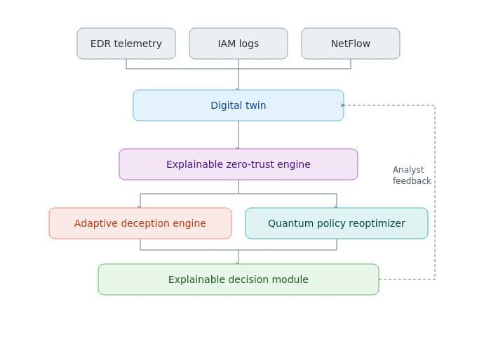
SYSTEM ARCHITECTURE
Telemetry from the Digital Twin drives explainable risk scoring and adaptive deception, while captured attacker intelligence feeds quantum-assisted policy reoptimization in a continuous, explainable feedback loop.

Slide 10
TECH STACK
🔹 Digital Twin & Risk Engine
Python — Core logic & orchestration
Neo4j (Docker) — Graph-based network modeling
Weighted-Sum Risk Function — Access risk scoring
🔹 Telemetry & Data Sources
RabbitMQ — Real-time telemetry pipeline
🔹 Deception Layer
Docker — Decoy host containers
Cowrie Honeypot — SSH/Telnet attacker traps
🔹 Quantum Optimization
PennyLane (lightning.qubit) — Quantum simulation
QUBO (NumPy/SciPy) — Policy formulation
QAOA Solver — Quantum policy optimization
SciPy Optimizer — Classical fallback/baseline
🔹 Explainability & Feedback
Jinja2 — Natural-language justifications
Streamlit — Analyst feedback dashboard
🔹 Deployment & Integration
FastAPI — Core API layer
SQLite — Policy storage
Docker Compose — System orchestration

Slide 11
REFERENCES
Rose, S., Borchert, O., Mitchell, S., & Connelly, S., "Zero Trust Architecture," NIST Special Publication 800-207, 2020.
Al Ridhawi, I., et al., "Decentralized Zero-Trust Framework for Digital Twin-based 6G," arXiv:2302.03107, Feb. 2023.
Bergholm, V., Izaac, J., Schuld, M., et al., "PennyLane: Automatic Differentiation of Hybrid Quantum-Classical Computations," arXiv:1811.04968, 2018.
Farhi, E., Goldstone, J., & Gutmann, S., "A Quantum Approximate Optimization Algorithm," arXiv:1411.4028, 2014.
Bhattacharyya, B., et al., "Hardware-Aware QAOA for Honeypot Traffic Partitioning on 100+ Qubit IBM Quantum Processors," arXiv:2606.09469, 2026.
Cao, Y., et al., "HoneyIoT: Adaptive High-Interaction Honeypot for IoT Devices Through Reinforcement Learning," arXiv:2305.06430, 2023.

Slide 12
Adaptive Honeypots: Dynamic Deception Tactics in Modern Cyber Defense. ResearchGate, 2025.
Kareem, S.A., Sachan, R.C., & Malviya, R.K. AI-Driven Adaptive Honeypots for Dynamic Cyber Threats. SSRN, 2024.
Oosterhof, M. Cowrie SSH/Telnet Honeypot (Open-source deception framework).
Farhi, E., Goldstone, J., & Gutmann, S. (2014). A Quantum Approximate Optimization Algorithm. arXiv:1411.4028.
Bhattacharyya, B., et al. (2025). Solving General QUBOs with Warm-Start QAOA via a Reduction to Max-Cut. arXiv:2504.06253.

Slide 13
THANK YOU

