Slide 1

ioremap & mmap in Linux
Taichien Chang

Slide 2
Outline
How to access Physical Address?
Why ioremap? & ioremap func.
Flow of I/O Memory Map Access
Why MMAP?
MMAP Syscall. & MMAP func.
MMAP flags : MAP_SHARED, MAP_PRIVATE , MAP_LOCKED.
Flow of implement of mmap
remap_pfn_range func.
The implement of mmap file operation

Slide 3
How to access Physical Address ?
Drivers use virtual address.
H/W use physical address(Registers,RAM)
Virtual memory doesn’t store anything, it simply maps a program’s address space onto the underlying physical memory.
In Direct Mapping Area :
“Virtual Memory NOT Physical RAM"
Virtual Address
Physical Address
4G
MMU
RAM
Kernel Space
0xd0200000
0xc0000000
3G
phys_to_virt() or __pa()
User Space
I/O Mem
0x200000
0x10200000

Slide 4
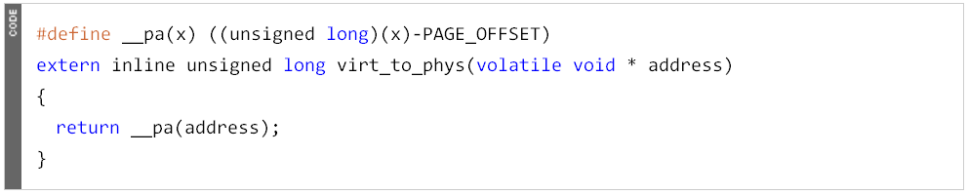
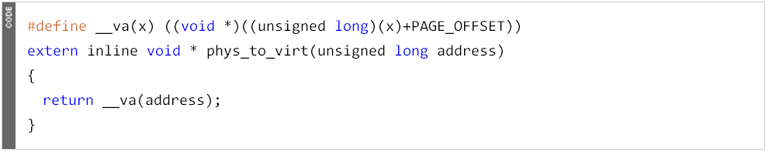
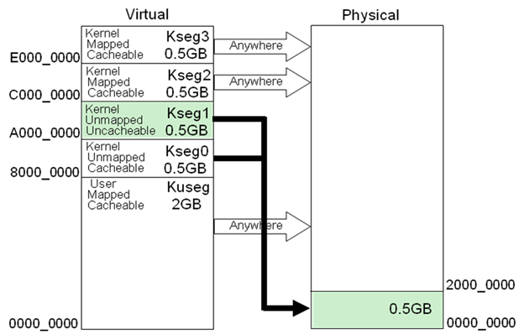
Address Translation func.
MIPS architectures.
PAGE_OFFSET= 0XC000000 (for x86)
PAGE_OFFSET= 0x80000000 (for MIPS Cached Address)
PAGE_OFFSET= 0xA0000000 (for MIPS Uncached Address)

Slide 5
Why ioremap ?
When physical memory or I/O Address is larger than virtual address space size.(0xffffffff)
How to access these extra physical addresses?
phys_to_virt(0x40200000)= 0x00300000 ????
“Using I/O Memory Mapping"
Virtual Address
Physical Address
0xffffffff
4G
Reserved for MMIO x86→ 128MB
MMU
RAM
0xf8044000
Kernel Space
ioremap()
I/O Mem
0x40200000
0xc0000000
3G
User Space
0x200000
3. Use __pa(high_memory)? 0x377fe000 ≒ 896MB

Slide 6
ioremap func.
#include <asm/io.h>
__u32 __iomem virt_addr = ioremap(unsigned long phys_addr, unsigned long size);
__u32 __iomem virt_addr = ioremap_nocache(unsigned long phys_addr, unsigned long size);
void iounmap(void * virt_addr );
You should not directly access addresses returned by ioremap as if they were pointer to virtual memory address. Why?
➔ We have these functions to access H/W register
“Guarantee read/write ordering"
readb(addr)
readw(addr)
readl(addr)
writeb(val,addr)
writew(val,addr)
writel(val,addr)
memcpy_fromio(buffer,addr, len);
memcpy_toio(addr,buffer,len);
memset_io(addr,val,len);

Slide 7
Flow of I/O Memory Map Access
#include <asm/ioport.h>
Using request_mem_region(unsigned long start, unsigned long len, char *name);
to reserve [start , start+len] region into “iomem_resource” & avoid another driver to use them.
All I/O memory allocations are listed in /proc/iomem.
request_mem_region(phy_addr,len,”NAME”)
virt_addr = ioremap(phy_addr,len)
readb/readw/readl (virt_addr) writeb/writew/writel (val,virt_addr)
iounmap(virt_addr)
release_mem_region(phy_addr,len)
Driver Open
Driver Release
Notes:
注: 調用request_mem_region()不是必須的，但是建議使用。該函數的任務是檢查申請的資源是否可用，如果可用則申請成功，並標誌為已經使用，其他驅動想再申請該資源時就會失敗

Slide 8
Memory Mapping between kernel & User space
Q:How can AP directly access to physical address ? (RAM or Registers)
A:Kernel provide a system call - “mmap”
1.Reserved Memory
2.Dynamic Memory
對kernel virtual address調用virt_to_phys也是沒有意義的
Virtual Address
Physical Address
4G
MMU
RAM
Kernel Space
kmalloc()
to create dynamic memory space
0xc0000000
3G
virt_to_phys()
mmap()
User Space
SetPageReserved()
0x10200000
Notes:
对kernel virtual address调用virt_to_phys也是没有意义的

Slide 9
Read File from Disk (1) – Using “read()”
AP allocate 8KB buffer in user space & exec “read()” file operation.
Kernel find & allocates 2 pages, initiates I/O requests for 8KB.
Driver send SCSI Command to read 16 sectors(8KB) & copy to allocated pages.
Kernel copies the requested 8KB from page cache to user buffer.
Virtual Address
Physical Address
4G
MMU
RAM
Kernel Space
0xc0000000
3G
HARD DISK
Read(2page) =8192bytes
fd=open(“file”)
read(8192byte)
User Space
Page Cache
offset
Find 2 free pages in RAM & Read (512bytes x 16)

Slide 10
Read File from Disk (1) – Using “mmap()”
AP call “mmap()” syscall to mapping file with length=8KB.
Kernel find & allocates 2 pages, initiates I/O requests for 8KB.
Driver send SCSI Command to read 16 sectors(8KB) & copy to allocated pages.
AP can directly access file via page buffer without allocating buffer again.
Virtual Address
Physical Address
4G
MMU
RAM
Kernel Space
0xc0000000
3G
HARD DISK
mmap(2page) =8192bytes
fd=open(“file”)
read(8192byte)
User Space
Page Cache
offset
Find 2 free pages in RAM & Read (512bytes x 16)

Slide 11
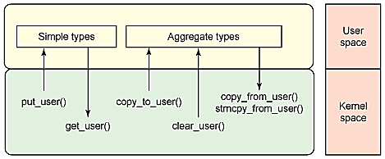
Why MMAP?
Reduced memory usage : 1 memory copy
Performance gain: Read/write file operations & ioctl syscall by using copy_from_user/copy_to_user make too much effort to copy large data between Kernel space & User Space.
“MMAP” can yield significant performance improvements. 30%
Notes:
struct file_operations{
struct module *owner;是一個指向擁有這個結構的模塊的指針. 這個成員用來當模塊在被使用時阻止其被卸載. 一般初始化為: THIS_MODULE loff_t (*llseek) (struct file *, loff_t, int);用作改變文件中的當前讀/寫位置, 並且新位置作為(正的)返回值. ssize_t (*read) (struct file *, char *, size_t, loff_t *);從設備中獲取數據. 空指針導致read系統調用返回-EINVAL("Invalid argument") . 非負返回值代表了成功讀取的字節數 ssize_t (*write) (struct file *, const char *, size_t, loff_t *);發送數據給設備. 空指針導致write 系統調用返回-EINVAL. 非負返回值代表成功寫的字節數. unsigned int (*poll) (struct file *, struct poll_table_struct *);3 個系統調用的後端: poll, epoll, 和 select. 都用作查詢對一個或多個文件描述符的讀或寫是否會阻塞. poll 方法應當返回一個位掩碼指示是否非阻塞的讀或寫是可能的. 如果一個驅動的 poll 方法為 NULL, 設備假定為不阻塞地可讀可寫. int (*ioctl) (struct inode *, struct file *, unsigned int, unsigned long);提供了發出設備特定命令的方法. 註意:有幾個 ioctl 命令被內核識別而不會調用此方法. int (*mmap) (struct file *, struct vm_area_struct *);請求將設備內存映射到進程的地址空間. 如果這個方法是 NULL,系統調用返回 -ENODEV. int (*open) (struct inode *, struct file *);open一個設備文件. 如果這個項是 NULL, 設備打開一直成功 int (*release) (struct inode *, struct file *);在文件結構被釋放時引用這個操作. 即在最後一個打開設備文件的文件描述符關閉時調用(而不是每次close時都調用) int (*fsync) (struct file *, struct dentry *, int datasync);fsync系統調用的後端, 用戶調用來刷新任何掛著的數據. 如果這個指針是 NULL, 系統調用返回 -EINVAL. int (*fasync) (int, struct file *, int);通知設備它的 FASYNC 標誌(異步通知)的改變. 這個成員可以是NULL 如果驅動不支持異步通知. ssize_t (*readv) (struct file *, const struct iovec *, unsigned long, loff_t *);包含多個內存區的單個讀操作; 如果為 NULL, read方法被調用( 可能多於一次 ). ssize_t (*writev) (struct file *, const struct iovec *, unsigned long, loff_t *);包含多個內存區的單個寫操作; 如果為 NULL, write方法被調用( 可能多於一次 ).
}

Slide 12
MMAP func.
#include <sys/mman.h>
virt_addr = mmap(start_addr, len, int prot, int flag, int fd, offset);
Returns →Starting virtual address of the mapping if OK, MAP_FAILED on error
start_addr → If NULL, then the kernel chooses the address available at which to create the mapping
prot → memory protection
flag → MAP_SHARED MAP_PRIVATE …..
fd → should be a valid file descriptor
offset→ should be a multiple of the page size
PROT_EXEC
Pages may be executed.
PROT_READ
Pages may be read.
PROT_WRITE
Pages may be written.
PROT_NONE
Pages may not be accessed.
User Virtual Address
File referenced by fd
PROT_NONE
PROT_READ PROT_WRITE
len
return value of mmap
start_addr
PROT_NONE
offset

Slide 13
MMAP with MAP_SHARED flag (Share Mapping)
Thanks to virtual memory management, different processes can have mapped pages in common.
Share this mapping with all other processes that map this object.
Storing to the region is equivalent to writing to the file. ➔ Changes are shared.
Ex:
virt_addr2 = (char*)mmap(0, size,PROT_WRITE|PROT_READ,MAP_SHARED,fd,offset);
Virtual Address in Process
Physical Address
MMU
RAM
② READ
virt_addr1
Read(2page) =8192bytes
Process 1
HARD DISK
Find 2 free pages in RAM & Read (512bytes x 16)
fd=open(“file”)
①WRITE (8192byte)
Write data
Write data
Write data
virt_addr2
Write(2page) =8192bytes
offset
Page Cache
msync() to force flush changes
Process 2
➔ msync(virt_addr2,size, MS_SYNC); ☞
virt_addr2 must be page aligned

Slide 14
MMAP with MAP_PRIVATE flag (Private Mapping)
Any modifications to the data are not reflected to the file.
Any modifications not visible to other processes mapping the same file. ➔ Changes are private.
A real life example can be found in : glibc’s Dynamically linking libraries (*.so) are loaded by using Private Mapping.
virt_addr2 = (char*)mmap(0, size,PROT_WRITE|PROT_READ,MAP_PRIVATE,fd,offset);
Ex:
Virtual Address in Process
Physical Address
3
MMU
RAM
② READ
2
1
Read(1page) =4096bytes
virt_addr1
Process 1
HARD DISK
3
fd=open(“file”)
2
3
①WRITE (2048byte)
1
offset
!
2
1
1.“copy-on-write”
Page Cache
virt_addr2
Process 2
2.Write(0.5page) =2048bytes
2
2

Slide 15
MMAP with MAP_LOCKED flag
Lock the pages of the mapped region into physical memory (avoid swapping out)
Kernel version > 2.5.37
Set the VMA flag of VM_LOCKED
In the same manner of mlock()
#include <sys/mman.h>
int mlock(const void * virt_addr, size_t len);
int munlock(const void * virt_addr, size_t len);
Ex:
virt_addr = (char*)mmap(0, size,PROT_WRITE|PROT_READ,MAP_SHARED|MAP_LOCKED,fd,offset);
Physical Address
HARD DISK
RAM
fd=open(“file”)
Virtual Address
SWAP
offset
MMU
Dirty Page
Reduce the size of page cache
mmap()
len
VMA
Clean Pages
Write
Swap it out!!
virt_addr
Dirty Page
Page Cache

Slide 16
The Usual Rules of mmap()
The requested memory protection (prot, flags) must be compatible with the file descriptor permissions (O_RDONLY, etc.).
Ex: If PROT_WRITE and MAP_SHARED are given, the file must be open for writing.
Usually, an entire mapping is unmapped, e.g.:
i f ( ( virt_addr = mmap(NULL, length , /* . . . */ ) ) < 0)
perror("mmap error") ;
/* access memory mapped region via addr */
i f (munmap( virt_addr , length ) < 0)
perror("munmap error ") ;
Accessing it after asuccessful munmap will (very likely) result in a segmentation fault.

Slide 17
Mmap --- Example
#include <fcntl.h>
#include <sys/mman.h>
#include <sys/stat.h>
#include <unistd.h>
int main( int argc,char **argv ) {
int fd ;
int filesize= getpagesize(); //sysconf(_SC_PAGESIZE)
void *virt_addr;
if ( ( fd = open( “test.bin”, O_RDONLY) ) < 0)
perror("open error”) ;
virt_addr = mmap(0, filesize, PROT_READ, MAP_SHARED | MAP_LOCKED, fd , 0) ;
if (virt_addr == MAP_FAILED) perror("mmap error”) ;
*(unsigned long*)virt_addr = 0x12345678;
msync(virt_addr,filesize,MS_SYNC)
munmap(virt_addr,filesize)
}

Slide 18
mmap - Direct Mapping to RAM
If we want to mapping directly to RAM & access physical addresses, we need to build a custom driver to implement mmap file operation.
Ex : We create a device file “mmapx” to replace normal file via our custom driver – “mmapx.ko”.
Virtual Address
Physical Address
fd=open(“/dev/mmapx”)
4G
mmapx
MMU
RAM
Kernel Space
HARD DISK
0xc0000000
3G
fd=open(“file”)
mmap()
offset
User Space
Physical address
=
offset

Slide 19
Flow of Direct Mapping via mmap syscall
mmapx driver
AP
ＫＥＲＥＮＬ ＳＰＡＣＥ
module_init :
Create a device file /dev/mmapx
ＵＳＥＲ ＳＰＡＣＥ
open device file:
fd = open(“/dev/mmapx”)
call mmap syscall:
virt_addr = mmap(0,size,PROT_READ|PROT_WRITE,MAP_SHARED|MAP_LOCKED,fd,phyaddr);
mmap file operation:
Using remap_pfn_range to do real memory mapping
call munmap syscall:
munmap(virt_addr ,size);
close device file:
close(fd);
time

Slide 20
What does “remap_pfn_range” do & before doing?
Kernel allocate a vma area. (Kernel manage user space address by using vm_area_struct)
Driver get pages (physical address) of physical RAM. (via vma->vm_pgoff)
Driver call remap_pfn_page() to build a new “page table” to map a range of physical addresses.
Process Descriptor
Physical Memory
fd=open(“/dev/mmapx”)
MMU
mmapx
RAM
Process Virtual Memory
vm_area_struct
vma->vm_end
remap_pfn_page()
address
page
=
vm_area_struct
address
page
address
page
vma->vm_start
=
vm_area_struct
=
Physical address
offset
vma->vm_pgoff
vm_area_struct
Link to new Page table
Notes:
建立vma->vm_start 到 vma->vm_end 的page table

Slide 21
Using remap_pfn_range
int remap_pfn_range(struct vm_area_struct *vma,unsigned long virt_addr, unsigned long pfn,unsigned long size, pgprot_t prot);
➔ Only for “reserved pages” (Out of memory management) & “physical address”
★ Kernel helps us to fill these arguments :
vma➔ The virtual memory area into which the page range is being mapped.
virt_addr➔ The user virtual address where mapping should begin.(vma->vm_start)
pfn➔ Page Frame Number corresponding to the physical address. For most users , vm->vm_pgoff contains physical address.
vma->vm_pgoff << PAGE_SHIFT is the value you need.
size ➔ The area size being remapped. In bytes. (vma->vm_end- vma->vm_start)
prot ➔ Protection for Pages in this VMA. Using vm->vm_page_prot .
If you don’t want the mapping area cached by CPU ,
vma->vm_page_prot = pgprot_noncached(vma->vm_page_prot);

Slide 22
The implement of mmap file operation
#include <linux/mm.h>
int sample_mmap(struct file *filp, struct vm_area_struct *vma)
{
unsigned long offset = vma->vm_pgoff << PAGE_SHIFT;
if (offset >=_pa(high_memory) || (filp->f_flags & O_SYNC))
vma->vm_flags |= VM_IO;
vma->vm_flags |= VM_RESERVED;
vma->vm_page_prot = pgprot_noncached(vma->vm_page_prot);
if (remap_pfn_range(vma , vma->vm_start, vma->vm_pgoff ,
vma->vm_end-vma->vm_start, vma->vm_page_prot))
return -EAGAIN;
vma->vm_ops=&sample_vm_ops ;
return 0;
}
→This VMA MUST be a MMIO/VRAM backend memory, not System RAM. & prevent the region being core dumped
→Out of memory management – never be swapped out
Ldd3 Example : http://www.cs.fsu.edu/~baker/devices/lxr/http/source/ldd-examples/simple/simple.c
Notes:
VM_LOCKED If set, the pages will not be swapped out. Set by
mlock()
VM_IO Signals that the area is a mmaped region for IO to
a device. It will also prevent the region being core
dumped
VM_RESERVED Do not swap out this region, used by device drivers

Slide 23
Flow of custom mmapx driver
mmapx driver
AP
module_init :
ＫＥＲＥＮＬ ＳＰＡＣＥ
Create a device file /dev/mmapx
ＵＳＥＲ ＳＰＡＣＥ
open device file:
fd = open(“/dev/mmapx”)
ioctl file opreation:
Case GET_MEMORY :
call ioctl syscall:
phyaddr = ioctl(fd,size,GET_MEMORY)
buf=kmalloc(size)
phyaddr=virt_to_phys(buf)
call mmap syscall:
virt_addr = mmap(0,size,PROT_READ|PROT_WRITE,MAP_SHARED|MAP_LOCKED,fd,phyaddr);
mmap file operation:
vma->vm_flags |=VM_RESERVED
Using remap_pfn_range to do real memory mapping
call munmap syscall:
module_exit :
munmap(virt_addr ,size);
close device file:
kfree(buf);
close(fd);
time

Slide 24
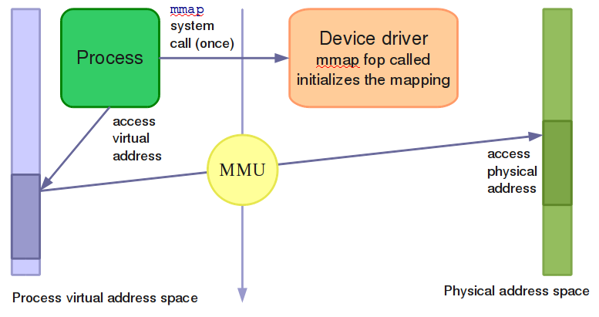
mmap summary
The device driver is loaded. It defines an mmap file operation.
A user space process calls the mmap system call.
The process gets a starting address to read from and write to . (depending on permissions).
The MMU automatically takes care of converting the process virtual addresses into physical ones.
Direct access to the hardware! No expensive read or write system calls!

Slide 25
More mmap:
1 : Operation not permitted for “/dev/mem” :
fd= open("/dev/mem", O_RDWR | O_SYNC);
Virtaddr=mmap(0, PAGE_SIZE, PROT_READ | PROT_WRITE,MAP_SHARED,fd,phyaddr);
not supported in defult for Linux Kernel 2.6.25↑ expect for disabling CONFIG_STRICT_DEVMEM on kernel building.
2. We need to set page reserved before doing real mapping(remap_pfn_range).
Linux 2.4 ↓ → Using mem_map_reserve() to set each pages as PG_Reserved.
Linux 2.6.0~2.6.18 ↓ → Using SetPageReserved() to set each pages as PG_Reserved.
Linux 2.6.25 ↑ → Setting vm_flags as VM_RESERVED to avoid swapping out.
3. We do not need use “msync()” to force flush changes in our AP via custom mmapx driver. Because there is no “Page-Cache” implemented in our custom mmapx driver. And msync will call fsync file operation, so we also do not implement fsync.
4. A buffer allocated by get_user_pages() does not need mlock() function.
Notes:
CONFIG_STRICT_DEVMEM

Slide 26
THANK YOU

Slide 27
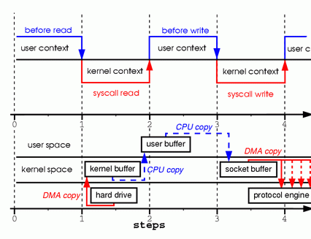
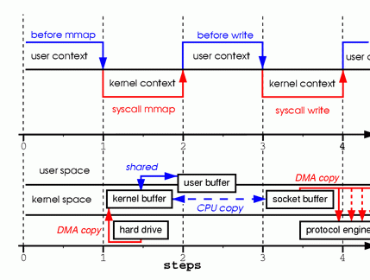
Why MMAP?
Read/write file operations & ioctl syscall by using copy_from_user/copy_to_user make too much effort to copy large data.
“MMAP” can yield significant performance improvements. 30%
Ex : Server read a file and send this file via socket to client.
read(file, tmp_buf, len); write(socket, tmp_buf, len);
tmp_buf = mmap(file, len); write(socket, tmp_buf, len);

Slide 28
Flow of implement of mmap
AP call Ioctl syscall to get a memory space.
Driver call kmalloc() or get_free_pages() to get continguous addesses in physical memory
AP call mmap syscall
mmap(NULL,len,PROT_WRITE|PROT_READ, MAP_SHARED|MAP_LOCKED,fd,phyaddr);
Kernel execute mmap syscall
Driver call mmap file operation
“int mmap(struct file *file, struct vm_area_struct *vma);”
Driver set VM_RESERVED to avoid VMA to SWAP OUT
Driver call remap_pfn_range to do real memory maping “int remap_pfn_range(struct vm_area_struct *vma, unsigned long addr, unsigned long pfn, unsigned long size, pgprot_t prot); “

Slide 29
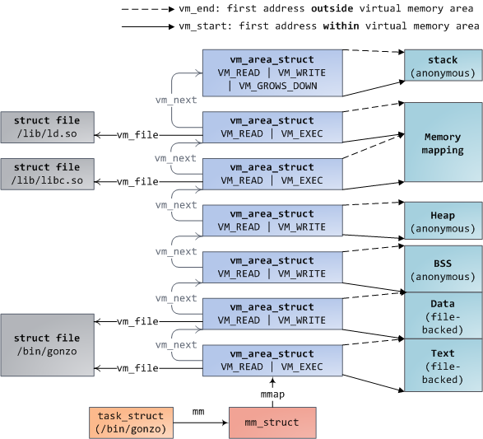
How the Kernel Manages your Memory ?

Slide 30
