Slide 1
SUFIA: Language-Guided Augmented Dexterity for Robotic Surgical Assistants
Masoud Moghani, Lars Doorenbos, William Chung-Ho Panitch, Sean Huver, Mahdi Azizian, Ken Goldberg, Animesh Garg
University of Toronto, University of Bern, University of California, Berkeley, NVIDIA, Georgia Institute of Technology

Slide 2
Introduction
Problem: Current robotic surgical assistants (RSAs) often require tedious teleoperation, leading to surgeon fatigue.
Objective: Develop SUFIA, a framework for natural language-guided augmented dexterity in RSAs.
Motivation: Improve surgical workflow, reduce surgeon fatigue, and enhance patient outcomes by enabling a learning-free, generalizable approach to surgical task automation.
Existing approaches using reinforcement learning are computationally expensive, require extensive data, and lack generalizability.

Slide 3
Methods
Methodology: A human-in-the-loop framework combining Large Language Models (LLMs) with perception modules for high-level planning and low-level robot control.
Datasets: Simulation environment (ORBIT-Surgical) and a physical dVRK surgical robotic platform.
Experimental Setup: Four simulated surgical sub-tasks and two physical sub-tasks (Needle Lift, Needle Handover) were evaluated. Used GPT-4 Turbo unless otherwise specified.
Perception Module: Uses RGB-D camera input and object segmentation (instance segmentation in simulation, trained network for physical experiments).

Slide 4
Results
SUFIA successfully performed all four simulated surgical sub-tasks and two physical sub-tasks.
Table I shows success rates and planning steps for each task (simulation and physical). Higher success rates observed in simulation.
Figure 3 shows the four simulated surgical sub-tasks: Needle Lift, Needle Handover, Vessel Dilation, and Shunt Insertion.
Figure 4 illustrates the physical Needle Handover task.
Figure 5 shows variations in simulated needles used to test generalizability.
Table II shows the success rates for lifting needles with varied shapes and sizes using LangSAM.
Physical experiments showed robustness but also highlighted challenges due to dVRK limitations (hysteresis, encoder mismatch).

Slide 5
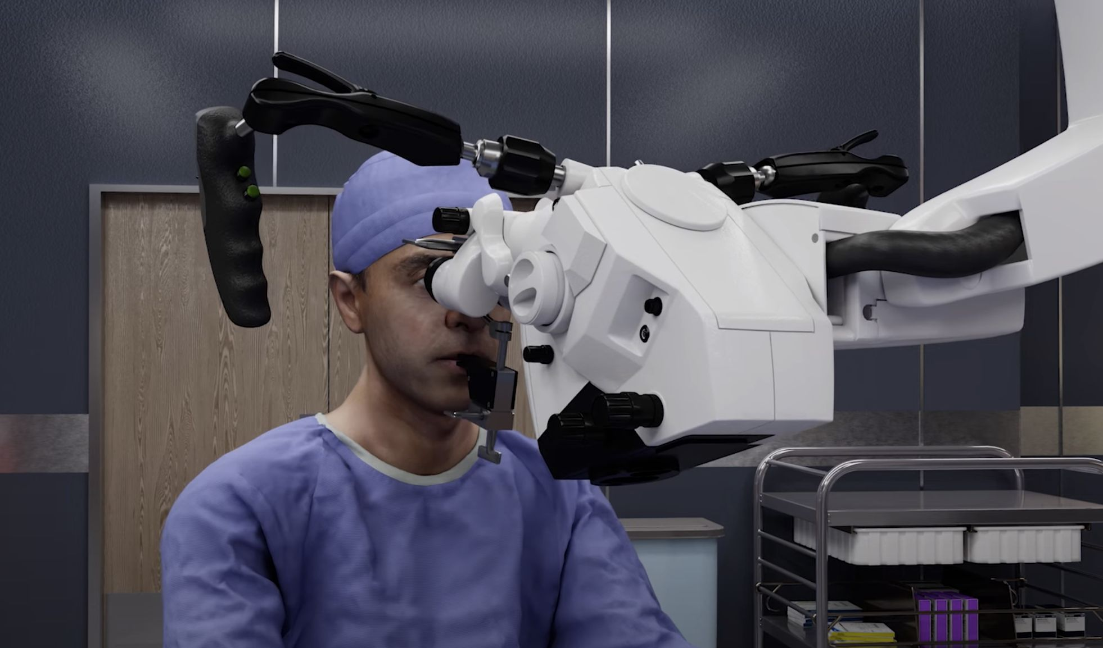
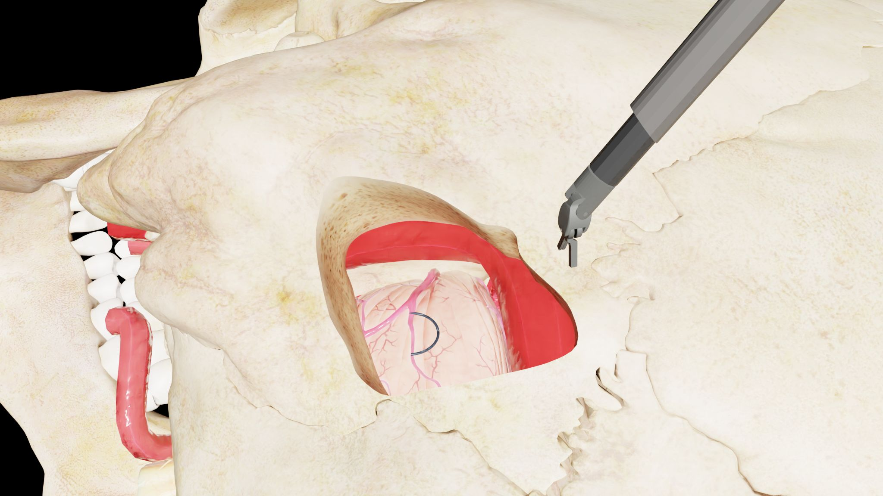
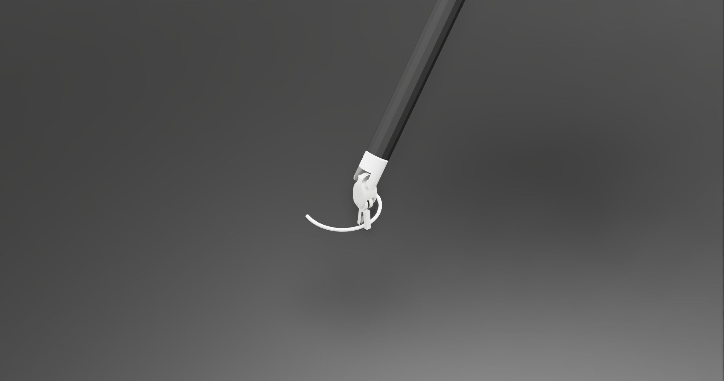
Fig. 1
Fig. 2
Fig. 3

Slide 6
Discussion
SUFIA demonstrates the potential of a general-purpose, language-guided approach to surgical augmented dexterity.
Comparison with prior work: Unlike task-specific learning-based methods, SUFIA is learning-free and generalizes across multiple tasks.
Significance: Reduces reliance on extensive training data and complex reward engineering.
Limitations: Current implementation is not real-time due to GPT-4 Turbo's API speed. Potential risks remain from unexpected circumstances.

Slide 7
Conclusion
SUFIA is a modular, natural language-guided framework for surgeon-robot interaction.
Successfully automates surgical sub-tasks using pre-trained LLMs and a human-in-the-loop approach.
Future work: Explore on-device, quantized open-source LLMs for real-time operation and privacy enhancement. Investigate fine-tuned LLMs and VLMs.
Language-guided autonomy shows promise for improving surgical efficiency.

Slide 8
References
[1]–[47] (See extracted text for full citations)

