Slide 1
Predicting Types of
Gliomas
By: Lavanya Pushparaj

Slide 2
Table of contents
1
Data Explained
4
SVM
2
Data Pre-processing
5
Random Forest
3
Data Visualization
6
XGBoost

Slide 3
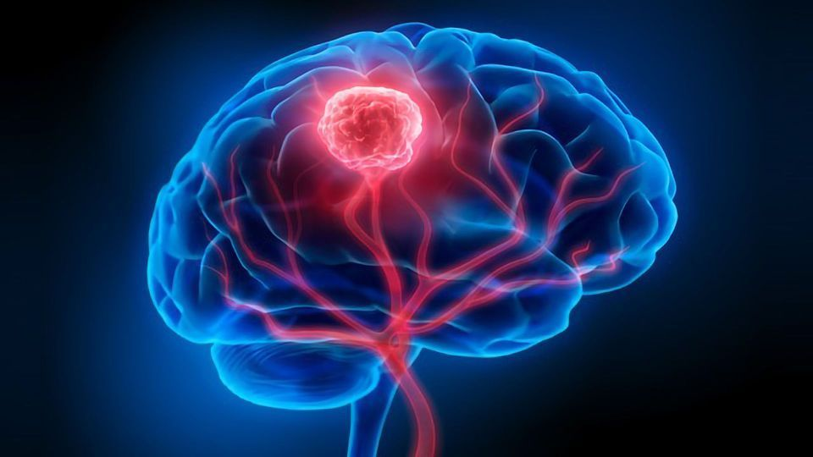
1
The data Explained

Slide 4
DATA
From UC Irvine Machine Learning Repository :
Glioma Grading Clinical and Mutation Features
839 Instance
23 Features
Classification task - target label

Slide 5

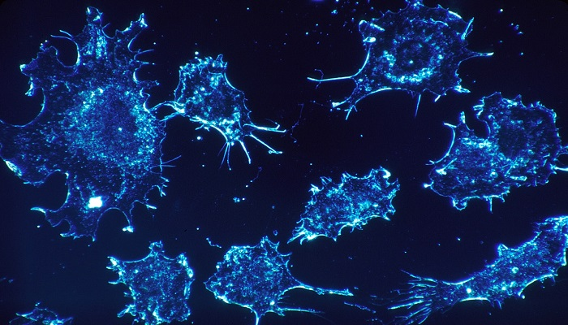
Introduction to Gliomas
Gliomas are a type of tumor that occur when glial cells are out of control. Glial cells are responsible for
Neural development
Mediating rate of nerve signal propagation
Controlling the uptake of neurotransmitters
Neural injury recovery

Slide 6
The two types:
1. Low-Grade Gliomas (LGG)
2. Glioblastoma Multiforme (GBM)
Grade II and III
Better prognosis and longer survival
Lower density of abnormal cells
Can remain stable for years
Can progress to become GBM
Grade IV
More aggressive
high density of abnormal cells
Significant heterogeneity within the tumor mass
Harder to treat

Slide 7
Purpose:
Identifying how mutations in key markers and other factors can indicate LGG vs GBM

Slide 8
Project | Project number | ATRX | Proper replication | FUBP1 | regulator
Case_ID | Case ID number | PTEN | Tumor suppressor | RB1 | Tumor suppressor
Gender | M / F / -- | EGFR | Promotes cell growth | NOTCH1 | Promotes cell growth
Age_at_diagnosis | Years and days | CIC | Transcriptional repressor | BCOR | Makes BCL6 - immune system
Primary_Diagnosis | Oligodendroglioma, Mixed gliomas, Astrocytoma, NOS | MUC16 | Cancer antigen | CSMD3 | May promote macrophages - function unknown
Race | 4 types of races | PIK3CA | Regulates cell functions | SMARCA4 | DNA repair and regulation
IDH1 | Makes enzyme called isocitrate dehydrogenase 1 | NF1 | Neurofibromin - mediates neuronal signals | GRIN2A | NMDA receptors (synapses)
TP53 | Makes p53 (tumor suppressor) | PIK3R1 | Regulate PIK3 | IDH2 | Cell protection
FAT4 | Makes tissue protein | PDGFRA | Cell signaling

Slide 9
2
The data Pre-processing

Slide 10
Steps
Determined columns that were categorical vs numerical
Used label encoding
‘Age_at_diagnosis’ - retrieved only the value for the years
Dropped any rows with missing values
Gender and race class was analyzed for values of ‘--’ where individuals didn’t specify gender

Slide 11
3
The data Visualization

Slide 12
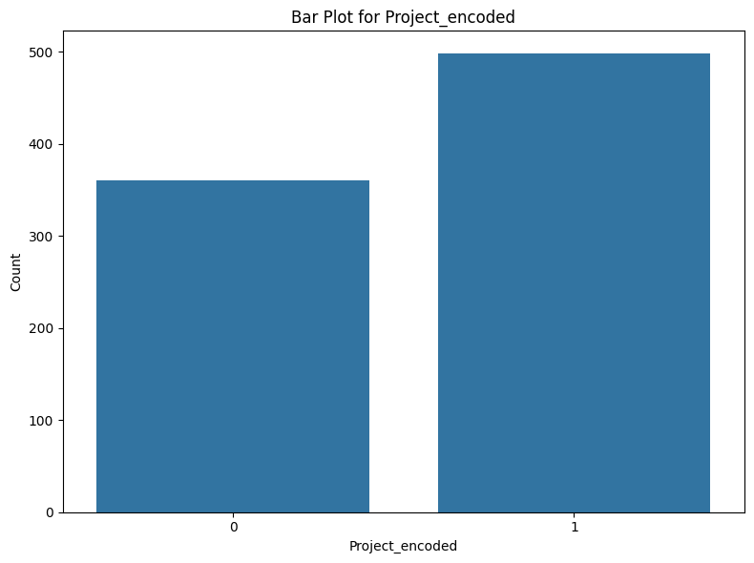
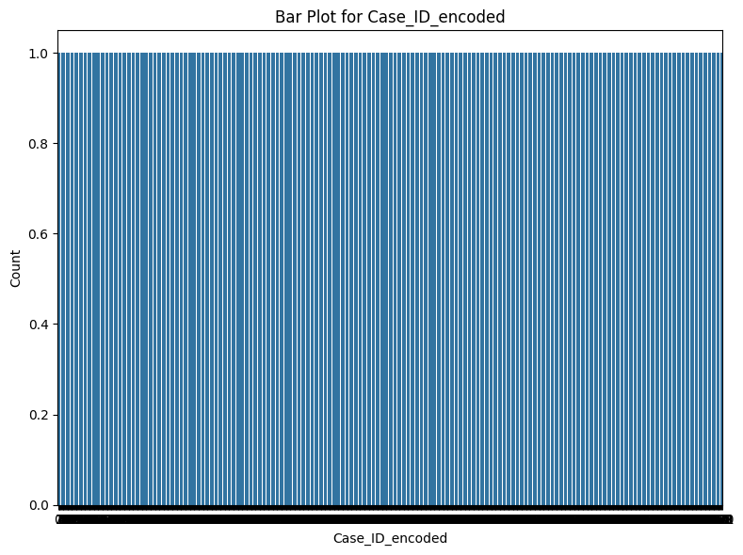
Bar Plots to visualize spread of data

Slide 13
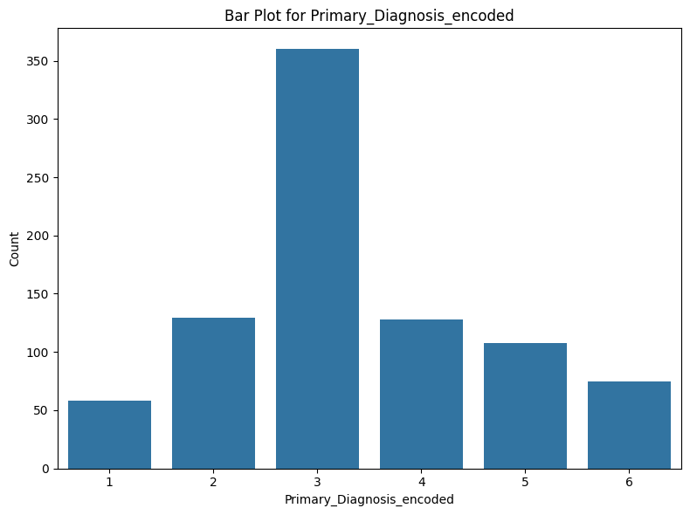

Bar Plots to visualize spread of data

Slide 14
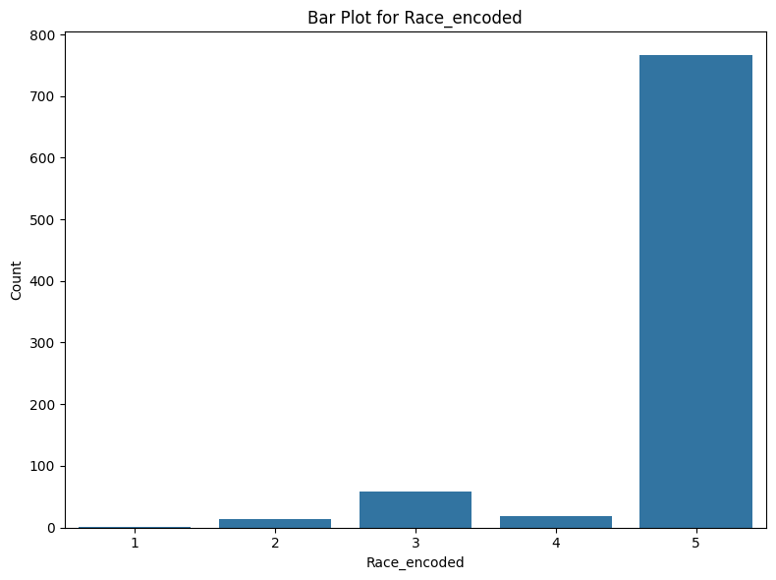
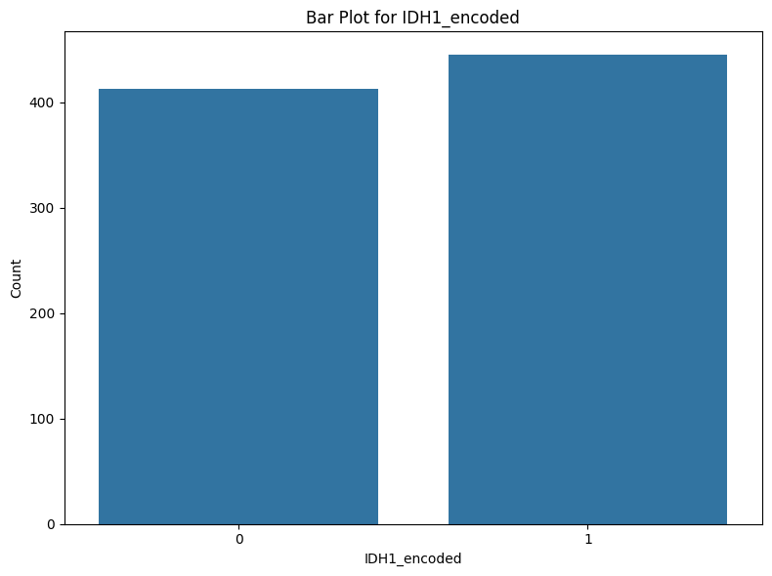
Bar Plots to visualize spread of data

Slide 15
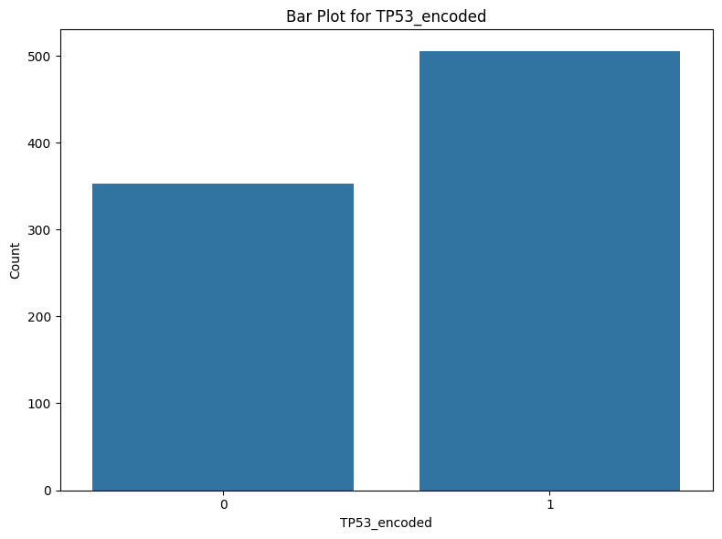
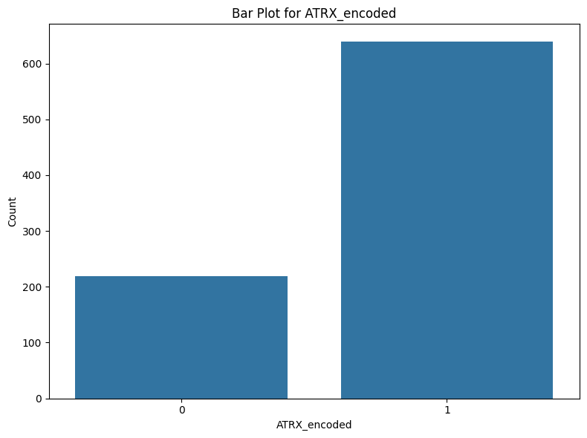
Bar Plots to visualize spread of data

Slide 16
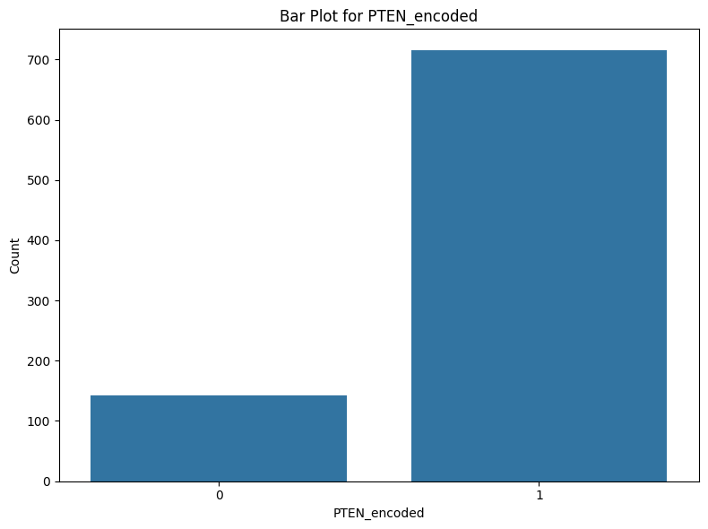
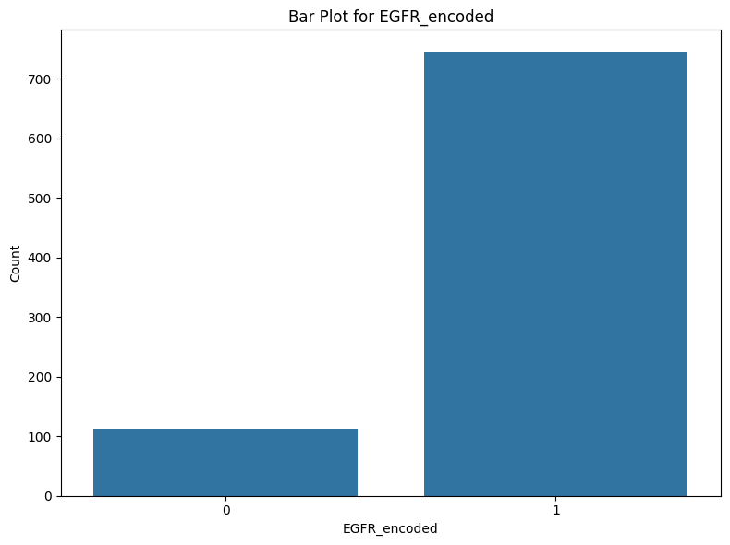
Bar Plots to visualize spread of data

Slide 17


Bar Plots to visualize spread of data

Slide 18
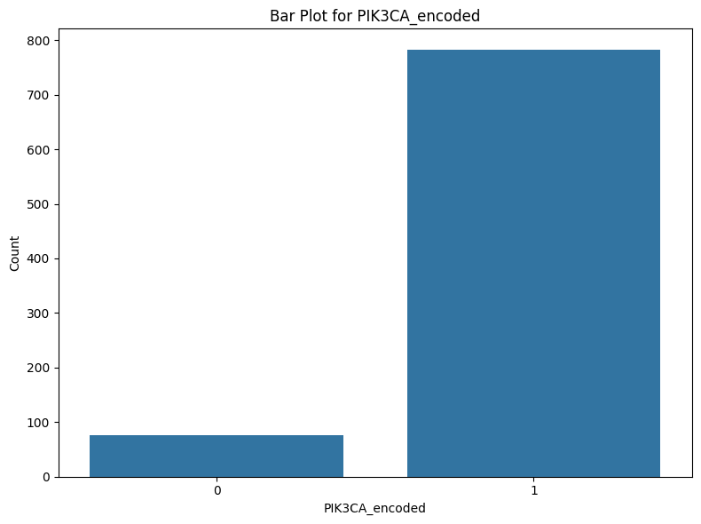

Bar Plots to visualize spread of data

Slide 19
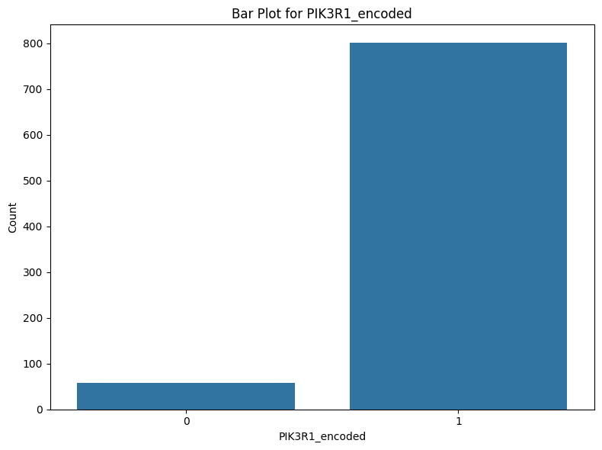
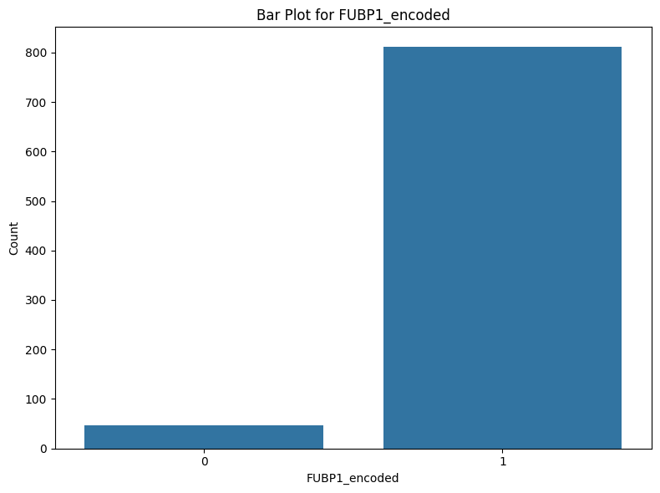
Bar Plots to visualize spread of data

Slide 20


Bar Plots to visualize spread of data

Slide 21
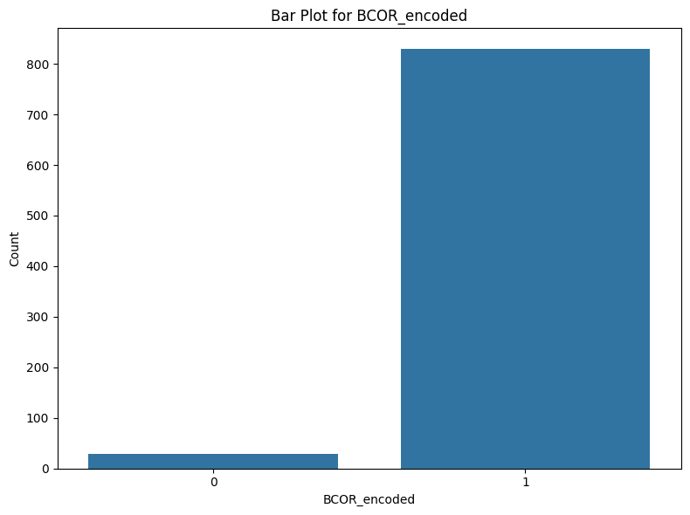

Bar Plots to visualize spread of data

Slide 22


Bar Plots to visualize spread of data

Slide 23


Bar Plots to visualize spread of data

Slide 24
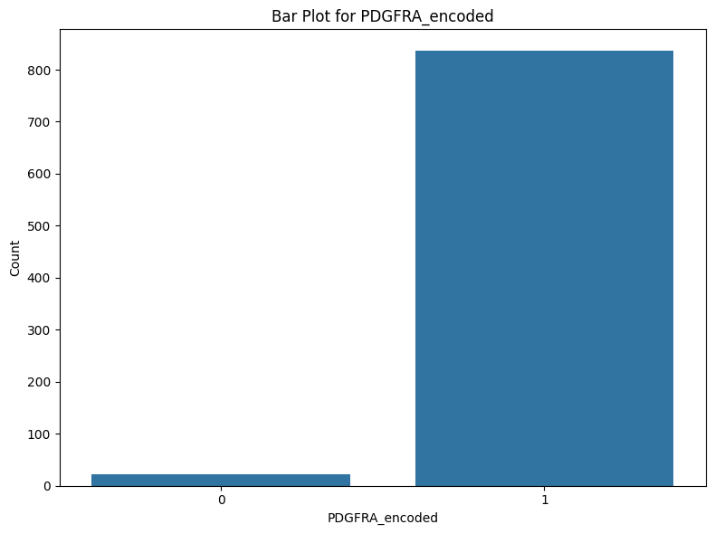
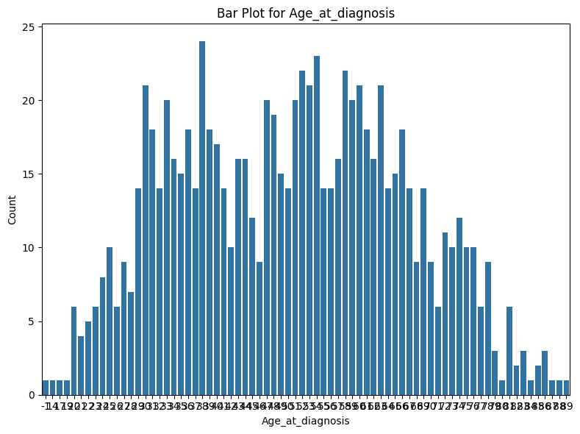
Bar Plots to visualize spread of data

Slide 25

Bar Plots to visualize spread of data

Slide 26
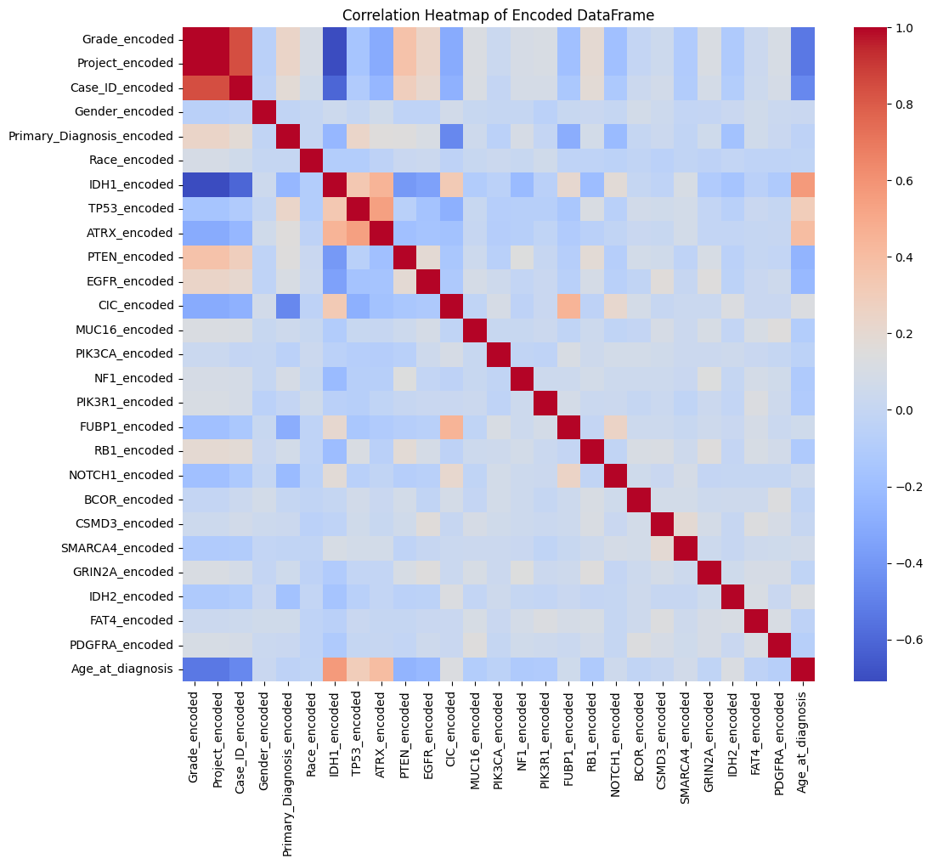
Correlation Heatmap
Drop 'Case_ID_encoded' and 'Project_encoded' from encoded_df
Correlation Values Greater Than 0.80 (excluding diagonal elements):
Correlation between Grade_encoded and Project_encoded: 1.0
Correlation between Grade_encoded and Case_ID_encoded: 0.8407524435225795
Correlation between Project_encoded and Grade_encoded: 1.0
Correlation between Project_encoded and Case_ID_encoded: 0.8407524435225795
Correlation between Case_ID_encoded and Grade_encoded: 0.8407524435225795
Correlation between Case_ID_encoded and Project_encoded: 0.8407524435225795

Slide 27
Preprocessing Steps Cont. (Post visualization)
Selected features and target (Grade)
Split data into train-test (70-30)
Normalized the features
Ready for model training
After implementing the models, also decided to drop ‘Primary_Diagnosis_encoded’ due to over-fitting

Slide 28
4
SVM

Slide 29
SVM specifics
kernel = linear (allows for linear separation)
SVM Accuracy: 0.86
SVM Classification Report:
precision recall f1-score support
0 0.78 0.94 0.85 109
1 0.95 0.81 0.87 149
accuracy 0.86 258
macro avg 0.87 0.88 0.86 258
weighted avg 0.88 0.86 0.87 258

Slide 30
Metrics Explained
Class 0
Precision: 78% of the instances predicted as class 0 are actually class 0.
Recall: Identifies 94% of all actual class 0
F1-Score: 0.85
Class 1
Precision: 95% of the instances predicted as class 1 are actually class 1
Recall: Identifies 81% of all actual class 1
F1-Score: 0.87

Slide 31
5
Random Forest

Slide 32
Random Forest specifics
N_estimators = 50
Number of trees
Random_state = 42
Random Forest Accuracy: 0.83
Random Forest Classification Report:
precision recall f1-score support
0 0.79 0.81 0.80 109
1 0.86 0.85 0.85 149
accuracy 0.83 258
macro avg 0.82 0.83 0.83 258
weighted avg 0.83 0.83 0.83 258

Slide 33
6
XGBoost

Slide 34
XGBoost Hyperparameter Tuning
use_label_encoder=False
Already used label encoding
eval_metric='logloss'
max_depth=6
Max depth of tree
colsample_bytree=0.8
Only used 80% of the feature columns
gamma=0.1
Minimum loss reduction

Slide 35
XGBoost specifics
Adjusted XGBOOST Accuracy: 0.86
Adjusted XGBOOST Classification Report:
precision recall f1-score support
0 0.81 0.86 0.84 109
1 0.89 0.85 0.87 149
accuracy 0.86 258
macro avg 0.85 0.86 0.85 258
weighted avg 0.86 0.86 0.86 258
Adjusted Cross-validation scores: [0.84166667 0.825 0.875 0.86666667 0.875 ]
Mean Adjusted cross-validation score: 0.86

Slide 36
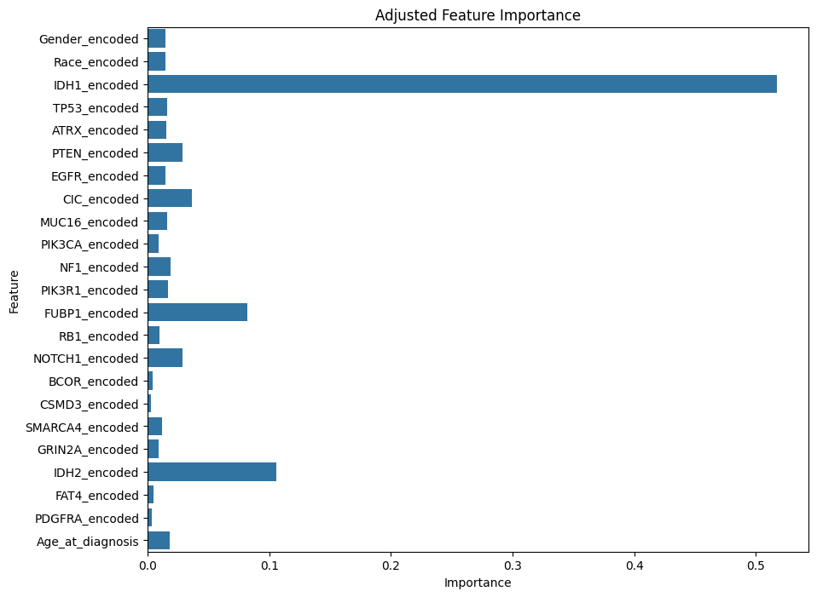
XGBoost

Slide 37
Conclusion
While SVM and XGBoost had the same accuracy, the PRF score for the XGBoost was higher
After further exploration, the feature IDH1 has the greatest influence, closely followed by IDH2
Matches with previous research done with Gliomas were these 2 genes are identified
Influences glucose, amino acid, and lipid metabolism which aids in the progression of gliomas

Slide 38
Thanks

Slide 39
Sources
https://www.ncbi.nlm.nih.gov/books/NBK10869/#:~:text=Glial%20roles%20that%20are%20well,in%20(or%20preventing%2C%20in%20some
https://www.futuremedicine.com/doi/10.2217/fon-2022-0583#:~:text=As%20a%20key%20enzyme%20in,the%20progress%20of%20the%20tumor.
https://pubmed.ncbi.nlm.nih.gov/19228619/
https://www.datacamp.com/tutorial/svm-classification-scikit-learn-python
https://www.datacamp.com/tutorial/random-forests-classifier-python
https://www.kaggle.com/code/stuarthallows/using-xgboost-with-scikit-learn

