Slide 1
Angular CLI
Command Line Interface Dependency Injection Build and Optimize

Slide 2
What we will learn? (Headers are links)
Angular CLI: - How to create a Skeleton? - Workflow for an Angular project. - Real world collection of commands.
Dependency Injection: - Data Mocking for Unit Testing. - How DI works in Angular? - Neat tricks with Services.
Build and Optimize: - Server Configs. - Cross-origin Resource Sharign (CORS). - Lazy Loading and Production Optimizations.
Explain of my university project that using Angular 7.1: - Working with Amazon Web Services (Cloud Deployment).

Slide 3
Few notes before we start:
I will mostly presenting.
There is not much in these slides. External documentations will be provided.
I think this approach will be better for the audiences as their have to pay attention to understand what’s actually going on and not rely on the slides.

Slide 4
Steps to create a Skeleton:
Step 1 ng n
Step 2 ng g m
Step 3 ng g c
Step 4 ng g s
Step 5 ng s -o

Slide 5
Learn by Heart:
ng n <dir/project-name> --minimal --routing --style=scss ng g m <dir/module-name> --routing ng g c <dir/component-name> --spec=false ng g s <dir/service-name> --spec=false ng s –o npm i npm run <command-defined-in-package.json> ("start": "ng serve --proxy-config proxy.config.json" "build": "ng build --prod --aot“)

Slide 6
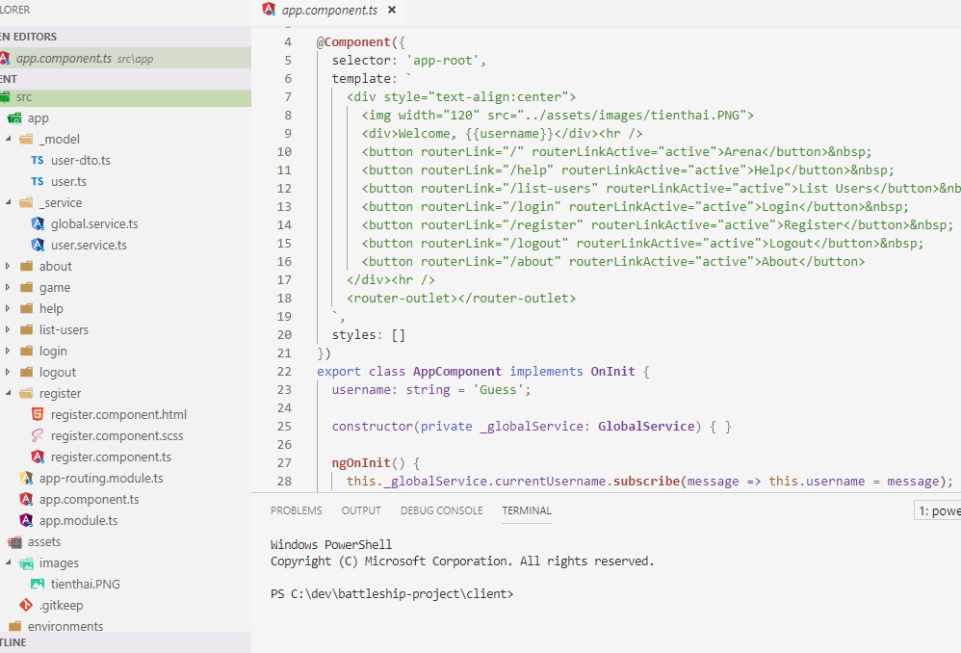
Angular Project Layout
My university project.

Slide 7
DI – Data Mocking for Unit Testing.
Live Demostration ( ͡° ͜ʖ ͡°)

Slide 8
DI – How DI works in Angular?
Live Demostration ( ͡° ͜ʖ ͡°)

Slide 9
DI – Neat tricks with Services.
Live Demostration ( ͡° ͜ʖ ͡°)

Slide 10
B&O – Server Configs.
Live Demostration ( ͡° ͜ʖ ͡°)

Slide 11
B&O – Cross-origin Resource Sharign (CORS).
Live Demostration ( ͡° ͜ʖ ͡°)

Slide 12
B&O – Lazy Loading and Production Optimizations.
Live Demostration ( ͡° ͜ʖ ͡°)

Slide 13
My university project
Project structure explained in details.
Deploy to real world via AWS Cloud Services.
Live Demostration ( ͡° ͜ʖ ͡°)

Slide 14
GLHF

