Slide 1
Smart Campus Lost-and-Found
PROJECT PRESENTATION • C++ CONSOLE APPLICATION
Smart Campus Lost-and-Found
Tracking System Using C++
Course name & code: DSA0105 (Object oriented programming in C+
Guide: DR.JAGADEESH
Submitted by:
K.SHEIK NASRIN(192571066)
SMART CAMPUS / LOST-AND-FOUND TRACKING SYSTEM
01

Slide 2
Abstract
A structured approach to recording, searching and returning campus belongings
• Proposes a centralized console application for registering lost and found items.
• Stores item details and status in local text or CSV files.
• Uses string matching and conditional filtering to identify possible matches.
• Supports ownership verification before recording an item as returned.
• Applies C++ classes, objects, functions, vectors and file handling.
SMART CAMPUS / LOST-AND-FOUND TRACKING SYSTEM
02

Slide 3
Problem Statement
The problem the project is designed to address
Current challenge
Operational gap
Project need
Lost-item reports can be scattered across notices, messages and informal inquiries.
Without a shared record, comparing reports and tracking unresolved items is difficult.
Provide one organized workflow to register items, find potential matches and document returns.
SMART CAMPUS / LOST-AND-FOUND TRACKING SYSTEM
03

Slide 4
Objectives
Five clear goals for the proposed system
• Register lost and found items with consistent, validated fields.
• Maintain unique item IDs and a searchable record collection.
• Identify potential matches using item attributes and search conditions.
• Verify ownership and track Lost, Found and Returned states.
• Preserve records between sessions and evaluate the system using test cases.
SMART CAMPUS / LOST-AND-FOUND TRACKING SYSTEM
04

Slide 5
Proposed System
Menu-driven workflow with persistent local storage
1 Register
2 Search & verify
3 Return & save
Enter item name, category, date, location and description.
Assign a unique item ID.
Filter records and compare descriptions.
Review candidates and request distinguishing ownership details.
Confirm the handover, update related records and save changes.
Review unresolved items.
SMART CAMPUS / LOST-AND-FOUND TRACKING SYSTEM
05

Slide 6
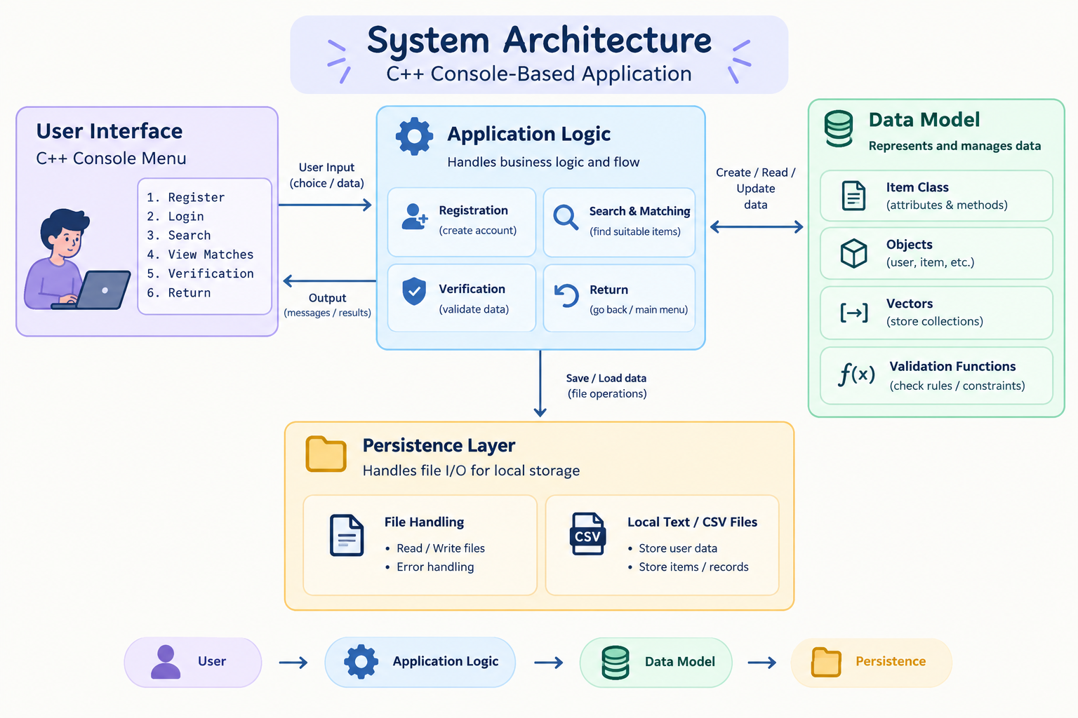
System Architecture Diagram
USER INTERFACE | C++ console menu
↓
APPLICATION LOGIC | Registration • Search & matching • Verification & return
↓
DATA MODEL | Item class • Objects • Vectors • Validation functions
↓
PERSISTENCE | File handling → Local text / CSV files
06

Slide 7
Module 1: Lost and Found Item Registration
Capture and validate a complete item report
• Collect item name, category, lost/found date, location and description.
• Generate a unique item ID and assign an initial Lost or Found status.
• Check required fields, date format and valid menu selections.
• Create an Item object and add it to the in-memory record collection.
• Forward the validated record to the storage module.
Input details
↓
Validate fields
↓
Assign ID & status
↓
Save record
SMART CAMPUS / LOST-AND-FOUND TRACKING SYSTEM
07

Slide 8
Module 2: Smart Item Search and Matching
String matching + linear search; not an AI or machine-learning model
• Accept keywords and optional category, location or date filters.
• Normalize letter case and trim input before comparing text.
• Scan stored records using linear search and conditional checks.
• Compare lost reports against found records and display potential matches.
• Present item IDs and supporting attributes; a match is not proof of ownership.
Enter query
↓
Normalize & filter
↓
Compare records
↓
Show candidates
SMART CAMPUS / LOST-AND-FOUND TRACKING SYSTEM
08

Slide 9
Module 3: Item Verification and Return Management
A controlled handover workflow
• Select the candidate item using its unique item ID.
• Ask the claimant for distinguishing details beyond the visible listing.
• Compare the claim with the item description and available evidence.
• Record the verification decision; keep unverified cases unresolved.
• After a confirmed handover, mark the related record(s) Returned and save.
Select candidate
↓
Verify ownership
↓
Confirm handover
↓
Update status
SMART CAMPUS / LOST-AND-FOUND TRACKING SYSTEM
09

Slide 10
Sample Output
Illustrative console mock-up — replace with screenshots after implementation
SMART CAMPUS / LOST-AND-FOUND TRACKING SYSTEM
11

Slide 11
Advantages and Evaluation
Expected benefits and planned validation — no measured results supplied
Expected benefits
Operational metrics
Quality & timing
Organized item records
Consistent search workflow
Traceable return status
Persistent local storage
Simple console interface
Lost / found registrations
Possible matches identified
Items returned
Unresolved lost items
Record-management efficiency
Search precision: relevant results / results shown
Recovery rate: recovered lost reports / lost reports
Search response time
Time saved vs. a defined baseline
SMART CAMPUS / LOST-AND-FOUND TRACKING SYSTEM
12

Slide 12
Conclusion
Implementation scope, environment and next steps
The proposed system connects registration, search, verification and persistent storage in one C++ application.
Build sequence: requirements & design → module development → integration → manual tests → error handling & documentation.
Actual matching accuracy, recovery rate and response time must be established through testing.
SMART CAMPUS / LOST-AND-FOUND TRACKING SYSTEM
13

Slide 13
Thank You
SMART CAMPUS / LOST-AND-FOUND TRACKING SYSTEM
14

