Slide 1


Department of Artificial Intelligence and Data Science
An Efficient Stacking Approach for Healthcare Insurance Cost Prediction
Mr.Thiyagarajan.G
Assistant Professor
Lavanya S (221801028)
Monisha M (221801034)

Slide 2
Problem Statement and Motivation
A health insurance provider needs to predict personalized premiums by analyzing user’s health data and demographic information. They aim to enhance pricing accuracy and streamline premium calculations.

Slide 3
Objectives
To build a machine learning model that accurately predicts personalized healthcare insurance premiums based on user health and demographic data.
To integrate the prediction system into a user-friendly Django web application, enabling seamless interaction and efficient premium calculation for users.

Slide 4
Abstract
Accurate prediction of healthcare insurance premiums is crucial for both providers and policyholders to ensure fair pricing and optimal financial planning. This project presents a machine learning-based solution to estimate personalized insurance premiums using health and demographic data. A stacking ensemble model, combining CatBoost, XGBoost, and RandomForest with a Ridge regression meta-learner, is developed to achieve high prediction accuracy. The system is integrated into a Django-based web application, offering users an intuitive interface to input their details and receive instant premium estimates. This approach streamlines premium calculation, ensuring precision and enhancing the user experience.

Slide 5
Introduction and Overview of the Project.
Objective:
To build a web-based system that predicts insurance premiums based on user health and demographic data.
Scope:
Develop a user interface for individuals to predict insurance premiums.
Provides personalized and accurate health insurance premium predictions using machine learning.

Slide 6
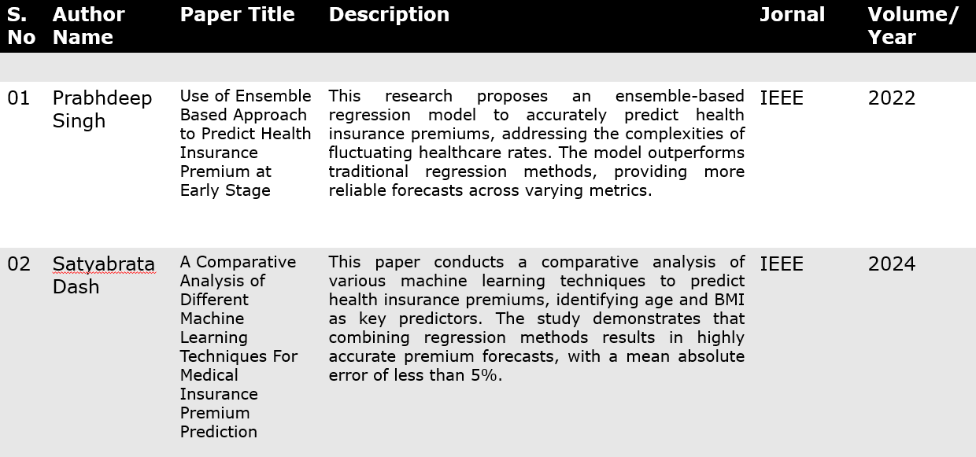
Literature Survey

Slide 7
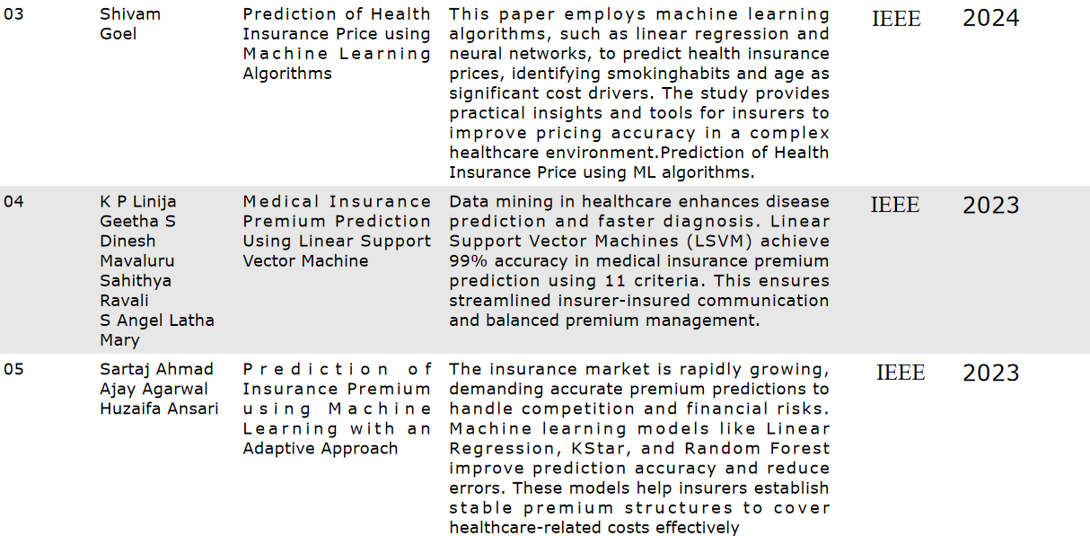
Literature Survey

Slide 8
Existing Sytem
The current system employs machine learning techniques to estimate insurance premiums accurately. It operates as follows:
Data Collection and Preparation: Historical data, including demographic details (age, gender, location), health factors (BMI, pre-existing conditions), and insurance information, is collected. The data is cleaned, normalized, and preprocessed with feature engineering and selection to ensure optimal analysis.
Model Training and Evaluation: Machine learning models such as Linear Regression, Decision Trees, Random Forest, and Neural Networks are trained on the processed data. Their performance is assessed using metrics like Mean Squared Error (MSE) and Mean Absolute Error (MAE).

Slide 9
Drawback of Existing System
Handling of Categorical Data: Requires explicit preprocessing like one-hot encoding, increasing dimensionality and computational complexity.
Feature Engineering: Needs more extensive feature engineering for categorical variables and transformation steps to prepare patient’s demographic data.
Overfitting Risk: More prone to overfitting as healthcare datasets are often high-dimensional datasets.
Training Time and Resources: Increased training times and memory usage due to high-dimensional data from preprocessing.

Slide 10
Proposed System
Implement a stacking ensemble model with CatBoost, XGBoost, and Random Forest as base learners and a Ridge regressor as the meta-learner to achieve high prediction accuracy for insurance premiums.
Develop a Django-based web application where users can input health and demographic information to receive personalized premium estimates instantly.
Integrate the trained machine learning model into the web application to ensure efficient, scalable, and accurate premium prediction for diverse user profiles

Slide 11
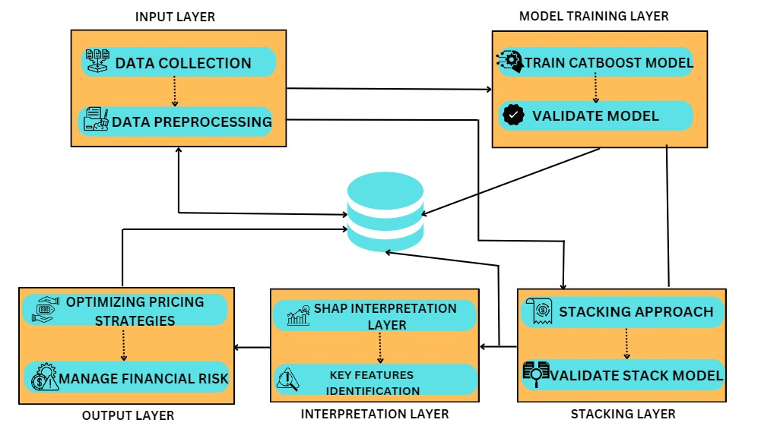
System Architecture

Slide 12
List of modules
Data Preprocessing Module
Model Training and Prediction Module
Web Application Module
Integration Module

Slide 13
Module1:Data Preprocessing
Step 1: System collects the data inputs (e.g., blood pressure, cholesterol levels, surgery details).
Step 2: Apply data cleaning to handle missing values,checking duplicate columns ans entries.
Step 3:Use the Interquartile Range (IQR) method to detect and remove outliers from the dataset .
Step 4: Perform train-test split of the cleaned data for model training and testing (e.g., 80/20 split).
Step 5: Store the preprocessed and cleaned data into the Cleaned Data Store.

Slide 14
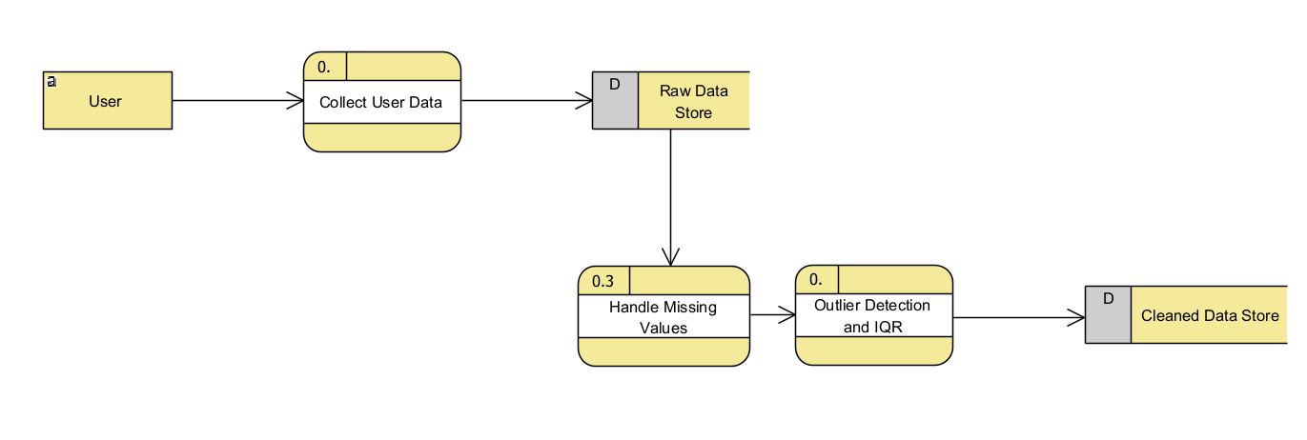
Module 1:DFD Diagram

Slide 15
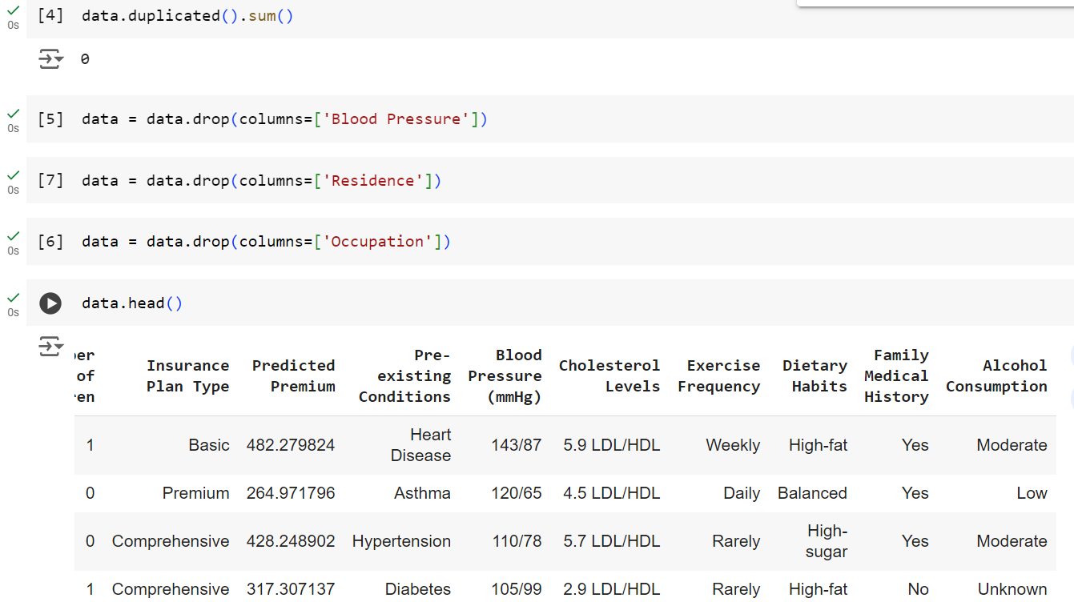
Module 1:Output Screenshots

Slide 16
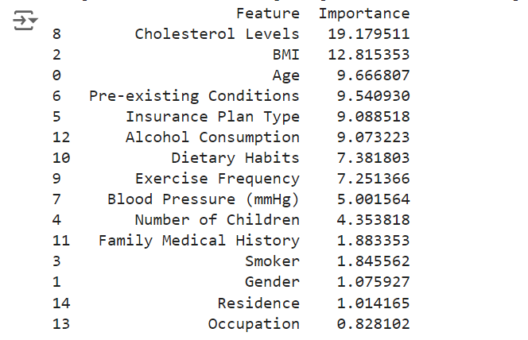
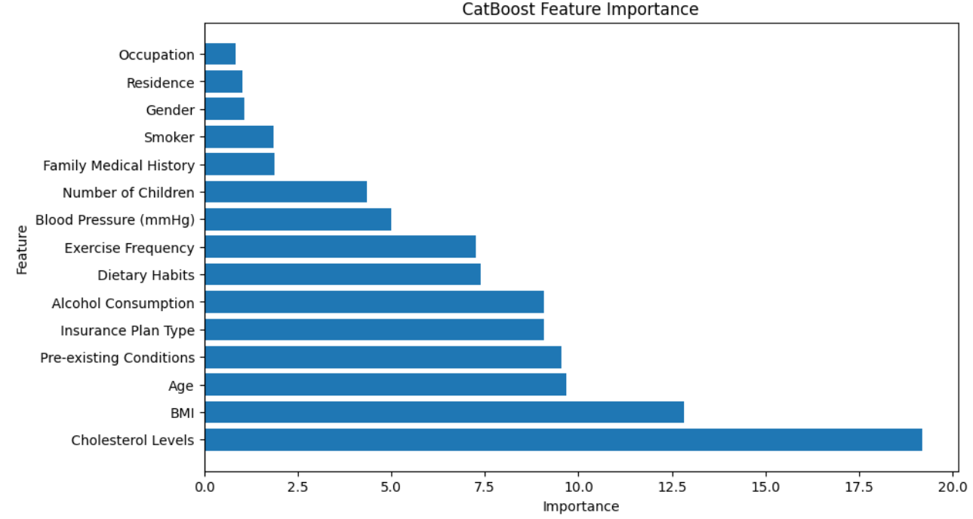
Module 1:Output Screenshots

Slide 17
Module 2: Model Training and Prediction
Step 1: Separate features into categorical and numeric categories for specialized preprocessing:
Categorical: Features like Diabetes, Blood Pressure Problems, etc.
Numeric: Features like BMI, Height, etc.
Step 2: Apply polynomial feature transformation (degree 3) to capture non-linear relationships
Step 3:Concatenate polynomial-transformed numeric features with the original categorical features
Step 4:Specify three base models – CatBoostRegressor, XGBRegressor, RandomForestRegressor.
Step 5: Define a Ridge regression model as the meta-model for aggregating predictions from the base models.
Step 6: Fit the stacking regressor and train the model.
Step 7: Use joblib to save the trained stacking regressor for deployment

Slide 18
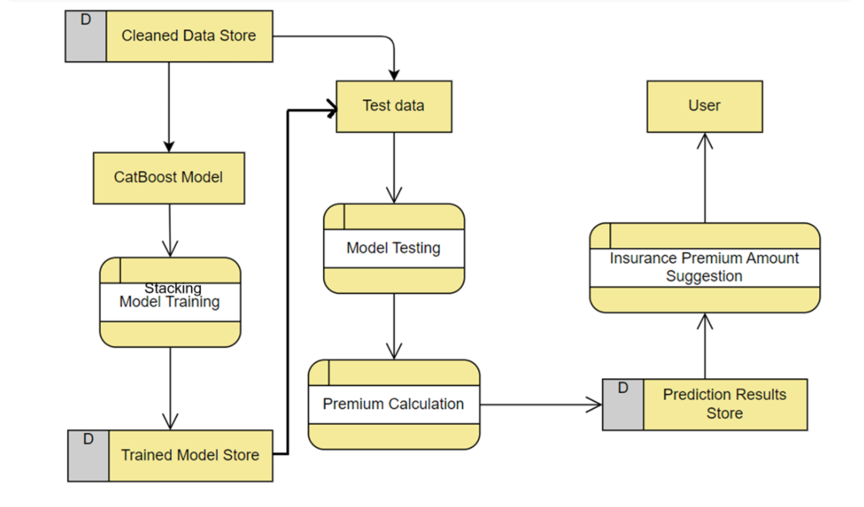
Module 2:DFD Diagram

Slide 19
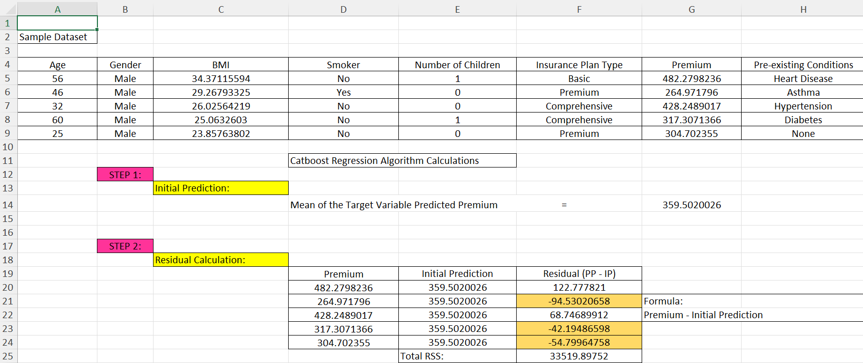
Module 2:Calculations

Slide 20
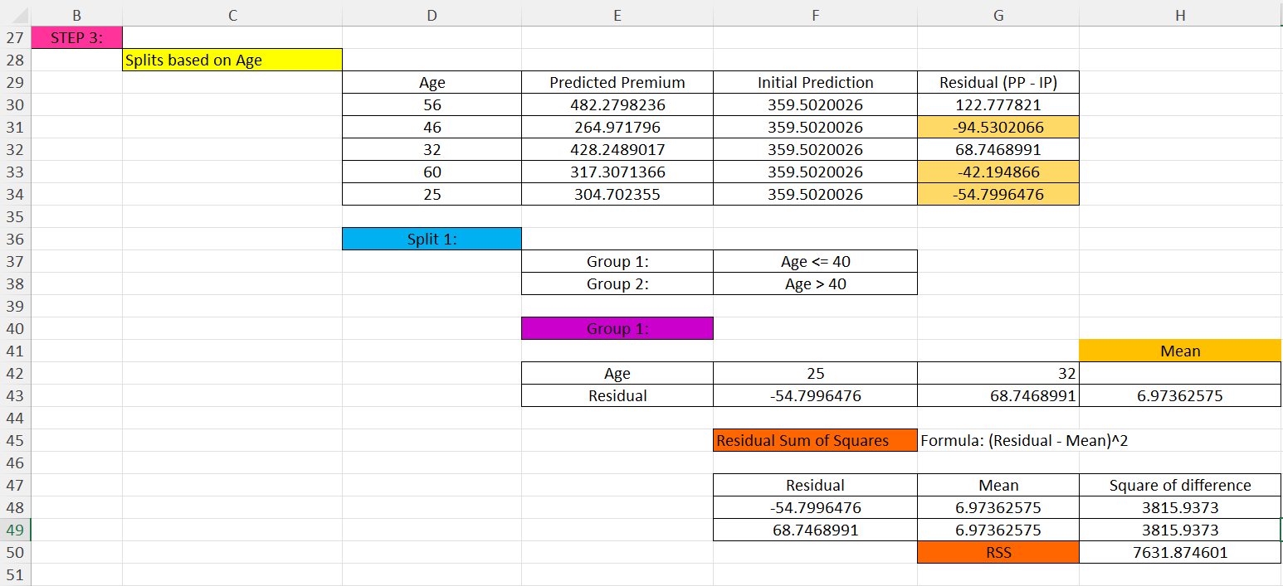
Module 2:Calculations

Slide 21
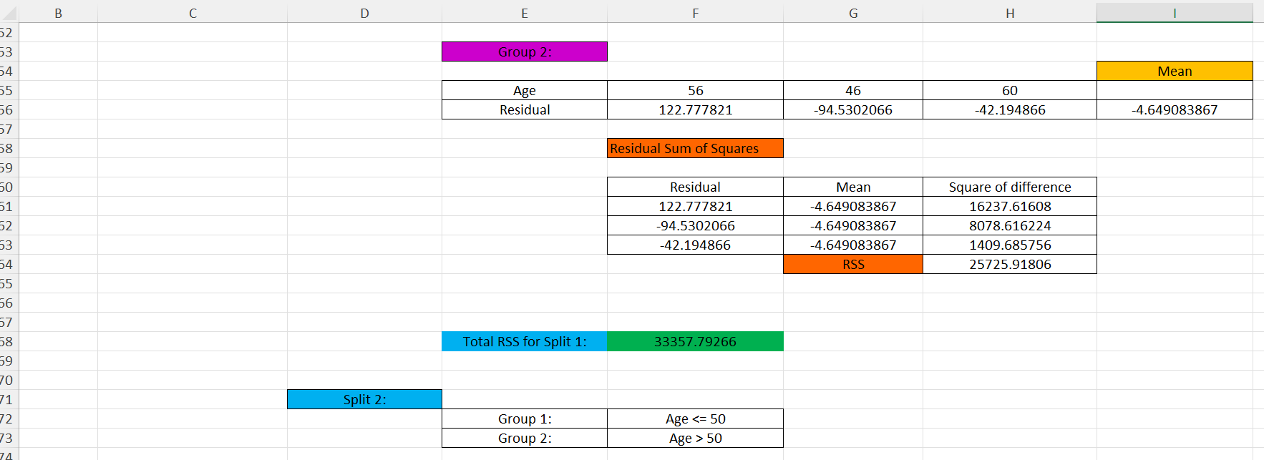
Module 2:Calculations

Slide 22
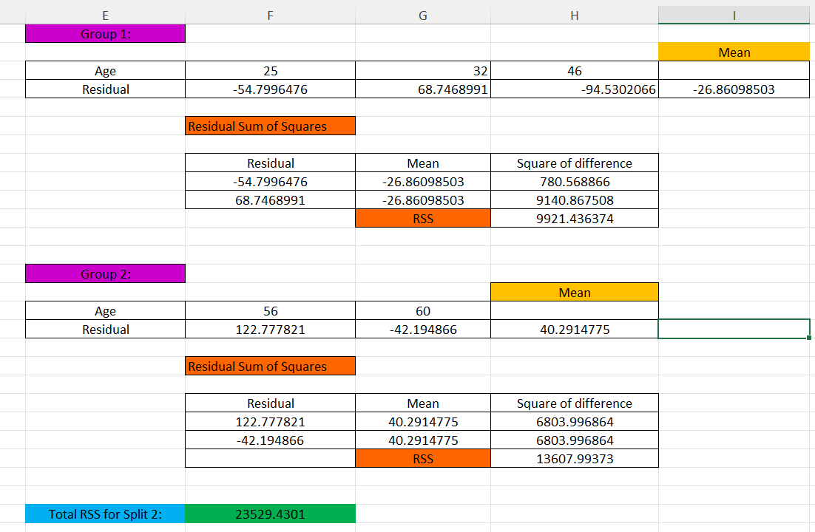
Module 2:Calculations

Slide 23
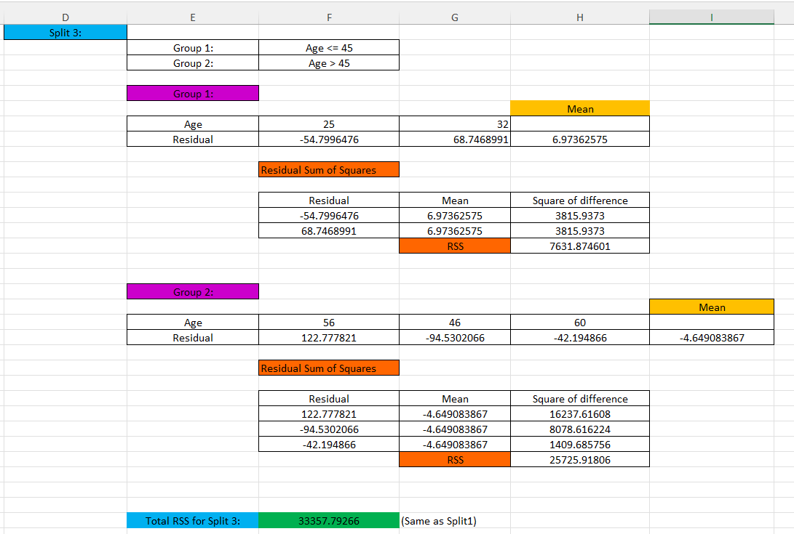
Module 2:Calculations

Slide 24
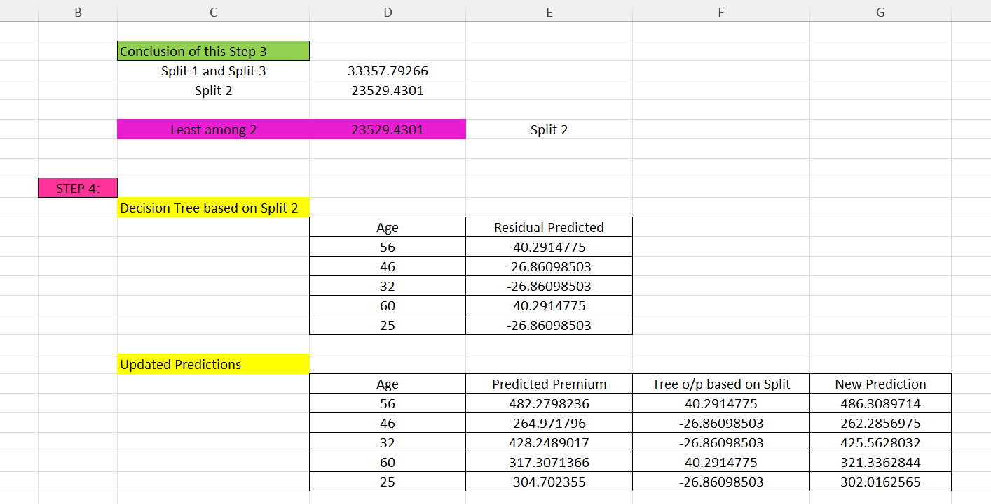
Module 2:Calculations

Slide 25
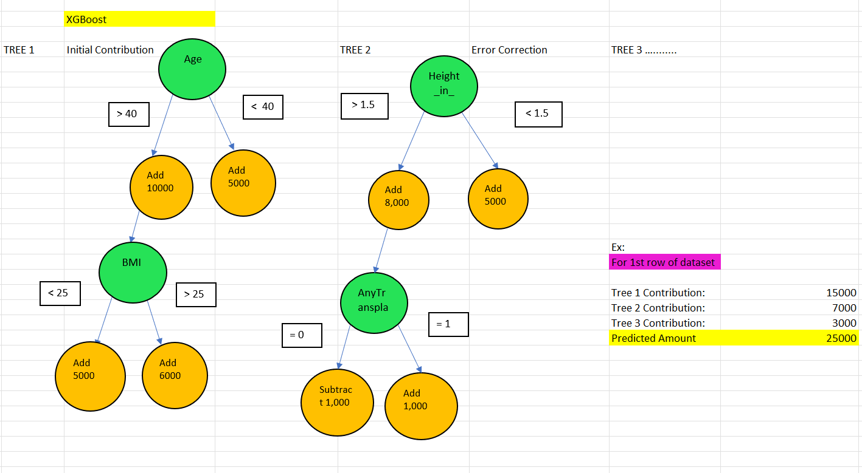
Module 2:Calculations

Slide 26
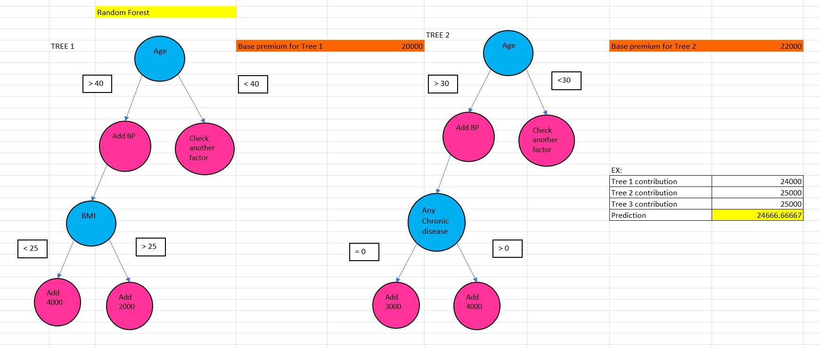
Module 2:Calculations

Slide 27
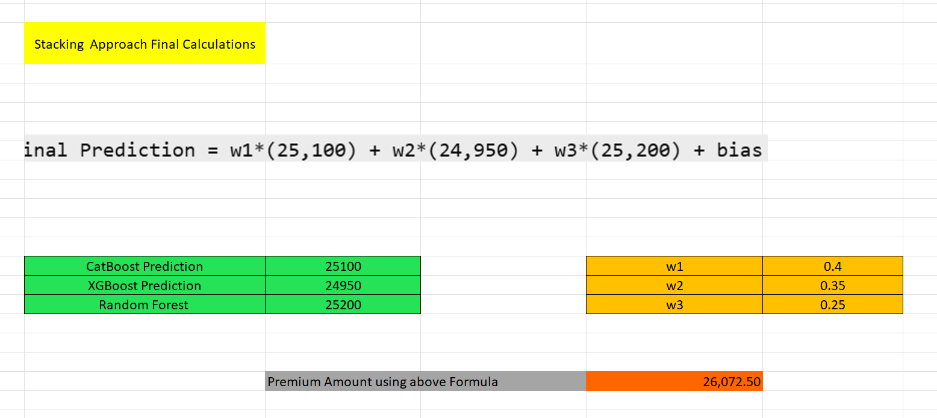
Module 2:Calculations

Slide 28
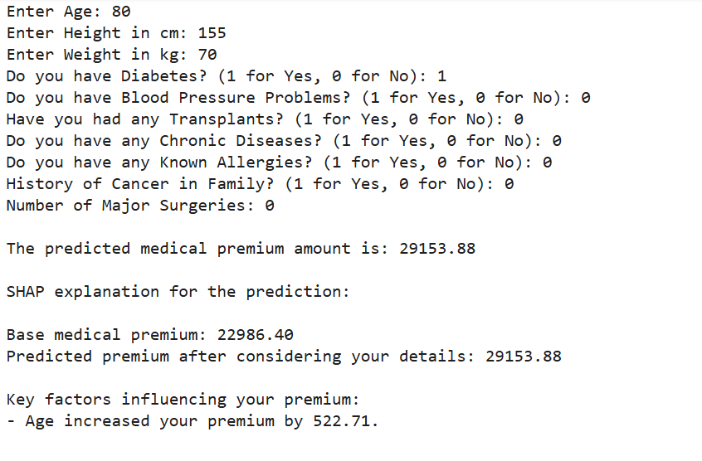
Module 2:Output Screenshots

Slide 29
Module 3: Web Application Module
Step1:Start a new Django project named insurance prediction.
Step2: Create a Django app named predictor and register it in the project settings.
Step3: Design a homepage with a form where users can input personal and medical details like age, height, weight, and medical history.
Step4: Receive user inputs from the frontend via HTTP POST requests.
Step5: Pass the preprocessed data to the stacking model for prediction.
Step6:Capture the predicted premium amount and format it for readability and redirect to result page.

Slide 30
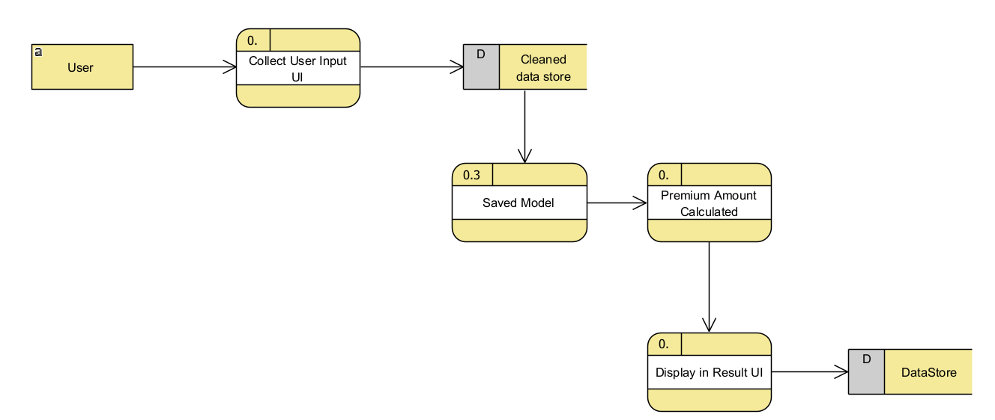
Module 3:DFD Diagram

Slide 31
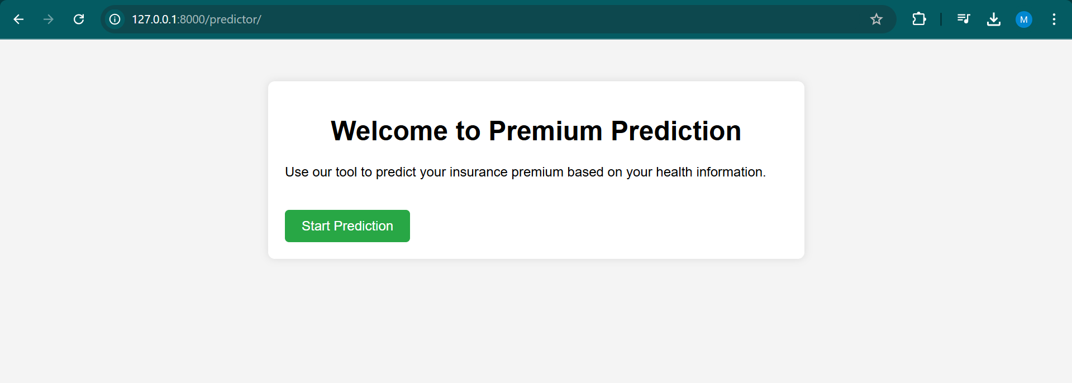
Module 3:Output Screenshots

Slide 32
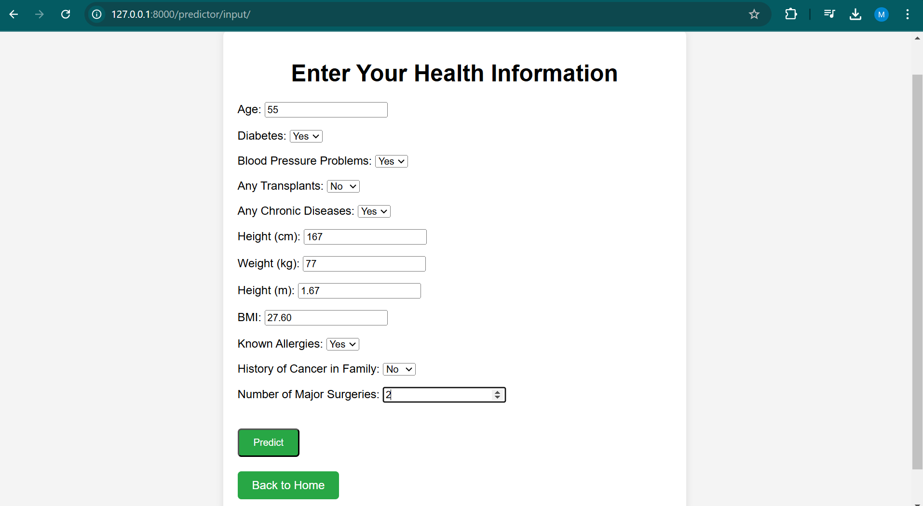
Module 3:Output Screenshots

Slide 33
Module 4: Integration Module
Step1: Store the model in saved_models folder in the Django project and configure it in settings.py.
Step2: Use the loaded model to make predictions.
Step3: Pass the preprocessed user input to the model’s predict() method.
Step4: Capture the prediction and format it .
Step5: Send the response back to the frontend for display.

Slide 34
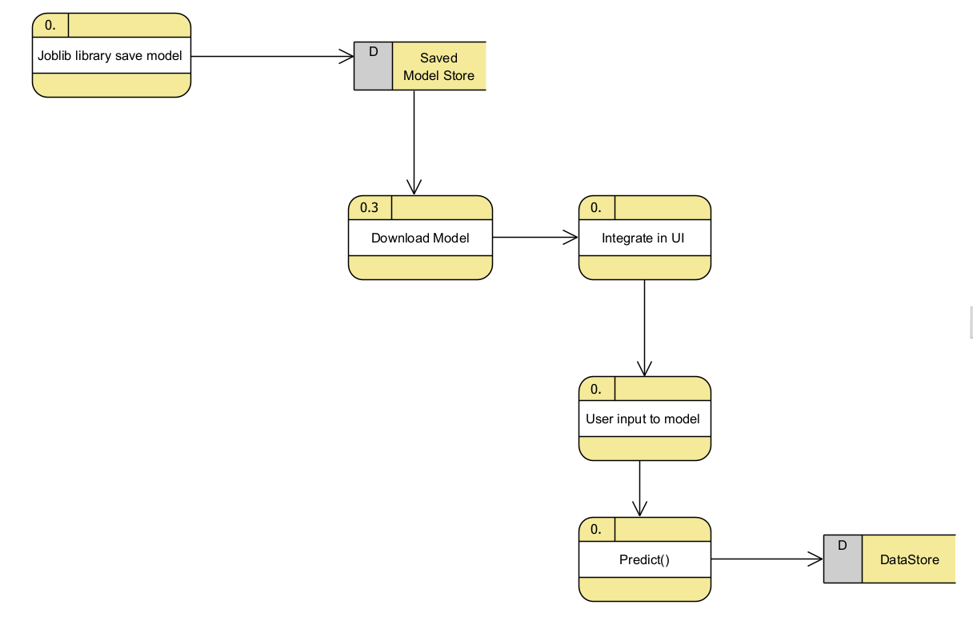
Module 4:DFD Diagram

Slide 35
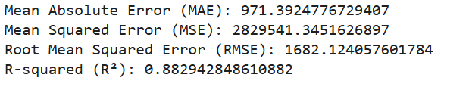
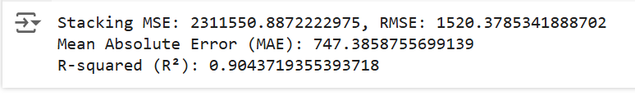
Module 4:Output Screenshots

Slide 36
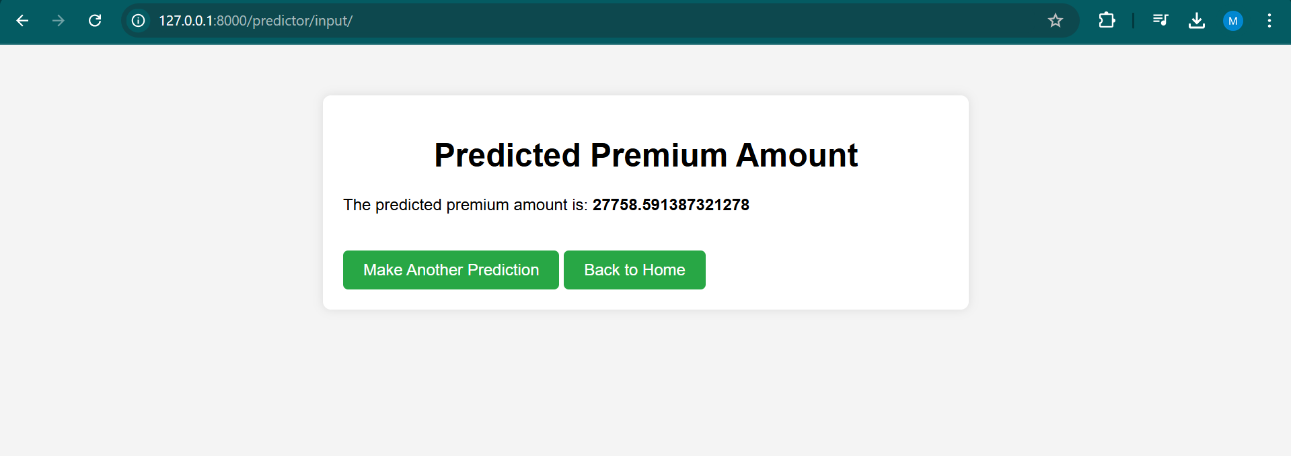
RESULTS AND DISCUSSION

Slide 37
CONCLUSION
The stacking approach using CatBoost, XGBoost, and Random Forest effectively predicted medical insurance premium amounts. Each base model contributed its strengths: CatBoost handled categorical features, XGBoost captured complex relationships, and Random Forest provided stability through ensemble learning. The meta-model (Ridge regression) combined their predictions, improving accuracy and reducing overfitting. This ensemble method outperformed individual models by providing more accurate and reliable premium predictions. The approach demonstrated significant potential for handling complex data and making robust predictions in real-world scenarios. Future improvements could include hyperparameter tuning for even better performance.

Slide 38
References.
J. H. Friedman, Stochastic gradient boosting, Comput. Statist. Data Anal., vol. 38, no. 4, pp. 367378, Feb. 2023.
R.RoyandK.T.George,Detecting insurance claims fraud using machine learning techniques, in Proc. Int. Conf. Circuit, Power Comput. Technol. (ICCPCT), Kollam, India, Apr. 2022, pp. 16.
J. West and M. Bhattacharya, Intelligent nancial fraud detection: A comprehensive review, Comput. Secur., vol. 57, pp. 4766, Mar. 2022.
G. Kowshalya and M. Nandhini, Predicting fraudulent claims in auto mobile insurance, in Proc. 2nd Int. Conf. Inventive Commun. Comput. Technol. (ICICCT), Coimbatore, India, Apr. 2024, pp. 13381343.
T.Badriyah,L.Rahmaniah,andI.Syarif, Nearest neighbour and statistics method based for detecting fraud in auto insurance, in Proc. Int. Conf. Appl. Eng. (ICAE), Batam, Indonesia, Oct. 2024, pp. 15.

Slide 39
Thank You

