Slide 1

Student Details
Name : M Sai lavANYA
SKILL BUILD ID : sailavanya_madam@srmap.edu.in
COLLEGE NAME : SRM University , Andhra Pradesh
COLLEGE STATE : ANDHRA PRADESH
Admission NO : AP22110011299
DOMAIN : CYBERSECURITY
Date of joining : 03.06.2024
END DATE OF INTERNSHIP : 25.07.2024

Slide 2
Project Title: “ Steganography: Hiding Information Within Digital Media ”
Problem Statement: With the increase in digital communication, the need for secure data transmission has become critical. Traditional encryption methods, while secure, can attract unwanted attention. Steganography offers an alternative by hiding the existence of the message itself. This project explores mainly LSB technique of hiding a text inside an image.

Slide 3
AGENDA
"Our steganography project begins with an introduction to its role in secure data transmission. We outline objectives, focusing on embedding and extracting hidden messages using the LSB technique and XOR encryption within digital images. Target users include cybersecurity professionals, government agencies, journalists, activists, and individuals needing secure communication. Key aspects include invisibility and security, simplified implementation with standard image formats, and customization efforts in algorithm optimization, user interface design, security enhancements, and performance testing. The presentation details modeling steps and includes practical code examples for embedding, extracting, and demonstrating implementation."

Slide 4
PROJECT OVERVIEW
Objectives:
Embedding and extracting hidden messages using the Least Significant Bit (LSB) technique combined with XOR encryption within digital images.
Methodology:
Utilizing LSB technique : Modifying the least significant bits of pixel values to embed secret data.
XOR encryption : Enhancing security by encrypting data before embedding.
Advantages :
Hard to Detect: Steganography hides data within files, making it difficult for unauthorized parties to notice.
Exclusive Receiver Detection: Only the intended receiver, who knows the method, can detect and extract the hidden information.
Versatile and Secure: Can be used with audio, video, and images, adding an extra layer of protection across various networks.

Slide 5
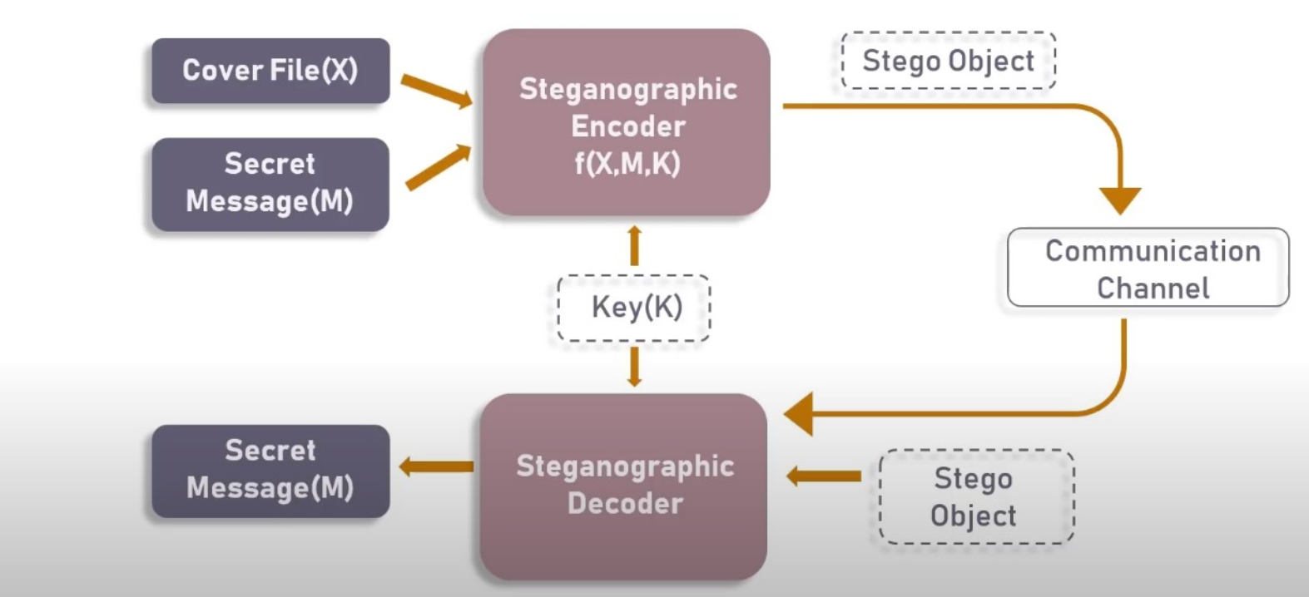
PROJECT OVERVIEW

Slide 6
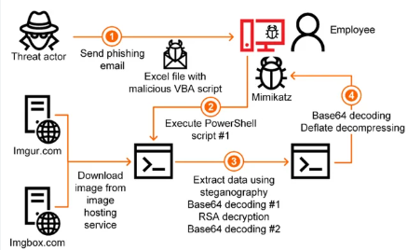
WHO ARE THE END USERS of this project?
Cybersecurity professionals
Government agencies
Journalists and activists
Individuals needing secure communication

Slide 7
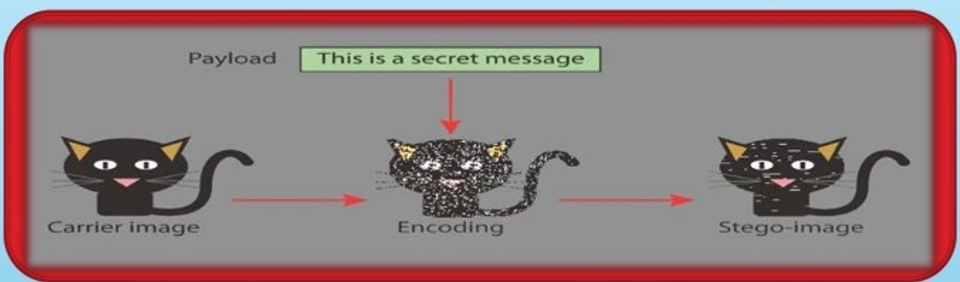
YOUR SOLUTION AND ITS VALUE PROPOSITION
Solution :
The project develops a steganography tool that combines the Least Significant Bit (LSB) technique with XOR encryption to hide and extract messages within digital images.
Embedding : Encrypt the message with XOR and embed it in the image's least significant bits.
Extracting : Retrieve and decrypt the message from the image using the same passcode.
Value Proposition:
Enhanced Security: Combines LSB steganography with XOR encryption for double-layer security.
Preserved Image Quality: Maintains the original image quality, making hidden data undetectable.
Simplicity and Efficiency: Easy to implement with low computational resources.
Robustness: Resistant to common image manipulations like compression and cropping.

Slide 8
How did you customize the project and make it your own
XOR Encryption:
Encrypts the message with a passcode before embedding.
Ensures message can only be extracted with the correct passcode.
Image Handling:
Uses Least Significant Bit (LSB) technique to embed and extract encrypted messages.
User-Friendly Enhancements:
Clear input prompts for image path, passcode, and text.
Feedback on successful hiding and extraction.
Automatically opens the encrypted image after saving.
Performance and Robustness:
Optimized for minimal impact on image quality and fast processing.
Ensures hidden message integrity against image manipulations.

Slide 9
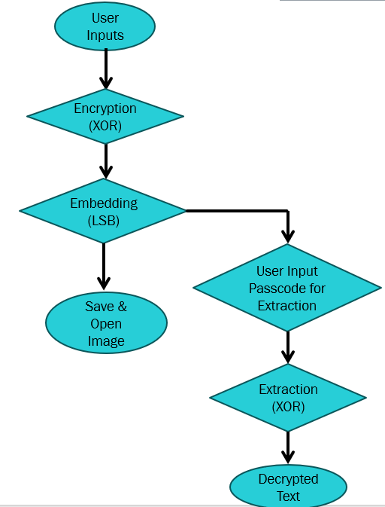
MODELLING
Input Handling:
User inputs the image path, passcode, and text to hide.
Encryption Process:
Converts text characters to ASCII values.
Encrypts ASCII values using XOR with passcode characters.
Embedding Process:
Embeds the encrypted text into the image using the Least Significant Bit (LSB) technique.
Cycles through image pixels and color planes (Blue, Green, Red).
Output Handling:
Saves the modified image with hidden data.
Provides user feedback and opens the saved image automatically.
Extraction Process:
User inputs the passcode to retrieve the hidden text.
Extracts and decrypts the text using the same XOR technique.

Slide 10
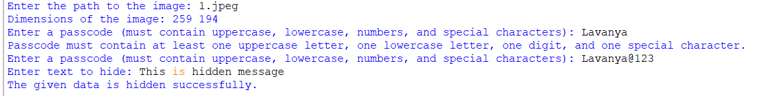


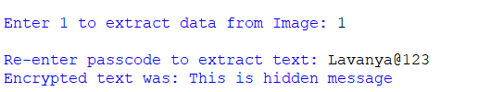
Results
Normal Image
Encrypted Image

Slide 11
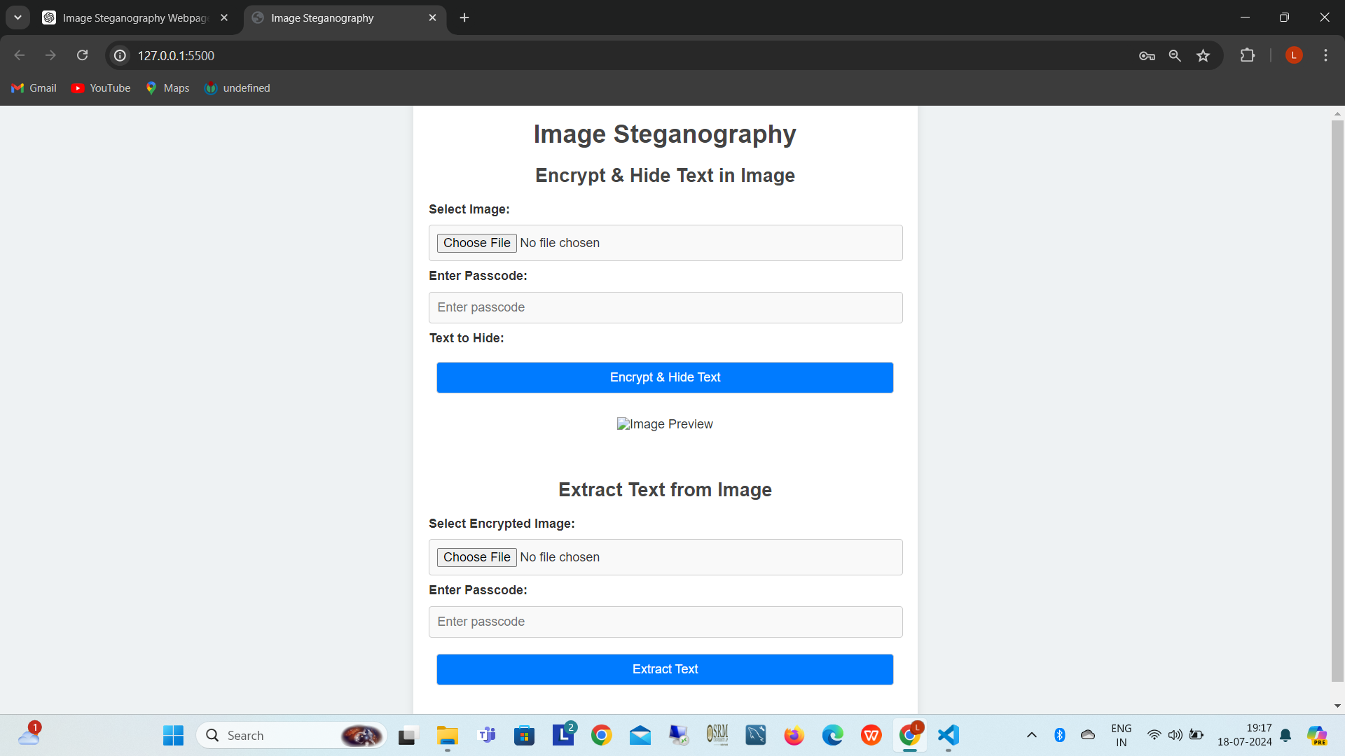
Future work
Trying to developing a website, enhance the user interface for improved usability, support a variety of image formats, strengthen security measures, explore advanced steganography techniques, ensure compatibility across different devices, provide clear feedback and error handling, optimize performance for efficient operation, offer comprehensive documentation and user guides, integrate with backend services for enhanced functionality, and conduct thorough testing before deploying updates.
There are some errors and it is in the progress.

Slide 12
links
Project link
Github repository of steganography (hiding text inside an image)
ctrl and click of the given link
Or https://github.com/lavanya0479/Steganography
IBM SkillsBuild Email ID
https://skills.yourlearning.ibm.com/profile/preference
https://en.wikipedia.org/wiki/Steganography

