Slide 1


Preboard Generator
CBSE Class 10 Science preboard papers in minutes.
AI drafts. The teacher decides.
A Lavanya AI Consultancy initiative to make Schools AI-enabled
Click the video to play ▶
Notes:
Open the meeting with the 30-second video: click it to play. It shows the late-night struggle, the one-click paper, and what the teacher does with the saved time. After it ends: 'This is what we built for teachers like yours.'

Slide 2
Every preboard paper costs a teacher hours
1
Read the CBSE sample paper
4–6 hrs
Study the 2026-27 pattern and marking scheme
2
Balance marks across chapters
Match marks per chapter, types and difficulty
to prepare ONE preboard paper – often late at night, after a full school day.
3
Write 16 fresh questions
Case-based, assertion–reason, competency-based
Every class. Every subject. Every preboard round.
Type the answer key
4
Step-wise marking scheme for every question
Notes:
Ask the principal or HOD: how long does a preboard paper take your teachers today? Most say 4 to 6 hours: reading the sample paper, balancing chapters, writing questions and typing the answer key.

Slide 3
Preboard Generator does the repetitive work
1
2
3
AI drafts
The teacher decides
One click, full paper
Agents study the official CBSE 2026-27 sample paper and past board papers, then write new CBSE-style questions with answers and step-wise marking.
Every AI question waits for the teacher. Approve, edit or reject – nothing reaches a paper without approval.
16 questions, 30 marks, the right marks per chapter. Question paper and answer key PDFs, ready to print.
Built by a CBSE teacher, for teachers.
Notes:
Three ideas: AI drafts, the teacher decides, one click makes the paper. Stress that the teacher stays in charge of every question.

Slide 4
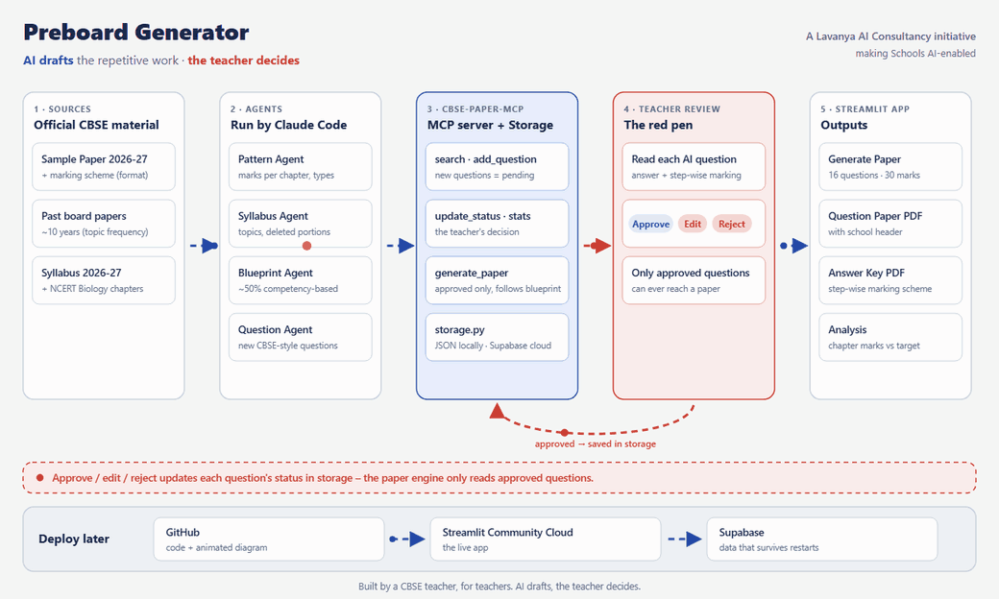
How it works
Notes:
The arrows move during the slideshow. Walk left to right: official CBSE sources → AI agents → the question bank → the teacher's red pen → the app that makes the paper. Point at the red loop: only approved questions are saved for papers.

Slide 5
The teacher stays in control
AI writes a question
Teacher reviews it
Only approved questions
Saved as Pending – never used yet
Approve · Edit · Reject in one click
can ever appear in a paper
Built-in checks before anything is saved
✓
Correct marks for each question type
✓
MCQ answer must be one of the options
✓
Near-duplicate questions are blocked
✓
Official CBSE and NCERT sources only
Notes:
This is the key difference: the AI never publishes on its own. New questions arrive as pending; the teacher approves, edits or rejects. The system also refuses wrong marks, wrong MCQ answers and duplicate questions.

Slide 6
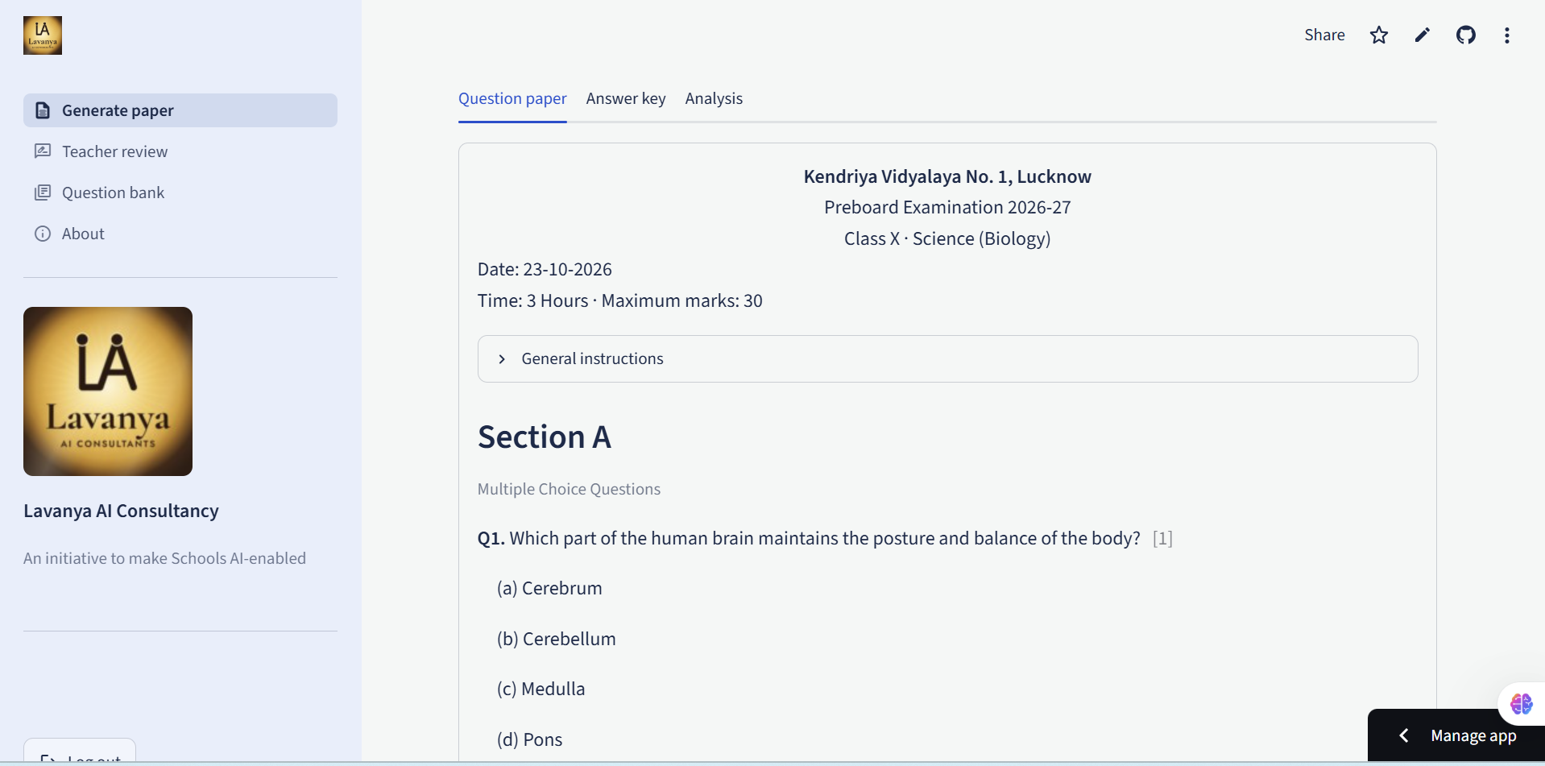
What the teacher gets
Question paper PDF
School header, ready to print
Answer key PDF
Step-wise marking scheme
Analysis
Marks per chapter vs target, difficulty mix
Question bank
Search, filter and reuse approved questions
A generated paper in the app – the school's name on top, sections A to E.
Notes:
Everything a teacher needs for the exam day: the paper, the answer key with marking, and a check that the chapter marks match the blueprint.

Slide 7
Built on the exact Board 2027 pattern
Full Science paper: 39 questions · 80 marks · 3 hours – as in the official CBSE 2026-27 sample paper
Section A
Section B
Section C
Biology
Chemistry
Physics
Q1–16 · 30 marks
Q17–29 · 25 marks
Q30–39 · 25 marks
✓
MCQ, assertion–reason, 2, 3 and 5-mark and case-based questions in the official numbers
Biology preboard (30 marks)
Live now
Full Science paper (80 marks)
Rolling out as the Physics and Chemistry question bank is approved
✓
Internal choice (OR) in the same places as the board paper
✓
Marks per chapter follow the official sample paper
Notes:
The app now follows the exact Board 2027 pattern from the official CBSE sample paper: Biology, Chemistry and Physics sections, the same question types and OR choices. Be clear that the Biology preboard is live today, and the full 80-mark paper is rolling out as Physics and Chemistry questions are written and approved by teachers. Demo only the Biology paper live.

Slide 8
Hours back for what matters
4–6 hours → about 15 minutes
per preboard paper (our target)
Mentoring students one-to-one
Creative, activity-based lessons
Extra help for students who need it
Time for family and rest
Notes:
The real benefit is not the software – it is the teacher's time. Hours saved go back to students and to the teacher's own life.

Slide 9
Bringing it to your school
1
2
3
Live demo
Pilot
Expand
Today – we make a paper together in this meeting.
Class 10 Science teachers use it for the next preboard round.
More subjects and classes, based on your teachers' feedback.
What the school needs: a laptop and a browser. No software to install, and the teacher approves every question.
Notes:
Propose a simple next step: a pilot with the Class 10 Science teachers for the coming preboard. Then expand to other subjects.

Slide 10
Let's make a paper together
Your school's name · one click · question paper and answer key in minutes
Open the live app →
Lavanya AI Consultancy · An initiative to make Schools AI-enabled
Notes:
Click the gold button (in slideshow mode) to open the app. Log in, type the school's name, press Generate, show the three tabs and download both PDFs. Then open Teacher review to show approve / edit / reject.

