Slide 1


PREDICTING THE MALIGNANCY OF BREAST CANCER USING PCA AND MACHINE LEARNING MODELS
BY
NAME : LAVANYA SINGH
STUDENT ID: 400547269
COURSE : SEP 765
MULTIVARIATE STATISTICAL METHODS FOR BIG DATA ANALYSIS AND PROCESS IMPROVEMENT
INSTRUCTOR: DR BRANDON CORBETT
GUIDED BY : DR HESAM HASSANPOUR

Slide 2
INTRODUCTION AND MOTIVATION
Breast cancer is one of the most prevalent illness among females. One out of every eight women has breast cancer.
With the exception of skin cancers breast cancer is the most frequent malignancy among Canadian women. For Canadian women, it is the second most common cause of cancer-related mortality. Men can also get breast cancer however it is rare.
While the majority of cases of breast cancer are benign, some are malignant (cancerous). Therefore, it is necessary to identify whether breast cancer is malignant or not.
Hence early diagnosis of Breast Cancer and ability to predict that cancer is malignant(cancerous) or benign(non-cancerous) is of utmost importance as it improves the survival and life expectancy of the effected woman

Slide 3
DATASET DESCRIPTION
Dataset have taken from Kaggle website:-https://www.kaggle.com/datasets/nancyalaswad90/breast-cancer-dataset
This dataset consists of 33 attributes which are x variables and two y variables as M(Malignant) and B(Benign)
There are 570 rows and 33 columns in the data set
Breast cancer Wisconsin(diagnostic) database was taken from open-source site Kaggle .This dataset we can help diagnose patients and predict the likelihood of a breast cancer(malignant)
The x variable are 33 attributes like radius ,texture ,perimeter ,area smoothness etc.

Slide 4
OBJECTIVES
/
My objective is to determine whether the tumour is malignant or benign
I will also implement classification algorithms like logistic regression, random forest , decision Tree algorithms
I propose to use Principal component analysis (PCA) model
The main objective of the project is to predict and help in early diagnosis of the breast cancer using ML algorithms AND PCA MODEL
I also propose to find out which algorithm is most effective method to predict breast cancer between logistic regression and random forest with the help of confusion matrix,accurarcy,precision,f1_score and recall

Slide 5
METHODOLOGY
USING THE MODEL, WE CAN PREDICT WHETHER TUMOUR IS MALIGNANT OR NOT AND WHICH MODEL HELPS US IN EARLY DIAGNONSIS
IMPORTING LIBRARIES
MAPPING THE VARIABLES AND USING THE DICTIONARY
COMPARING RESULTS
USING STANDARD SCALING
BEFORE REMOVING OUTLIERS PERFORMING MACHINE LEARNING AND PCA
BEFORE REMOVING THE OUTLIERS BUILD CONFUSION MATRIX AND PREDICT ACCURACY ,PRECISION ,f1_Score RECALL
AFTER REMOVING THE OUTLIERS REPEAT SAME THE STEPS
PERFORMING TRAINING AND TESTING DATA

Slide 6

WHY ARE WE USING PCA MODEL ?
PCA is a useful tool while working with cancer classification tasks:-
1)Dimensionality Reduction-By reducing dimensional space the efficiency of the classification algorithm is improved
2)Feature Selection-PCA identifies the most significant component(principal component),discards redundant or noise prone variables
3)Visualization- identifies patterns and separability of malignant or non-malignant cases
4) Noise reduction
5) Collinearity handling –Cancer dataset are highly corelated PCA helps to decorrelate features
6) Improved Model Performance
7) Mitigated the risk of overfitting
8) PCA is very effective tool for our study

Slide 7
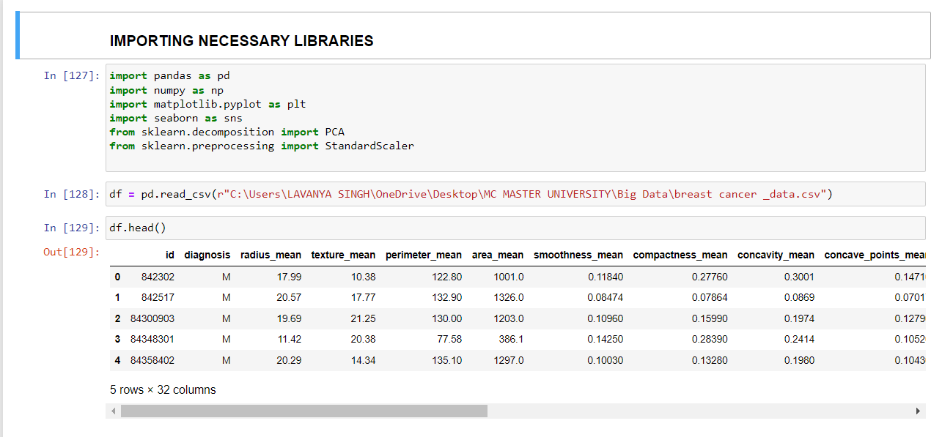
CODE

Slide 8
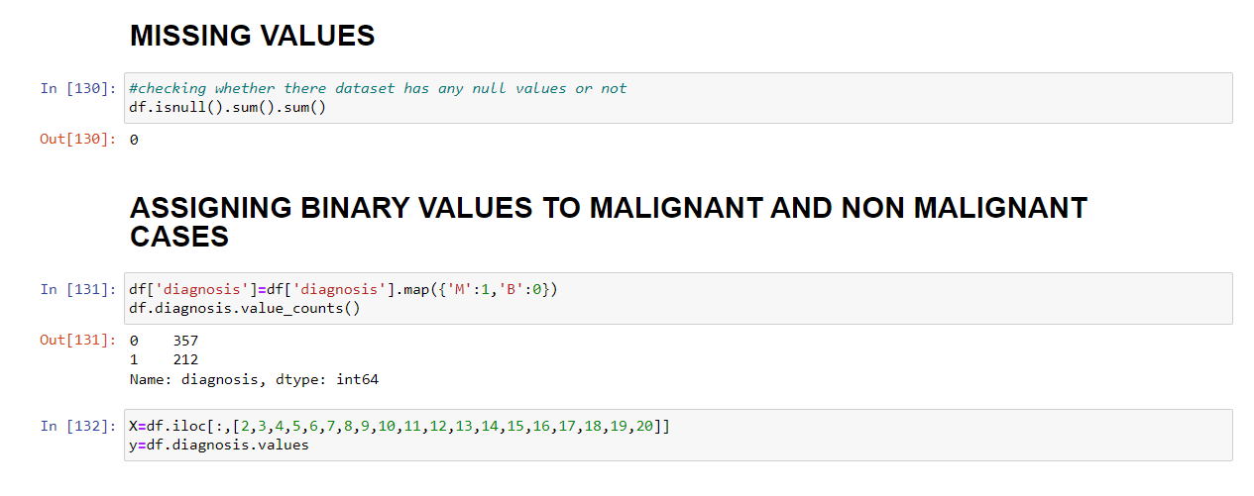
CODE

Slide 9
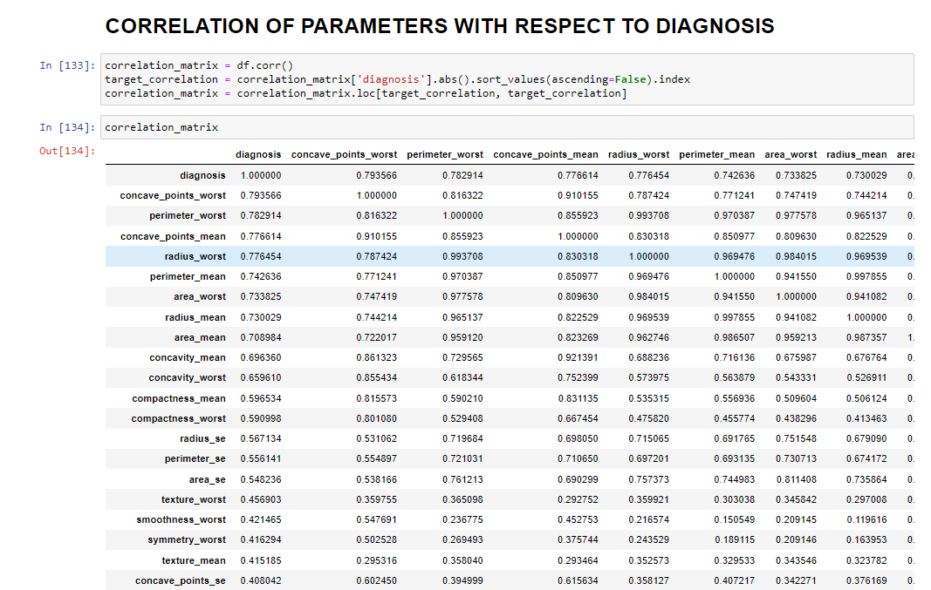
CODE

Slide 10
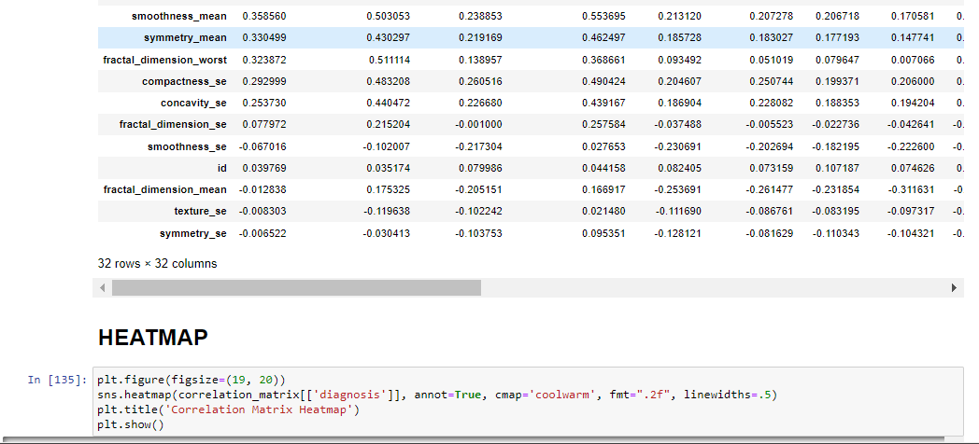
CODE

Slide 11
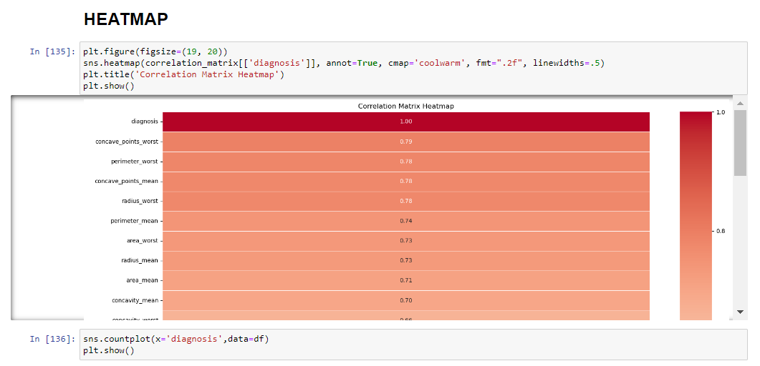
CODE

Slide 12
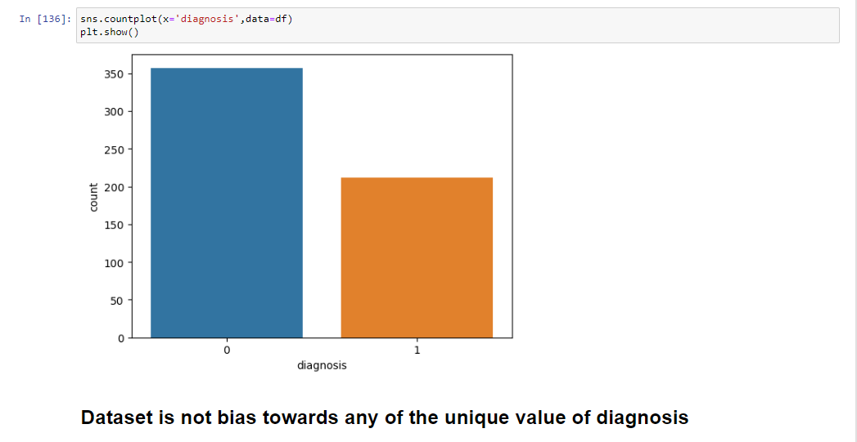
CODE

Slide 13
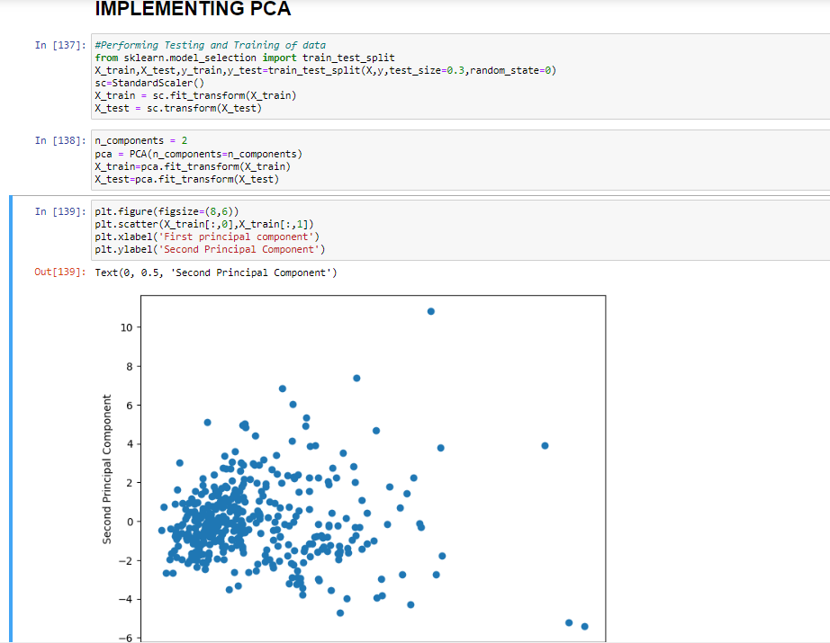
CODE

Slide 14
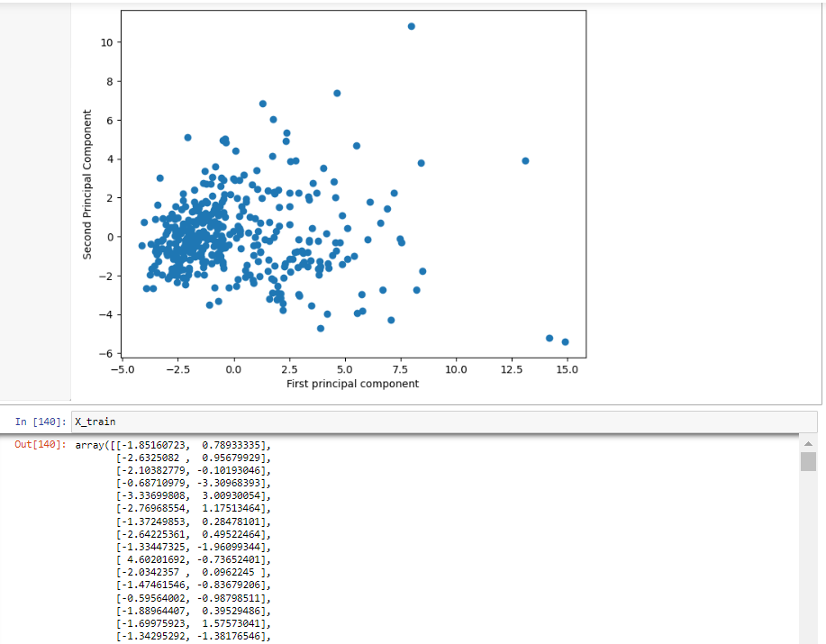
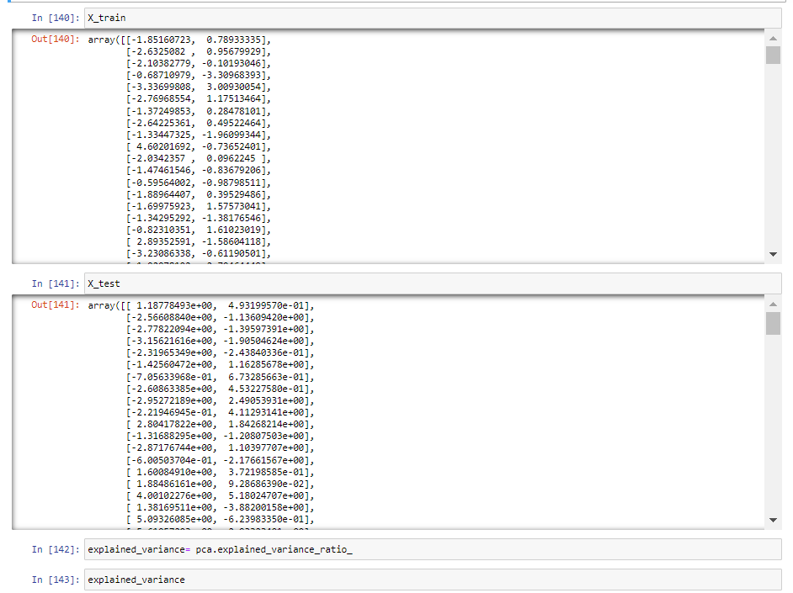
CODE

Slide 15
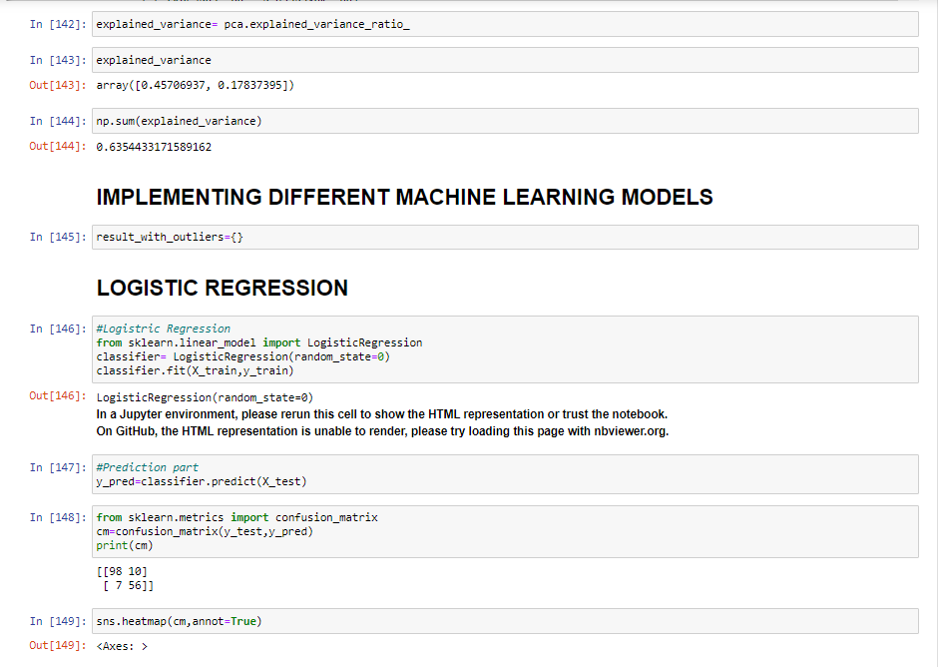
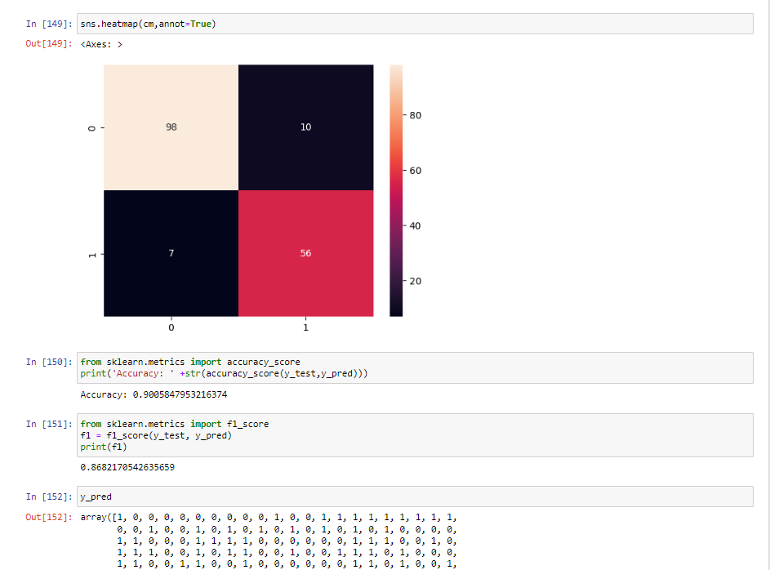
CODE

Slide 16
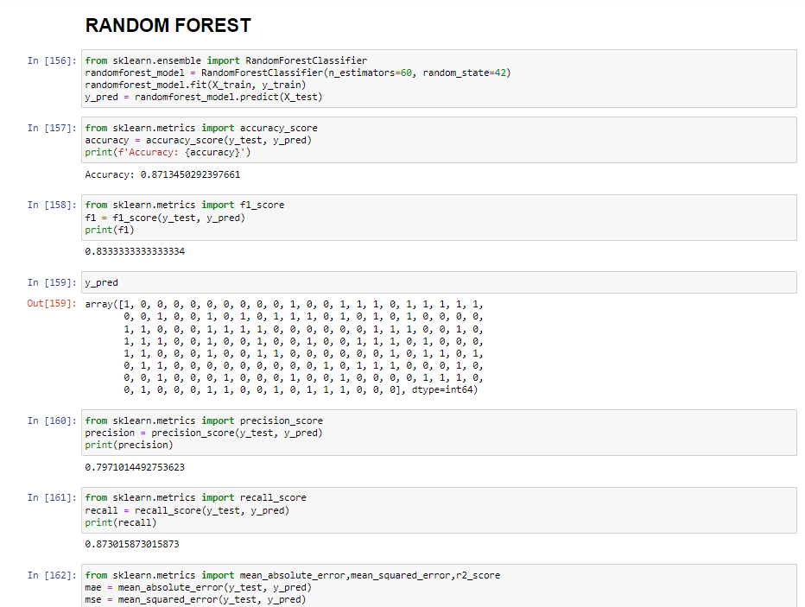
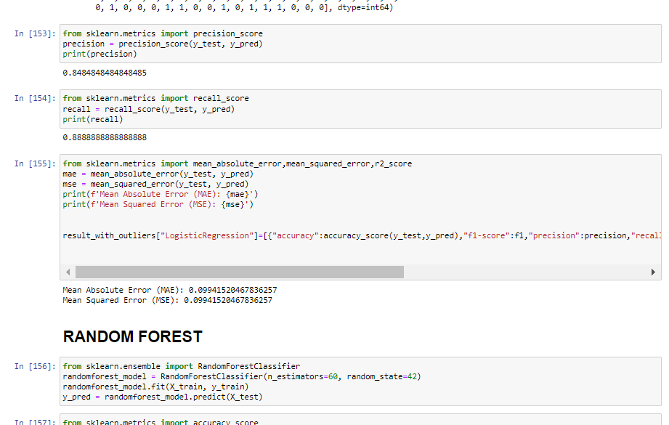
CODE

Slide 17
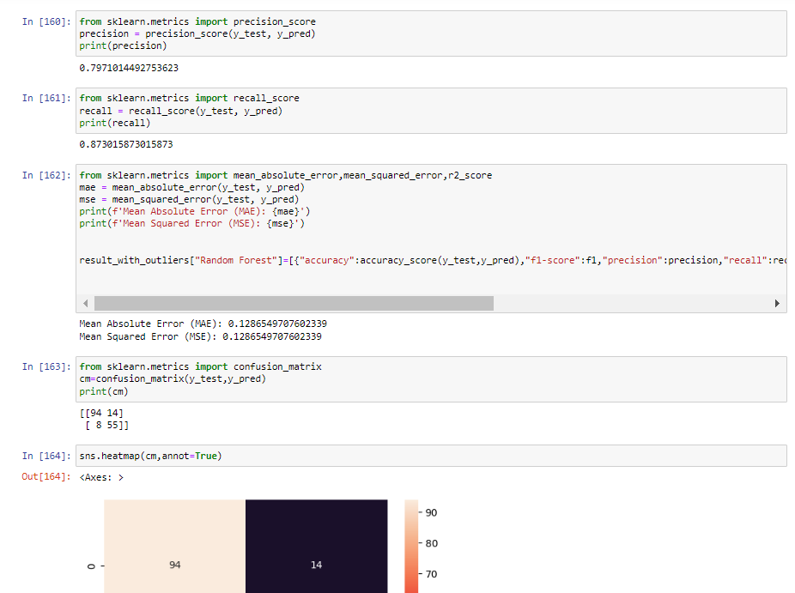
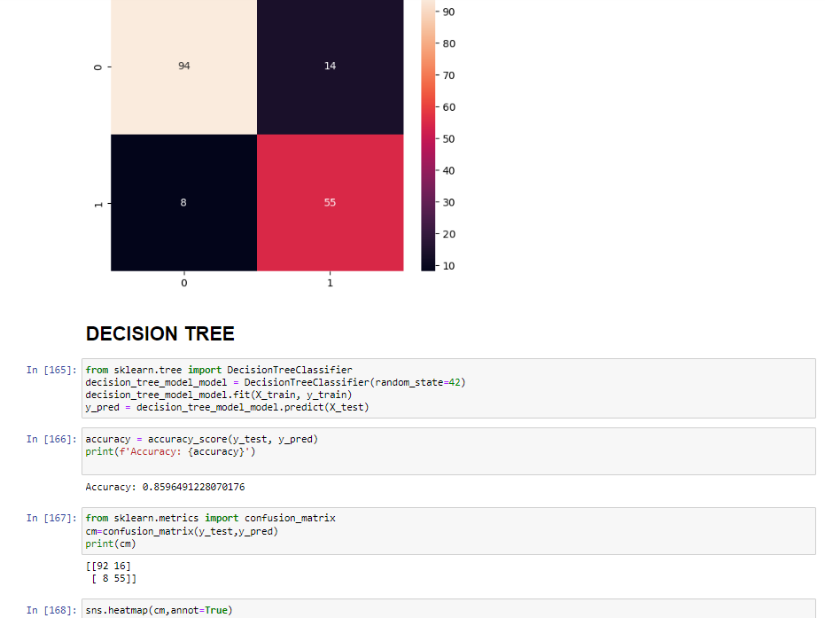
CODE

Slide 18
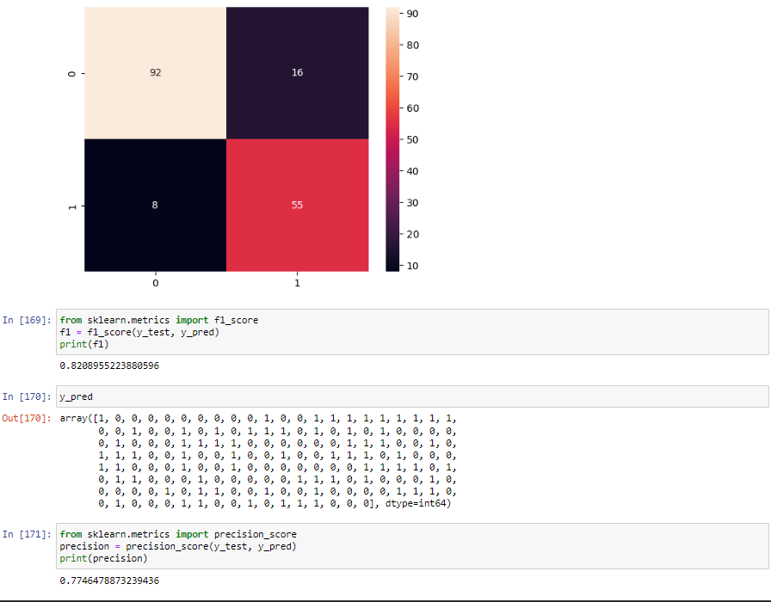
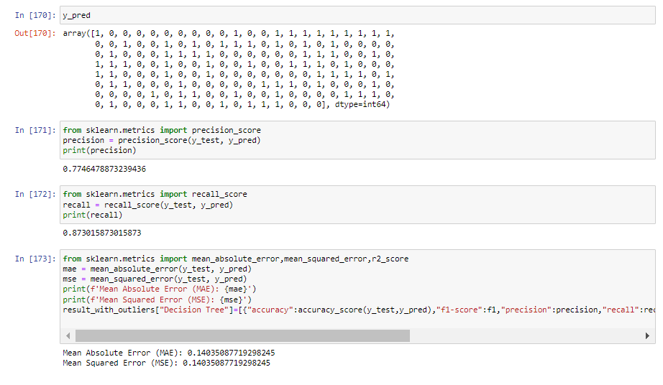
CODE

Slide 19
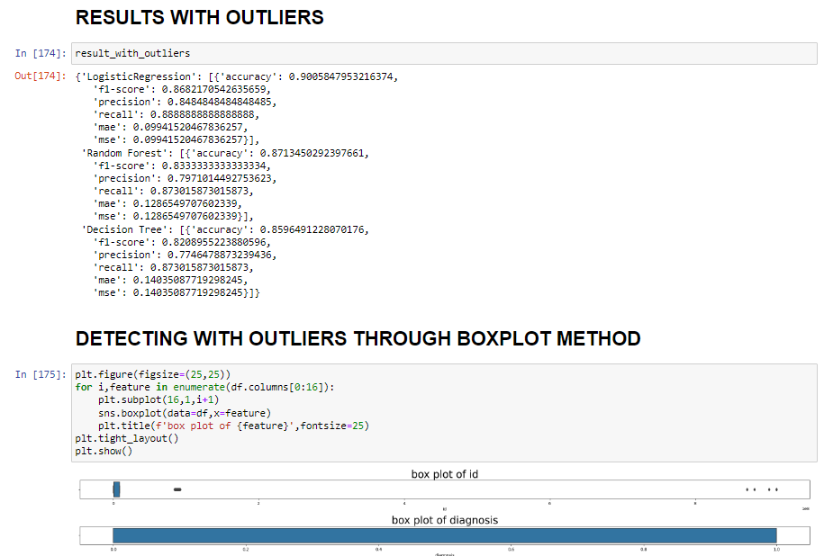
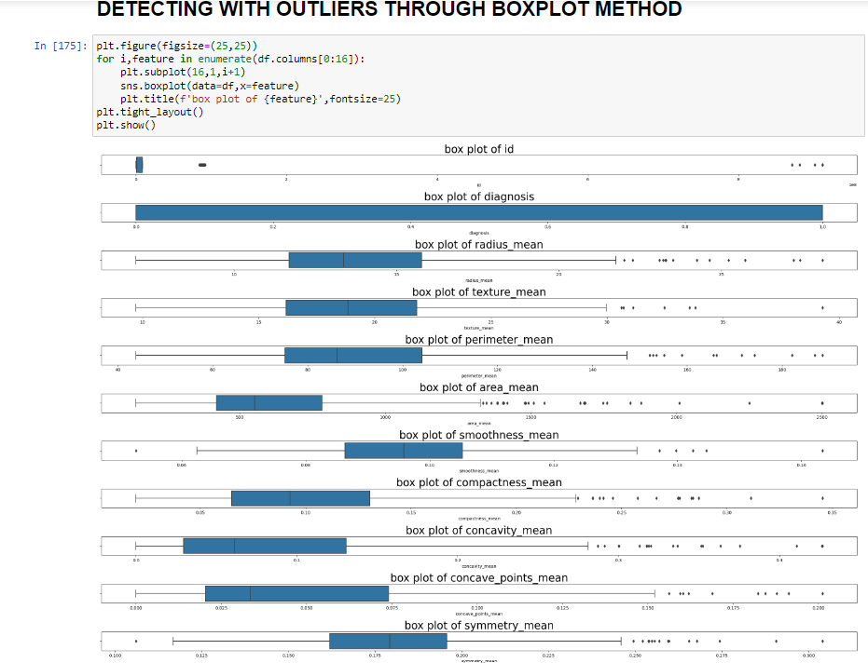
CODE

Slide 20
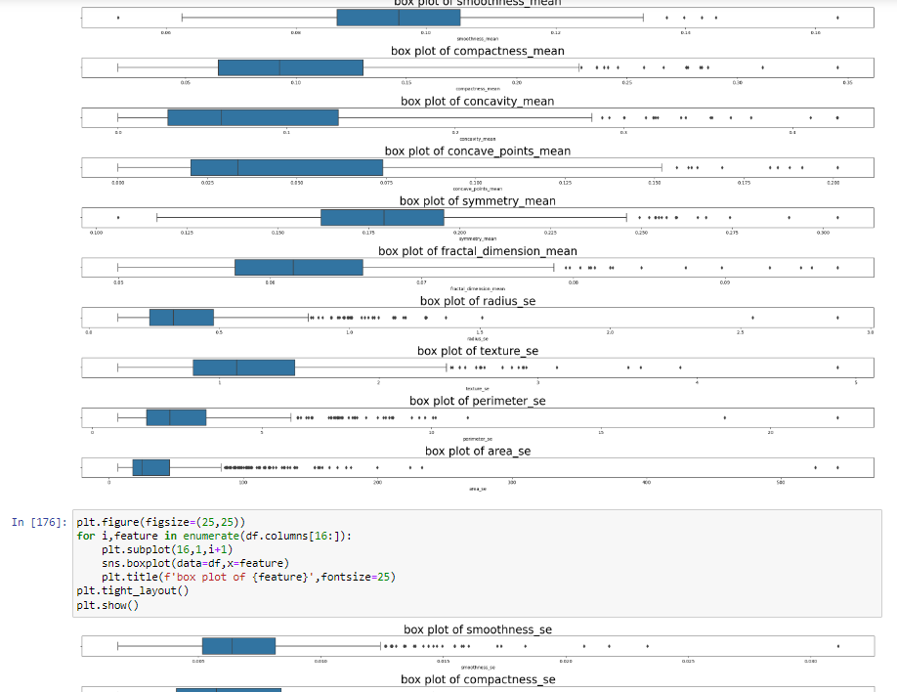
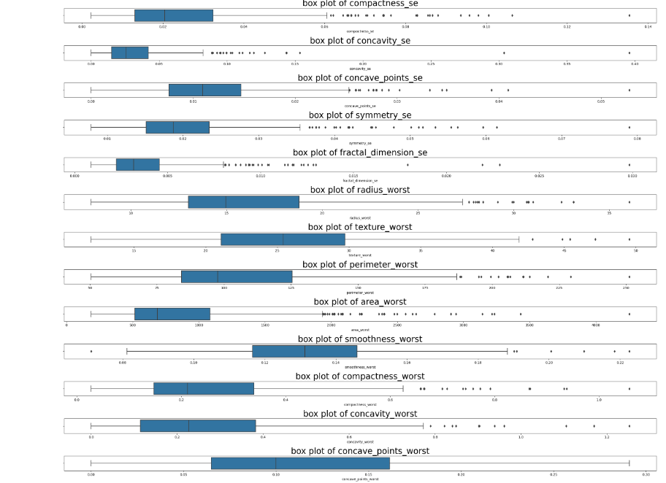
CODE

Slide 21
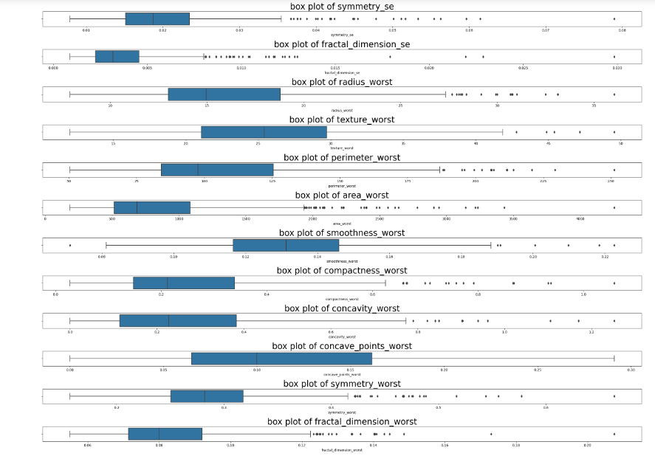
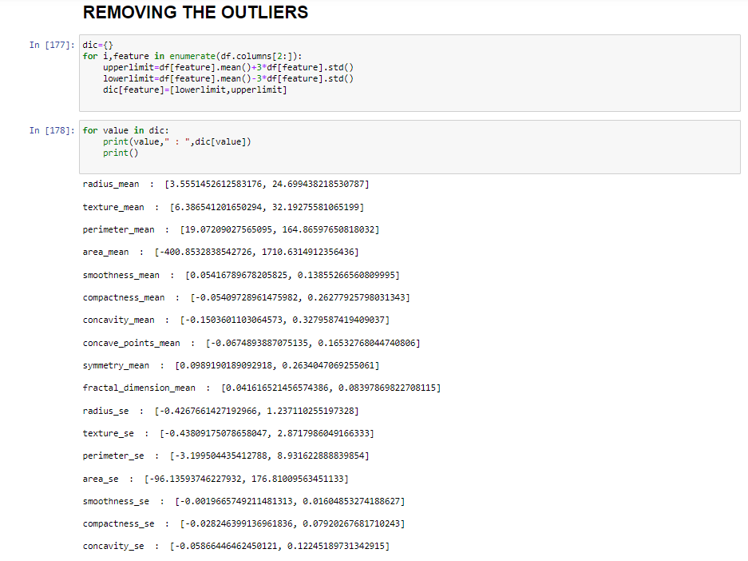
CODE

Slide 22
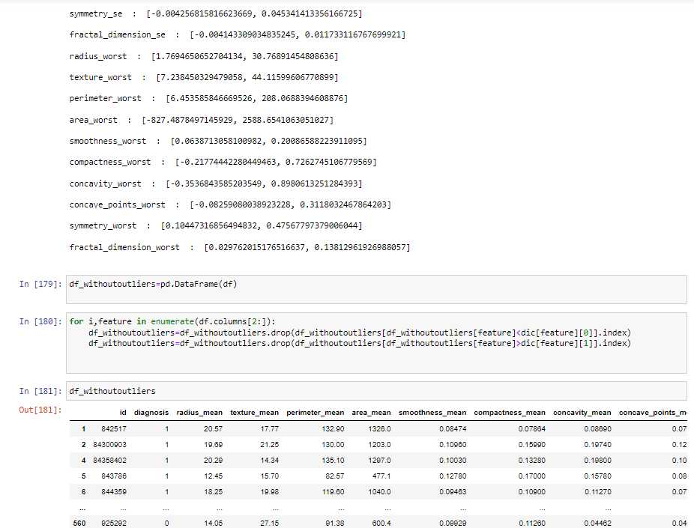
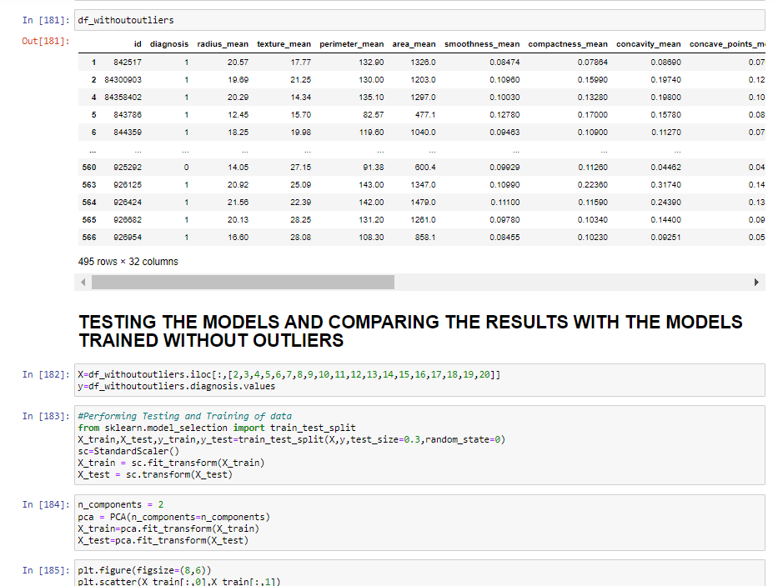
CODE

Slide 23
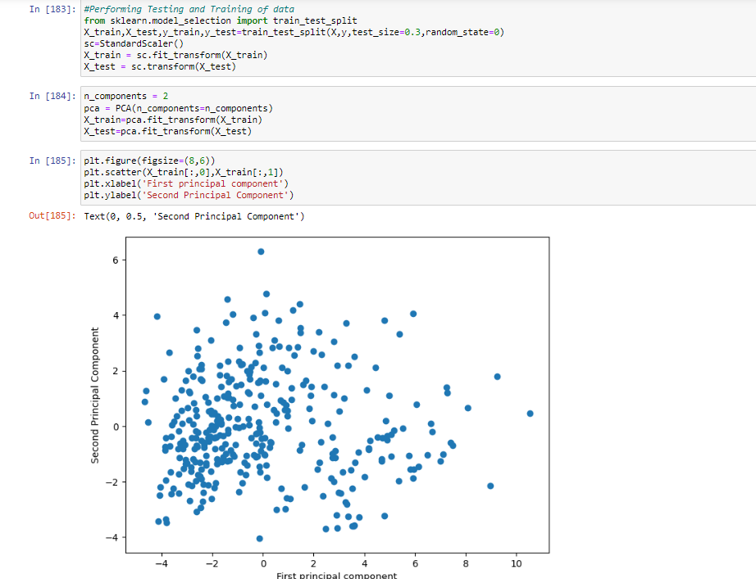
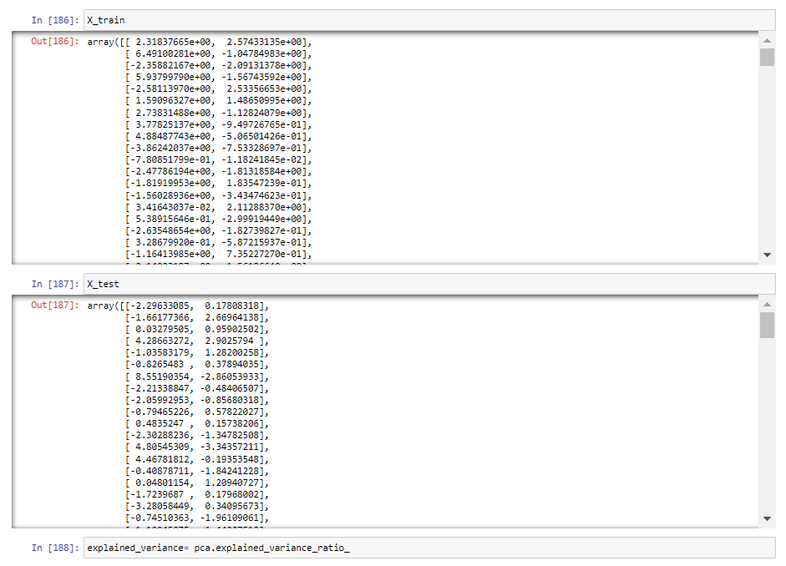
CODE

Slide 24
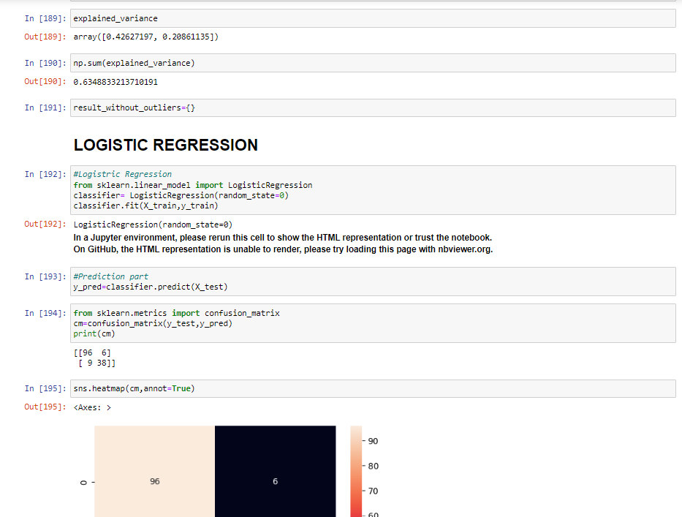
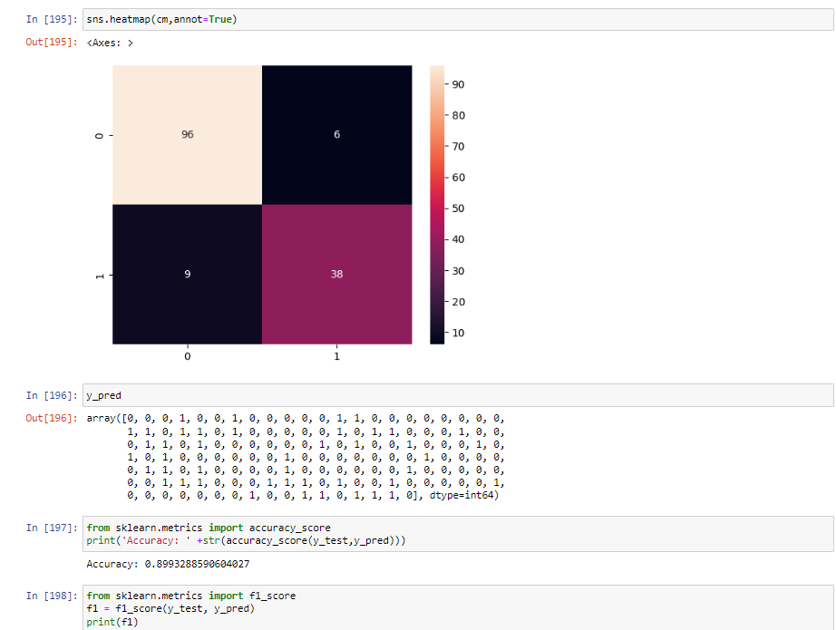
CODE

Slide 25
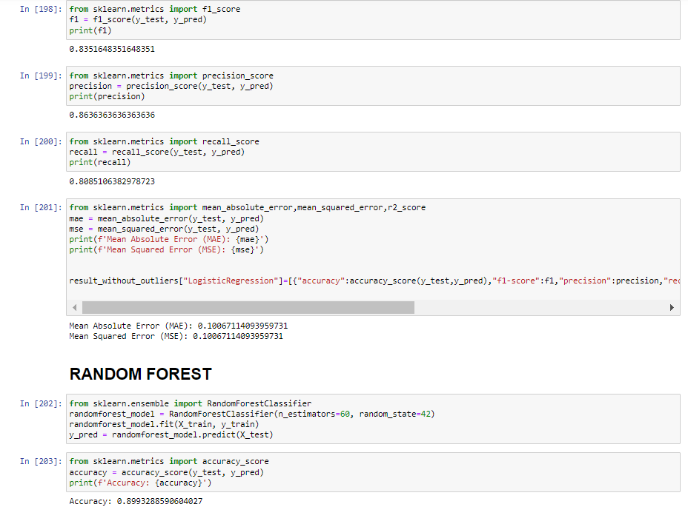
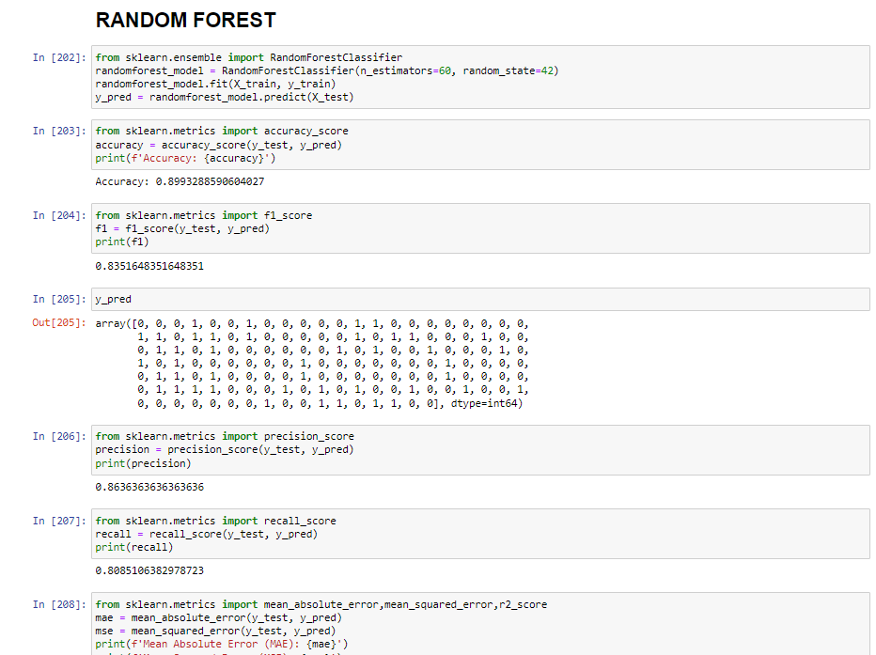
CODE

Slide 26
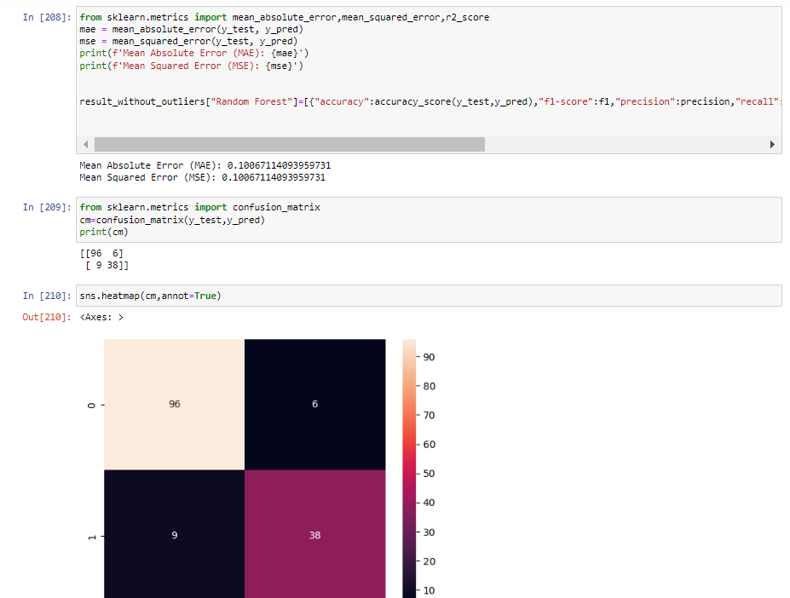
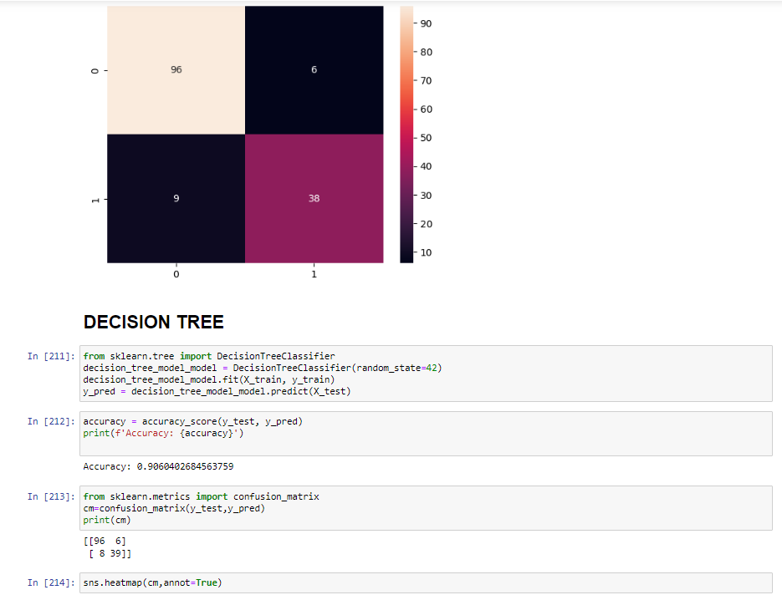
CODE

Slide 27
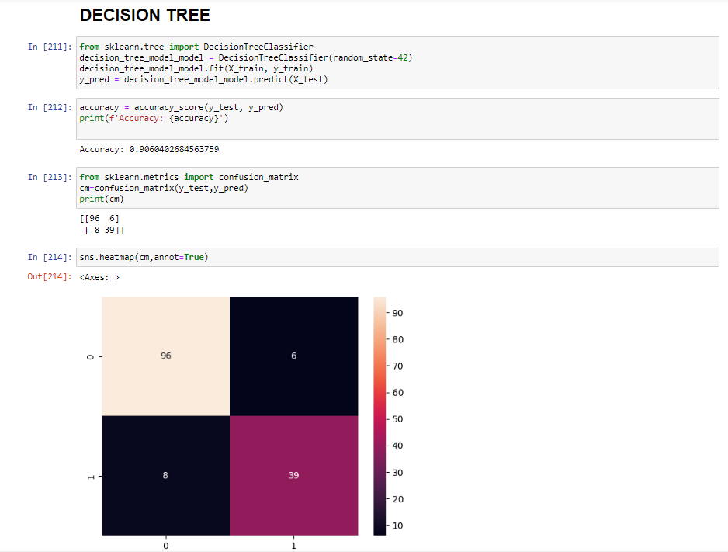
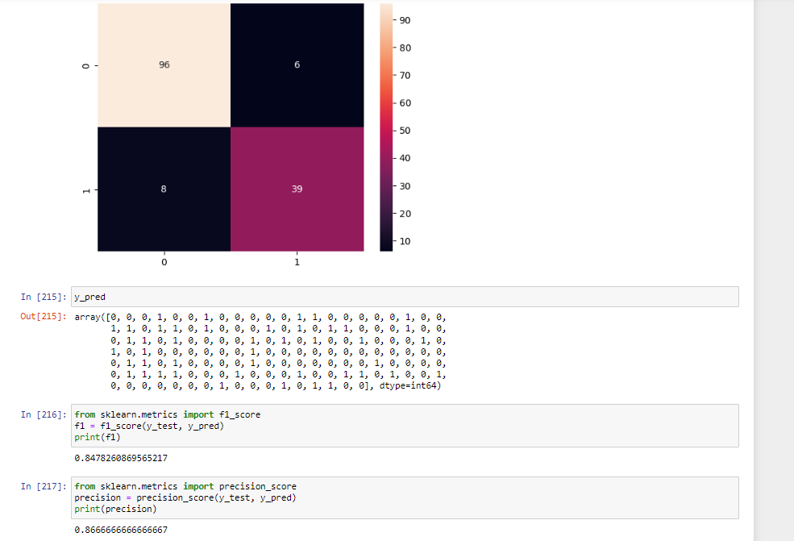
CODE

Slide 28
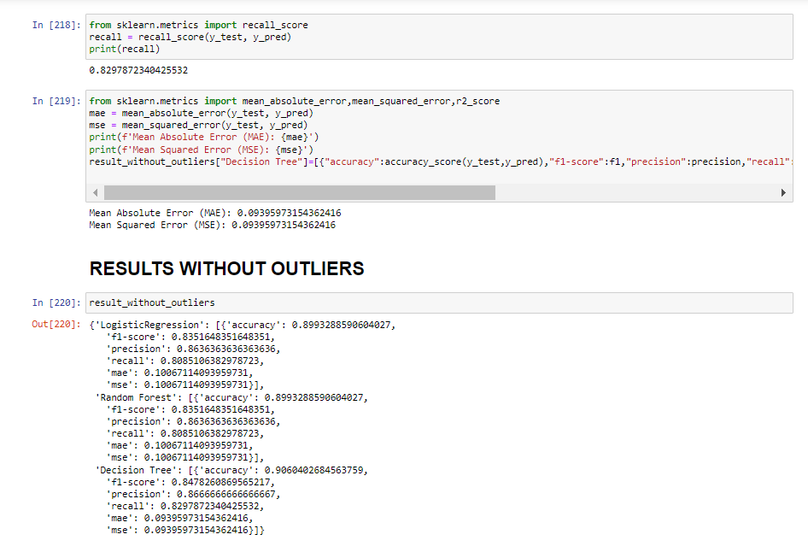
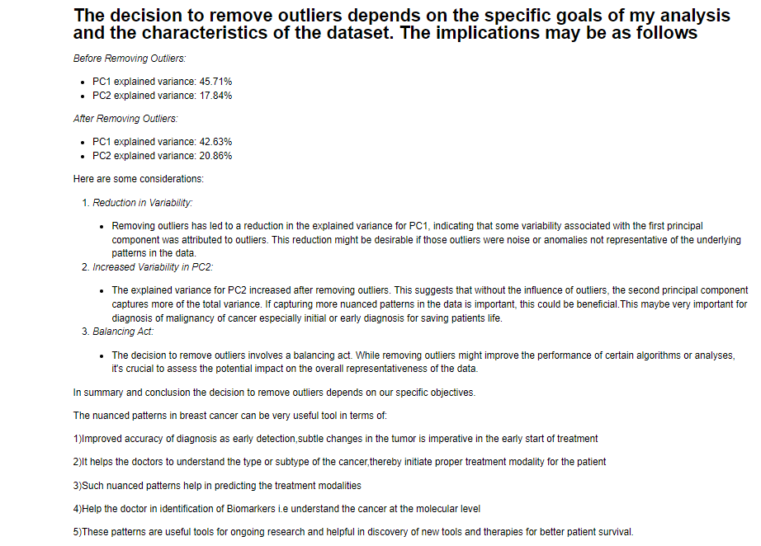
CODE

Slide 29
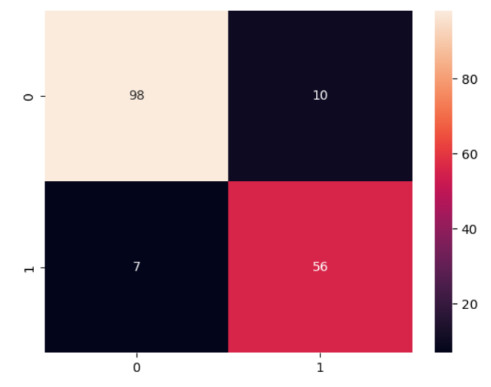
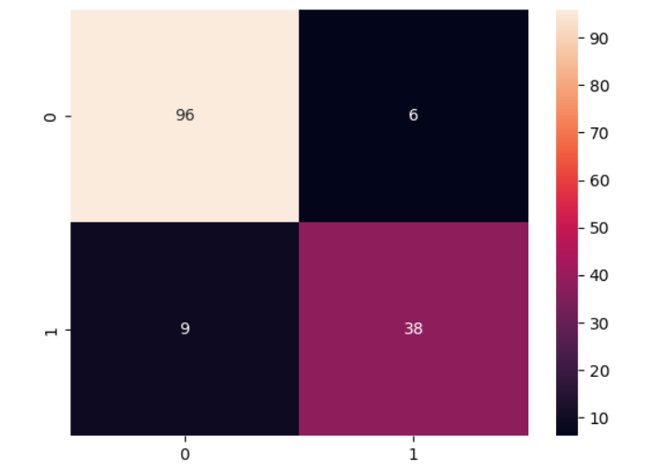
LOGISTIC REGRESSION
BEFORE REMOVING OUTLIERS
AFTER REMOVING THE OUTLIERS

Slide 30
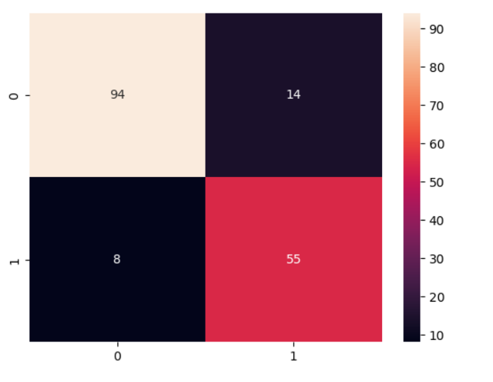
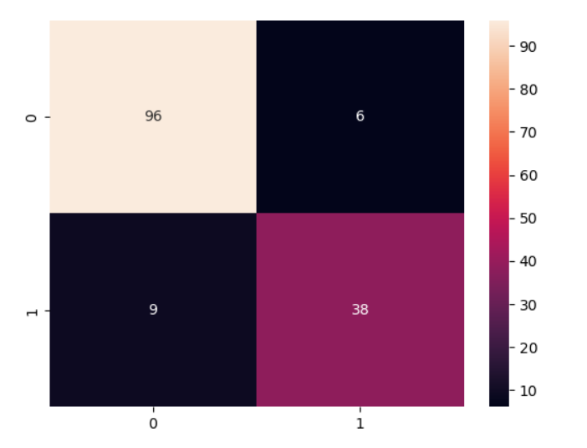
RANDOM FOREST
BEFORE REMOVING OUTLIERS
AFTER REMOVING OUTLIERS

Slide 31
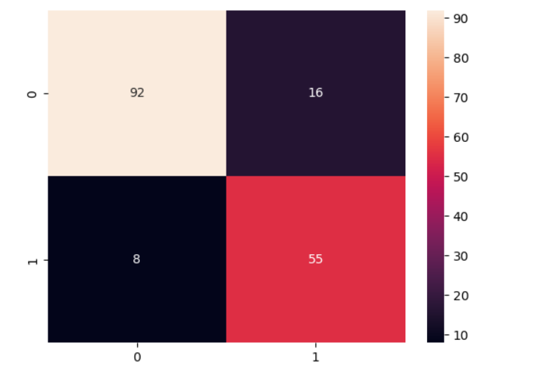
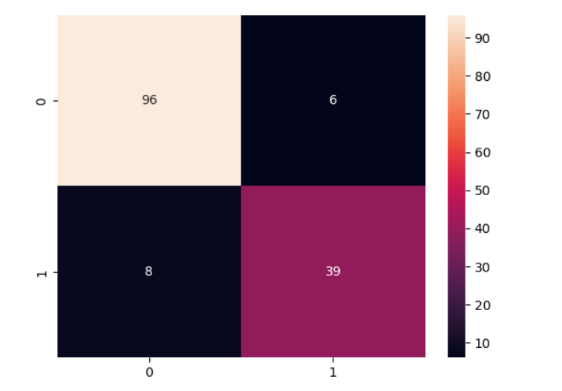
DECISION TREE
BEFORE REMOVING OUTLIERS
AFTER REMOVING THE OUTLIERS

Slide 32
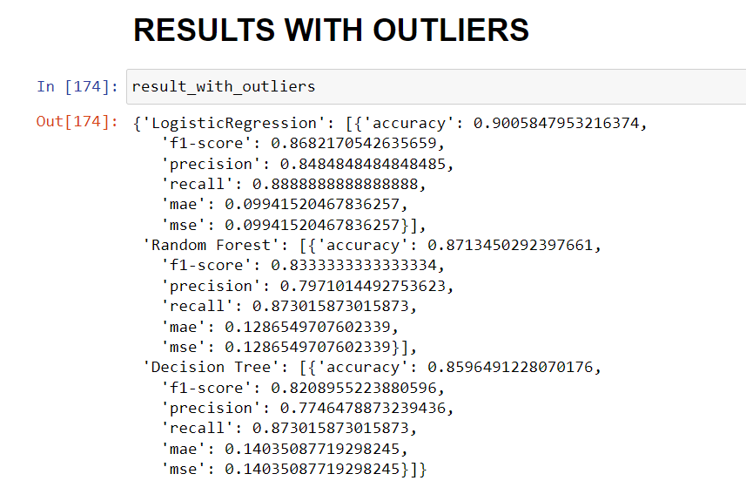
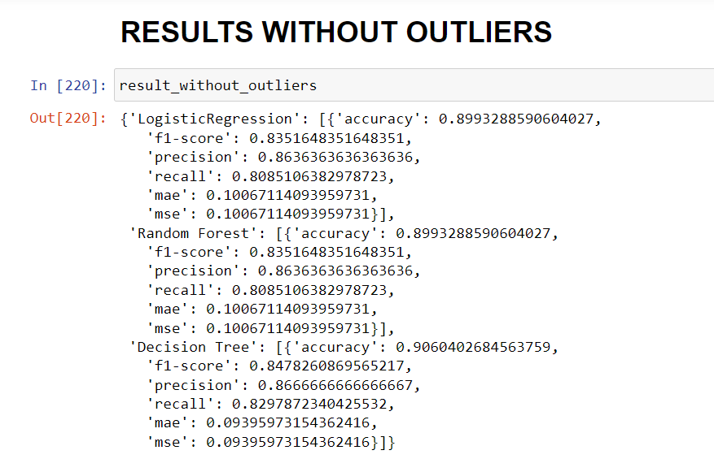
RESULTS AND DISCUSSIONS

Slide 33
RESULTS AND DISCUSSION (CLASSIFIERS)
1. Logistic Regression: -It shows a marginal decrease in accuracy and F1-score after outlier removal which Indicates a potential trade-off between precision(based only on true and false positives) and recall(which is based on both true positives and false negatives) has to considered while building our model.
However logistic regression is a linear model for binary classification it has showed good accuracy in both cases with (90.05%) or without outliers(89.93%), hence we can conclude logistic regression model is very useful in detecting breast cancer malignancy
2. Random Forest: - Stability in performance metrics, suggesting resilience to outlier presence. Hence, we can say it suggests that the model is robust and handles unusual situations without getting easily influenced by them.
3. Decision Tree:- Improvement in accuracy and F1-score after outlier removal. - Highlights a positive impact on model performance. Decision Tree perform more accurately, providing better predictions and a better balance between being cautious (precision) and catching all the important cases (recall).
Hence, we can say that all the 3 models have overall performed well

Slide 34
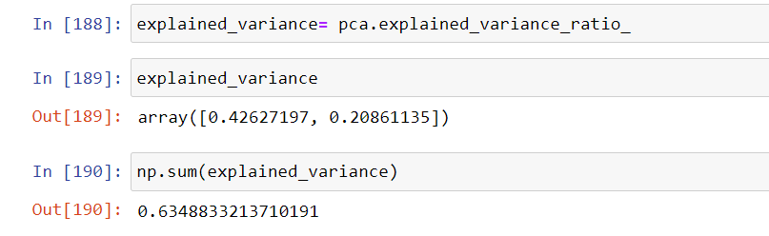
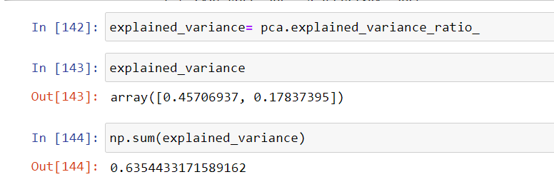
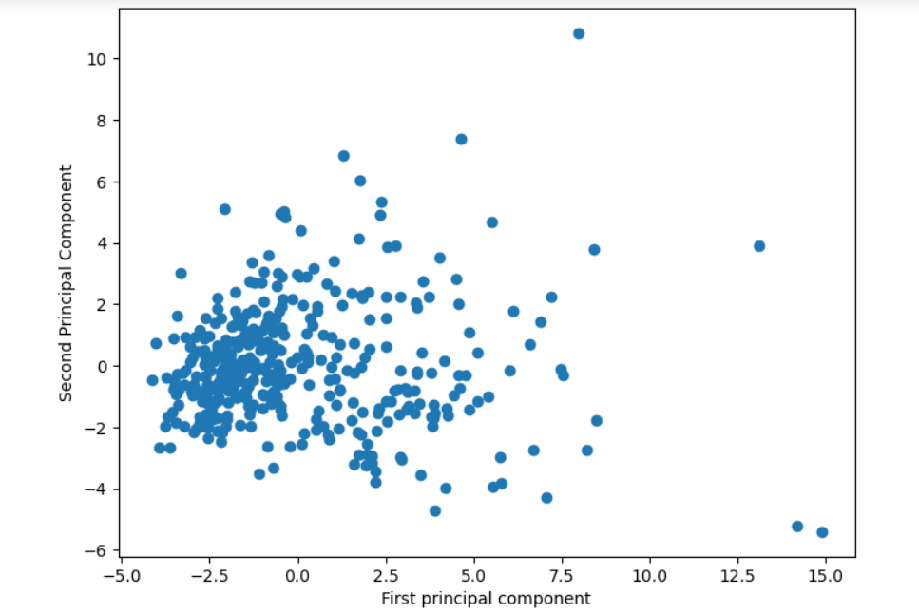
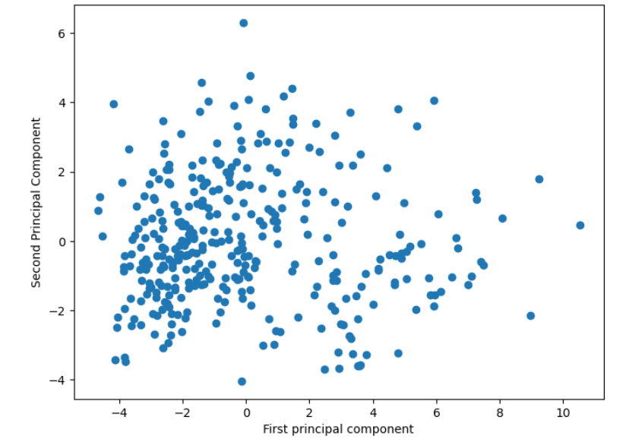
RESULTS AND DISCUSSION (PCA)
PCA WITH OUTLIERS
PCA WITHOUT OUTLIERS

Slide 35
PCA RESULTS: -
1)Before outlier removal, PC1 explained variance was 45.71% which slightly decreased to 42.63%. After outlier removal.
2) PC2 showed an increase in explained variance from 17.84% to 20.86% after outlier removal which indicates nuanced effects on the variability captured by principal components.
RESULTS AND DISCUSSIONS
Before Removing Outliers: After Removing Outliers:
- PC1 explained variance: 45.71% - PC1 explained variance: 42.62%
- PC2 explained variance:17.84 % - PC2 explained variance: 20.86%

Slide 36
CONCLUSION
The intricate nuance effects observed after outlier removal in breast cancer present valuable advantages in several aspects:
1) Enhancing the accuracy , early diagnosis which is crucial for timely treatment initiation, as detecting subtle changes in the tumor is imperative in the patient survival.
2) Facilitating a deeper understanding of the cancer type or subtype, aiding doctors in implementing appropriate treatment modalities for individual patients.
3) Contributing to the prediction of effective treatment approaches based on the identified nuanced patterns.
4) Assisting doctors in the identification of biomarkers, enabling a molecular-level comprehension of the cancer and paving the way for more targeted interventions.
5) Serving as instrumental tools in ongoing research efforts, these patterns play a vital role in the discovery of new therapies and tools, ultimately improving patient survival outcomes.

Slide 37
CONCLUSION
Therefore, I can conclude that it is better to use
1) logistic regression is a linear model for binary classification it has showed good accuracy in both cases with (90.05%) or without outliers(89.93%), hence we can conclude logistic regression model is very useful in detecting breast cancer malignancy
2)Tree-based classifiers used in the study are decision tree and random forest .Random forest was not affected by the removal of the outliers which suggests that the model is robust and handles unusual situations without getting easily influenced by them. On the other hand, decision tree tend to exhibit improved performance when outliers are eliminated from the dataset.
3) With regard to PCA The decision to remove outliers depends on the specific goals of my analysis and the characteristics of the dataset where early detection of malignancy is of utmost importance in patient life expectancy.
The removal of outliers helped in increasing the explained variance in PCA 2 helps in detection of nuanced patterns. The advantages of nuanced patterns are:
1. It has helped in improving diagnostic accuracy and pivotal in early detection .There is an imperative need to identify minute tumor changes for timely treatment initiation.
2. This helps in Assisting doctors in understanding cancer types or subtypes which enables the implementation of suitable treatment approaches and also tailored to individual patients needs.
3. Nuanced patterns play a crucial role in anticipating various treatment modalities, contributing to the development of more personalized and efficient healthcare interventions.
4. Assisting doctors in pinpointing biomarkers enhances the understanding of cancer at the molecular level, guiding the application of targeted and precise therapeutic strategies.
5. These intricate patterns serve as valuable tools in continuous research, fostering the exploration of innovative tools and therapies that ultimately improve patient survival outcomes.
.

Slide 38

REFERENCES
https://cancer.ca/en/cancer-information/cancer-types/breast/statistics
https://www.sciencedirect.com/science/article/pii/S1877050921014629
https://www.ncbi.nlm.nih.gov/pmc/articles/PMC9175124/
https://eminebozkus.medium.com/maximizing-performance-in-breast-cancer-prediction-through-machine-learning-hyperparameter-tuning-7118e9583efb#:~:text=Another%20technique%20for%20maximizing%20performance,and%20may%20lead%20to%20overfitting.

Slide 39


