Slide 1

DATA ANALYTICS WITH COGNOS
PROJECT 5:
PRODUCT SALES ANALYSIS

Slide 2
CONTENT:
Objectives
Methodology
Sales Performance
Sales Trends
Product Analysis
Customer Analysis
Result
Conclusion

Slide 3

Objective:
To assess and analysis the sales performance of a specific product or product line in order to gain insights into its market position, identify areas of strength and weakness, and develop strategies to improve sales and profitability. The primary objective of a product sales analysis is to provide a comprehensive understanding of the product's performance in the market, including factors such as revenue, units sold, market share, and customer satisfaction. This analysis helps in identifying trends, patterns, and opportunities that can inform decision-making and drive business growth.

Slide 4


Methodology:
The methodology for product sales analysis can be defined as the systematic approach and techniques used to gather, analyze, and interpret sales data to gain insights into the performance and trends of a specific product or product line. The methodology typically involves the following steps
Define objectives: Clearly define the objectives of the analysis, such as identifying sales trends, evaluating product performance, or identifying areas for improvement.
Data collection: Gather relevant sales data for the product, including revenue, units sold, pricing information, customer data, and any other relevant metrics. This data can be obtained from internal sales records, point-of-sale systems, CRM systems, or other data sources.

Slide 5

Sales performance:
Sales performance is a key aspect of product sales analysis. It refers to the evaluation and assessment of a product's sales results and metrics over a specific time period. Here are some key components and metrics to consider when analyse sales performance:
Average selling price: Calculate the average price at which the product is sold. This metric helps in understanding pricing dynamics and can be compared with competitors' pricing strategies.
Sales growth rate: Determine the rate at which sales have grown over a specific time period. This metric helps in evaluating the product's performance and potential for future growth.
Market share: Assess the product's market share by comparing its sales to the total market sales for similar products or competitors. This metric indicates the product's position in the market and its competitiveness.
This Photo by Unknown author is licensed under CC BY-SA.

Slide 6
Sales Trends:
Sales trends refer to the patterns and changes in the buying behavior of consumers or businesses over a specific period of time. Analyzing sales trends is crucial for businesses to make informed decisions about their products, marketing strategies, and overall business operations. Here's a description of some key aspects of sales trends:
Seasonal Fluctuations: Many products and services experience fluctuations in sales throughout the year due to seasonal factors. For example, winter clothing tends to sell more during the cold months, while beachwear sells better in the summer.
Cyclical Trends: Some industries or products may go through cyclical trends that repeat over a longer period. These trends are often influenced by economic cycles and can span several years. For instance, the housing market experiences cycles of boom and bust.

Slide 7

Product Analysis:
Product analysis is a crucial component of product sales analysis as it focuses on evaluating the performance, features, and market positioning of a specific product. Here are some key steps and considerations when conducting a product analysis for sales analysis:
Product features and specifications: Review and document the key features, specifications, and unique selling points of the product. This helps in understanding the product's value proposition and competitive advantages.
Target market analysis: Identify the target market and customer segments for the product. Analyze the demographics, preferences, needs, and buying behavior of the target market. This information helps in tailoring marketing strategies and sales approaches.
This Photo by Unknown author is licensed under CC BY-SA.

Slide 8
Customer Analysis:
Customer analysis is a critical component of marketing and business strategy that involves gathering and evaluating information about your customers. It aims to gain insights into their characteristics, behaviors, preferences, and needs. This information helps businesses make informed decisions, tailor their products or services, and create effective marketing campaigns. Here are key elements of customer analysis:
Demographic Information: Demographics include age, gender, income, education, marital status, and geographic location. Analyzing demographics helps you understand who your typical customers are and can guide product design and marketing messaging.
Psychographic Factors: This includes lifestyle, values, interests, and opinions. Psychographic analysis helps businesses create more personalized marketing campaigns and target customers with similar values and interests.

Slide 9
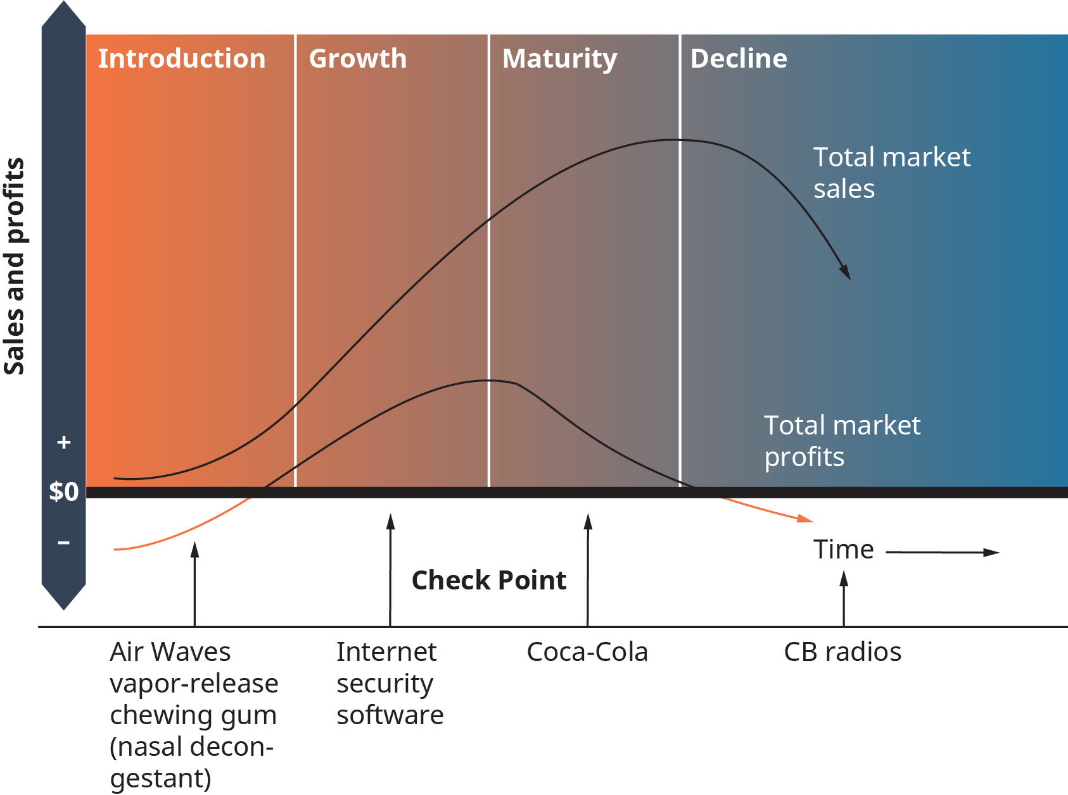
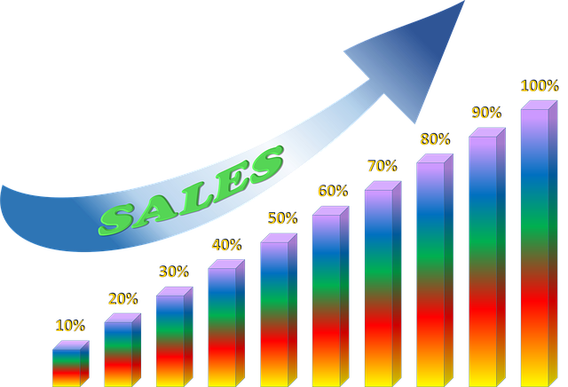
Result and Conclusion:
z

