Slide 1

D’BUGGERS

Slide 2
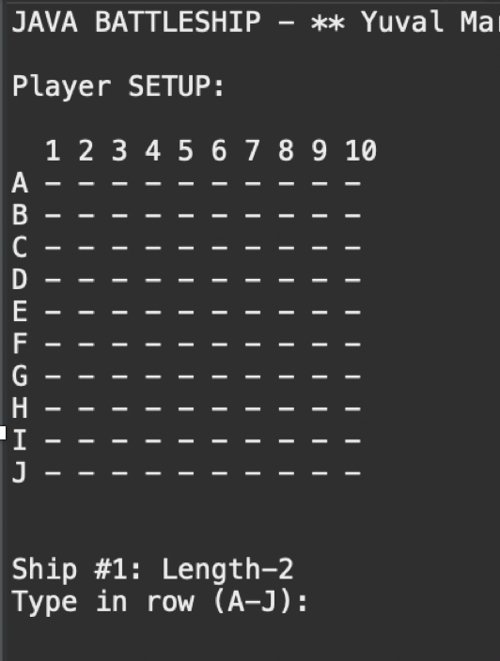
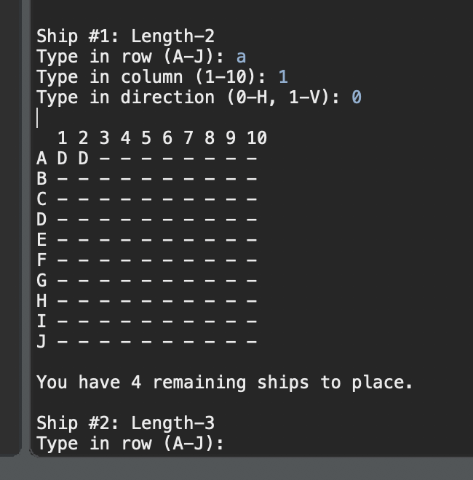
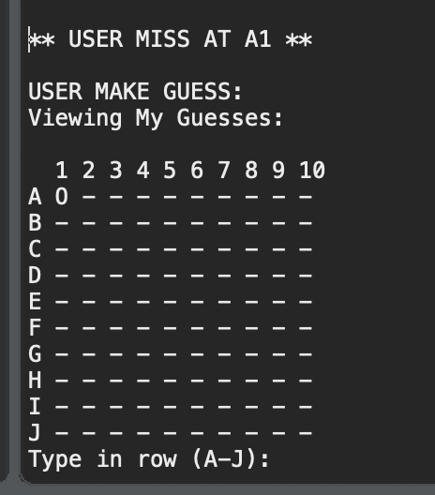
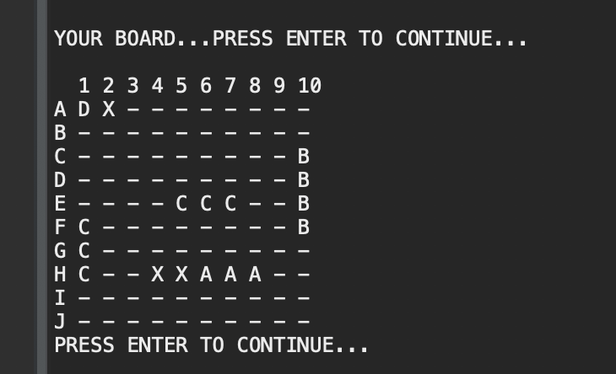
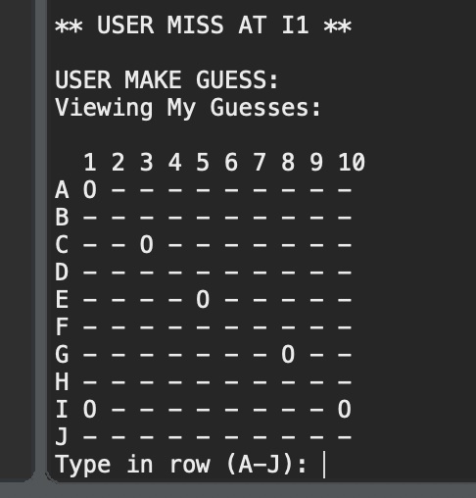
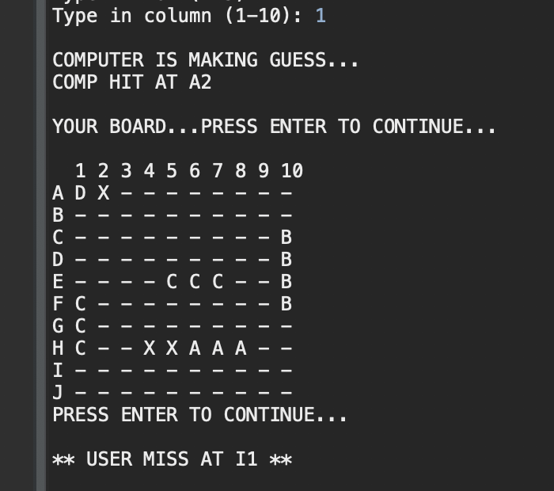
D’Buggers
Battleship Game

Slide 3
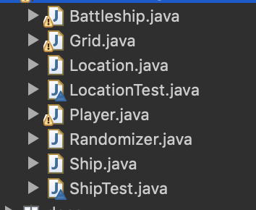
Class Structure & Excluded Classes From Test
Driver Class
Exclusively Calls Other Classes (Requires Mocks)
Untestable randomization class

Slide 4
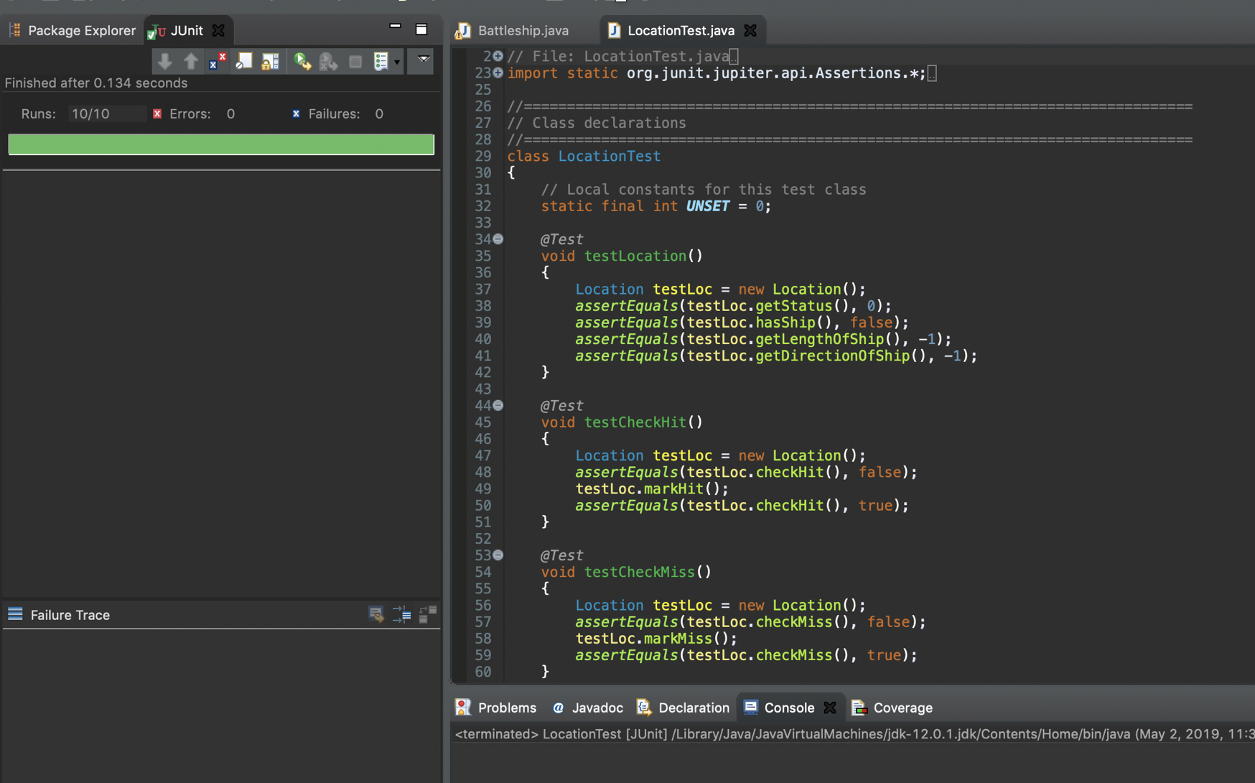
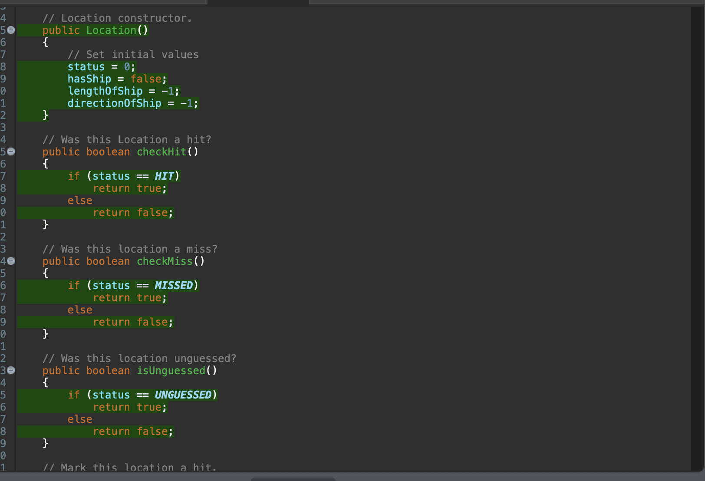
Unit Tests On Location Class

Slide 5

Code Coverage Analysis

Slide 6
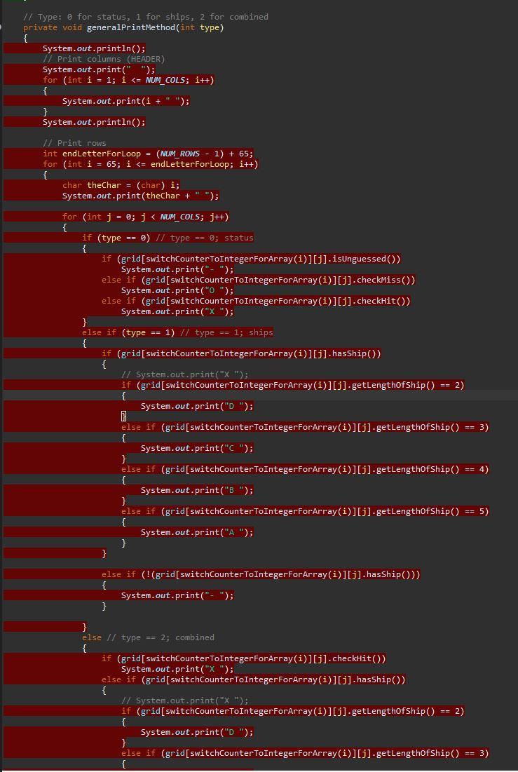
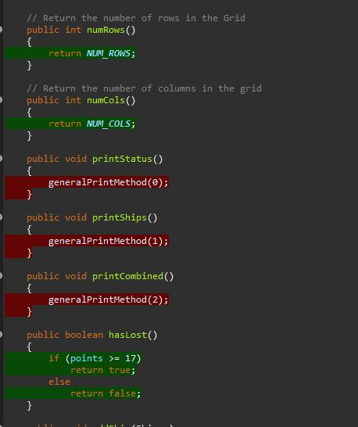
Code Coverage on Grid

Slide 7
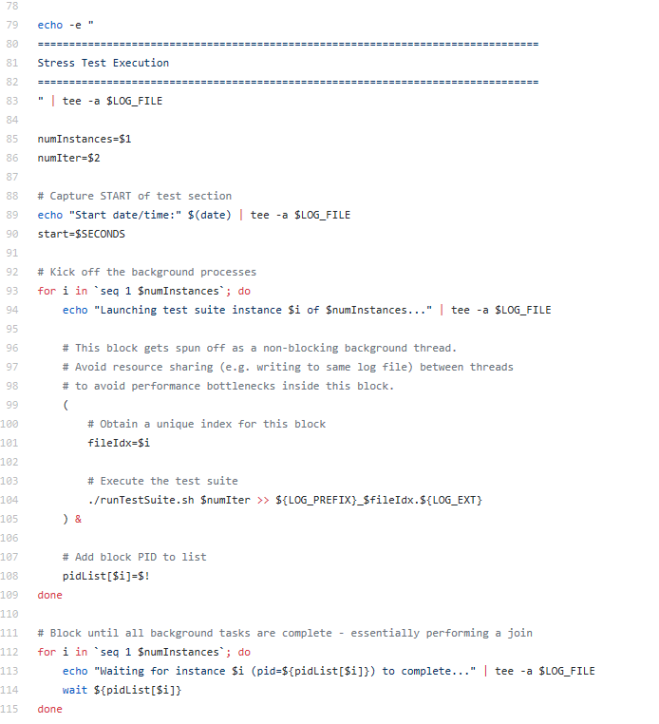
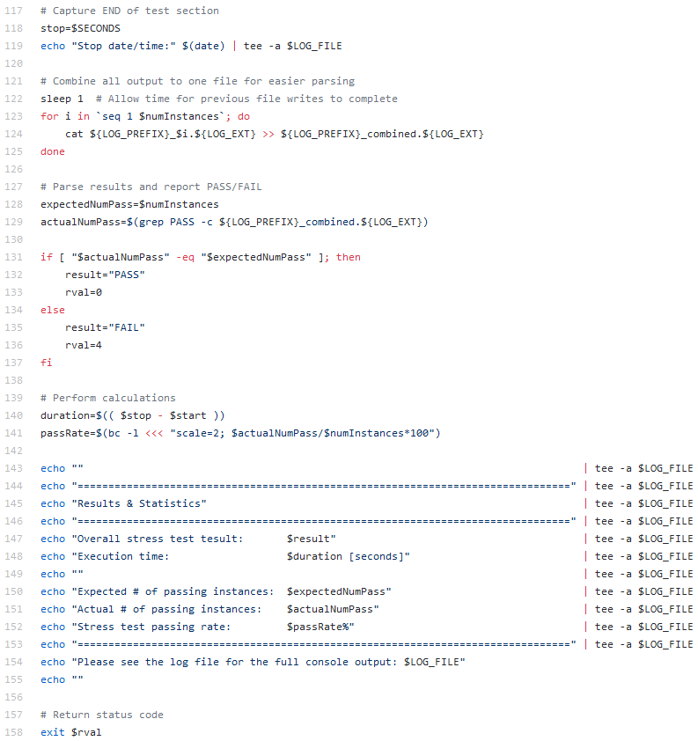
Stress Testing and Test Suite Execution

Slide 8


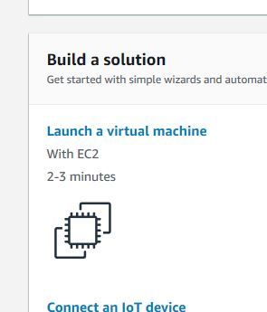
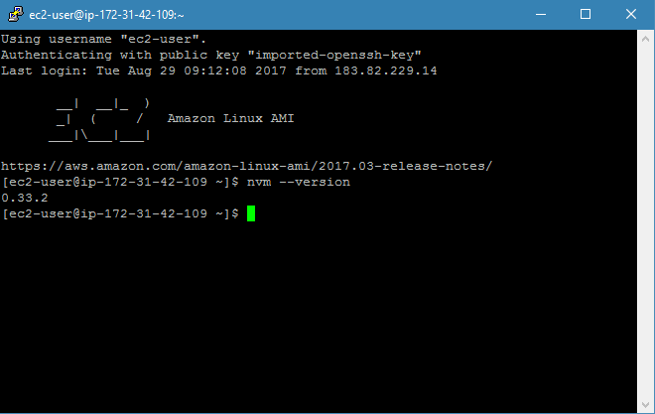

Configuring A Server For Automated Testing
Username: mckeem
Password: pickleball_2019
http://ec2-54-163-130-1.compute-1.amazonaws.com:8080/

