Slide 1
Agenda
Intro to web services
Mohammed Kashif Nawaz

Slide 2
Web Service definition
A simple definition:
“a Web Service is an application component accessible over open protocols”.
Over the last couple of years, Web services have expanded to become more popular with application developers — and for good reason. Web services technology represents an important way for businesses to communicate with each other and with clients as well.
Unlike traditional client/server models, such as a Web server or Web page system, Web services do not provide the user with a GUI. Instead, Web services share business logic, data and processes through a programmatic interface across a network.
Notes:
http://www.programmableweb.com/category/all/apis
https://marketplace.adp.com/

Slide 3
History
Web services evolved from previous technologies that served the same purpose such as RPC, ORPC (DCOM, CORBA and JAVA RMI).
Web Services were intended to solve three main problems:
Interoperability
Firewall traversal
Complexity
Interoperability
Earlier distributed systems suffered from interoperability issues because each vendor implemented its own on-wire format for distributed object messaging.
Development of DCOM apps strictly bound to Windows Operating system.
Development of RMI bound to Java programming language.

Slide 4
History….
Firewall traversal
Collaboration across corporations was an issue because distributed systems such as CORBA and DCOM used non-standard ports.
Web Services use HTTP as a transport protocol and most of the firewalls allow access though port 80 (HTTP), leading to easier and dynamic collaboration.
Complexity
Web Services is a developer-friendly service system.
Most of the above-mentioned technologies such as RMI, COM, and CORBA involve a whole learning curve.
New technologies and languages have to be learnt to implement these services.

Slide 5
Understanding ADP's REST Web APIs
An Application Programming Interface (API) is a set of operations (functions and data) offered by a provider system to a consumer application. The API is used to enable communication between the provider and consumer application. An API exposed on the Internet as a Web Service is known as a Web API. A Web API that conforms to the REST architectural style is known as a RESTful Web API.
REST (REpresentational State Transfer) is an architectural style, and an approach to communications that is often used in the development of Web services.
The use of REST is often preferred over the more heavyweight SOAP (Simple Object Access Protocol) style because REST does not leverage as much bandwidth, which makes it a better fit for use over the Internet. The SOAP approach requires writing or using a provided server program (to serve data) and a client program (to request data).
A REST web service follows 4 basic design principles:
Use HTTP methods explicitly
Stateless
Expose directory structure-like URIs
Transfer XML, JavaScript Object Notation (JSON) or both. JSON has been adopted as the standard for the ADP APIs.
Lighter weight than XML (i.e. less bandwidth consumption)
Most browsers support parsing of JSON

Slide 6
RESTful Service Specification Standard v1.0.1
URI Template Design Rules
Versioning
Standard HTTP Request/Response Headers
Patterns
List/Detail
Conditional Get
Paging Pattern
Limit/Offset/Order
Relevant HTTP Response Codes
Response Object (application errors)

Slide 7
Resource
What is a Resource?
Every system uses resources. These resources can be pictures, video files, Web pages, business information, or anything that can be represented in a computer-based system. The purpose of a service is to provide a window to its clients so that they can access these resources. Service architects and developers want this service to be easy to implement, maintainable, extensible, and scalable.
Resource Identifier
Each distinct web-based concept is known as a resource and may be addressed through a unique identifier. RESTful Web Services use Uniform Resource Identifiers (URIs) used to identify resources.
Resource Representation
Resource State Representation is the rendered state of a resource in a representation such as JSON or XML. A resource’s desired state can be represented in a client’s request message. A resource’s current state can be represented in a server’s response message.

Slide 8
Resources…
Resource Versions
A RESTful Web API may contain several essential parts that are separately managed artifacts. All artifacts in the API and its parts are versioned as needed.
API resources are released by major version. An API may be expanded without breaking backwards compatibility such as the addition of an optional property, an extension of a code list, or addition of a query parameter. The expanded API in this case does not require its major version be increased. If an API requires a change that will break backwards compatibility, then it will be incremented to its next major version such as V2. Once a new version of an API is published, the older version of the API is deprecated. The older API is supported for 1 year from the day that it was deprecated.
Our Resource Data
A key aspect of an API is the data communicated or managed by the API. We have adopted the JSON Schema and Hyper-Schema Specification. This specification describes the data format in a clear, human and machine-readable format expressed in JSON. Complete structural validation of a resource instance is possible with the JSON schema. JSON Hyper-Schema describes how to navigate from a resource to another.
The JSON Schema and Hyper-Schema Specification has not been finalized as a standard at this time, but it is a proposed IETF draft. The published schemas are currently based on Draft 2, but Draft 3 will be published soon. The latest version of the specification is draft 4, with draft 5 under development. Draft 4 has not been adopted due to tooling incompatibilities.
The specification is constantly monitored and we post comments and provide feedback to the publishers via forums. Once a draft is stabilized and the appropriate tool support is available, the schema publication will be upgraded to the latest version of the specification.
The JSON schema describes the structure of the payload in JSON. Constraints such as required properties, relevant properties, lengths, min/max items, enumerations, etc. are typically not communicated in the schema. These validation rules are externalized via a context object (i.e. via API/or embedded object).

Slide 9
Resource URI
Generic URI Design and Format
The generic URI syntax is described in IETF’s RFC 3986 [Berners-Lee (2005)] as:
URI = scheme "://" authority "/" path ["?" query] ["#" fragment]
The syntax consists of a hierarchical sequence of components:
A required scheme component that refers to a specification for assigning identifiers within that scheme (e.g. http).
An optional authority component that refers to a naming authority (e.g. api.adp.com)
A required path component that identifies a resource within the scope of the URI’s scheme and naming authority (if any); it is usually organized in a hierarchical form.
An optional query component, containing non-hierarchical data, that along with data in the path component identifies a resource within the scope of the URI’s scheme and naming authority (if any).
An optional fragment component allows indirect identification of a secondary resource by reference to a primary resource and additional identifying information
ADP URI Design and Format (Pattern)
/{domain}/v{M}/{pluralNoun}/{id}[/custom-operation][?{query-parameters}]
{domain} – Identifies the business domain
v{M} – M Identifies the major version
{pluralNoun} – The noun represented by the resource
{id} – Unique identifier of the resource
{custom-operation} – Custom operation against the resource which describes the semantic of the action.
{query-parameters} – API specific parameters
Example:
/payroll/v1/workers/1221/pay-statements
[ ] – indicates optional
{ } – indicates a variable property

Slide 10
Resource Domains
Our ADP Web APIs are organized by the following Human Capital Management domains.
Core APIs include services that cross our Human Capital Management domains such as “View News.”
HR APIs include Human Resource Management services such as “View Worker Information.”
Talent APIs include Talent Management services such as “Apply for a Job.”
Payroll APIs include Payroll Management services such as “View Pay Statements.”
Time APIs include Time and Labor Management services such as “Request Time Off.”
Benefits APIs include Health and Welfare Benefits Administration services such as “View Benefit Elections” and “Enroll in Benefits.”

Slide 11
Resource Verbs
Standard HTTP verbs are used to communicate the action:
Get – request a resource
Post – request the creation of a resource
Put – request the update of a resource in its entirety
Delete – request the deletion of a resource
Resource Verb Custom Operations
The standard HTTP verbs are great at communicating standard CRUD (create, read, update, delete). They do fall short of communicating non-crud operations.
Examples:
Post /time/v1/time-off-request/123/cancel
Clearly communicates a request to cancel time-off-request 123. The providing system applies its business logic and determines what exactly is done with the request. It may be logically deleted, status changed to cancel, etc… The service is communicating an explicit instruction to the provider of the service rather than just updating the resource. The semantic is much clearer with the custom operation.

Slide 12
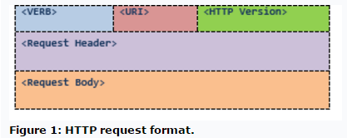
Messages
The client and service talk to each other via messages. Clients send a request to the server, and the server replies with a response. Apart from the actual data, these messages also contain some metadata about the message. It is important to have some background about the HTTP 1.1 request and response formats for designing RESTful Web services.
HTTP Request
An HTTP request has the format shown in Figure 1:
Figure 1: HTTP request format.
<VERB> is one of the HTTP methods like GET, PUT, POST, DELETE, OPTIONS, etc
<URI> is the URI of the resource on which the operation is going to be performed
<HTTP Version> is the version of HTTP, generally "HTTP v1.1" .
<Request Header> contains the metadata as a collection of key-value pairs of headers and their values. These settings contain information about the message and its sender like client type, the formats client supports, format type of the message body, cache settings for the response, and a lot more information.
<Request Body> is the actual message content. In a RESTful service, that's where the representations of resources sit in a message.

Slide 13
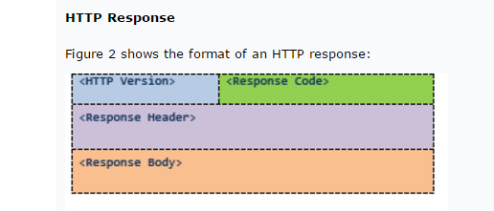
Messages Continued..
HTTP Response
Figure 2 shows the format of an HTTP response:
The server returns <response code>,
which contains the status of the request. This response code is generally the 3-digit HTTP status code.
<Response Header> contains the metadata and settings about the response message.
<Response Body> contains the representation if the request was successful.

Slide 14
Resource Header Parameters
Method1 | Type | Parameter2 | DataType | Required | Default | Standard/ ADP header
Method1 | Type | Parameter2 | DataType | Required | Default | Standard/ ADP header
Get | request | Accept | string | Yes | application/ json | standard
Get | request | Accept-Language | string | Yes | en/US | standard
Get | request | ETag | string | Conditional | conditional | standard
Put/Patch | request | If-Match | string | Conditional |  | standard
Get | request | If-None-Match | string | Conditional |  | standard
Get | response | Cache-Control | string | Conditional |  | standard
* | response | Content-Language | string | Yes |  | standard
* | response | Content-Type |  | Yes | en/US | standard
Get | response | Expires | string | Conditional |  | standard
Post | response | Location | string | Conditional |  | standard

Slide 15
Meta/Context Object
Context API/Meta is a resource, which provides validation rules for a related resource in a given context. These rules include but are not limited to: maxLength, minLength, required, regular expression pattern, linking to a enumerated value set (e.g. code, and short name), etc.… An example use of the context API is that the caller wants to update a Person’s address. The context API would provide the caller the information on which properties are relevant for the address, which are required, what the allowed lengths of each property are and whether any property has an enumerated value
The address has the following relevant properties and each property has the related validation rules:
Line one:Is required Max Length of 30
Line two:Is optional ,Max Length of 30
City Name: Is required ,Max Length is 30
Country Subdivision (e.g. State) :Is required Must use a value from an enumerated value set. The uri of the enumerated set is provided.
Postal Code :Is required
Country Code:Is required
The caller of the service may or may not decide to call the context API to determine the validation rules at runtime

Slide 16
Links Object
Linked data describes a method of publishing structured data so that it can be interlinked and become more useful. It builds upon standard Web technologies such as HTTP and URIs, but rather than using them strictly to serve web pages for human readers, it extends this to share information in a way that can be interpreted by a machine. This enables data from different sources to be connected and queried. This pattern is leveraged throughout our APIs. The following are example use cases where we leverage the links object.
The following example shows a link to the full representation of the workers resource where the related resource may have only a partial representation.
{”links”:[{”rel”:“full”,“href”:“/hr/v1/workers/123”,“title”:“Worker”,“method”:”GET”}].
The following example shows an action to change a worker address. The links item with rel=/adp/invoke provides instructions on how to invoke the action. The links with rel=describedby provides the instructions on how to get the validation rules for the given action.
{”actions”:[{“operationID”:“worker.address.change,{”links”:[{”rel”:“/adp/invoke”,“href”:“/hr/v1/workers/123/addresses/33”,“title”:“UpdateAddress”,“method”:”PUT”}{”rel”:“describedby”“href”:“/hr/v1/context/workers/addresses/us”,“method”:”GET”},]]}.

Slide 17
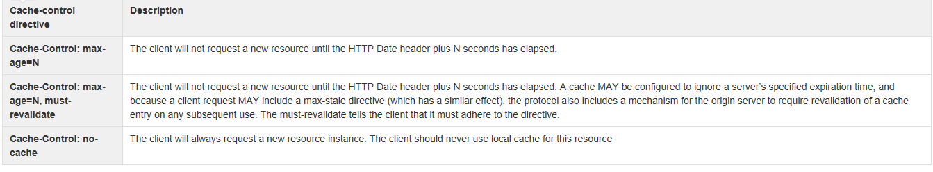
Resource Cache Controller
Our goal is to save on bandwidth whenever possible. To that end, cache control directives are communicated via standard HTTP headers. The following principles are followed:
All RESTful responses will return an HTTP header cache-control.
The cache-control directive will specify to the client how long this object is considered “fresh”. A cache-control directive may state that there should be no cache. This is a directive to the client that they should always request an object from the server, and never cache the object. A client should not request an object if the object in the local cache is still considered “fresh”.

Slide 18
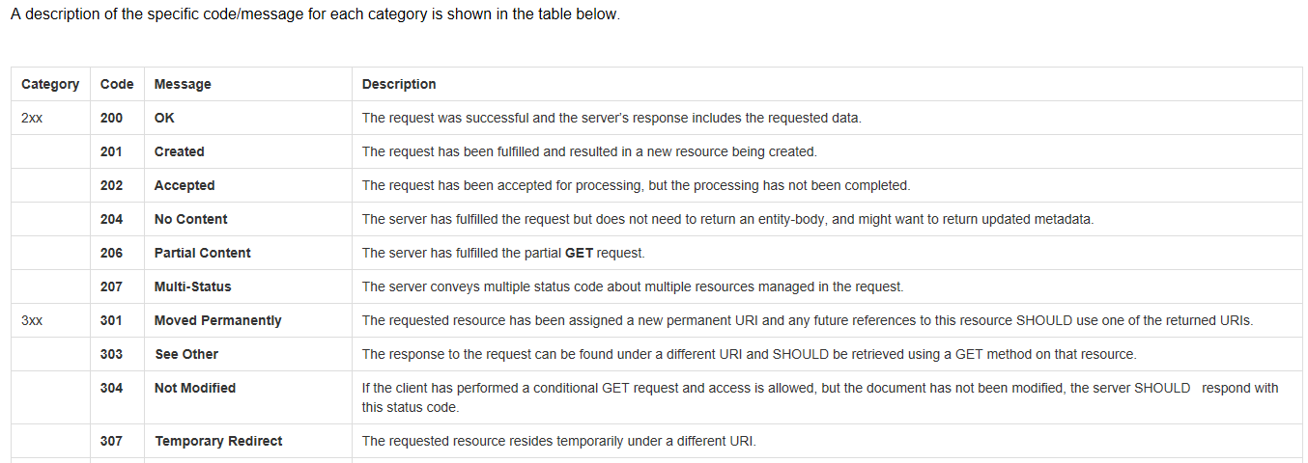
HTTP Response Status
The five categories of response status codes are listed below.
• 1xx: Informational - Request received, continuing process
• 2xx: Success - The request was successfully received, understood and accepted
• 3xx: Redirection - Further action must be taken in order to complete the request
• 4xx: Client Error - The request contains bad syntax or cannot be fulfilled
• 5xx: Server Error - The server failed to fulfill an apparently valid request

Slide 19
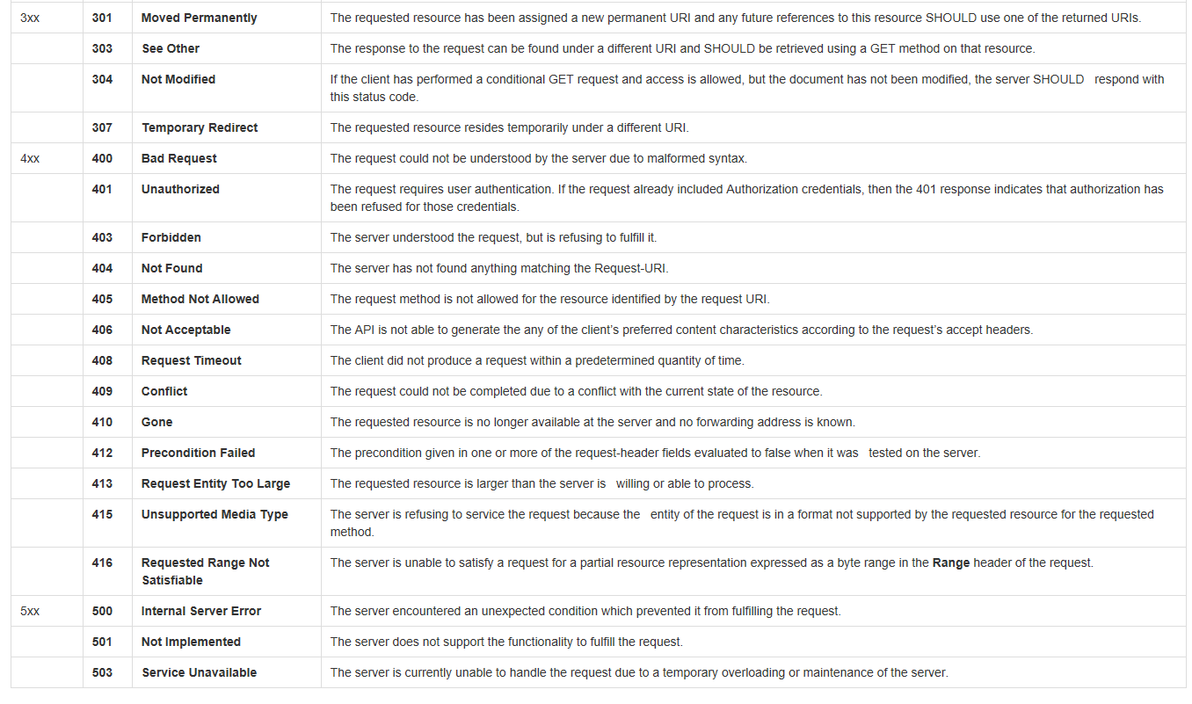
HTTP Response Status…

Slide 20
Paging pattern
Standard paging
An API will leverage standard defined query parameters to request that the instances of a collection are returned in a set amount. This pattern does not make provisions for communicating the size of the total set in the response. The following parameters are used in this pattern:
Parameters
The list of supported query string
Parameter | Obligation | Description | Default | Example Request
limit | Conditional, rules are specified in the API, which supports this parameter. | Limit the number of items returned in the result set of a Get | N/A | GET /{resource}?limit={limitval} Where {limitval} is an integer which states the number of “items” in the collection returned by the Get. Example: Get /hr/v1/corporate-contacts?limit=50 Will return 50 contacts starting from offset 0
offset | Conditional, required if limit is specified and it is not the initial request which defaults to 0 offset. | The offset from the original result set. | If offset is not passed than the default is offset=0 | GET /{resource}?limitval={limitval}offset={offsetval} Where {offsetval} is an integer which represents the starting point of a result set. Example: GET /hr/v1/corporate-contacts?limit=50&offset=50 The first item in the collection is offset 0. In the above example, the first request asked for is item 50. Return the next 50 items in the collection.

Slide 21
Examples from devlopers.adp.com
https://developers.adp.com
https://developers.adp.com/external-api-list/

Slide 22
SOAP-Web Services Components for SOAP
XML – eXtensible Markup Language – A uniform data representation and exchange mechanism.
SOAP – Simple Object Access Protocol – A standard way for communication.
WSDL – Web Services Description Language – A standard meta language to described the services offered.
XML stands for EXtensible Markup Language.
XML is a markup language much like HTML.
XML was designed to describe data.
XML tags are not predefined. You must define your own tags.
The prefect choice for enabling cross-platform data communication in Web Services.

Slide 23
SOAP
SOAP originally stood for "Simple Object Access Protocol" .
Web Services expose useful functionality to Web users through a standard Web protocol called SOAP.
Soap is an XML vocabulary standard to enable programs on separate computers to interact across any network. SOAP is a simple markup language for describing messages between applications.
Soap uses mainly HTTP as a transport protocol. That is, HTTP message contains a SOAP message as its payload section.
WSDL stands for Web Services Description Language.
WSDL is an XML vocabulary for describing Web services. It allows developers to describe Web Services and their capabilities, in a standard manner.
WSDL specifies what a request message must contain and what the response message will look like in unambiguous notation. In other words, it is a contract between the XML Web service and the client who wishes to use this service.
In addition to describing message contents, WSDL defines where the service is available and what communications protocol is used to talk to the service.

Slide 24
Example – A simple Web Service
A buyer (which might be a simple client) is ordering goods from a seller service.
The seller service is a Web Service whose interface is defined using Web Services Description Language (WSDL).
The buyer is invoking the order method on the seller service using Simple Object Access Protocol (SOAP) and the WSDL definition for the seller service.
The buyer knows what to expect in the SOAP reply message because this is defined in the WSDL definition for the seller service
Web Service definition revisited
an application component that:
Communicates via open protocols (HTTP, SMTP, etc.)
Processes XML messages framed using SOAP
Describes its messages using XML Schema
Provides an endpoint description using WSDL
.

Slide 25
WSDL Document
A WSDL document is just a simple XML document.
It defines a web service using these major elements:
port type - The operations performed by the web service.
message - The messages used by the web service.
types - The data types used by the web service.
binding - The communication protocols used by the web service.
<message name="getTermRequest"> <part name="term" type="xs:string"/> </message> <message name="getTermResponse"> <part name="value" type="xs:string"/> </message> <portType name="glossaryTerms"> <operation name="getTerm"> <input message="getTermRequest"/> <output message="getTermResponse"/> </operation> </portType> <binding type="glossaryTerms" name="b1"> <soap:binding style="document" transport="http://schemas.xmlsoap.org/soap/http" /> <operation> <soap:operation soapAction="http://example.com/getTerm"/> <input><soap:body use="literal"/></input> <output><soap:body use="literal"/></output> </operation> </binding>
<definitions> <types> data type definitions........ </types> <message> definition of the data being communicated.... </message> <portType> set of operations...... </portType> <binding> protocol and data format specification.... </binding> </definitions>

Slide 26
SOAP Building Blocks
A SOAP message is an ordinary XML document containing the following elements:
A required Envelope element that identifies the XML document as a SOAP message.
An optional Header element that contains header information.
A required Body element that contains call and response information.
An optional Fault element that provides information about errors that occurred while processing the message.

Slide 27
SOAP Request
POST /InStock HTTP/1.1 Host: www.stock.org Content-Type: application/soap+xml; charset=utf-8 Content-Length: 150 <?xml version="1.0"?> <soap:EnvelopeIntro to web services using SOAP xmlns:soap="http://www.w3.org/2001/12/soap-envelope" soap:encodingStyle=http://www.w3.org/2001/12/soap-encoding”> <soap:Body xmlns:m="http://www.stock.org/stock"> <m:GetStockPrice> <m:StockName>IBM</m:StockName> </m:GetStockPrice> </soap:Body> </soap:Envelope>

Slide 28
SOAP Response
HTTP/1.1 200 OK Content-Type: application/soap; charset=utf-8 Content-Length: 126 <?xml version="1.0"?> <soap:Envelope xmlns:soap="http://www.w3.org/2001/12/soap-envelope" soap:encodingStyle="http://www.w3.org/2001/12/soap-encoding"> <soap:Body xmlns:m="http://www.stock.org/stock"> <m:GetStockPriceResponse> <m:Price>34.5</m:Price> </m:GetStockPriceResponse> </soap:Body> </soap:Envelope>

