Slide 1
Performance Testing - Introduction
-For Testing SIG

Slide 2
Agenda
Performance Testing Overview
What is Performance Testing
Why we do Performance Testing
Parameters and Types of Testing
Tools
LoadRunner overview

Slide 3
What is Performance Testing
Performance Testing
Performance Testing is the process of measuring the effectiveness of the software.
It is generally performed to determine the responsiveness and stability of the system under concurrent user load.
Is test of application productivity and conformity to Non Functional requirements
HOW FAST IS YOUR SYSTEM

Slide 4
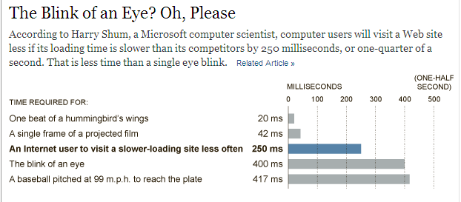
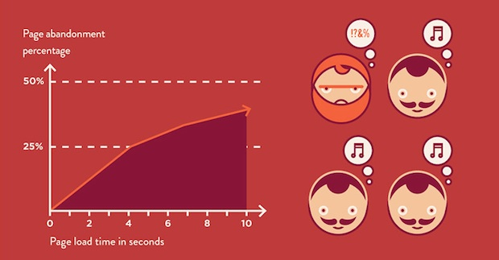
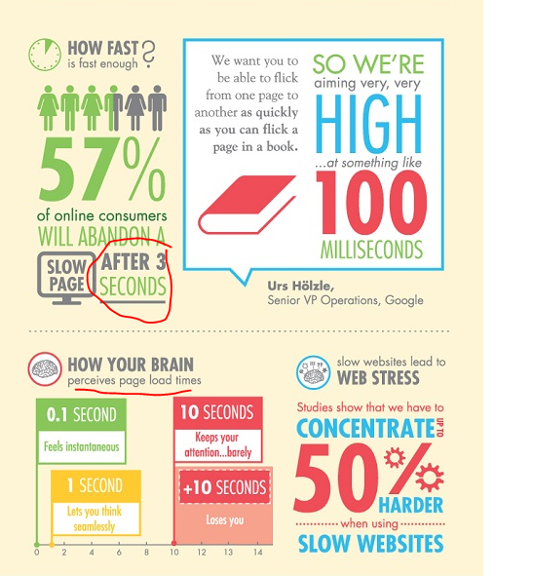
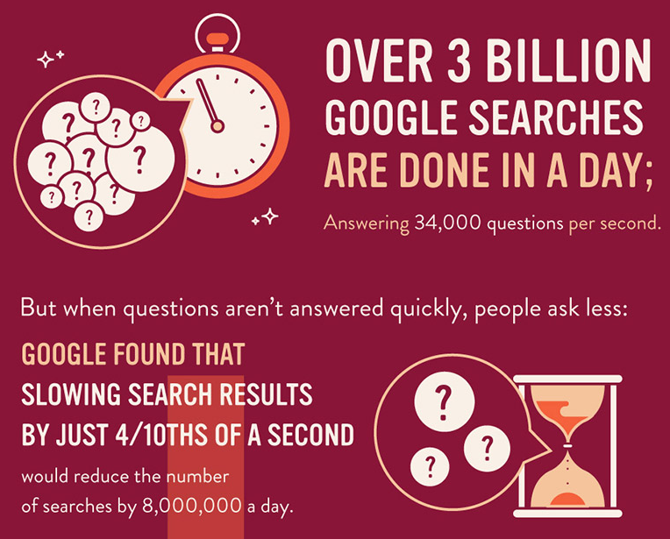
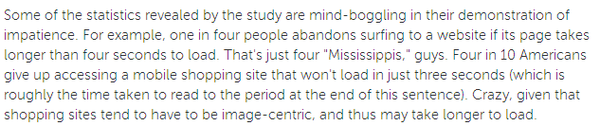
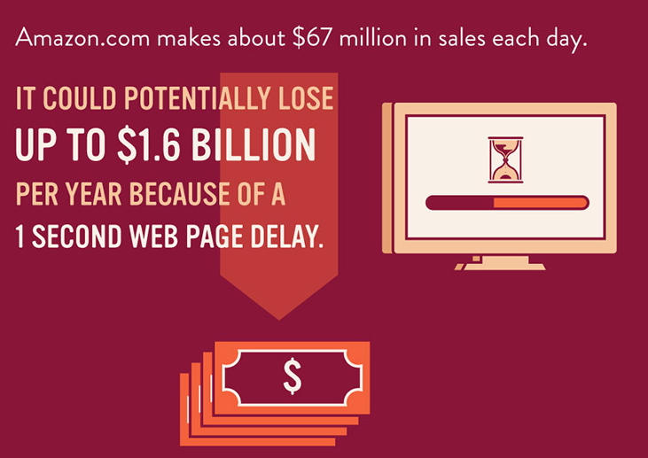
Why Performance Testing

Slide 5
Why Performance Testing
Project Management
Release Readiness
Increased ROI
Application Software
Response Times
Application configuration
Infrastructure
Over\Under Utilization
Validate Hardware
Plan for future
Throughput
Code Inadequacies
Capacity Planning
Hardware inadequacies
Assess risk
Architecture Validation
Notes:
▪Maximize returns on IT assets
▪Identify performance bottlenecks prior to production release
▪Ensure system can grow to meet future demand
▪Lower capital and operational costs
▪Improved application reliability
▪Enhanced user experience
▪Optimize on available resources and reduce stress on existing infrastructure

Slide 6
Parameters of Performance Testing
Non Functional Requirements
User Expectation, Business Requirements and Resource Limitation
Basic parameters are
Scalability
Availability
Reliability
Other parameters
User Load
Speed: Response Time
Throughput
Hits per second
CPU / Memory / Disk Utilizations

Slide 7
Types of Testing
Performance Testing
Load Testing:
Test application under expected load in production
Stress Testing: Test application beyond the expected user load.
Spike Testing: Subset of Stress Testing
Endurance Testing: Test the application for longer duration.
Volume Testing: Testing the application with higher volumes of data
Notes:
There is NO exhaustive list of types of performance testing. Basic types of Performance Testing are highlighted below. Usually there is tweaking to these tests to achieve the objective

Slide 8
Tools
There are many tools available in market for Performance Testing
LoadRunner - HP
VSTS – Performance Studio – Microsoft
JMeter – Free Open Source
Silk Performer - IBM
Crawler
…and the list goes on
There are specific tools which deal with Front End Performance Testing
Fiddler
HTTPWatch
dynaTrace

Slide 9
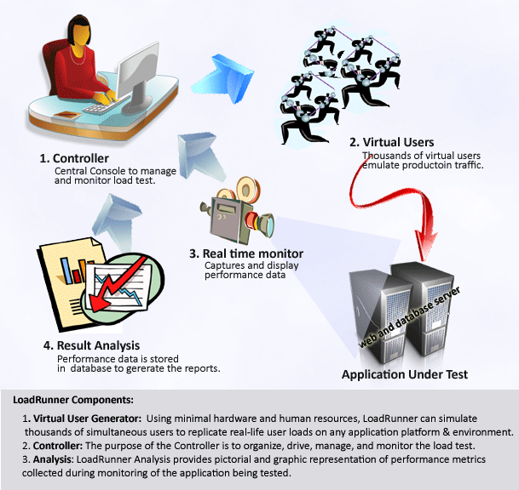
LoadRunner – Overview

Slide 10
So what’s the Story?

Slide 11
The Story…
DNS Lookup
Browser resolves the IP of the domain name
Involves 1 RTT
Browser Opens a Connection
Open a TCP connection with the server
Involves 1 RTT
Browser Sends Request
Send a Request Header, body
Involves 1 RTT to receive the first byte
In case of https websites, this involves a SSL Handshake, at least 1 RTT
Of the HTTP Request
Web Server prepares Response
Server stitches together the requested resource
Could involve interacting with other servers
Response Sent by the server
Browser Starts rendering
Server responds with the requested resource
Involves 1 RTT until the content is downloaded
Browser starts rendering the response to the user

Slide 12

Questions?
http://www.nytimes.com/2012/03/01/technology/impatient-web-users-flee-slow-loading-sites.html?_r=0
http://mashable.com/2012/03/14/slow-website-stats-infographic/
http://www.fastcompany.com/1825005/how-one-second-could-cost-amazon-16-billion-sales

