Slide 1
Healthcare Data Analytics
Project Report
Objective: Analyze hospital admission data to uncover patterns in patient demographics, diagnoses, and care delivery — and translate them into actionable strategies.
Dataset
Doctors
Tools
Scope
4,529 Admissions
27 Specialists
Power BI · SQL
Multi-region

Slide 2
Key Metrics
4,529
27
54.4%
45.6%
Total Admissions
Total Doctors
Male Patients
Female Patients
75.25%
24.75%
11
Patients born in 90s
Patients born in 2000s
Top Diagnosis Types
Admission Trend by Quarter
Top Diagnoses

Slide 3
Key Insights
Gender Distribution
Age Group Patterns
Top Diagnoses
Male patients account for 54.4% of total admissions vs. 45.6% female. This gap holds across all diagnosis categories, suggesting male patients are admitted at higher rates across most conditions.
Patients born in the 1990s make up 75.25% of all admissions, far outnumbering those born in the 2000s (24.75%). The dataset spans births from 1919 to 2018, indicating a broad patient age range.
Congestive Heart Failure (CHF) and Pregnancy top the diagnosis list, followed by Appendicitis, Myocardial Infarction, and Chest Pain. Cardiovascular and maternal health conditions dominate the caseload.
Allergy Profile
Admission Seasonality
Specialist Coverage
NKA (No Known Allergies) is the most common allergy record, followed by Penicillin and Codeine. This data is essential for safe prescribing practices and medication planning.
Admissions peak in Qtr 3 (~1,300) and dip in Qtr 1 (~1,240). This consistent quarterly pattern can guide staffing, resource allocation, and seasonal preparedness.
27 doctors across 15+ specialties cover the hospital's needs. Cardiology, Respiratory, and Obstetrics/Gynecology have multiple practitioners, reflecting the volume of cardiovascular and maternal cases.

Slide 4
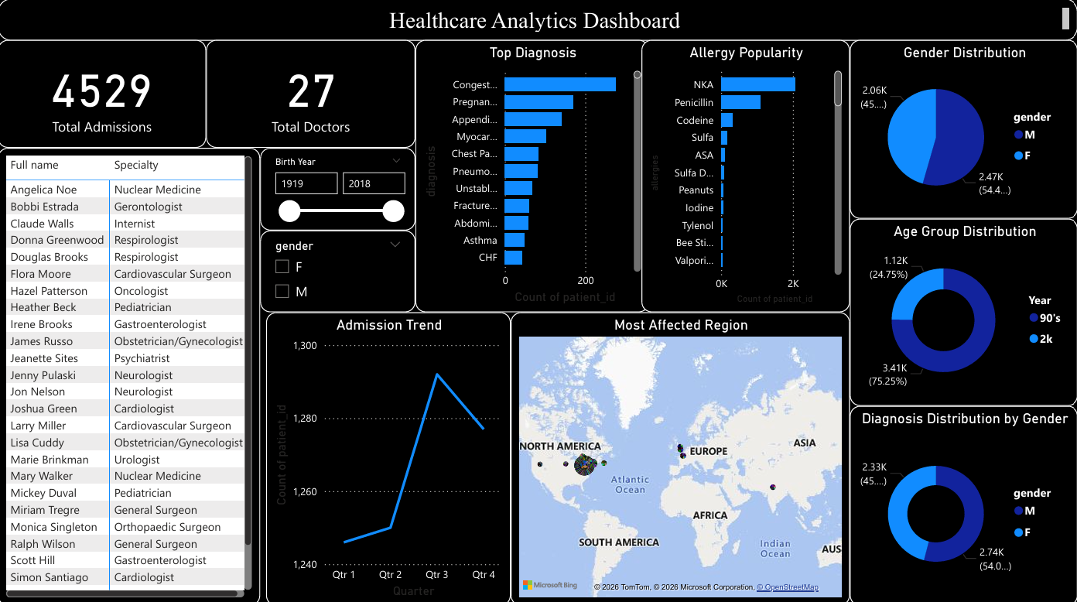

Slide 5
Business Recommendations
01
Strengthen Cardiovascular Programs
02
Improve Qtr 1 Readiness
03
Address Gender-Specific Health Gaps
CHF and Myocardial Infarction are the leading diagnoses. Investing in specialized cardiac care units, preventive screening, and patient education programs will reduce readmission rates.
Q1 shows the lowest admissions, which may reflect under-utilization or reduced access. Targeted outreach and flexible scheduling can help maintain consistent care delivery year-round.
With males admitted at higher rates across most conditions, gender-targeted preventive care programs — especially for cardiovascular health — could reduce avoidable hospitalizations.
04
Expand Allergy Documentation Practices
05
Optimize Specialist Staffing
06
Leverage SQL Insights for Ongoing Monitoring
The high volume of NKA records warrants a documentation audit. Accurate allergy data is critical for patient safety, especially for Penicillin and Codeine, the next most common recorded allergies.
Ensure specialty coverage aligns with admission volume — particularly in Cardiology, Respiratory, and OB/GYN where caseloads are highest. Consider cross-training for surge periods.
The SQL queries built in this project enable repeatable reporting. Deploy them as scheduled reports to track admission trends, patient demographics, and diagnosis patterns in real time.

