Slide 1

Movie Rulz –POC
UI Department
Team :
Varsha Thangellapalli
Lavanya Raavi
Shaik Akram Hussain

Slide 2
Movie Rulz –POC
Abstract: To provide search and watch every movie trailer present in this website and watch about the Popular. movies, Trending movies, Upcoming movies and all latest movies trailers
The main goal provided to the user is to watch all the latest movies trailer.

Slide 3
Movie Rulz –POC
PRE REQUISITIES
HTML5
CSS3
JavaScript

Slide 4
Movie Rulz –POC
INTRODUCTION
Website is a group of World Wide Web pages usually containing hyperlinks to each other and made available online by an individual, company, educational institution, government, or organization.
The title of our project is Movie Rulz” where the main goal provided to the user is to watch all the latest movies trailer.
This website is made by using HTML, CSS and JAVASCRIPT to obtain the final result.

Slide 5
Movie Rulz –POC
IMPLEMENTATION
Setting up the file structure and link CSS and JavaScript in the HTML file.
Getting form value and display.
Getting API Key, and start searching movies base on the user input.
Display the movie posters into the App.
Reset the user input value after searching for a movie
Fetching video trailer by movie id for every clickable movie.
Adding multiple movie section.
Adding movie section title.

Slide 6
Movie Rulz –POC
List of the methods and properties used
querySelector
createElement
innerHTML
appendChild
insertBefore
preventDefault
dataset

Slide 7
Movie Rulz –POC
IMPLEMENTATION
parentElement
nextElementSibling
classList
add
remove
fetch
bind

Slide 8
Movie Rulz –POC
IMPLEMENTATION
setAttribute
onClick
toLowerCase
target

Slide 9
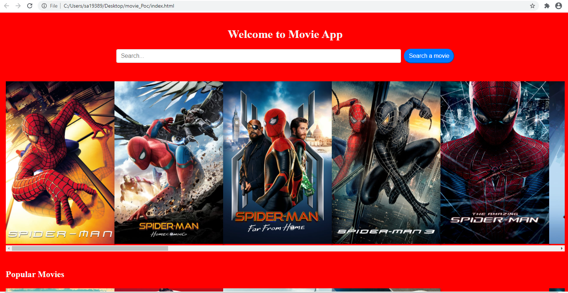
Movie Rulz –POC
SCREEN SHOT

Slide 10
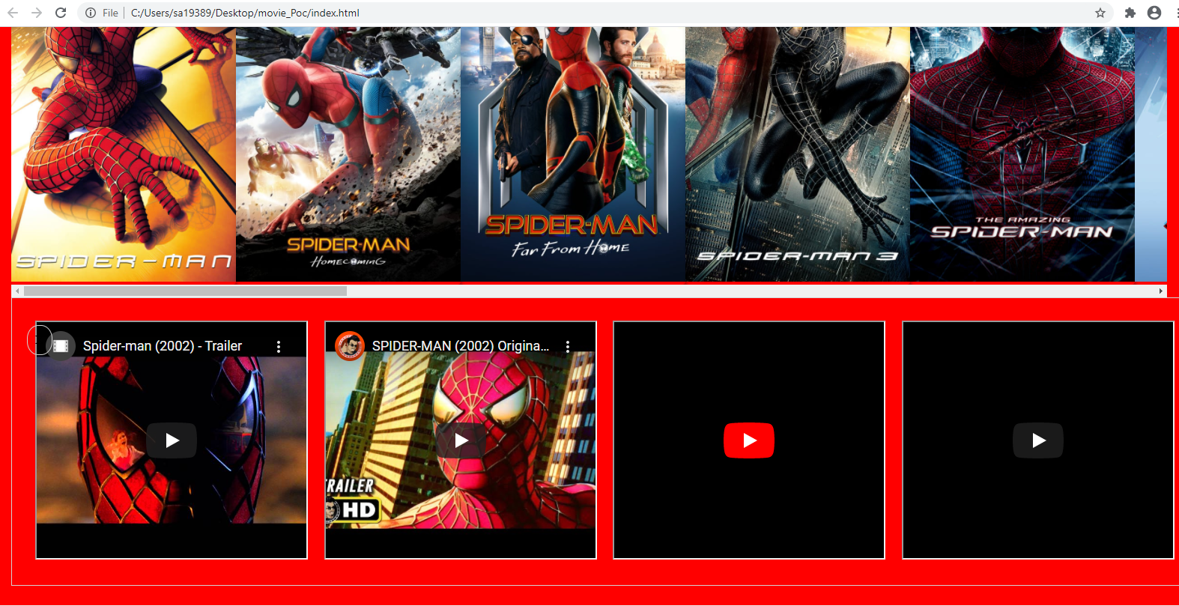
Movie Rulz –POC
SCREEN SHOT TRAILER

Slide 11
Movie Rulz –POC
CONCLUSION
The main purpose of this website is to help the user search and watch about the Popular Movies, Trending movies, Upcoming movies and all latest movies trailers present in this website.
This website is made by using JavaScript, CSS and HTML.

