Slide 1
Project Presentation of Industry Oriented Hands on Experience (22CS422)
On
InventralQ
Shruti(2210992354)
Lavanya Sharma(2210992590)
Devansh Mahajan(2210992589)
Supervised By
Dr. Swati Goel
Department of Computer Science and Engineering,
Chitkara University, Punjab

Slide 2
Introduction
In today’s fast-paced business environment, efficient inventory management plays a crucial role in ensuring smooth operations and profitability. Many small and medium-sized businesses still rely on manual methods or basic tools like spreadsheets to manage their inventory, which often leads to errors, delays, and lack of proper tracking. These limitations make it difficult to maintain accurate stock levels, resulting in issues such as overstocking, stock shortages, and poor decision-making.
InventraIQ is designed as a modern, web-based inventory management system that addresses these challenges by providing a centralized and real-time solution for managing inventory. The system enables users to monitor stock levels, manage products, and track sales efficiently through an intuitive interface. It supports multiple users with role-based access control, ensuring secure and organized operations.
2

Slide 3
Introduction
In addition to core inventory functionalities, InventraIQ integrates machine learning techniques to enhance decision-making. By analyzing historical sales data, the system predicts future demand for the next 30 days, helping businesses plan their inventory more effectively. This combination of real-time tracking and predictive analytics makes InventraIQ a smart and scalable solution for improving inventory management and supporting data-driven business decisions.

Slide 4
Problem Statement
Many small and medium-sized businesses still rely on manual methods or basic tools like spreadsheets to manage their inventory. These approaches are often inefficient and prone to errors such as incorrect stock records, delayed updates, and data duplication. As a result, businesses face common issues like overstocking, stock shortages, and lack of visibility into inventory movement, which negatively affects their operations and profitability.
The solution to these issues is the creation of a Real time Inventory, which allows businesses to monitor, manage and update their Inventory in a timely and accurate manner. Furthermore, there are many benefits to having real-time inventory management systems such as reduce error rates, create greater transparency about what inventory is on hand, provide accurate reports and decrease time spent searching for items, allow users to add items or make changes quickly and easily.

Slide 5
Features
InventraIQ offers real-time inventory tracking with automatic stock updates, along with secure user authentication and role-based access control. Additionally, the system uses machine learning to predict 30-day demand and provides insights for better inventory decision-making.
Real-Time Inventory Tracking Automatically updates stock levels whenever a product is added, updated, or sold, ensuring accurate and up-to-date inventory data.
User Authentication & Role-Based Access Secure login system with roles such as Admin, Manager, and Staff to control access and maintain system security.
Product Management Allows users to add, update, and delete product details, including stock quantity, price, and category.

Slide 6
Features
Sales Management Records all sales transactions and automatically adjusts inventory levels to reduce manual effort.
Machine Learning-Based Demand Prediction Uses historical sales data and linear regression to predict product demand for the next 30 days.
Inventory Insights & Analytics Provides insights such as fast-moving products, slow-moving items, and low-demand or dead stock.

Slide 7
Methodology
Frontend Design: Created using React.js and Tailwind CSS, focusing on an intuitive and responsive user interface for seamless user interaction.
Backend Design: Implemented using Node.js and Express.js for efficient API handling, request routing, and server management.
Database Design: Employed MongoDB with Mongoose ODM to store user information, image metadata, and transaction details securely.
ML Service: A separate Flask-based microservice is used to handle demand prediction.

Slide 8
Technical Details
React.js:
Used for building the dynamic and interactive user interface of the application, allowing users to browse, view smoothly.
Node.js and Express.js:
Backend built using Node.js with Express framework to handle routing, API endpoints, and server logic efficiently.
MongoDB and Mongoose:
A NoSQL database is used to store user data, image generation requests, generated image metadata, and credit transactions. Mongoose serves as the Object Data Modeling (ODM) tool to define schemas and interact with the MongoDB database.
Tailwind CSS:
A utility-first CSS framework that enables rapid UI development with a responsive and mobile-friendly layout.

Slide 9
Technical Details
JWT (JSON Web Token):
Implements secure user authentication and session management by issuing and verifying tokens.
Flask:
The machine learning module is implemented as a separate microservice using Flask, a lightweight Python web framework. Flask provides RESTful API endpoints.

Slide 10
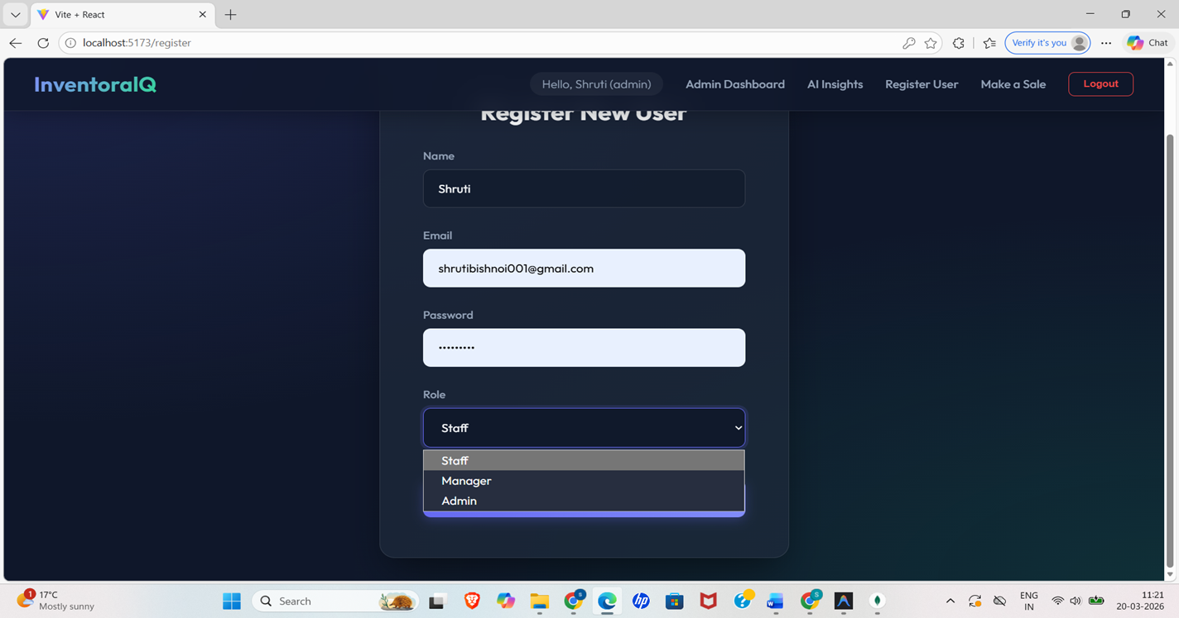
Result

Slide 11
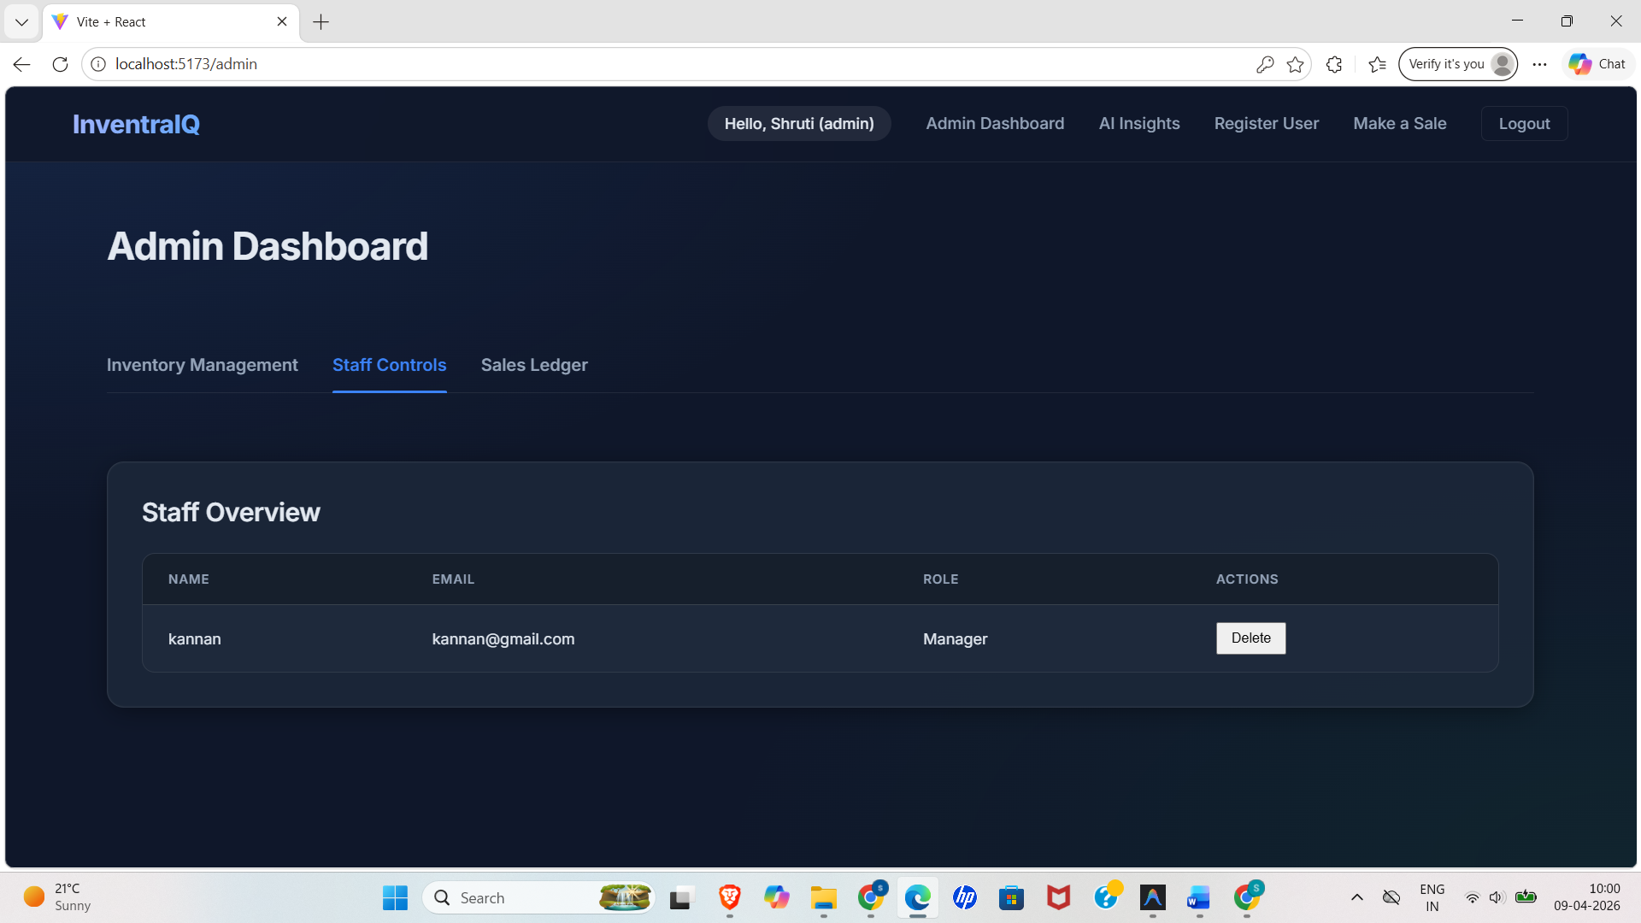
Result

Slide 12
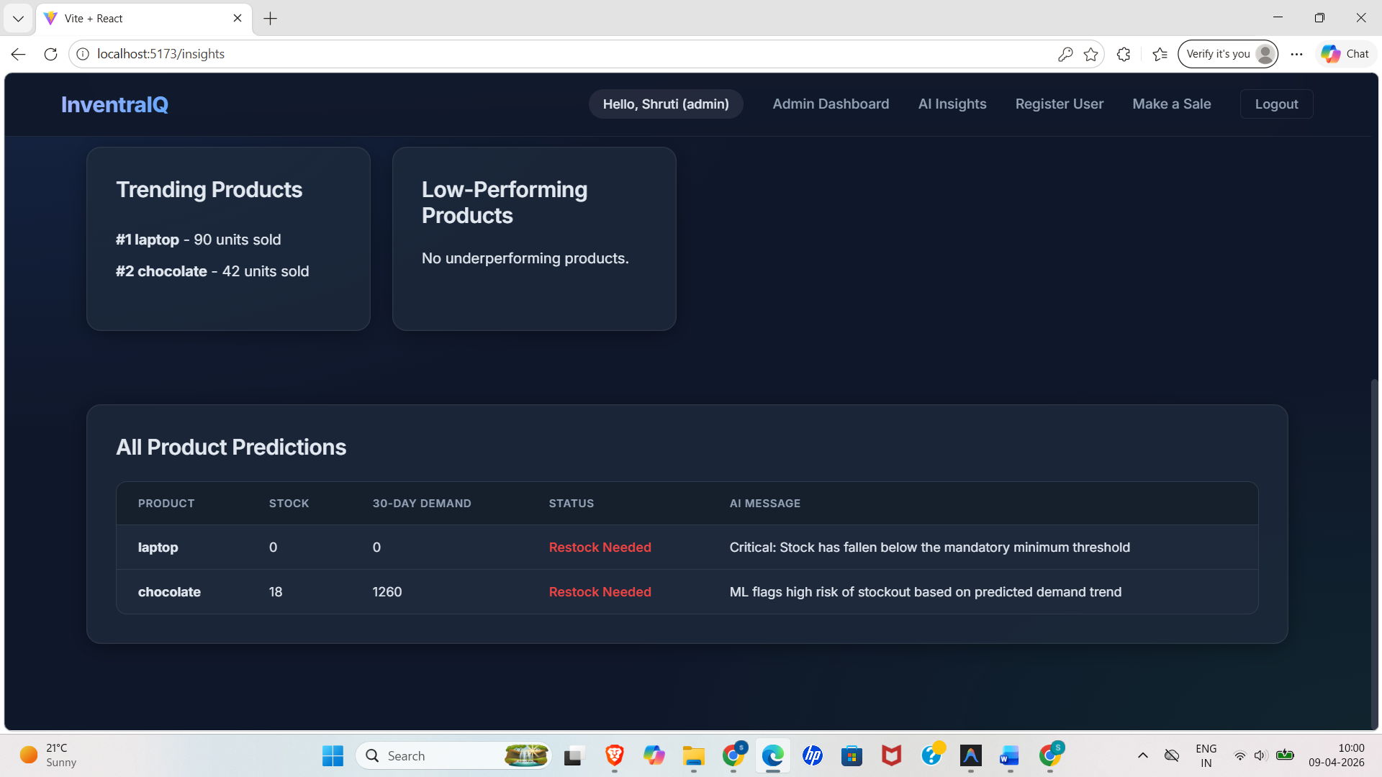
Result

Slide 13
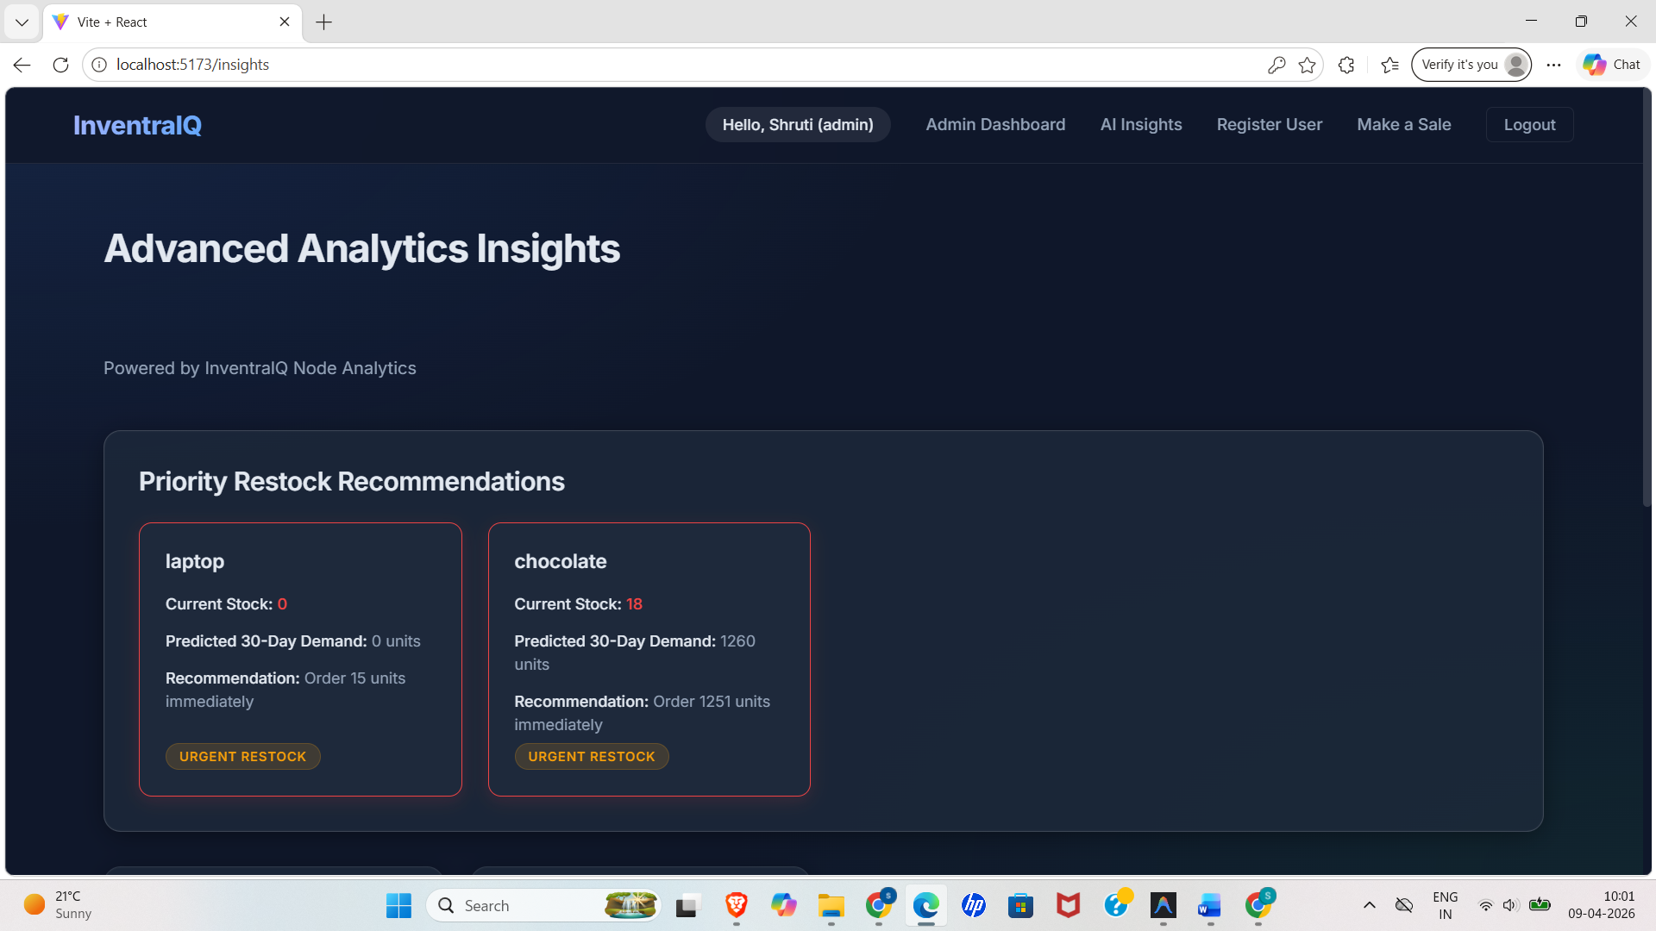
Result

Slide 14
Conclusion
InventraIQ successfully addresses the limitations of traditional inventory management systems by providing a real-time, efficient, and user-friendly solution. The system simplifies inventory operations through features such as product management, sales tracking, and automatic stock updates, ensuring accuracy and reducing manual effort. The use of a full-stack architecture with React, Node.js, and MongoDB enables smooth performance and scalability.
In addition, the integration of a Flask-based machine learning module enhances the system by enabling 30-day demand prediction using historical sales data. This helps businesses make informed decisions regarding restocking and inventory planning. Overall, InventraIQ improves operational efficiency, reduces errors, and supports data-driven decision-making, making it a reliable solution for modern inventory management needs.

Slide 15
Thank You
15

