Slide 1
Unsolicited Commercial Communication
Originator | +91 120 4788800
Time Stamp(s) | 12th December 2024 09:05:14
Organisation | Voltas
Call Purpose | Feedback Solicitation Call. But no active requests for past several months
Call Type | Voice
Category | Consumer Goods and Automobiles

Slide 2
ICICI – Click To Call FollowUp (Credit Card)
Call Originator | +91 40 7140 5200
Time Stamp | 26th February 2024 18:06:32
Organisation | ICICI Bank
Call Purpose | Looking to see if a previously issued Amex (ICICI Amex) be re activated sharing the Credit Limit with the current Credit Card. Resolution Provided: Not Possible (by Customer Care)
Call Type | Voice

Slide 3
BAD COMMUNICATION SKILLS FROM INCOMPETENT
CUSTOMER SERVICE
Originating Call | +91 11 3564 5203
UCC Time Stamp | 6th August 2024 09:21:31
Organisation | Milk Basket
Call Purpose | Remorseless regretless and sans any concern to paid premium delivery commitments
Call Type | Voice

Slide 4
UNSOLICITED COMMERCIAL COMMUNICATION
UCC Originator | +9174838 59654 | UCC Text
UCC Time Stamp | 8th March 2024 13:10
Organisation | Unrecognised | PERSONAL & HOME LOAN *Roi start10.25% *PL,app loans&CC BT *part payment,preclosure available * 7yrs tenure,cibil issues *call,whatsapp 6361927265
UCC Purpose | Personal and Home Loan Sales
UCC Type | Text

Slide 5
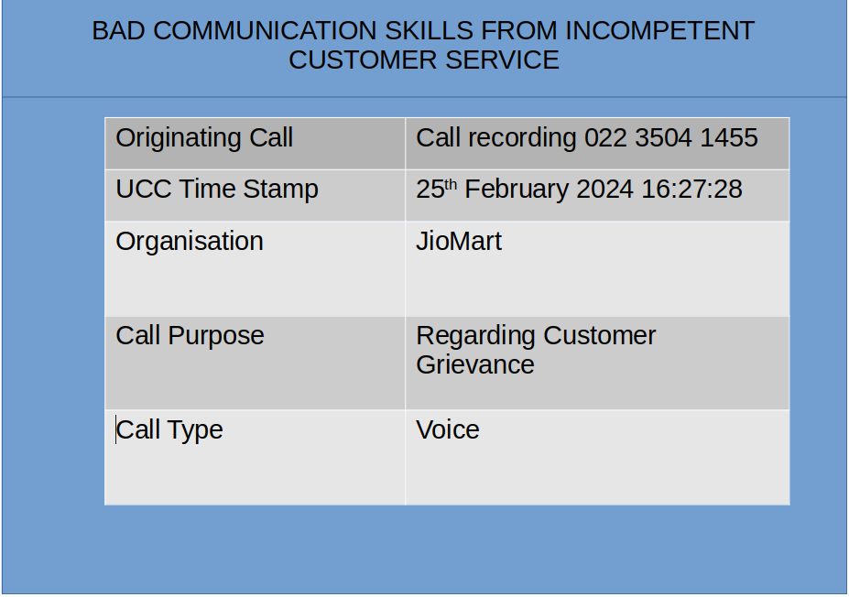

Slide 6
Transcription Notes
Call Originator | +91 80 2294 2147
Date and Time | 16 January 2024 14:43:53
Notes (if any) | Accepted by Answering Machine for Review Purposes. No person attended it.

Slide 7
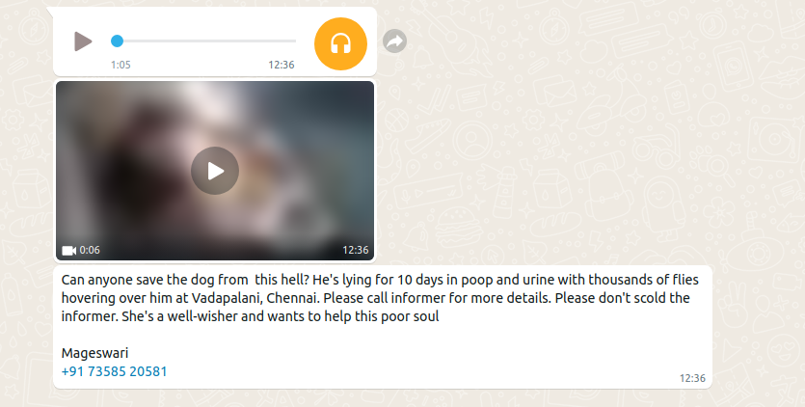
Rescue Request

