Slide 1

High Speed Networks Need Proactive Congestion Control
Lavanya Jose, Steve Ibanez, Lisa Yan, Nick McKeown, Sachin Katti
Stanford University
Mohammad Alizadeh
MIT
George Varghese
Microsoft Research
Notes:
I’m gonna describe why high speed networks need proactive congestion control
----- Meeting Notes (11/3/15 09:43) -----
test story
see how well it holds up
implement
TCP to Fastpass continuum (queuing) for discussion

Slide 2
At 100 Gb/s the network will be very dynamic and a typical flow will finish in just a few RTTs.
1MB / 100 Gb/s = 80 µs

Slide 3
Traditional congestion control: react to congestion signals to adjust flow rates. Take tens of RTTs.
Adjust
Flow Rate
We need new faster approaches.
Measure Congestion
Notes:
They don’t knwo the correct flow rates but know the direction in which to adjust. Because their reaction feeds back into the system they have to be cauitous. and they end up taking tesn of RTTs.

Slide 4
Explicitly calculating rates in the network based on the traffic matrix can be much faster. (Example)

Slide 5

Fair Share for a Single Link
flow | demand
A | ∞
B | ∞
Capacity at Link 1: 30G
So Fair Share Rate: 30G/2 = 15G
15 G
Link 1
30 G
Flow A
∞
Flow B
∞

Slide 6
A second link introduces a dependency
flow | demand
A | ∞
B
10 G
∞
Link 1
30 G
Link 2
10 G
Flow A
Flow B

Slide 7
In-network congestion control is promising in the context of re-configurable switch chips.
Queues
L2 Table
Match Table
Match Table
IPv6 Table
ACL Table
IPv4 Table
Match Table
Action Macro
Match Table
Action Macro
Action Macro
Action Macro
Parser
Fixed Action
Fixed Action
Fixed Action
Fixed Action

Slide 8
PERC
Control Packet For Flow B
d| ∞ | ∞
f| ? | ?
Notes:
Flows exchange messages with their links using control packets. Here in Flow B’s control packet you can see demands for each link on its path and placeholders for fair shares. Links on the way look at the demand an fill in the fair shares. Note that each flow is sending these control packets as long as it’s active and independently of other flows, in an asynchronous way.

Slide 9
It is possible to deploy a robust, pro-active, in-network congestion control scheme in DCs with re-configurable switch chips.

Slide 10


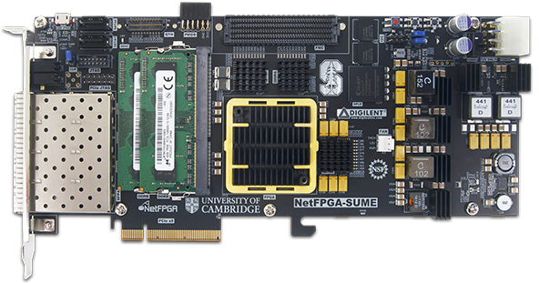
PERC FPGA prototype
P4 Front end
PX
Xilinx SDNet
Compilation
NetFPGA SUME Switch

Slide 11
Some food for thought 1. Congestion Control at 100 Gb/s - Metrics? Approaches? 2. Constraints of Re-configurable Switch Chips at 100 Gb/s speeds - Per-packet compute, Per-flow state, New Abstractions? 3. Deploying Robust Pro-active Schemes - Handling errors from control packet loss, inaccurate demand estimates

