Slide 1

High Speed Networks Need Proactive Congestion Control
Using Programmable Forwarding Planes!
Lavanya Jose, Steve Ibanez, Lisa Yan, Nick McKeown, Sachin Katti
Stanford University
Mohammad Alizadeh
MIT
George Varghese
Microsoft Research

Slide 2
Outline
At 100G speeds, we’ll need much faster congestion control schemes
Letting networks switches directly compute rates is a fast and scalable scheme
We can realize such a scheme in 100G networks using programmable forwarding planes (stateful data planes)

Slide 3
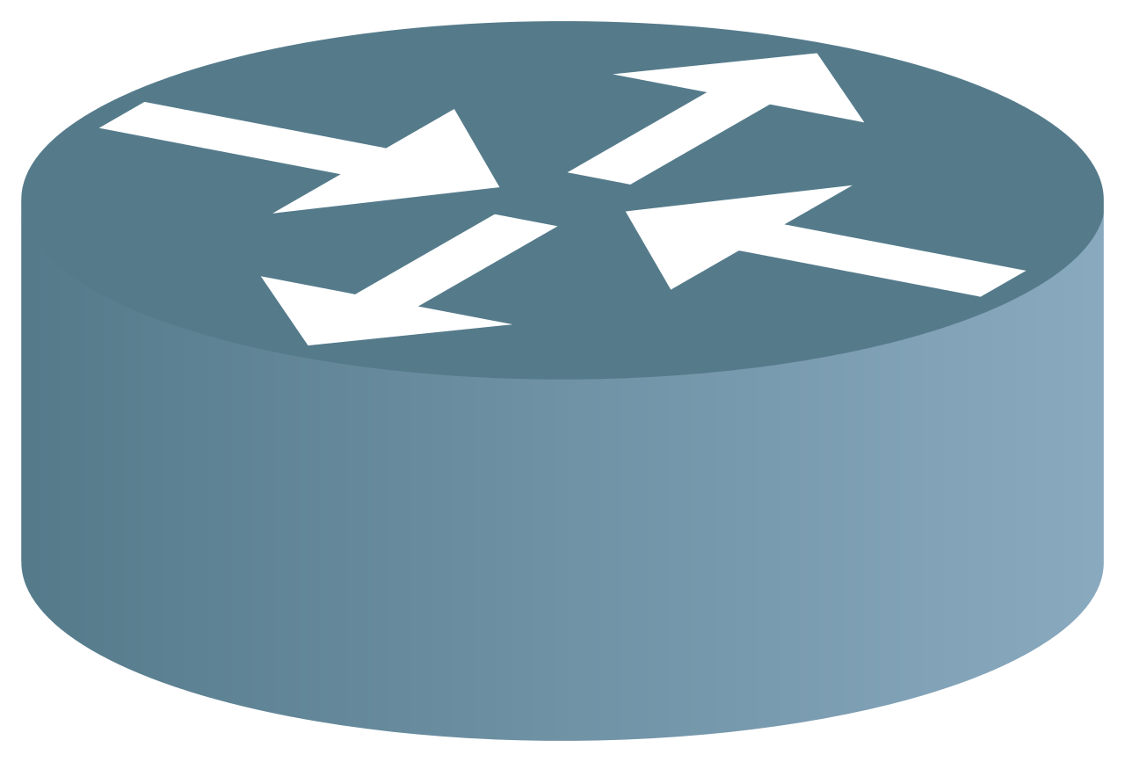
The Congestion Control Problem
Link 0
100 G
Link 1
60 G
Link 2
30 G
Link 3
10 G
Link 4
100 G
Flow A
Flow C
Flow B
Flow D

Slide 4

Ask an oracle.
Link | Capacity
0 | 100
1 | 60
2 | 30
3 | 10
4 | 100
 | Link 0 | Link 1 | Link 2 | Link 3 | Link 4
Flow A | √ | √
Flow B |  | √ | √
Flow C |  |  | √ | √
Flow D |  |  |  | √ | √
Flow | Rate
Flow A | 35
Flow B | 25
Flow C | 5
Flow D | 5
Link 0
100 G
Link 1
60 G
Link 2
30 G
Link 3
10 G
Link 4
100 G
Flow A
Flow A = 35G
Flow C
Flow C = 5G
Flow B
Flow B = 25G
Flow D
Flow D = 5G
Notes:
We give her the list of flows, the links they use and the link capacities and she magically gives us the rates for every flow.
Well it’s not quite magic, since given the traffic matrix and link capacities anyone can compute the fair sahre rates.
On the other hand here’s what we do today.

Slide 5
Traditional congestion control
No explicit information about traffic matrix
Measure congestion signals, then react by adjusting rate after measurement delay
Gradual, can’t jump to right rates, know direction
“Reactive Algorithms”
Adjust
Flow Rate
Measure Congestion
Notes:
In today’s congetsion scontrol schemes no one netiehr the end hosts nor the links have any explicit information abotu thte traffic matrix. intested measure congestion signals such as queueing or packet loss and react by adjusting their rates after osme measurement dealy. This is a gradual process. They can’t jump directly ot the right rates but they know the direction in whihc to go.
Measure congestion signals such as queueing or packet loss
I’m gonna show you a typical example of such a reactive algorithm. This is called RCP. RCP was designed specifically to quickly find max min fair rates, which is the notion of fairness I’m looking at.
----- Meeting Notes (11/16/15 08:54) -----
Traditional`

Slide 6
Notes:
I’m gonna show you how RCP tries to figure out the rates for these flows. On the y axis I have the transmission rate, on x I have time measured in RTTs.
First, let me plot the ideal rate for Flow C. At the smaller 10G link, there’s one other flow. So the red Flow C’s ideal fair share is 5G.
Just to give some background in RCP switches try to figure out a fair share rate by only measuring congestion signals like queuing and input traffic rate at their links.
A flow sends at the minimum rate it hears from its links.
And now let’s see what RCP does for the Flow.
----- Meeting Notes (11/13/15 12:28) -----
flow

Slide 12
30 RTTs to Converge
Notes:
This behavior is typical of all traditional congestion control be it TCP, XCP or DCTCP. It’s cool that.. they don’t ned any explicit info to figure out rates. But steppin gback wy do we need 30 RTTs to figure otu a few rates. Why not 1 like the oracle.

Slide 13
Convergence Times Are Long
Reactive schemes are slow for 100G
At 100G, a typical flow in a search workload is < 7 RTTs long.
1MB / 100 Gb/s = 80 µs
Notes:
As link speeds get faster, this problem will only get worse. For e.g., at 100G a typical flow in a search workload is less than 7 RTTs long

Slide 14
Reactive algorithms trade off explicit flow information for long convergence times
Can we use explicit flow information
and get shorter convergence times?

Slide 15
Back to the oracle, how did she use traffic matrix to compute rates?
Link 0
100 G
Link 1
60 G
Link 2
30 G
Link 3
10 G
Link 4
100 G
Flow A
Flow A = 35G
Flow C
Flow C = 5G
Flow B
Flow B = 25G
Flow D
Flow D = 5G
Notes:
----- Meeting Notes (11/16/15 08:00) -----
rates anim

Slide 16
Waterfilling Algorithm
Link 0 (0/ 100 G)
Link 4 (0/ 100 G)
Link 1 (0/ 60 G)
Flow A (0 G)
Link 2 (0/ 30 G)
Link 3 (0/ 10 G)
Flow C (0 G)
Flow B (0 G)
Flow D (0 G)
Notes:
. The colored boxes are the flow allocations and the gray ones are links. The height of the boxes are prop. to the allocation and to the link capacity.
I start with 0 rates for all flows and increase everyone’s rate at the same time till some link gets fully used so link 3 is fully used. Continue.. Both flows are botllenecked and continue until everyf lwo is bottlenecked
.

Slide 17
Waterfilling- 10 G link is fully used
Link 0 (5/ 100 G)
Link 4 (5/ 100 G)
Link 1 (10/ 60 G)
Flow A (5 G)
Link 2 (10/ 30 G)
Link 3 (10/ 10 G)
Flow C (5 G)
Flow B (5 G)
Flow D (5 G)

Slide 18
Waterfilling- 30 G link is fully used
Link 0 (25/ 100 G)
Link 4 (5/ 100 G)
Link 1 (50/ 60 G)
Flow A (25 G)
Link 2 (30/ 30 G)
Link 3 (10/ 10 G)
Flow C (5 G)
Flow B (25 G)
Flow D (5 G)

Slide 19
Waterfilling- 60 G link is fully used
Link 0 (35/ 100 G)
Link 4 (5/ 100 G)
Link 1 (60/ 60 G)
Flow A (35 G)
Link 2 (30/ 30 G)
Link 3 (10/ 10 G)
Flow C (5 G)
Flow B (25 G)
Flow D (5 G)

Slide 20
Fair Share of Bottlenecked Links
Link 0 (35/ 100 G)
Fair Share: 35 G
Link 4 (5/ 100 G)
Link 1 (60 G)
Fair Share: 25 G
Link 2 (30 G)
Fair Share: 5 G
Flow A (35 G)
Link 3 (10 G)
Flow C (5 G)
Flow B (25 G)
Flow D (5 G)
Notes:
If we try to implement this in a centralized controller, the controller would have to be involved in each flow event,
and communicate new rates to all the affected flows.
Moreover this scheme takes time proportion to number of links and flows.

Slide 21
A centralized water-filling scheme may not scale.
Can we let the network figure out rates in a distributed fashion?

Slide 22
Fair Share for a Single Link
flow | demand
A | ∞
B | ∞
Capacity at Link 1: 30G
So Fair Share Rate: 30G/2 = 15G
15 G
Link 1
30 G
Flow A
∞
Flow B
∞

Slide 23
A second link introduces a dependency
flow | demand
A | ∞
B
Capacity at Link 1: 30G
Demand of Flows restricted at other links: 10G
Number of unrestricted flows: 1
So Fair Share Rate: 30G-10G/1 = 20G
10 G
∞
Link 1
30 G
Link 2
10 G
Flow A
Flow B

Slide 24
Proactive Explicit Rate Control (PERC)
Control Packet For Flow B
d| ∞ | ∞
f| ? | ?
Notes:
Flows exchange messages with their links using control packets. Here in Flow B’s control packet you can see demands for each link on its path and placeholders for fair shares. Links on the way look at the demand an fill in the fair shares. Note that each flow is sending these control packets as long as it’s active and independently of other flows, in an asynchronous way.

Slide 25
Constraints of Programmable Forwarding Planes at 100 Gb/s
Limited compute- action ~ ns, typically primitives like add/ compare etc.
Limited info. that we can modify per packet.
Limited area for state and look-up tables ~ MB, much of which is for L2/L3
Queues
L2 Table
Match Table
Match Table
IPv6 Table
ACL Table
IPv4 Table
Match Table
Action Macro
Match Table
Action Macro
Action Macro
Action Macro
Parser
Fixed Action
Fixed Action
Fixed Action
Fixed Action
Notes:
In particular, I looked at he abstract siwthc model described by P4, a pipeline of match-action tables with configurable match and actions.
- what kind of computation we can do, only that can run in a few pipeline stages made up of simple primitive actions supported by the switch.
dpemding on the switch is designed these limits might be just enough for your use case or not- some switches may have complex action primitives, some may support performing an action on many 2 inputs some may say 3.. the area could also vary deoending on what else the switch is doing. yet these are things we need to be mindful of.

Slide 26


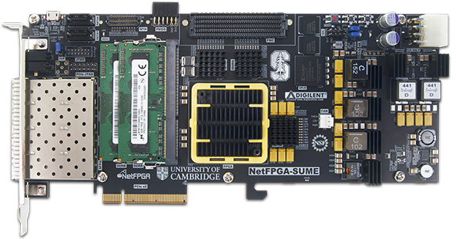
PERC in P4 → NetFPGA
P4 Front end
PX
Xilinx SDNet
Compilation
NetFPGA SUME Switch
Notes:
We took a first stab at making this scheme real by writing up a version of PERC in P4 v1.0 and compiling it to a NetFPGA. Note that the P4 program uses the most basic version of P4 and so reflects a very simple programmable forwarding plane. So we had to modify the PERC version I described to you considerably. We had the switch keep the bare minimum state needed. And, moved much of the per-packet compute for a flow to the flow’s sourc end host (pic of moving xx to end host, and putting some info in packet) However depending on how flesible the forwarding plane is (e.g., if we can do divisions at perhaps a slightly slower timescale), we can split the computation accordingly. This is something we’re exploring

Slide 27
Interesting Questions
Minimum time for a distributed scheme
Minimum amount of state for provable convergence
How many active flows in a max-min fair network?
Imprecise demands → some reactive component
Notes:
We also have fundamental questions on the theory side some of which we’re looking into now
What is the minimum time it takes for a distributed scheme to converge to fair share rates? Our intuition was it is limited by the dependency chains. A paper from 2012 did show that the minimum time is 2x the depth of the constraint precedence graph.. basically a graph of all the dependency chains in the network.
What is the minimum amount of state needed at the switch. While there are existing schemes that use less state, the ones that provably converge all seem to require per-flow state. Is this necessary?
How many active flows in a max-min fair network? This question is also important to understand what the control traffic overhead would be since we sent control messages on a per-flow basis. What we have seen from experiments is that at loads of up to 80% the number of flows that are active at any moment is less than a hundred. This is consistent with the result from queueing theory that on a single P.S. with Poisson arrival link the number of flows depends only on the load and is very small. We want to see how we can use this fact for a network and with realistic workloads that may also have in-cast patterns.

