Slide 1

High Speed Networks Need Proactive Congestion Control
Lavanya Jose, Lisa Yan, Nick McKeown, Sachin Katti
Stanford University
Mohammad Alizadeh
MIT
George Varghese
Microsoft Research
Notes:
----- Meeting Notes (11/3/15 09:43) -----
test story
see how well it holds up
implement
TCP to Fastpass continuum (queuing) for discussion

Slide 2
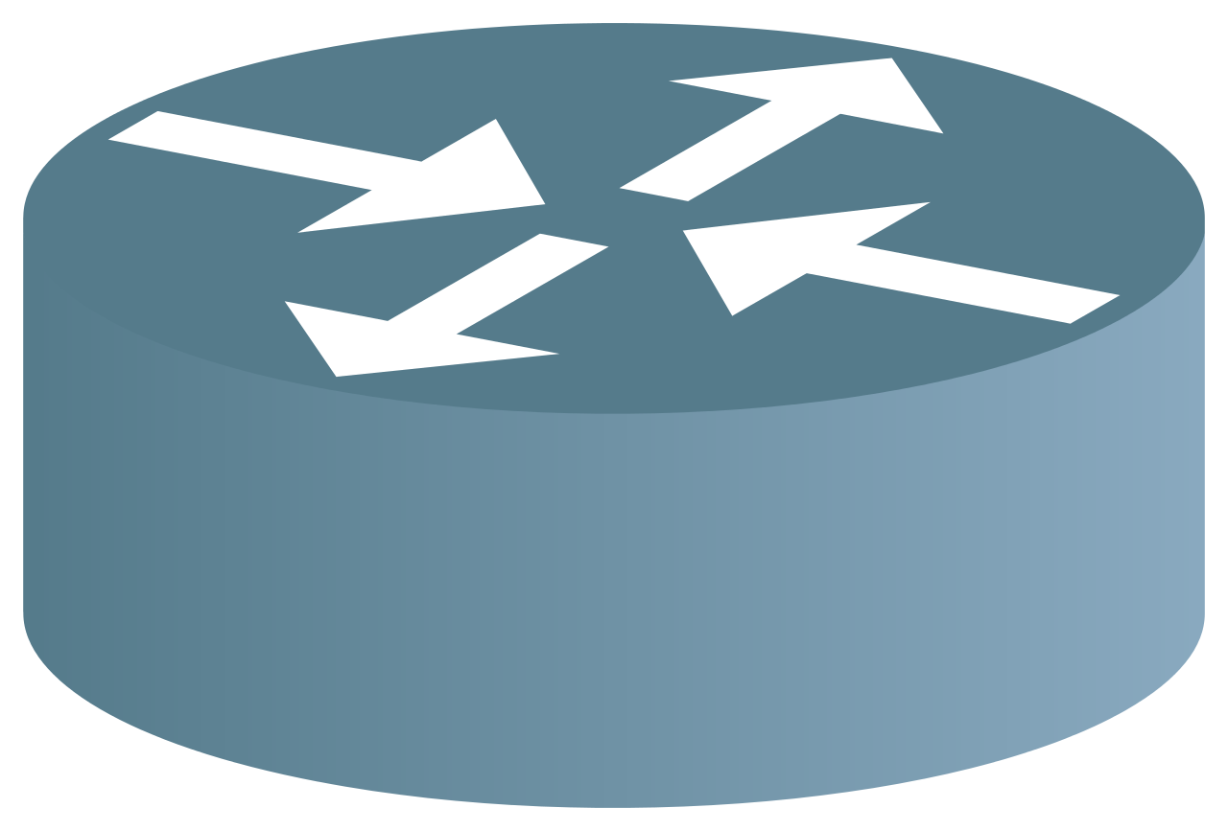
The Congestion Control Problem
Link 0
100 G
Link 1
60 G
Link 2
30 G
Link 3
10 G
Link 4
100 G
Flow A
Flow C
Flow B
Flow D

Slide 3

Ask an oracle.
Link | Capacity
0 | 100
1 | 60
2 | 30
3 | 10
4 | 100
 | Link 0 | Link 1 | Link 2 | Link 3 | Link 4
Flow A | √ | √
Flow B |  | √ | √
Flow C |  |  | √ | √
Flow D |  |  |  | √ | √
Flow | Rate
Flow A | 35
Flow B | 25
Flow C | 5
Flow D | 5
Link 0
100 G
Link 1
60 G
Link 2
30 G
Link 3
10 G
Link 4
100 G
Flow A
Flow A = 35G
Flow C = 5G
Flow C
Flow B
Flow B = 25G
Flow D
Flow D = 5G

Slide 4
Traditional Congestion Control
No explicit information about traffic matrix
Measure congestion signals, then react by adjusting rate after measurement delay
Gradual, can’t jump to right rates, know direction
“Reactive Algorithms”
Notes:
Measure congestion signals such as queueing or packet loss
I’m gonna show you a typical example of such a reactive algorithm. This is called RCP. RCP was designed specifically to quickly find max min fair rates, which is the notion of fairness I’m looking at.
----- Meeting Notes (11/16/15 08:54) -----
Traditional`

Slide 5
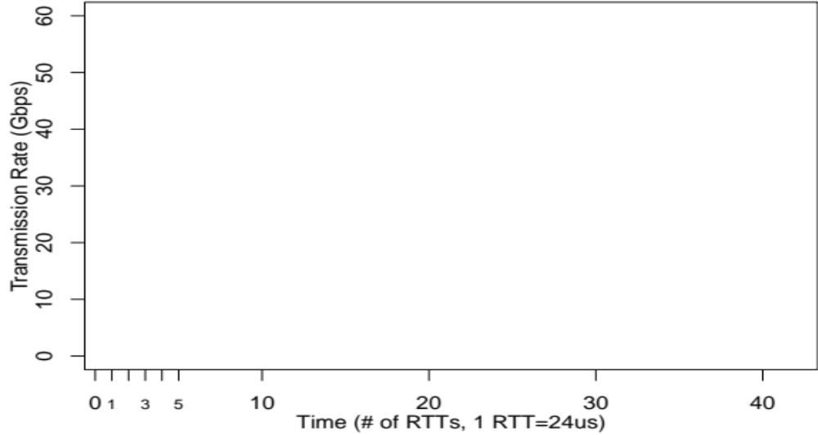
Notes:
I’m gonna show you how RCP tries to figure out the rates for these flows. On the y axis I have the transmission rate, on x I have time measured in RTTs.
First, let me plot the ideal rate for Flow C. At the smaller 10G link, there’s one other flow. So the red Flow C’s ideal fair share is 5G.
Just to give some background in RCP switches try to figure out a fair share rate by only measuring congestion signals like queuing and input traffic rate at their links.
A flow sends at the minimum rate it hears from its links.
And now let’s see what RCP does for the Flow.
----- Meeting Notes (11/13/15 12:28) -----
flow

Slide 6
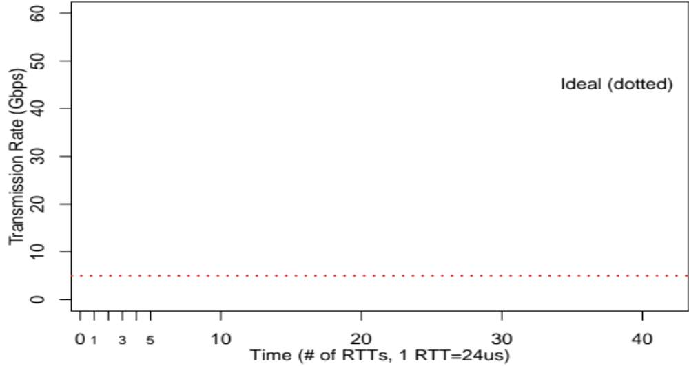

Slide 7
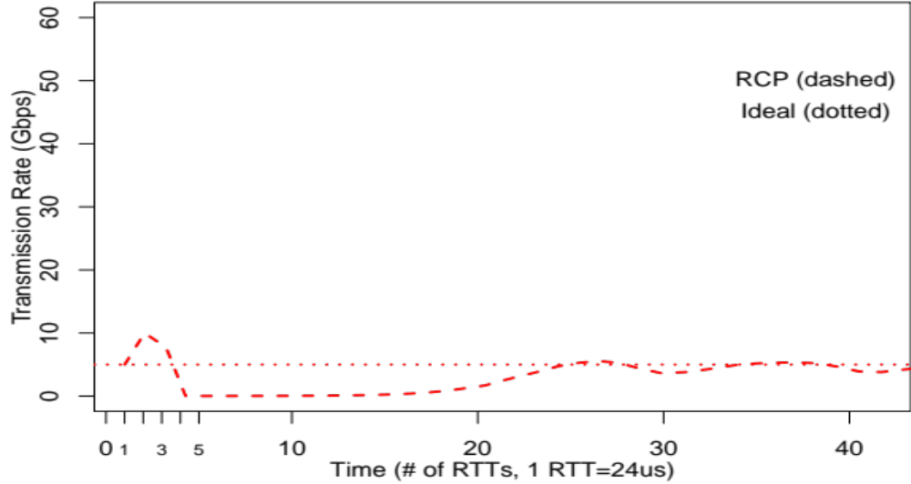

Slide 8
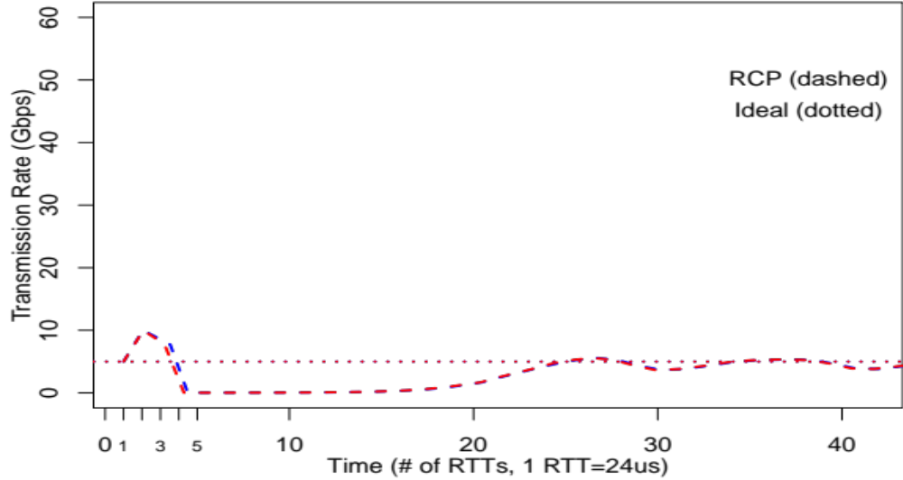

Slide 9
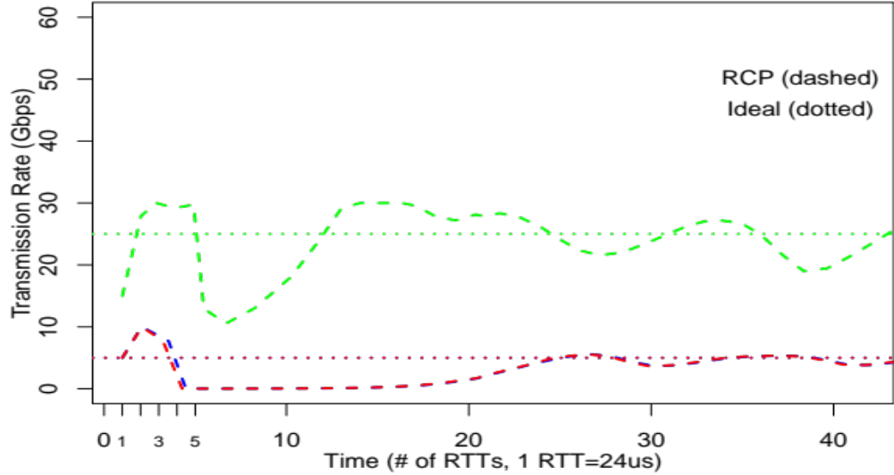

Slide 11
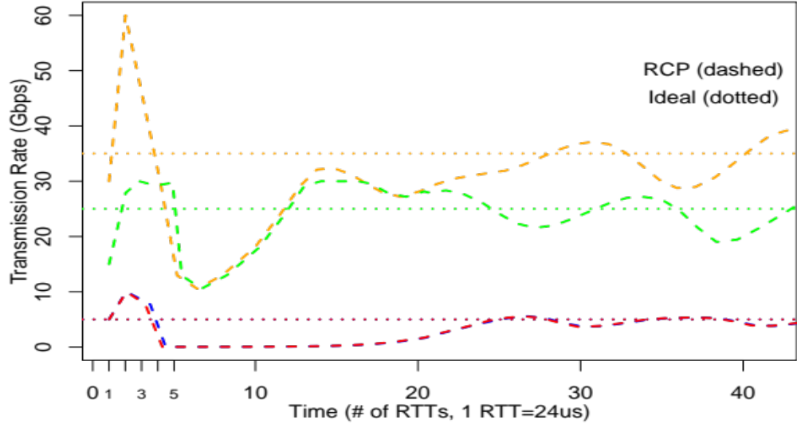
30 RTTs to Converge
Notes:
This behavior is typical of all traditional congestion control be it TCP, XCP or DCTCP. It’s cool that..

Slide 12
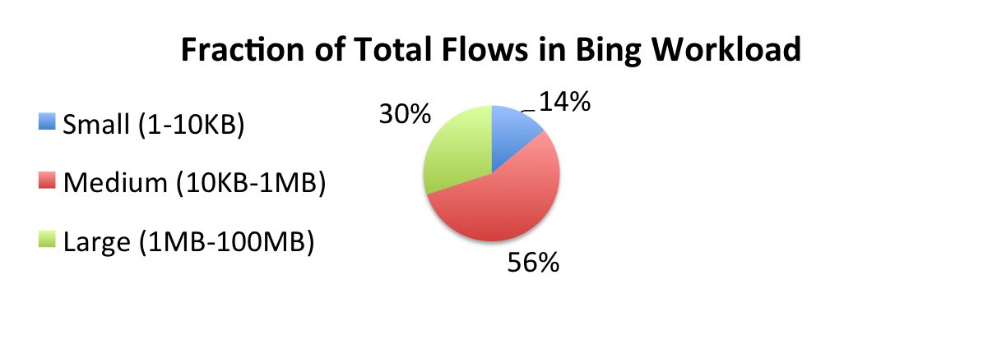
Convergence Times Are Long
If flows only last a few RTTs, then we can’t wait 30 RTTs to converge.
At 100G, a typical flow in a search workload is < 7 RTTs long.
1MB / 100 Gb/s = 80 µs
Notes:
As link speeds get faster, this problem will only get worse. For e.g., at 100G a typical flow in a search workload is less than 7 RTTs long

Slide 13
Why “Reactive” Schemes Take Long
No explicit information
Therefore measure congestion signals, react
Can’t leap to correct values but know direction
Reaction is fed back into network
Take cautious steps
Adjust
Flow Rate
Measure Congestion
Notes:
----- Meeting Notes (11/13/15 12:28) -----
animate points

Slide 14
Reactive algorithms trade off explicit flow information for long convergence times
Can we use explicit flow information
and get shorter convergence times?

Slide 15
Back to the oracle, how did she use traffic matrix to compute rates?
Link 0
100 G
Link 1
60 G
Link 2
30 G
Link 3
10 G
Link 4
100 G
Flow A
Flow A = 35G
Flow C = 5G
Flow C
Flow B
Flow B = 25G
Flow D
Flow D = 5G
Notes:
----- Meeting Notes (11/16/15 08:00) -----
rates anim

Slide 16




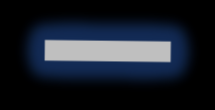
Waterfilling Algorithm
Link 0 (0/ 100 G)
Link 4 (0/ 100 G)
Link 1 (0/ 60 G)
Flow A (0 G)
Link 2 (0/ 30 G)
Link 3 (0/ 10 G)
Flow C (0 G)
Flow B (0 G)
Flow D (0 G)

Slide 17
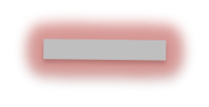
Waterfilling- 10 G link is fully used
Link 0 (5/ 100 G)
Link 4 (5/ 100 G)
Link 1 (10/ 60 G)
Flow A (5 G)
Link 2 (10/ 30 G)
Link 3 (10/ 10 G)
Flow C (5 G)
Flow B (5 G)
Flow D (5 G)

Slide 18
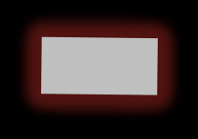
Waterfilling- 30 G link is fully used
Link 0 (25/ 100 G)
Link 4 (5/ 100 G)
Link 1 (50/ 60 G)
Flow A (25 G)
Link 2 (30/ 30 G)
Link 3 (10/ 10 G)
Flow C (5 G)
Flow B (25 G)
Flow D (5 G)

Slide 19

Waterfilling- 60 G link is fully used
Link 0 (35/ 100 G)
Link 4 (5/ 100 G)
Link 1 (60/ 60 G)
Flow A (35 G)
Link 2 (30/ 30 G)
Link 3 (10/ 10 G)
Flow C (5 G)
Flow B (25 G)
Flow D (5 G)

Slide 20
Fair Share of Bottlenecked Links
Link 0 (35/ 100 G)
Fair Share: 35 G
Link 4 (5/ 100 G)
Link 1 (60 G)
Fair Share: 25 G
Link 2 (30 G)
Fair Share: 5 G
Flow A (35 G)
Link 3 (10 G)
Flow C (5 G)
Flow B (25 G)
Flow D (5 G)
Notes:
If we try to implement this in a centralized controller, the controller would have to be involved in each flow event,
and communicate new rates to all the affected flows.
Moreover this scheme takes time proportion

Slide 21
A centralized water-filling scheme may not scale.
Can we let the network figure out rates in a distributed fashion?

Slide 22
Fair Share for a Single Link
flow | demand
A | ∞
B | ∞
Capacity at Link 1: 30G
So Fair Share Rate: 30G/2 = 15G
15 G
Link 1
30 G
Flow A
∞
Flow B
∞

Slide 23
A second link introduces a dependency
flow | demand
A | ∞
B
10 G
∞
Link 1
30 G
Link 2
10 G
Flow A
Flow B

Slide 24
Dependency Graph

Slide 25

Dependency Graph
10
10
Notes:
----- Meeting Notes (11/12/15 16:17) -----
Add animations.

Slide 26
Proactive Explicit Rate Control (PERC) Overview
Round 1 (Flows → Links)
Flows and links alternately exchange messages.
A flow sends a “demand”
  ∞ when no other fair share
  min. fair share of other links
A link sends a “fair share”
  C/N when demands are ∞
  otherwise use water-filling
∞
15
15
∞
∞
10

Slide 27
Proactive Explicit Rate Control (PERC) Overview
Round 2 (Flows → Links)
Flows and links alternately exchange messages.
A flow sends a “demand”
  ∞ when no other fair share
  min. fair share of other links
A link sends a “fair share”
  C/N when demands are ∞
  otherwise use water-filling
Messages are approximate, jump to right values quickly with more rounds
∞
10
15

Slide 28
Proactive Explicit Rate Control (PERC) Overview
Round 2 (Links → Flows)
Flows and links alternately exchange messages.
A flow sends a “demand”
  ∞ when no other fair share
  min. fair share of other links
A link sends a “fair share”
  C/N when demands are ∞
  otherwise use water-filling
Messages are approximate, jump to right values quickly with more rounds
20
20
10

Slide 29
Message Passing Algorithms
Decoding error correcting codes
(LDPC- Gallager, 1963)
Flow counts using shared counters
(Counter Braids- Lu et al, 2008)
Parity Check 1
Counter 1
Flow A
x₁
36
0
x₁ ₊ x₃ = 0
x₂
1
Parity Check 2
Flow B
Counter 2
x₃
1
x₂₊ x₃ = 0
32
...
...
Notes:
REDRAW and label
----- Meeting Notes (11/12/15 16:17) -----
New SLIDE PERC

Slide 30
Making PERC concrete

Slide 31
PERC Implementation
Control Packet For Flow B
d| ∞ | ∞
f| ? | ?
Notes:
The messages that a flow exchanges with its links are all in a control packets. Here in Flow B’s control packet you can see demands for each link on its path and placeholders for fair shares. Links on the way look at the demand an fill in the fair shares. Note that each flow is sending these control packets as long as it’s active and independently of other flows, in an asynchronous way.

Slide 32
PERC Implementation
Control Packet For Flow B
d| ∞ | ∞
f|15 | ?
d| ∞ | ∞
f| ? | ?

Slide 33
PERC Implementation
Control Packet For Flow B
d| ∞ | ∞
f|15 |10
d| ∞ | ∞
f|15 | ?

Slide 34
PERC Implementation
Control Packet For Flow B
d| ∞ | ∞
f|15 |10
d|10 |15
f|? | ?
send at 15G!
Notes:
make send at text bigger!

Slide 35
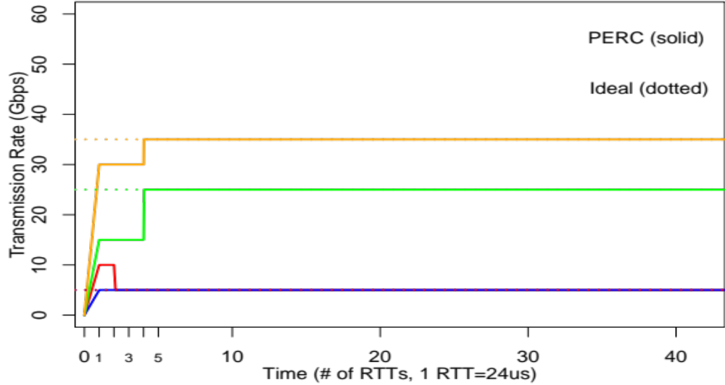
PERC converges fast
< 5
RTTs
RCP took
30 RTTs to Converge

Slide 36
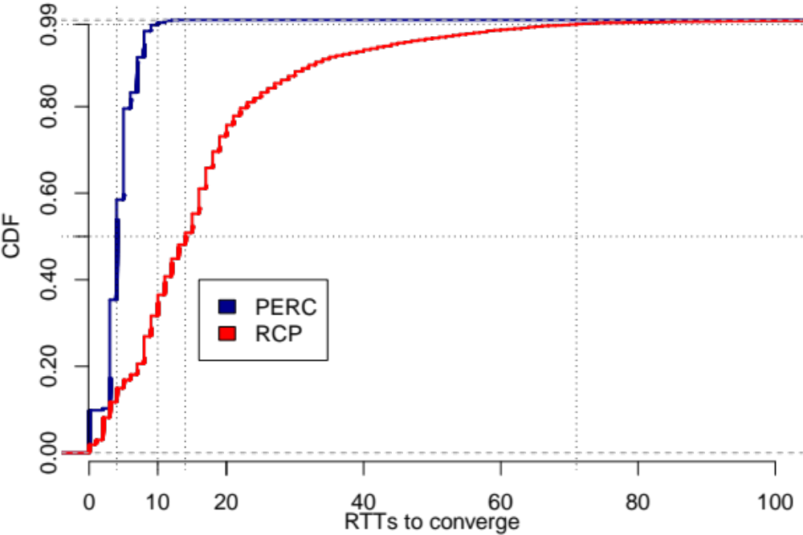
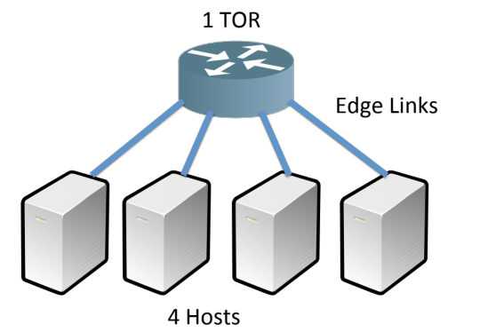
PERC Converges Fast
4 vs 14 at Median
10 vs 71 at Tail (99th)
Notes:
label median and tail

Slide 37
Some unanswered questions
How to calculate fair shares in PERC switches?
How to bound convergences times in theory?
What about other policies?

Slide 38
Takeways
Reactive schemes are slow for short flows (majority) at 100G
Proactive schemes like PERC are fundamentally different and can converge quickly because they calculate explicit rates based on out of band information about set of active flows.
Message passing promising proactive approach- could be practical, need further analysis to understand good convergence times in practice.

Slide 39
Thanks!

Slide 40
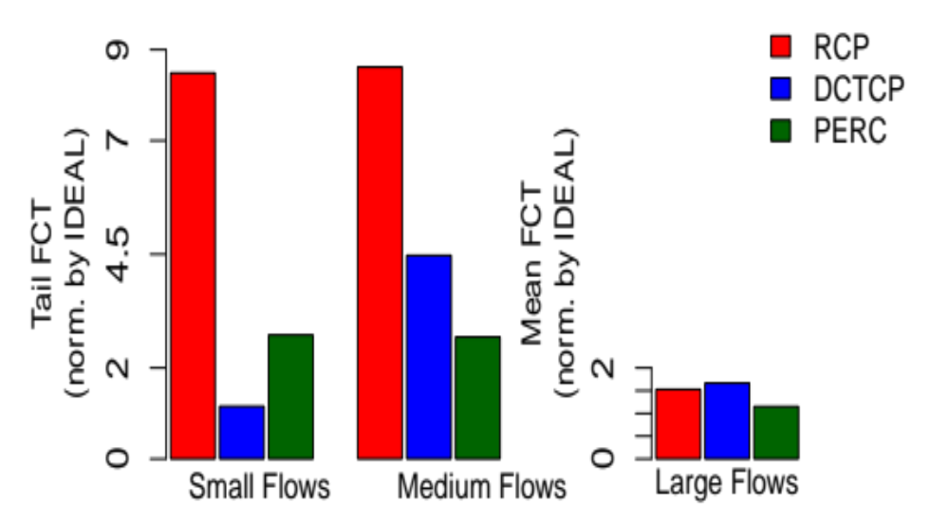
Shorter FCTs For Flows
That Last A Few RTTs (“Medium”)
100G, 12us

Slide 41
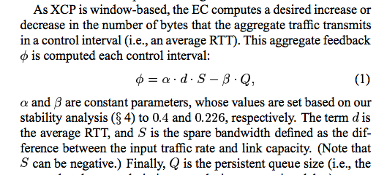
XCP

Slide 42
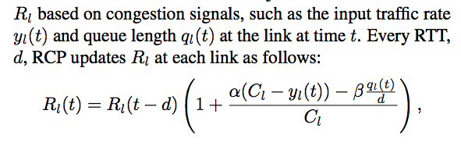
RCP

Slide 43
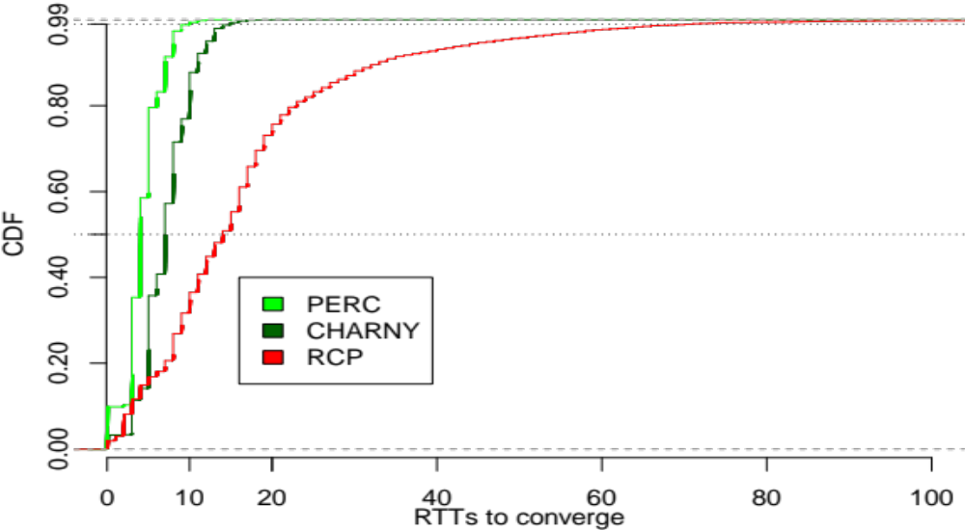
ATM/ Charny etc.
Notes:
- ATMs
- flow set up time
experiments show we converge faster
message passing based idea seems promising

Slide 44
Discussion
Fundamentally any limit on how fast we can get max-min rates? Explicit or implicit whatever

