Slide 1



Housing Prices in Metropolitan Areas of India
SUBMITTED BY
LAVANYA K 35621U25018
LAKSHMI F 35621U25017
SANDHIYA K 35621U25025
MEENAKSHI P 35621U25020
Under the Guidance of
Mr.K.SANGEETHA THULASI RAMAN M.Sc., M.Phil.,B.Ed.,SET.
PG-DEPARMENT OF MATHEMATCS
GOVERNMENT ARTS AND SCIENCE COLLEGE (Attupakam) , ARAKKONAM-631051, RANIPET DISTRCT,
TAMIL NADU.

Slide 2
INTRODUCTION :
Since the inception of the theory and idea of development, the common feature that emerged in different point of time is the developmental gap that emerged in different parts of the world and also among various parts of a country in a particular time period. This disparity in development, like many other indicators, has also been reflected in India. Traditional development theories believed that agriculture, industrialisation, urbanisation, are significant ingredients of growth, and, ultimately important prerequisites for achieving development. Within the economy itself, the status of growth of a state can be judged through its performance in agricultural and industrial production, performance of service sector and urbanisation, and their impact through their contribution in income and employment generation at the national level. Thus, house price behaviour may also reflect some short of developmental status of the households of a country.

Slide 3


Slide 4

EMPATHY MAP

Slide 5

BRAINSTORM

Slide 6
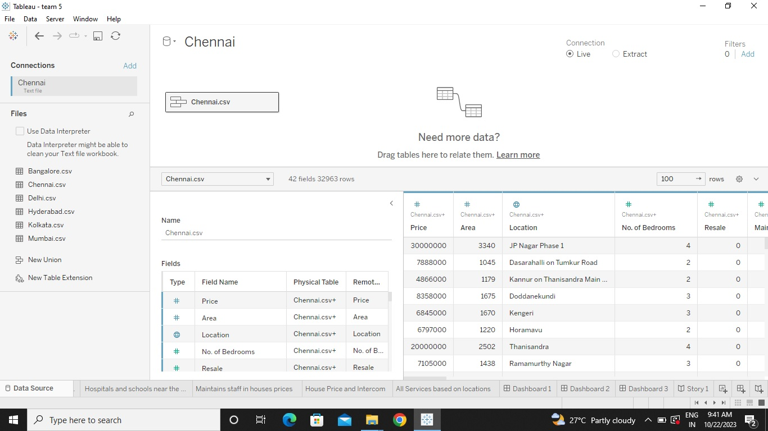
DATASET

Slide 7
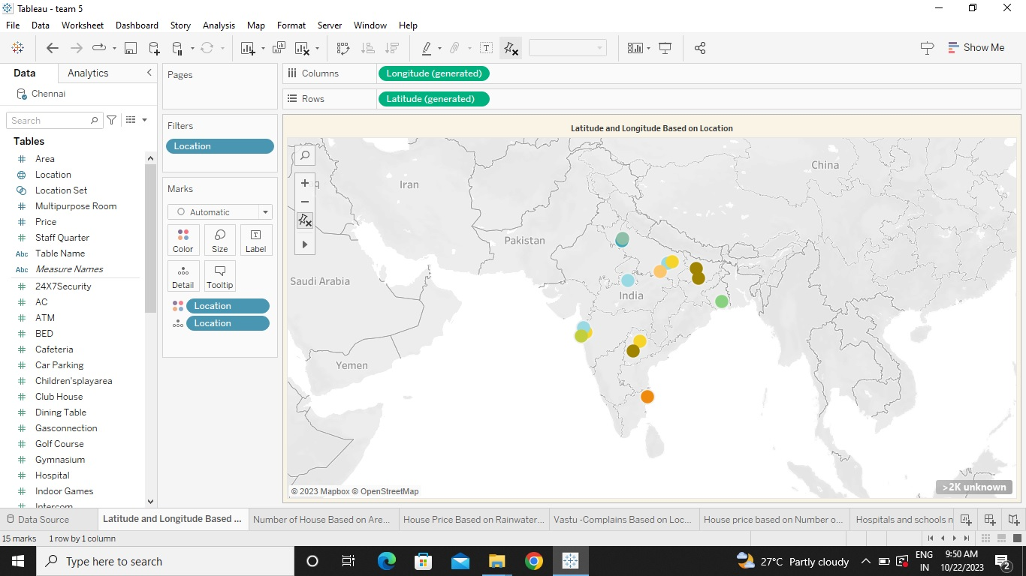
Latitude and Longitude Based on Location

Slide 8
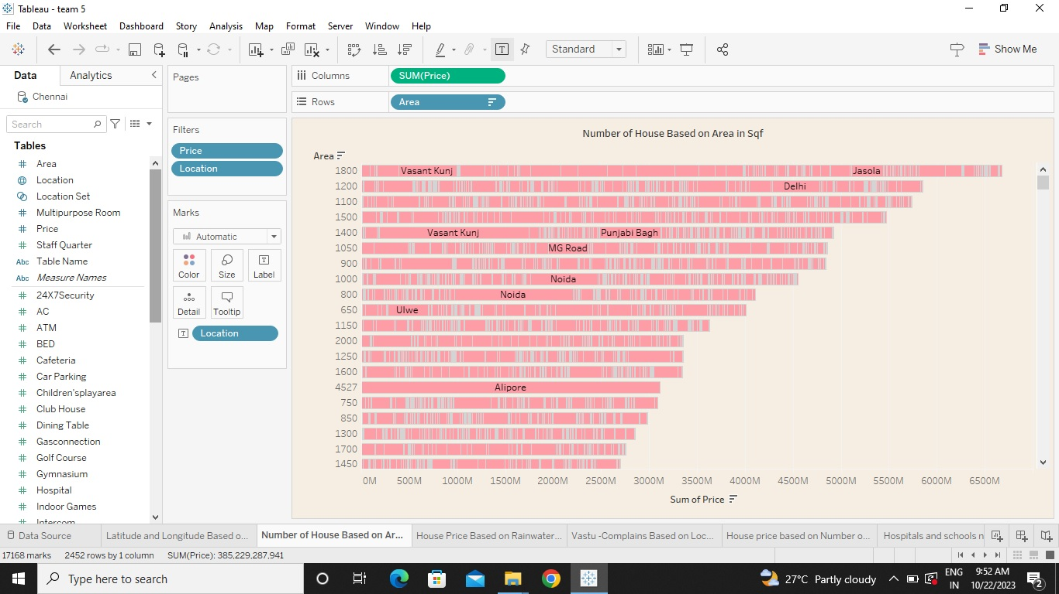
Number of House Based on Area in Sqf

Slide 9
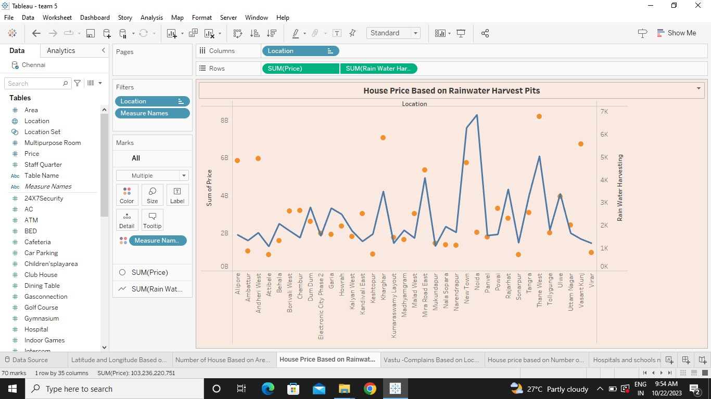
House Price Based on Rainwater Harvest Pits

Slide 10
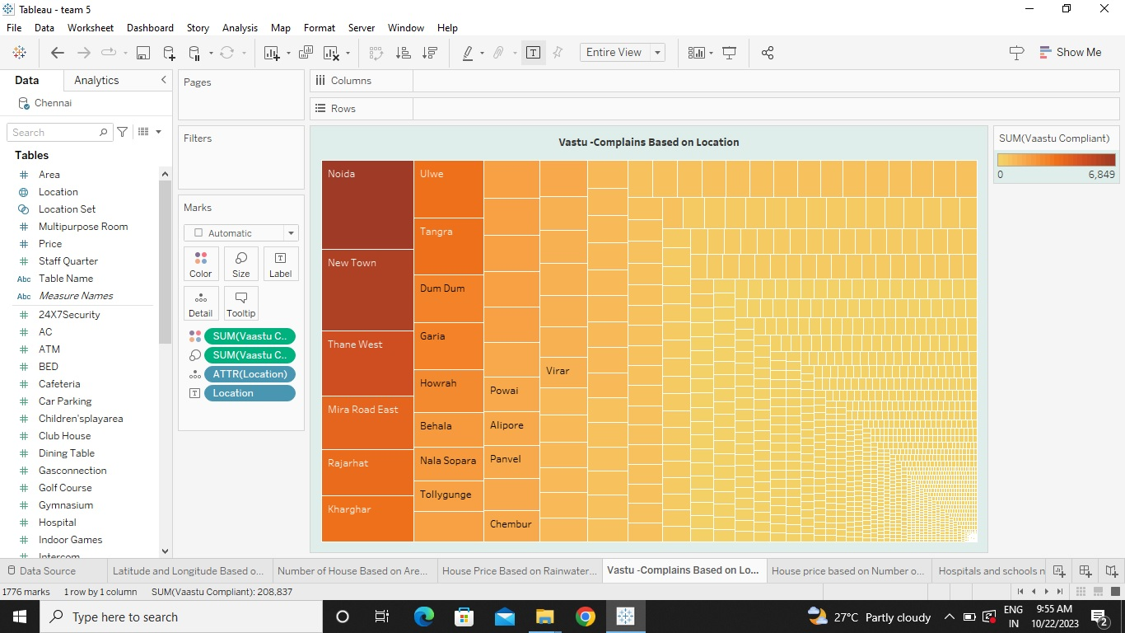
Vastu -Complains Based on Location

Slide 11
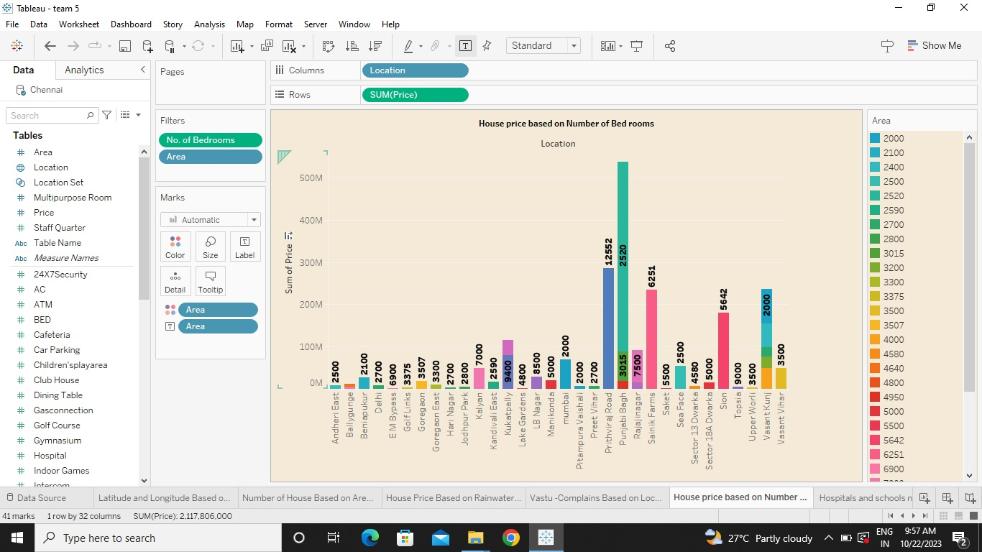
House price based on Number of Bed rooms

Slide 12
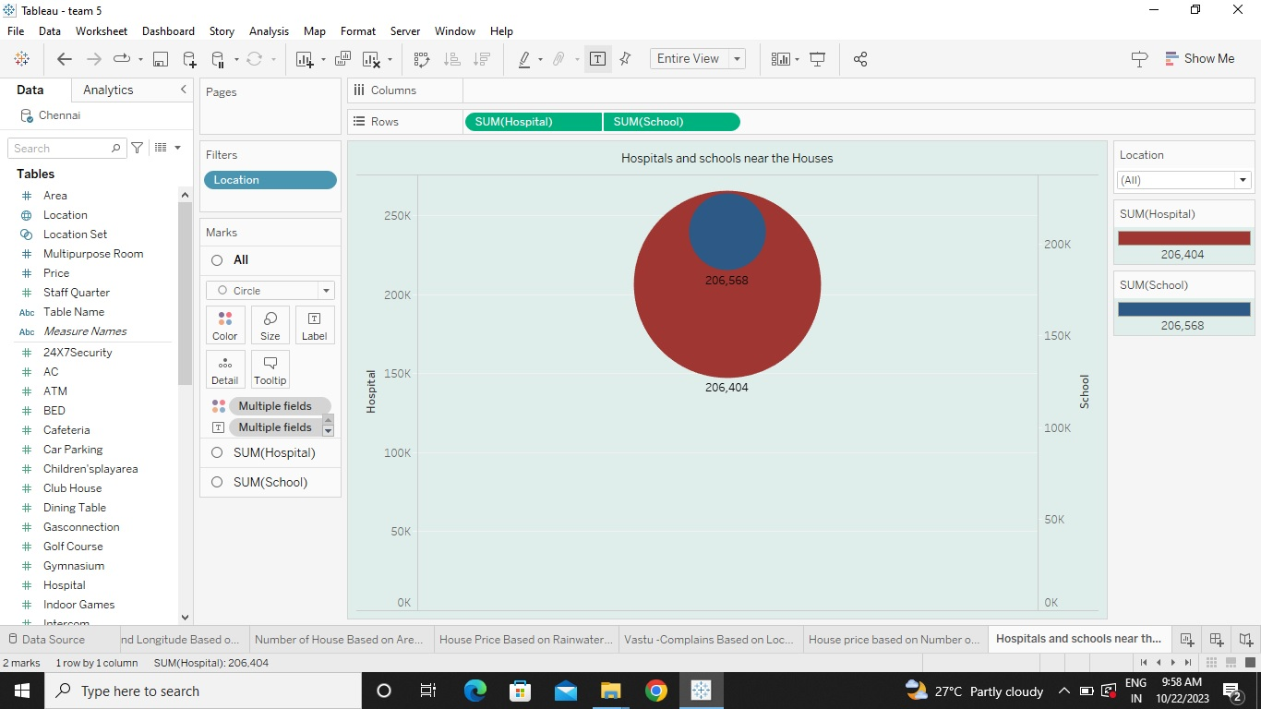
Hospitals and schools near the Houses

Slide 13
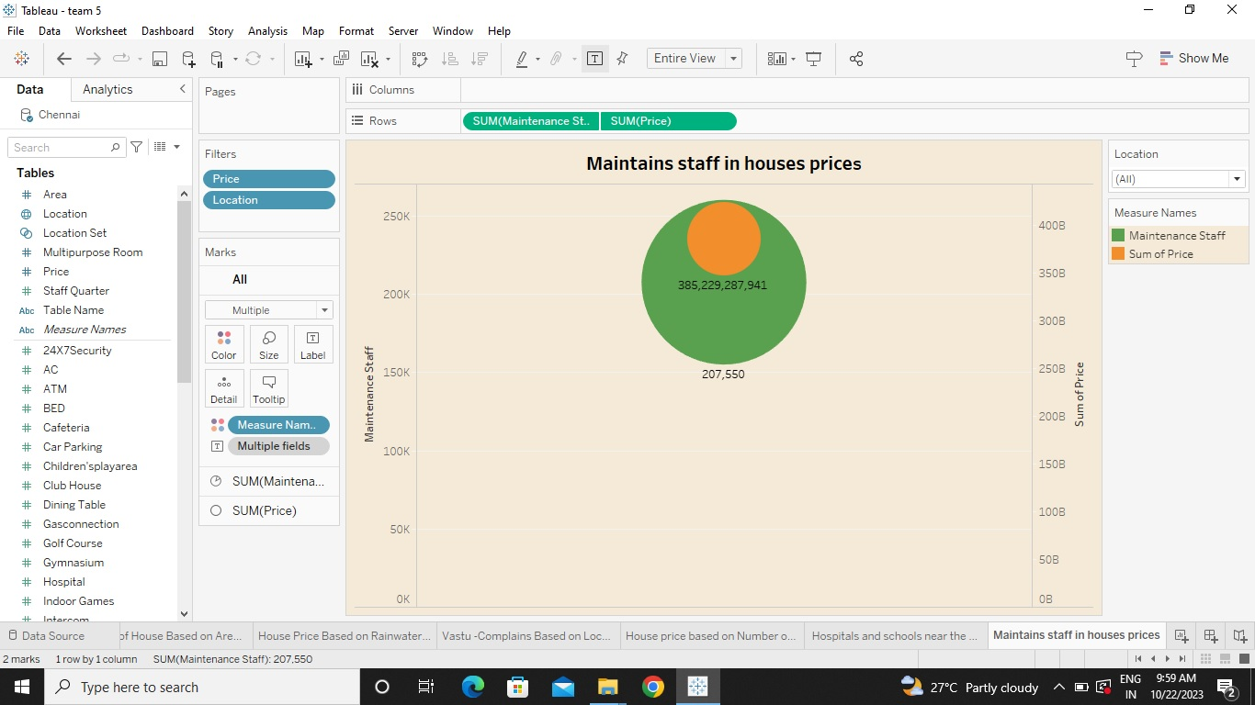
Maintains staff in houses prices

Slide 14
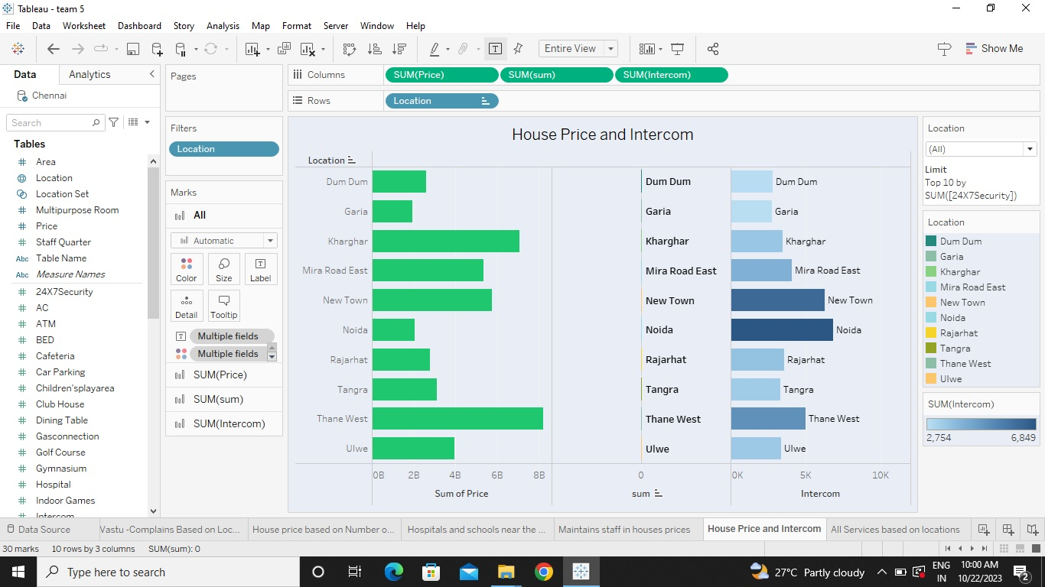
House Price and Intercom

Slide 15
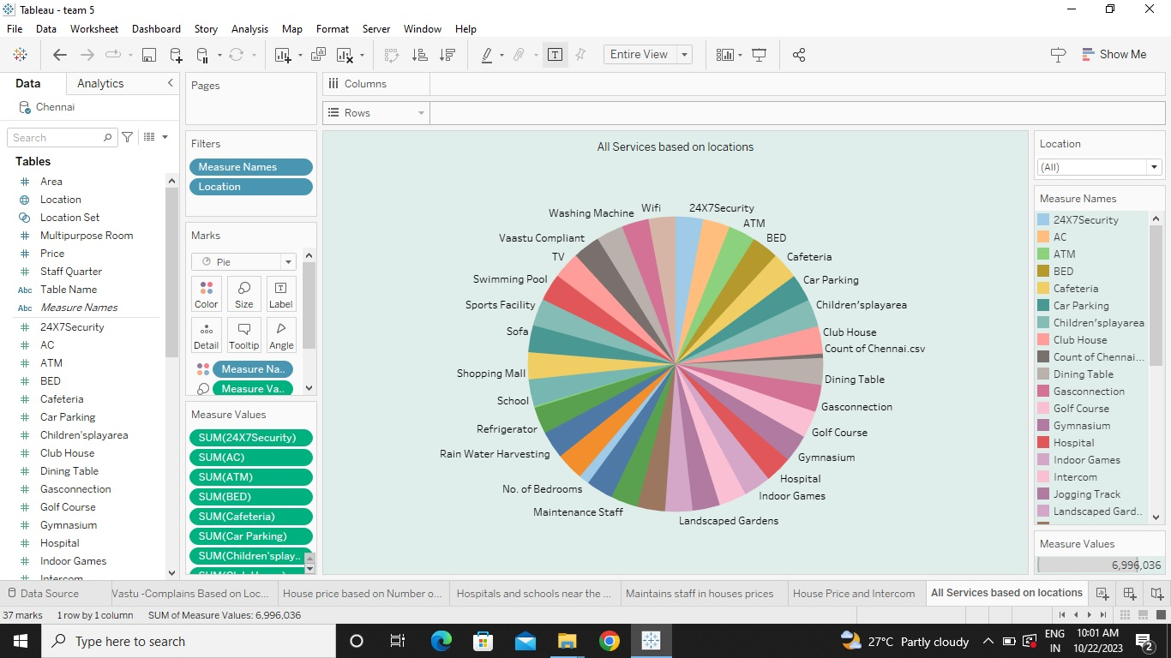
All Services based on locations

Slide 16
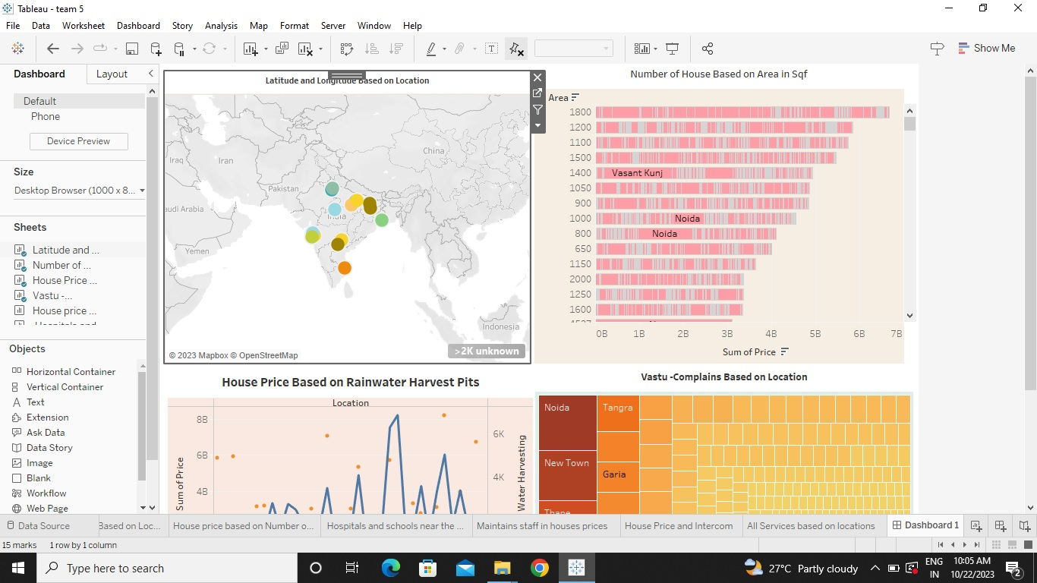
DASHBOARD

Slide 17
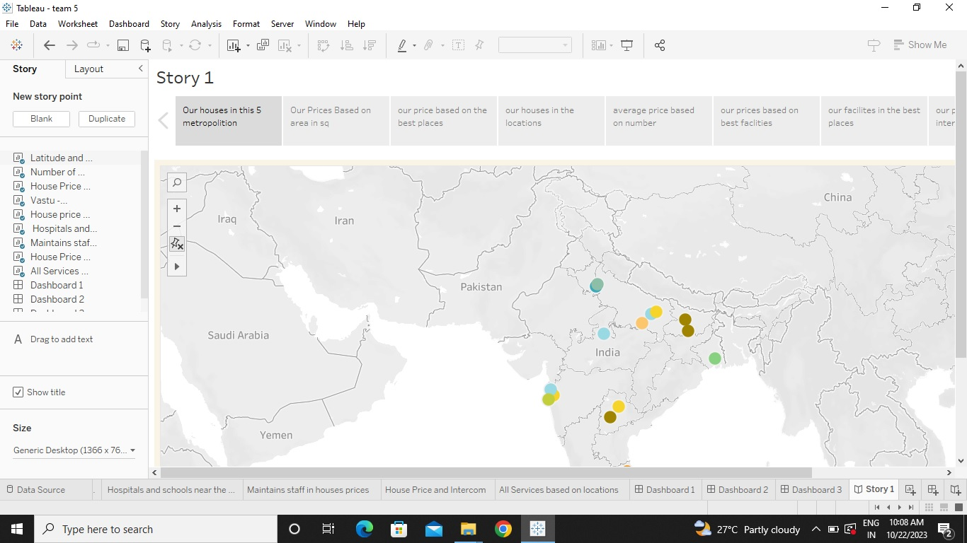
STORY

Slide 18
CONCLUSION
This paper analyzes whether the Law of One Price (LOOP) holds in the housing market of fifteen metropolitan areas in India, namely Delhi, Mumbai, Bengaluru, Kolkata, Chennai, Jaipur,
Lucknow, Hyderabad, Pune, Surat, Ahmedabad, Patna, Faridabad, Kochi and Bhopal. We test the existence of LOOP using the Im, Pesaran and Shin (2003) panel unit root test based on quarterly data on residential property prices covering the period of 2018Q1 to 2023Q4 of the Indian housing market. Based on the criterion of price convergence, house prices in the 15 metropolitan cities do not converge to the LOOP. This implies that the housing markets in the different areas operate as segmented independent local markets. Therefore, house prices in one location in India cannot impose a competitive constraint on house prices in other location, and as such a home owner can freely set the price of his house.

