Slide 1
STACWARS • HACKATHON
TEAM 404
STACWARS
HACKATHON PROJECT REPORT
PRESENTED BY
404: Brain not Found
YOGITA
PREET MIDHA
NIMISHA SHELKE
NARAYNI PATIL
LAVANYA KASHANWAL
SAME TEAM. DIFFERENT MISSIONS.

Slide 2
404: BRAIN NOT FOUND • OPERATION EMBER ASCENT
01
A 1 kg payload reached a 4 km-class apogee
Two-stage sounding rocket simulated in OpenRocket under Mustafar’s extreme atmospheric conditions
4,052 m
174 m/s
42.5 s
6.04 m/s
SIMULATED APOGEE
PEAK VELOCITY
TIME TO APOGEE
DESCENT SPEED
DESIGN THAT MET THE MISSION
KEY DISCOVERY
• Two-stage H73-6 booster + I218-14 sustainer
• 1.0 kg scientific payload
• 54.5 cm long; 5 cm maximum diameter
• Positive static stability margin: +0.131 cal
The calibrated Mustafar model reached over twice the Earth-standard simulated apogee: 4,052 m vs 1,820 m. Lower gravity and thinner air were the main performance advantages.
RESULT: The simulated flight met the report’s target altitude and recovery requirements.

Slide 3
OPERATION EMBER ASCENT • ENVIRONMENT COMPARISON
02
Mustafar’s thin air boosts ascent—but complicates recovery
Simulation comparison: Earth-standard settings versus the full Mustafar environment
MEASURE
EARTH MODEL
MUSTAFAR
WHAT IT REVEALS
Apogee
1,820 m
4,052 m
More than 2× altitude
Peak velocity
132 m/s
174 m/s
Lower drag supports faster ascent
Stability margin
+0.21 cal
+0.131 cal
Stability margin narrows
Descent rate
4.15 m/s
6.04 m/s
Thin air weakens parachute braking
Downrange drift
45 m
10 m
Different wind/flight response in model
ENVIRONMENT USED
ENGINEERING TAKEAWAY
g = 6.50 m/s² • density = 0.374 kg/m³ • temperature = 700 K
Parachute sizing and directional stability must be tuned for the local atmosphere.

Slide 4
STAC PS3 • EXOPLANET TRANSIT ANALYSIS
03
Periodic brightness dips reveal three candidate planets
Transit depth estimates planetary size; repeat timing estimates orbital period
SYSTEM
PERIOD
TRANSIT DEPTH
PLANET RADIUS
INFERRED CLASS
STAC-1 b
4.25 days
0.30%
5.98 R⊕
Neptune-sized
STAC-2 b
80 days
0.10%
2.76 R⊕
Super-Earth / mini-Neptune
STAC-3 b
37.5 days*
~0.09%
1.64 R⊕
Super-Earth
STAC-3: ANOMALOUS SIGNAL
OUR INTERPRETATION
STAC-3’s dips do not stay consistent: depths vary (~0.07–0.10%), and an extra dip appears at day 170 instead of the expected day 180 transit.
A slightly shorter true period (~37.5 days) could make transits drift relative to the observation times. The report also considers edge-crossing geometry; noise or starspots alone may not explain the extra dip.
Caution: the data do not prove the cause. Irregular sampling, measurement noise, stellar activity, or transit geometry are possibilities; more observations are needed.

Slide 5
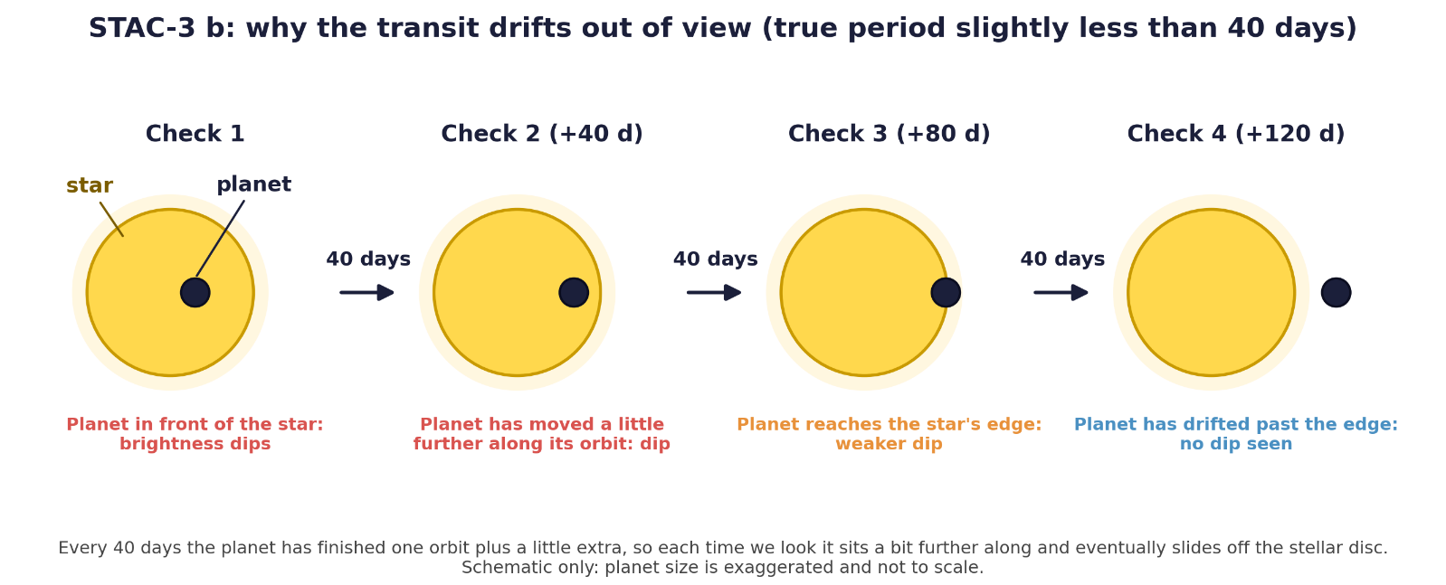

Slide 6
STAC PS3 • HABITABILITY SCREENING
04
STAC-3 b is the strongest candidate—not a confirmed habitable world
The report selects STAC-3 for follow-up based on relative proximity to its estimated habitable zone
STAC-1 b
STAC-2 b
STAC-3 b • SELECTED WITH CAUTION
Orbit: ~0.051 AU
Reference HZ distance: 1.00 AU
Neptune-sized (~5.98 R⊕)
Far inside the reference distance
Orbit: ~0.337 AU
Reference HZ distance: 0.632 AU
~2.76 R⊕
Inside the reference distance
Orbit estimate is uncertain
Transit depths vary (~0.07–0.10%)
Extra dip at day 170; expected day 180 dip is missing
~1.64 R⊕ if the transit interpretation holds
KEY DISCOVERY & DATA LIMITATION
STAC-3 b is our best relative candidate for follow-up, but its irregular light curve makes the period and orbit less secure. The data suggest a possible planet—not confirmed habitability.
NEXT STEP
Collect more frequent, precise observations around predicted transits to test the ~37.5-day period and rule out noise or stellar activity.

Slide 7


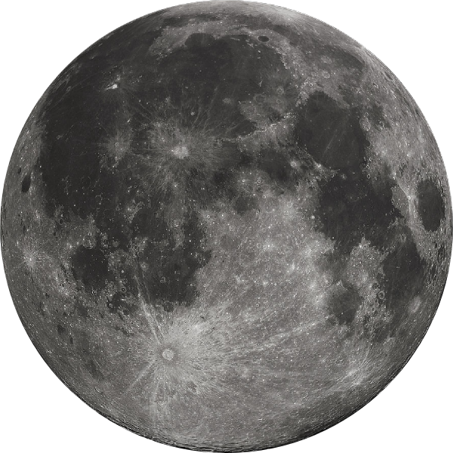
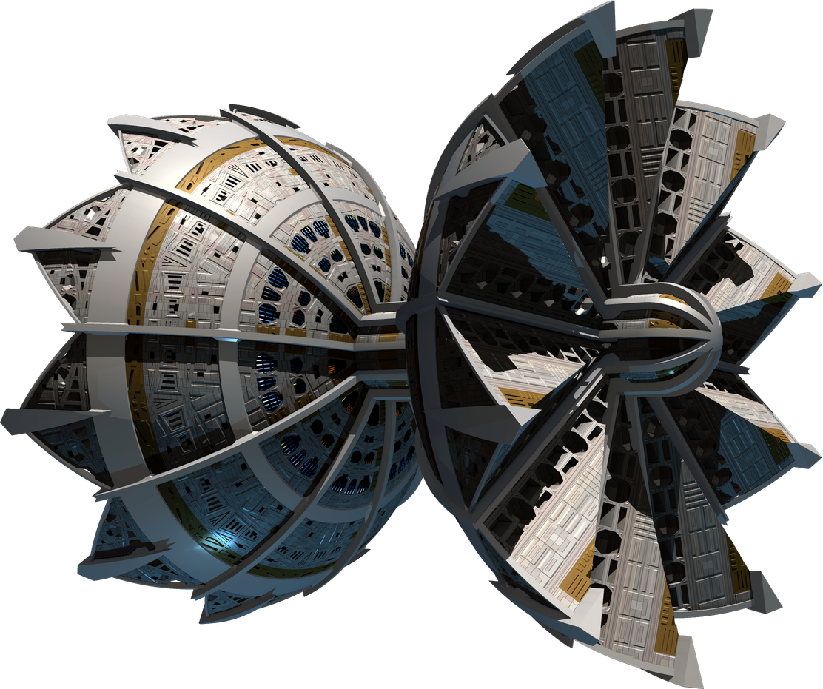
Project NovaOre
Project NovaOre
Earth’s next resource frontier
Beyond Earth. Beyond Limits. Beyond Scarcity.
404: Brain not found

Slide 8
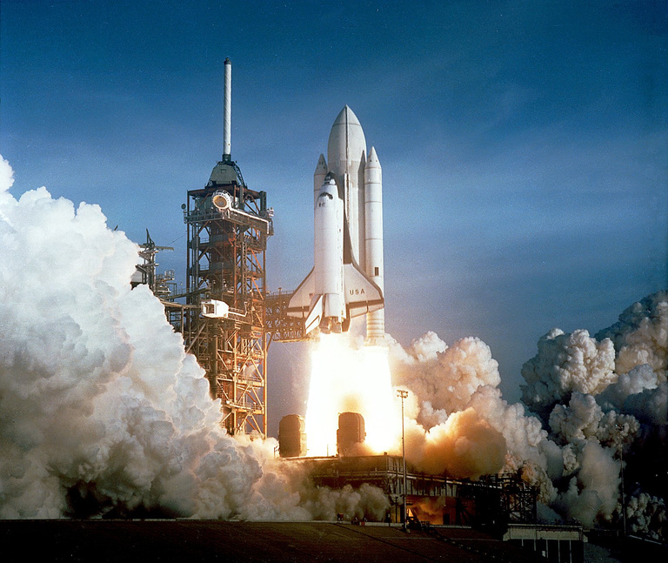
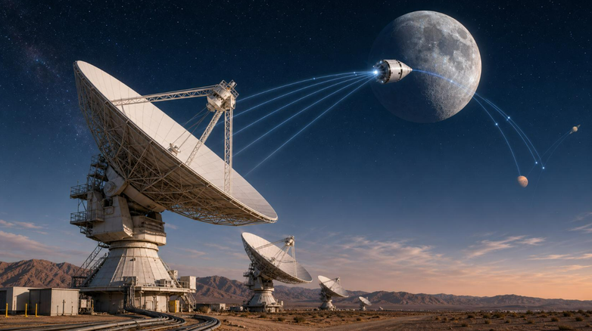
SubPart A - ENGINEERING
BUILD THE MINING ARCHITECTURE
Reaching & Landing & Operation
Communication
  Propulsion system
  Hybrid engines (Solar + Propellant)
  Gripping Mechanism
  Spectroscopic sensors: detect level of the ore on asteroids
  Radio Antennas and Relay satellites
  Mining Probes will indepently perform routine tasks
  Equipment Failure: monitoring of temperature, power motors and propulsion.
  Backup systems and auto-fault detection
  Refining - Done on the Carrier (Majorly)
  Some is done during extraction itself using magnets & other tech
  Semi-refined ores taken to lunar base for refining using solar mirrors to remove sludge from ores
  Using Delay/Disruption Tolerant Networking (DTN)
  The rover / spacecraft could carry:
  visible & infrared spectrometers
  X-ray fluorescence (XRF)
  Neutron & gamma-ray instruments
  Radars, cameras & thermal sensors
  Optical navigation
  LiDAR: Laser pulses → generate surface maps
  Inertial Measurement Units(IMUs): Gyroscopes & accelerometers

Slide 9
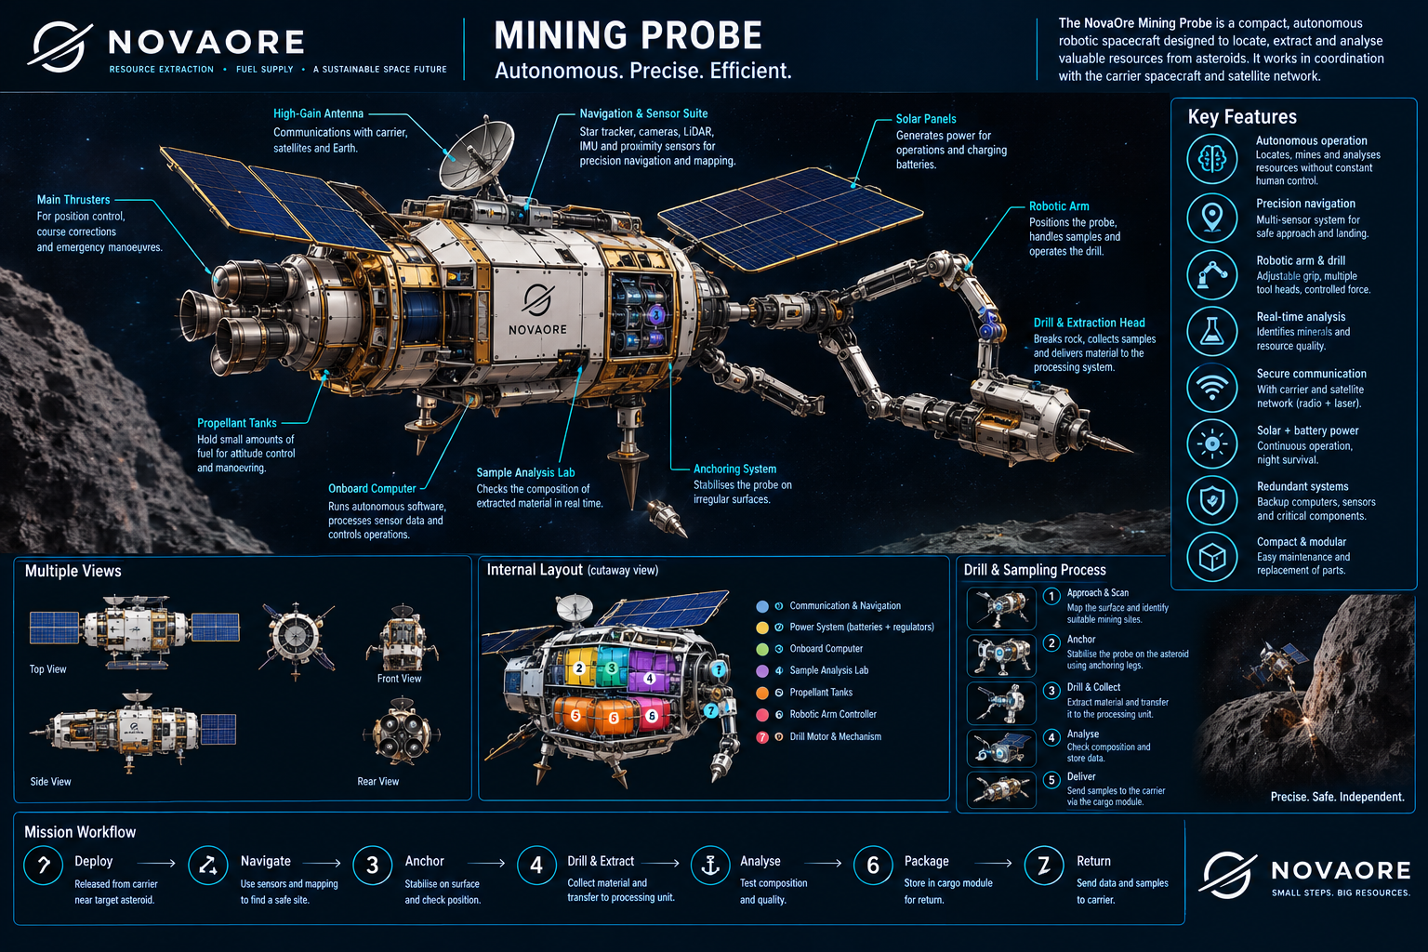

Slide 10
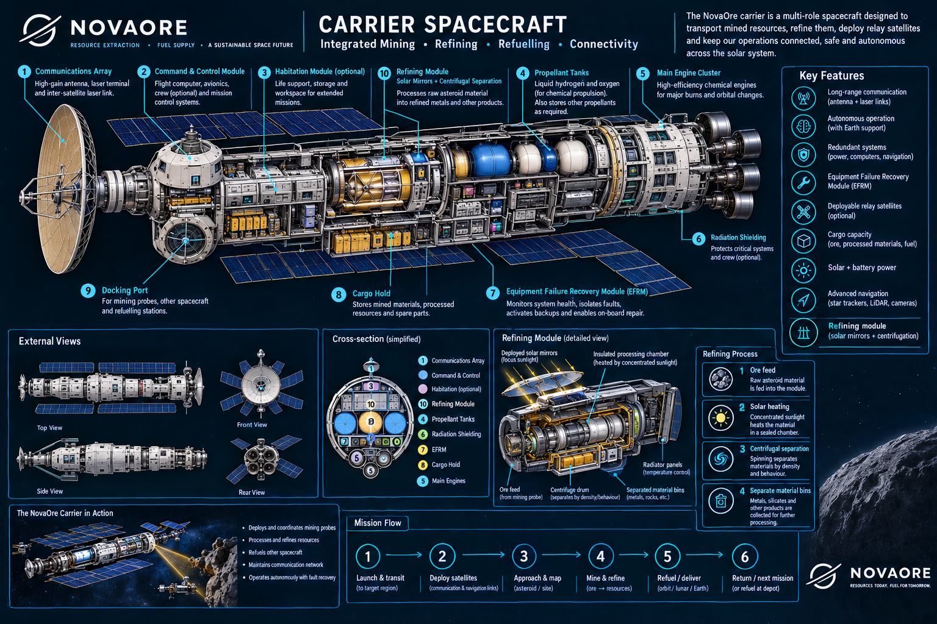

Slide 11
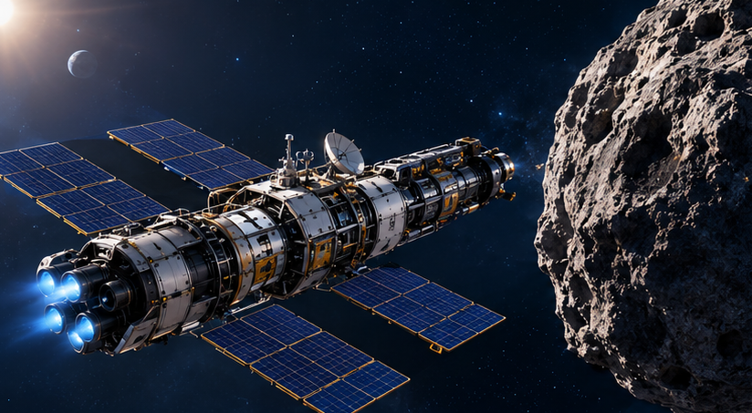
SubPart B
  Communication Cost
Instead of sending multiple sattelites in space to keep track of our carriers and probes, we will integrate them within our carriers which will result in more targeted communication.
Major Cost Drivers
  Fuel Cost → Expensive
HYBRID SYSTEM- (less fuel means less thrust tho)
We solve that by making use of the water ice we mine
  Making a Lunar Base will be Expensive
(kind of like a Space Pump-- lookout for this in our buisness proposal)
We reduce fuel cost for refining by using solar mirrors and a centrifugation process
Hence we proposed integration of our refining systems in our carriers initially, until we get some capital flowing
  Transportation Cost
Launching from Earth is EXPENSIVE
·Surface gravity: 9.81 m/s², Escape velocity: 11.2 km/s, air resistance
·Rockets need enormous amounts of fuel to lift themselves and their payload.
Launching from the Moon however-
·Surface gravity: 1.62 m/s² (about one-sixth of Earth's), Escape velocity: 2.38 km/s, Virtually no atmosphere, so almost no atmospheric drag.
·A rocket needs much less velocity change to escape the Moon's gravity.
DESIGN FOR MINIMUM COST

Slide 12
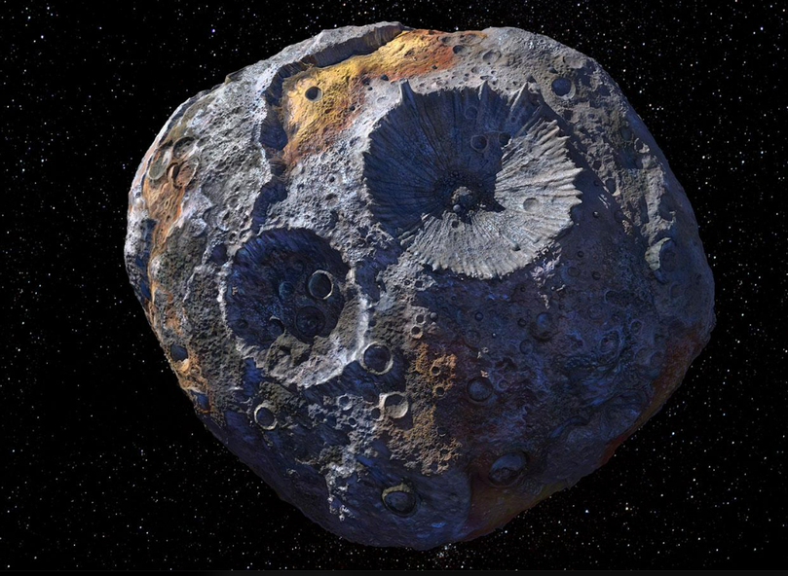
SubPart C
What are we mining?
BUSINESS: Who pays for it?
Majorly:
Ice Water
COSTUMER BASE
Available Platinum, nickel & iron
Space Companies-- companies can reduce the weight of their probes and rockets by relying on our “Space Pumps”.
Industrialists-- since we can mine a lot of Iron and Platinum cheaply in space, iron and platinum needed in space can be supplied by us as well as on earth as environmental concerns come into play.
USE:
Ice water → steam → sold as fuel to space companies
Become a leading supplier of iron and platinum
Making Money ~~
Space Pumps
Orbital Manufacturing
Platinum Monopoly 😈

Slide 13
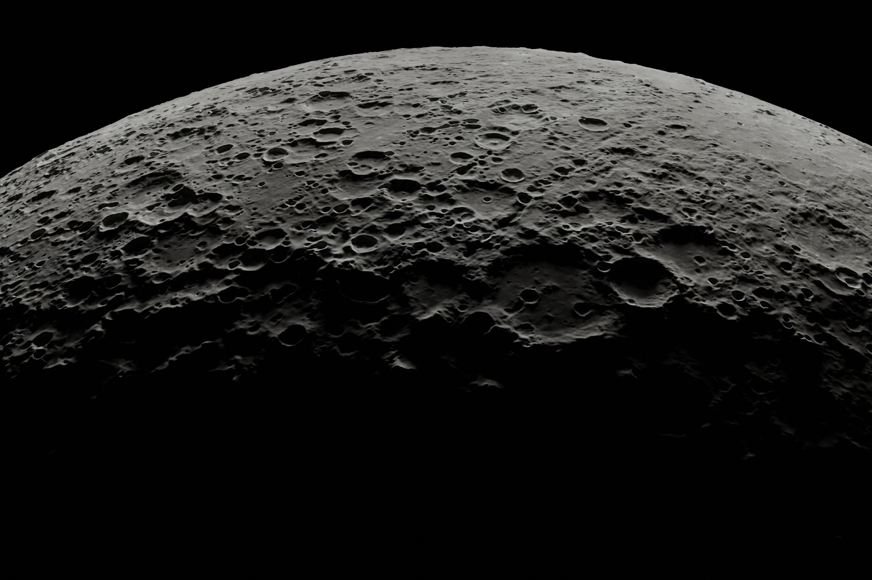
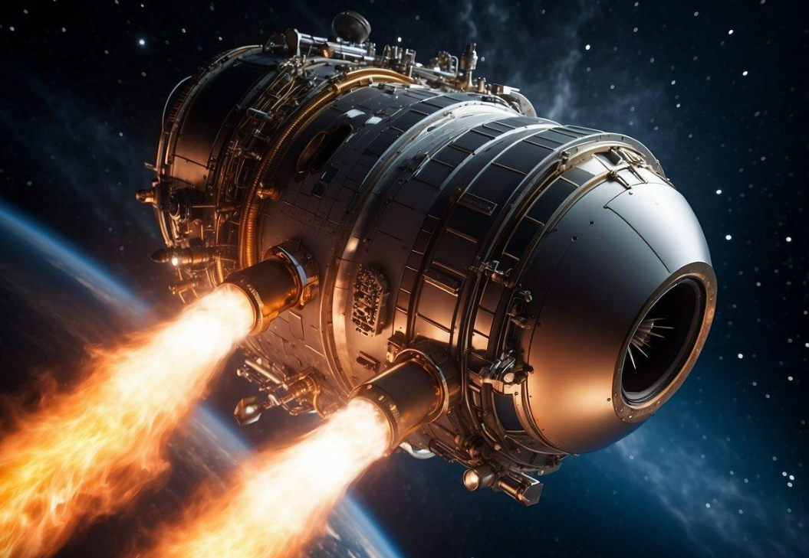
Bonus — “I’ve got a bad feeling about this”
The influx of such amounts of iron and platinum directly in the market might cause it to crash. Therefore, we won’t supply it “ALL” to the market. We plan to keep just enough in the market that the prices decrease by a little and it is profitable to us only.
Once we have monopolized iron and platinum, the world countries could oppose such concentration of resources by us and hence we might get into legal troubles. Therefore we propose to start expansion as soon as we can to get our rovers on the most profitable asteroids, so we have some leverage.

Slide 14


