Slide 1
INSIGHTS

Slide 2
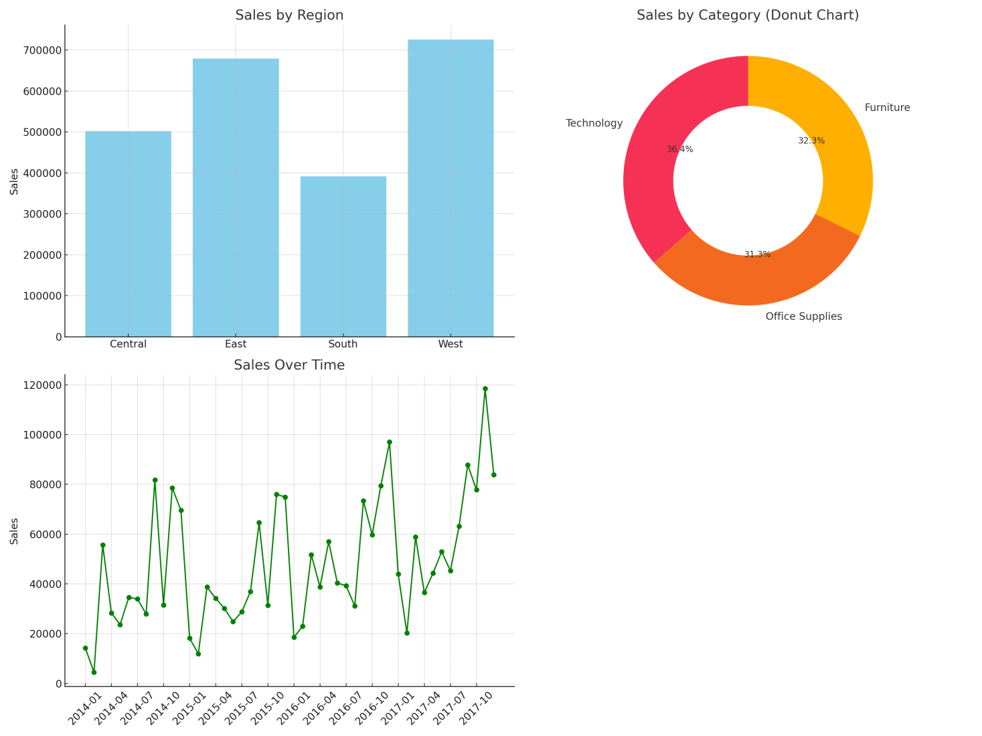
DASHBOARD

Slide 3
DASHBOARD INSIGHTS
Total Sales: Indicates the overall revenue generated. This provides a big-picture view of business performance.
Total Orders: Reflects customer activity and purchasing behavior.
Average Profit: Helps measure profitability on average per order or product essential for assessing cost-effectiveness.

Slide 4
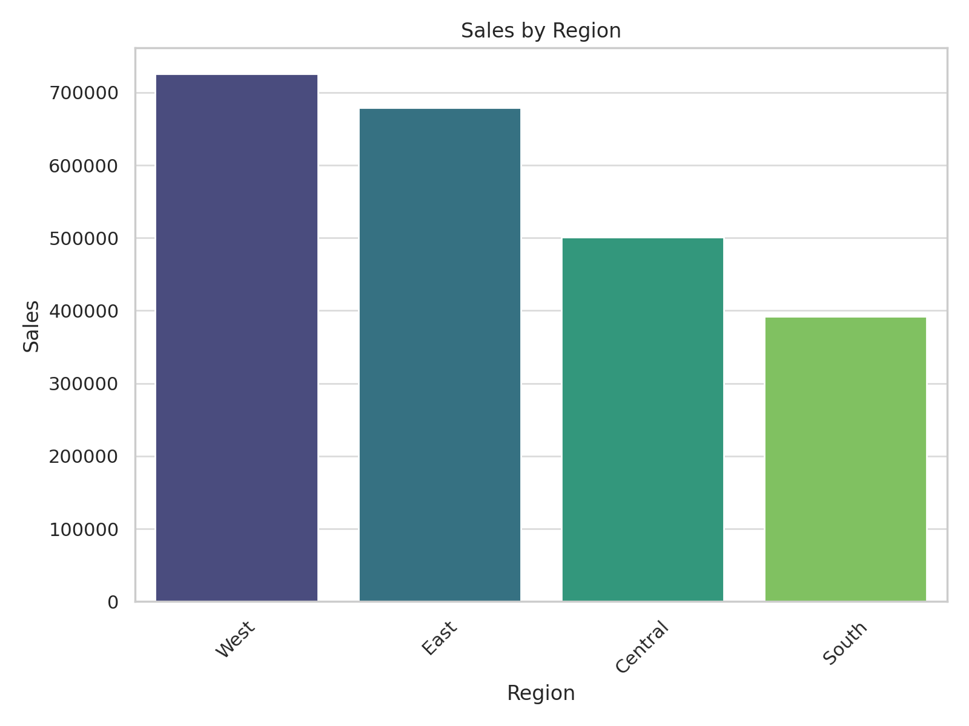
BAR CHART (SALES BY REGION)

Slide 5
BAR CHART INSIGHTS
Top-performing Region: Usually, the West or East tends to lead in sales.
Low-performing Region: Central or South regions often have lower total sales.
Marketing and expansion efforts can be focused on underperforming regions to increase overall sales.

Slide 6
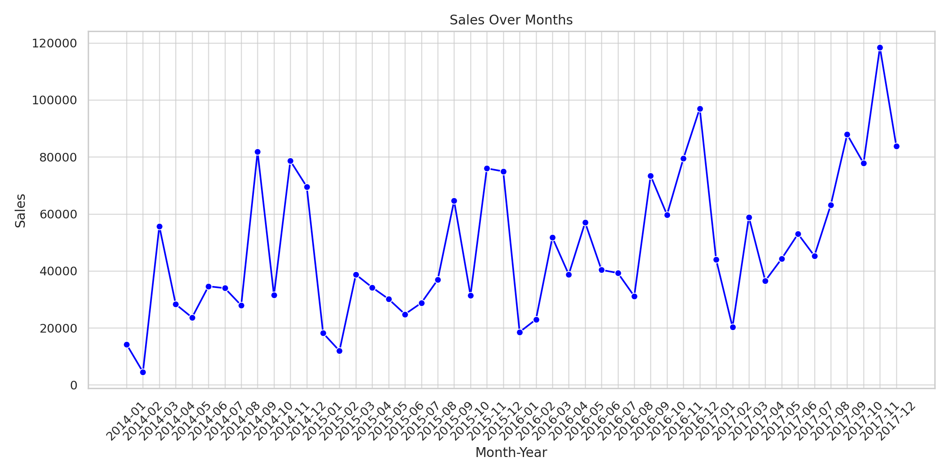
LINE CHART (SALES OVER TIME)

Slide 7
LINE CHART INSIGHTS
Sales may show seasonal spikes, such as during Q4 (October–December) due to holiday shopping.
Identifying months with low sales can help in planning discounts or special offers to balance revenue.

Slide 8
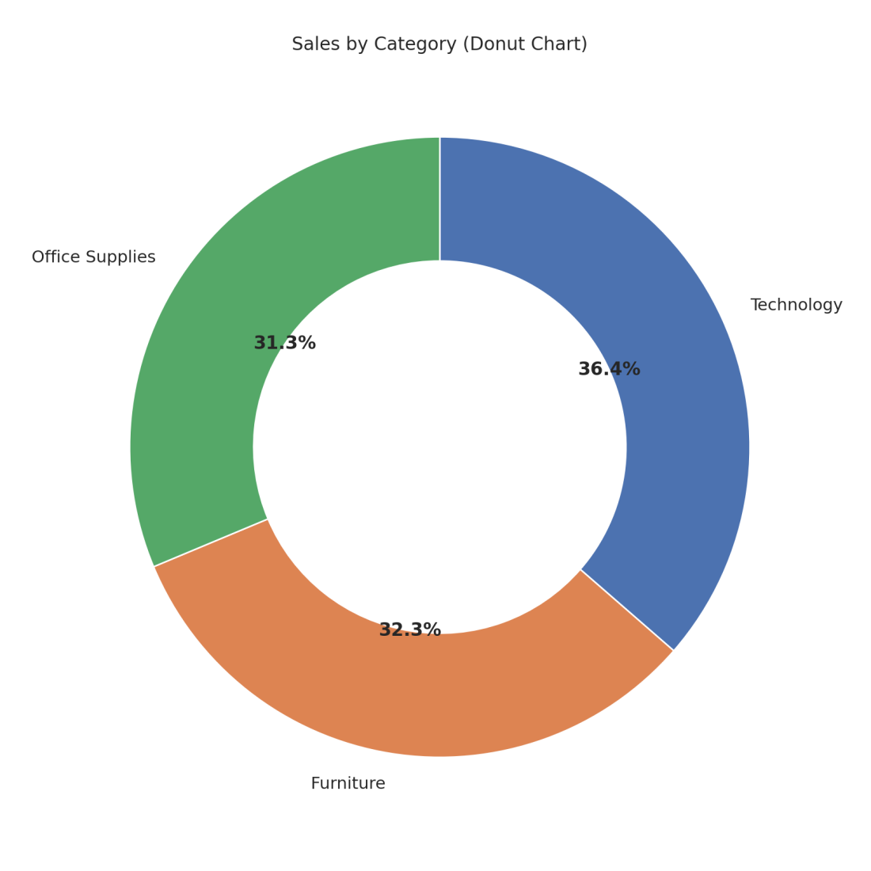
DONUT CHART (SALES BY CATEGORY)

Slide 9
DONUT CHART INSIGHTS
Top Category: Typically Technology generates the highest revenue.
Low Category: Office Supplies might have the lowest share.
High-profit categories like Technology should be prioritized in promotions and inventory planning.

