Slide 1
Sales Performance Overview
E-Commerce Dashboard Insights Summary

Slide 2
Total Sales and YoY Growth
The dataset reveals a strong overall performance, with total sales surpassing $2.26 million.
The YoY sales growth shows a significant upward trajectory, especially from 2016 to 2017, where sales rose by over 30%, followed by a consistent increase into 2018.
The minor dip in 2016 suggests potential operational or seasonal issues but was quickly corrected.

Slide 3
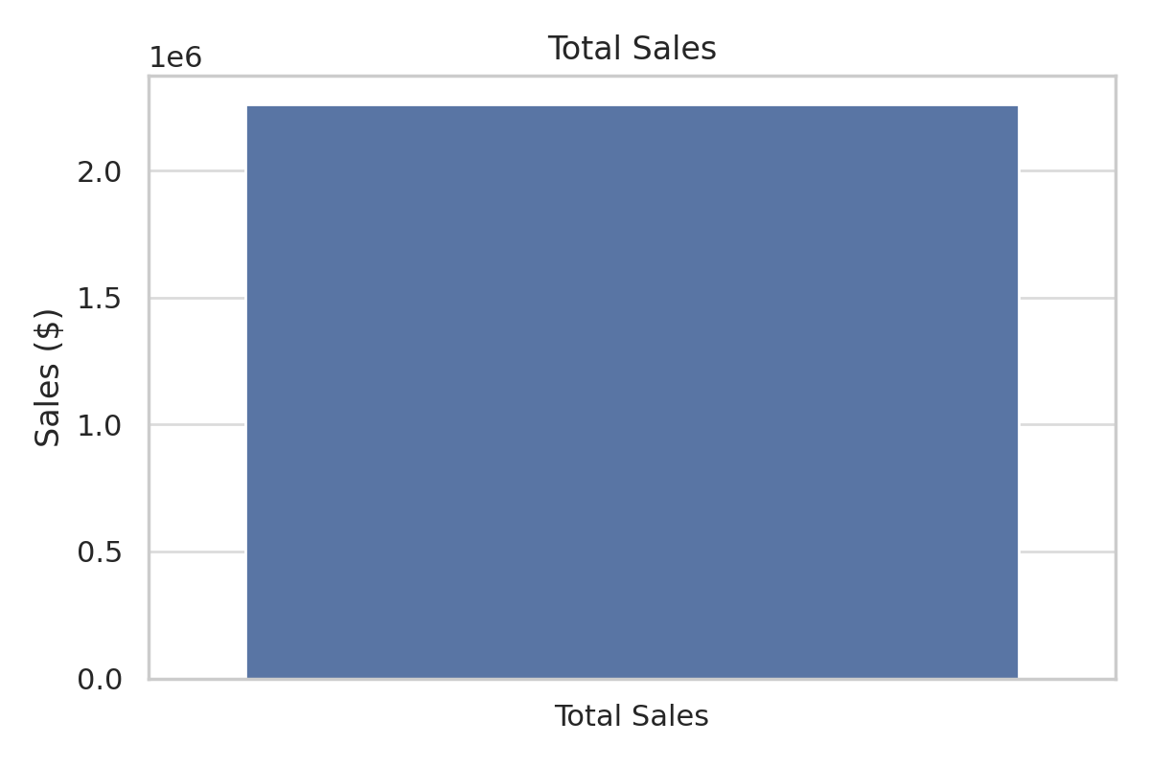
TOTAL SALES

Slide 4
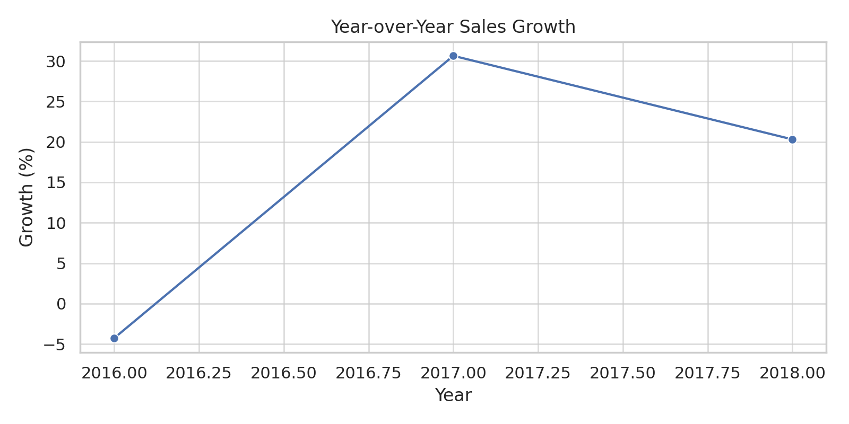
YoY Growth

Slide 5
Sales by Category and Sub-Category
Among the three main product categories—Furniture, Office Supplies, and Technology—Technology leads with the highest sales.
This implies stronger demand and possibly better margins in tech-related products.
Sub-categories like Phones, Chairs, and Storage dominate, highlighting customer preferences and opportunities for targeted promotions.

Slide 6
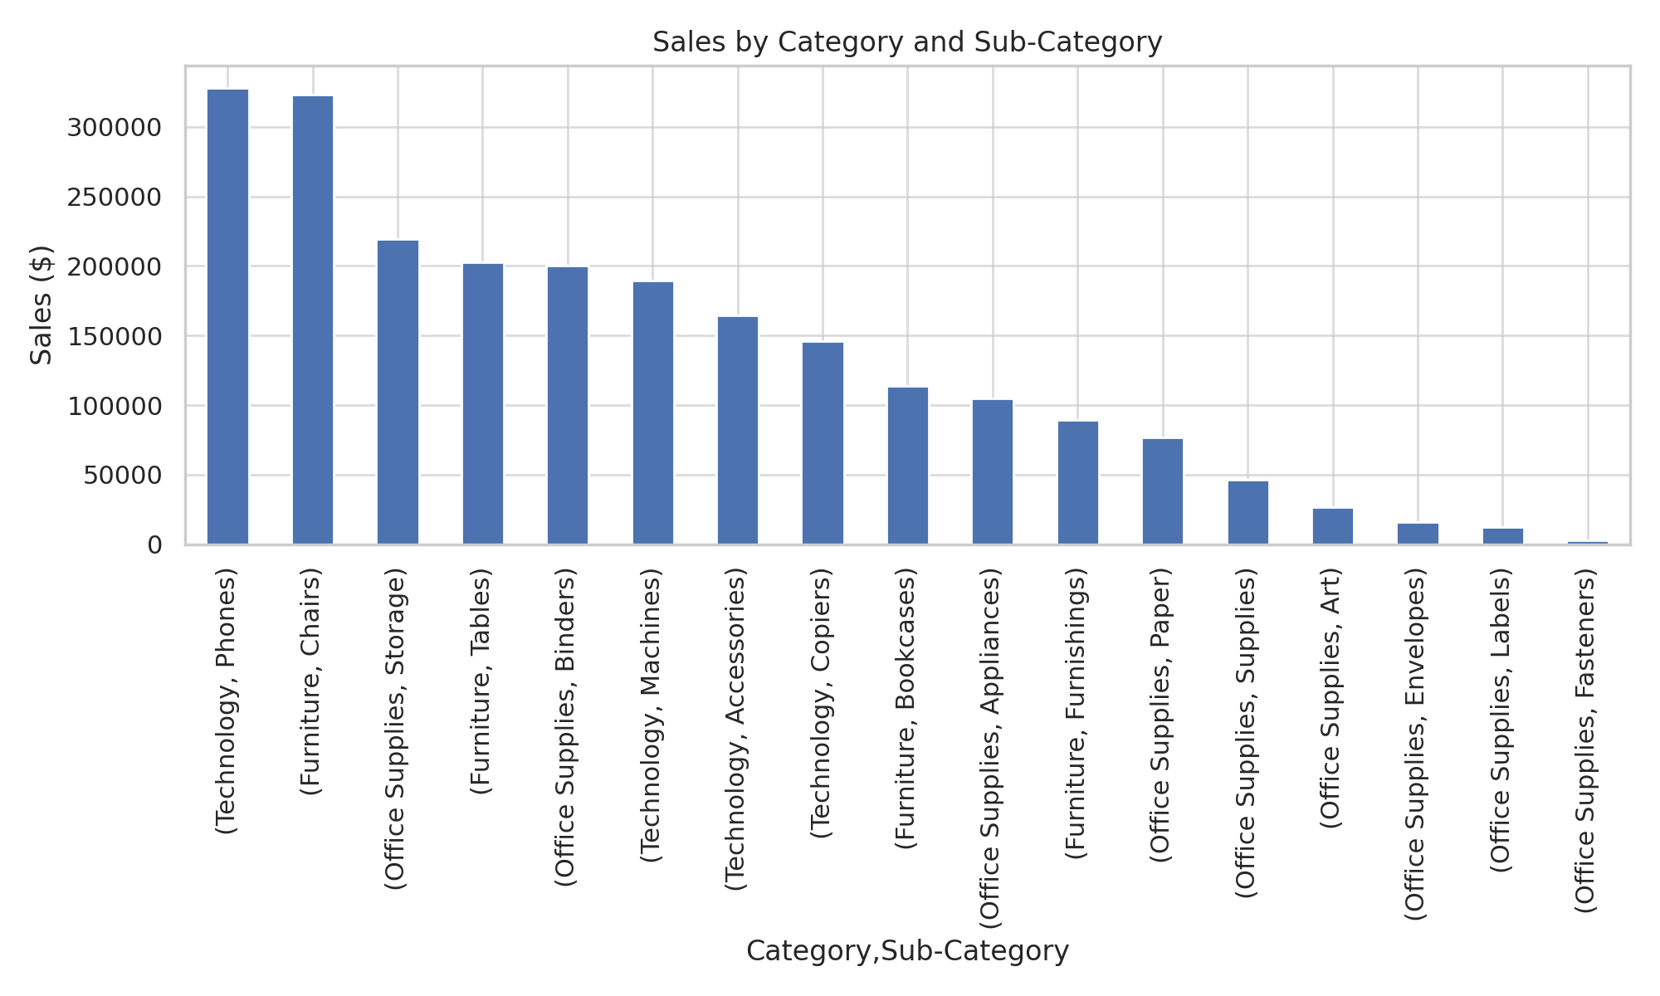
Sales by Category and sub-Category

Slide 7
Sales Trend Over Years
The line chart visualizing sales trends from 2015 to 2018 shows a clear growth pattern, with the steepest incline between 2016 and 2017.
Seasonal peaks suggest potential spikes during Q4, indicating opportunities for optimized inventory and marketing strategies.

Slide 8
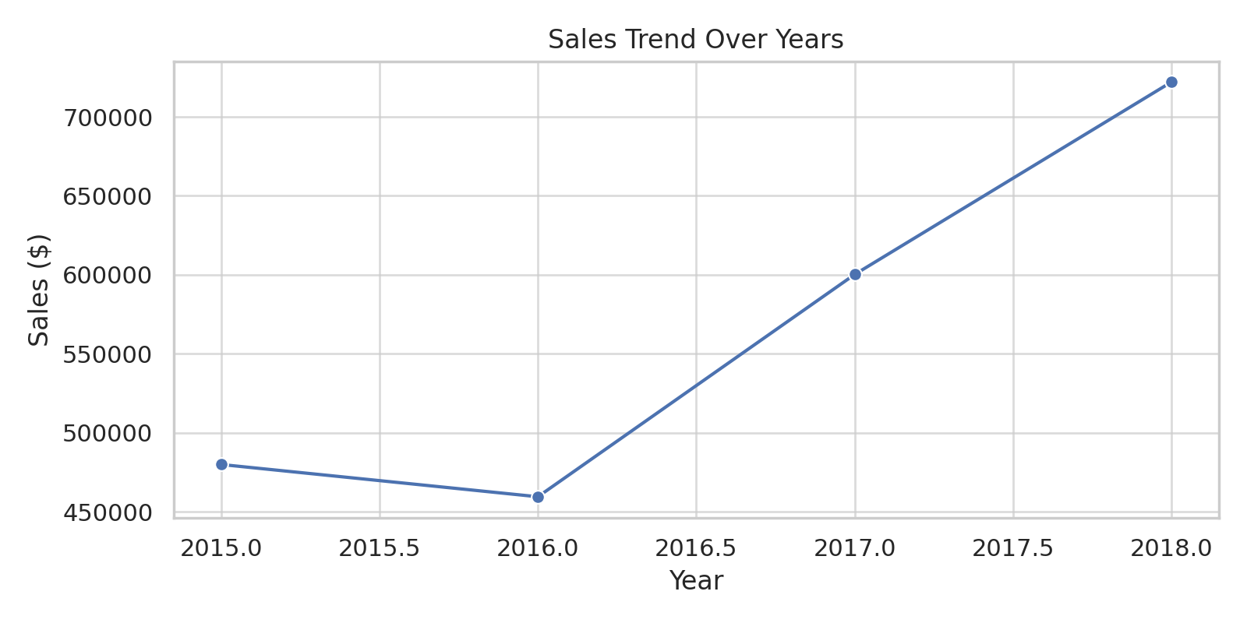
Sales Trend Over Years

Slide 9
Top Performing Cities and States
Geographically, California, New York, and Texas emerge as the top-performing states.
Cities like Los Angeles, New York City, and San Francisco consistently generate high sales volumes.
These areas should be primary targets for launching new products or loyalty programs.

Slide 10
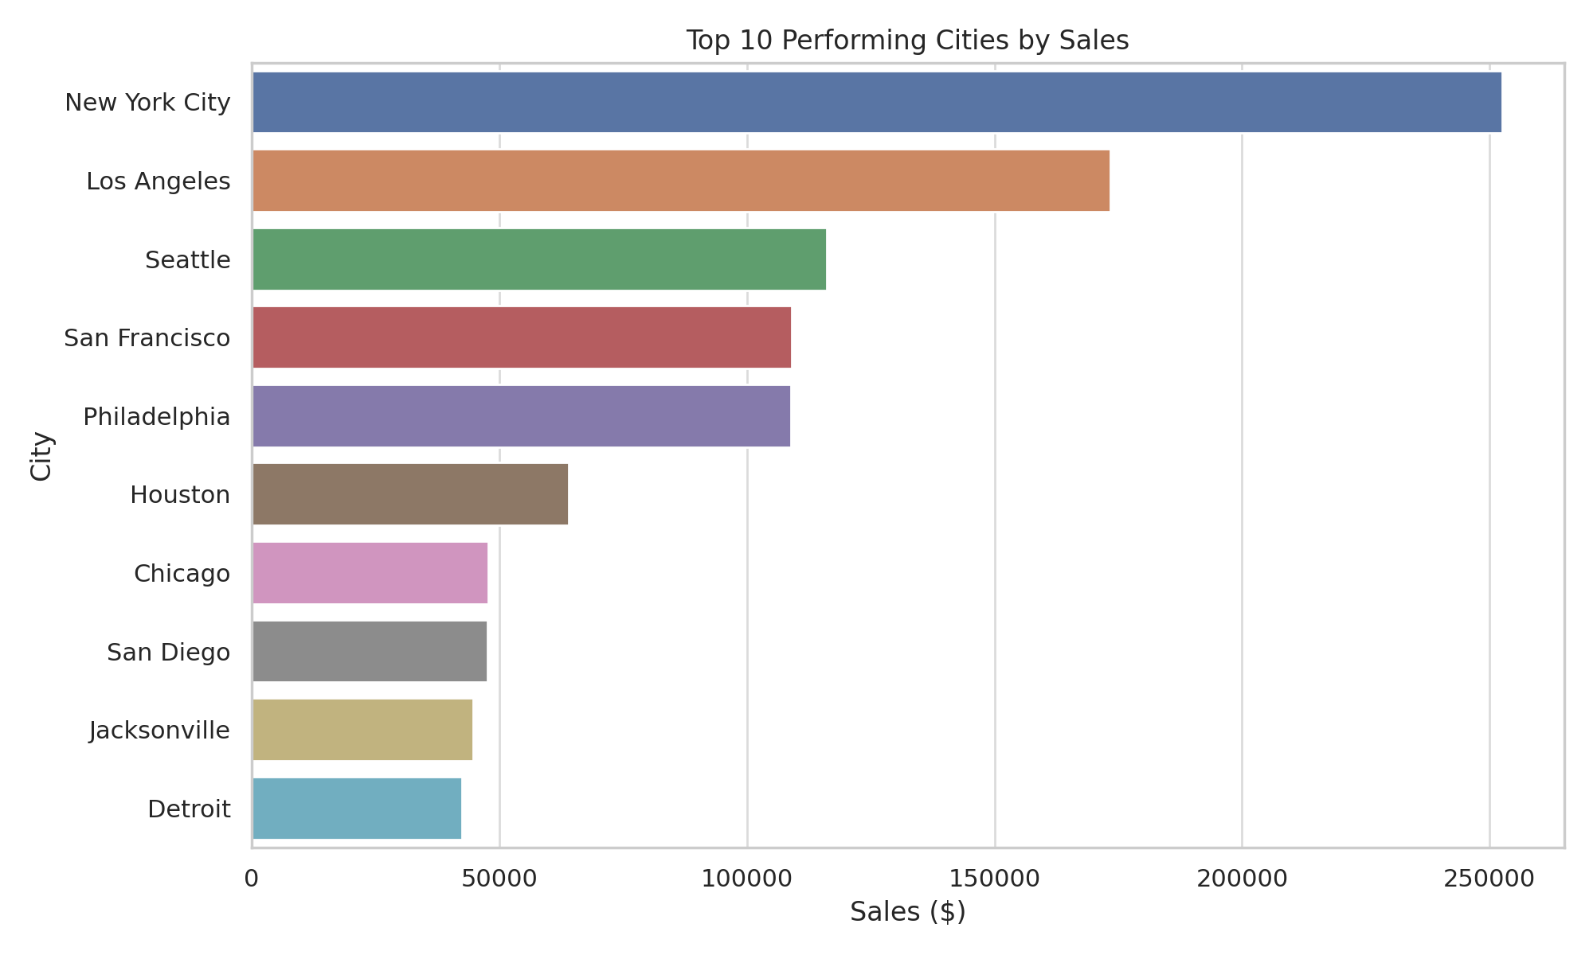
Top 10 Performing Cities by Sales

Slide 11
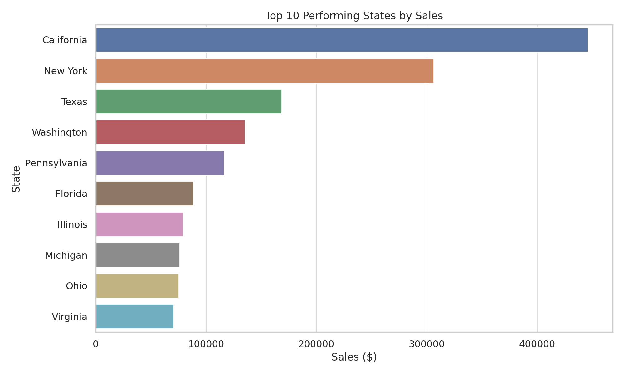
Top 10 Performing States by Sales

Slide 12
Overall Insights
The company is on a solid growth path with strong contributions from the Technology segment and sales concentration in major cities.
To accelerate momentum, focus should be on enhancing supply chains, investing in technology products, and exploring seasonal campaigns.

