Slide 1

SignBridge
AI-Powered Two-Way Sign Language Translator
Project Review 1 & 2 – Consolidated
K. Hasini – 2520090209
L. Lavanya – 2520090009
Y25 • 2026-2027 Trimester 4

Slide 2
Abstract & Introduction
Bridging the communication gap
Communication barriers between sign language users and the wider community remain a significant accessibility challenge, particularly when interpreters are unavailable.
Two-Way Translation
Intelligent Platform
Converts hand gestures into text and speech, and translates text or voice into visual sign representations in real time.
Combines AI-based recognition, confidence-aware translation, personalized learning, and modern backend engineering.

Slide 3
Problem Statement
Why a new approach is needed
Communication barriers persist between sign language users and the hearing community, especially when a human interpreter is unavailable.
Existing tools are typically one-directional: they convert signs to text but do not translate spoken or written language back into sign form.
Most gesture-recognition systems cannot flag uncertain predictions, so misread gestures become confident, incorrect translations.
Deaf and hard-of-hearing people lack a fast, dedicated way to communicate critical or emergency information when interpreters or app support are limited.

Slide 4
Objectives
Two-way translation
Gestures to text/speech, and text or voice to visual signs, in real time.
Reliable recognition
Confidence scoring detects uncertain predictions and prompts a repeat.
Personalized vocabulary
“Teach the AI” lets users add their own gestures.
Emergency communication
Emergency Mode gives quick access to critical phrases.
Secure, scalable platform
Service-oriented architecture with JWT, RBAC and Docker deployment.

Slide 5
Proposed System
A real-time, two-way sign language translation platform
OpenCV and MediaPipe capture hand gestures and extract landmarks; a TensorFlow / TF-Lite model classifies the gesture.
A confidence-scoring mechanism flags uncertain predictions and asks the user to repeat unclear gestures.
A Smart Phrase Builder combines recognized signs into meaningful sentences.
Emergency Mode surfaces critical phrases instantly; “Teach the AI” expands the gesture vocabulary.
Built with React.js, FastAPI and MySQL (SQLAlchemy), secured with JWT authentication and role-based access control.

Slide 6
Hardware & Software Requirements
Capture Hardware
Frontend & API
AI & Vision Stack
Backend & DevOps
Camera-enabled device with enough processor and memory for computer-vision inference; audio output for spoken translations.
React.js frontend with a FastAPI backend for a responsive UI and REST API layer.
OpenCV and MediaPipe for hand landmarks; TensorFlow/Keras or TF-Lite for gesture classification.
MySQL with SQLAlchemy ORM, JWT, RBAC, Docker deployment, API docs, testing and monitoring.

Slide 7
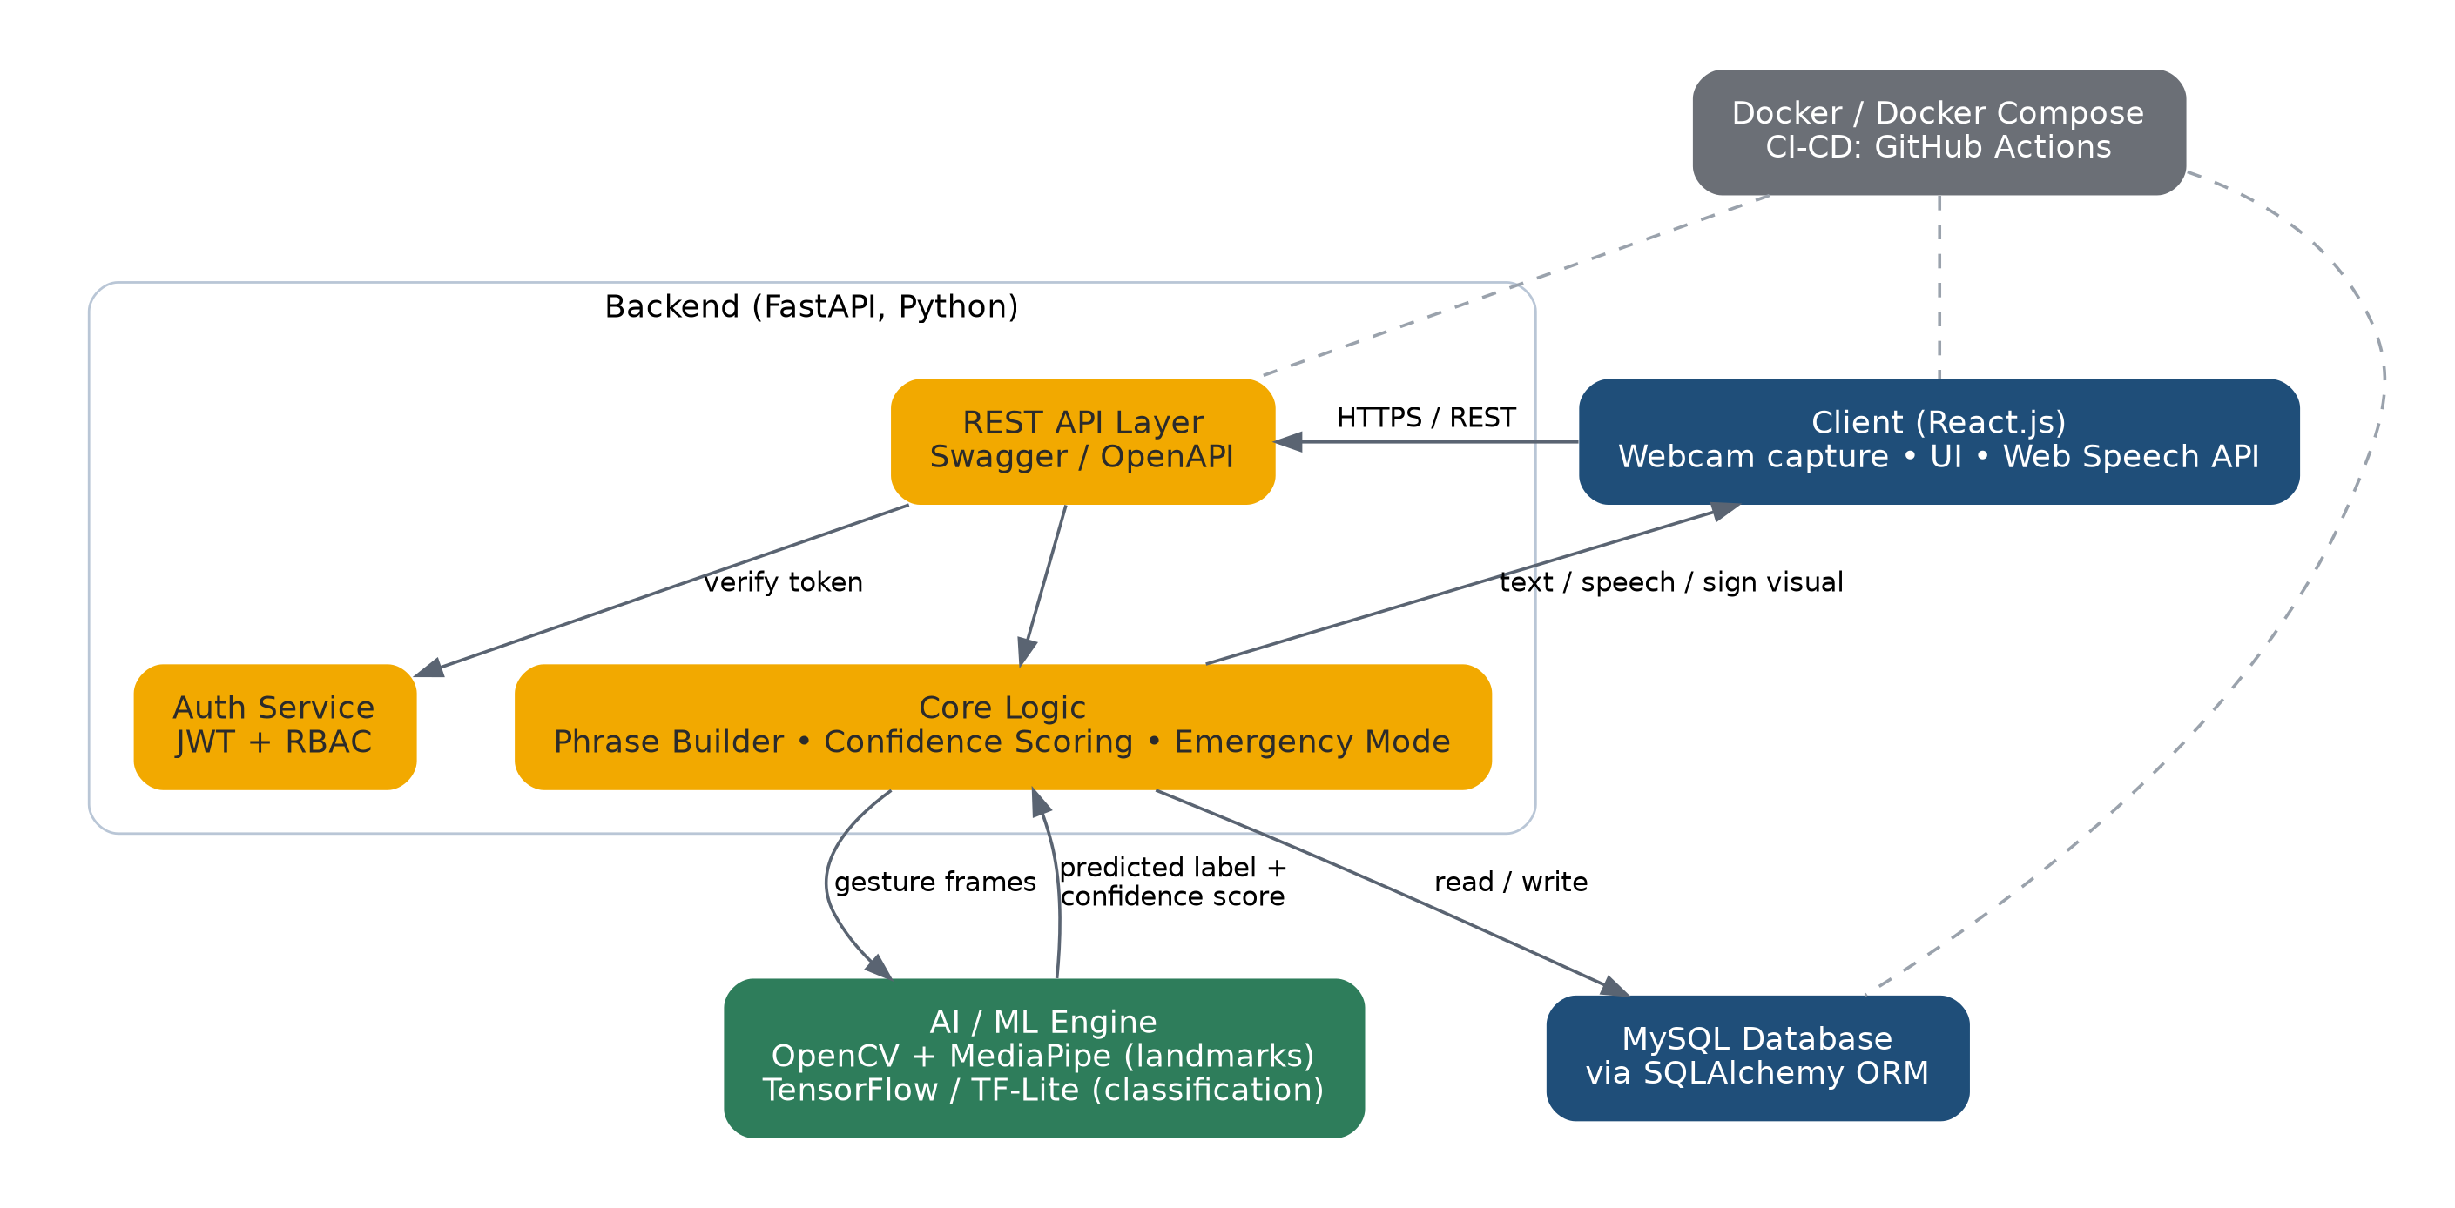
System Architecture
React client • FastAPI backend • AI/ML engine • MySQL

Slide 8
Key System Capabilities
From gesture capture to a meaningful sentence, with confidence checks at every stage
Capture Landmarks
›
Classify Gesture
›
Score Confidence
›
Build Phrase
Landmark Recognition
Smart Phrase Builder
OpenCV + MediaPipe capture precise hand landmarks for the TensorFlow classifier.
Combines recognized signs into grammatically coherent sentences.
Emergency Mode
Teach the AI
One-tap access to critical preset phrases for time-sensitive situations.
Users add personalized gestures beyond the default sign set.

Slide 9
Modules / Functionalities
Gesture Recognition Engine
Two-Way Translation Engine
OpenCV + MediaPipe landmarks, TensorFlow / TF-Lite classifier
Gesture → text/speech and text/voice → sign visual
Confidence Feedback Loop
Smart Phrase Builder
Flags low-confidence predictions; user can correct them
Joins recognized signs into a coherent sentence
Emergency Mode
Teach the AI
One-tap access to critical predefined phrases
Users add and label personalized custom gestures
Authentication & RBAC
Dashboard & Sign Library
JWT login with admin / user / guest roles
Known signs, saved phrases, translations, custom gestures

Slide 10
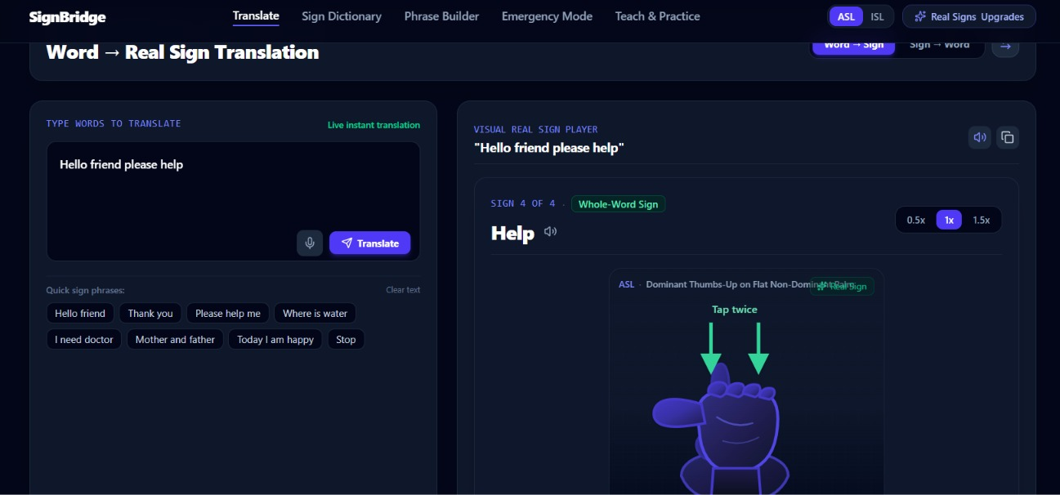
Frontend Design & Implementation
Live dashboard built with React.js
Dashboard / Home: quick launch and live usage stats
Translate: real-time gesture-to-text/speech
Phrase Builder: combine signs into sentences
Emergency Mode: one-tap critical phrases
Teach the AI: add custom gestures
Sign Library: browse all known signs

Slide 11
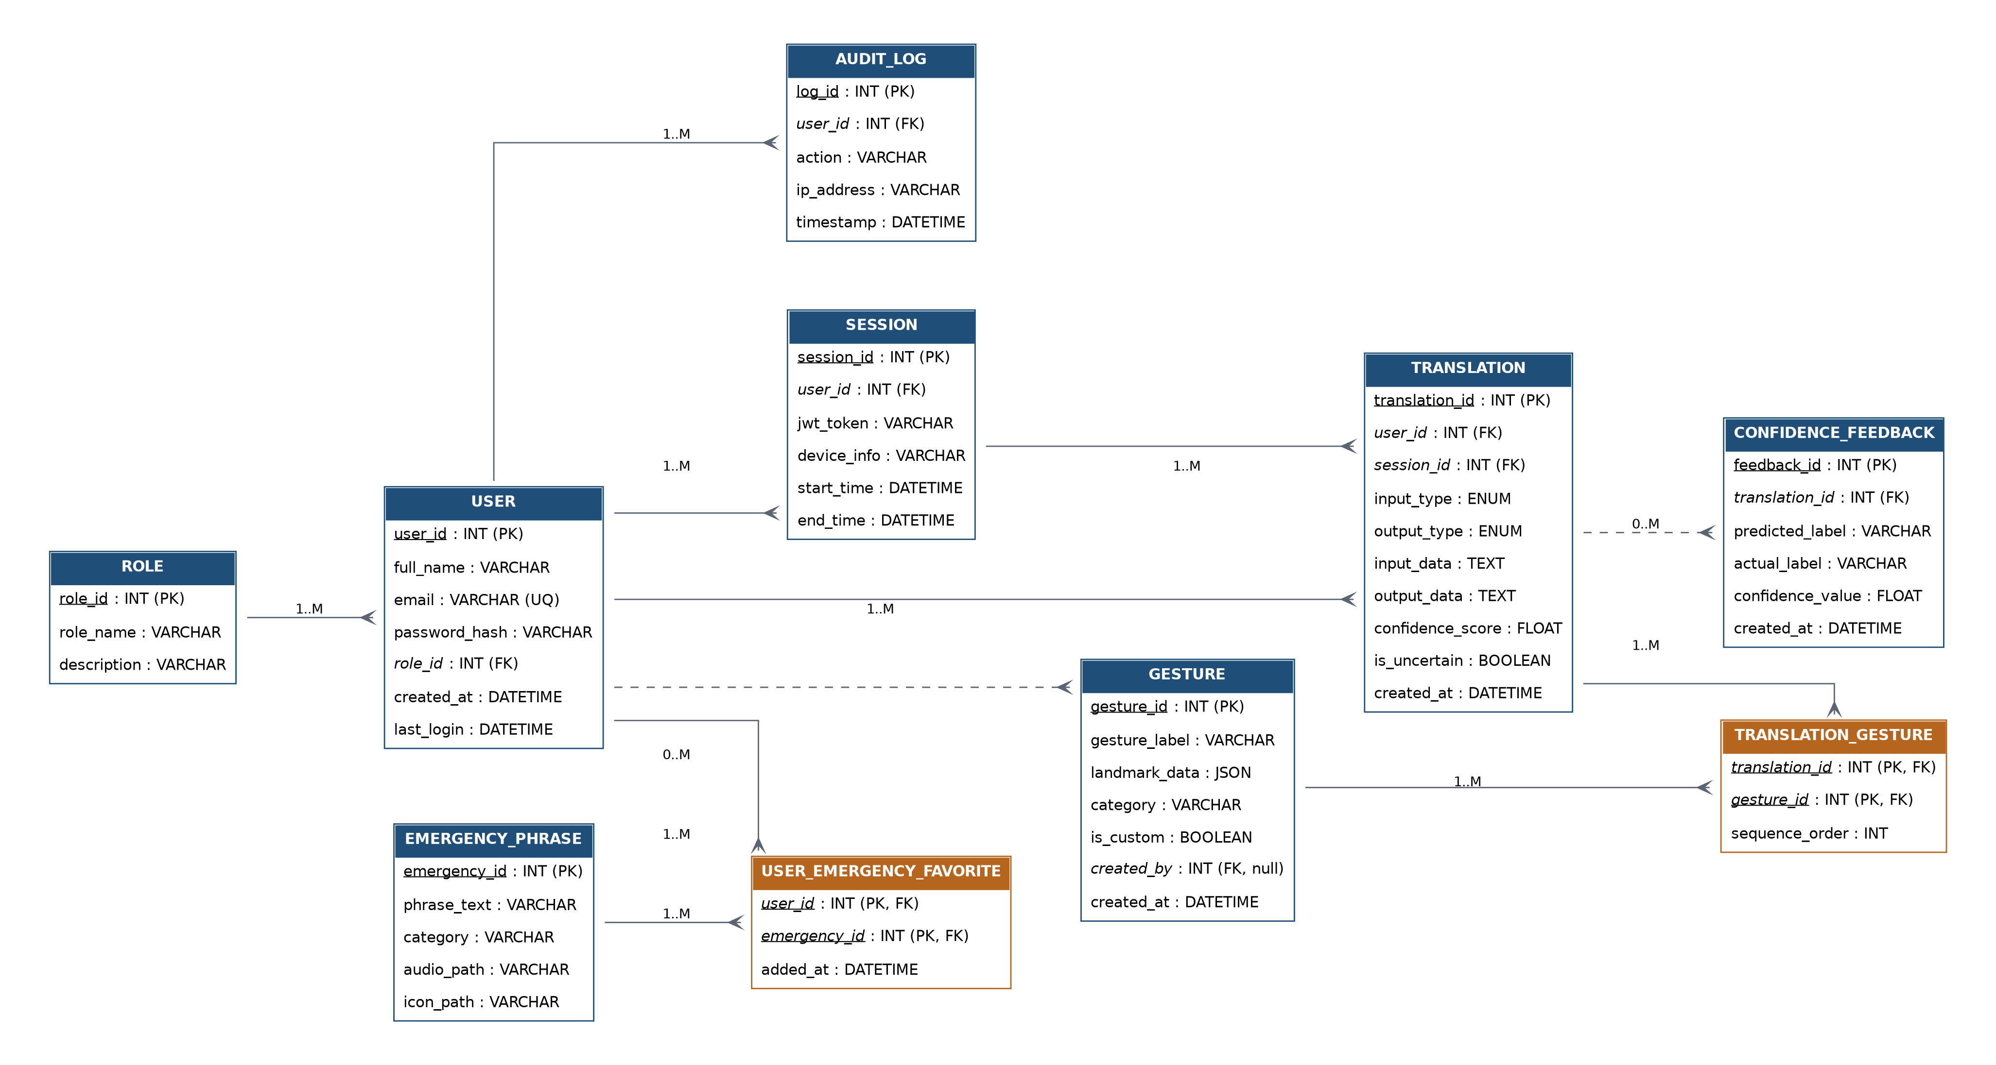
ER Diagram (Logical)
Crow's foot notation – 10 tables with PK / FK relationships

Slide 12
Database Schema
MySQL, accessed via SQLAlchemy ORM
Table | Key Columns
role | role_id (PK), role_name, description
user | user_id (PK), full_name, email, role_id (FK)
session | session_id (PK), user_id (FK), jwt_token, device_info
gesture | gesture_id (PK), gesture_label, landmark_data, created_by (FK)
translation | translation_id (PK), user_id (FK), session_id (FK), confidence_score
translation_gesture | translation_id, gesture_id (PK, FK), sequence_order
confidence_feedback | feedback_id (PK), translation_id (FK), predicted_label, actual_label
emergency_phrase | emergency_id (PK), phrase_text, category
user_emergency_favorite | user_id, emergency_id (PK, FK), added_at
audit_log | log_id (PK), user_id (FK), action, timestamp

Slide 13
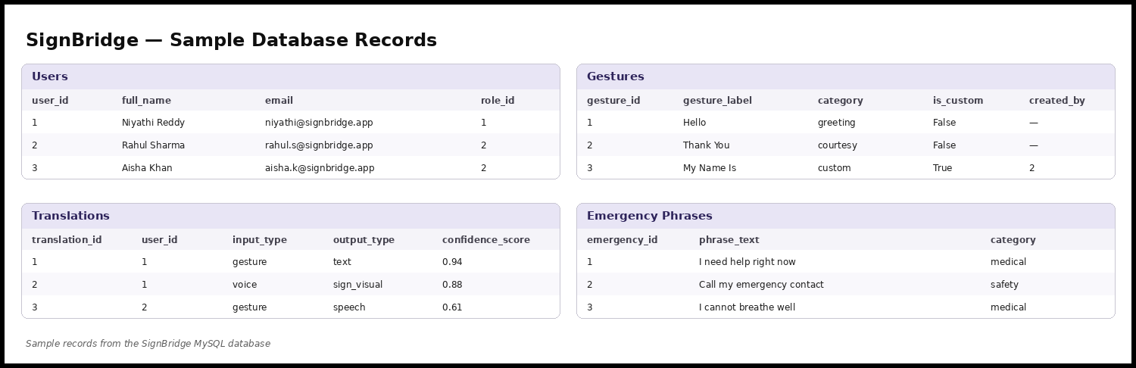
Sample Database Records
Populated MySQL data

Slide 14
Current Progress
37
3
5
2
Known signs
Saved phrases
Translations logged
Custom gestures
Dashboard UI implemented in React.js with live usage statistics.
Database schema fully designed and implemented in MySQL, with sample data.
Backend API scaffolding underway in FastAPI, including JWT authentication endpoints.
Gesture-recognition pipeline (OpenCV + MediaPipe + TensorFlow) integrated in a working prototype.

Slide 15
Challenges / Issues Faced
Reliable hand-landmark detection under varying lighting, backgrounds and skin tones.
Balancing model size and inference speed for real-time use on modest hardware (TF-Lite optimization).
Designing a confidence threshold that catches genuine errors without over-prompting the user.
Structuring the database for ordered gesture sequences and user-taught gestures.
Applying JWT authentication and RBAC consistently across all API endpoints.

Slide 16
Future Work
Expanded vocabulary & sign languages
Grow the gesture library; support multiple standards (ASL, ISL) and regional variations.
Continuous, sentence-level recognition
Move from isolated signs to fluent continuous-sign understanding.
Better accuracy & personalization
Larger, more diverse dataset; richer feedback loops and adaptive fine-tuning.
Mobile, edge & video calls
Mobile app, edge deployment, live video-call translation, and monitoring.
User testing
Test with the Deaf and hard-of-hearing community to refine usability and accuracy.

Slide 17
Conclusion
Beyond conventional detection
Inclusive by design
Built to scale
Moves past isolated gesture recognition to a reliable, adaptive, two-way platform.
Serves both sign language users and hearing people unfamiliar with sign language.
Modular, service-oriented design with FastAPI, MySQL, JWT/RBAC and Docker.
Thank You

