Slide 1
AI-Powered Accessibility
SignBridge
Intelligent Two-Way Sign Language Translator
Project Review 2
K.Hasini – 2520090209
L.Lavanya - 2520090009
Y25 • 2026-2027 Trimester 4
SignBridge • Review 2
1

Slide 2
Problem Statement
Communication barriers persist between sign language users and the wider hearing community, especially when a human interpreter is unavailable.
Existing tools are typically one-directional — they convert signs to text, but do not translate spoken or written language back into sign form.
Most gesture-recognition systems lack a way to flag uncertain predictions, so misread gestures are passed on as confident, incorrect translations.
Deaf and hard-of-hearing individuals have no fast, dedicated way to communicate critical or emergency information when an interpreter or app support is limited.
SignBridge • Review 2
2

Slide 3
Objectives
Objective | Description
Two-way translation | Convert hand gestures to text/speech, and text or voice into visual sign representations, in real time.
Reliable recognition | Use a confidence-scoring mechanism to detect uncertain predictions and prompt the user to repeat unclear gestures.
Personalized vocabulary | Let users teach the AI new, personalized gestures through the “Teach the AI” feature.
Emergency communication | Provide an Emergency Mode with quick access to critical phrases when time matters most.
Secure, scalable platform | Build on a modular, service-oriented architecture with JWT authentication, RBAC, and Docker-based deployment.
SignBridge • Review 2
3

Slide 4
Proposed System
An AI-powered, two-way Sign Language Translation platform enabling real-time communication between sign language users and others.
OpenCV and MediaPipe capture hand gestures and extract landmarks; a TensorFlow / TensorFlow Lite model classifies the gesture.
A confidence-scoring mechanism identifies uncertain predictions and asks the user to repeat unclear gestures, improving reliability.
A Smart Phrase Builder combines recognized signs into meaningful sentences.
Emergency Mode surfaces critical phrases instantly; “Teach the AI” lets users add and expand their own gesture vocabulary.
Built with React.js, FastAPI, and MySQL (via SQLAlchemy), secured with JWT authentication and role-based access control.
SignBridge • Review 2
4

Slide 5
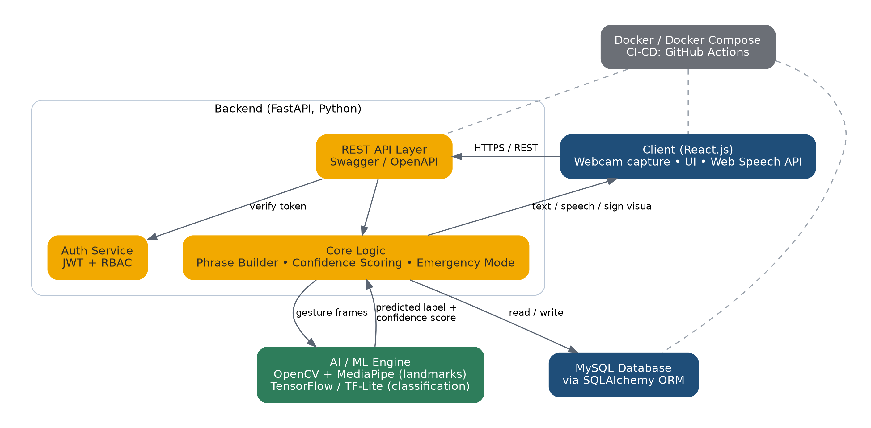
System Architecture
SignBridge • Review 2
5

Slide 6
Modules / Functionalities
Module | Functionality
Authentication & RBAC | JWT-based login with role-based access control (admin / user / guest).
Gesture Recognition Engine | OpenCV + MediaPipe landmark extraction and TensorFlow/TF-Lite classification.
Two-Way Translation Engine | Gesture → text/speech and text/voice → sign visual, in real time.
Smart Phrase Builder | Combines a sequence of recognized signs into a coherent sentence.
Confidence Feedback Loop | Flags low-confidence predictions and lets the user correct them.
Emergency Mode | One-tap access to critical, predefined phrases.
Teach the AI | Lets users add and label personalized custom gestures.
Dashboard & Sign Library | Tracks known signs, saved phrases, translations, and custom gestures.
SignBridge • Review 2
6

Slide 7
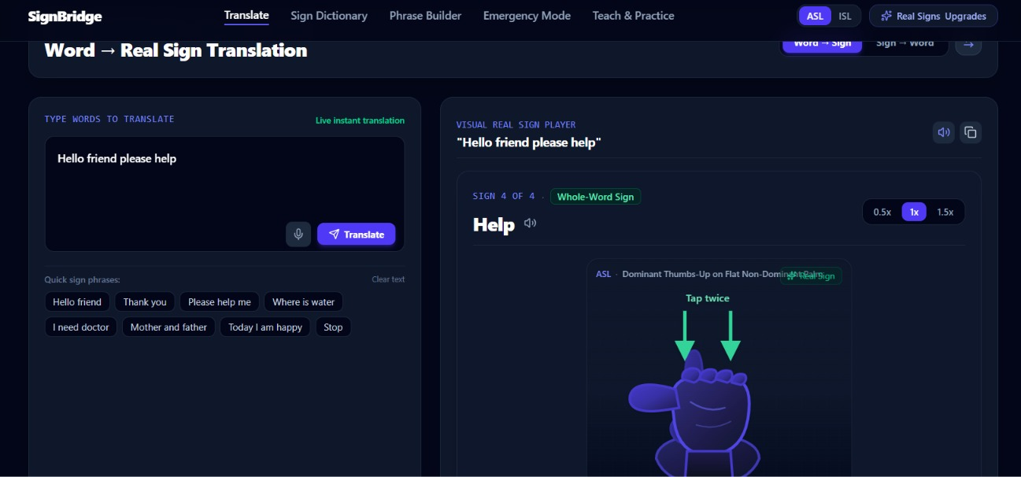
Frontend Design & Implementation
Live dashboard — React.js
Dashboard / Home — quick-launch hero, live usage stats.
Translate — real-time gesture-to-text/speech conversion.
Phrase Builder — combine signs into full sentences.
Emergency Mode — one-tap critical phrases.
Teach the AI — add custom, personalized gestures.
Sign Library — browse all known signs.
SignBridge • Review 2
7

Slide 8
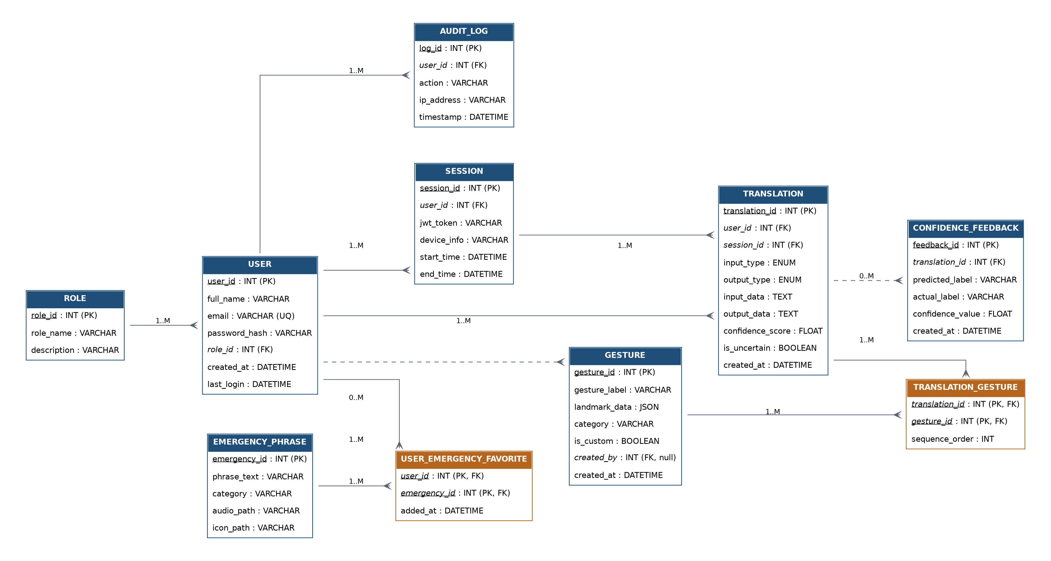
Database Design — ER Diagram (Logical)
Crow's foot notation: tables, data types, primary/foreign keys
SignBridge • Review 2
9

Slide 9
Database Tables / Schema
MySQL, accessed via SQLAlchemy ORM
Table | Key Columns
role | role_id (PK), role_name, description
user | user_id (PK), full_name, email, role_id (FK)
session | session_id (PK), user_id (FK), jwt_token, device_info
gesture | gesture_id (PK), gesture_label, landmark_data, created_by (FK)
translation | translation_id (PK), user_id (FK), session_id (FK), confidence_score
translation_gesture | translation_id (PK, FK), gesture_id (PK, FK), sequence_order
confidence_feedback | feedback_id (PK), translation_id (FK), predicted_label, actual_label
emergency_phrase | emergency_id (PK), phrase_text, category
user_emergency_favorite | user_id (PK, FK), emergency_id (PK, FK), added_at
audit_log | log_id (PK), user_id (FK), action, timestamp
SignBridge • Review 2
10

Slide 10
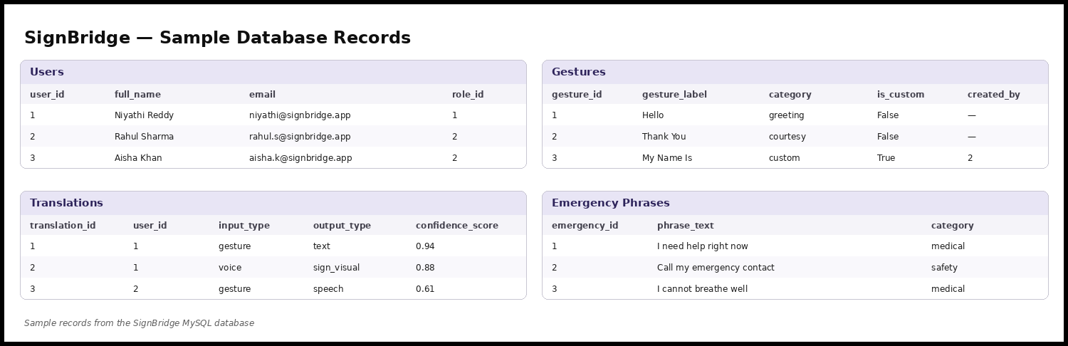
Sample Database Records
SignBridge • Review 2
11

Slide 11
Current Progress
37
3
5
2
Known signs
Saved phrases
Translations logged
Custom gestures
Dashboard UI implemented in React.js with live usage statistics (screenshot on Slide 7).
Database schema fully designed and implemented in MySQL, with sample data populated.
Backend API scaffolding underway in FastAPI, including JWT authentication endpoints.
Gesture-recognition pipeline (OpenCV + MediaPipe + TensorFlow) integrated in a working prototype.
SignBridge • Review 2
12

Slide 12
Challenges / Issues Faced
Achieving reliable hand-landmark detection under varying lighting, backgrounds, and skin tones.
Balancing model size and inference speed for real-time performance on modest hardware (TF-Lite optimization).
Designing a confidence-scoring threshold that catches genuine errors without over-prompting the user.
Structuring the database to support ordered gesture sequences (Smart Phrase Builder) and user-taught gestures cleanly.
Implementing secure JWT authentication and role-based access control consistently across all API endpoints.
SignBridge • Review 2
13

Slide 13
Future Work
Expand the gesture vocabulary and add support for multiple sign language standards (e.g., ASL, ISL).
Improve model accuracy with a larger, more diverse training dataset.
Package a mobile application for on-the-go translation.
Integrate real-time translation into live video calls.
Conduct user testing with the Deaf and hard-of-hearing community to refine usability and accuracy.
SignBridge • Review 2
14

Slide 14
Conclusion
SignBridge combines AI-based gesture recognition, confidence-aware translation, personalized learning, and two-way communication into one accessible platform.
A modern, secure backend (FastAPI, MySQL, JWT/RBAC, Docker) supports a scalable and maintainable system.
The goal is a reliable, adaptive communication solution — not a conventional gesture-detection system — that meaningfully reduces communication barriers.
Thank You
SignBridge • Review 2
15

