Slide 1
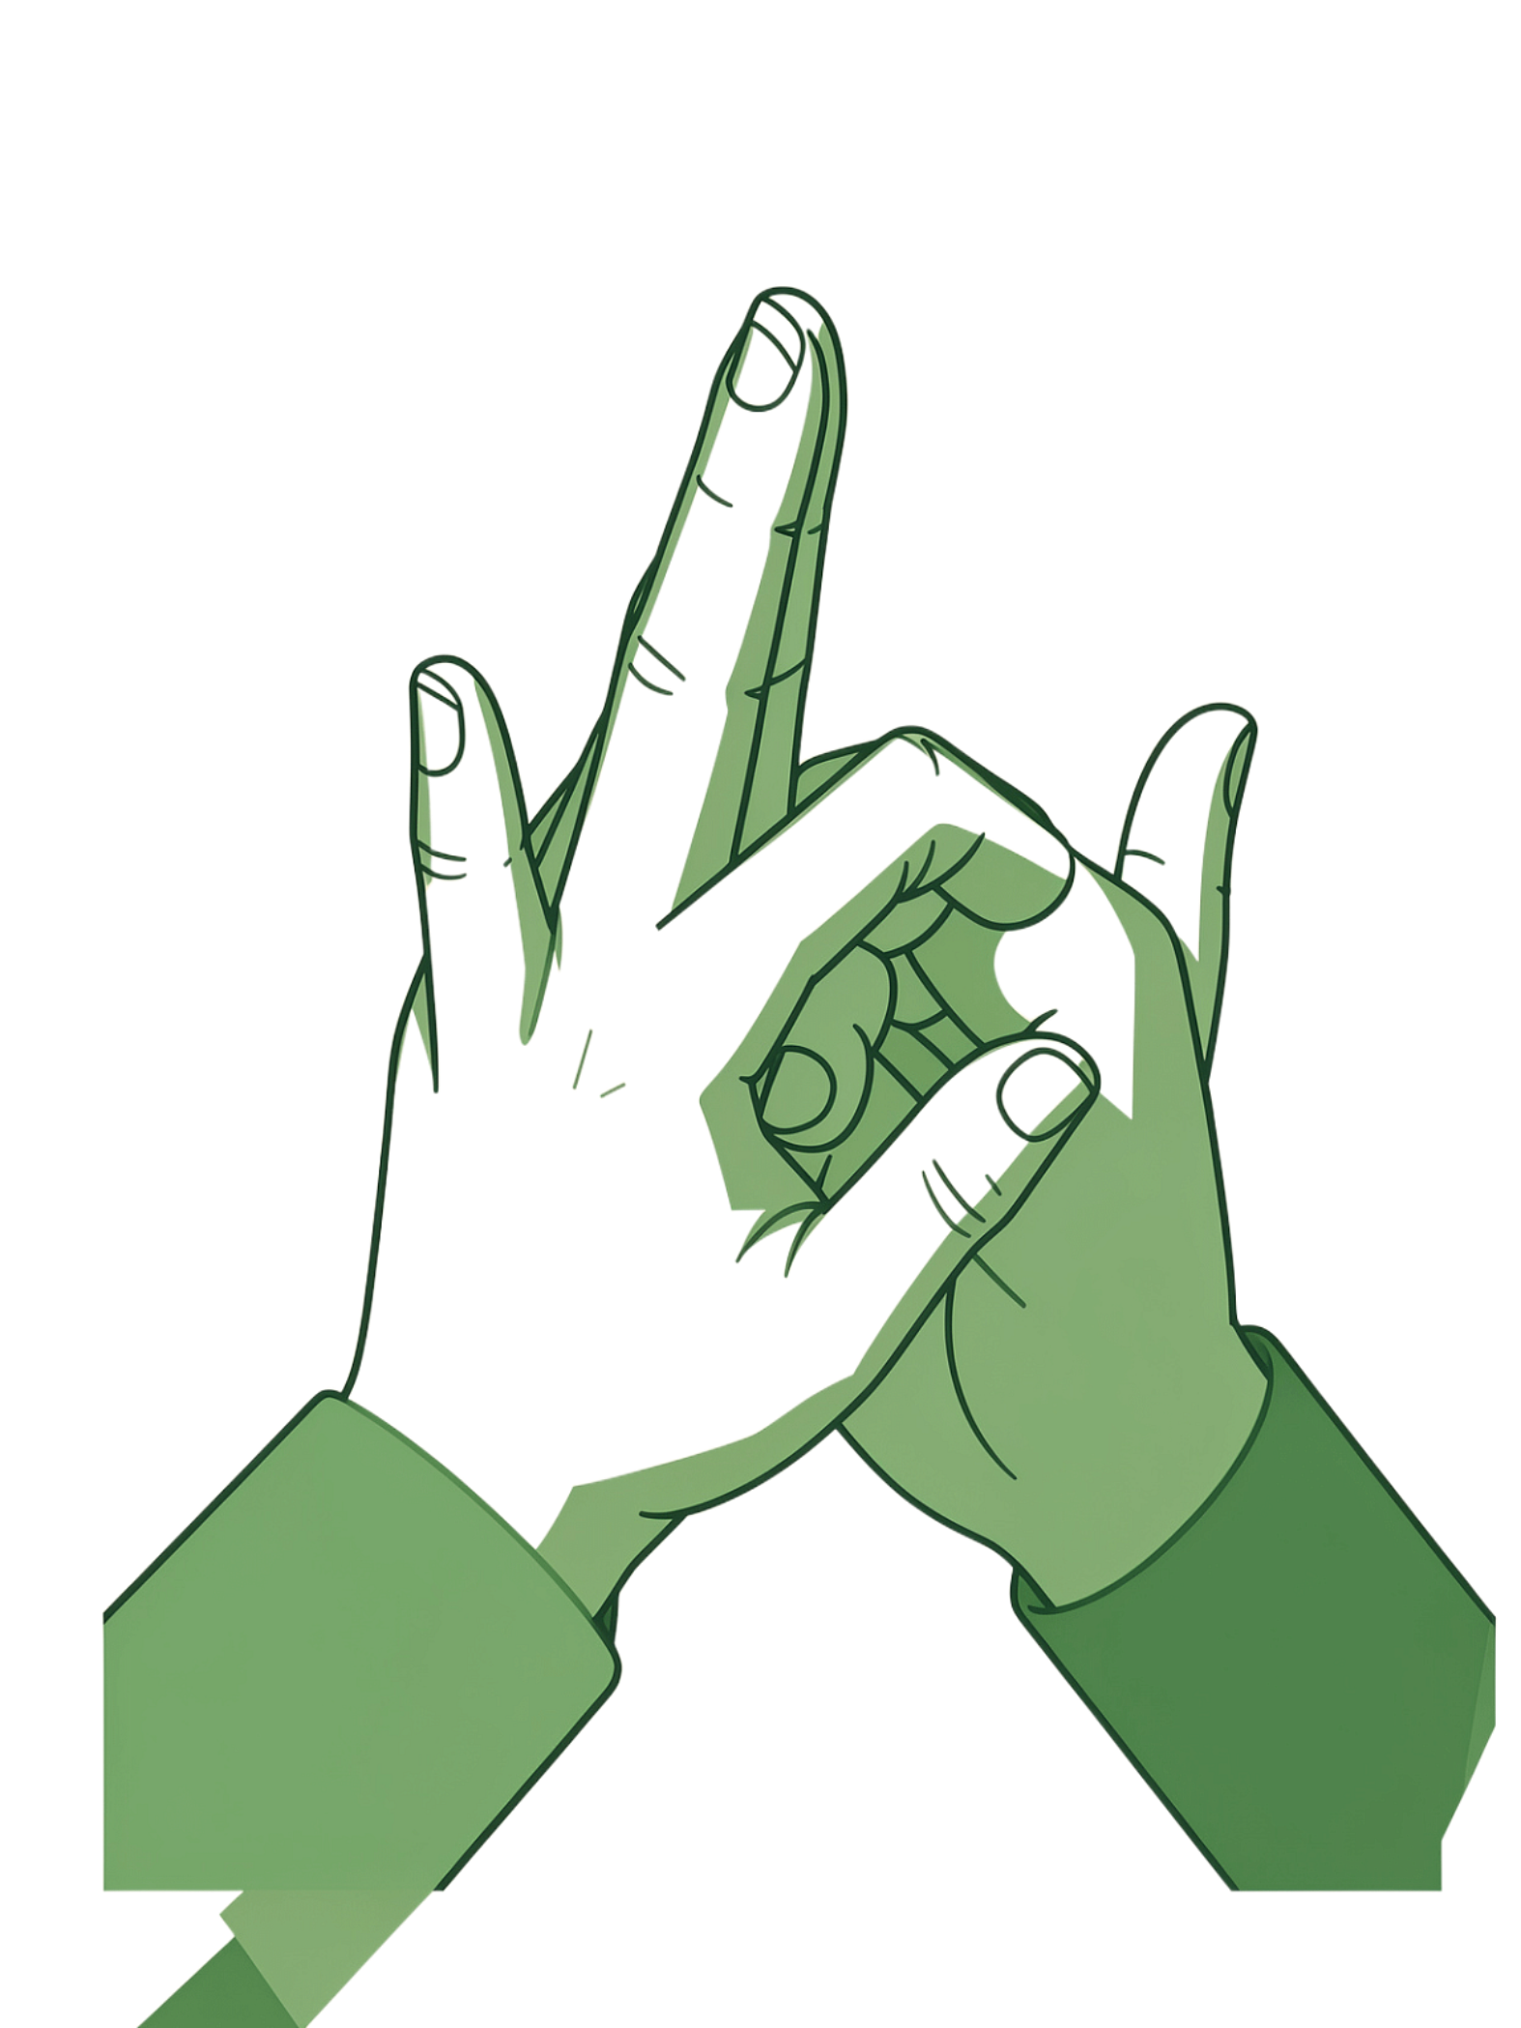
SignBridge
AI-Powered Two-Way Sign Language Translation

Slide 2

ABSTRACT & INTRODUCTION
Bridging the Communication Gap
Communication barriers between sign language users and the wider community remain a significant accessibility challenge, particularly when interpreters are unavailable.
Two-Way Translation
Intelligent Platform
Converts hand gestures into text and speech, and translates text or voice into visual sign representations in real time.
Combines AI-based recognition, confidence-aware translation, personalized learning, and modern backend engineering.

Slide 3
Problem Statement and Objectives
Problem Statement
Project Objectives
Sign language users may face delays or exclusion when interpreters are unavailable and communication partners cannot understand signs. This creates real-time accessibility barriers across healthcare, education, and everyday interactions.
1
Recognize hand gestures in real time
Translate them immediately into text and speech output.
2
Reverse translation
Convert text or voice input into visual sign representations.
3
Improve reliability
Apply confidence scoring and repeat prompts for uncertain predictions.
4
Personalization
Support user-defined gestures and critical emergency phrases.

Slide 4
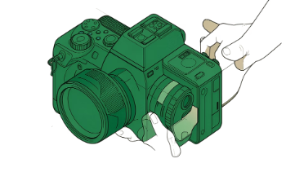
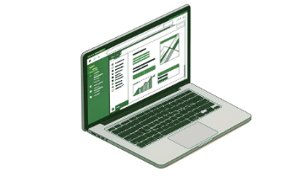
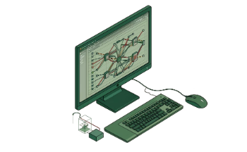
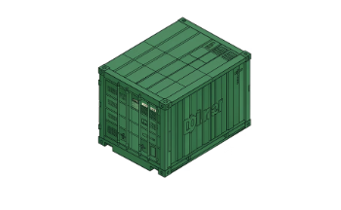
Hardware and Software Requirements
Capture Hardware
Frontend and API
AI and Vision Stack
Backend and DevOps
Camera-enabled device for real-time hand gesture capture, with sufficient processor and memory for computer vision inference.
React.js frontend paired with a FastAPI backend for a responsive, high-performance user interface and REST API layer.
OpenCV and MediaPipe for hand landmark detection; TensorFlow/Keras or TensorFlow Lite for gesture classification.
MySQL with SQLAlchemy ORM, JWT authentication, RBAC, Docker-based deployment, API documentation, testing, and monitoring.
Audio output for spoken translations

Slide 5

Results
Key System Capabilities
Landmark Recognition
OpenCV and MediaPipe capture precise hand landmarks fed into the TensorFlow/Keras or TensorFlow Lite classifier.
Capture Landmarks
Classify Gesture
Smart Phrase Builder
Combines individually recognized signs into grammatically coherent, meaningful sentences for the recipient.
Score Confidence
Emergency Mode
Build Phrase
Rapid one-tap access to critical pre-set phrases for high-stakes or time-sensitive communication scenarios.
The end-to-end pipeline from gesture capture to meaningful sentence output, with confidence-aware error handling at every stage.
Teach the AI
Users contribute personalized gestures that expand the model's vocabulary beyond the default sign set.

Slide 6
Future Scope
Expanded Vocabulary and Sign Languages
Grow the gesture library and add support for multiple sign languages and regional variations worldwide.
Continuous and Sentence-Level Recognition
Advance from isolated sign classification to fluent, continuous-sign sentence understanding for more natural conversations.
Enhanced Personalized Learning
Incorporate richer user feedback loops and adaptive model fine-tuning to tailor the system to individual signing styles.
Cross-Platform and Edge Deployment
Extend availability across mobile, web, and edge devices with strengthened monitoring pipelines and accessibility compliance.

Slide 7
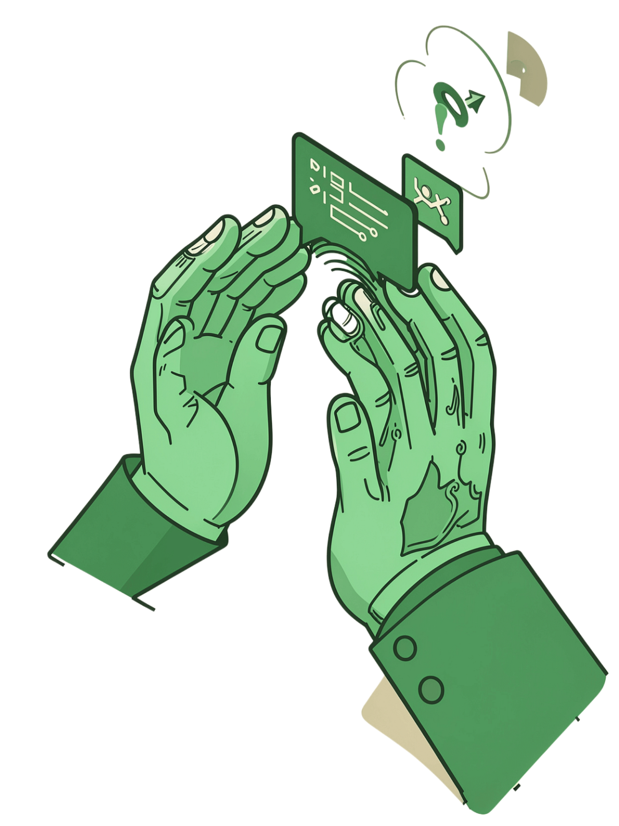
Conclusion
Beyond Conventional Detection
Inclusive by Design
Two-way translation serves both sign language users and hearing individuals unfamiliar with sign language, reducing barriers in both directions.
SignBridge moves past isolated gesture recognition toward a reliable, adaptive, and fully accessible two-way communication platform.
Built to Scale
A modular, service-oriented architecture with JWT security, RBAC, and Docker-based deployment supports long-term maintainability and growth.

