Slide 1

Cyber Attack Detection on Android Using CRL
UNIVERSITY COLLEGE OF ENGINEERING,BIT CAMPUS,TIRUCHIRAPPALLI-620024
Presented by
Nithish babu G - 810020205058
Pradeepan M - 810020205060
Under The Guidance of Dr. P. Karthikeyan Assistant Professor Department of CSE

Slide 2
Agenda
Generic Objective
Introduction
Literature Survey
Scope of the project
Feasibility Study
Specific Objective
Proposed System
Architectural Diagram
Data Flow Diagram
Modules
System Requirements
Experimental Results
Gantt Chart
References

Slide 3
Generic Objective
To Develop a Cyber Attack Detection System (CADS) to enhancing cybersecurity on android devices.

Slide 4
Introduction
Ensemble Learning (CRL)
Enhancing Cyber Attack Detection System (CADS)
Safeguarding Digital Realm
Improved Detection with Diversity

Slide 5
Literature Survey
S.No | Year | Author | Technique | Advantage | Disadvantage
1 | 2022 | Ali Parizad , Hatziadoniu | Principal Component Analysis (PCA), Support Vector Machine (SVM), Noisy Clustering | Efficient Dimensionality Reduction , Improved Clustering Accuracy | Loss of Interpretability, Sensitivity to Noise
2 | 2021 | Fahima Hossain, Marzana Akter , Mohammed Nasir Uddin | Gradient Boosting, Random Forest | Process large-scale datasets efficiently, Achieves high accuracy | Heavily relies on the quality, Risk of generating false alarms
3 | 2023 | Faeiz Alserhani , Alaa Aljared | K Nearest Neighbors (KNN), Support Vector Machine , XGBoost | Robustness to Uncertainty, Adaptability to Evolving Threats | Potential for Overfitting Dependency on Model Diversity
4 | 2022 | Kim-Hung Le , Minh-Huy Nguyen , Trong-Dat Tran , Ngoc-Duan Tran | Convolutional Neural Network (CNN) | providing targeted protection against cyber threats Intelligent Threat Detection | Configuration Complexity False Positive Risks

Slide 6
Literature Survey
S.no | Year | Author | Technique | Advantage | Disadvantage
5 | 2022 | Abdulrahman Al-Abassi, Hadis Karimipour , Ali Dehghantaha , Reza M. Parizi | Deep Neural Network (DNN) Decision Tree (DT) | Robustness to Varied Attacks, Adaptability to Complex Environments | Increased Vulnerability to False Positives , Difficulty in Model Interpretation
6 | 2020 | Hamed Alqahtani , Iqbal H. Sarker , Asra Kalim , Syed Md. Minhaz Hossain , Sheikh Ikhlaq , Sohrab Hossain | Bayesian Network,Naive Bayes classifier, Random Tree, Decision Table, Artificial Neural Network. | Enhanced Intrusion Detection, Automated Detection Process | Risk of False Positives and Negatives Complexity in Model Selection
7 | 2023 | Hayam Alamro ,Wafa Mtouaa, Sumayh Aljameel , Ahmed S. Salama, Manar Ahmed Hamza , Aladdin Yahya Othman | Least Square Support Vector Machine (LS-SVM), kernel extreme learning machine(KELM), Regularized random vector functional link neural network (RRVFLN) | Enhanced Detection Accuracy, Adaptability to Evolving Threats | Complexity in Model Integration, Risk of False Positives, Dependency on Training Data
8 | 2020 | Ji Wang, Qi Jing, Jianbo Gao, Xuanwei Qiu | Logistic Regression(LR), Decision Tree (DT), SVM ,Deep Belief Neural Network (DBN) | Minimizing false positives, Adaptability to New Threats | Complexity in Model Selection, Dependency on Training Data

Slide 7
Scope of the project
Scope 1 - Loss of interpretability
Scope 2 - Sensitivity to Noise
Scope 3 - Heavily relies on the quality of datasets
Scope 4 - Risk of generating false detection
Scope 5 - Potential for Overfitting
Scope 6 - Dependency on Model Diversity
Scope 7 - Configuration complexity
Scope 8 - Increased Vulnerability to False Positives
Scope 9 - Difficulty in Model Interpretation
Scope 10 - Risk of False Positives and Negatives
Scope 11 -Complexity in Model Selection

Slide 8


Feasibility Study
Feasibility | Economic Feasibility | Technical Feasibility | Operational Feasibility | Schedule Feasibility
Scope 1
Scope 2
Scope 3
Scope 4
Scope 5

Slide 9
Feasibility Study
Feasibility | Economic Feasibility | Technical Feasibility | Operational Feasibility | Schedule Feasibility
Scope 6
Scope 7
Scope 8
Scope 9
Scope 10
Scope 11

Slide 10
Specific Objective
Loss of interpretability
Heavily relies on the quality of datasets
Risk of generating false detection
Configuration complexity
Complexity in Model Selection

Slide 11



Proposed System
2)Develop an Ensemble Model from the extracted Features
3)Import the model in Android Studio using TFlite
1)Prepare the dataset and extract necessary features
6)Display the Cyber attack details
5)Enable real time scan and Start scanning
4)Run and install the
CAD App

Slide 12




Architectural Diagram:
Data Preparation
Model Creation
App Development
User Interface
CNN
Run and Install the app
Data Pre Processing
RNN
Feature Extraction
TFLite (CRL.Tflite)
LSTM
Scan Apps
Feature Selection
Voting Classifier
Training
and
Test Data
CRL Model
Display Attack Details
Android App

Slide 13
Ensemble Model Architecture:
CNN Component
Input Data
Convolutional Layers
Feature Maps
RNN Component
Input Data
Recurrent Layers
Hidden States
LSTM Component
Input Data
Long Short-Term Memory Cells
Memory States
Feature Fusion
Combined Feature Set
Voting Classifier
Output

Slide 14
Data Flow Diagram:
LEVEL 0
I/P : Installed apps and Files
Ensemble Model(CRL Model)
O/P : Cyber Attack Details
0

Slide 15
Data Flow Diagram:
LEVEL 1
CRL Model
Data Pre processing
TensorFlow lite
1
2
3
CAD App
Android Studio
5
4

Slide 16
Data Flow Diagram:
LEVEL 2
Extract and Remove Duplicates
App Dataset
Data Preprocessing
1.1
1.2
Prepare Dataset & Feature Selection
Unique Permissions
& Intents File
Training & Testing Sets
1.4
1.3

Slide 17
Data Flow Diagram:
LEVEL 2
Test & Training Sets
RNN
CNN
2.1
2.2
LSTM
2.3
CRL Model
Voting Classifier
2.4

Slide 18
Data Flow Diagram:
LEVEL 2
CRL Model
Install TFlite
Convert to TFLite
Load CRL Model
3.1
3.2
3.3
Save Converted TFLite Model
3.4
Test The TFLite Model
View Model Via Netron
3.6
3.5

Slide 19
Data Flow Diagram:
LEVEL 2
Tested TFLite Model
Set Up Android Development
Design UI
4.1
4.2
Import TFLite File
4.3
Load and run TFLite Model
Display CAD Results
Process input Data
4.5
4.4

Slide 20
Data Flow Diagram:
LEVEL 2
User Inititates Scanning Process
Run And Install the App
Android App
5.1
5.2
Permission and Intent Verification
Dtetect Cyber Attack Uisng CRL
Show Attack Information
5.4
5.3

Slide 21
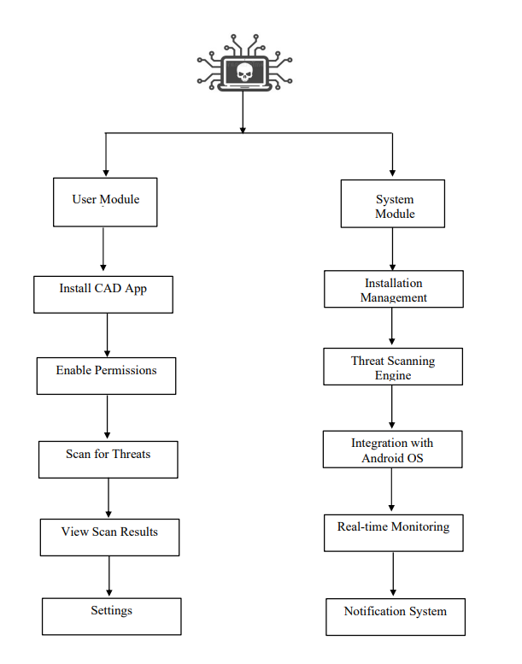
Modules :

Slide 22
System Requirements
Hardware Requirements
System : Desktop
RAM : 8 GB
ROM : 512 GB SSD
Android device
Software Requirements
Tools : Python , Java , Tensor Flow Lite
IDE : Android studio , Jupyter Notebook
Techniques Used
Ensemble Learning (CRL)
Convolutional Neural Network (CNN)
Recurrent Neural Network (RNN)
Long Short Term Memory (LSTM)

Slide 23
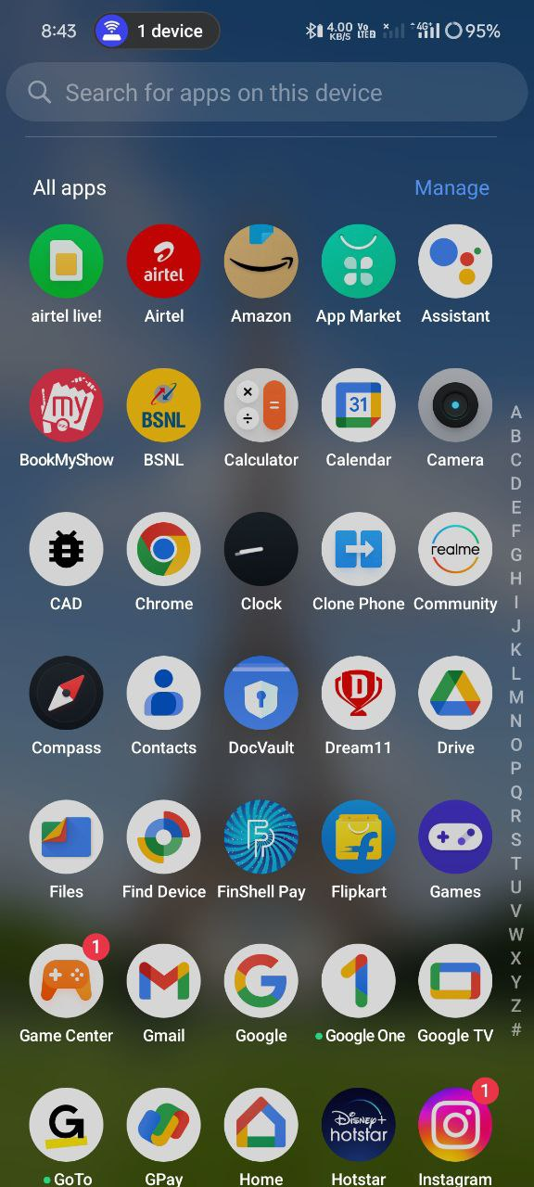
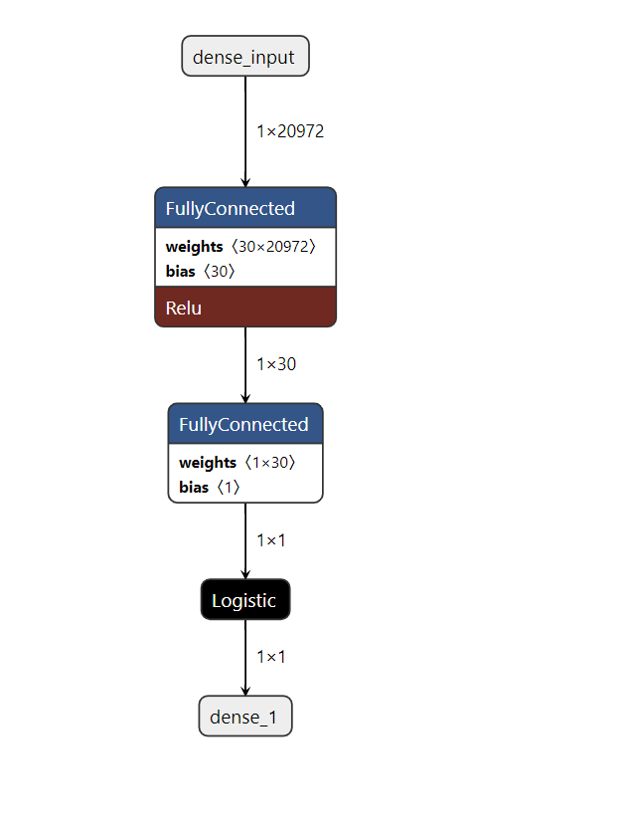
Experimental Results:
Ensemble Model
CAD App Installation

Slide 24
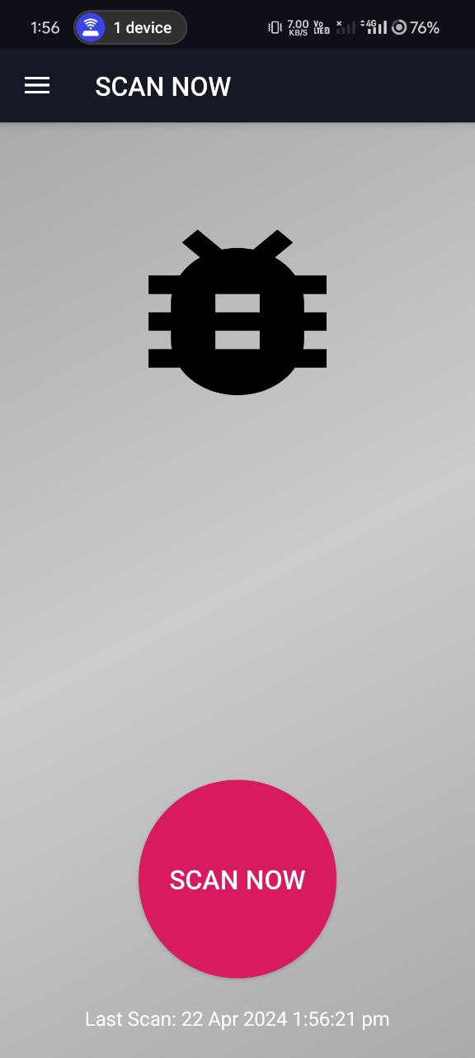
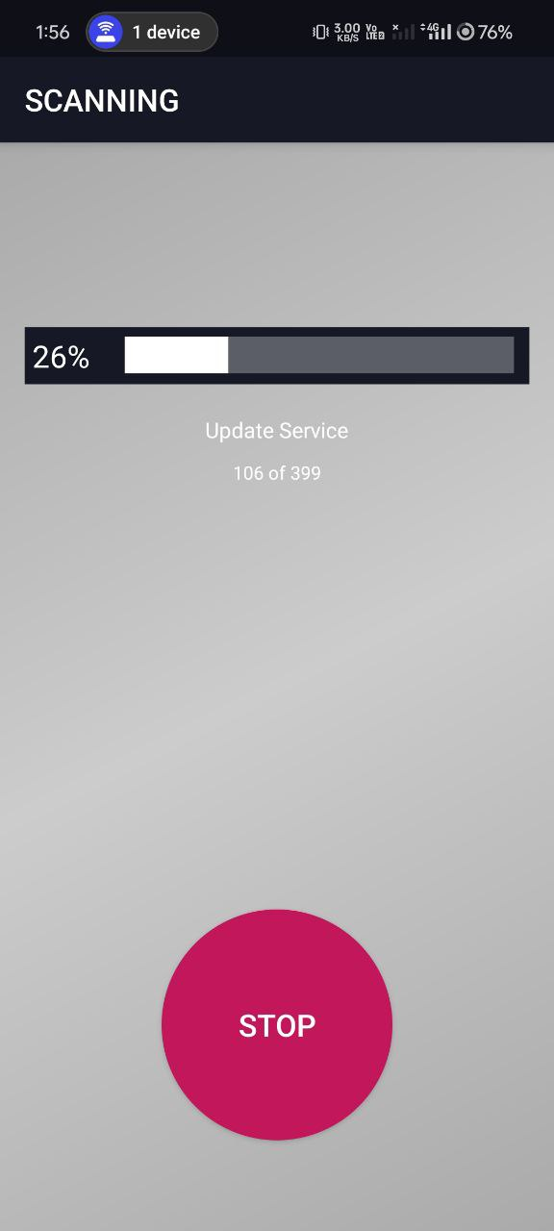
Experimental Results:
Start Scan Button
Scanning Process

Slide 25
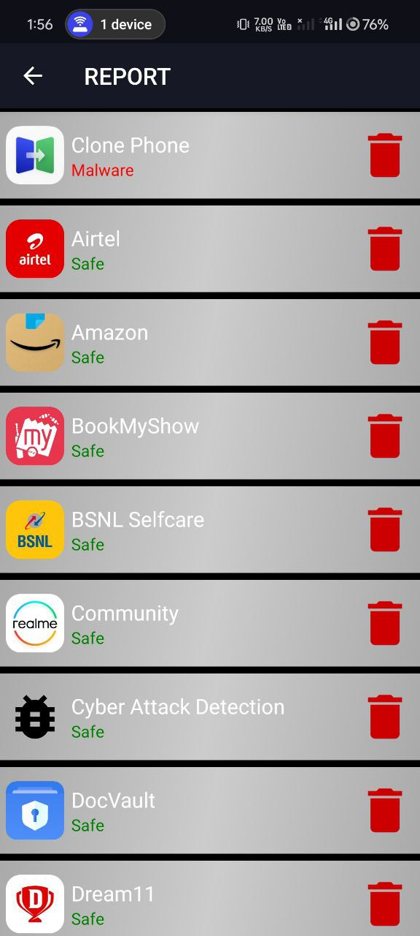
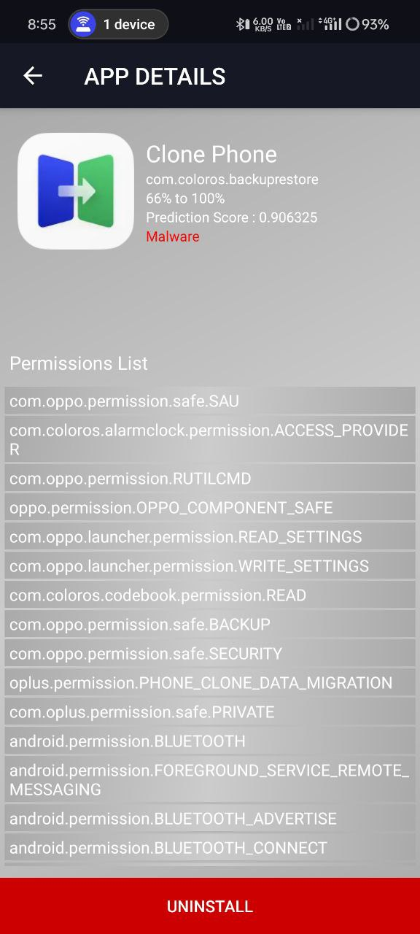
Experimental Results:
Scanning Results
Permission List of Detected App

Slide 26
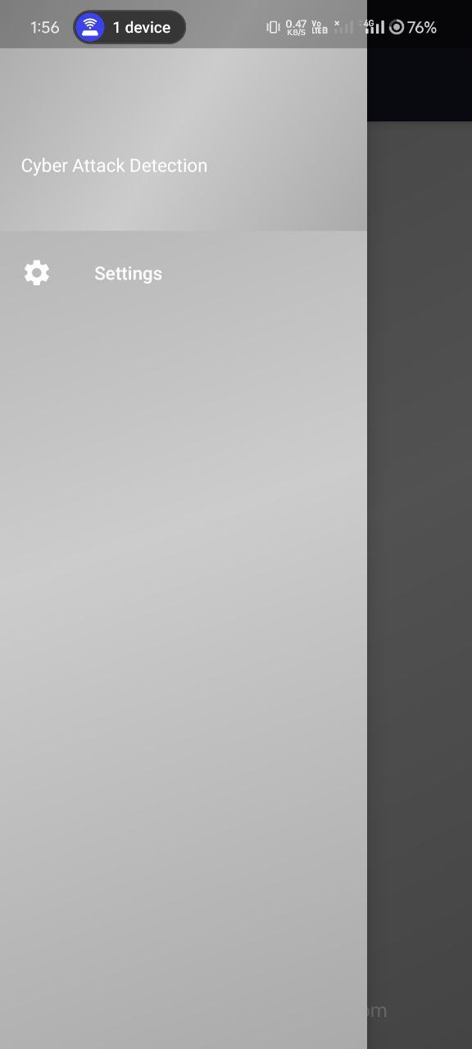
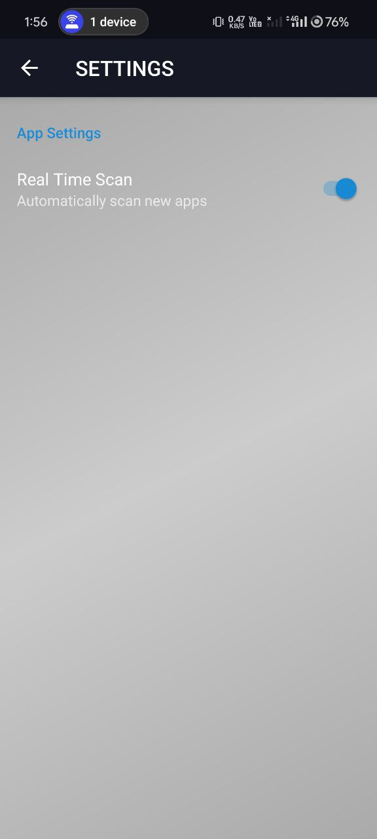
Experimental Results:
About the Settings
Real Time Scanning

Slide 27
Gantt Chart:
Activity/Month | February | March | April
w1 | w2 | w3 | w4
w1 | w2 | w3 | w4
w1 | w2 | w3 | w4
Planning
Study
Implementation
Testing
Output
Documentation
27

Slide 28
References :
[1] Suleiman Y Yerima, Sakir Sezer, Gavin McWilliams, and Igor Muttik, “ A new android malware detection approach using bayesian classification in Advanced Information Networking and Applications (AINA),” 2013 IEEE 27th International Conference on, pages 121–128. IEEE, 2013.
[2] Toshiki Shibahara, Takeshi Yagi, Mitsuaki Akiyama, Daiki Chiba, and Takeshi Yada, “Efficient dynamic malware analysis based on network behavior using deep learning”, In 2016 IEEE Global Communications Conference (GLOBECOM), pages 1–7. IEEE, 2016.
[3] S.Y. Yerima, S. Sezer, G. McWilliams, and I. Muttik. “A New Android Malware Detection Approach Using Bayesian Classification, in Advanced Information Net- working and Applications (AINA)”, 2013 IEEE 27th International Conference, pages 121–128, March 2013.
[4] Suarez-Tangil, Guillermo, Juan E. Tapiador, Pedro Peris-Lopez, and Arturo Ribagorda. "Evolution, detection and analysis of malware for smart devices." IEEE Communications Surveys & Tutorials 16, no. 2 (2013): 961-987.
[5] Liu, Xing, and Jiqiang Liu. "A two-layered permission-based android malware detection scheme." In 2014 2nd IEEE International Conference on Mobile Cloud Computing, Services and Engineering, pp. 142-148. IEEE, 2014.

