Slide 1

SAI VIDYA INSTITUTE OF TECHNOLOGY PROJECT TITLE AUTOMATED RESUME ANALYZER
Deeksha M (CSE) – 1VA22CS026
Hithashree R (ISE) – 1VA22IS037
Lavanya M R (CSE) – 1VA22CS060
Rakshitha N (CSE) – 1VA22CS097
Guide: Rajesh Kumar
Date: 20/04/2026

Slide 2
INTRODUCTION
The Resume Analyzer System is a web-based application designed to analyze resumes by comparing them with a given job description. It evaluates the content of a resume, calculates a match score, and identifies both matched and missing skills to help users improve their chances of selection. In today’s competitive job market, many candidates face rejection due to poorly structured resumes and lack of alignment with job requirements. This makes resume optimization an important factor in the hiring process. The system is inspired by real-world Applicant Tracking Systems (ATS) used by companies, making it highly relevant as it helps job seekers enhance their resumes and enables faster, more efficient candidate evaluation.

Slide 3
PROBLEM STATEMENT
In the current job application process, many candidates face rejection because their resumes do not match the keywords and structure expected by job descriptions. Since most companies use keyword-based filtering systems, applicants often do not know whether their resumes meet these requirements or what improvements are needed. This problem mainly affects job seekers, making it difficult for them to improve their resumes and choose the right opportunities. The proposed system addresses these issues by analyzing resumes, providing match scores, identifying skill gaps, and suggesting relevant job roles to improve selection chances.

Slide 4
OBJECTIVES
To analyze resumes by comparing them with job descriptions.
To calculate keyword match, skill match, and completeness scores.
To identify matched and missing skills in the resume.
To suggest suitable job roles based on the user’s profile.
To track resume performance using graphical representation.
To provide an admin module for managing users and system data.

Slide 5
SCOPE OF THE PROJECT
Covers:
User registration and login
Resume upload and content extraction
Keyword matching with job description
Skill analysis (matched and missing skills)
Resume completeness and score calculation
Job role recommendation based on profile
Performance tracking using graphs
Does NOT Cover:
No advanced AI or machine learning-based analysis
No real-time integration with job portals
No mobile application support

Slide 6
LITERATURE REVIEW
Verma et al. (2025):
Proposed a smart resume analyzer using NLP to extract and analyze resume content, improving hiring efficiency.
Surwase et al. (2025):
Developed an AI-based resume analyzer using NLP and machine learning to match candidate skills with job descriptions and generate compatibility scores.
Rai & Kumar (2018):
Introduced an automated resume analysis system using text mining techniques to extract information and support recruitment decisions.

Slide 7
EXISTING SYSTEM
Use of Applicant Tracking Systems (ATS) for resume filtering.
Dependency on keyword matching without deeper analysis.
No clear identification of missing skills or improvement areas
Lack of resume completeness evaluation.
No feature to track resume performance over multiple applications.

Slide 8
PROPOSED SYSTEM
Automated resume analysis based on job description.
Calculates keyword match, skill match, and completeness score.
Clearly identifies matched and missing skills.
Suggests suitable job roles based on user profile.
Provides performance tracking using graphical representation.

Slide 9
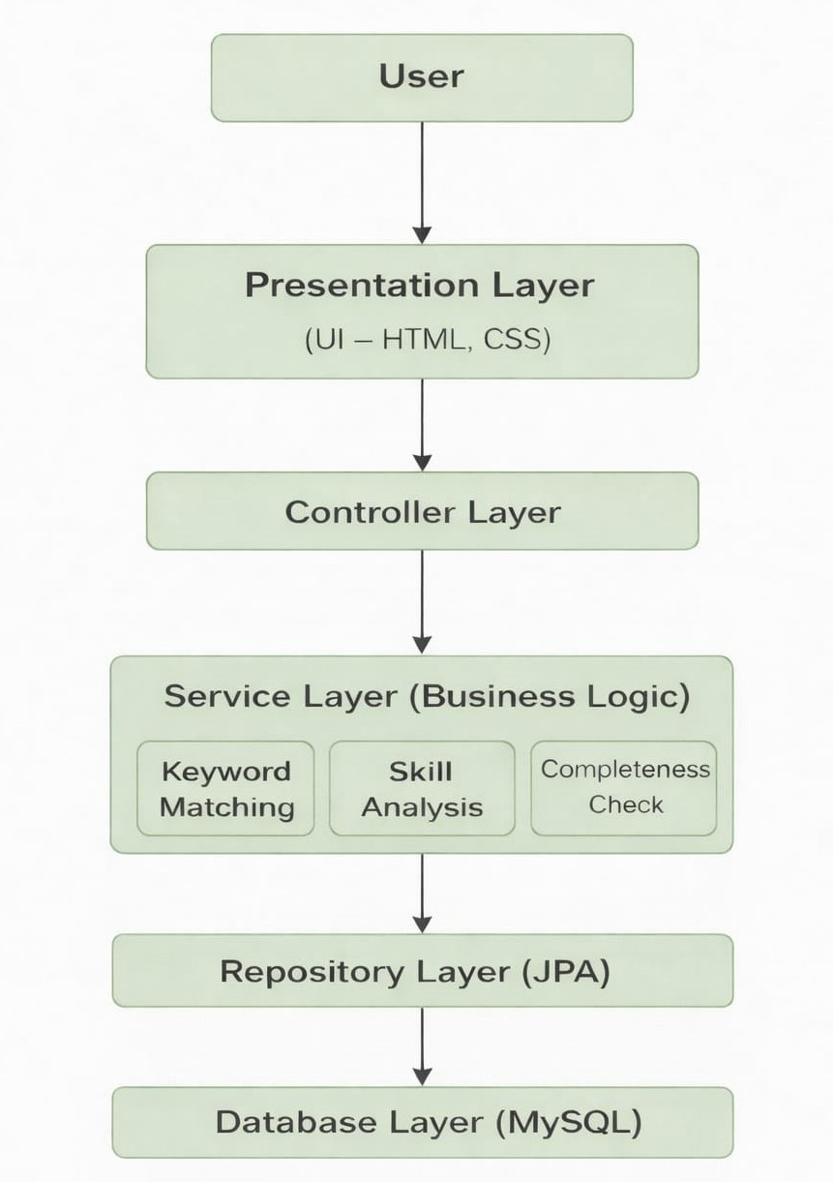
SYSTEM ARCHITECTURE

Slide 10
Methodology
User Input :User logs in and uploads resume.
Resume Parsing: Apache Tika extracts text from the resume.
Preprocessing: Convert text to lowercase, Remove special characters, Tokenization (split into words).
Keyword Extraction: Extract important skills/keywords from resume, Compare with predefined job description keywords.
Skill Analysis: Identifies matched skills and missing skills.
Score Calculation: Keyword Match Score, Skill Match Score, Resume Completeness Score.
Job Recommendation: Suggest job roles based on matched skills.
Result Display: Shows Scores, Missing skills, Recommended jobs, Graphical representation and saved history.

Slide 11
Algorithm
Keyword Matching & Scoring Algorithm
Extract and preprocess resume text
Compare with job keywords
Count matched and missing skills
Calculate match score
Classify result and recommend jobs

Slide 12
Technologies
Backend: Java, Spring Boot
Frontend: HTML, CSS, Thymeleaf
Database: MySQL
Library: Apache Tika (for resume parsing)

Slide 13
IMPLEMENTATION
The project is developed using Spring Boot with layered architecture
Frontend is created using HTML, CSS, and Thymeleaf
Resume parsing implemented using Apache Tika
Database integration done using MySQL and JPA Repository
Analysis logic implemented in Service Layer
Modules developed:
User Module: User registration and login functionality
Resume Upload Module: Upload and process resume files
Analysis Module: Perform keyword matching and score calculation
Result Module: Display scores, skills, and graph
Admin Module: Manage users (view, suspend, delete accounts)

Slide 14
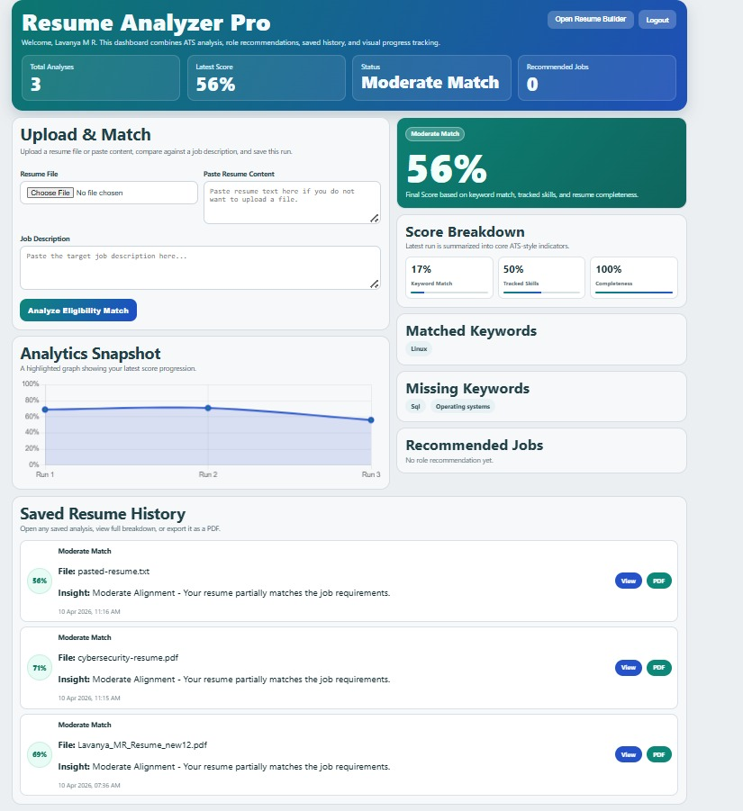
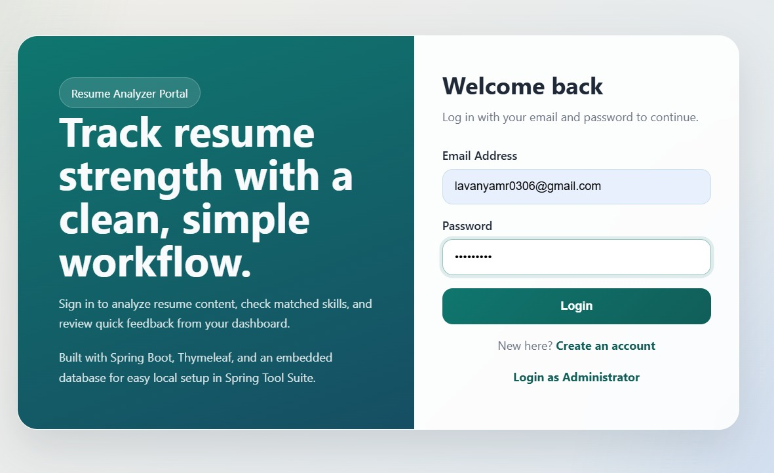
Results

Slide 15
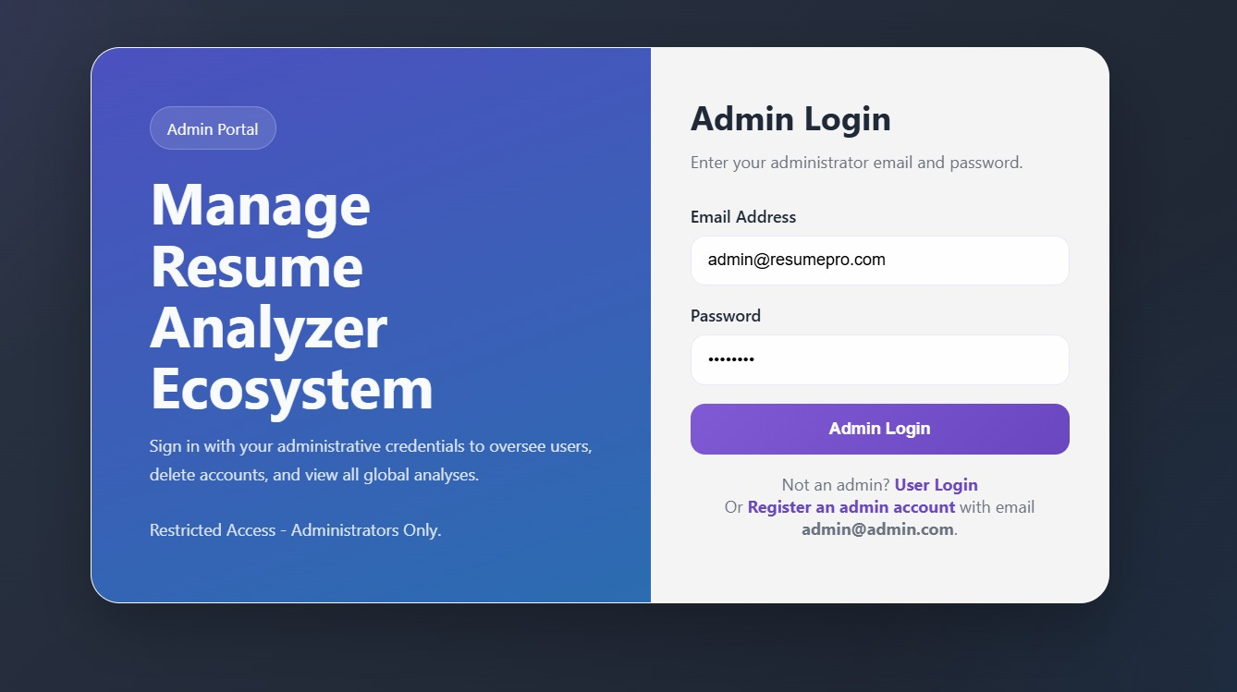
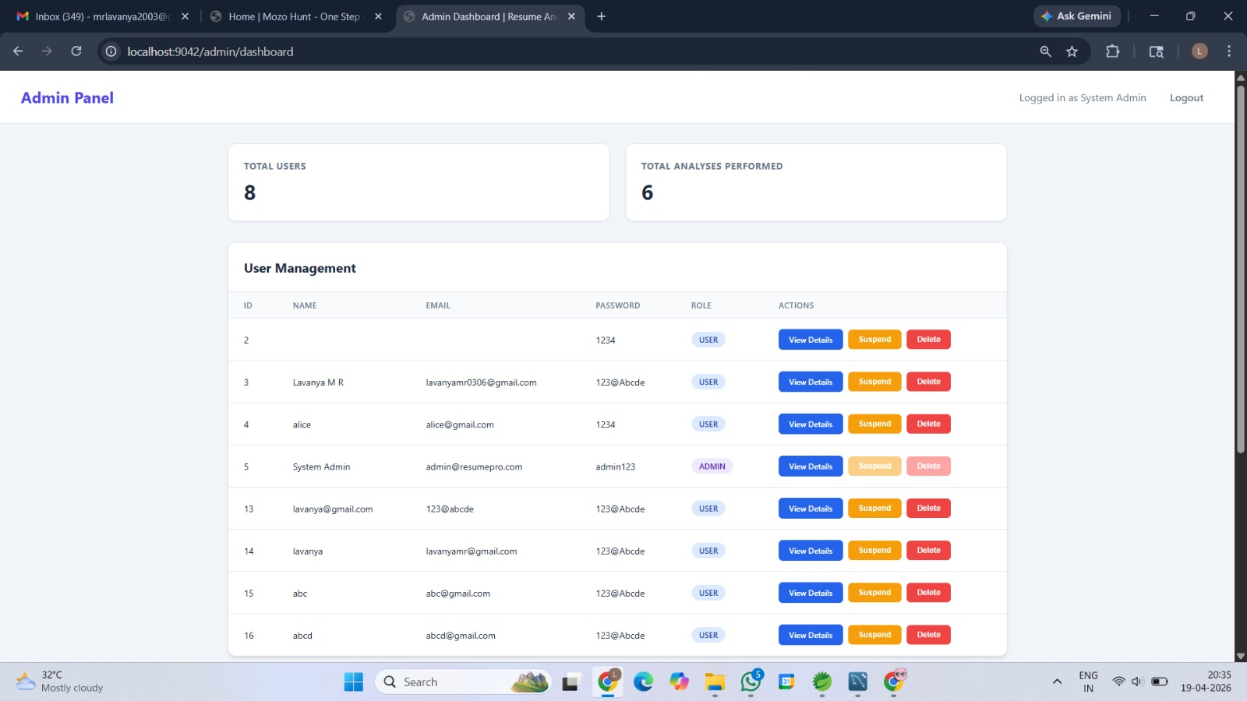
RESULTS

Slide 16
ADVANTAGES
Automates resume analysis and reduces manual effort.
Provides quick and clear match score.
Identifies matched and missing skills effectively.
Helps users improve resumes based on feedback.
Suggests suitable job roles based on profile.
Tracks performance using graphical representation.

Slide 17
LIMITATIONS
Based only on keyword matching (no deep understanding).
Limited job role mapping and predefined data.
Does not support real-time job portal integration.

Slide 18
FUTURE SCOPE
Integration with job portals (LinkedIn, Naukri, etc.).
Use of AI/ML for better resume analysis.
Advanced NLP for semantic understanding.
Personalized recommendations and suggestions.
Development of mobile application.

Slide 19
Conclusion
The Resume Analyzer System provides an efficient way to evaluate resumes based on job descriptions using a rule-based approach. It helps users identify skill gaps, improve resume quality, and understand suitable job roles. By automating the analysis process and providing clear results, the system reduces effort and enhances decision-making. Overall, the project successfully demonstrates a practical solution for resume evaluation.

Slide 20
REFERENCES
Spring Boot Documentation: https://spring.io
MySQL Documentation: https://www.mysql.com
Apache Tika Documentation: https://tika.apache.org⁠

Slide 21

THANK YOU

