Slide 1
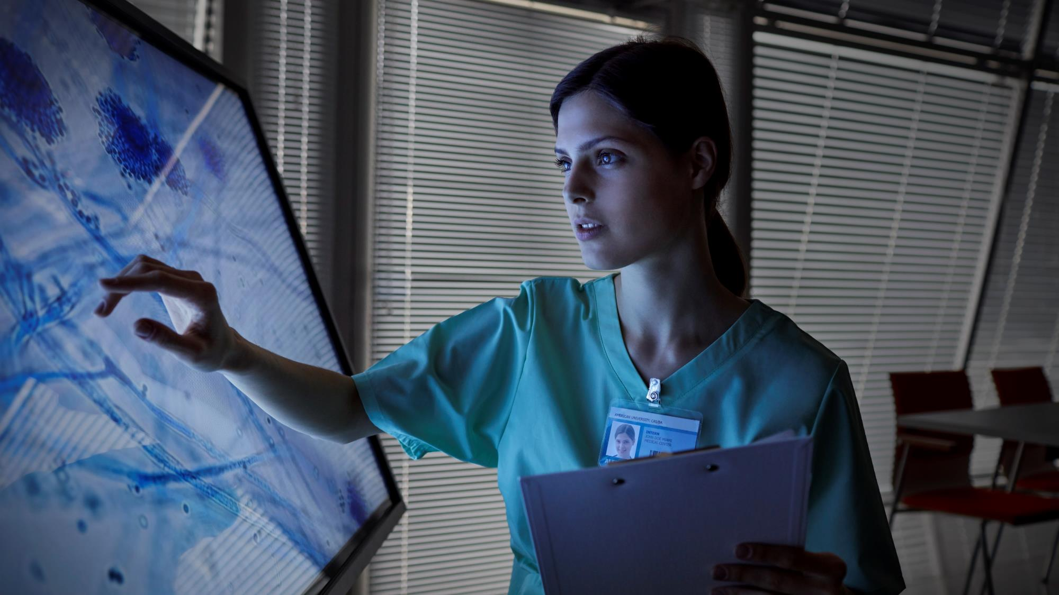
MEDX
Your Guide to Health, Nutrition, and Care.

Slide 2

Team Details:-
Team Name – Med-X
Team Member Details :—
1. Name — Jiya Yadav
2. Name — Lavanya Chaudhary
Institute Name and Address —
KIET Group of Institutions, Delhi-NCR, Meerut Road(NH-58), Ghaziabad - 201206, Uttar Pradesh, India.

Slide 3
Ideation statement:-
Theme:
Our aim is to create a website that uses machine learning algorithms to enhance user experience by providing patients results with optimum accuracy.
Our website delivers personalized patient care by predicting diseases, providing tailored wellness recommendations, and facilitating quick doctor referrals based on symptoms.
Leveraging advanced deep learning, we analyse image data for early disease detection while connecting patients to nearby doctors and hospitals for comprehensive care.
Artificial Intelligence in Healthcare

Slide 4
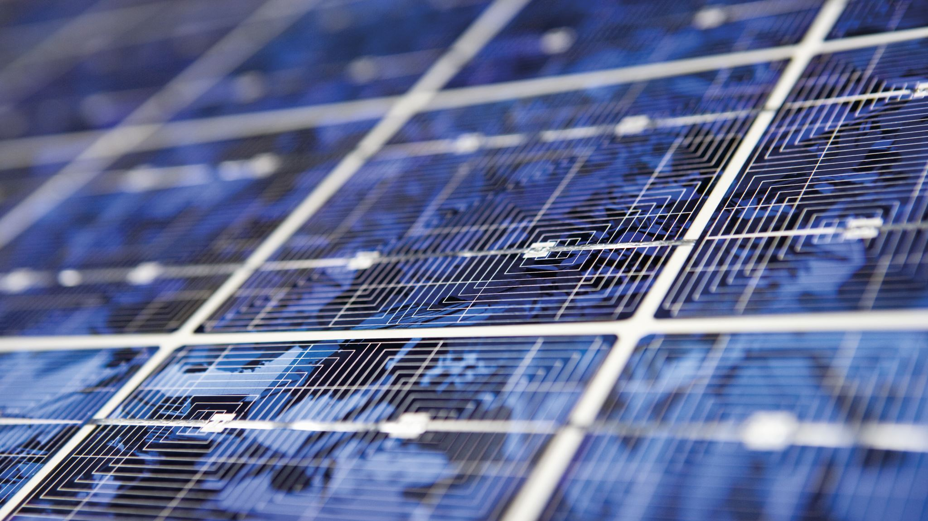
Problem statement:-
Timely Diagnosis Challenge: Patients face delays in receiving accurate diagnoses based on their symptoms, hindering prompt treatment.
Lack of Personalized Care: Existing resources do not provide tailored health recommendations or easy access to local healthcare options.
Need for Advanced Detection: Early detection of conditions like skin cancer and diabetic retinopathy is often missed due to inadequate image analysis tools.
Accessibility to Healthcare: Patients require a streamlined way to connect with nearby doctors and hospitals for effective care.

Slide 5
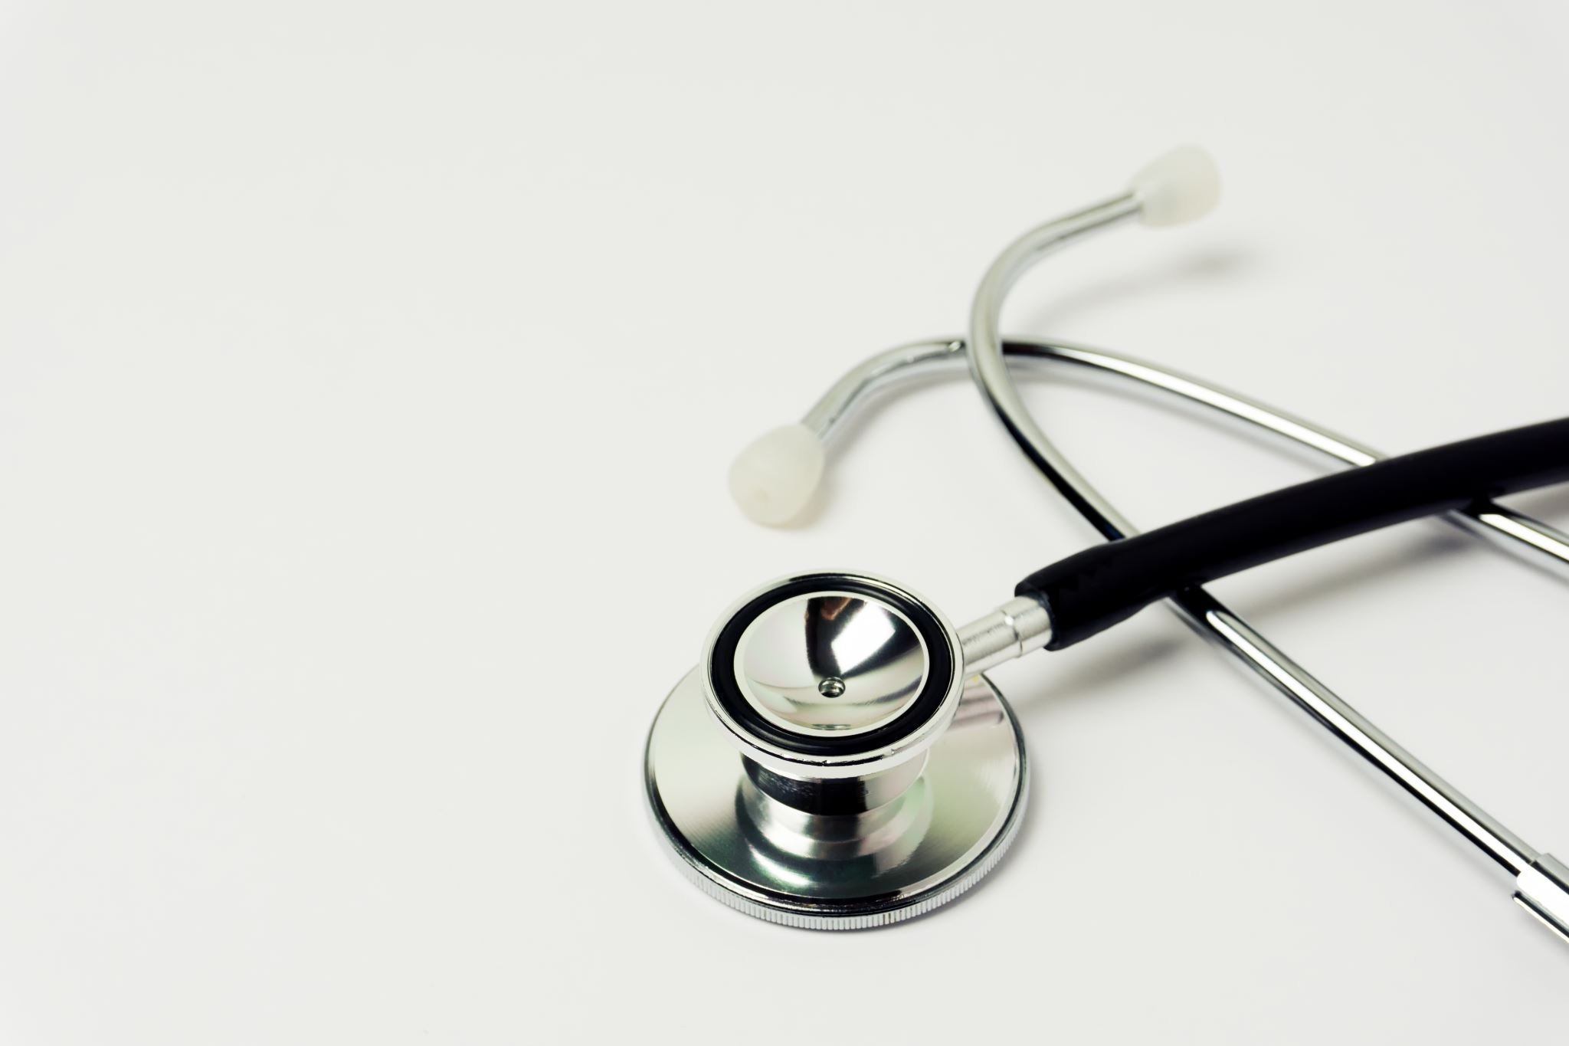
Description:-
Personalized Disease Prediction: Predicts diseases from patient-reported symptoms and offers tailored health advice.
Deep Learning for Early Detection: Analyzes medical images to detect conditions like malaria, skin cancer, etc.
Doctor & Hospital Recommendations: Suggests nearby doctors and hospitals based on the patient’s geographical location.
Holistic Patient Care: Provides a comprehensive solution for disease prediction, wellness suggestions, and medical referrals.

Slide 6
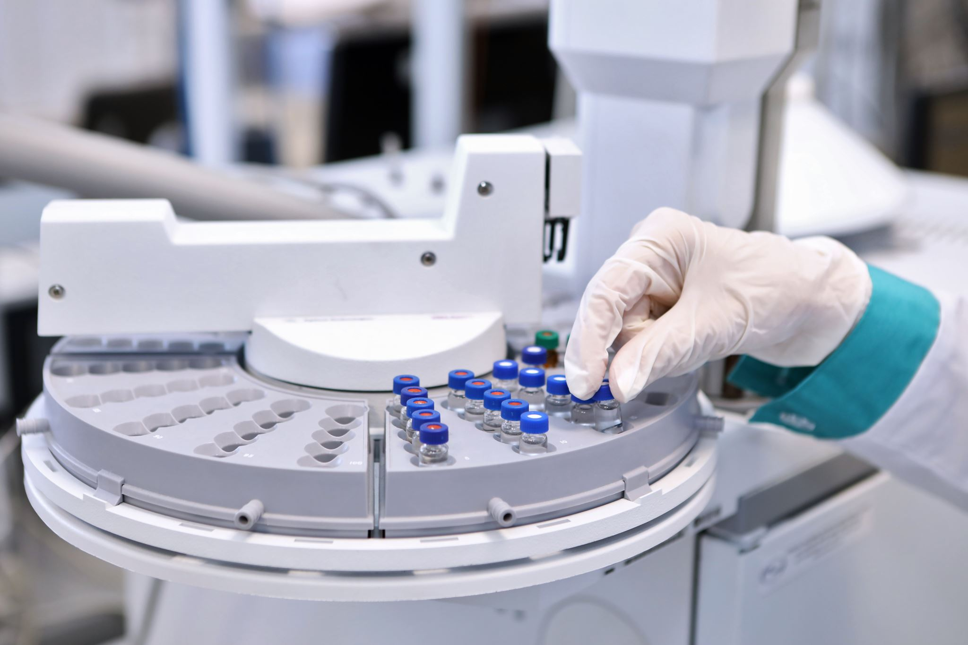
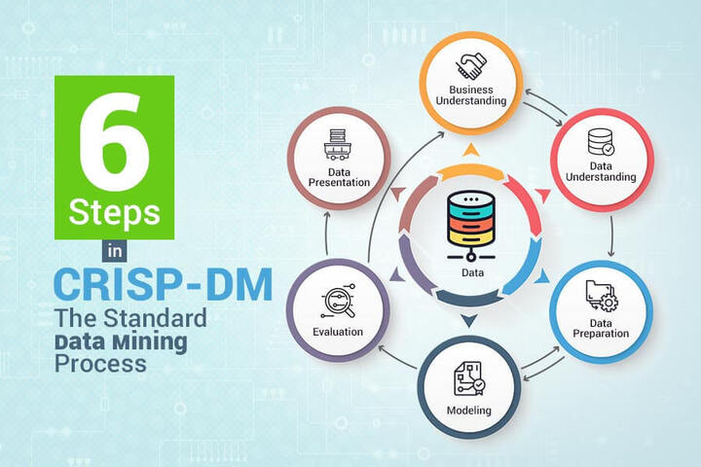
Solution Approach:-
Department prediction-
1. Data Collection: Gathering a dataset containing patient information and department.
2. Data Preprocessing: Cleaning and preprocessing the data
3. Machine Learning Model: Developing a machine learning model to predict department and heart disease. Algorithms used random forests, SVM classifier, naive bayes, etc are used for classification tasks.
4. Model Training: Training the machine learning model, fine-tuning it for optimal performance.
5. Model Evaluation: Evaluating the model’s performance on the testing dataset with the help of classification report, confusion matrix, accuracy score.

Slide 7
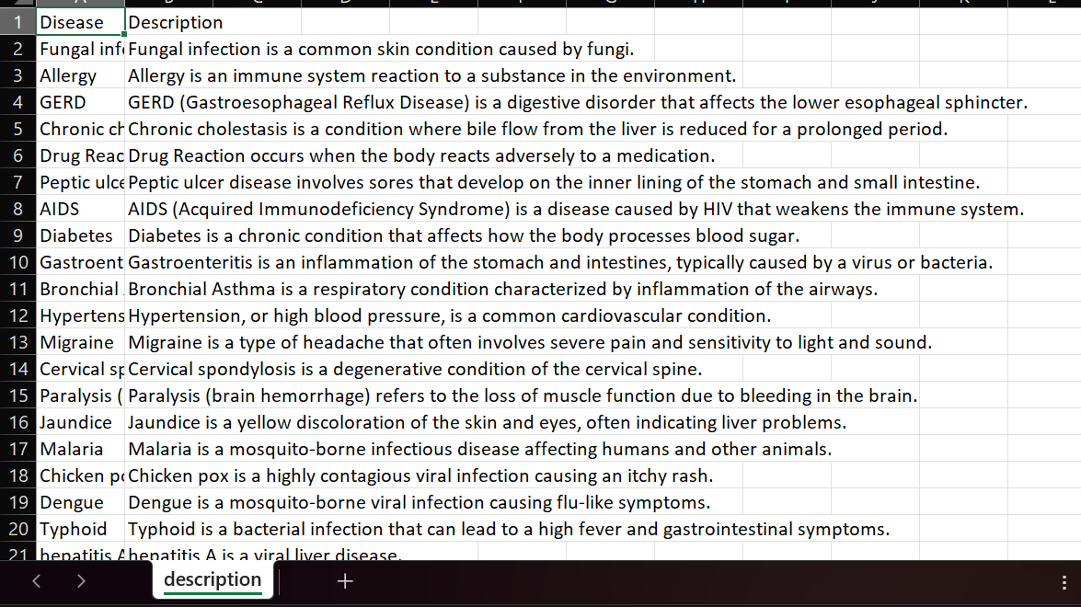
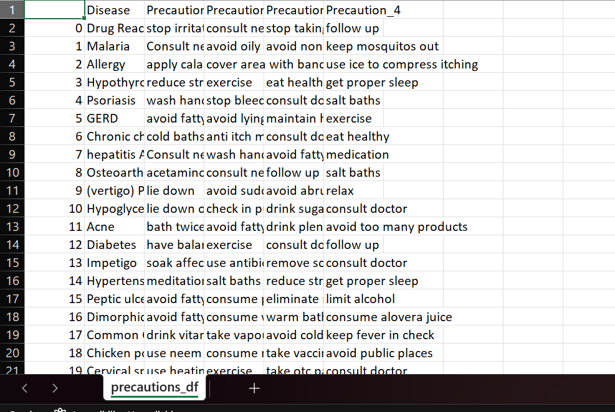
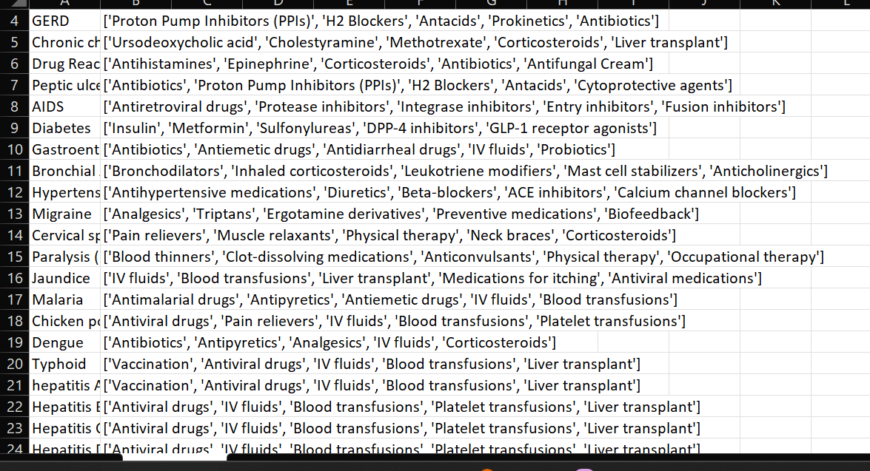
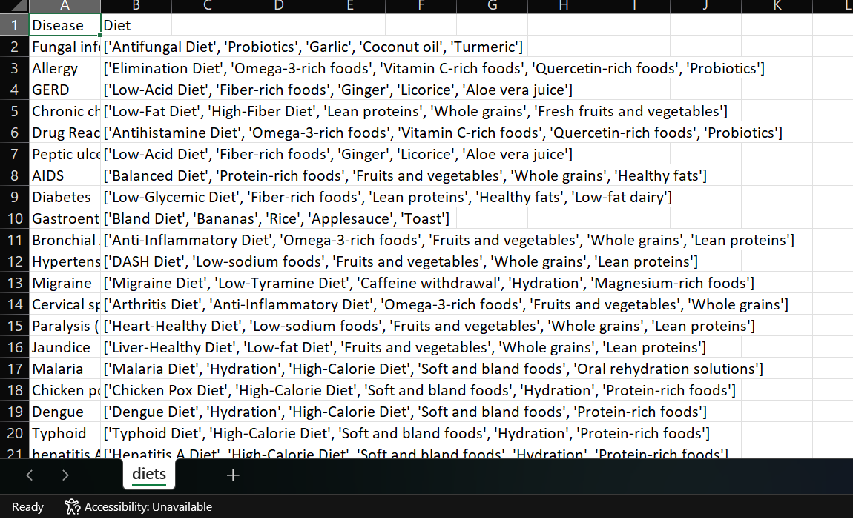
Sample Data:-

Slide 8

Technology Used:-
Language: Python v3.11.4
Platform: Google Colab
Libraries used:
Scikit-Learn (sklearn)
decision trees
random forests
Pandas
NumPy
Matplotlib and Seaborn
XGBoost (Gradient Boost)
Light GBM

Slide 9
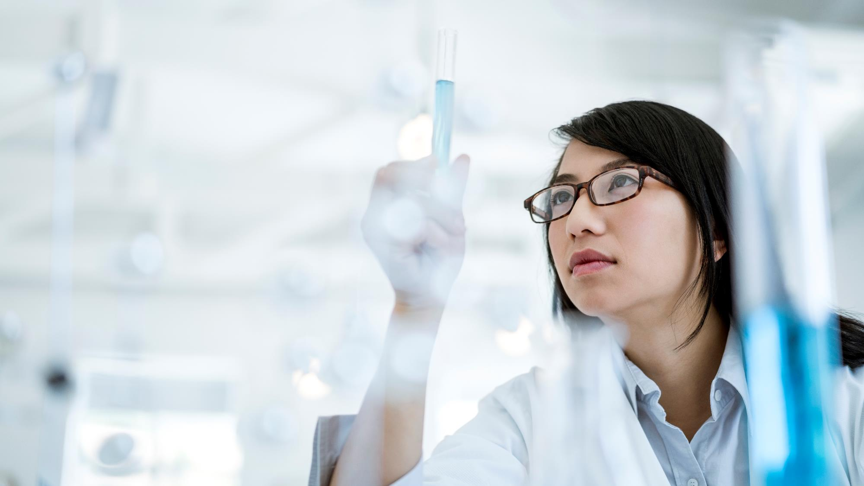
Thank you

