Slide 1
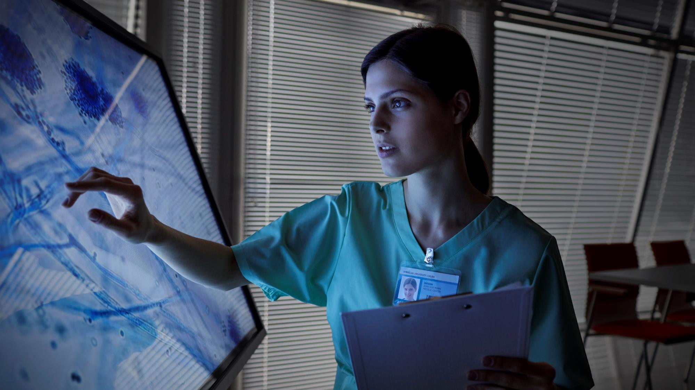
MEDX
Healthcare especially for you

Slide 2

Team Details:-
Team Name – Med-X
Team Member Details :—
1. Name — Lavanya Chaudhary
2. Name — Jiya Yadav
Institute Name and Address —
KIET Group of Institutions, Delhi-NCR, Meerut Road(NH-58), Ghaziabad - 201206, Uttar Pradesh, India.

Slide 3
Ideation statement:-
Theme:
Machine learning in Healthcare
Our aim is to create a website that uses machine learning algorithms to enhance user experience by providing them results with optimum accuracy.
The website will consist of two sections, first will offer patient care service like predicting appropriate department to visit based on symptoms.
Second section helps patients to predict heart disease, diabetes and other life threatening diseases.

Slide 4

Problem statement:-
Many patients arrive at the hospital without a clear understanding of which department to visit, resulting in suboptimal patient experiences and resource misallocation.
Building a predictive model that can assess the risk of heart disease and other life threatening disease in individuals based on a set of clinical and demographic features. .

Slide 5

Description:-
We aim to assist patients who arrive at the hospital seeking appointments but lack of clarity regarding the appropriate department to visit. By analyzing their symptoms, the system will effectively direct patients to the relevant department for further assistance and guidance.
If a patient arrives to a certain department after waiting in a long queue and doctor recommends him to visit another department for diagnosis and treatment, his time will be wasted. To avoid the wastage of time, our system will predict the department for patient with optimum accuracy.
Heart disease, diabetes, etc are the leading causes of death worldwide. Early detection and accurate prediction of these diseases can significantly improve patient outcomes and reduce the overall healthcare burden.

Slide 6
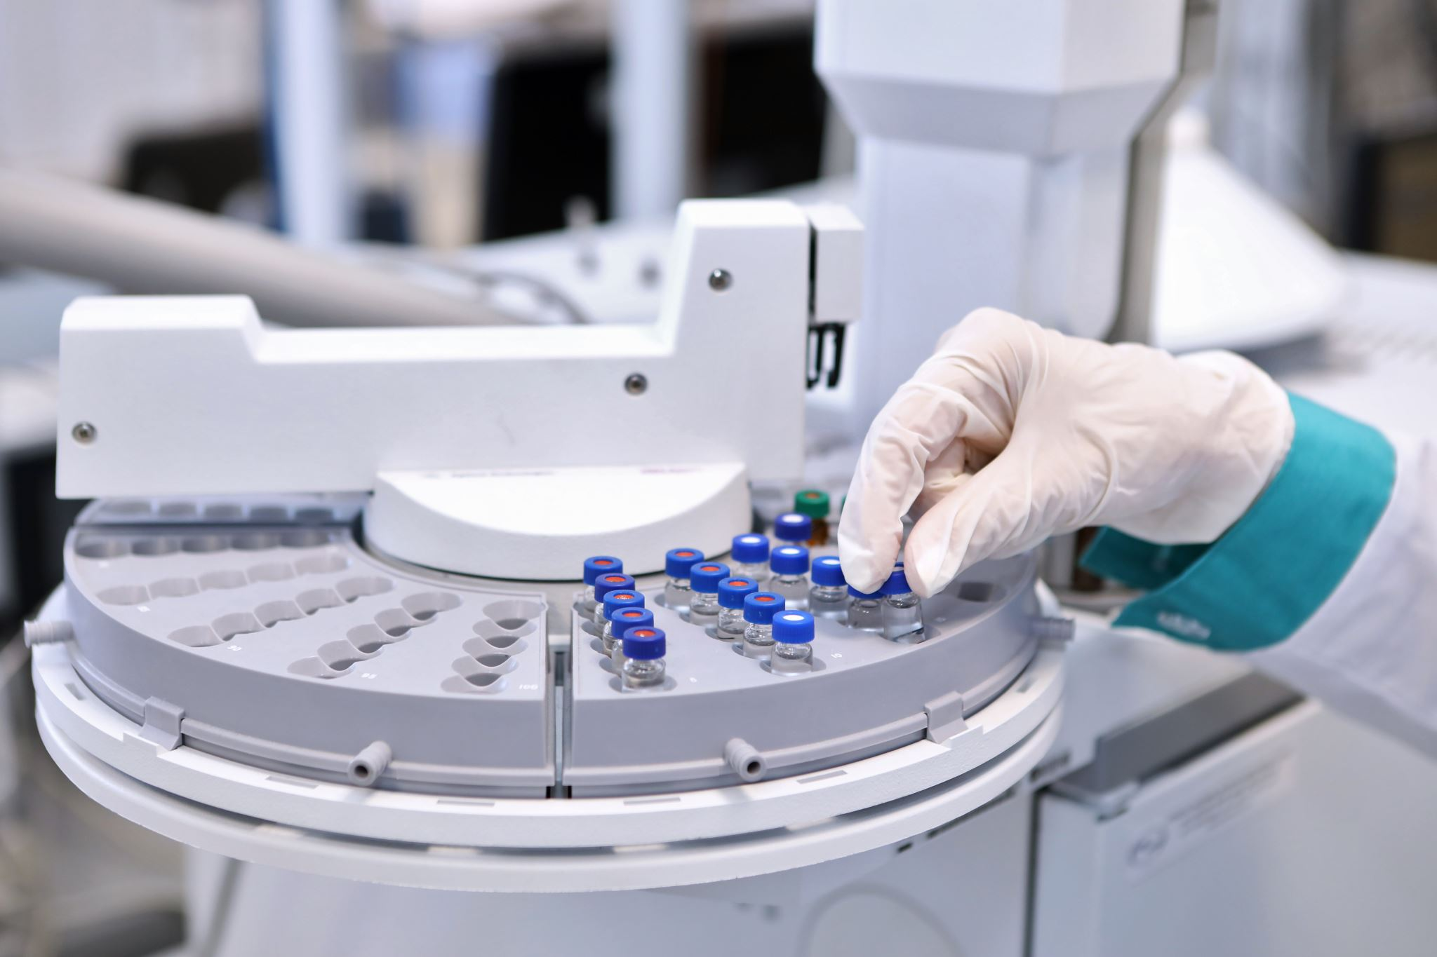
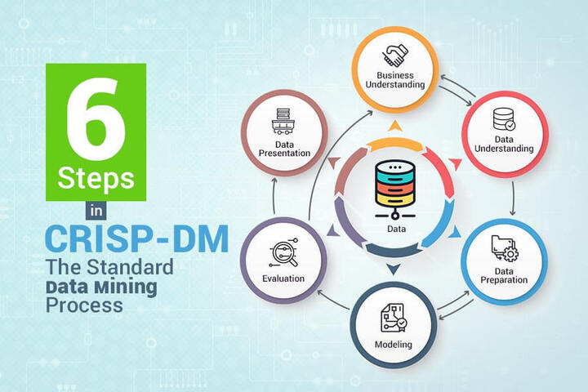
Solution Approach:-
Department prediction-
1. Data Collection: Gathering a comprehensive dataset containing patient information and department.
2. Data Preprocessing: Cleaning and preprocessing the data, including handling missing values and standardizing data formats.
3. Machine Learning Model: Developing a machine learning model that can effectively analyse patient symptoms to predict department and heart disease. Algorithms such as random forests, XG Boost, naive bayes, light gbm, etc are used for classification tasks.
4. Model Training: Training the machine learning model on the prepared dataset, fine-tuning it for optimal performance.
5. Model Evaluation: Evaluating the model's performance on the testing dataset with the help of classification report, confusion matrix, accuracy score.

Slide 7
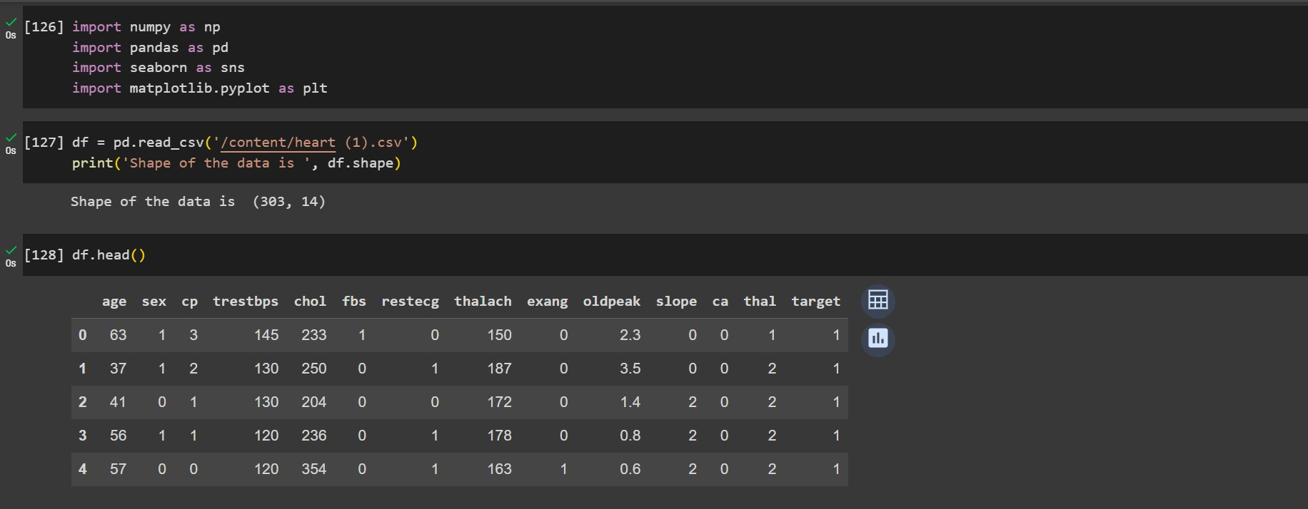
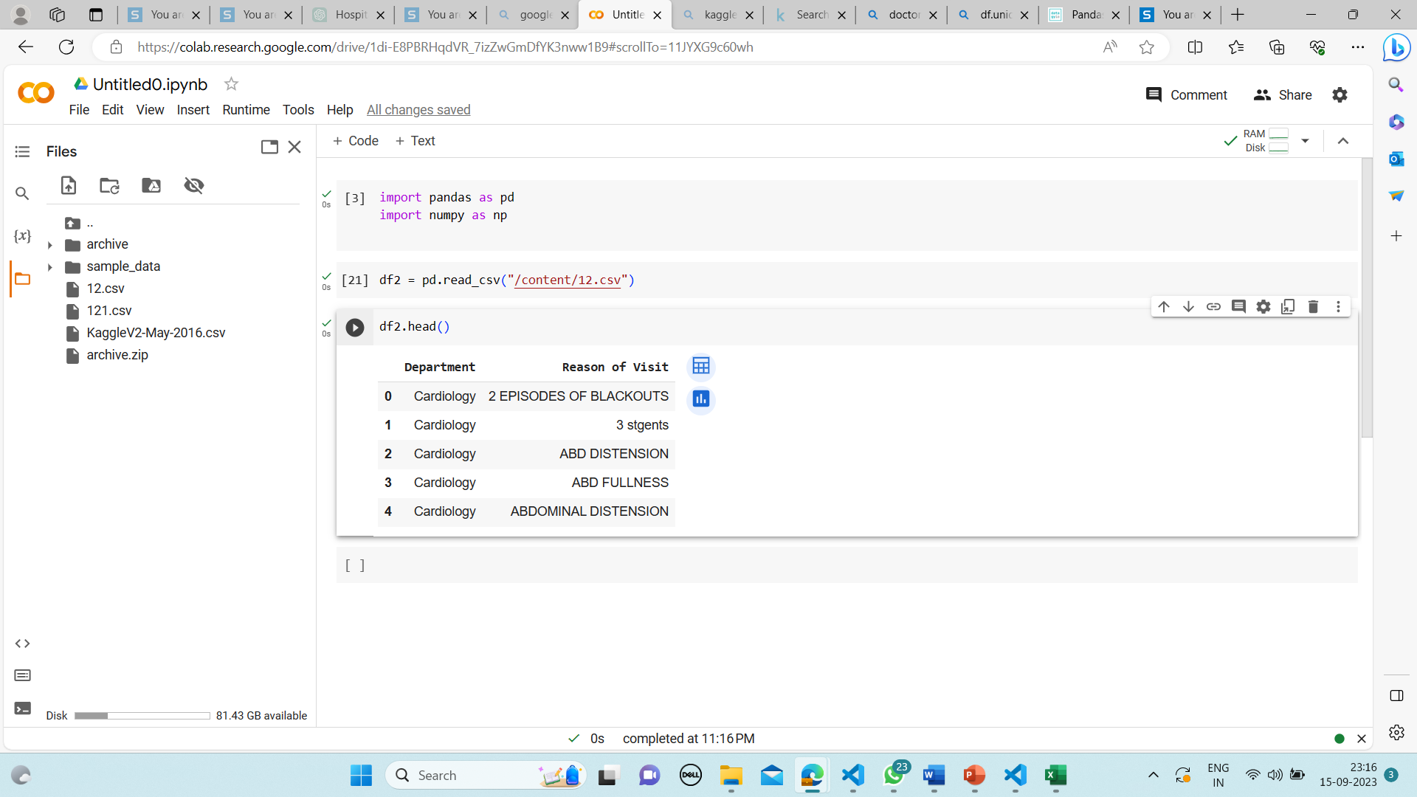
Sample Data:-
Heart disease prediction
Department prediction

Slide 8

Technology Used:-
Language: Python v3.11.4
Platform: Google Colab
Libraries used:
Scikit-Learn (sklearn)
decision trees
random forests
Pandas
NumPy
Matplotlib and Seaborn
XGBoost (Gradient Boost)
Light GBM

Slide 9
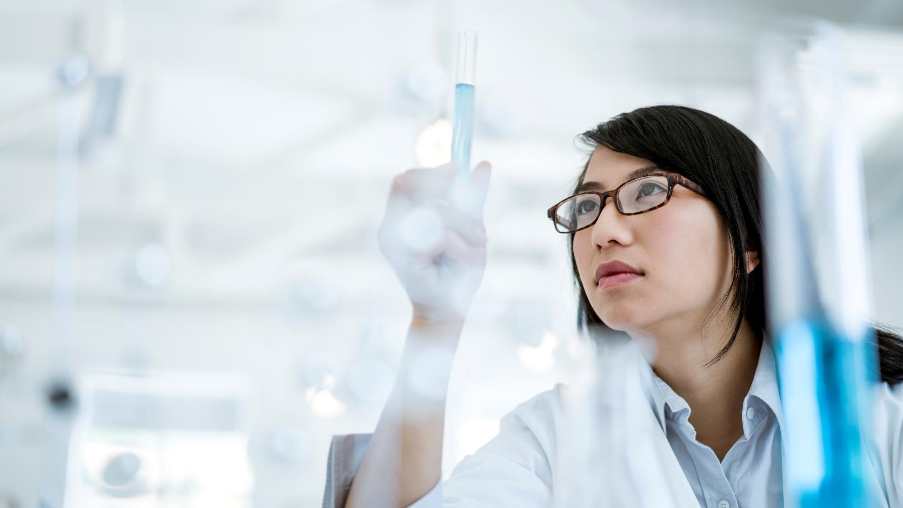
Thank you

