Slide 1
Airbnb Revenue Analysis and Strategies for Post-Pandemic Growth
Lavanya Ravilla

Slide 2
Agenda
Objective
Insight
Appendix
Data Source ,Methodology

Slide 3
Agenda
Airbnb, as in “Air Bed and Breakfast,” is a service that lets property owners rent out their spaces to travelers looking for a place to stay.
Airbnb's revenue has declined significantly in recent months.
With restrictions lifting and travel on the rise, Airbnb is gearing up for a post-pandemic boom.
Understanding the dataset and finding the key inference where the business is stable and unstable.

Slide 4
Objective:
Enhance business strategies and predict customer preferences in NYC for the post-pandemic travel boom.
Analyze the revenue returns of different boroughs and identify areas for improvement.
Discuss customer preferences for the type of listing, minimum stay, and host.
Discuss the popularity and compare customers preference between boroughs
Finding the top 10 hosts, popular areas and unpopular areas .

Slide 5
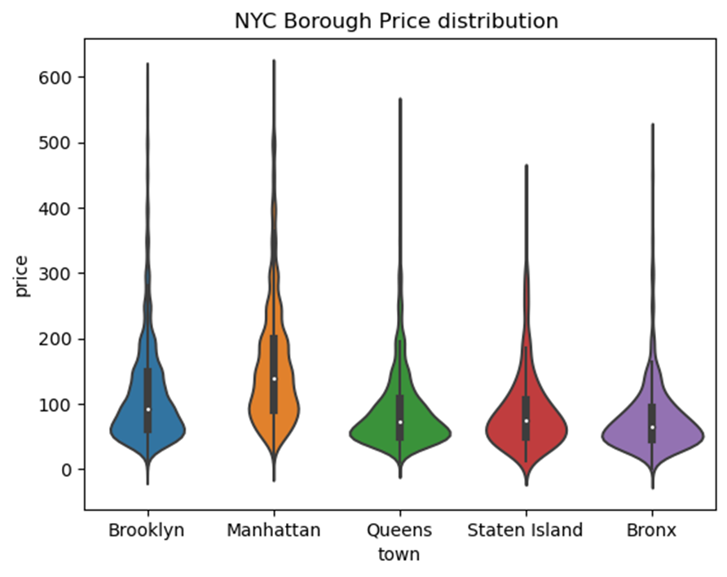
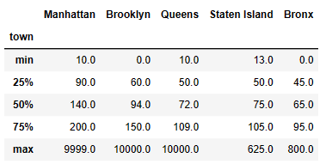
NYC Borough price distribution
Insight
Manhattan is the most popular town for customers, with the highest average price greater than 130$. This is likely due to its popularity as a tourist destination and its central location in New York City.
Bronx ,Queens Town and Staten Island have the lowest average price less than of 75$.
The Max price of Manhattan goes up to $360 followed by Brooklyn and Staten Island $320

Slide 6
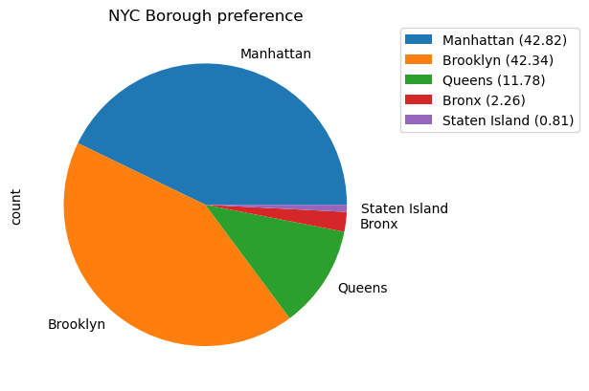
Contd..
NYC BOROUGH AND ITS LISTINGS
'Manhattan’ and 'Brooklyn has most listing with 42%.
This means customer prefer Manhattan and Brooklyn over other borough due to Convenience,Diversity,Transportation and Safety.
'Staten Island’ has less the 1 % listings only which Customer prefer Manhattan and Brooklyn over other borough due to Convenience,Diversity,Transportation and Safety.
Implies customer preference is not significant.

Slide 7
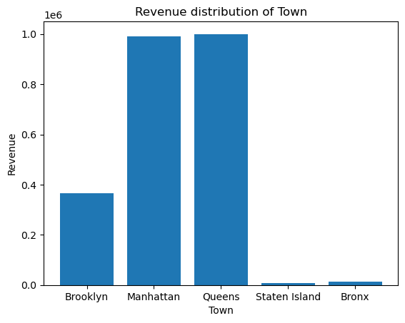
Contd..
Manhattan and Queens Town has high revenue returns.
Queens Town had only 11% listings but best revenue.
As expected Manhattan has highest return.

Slide 8
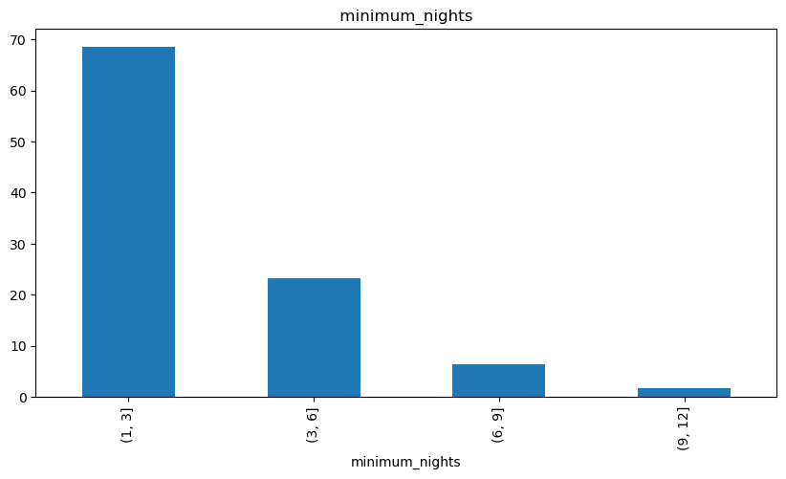
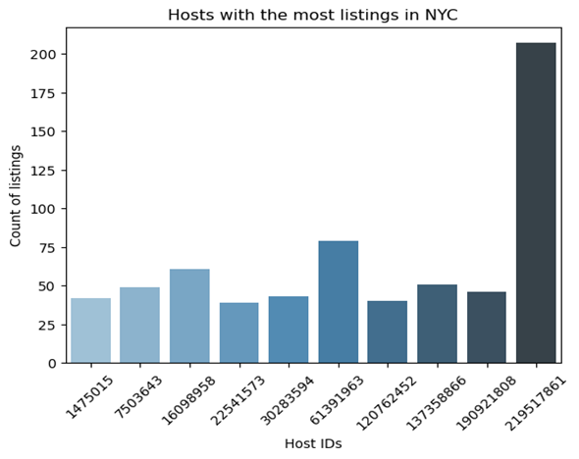
Contd..
Customer Prefer Minimum night in the range 1 to 3
Sonder (NYC) host with id 21951861 has more than 200 listing

Slide 9
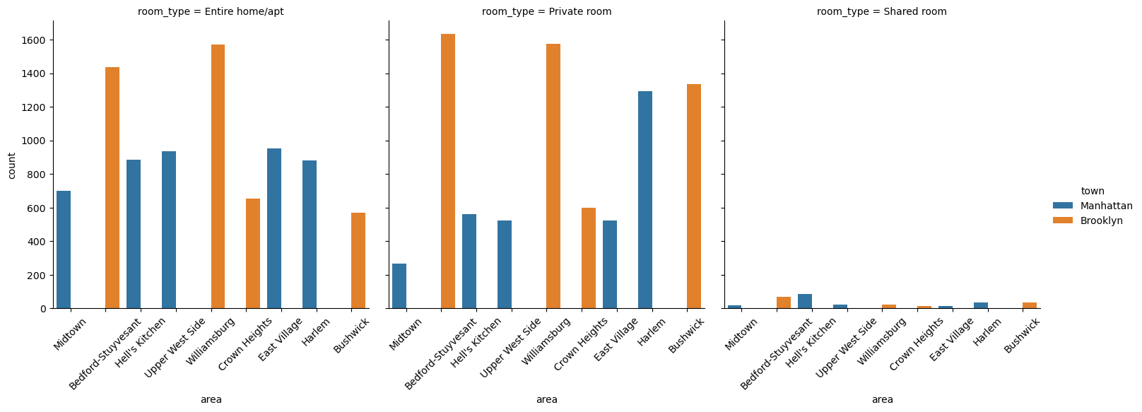
Top 10 popular properties present in Town with room type
Entire homes, apartments, and private rooms in Brooklyn, especially in the Bedford-Stuyvesant and Williamsburg areas, are popular listings.
Private rooms in the Harlem area of Manhattan are also popular listings, but none choose shared rooms.

Slide 10
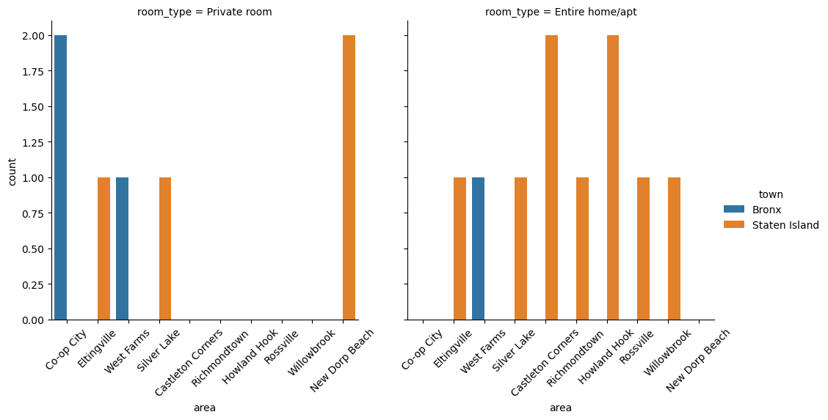
Top 10 unpopular properties present in Town
Top unpopular listings found in Staten Island areas .
Eltingville and Silver Lake shows prominent areas which needs to be improved.
Co-op city in Bronx of private room requires attention

Slide 11
Appendix;
Manhattan and Brooklyn are the most popular boroughs for Airbnb listings with 42% .
Manhattan is the most popular town for customers, with the highest average price greater than $130.
Queens Town has the best revenue returns, despite having only 11% listings.
Customers prefer entire homes, apartments, and private rooms in Brooklyn, especially in the Bedford-Stuyvesant and Williamsburg areas.
Customers prefer private rooms in the Harlem area of Manhattan, but none choose shared rooms.
The most unpopular listings are found in Staten Island areas, especially Eltingville and Silver Lake.
Sonder (NYC) host with id 21951861 has more than 200 listings.
Customers prefer a minimum stay of 1 to 3 nights.

Slide 12
Data Source and Methodology
Data set “AB_NYC_2019” is provided in the form of excel with 48895 rows and 16 columns
Used Jupiter Python is used for Data Understanding, Pre-processing, and general Univariate ,Bivariate and Multivariate Analysis.

