Slide 1
Airbnb in New York City: A Case Study in Acquisition, Operations, and User Experience
Lavanya Ravilla

Slide 2
Agenda
Objective
Insight
Appendix
Data Source ,Methodology

Slide 3
Agenda
Analysis of Air bnb average revenue and average review ratings
Identify neighborhoods in demand.
Forecast average price of Airbnb listings.
How to maximize guest satisfaction on neighborhood group

Slide 4
Objective
Identify neighborhoods which are higher revenue potential.
Understand the factors that contribute to high revenue.
Identify neighborhoods that are undervalued.
Identify opportunities for Airbnb to grow its business.
Forecast property listing price post pandemic

Slide 5
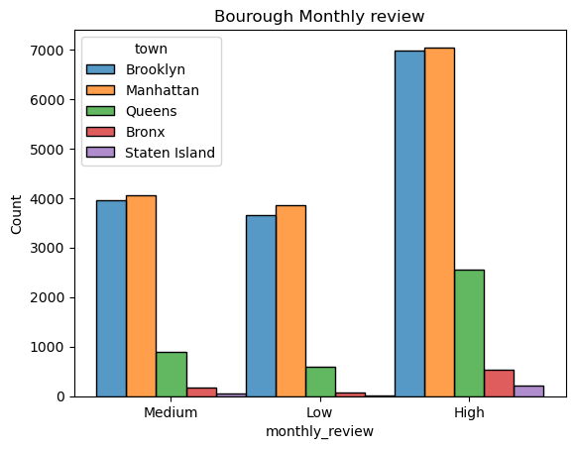
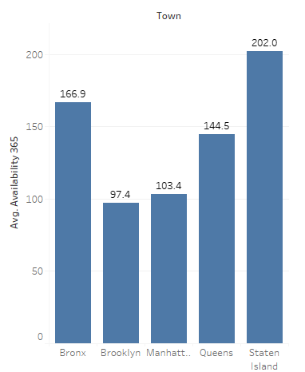
NYC Borough monthly review and its Average Availability
Guest satisfaction review rating for Manhattan and Brooklyn is high
Satisfaction review for Queens is medium.
Bronx and Staten Island listing properties given very less review rating.

Slide 6
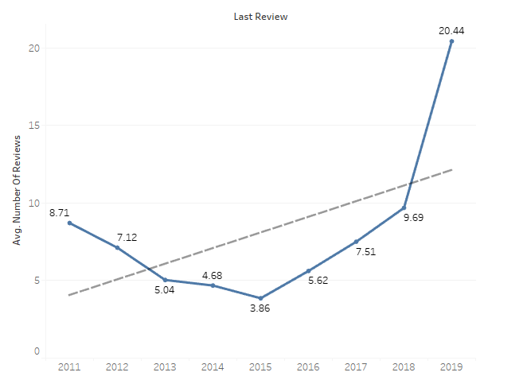
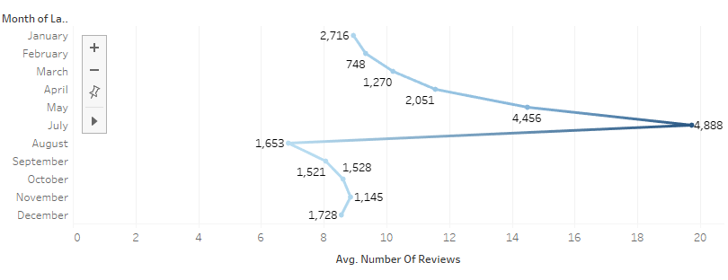
Number of Customer Reviews - Year and Month wise analysis
The average number of reviews shoot up in 2019
More number of reviews are observed in the month of July.

Slide 7
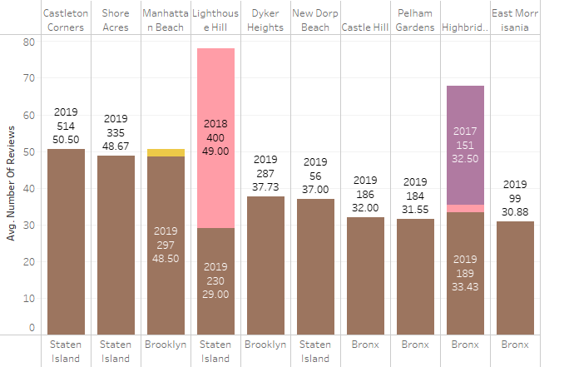
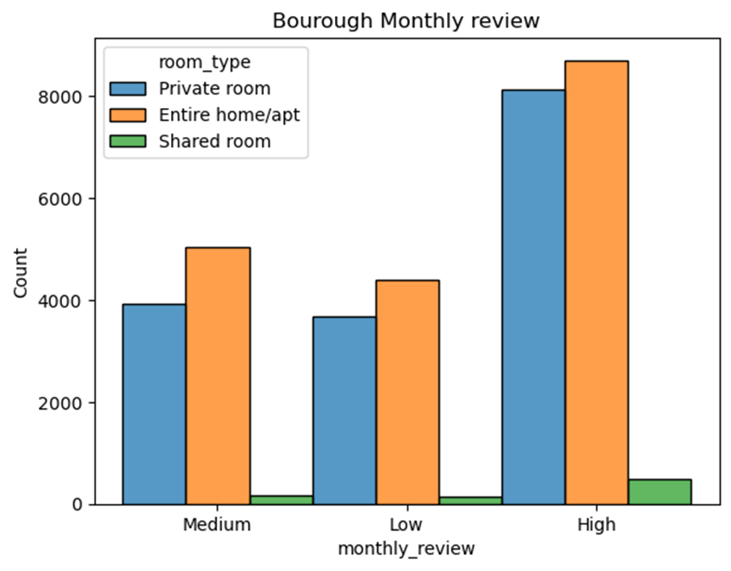
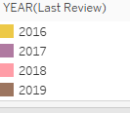
Average reviews in top 10 areas under NYC borough
Casrleton corners,shore acres of Staten island followed by Manhattan Beach of Brooklyn had average revenue based on average number of reviews in the year 2019 .
Least reviews were found in the year 2016 and 2017

Slide 8
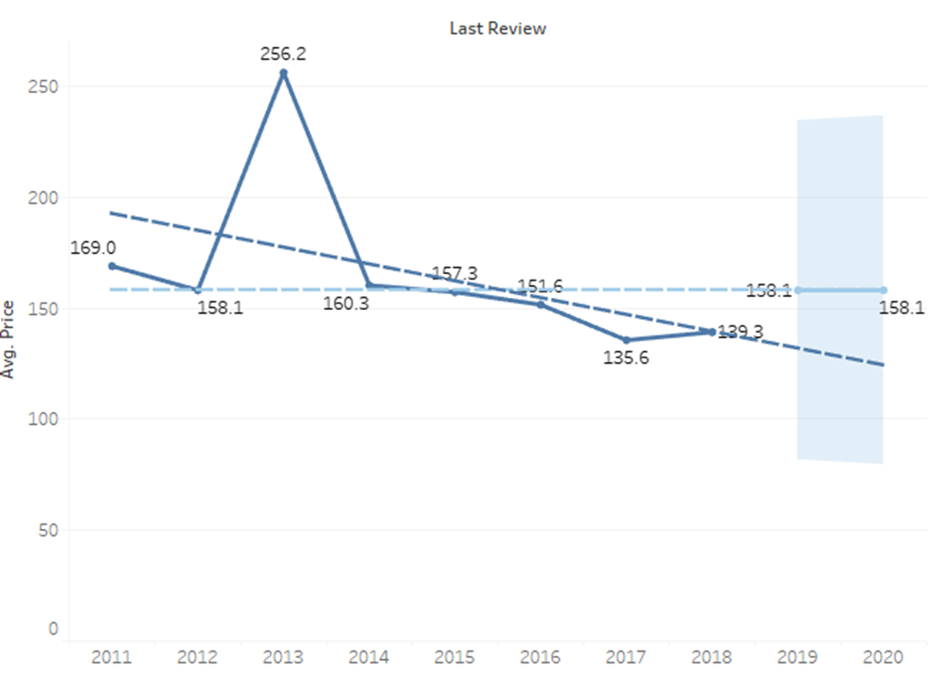
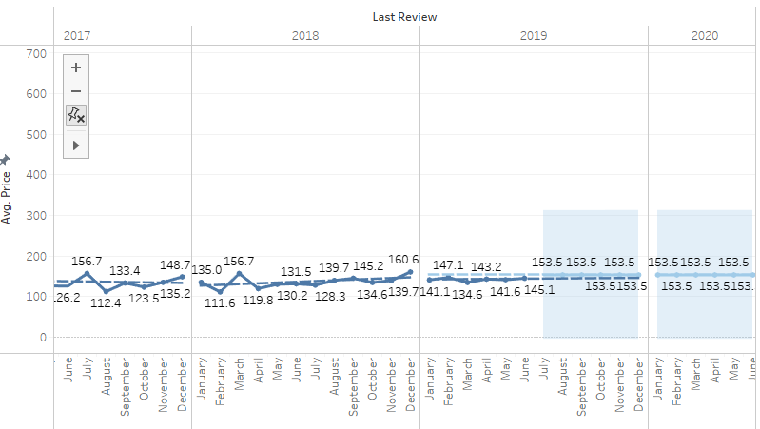
Forcast -Average price w.r.t year ,month
Average Price forecasted post pandemic for the first two quarter of 2020 is $153

Slide 9
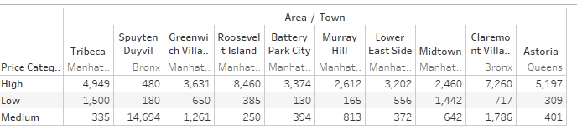
top 10 NYC Borough areas -Price category in average revenue
Roosevelt Island of Manhattan and Astoria of Queens have high price category with average revenue in medium range.
Spuyten Duyvil of Bronx has medium price category with high revenue.
Battery Park City of Manhattan has low pricing and lower revenue

Slide 10
Appendix:
This suggests that customers who leave high reviews are more likely to spend more money.
Manhattan Beach is a popular destination for Airbnb guests who are willing to spend more money.
Average price of Airbnb listings is expected to increase in the first two quarters of 2020.
Customers in Roosevelt Island and Astoria are willing to pay more for Airbnb listings, even though the average revenue in these areas is not the highest.
Spuyten Duyvil is a good value for Airbnb guests, as it offers medium-priced listings with high revenue.
Battery Park City is a good option for budget-minded Airbnb guests

Slide 11
Data Methodology
Data set “AB_NYC_2019” is provided in the form of excel with 48895 rows and 16 columns
Used Jupiter Python is used for Data Understanding, Pre-processing
Further Analysis and visualization done in Tableau desktop.

