Slide 1
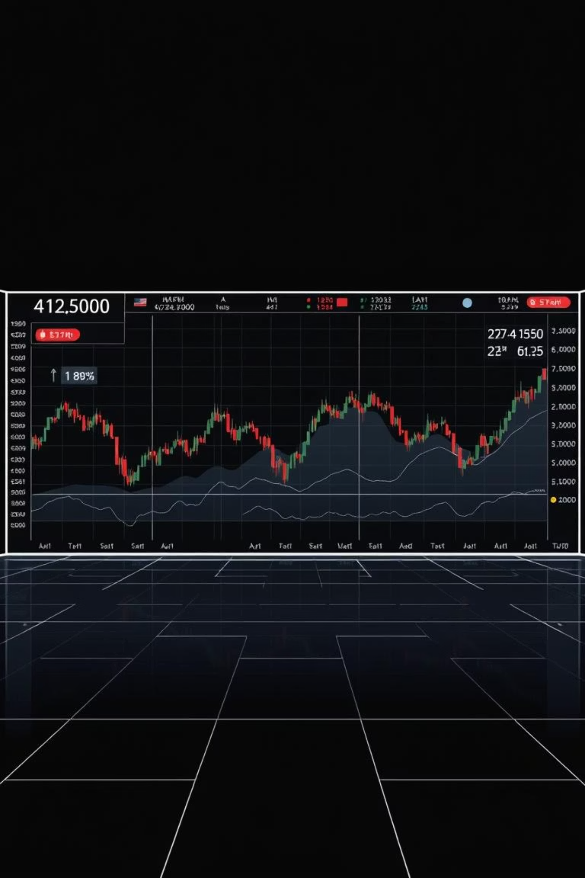
📈 StockInfo – Real-Time Stock Monitoring System
Empowering investors with instant insights into market fluctuations, StockInfo is designed to provide real-time alerts on stock price volatility. Our system ensures you're always informed when prices move beyond your specified thresholds, keeping you ahead in dynamic markets.

Slide 2





System Architecture: From Data to Decision
Watchlist Management
SharePoint List
Automated Data Fetch
Power Automate
External API Integration
Alpha Vantage (via Postman)
Threshold Monitoring
Real-Time Alerts
Dynamic Visuals
Excel Dashboards
Our robust architecture leverages Power Automate to fetch real-time stock data from the Alpha Vantage API. This data is then compared against user-defined volatility thresholds in a SharePoint-managed watchlist. Significant price movements trigger automated email notifications, while all data is seamlessly integrated into Excel for dynamic visualization and in-depth analysis.

Slide 3



Outcome & Future Scope: Expanding Horizons
Immediate Impact
Strategic Enhancements
Instant Volatility Alerts
Users receive real-time notifications on significant stock price fluctuations.
Snowflake Integration
Centralized Data Management
Enabling advanced analytics with historical stock data storage.
SharePoint offers a secure and accessible platform for watchlists and stock data.
Interactive Analysis
Power BI Visualizations
Excel dashboards provide dynamic visualization for informed decision-making.
Introducing richer, real-time dashboards and predictive trend analysis.
Mobile-Friendly Alerts
Expanding notifications to Teams or SMS for on-the-go accessibility.

