Slide 1
Employee Data Analysis using Excel
STUDENT NAME: Lavanya. S
REGISTER NO: 122202178
NM ID(User Name): 20D288B5FC1FD78A3A44F42117CB2778
DEPARTMENT: B.COM (Corporate Secretaryship)
COLLEGE: Anna Adarsh College For Women

Slide 2
PROJECT TITLE
Employee Performance Analysis using Excel

Slide 3


AGENDA
Problem Statement
Project Overview
End Users
Our Solution and Proposition
Dataset Description
Modelling Approach
Results and Discussion
Conclusion
3/21/2024 Annual Review

Slide 4

PROBLEM STATEMENT
Employee Performance Analysis is used either to achieve a performance improved or to ensure that the performance of an employee remains at an acceptable level.

Slide 5

PROJECT OVERVIEW
Employee Performance Analysis involves evaluating various metrics such as productivity, efficiency, and output quality to assess individual and term performance.

Slide 6
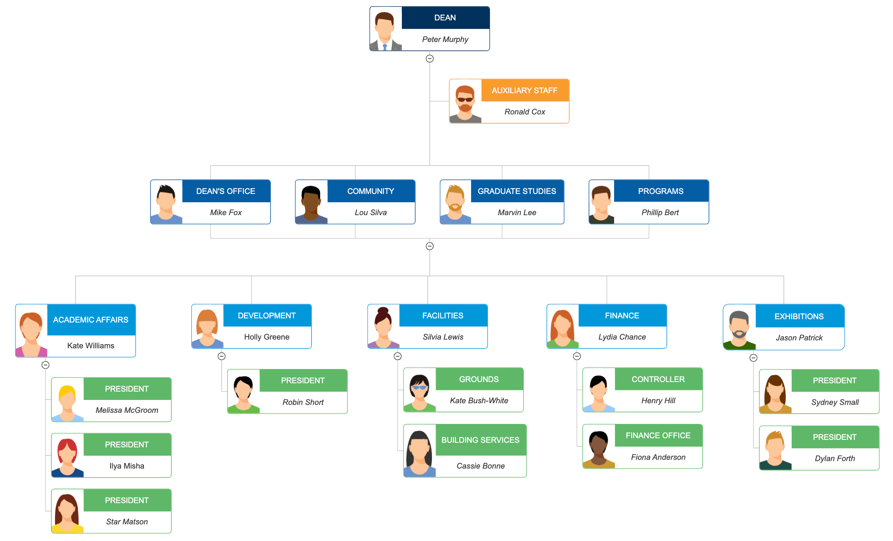

WHO ARE THE END USERS?
Employer
Employee
Organization
Various IT Sectors
Industries

Slide 7

OUR SOLUTION AND ITS VALUE PROPOSITION
Conditional Formatting- missing
Filter- Remove
Formula- Performance
Pivot- Summary
Graph- Data Visualization

Slide 8
Dataset Description
Employee- kaggle
26- Feature
9- Feature
Employee id- Num
Name- Text
Employee Type
Performance Level
Gender- Male Female
Employee Rating- Num

Slide 9
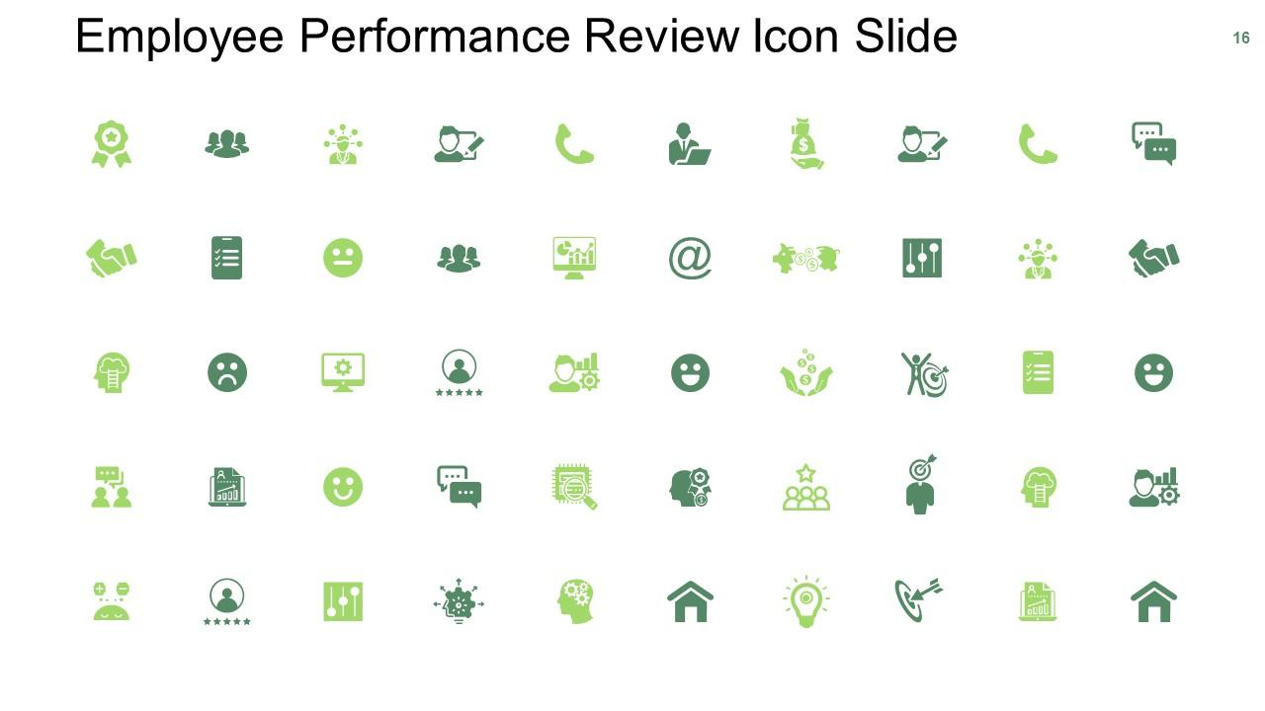

THE "WOW" IN OUR SOLUTION
3/21/2024 Annual Review
9

Slide 10
MODELLING
Data Collection
Downloaded from Kaggle
Downloaded from Edu net dashboard
Feature Collection
Pivot Table
Charts
Bar Graph
Data Cleaning
Identifying Missing Values
Filtering the Missing Values
10

Slide 11
RESULTS
11

Slide 12
RESULTS

Slide 13
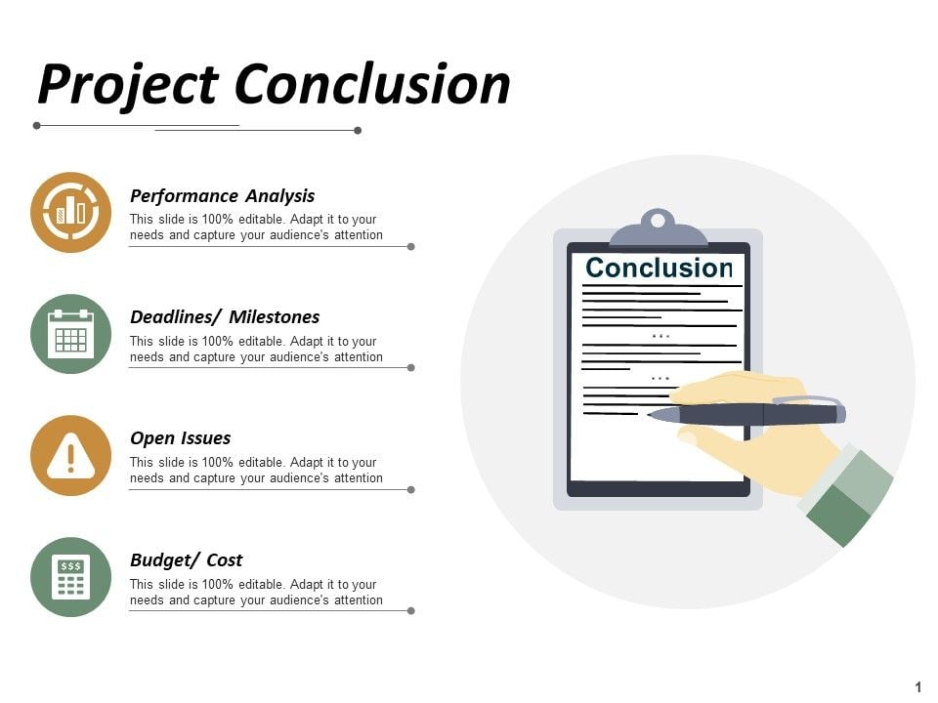
conclusion

