Slide 1
AgroPro

Slide 2
TEAM NAME : GEARHEADS
LAVEENA DUDANI
19BCE10378
ADITI NIGAM
19BCE10300
DIVYA MATHEW
19BCE10456

Slide 3
01
PROBLEM STATEMENT & OBJECTIVE
CONTENTS
02
OUR IDEA AND OUTLOOK
03
FLOW DIAGRAM
03

Slide 4
Traditional cropping patterns are not effective in today's rapidly changing,unpredicted climate and polluted soils.
Likewise, every region is unique in relation to each other and has various properties.
Our goal is to design a system to predict the most suitable crop for that region,
harvest time, plantation pattern and maintenance of that crop for better yield
utilizing information like soil quality, weather, resources, and other factors that
affect crop production.
PROBLEM STATEMENT & OBJECTIVE

Slide 5
OUR IDEA AND OUTLOOK

Slide 6
Infographic Style
Our idea and outlook
PIVOTAL ELEMENTS
Our aim is to develop an app which is facile and trouble - free. In today's rapidly and increasingly changing climate and weather,it often becomes hard to determine which crop needs to be grown in which part of India. So to determine the crops to be grown, we have made ou app based on some pivotal elements that determines the efficiency of crop production in a particular district of a particular state of India.
LOCATION
SEASONS
SOIL TYPE
CROPS GROWN
CROP INFO

Slide 7
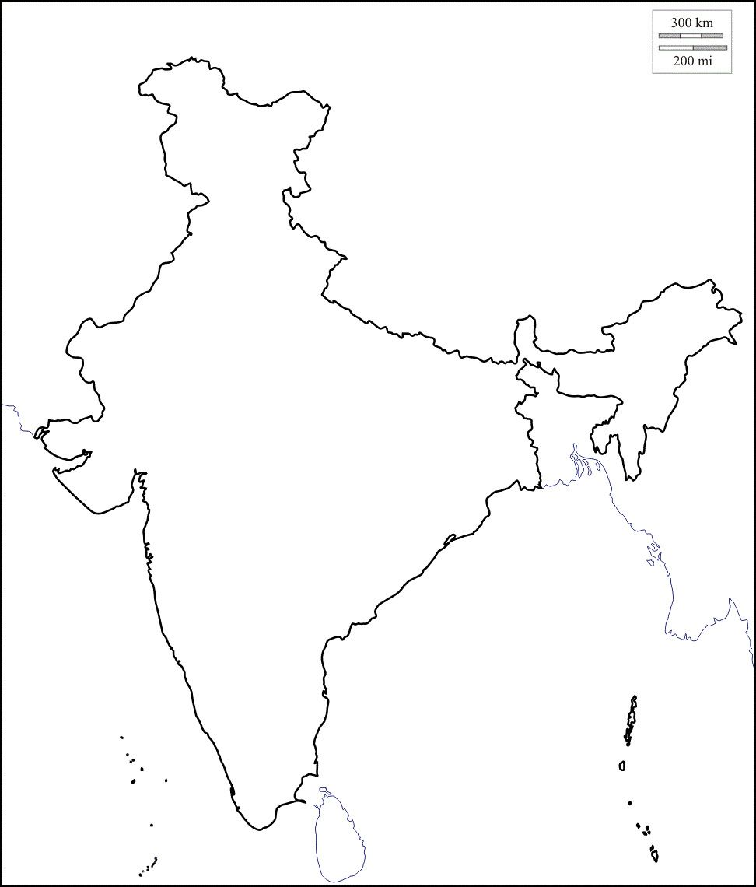
LOCATION
We have considered 5 districts of UP and determined which crops needs to be grown
We haveconsidered 5 districts of MP and determined which crops needs to be grown
UTTAR PRADESH
MADHYA PRADESH
We haveconsidered 5 districts of west bengal and determined which crops needs to be grown
We have considered 5 districts of Maharashtra and determined which crops needs to be grown
WEST BENGAL
MAHARASHTRA
5 districts of Kerela are considered
NOTE : This app is just a prototype, hence we have considered only 5 states. We can add all the 28 states of India, which will allow the user to decipher the crops grown in any part of the country by simply selecting the state, district, crop season and soil type.
KERELA

Slide 8
SEASONS
KHARIF SEASON
RABI SEASON
ZAID SEASON
This is another major component to determine the crops grown in a particular area.
This is another major component to determine the crops grown in a particular area.
This is another major component to determine the crops grown in a particular area.
KHARIF SEASON
Time period
June - Nov
RABI SEASON
ZAID SEASON
Time period
Nov - April
Time period
March - June

Slide 9
SOIL TYPE
Minerals
Air
01
02
Organic matter
Sand and gravel
03
04
Silts and clays
05
06
Water
Soil type is one of the major components when it comes to crop production. Most of the crops grow only in particular type of soil. It's also important to know the pH of the soil, the weather required, etc. for crop production.

Slide 10
CROPS GROWN and CROP INFO(OUTPUT)
WEATHER
This will provide us with the weather suitable for the particular crop to be grown.
CROPS GROWN
This will determine and provide the list of crops grown in the particular district of the state selected based on the season and soil type in which the crop is grown.
RESOURCES
This will provide us tge resources like the climate or temperature suitable for crop production.
pH OF THE SOIL
The crop info will provide us with the pH of the soil in which the particular crop is grown.

Slide 11
FLOW DIAGRAM

Slide 12
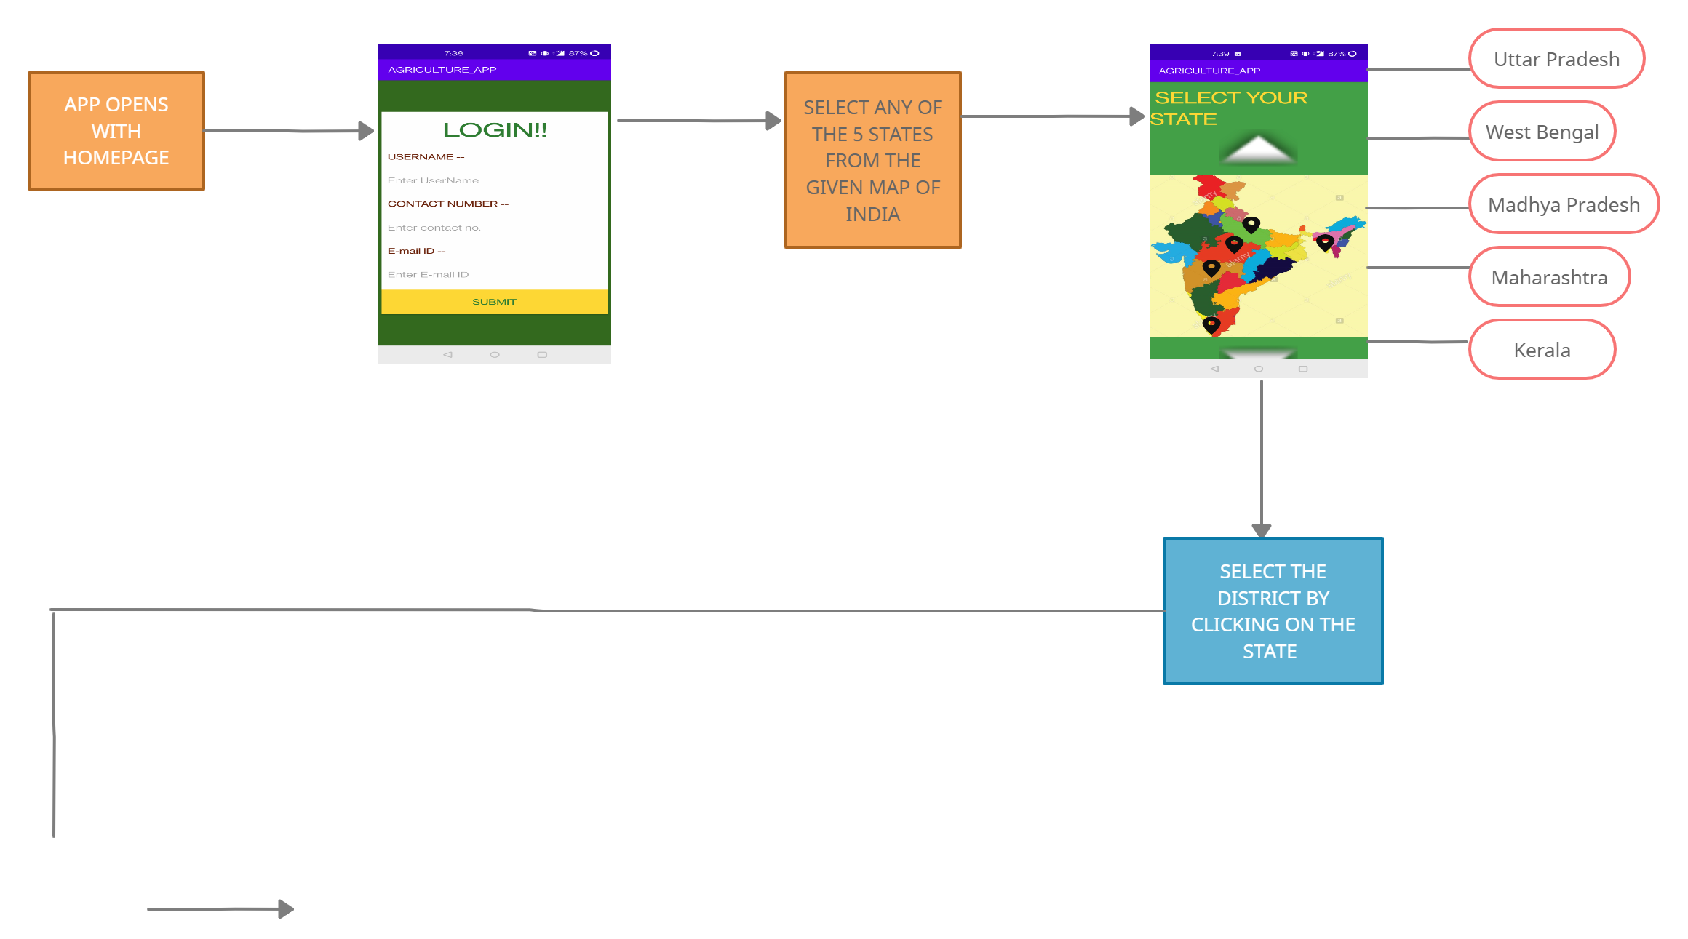
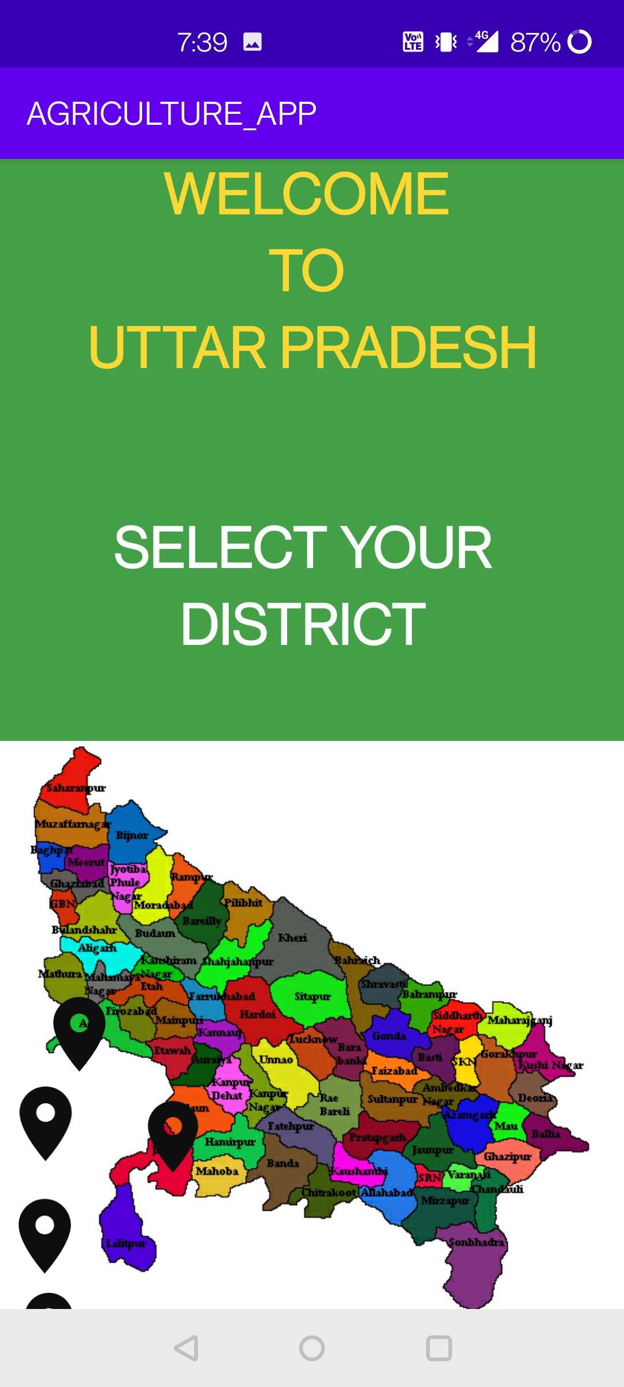
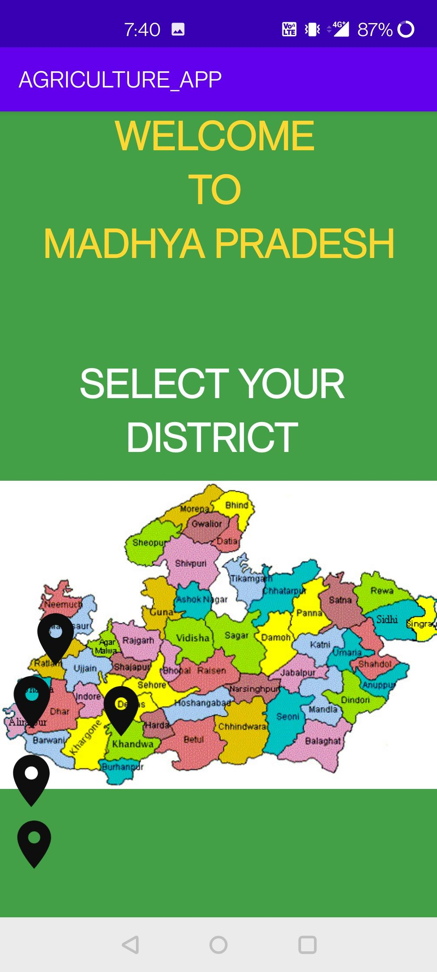
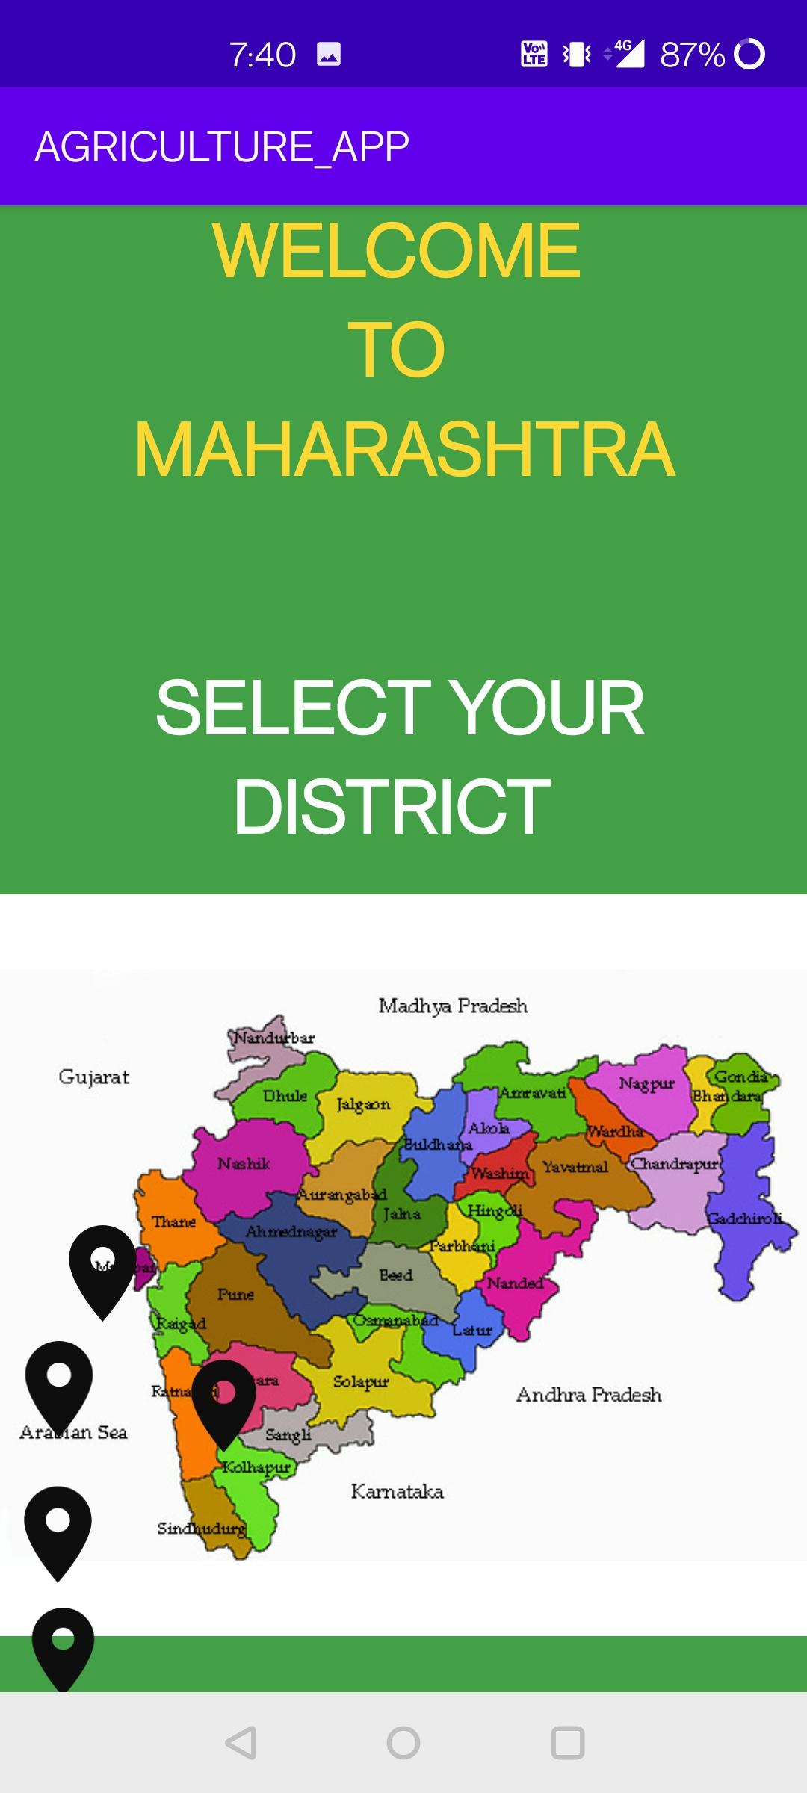
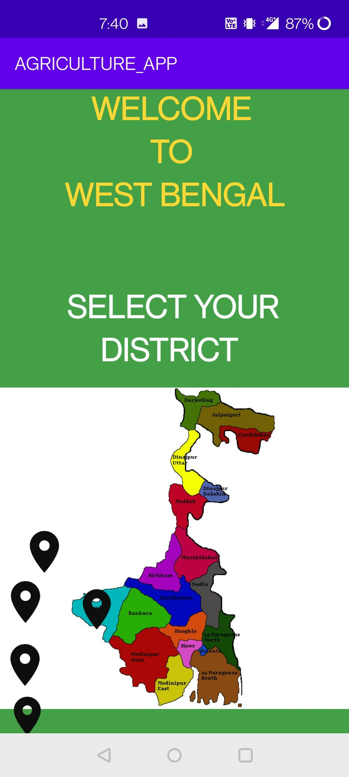
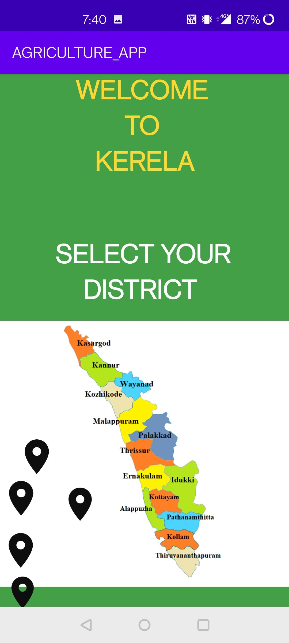
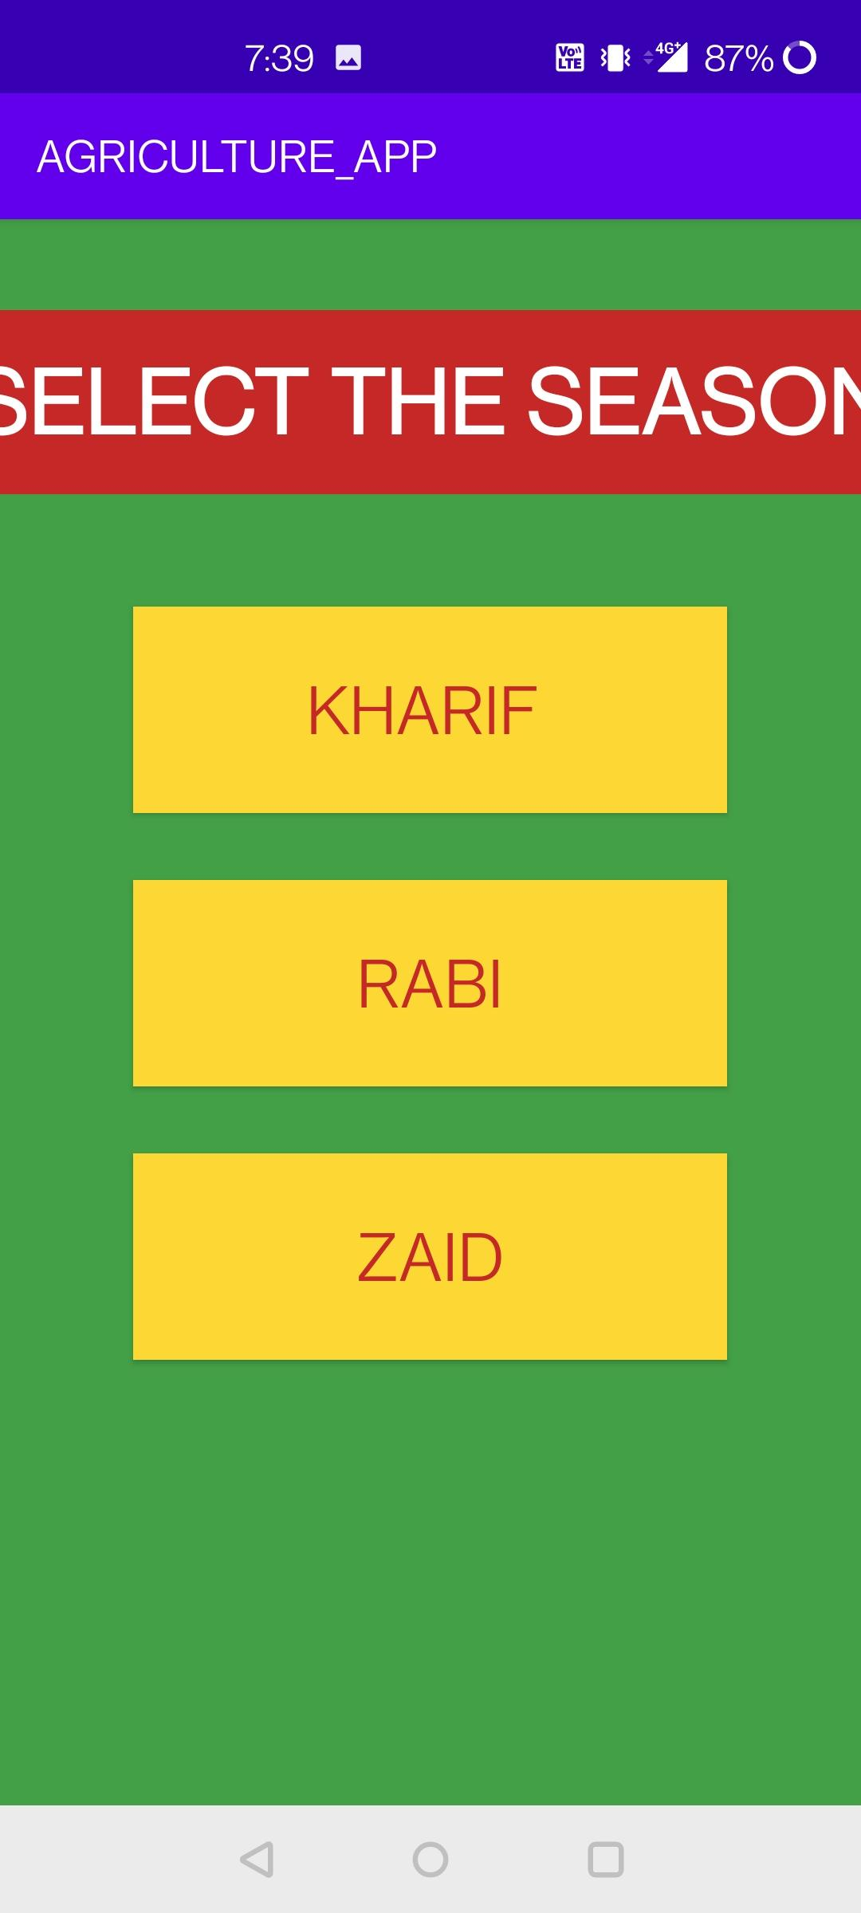
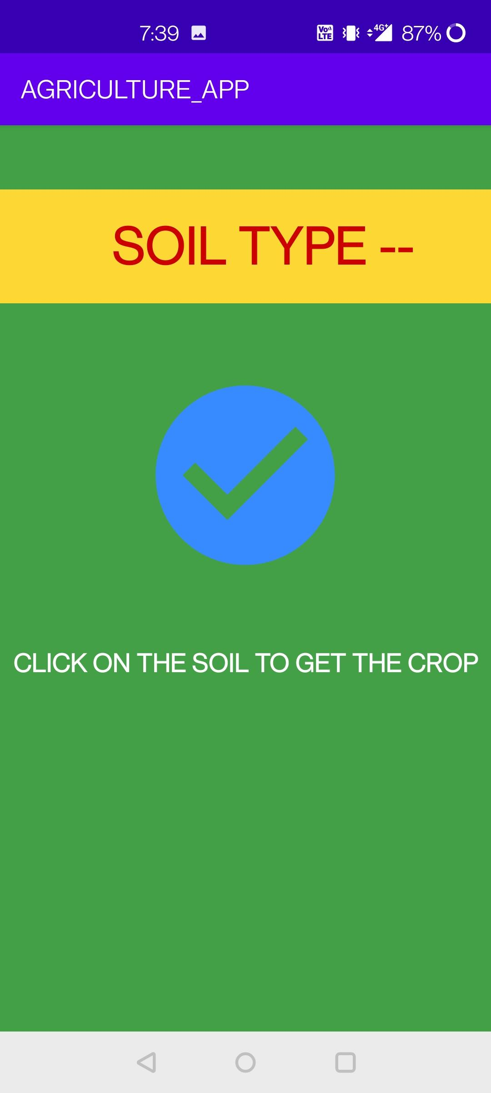
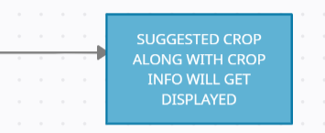

Slide 13
THANKS!!!

