Slide 1
The 4 Styles of Documentation
Adapted from Divio’s “The Documentation System”

Slide 2
Why document code?
Code documentation serves to:
Introduce and familiarize new users to your project
Show users how to effectively use your project
Allow users to understand your code
Explain any unusual decisions you made in your code

Slide 3
1: Tutorials
Tutorials serve as an introduction to your project.
They:
Guide a completely new user step by step
Are usually very simple/small in scope
Begin to familiarize someone with your project

Slide 4
2: How-To Guides
How-To guides are directions for specific use cases.
They:
Assume some level of competence
Provide step-by-step instructions on a specific problem

Slide 5
3: Reference Guides
Reference guides are detailed descriptions of what your code does.
They:
Describe the input and output of specific functions
Generally include both summaries and in-depth descriptions
Focus on information and nothing else

Slide 6
4: Explanations
Explanations are the “why” of your code.
They:
Provide commentary on any unusual or important decisions in your code
Can be used as a form of context or discussion

Slide 7
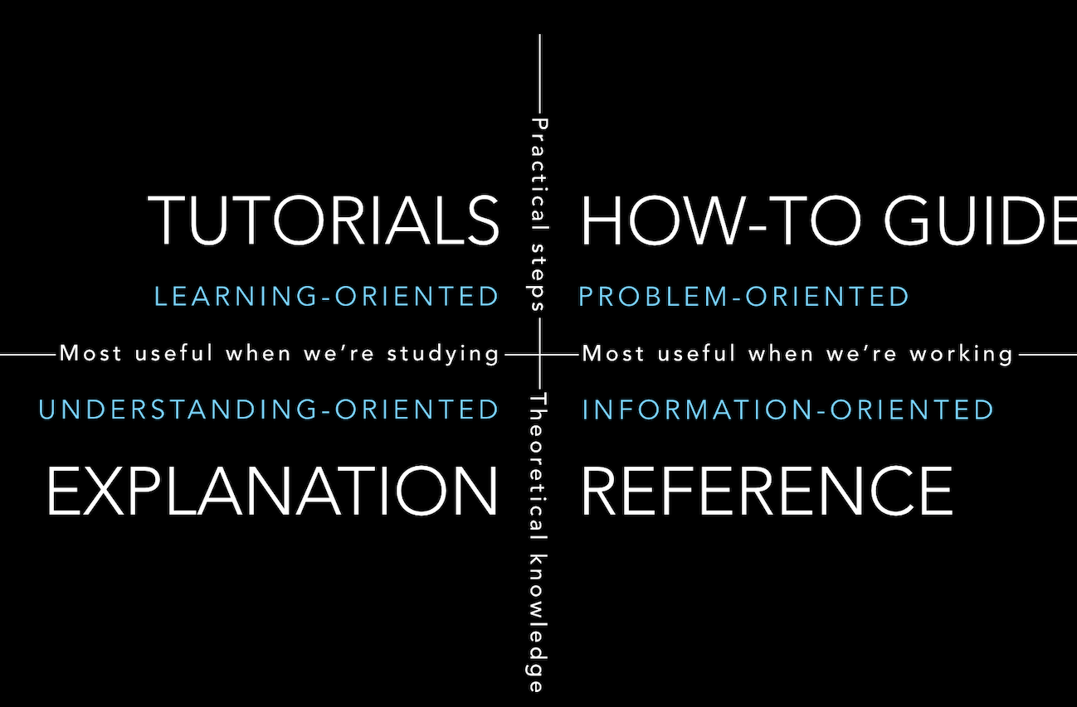
Review
Image from documentation.divio.com

