Slide 1
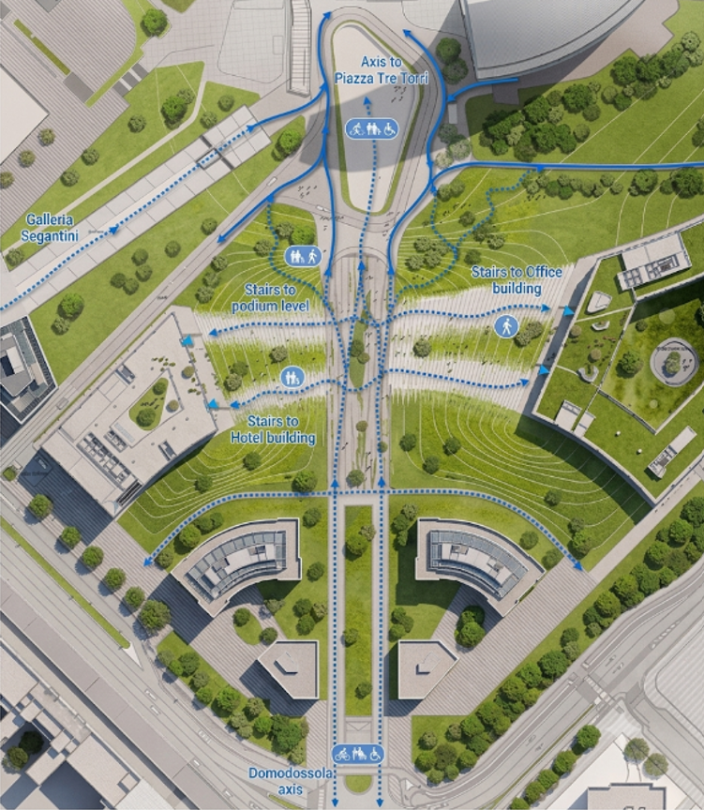

AccessMap
Can data predict which sidewalks
are accessible?
Group 13A · AI4ALL Ignite Summer 2026
· Zheng Zhang · Zaina Nadeem
· Laxmi Pesara · Amen Bush
· Ashton Moraes
Live demo: accessmap-13a.streamlit.app
Notes:
Slide 1 — Title Slide/ Zaina Nadeem
Hi everyone. We are Group 13A. Our project is called AccessMap. We asked one question: Can data predict which sidewalks are safe for wheelchairs? You can try our app right now at this link.

Slide 2



The Problem
Wheelchair users can't tell if a sidewalk is passable before they get there.
Too narrow, curb too high, they find out on the spot. A wrong route isn't an inconvenience; it can end a trip.
Maps show that a road exists. They don't show whether a wheelchair can use it.
Why it matters
Wheelchair users, caregivers, seniors plan routes with confidence
Cities collect sidewalk data but rarely turn it into anything usable
A working model plugs into any routing app as a scoring layer
Research question: Can data predict which sidewalks are accessible for wheelchair users?
Notes:
Slide 2 — The Problem/ Zaina Nadeem
Imagine you use a wheelchair. You want to go somewhere. But you don't know if the sidewalk is wide enough. You don't know if the curb is too high. You only find out when you get there. If it's bad, your trip is over. Google Maps shows you roads. But it does not tell you if a wheelchair can use them. That is the problem we want to solve.

Slide 3


Two Datasets, One Question
PMR — Amsterdam sidewalks
Housing — US addresses
72,274
Physical measurements: width, curb height, crossings. Measures the physical world.
10,104
Crowd-sourced “sidewalk ok?” labels judged from Google Maps street images.
measured segments
crowd-labeled rows
No geographic overlap. One is meters in Amsterdam, the other spans a continent in degrees. Same pipeline runs on each; results are compared at the model level. Rows are never merged.
Notes:
Slide 3 — Two Datasets, One Question/ Zaina Nadeem
We used two datasets. The first one is from Amsterdam. It has over 72,000 sidewalk segments with real measurements — like width and curb height. The second one is from the US. It has about 10,000 addresses. People looked at Google Street View and said if the sidewalk was okay or not. These two datasets are from different places. We never mixed them together. We trained a separate model on each one.

Slide 4
The Algorithms
Random Forest (main model)
Supporting tools
Type: Supervised classification many decision trees vote Inputs: PMR: width, curb height, crossing, length. Housing: house type + crowd-confidence scores Output: accessible / not accessible, with a probability
ModernBERT
Embeds each address into a 768-dim vector (6,425 addresses)
FAISS
Similarity search over those vectors: “find addresses like this one,” ranked by distance
Why we chose it (pros)
Trade-offs (cons)
Handles mixed features well
Feature importance is readablethat's how we caught the bias
Strong baseline without heavy tuning
Can't invent signal that isn't in the features
Happily rides a biased shortcut feature
Less interpretable than a single tree
Notes:
Slide 4 — The Algorithms/ Ashton Moraes
Among all the algorithms we evaluated, we chose Random Forest as our main model for our accessibility map. Because we are predicting whether a route or space is accessible for people with disabilities based on real physical measurements like sidewalk width, curb height, and crossing details, we needed something reliable. Random Forest is great because it handles these mixed features effortlessly and gives us a strong baseline right out of the box. Essentially, it’s a group of many decision trees that all vote together. We really like it because it shows us clearly which features matter most—and that is actually how we found a hidden bias in our data, which I'll explain in just a moment. (Of course, it does have a few trade-offs, like sometimes latching onto shortcut features). To support our mapping tool, we also used ModernBERT to turn thousands of addresses into numbers, and FAISS to quickly search and find similar addresses by distance.

Slide 5
How the Project Evolved
V1
V2
V3
V4
Baselines
Bias fix
Precision fix
Deployment
Both models trained. Two problems surface: Housing below baseline, PMR over-flags.
Drop state from Housing, retrain. Result: a null finding — and an honest one.
PMR threshold tuning fails. Root cause found in features; curb height added.
Streamlit app built, tested locally + on the cloud, live for anyone to use.
We didn't get it right the first time — and that's the story worth telling.
Notes:
Slide 5 — How the Project Evolved/ Ashton Moraes
We didn't get this right the first time—and honestly, that’s the best part of our story. Let me walk you through how the project evolved:
In Version 1 (our baselines), we trained both initial models. But we ran into trouble: the housing model performed below baseline, and our PMR model was throwing way too many false alarms.
In Version 2, we dug in, found a hidden bias, dropped state from the housing data, and retrained. It resulted in a null finding, but an honest one.
In Version 3, we tackled precision issues by looking closer at our features, tracking down the root cause, and adding curb height data to get our predictions right.
And finally, in Version 4, with everything refined and tested, we built our Streamlit app and deployed it live to the cloud so anyone can use it.
(Ashton)

Slide 6
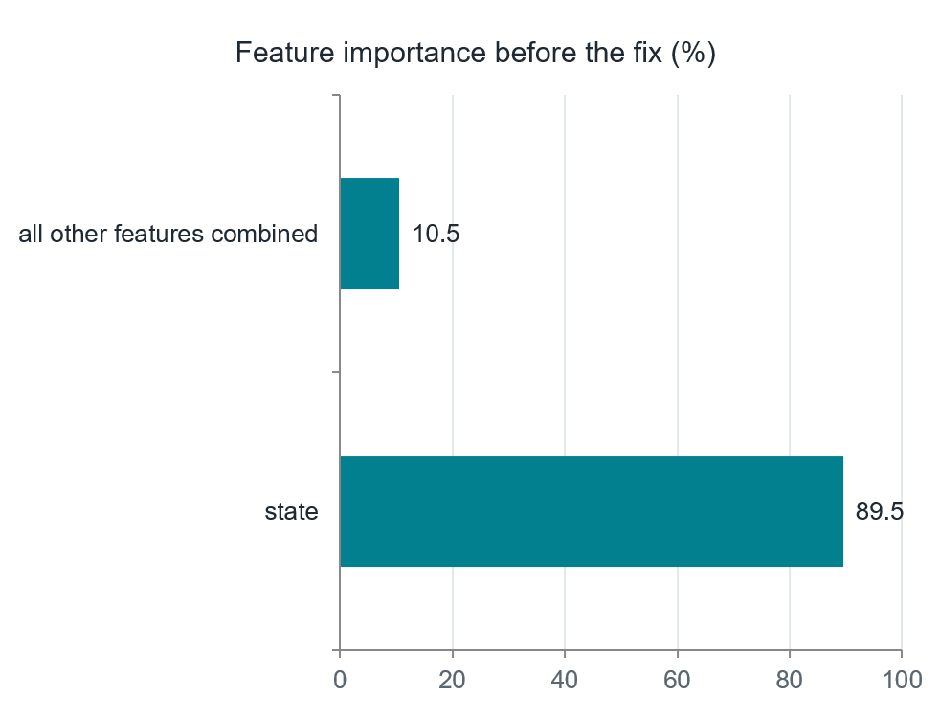
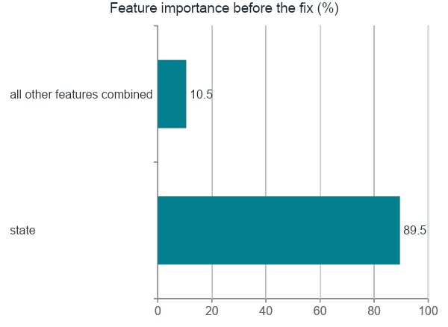
Challenge 1 - The Housing Model Learned Geography
67.4% accuracy vs. an 85.3% baseline worse than guessing. One feature, state, drove 89% of every decision. The model wasn't judging house condition. It was memorizing which states have more “bad sidewalk” labels. This is a bias problem, not a tuning problem.
Notes:
Slide 6 — Challenge 1: The Housing Model Learned Geography/ Ashton Moraes / Gavino Vargas
Here is what went wrong with our first attempt. Our Housing model scored only 67.4% accuracy—which is actually worse than just guessing the baseline.
Why? Because as the chart makes obvious, one feature was doing all the work: state. It drove 89.5% of every single decision.
The model wasn't judging the actual housing or sidewalk conditions; it was just memorizing which states happened to have more 'bad sidewalk' labels.
To be clear: this is a bias problem, not a tuning problem.

Slide 7
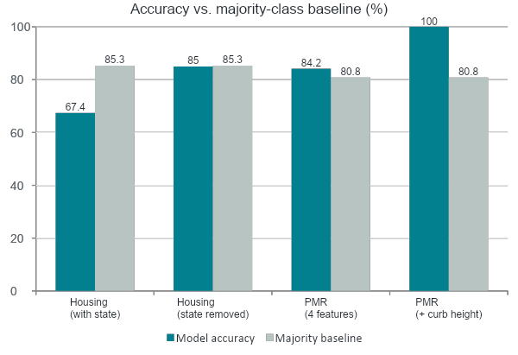
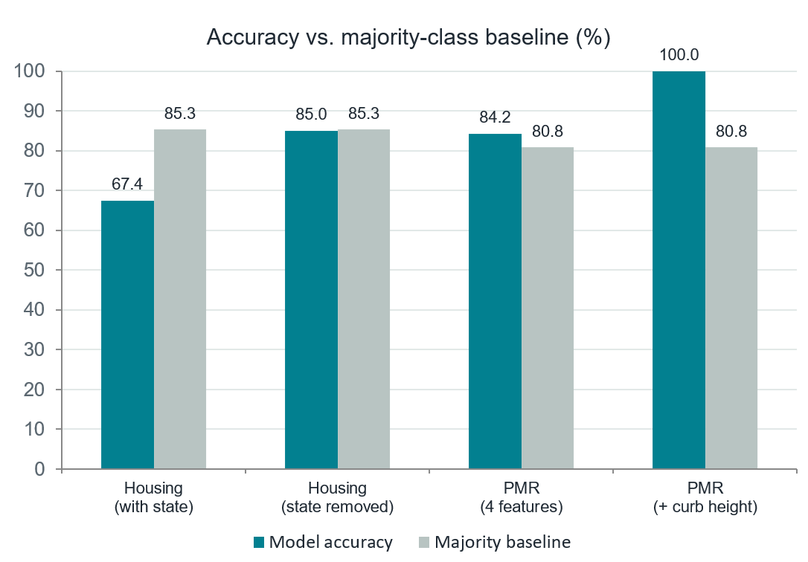
The Fix Revealed the Real Finding
Housing: 85.0% ties the 85.3% baseline. Recall on bad sidewalks: 0.01. Without state, no signal is left and the raw data has no other features to add.
A null result is a result. “This dataset can't predict sidewalk condition, and here's why” is our headline bias finding not a failure to hide.
Notes:
Slide 7 — The Fix Revealed the Real Finding/ Amen Bush / Gavino Vargas
So we removed the state feature and retrained. The accuracy went up to 85%. But the baseline — just always guessing 'okay' — is 85.3%. So the model is the same as guessing. It cannot find bad sidewalks at all. This is a null result. It means: this data cannot predict sidewalk condition. We think this is an important finding, not a failure.

Slide 8


Challenge 2 - Confidently Wrong, Not Unsure
Attempt 1: move the threshold — failed
Attempt 2: fix the features — worked
PMR over-flagged “not accessible” (precision 0.55). We raised the cutoff from 0.5 to 0.65. Nothing changed.
Our label rule = width + curb height. But the model only ever saw width, it was guessing the curb half blind.
14 / 14,455
We added curb_height_max and a missing-value flag (74% of rows have no curb measurement the missingness itself is information).
test predictions sat anywhere near the cutoff. Probabilities were pinned at 0 or 1 — the model wasn't hesitating, it was confidently wrong. A threshold can't fix confident mistakes.
Lesson: check the probability distribution before reaching for a threshold.
Notes:
Slide 8 — Challenge 2: Confidently Wrong/ Amen Bush / Gavino Vargas
The PMR model had a different problem. It said too many sidewalks were not accessible. We tried raising the cutoff from 0.5 to 0.65. Nothing changed. Why? Because out of 14,455 predictions, only 14 were near the cutoff. The model was very confident — but wrong. So we looked at the features. Our label uses width and curb height. But we only gave the model width. It was guessing the curb part. We added curb height and a flag for missing data. That fixed it. The lesson: check the probability distribution before changing the threshold.

Slide 9
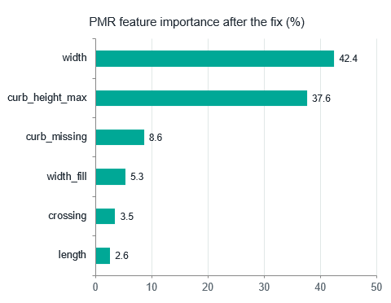
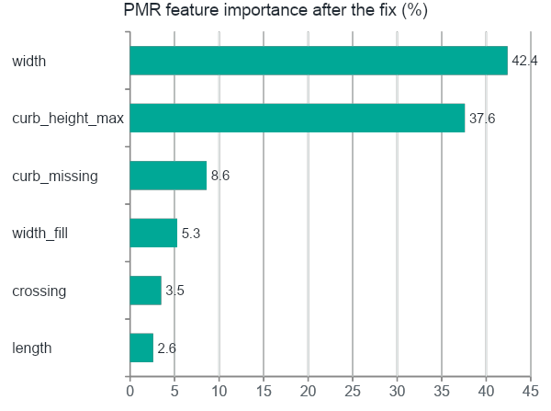
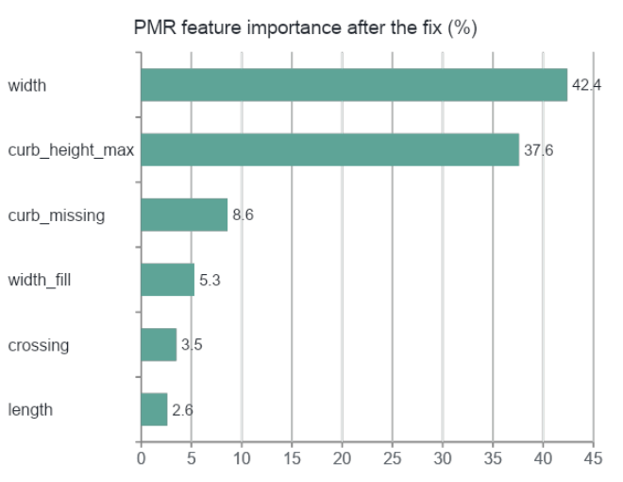
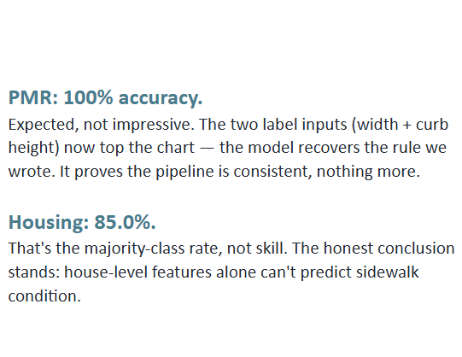
Evaluation - Read the Numbers Honestly
PMR: 100% accuracy. Expected, not impressive. The two label inputs (width + curb height) now top the chart — the model recovers the rule we wrote. It proves the pipeline is consistent, nothing more. Housing: 85.0%. That's the majority-class rate, not skill. The honest conclusion stands: house-level features alone can't predict sidewalk condition.
Notes:
Slide 9 — Evaluation/Gavino Ashton Moraes
After the fix, the PMR model got 100% accuracy. But we are honest — this is expected, not impressive. The model just learned the rule we wrote. It proves the pipeline works. The Housing model stays at 85%, which is the same as guessing. We report both results honestly."

Slide 10
Results, In Plain Language
What were the results?
What do the results mean?
PMR (Amsterdam): 100% accuracy after adding curb height. Housing (US): 85.0% vs. an 85.3% majority baseline once state was removed recall on bad sidewalks just 0.01. Address search: FAISS retrieval works and ships in the live app.
The PMR score means the model consistently recovers the width + curb rule we wrote, proof the pipeline works, not superhuman skill. The Housing tie with the baseline is an honest null result: house-level features alone can’t predict sidewalk condition.
How did we get them?
How accurate are they?
The same recipe on both datasets: clean, encode, train a Random Forest, score on a held-out 20% test set, then audit feature importance. That audit not the accuracy score is what exposed the state bias and the missing curb feature.
PMR: 100% on 14,455 held-out segments, but scored against our own rule-based label; only 50 verified labels exist, too few to test on. Housing: no better than always guessing “ok.” We trust the audited pipeline more than any single number.
Notes:
Slide 11 — Results, In Plain Language/ Amen Bush
"To summarize: the Amsterdam model works because we gave it the right features. The US model does not work because the data does not have enough information. Our audit of feature importance was more valuable than any accuracy number. It helped us find the bias and the missing feature.

Slide 11


AccessMap
accessmap-13a.streamlit.app
Sidewalk Checker
Address Search
About & Limits
Enter width, curb height, crossing, length → accessible / not accessible + confidence
Pick an address → FAISS returns similar addresses with sidewalk labels + distances
What the app does, what it refuses to do, and why, honesty as a feature
One deployment decision we're proud of: the app does NOT predict sidewalk condition for US addresses. We tested that model — it has no signal — so the app reports the real crowd label instead of pretending to predict.
Notes:
Slide 10 — Live Demo/ Amen Bush
https://accessmap-13a.streamlit.app
Here is our app. It has three pages. The Sidewalk Checker lets you enter width, curb height, and other numbers, and it tells you if the sidewalk is accessible. The Address Search finds similar addresses using FAISS. And the About page explains what the app can and cannot do. One decision we are proud of: the app does NOT predict sidewalk condition for US addresses. That model has no signal. So we show the real crowd label instead.

Slide 12
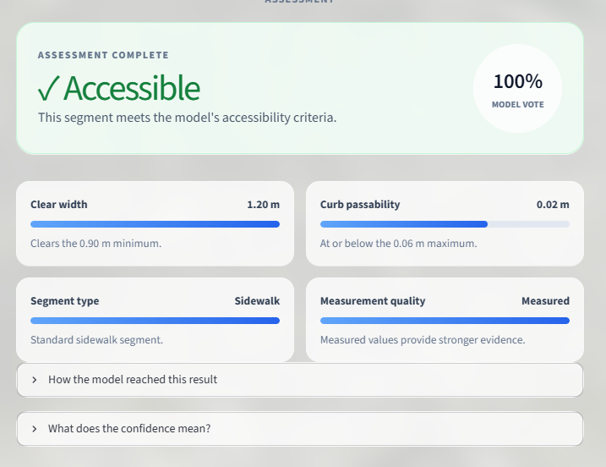
Why we keep the app simple…
Deployment
Every feature maps to a result we validated. We ship the two things that work, the PMR checker and the address search, and we refuse to ship US sidewalk prediction, because we tested that model and it has no signal. Fewer moving parts also means fewer failure points for the people who rely on the answer.
How reliable is it…
Confidence now comes with an explanation: it’s the share of the forest’s trees voting for that label, shown with the factors that drove the call. Inputs are range-checked, missing curb heights use the same fill value as training, and every known limit is stated inside the app itself.
Notes:
Slide 12 — Deployment/ Laxmi Pesara
We kept the app simple on purpose. We only ship features we tested and trust. The confidence score is explained — it shows how many trees voted for that answer. Inputs are checked, and every limit is written inside the app.

Slide 13

Impact - Both Sides
Positive
Negative / risks
Wheelchair users and caregivers plan routes before leaving home
Cities can find clusters of bad segments and prioritize repairs
Accessibility becomes a data layer any routing app can adopt
A biased model could systematically mislabel whole regions exactly what our Housing model did before the fix
False “accessible” labels are worse than no label: someone plans a trip they can't finish
Rule-based labels (ours) can encode wrong assumptions if never validated against real users
Notes:
Slide 13 — Impact: Both Sides/ Laxmi Pesara
The positive side: wheelchair users can plan better routes. Cities can find bad sidewalks and fix them. Accessibility can become a layer in any map app. The risk side: a biased model can mislabel whole areas. A false 'accessible' label is worse than no label — because someone might plan a trip they cannot finish. And our own labels could be wrong if we never test them with real users.

Slide 14
Essential Question
How can the process of creating AI/ML solutions amplify or mitigate bias in our case?
It amplified bias when…
It mitigated bias when…
we let a geographic proxy (state) dominate training. The model looked like it was scoring house condition; it was really scoring ZIP codes. High feature importance made an unfair shortcut look like intelligence.
we audited feature importance, removed the proxy, retested, and reported the honest null result instead of a prettier number. The same ML process that created the bias also gave us the tools to catch it if we chose to look.
Notes:
Slide 14 — Essential Question/ Laxmi Pesara
The essential question is about bias. AI amplified bias when we let the state feature dominate. The model looked smart, but it was just memorizing geography. AI helped us reduce bias when we checked feature importance, removed the shortcut, and reported the honest result. The same tools that created the problem also helped us find it — but only because we chose to look.

Slide 15




Next Steps
Rule-free PMR experiment
Week 13
Retrain on only features outside the label rule (crossing, length, width_fill): can accessibility be guessed without measuring? The one test where the model can show real skill.
Validate the label
Week 13
Compare our width/curb rule against the 50 verified accessibility labels; report agreement.
Location-aware retrieval
Week 14
Add coordinates to the PMR index so retrieval ranks within tied groups instead of returning exact ties.
Individual roadmaps
Ongoing
Each member continues per their My AI Roadmap; repo stays public as a portfolio piece.
Notes:
Slide 15 — Next Steps/ Zheng Zhang
Going forward, we want to retrain the PMR model without width and curb height to see if the other features can predict anything on their own. We want to test our labeling rule against the 50 verified ground-truth labels we have. We're planning to add location awareness to the search so it ranks results better. And individually, each of us wants to keep building our skills in this space.

Slide 16
Citations & Sources
Data sources
City of Amsterdam Open Data - PMR sidewalk accessibility dataset (72,274 segments)
CrowdFlower / Figure Eight “Data for Everyone” - Housing: Wheelchairs dataset (10,104 crowd-labeled US addresses)
Related work & methods
Breiman, L. (2001). Random Forests. Machine Learning, 45(1).
Johnson, J., Douze, M., & Jégou, H. (2019). Billion-scale similarity search with GPUs. IEEE Transactions on Big Data. (FAISS)
Warner, B., et al. (2024). Smarter, Better, Faster, Longer: A Modern Bidirectional Encoder. (ModernBERT)
Mehrabi, N., et al. (2021). A Survey on Bias and Fairness in Machine Learning. ACM Computing Surveys.
Saha, M., et al. (2019). Project Sidewalk: A Web-based Crowdsourcing Tool for Collecting Sidewalk Accessibility Data at Scale. ACM CHI.
Live app: accessmap-13a.streamlit.app Code + docs: github.com/zhang-systems/ai4all-accessmap
Notes:
Slide 16 — Citations & Sources/ Zheng Zhang
Here are our sources. Amsterdam data is from the City of Amsterdam Open Data portal. US data is from CrowdFlower. We used Random Forest, FAISS, and ModernBERT. Code and app links are listed here.

Slide 17
Thank You!
Questions? Try the app yourself while we talk.
accessmap-13a.streamlit.app
Group 13A — AI4ALL Ignite Summer 2026
Notes:
Slide 17 — Thank You/ Zheng Zhang
Thank you for listening. You can try the app right now at our app. We are happy to answer questions.

