Slide 1
Journey Through Codsoft
Hello, I'm Lavesh Gaur, and this presentation covers my 4-week internship journey at Codsoft. During my 4-Week Internship at codsoft, I had the opportunity to explore 5 distinct programs and
was required to complete 3 of them.

Slide 2
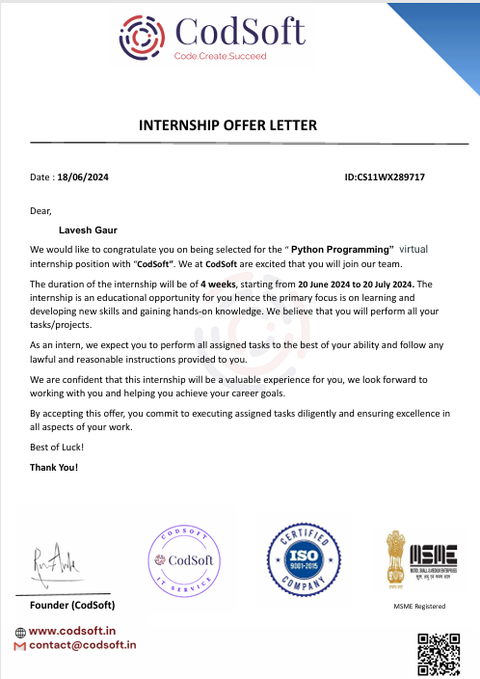
Internship offer letter

Slide 3
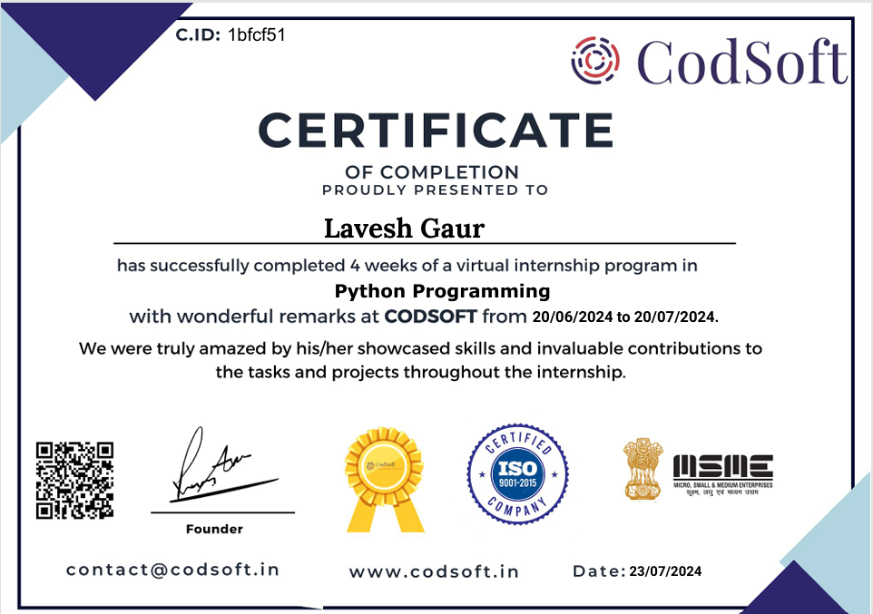
certificate

Slide 4
Company Overview
CodSoft are IT services and IT consultancy that specializes in creating innovative solutions for businesses. We are passionate about technology and believe in the power of software to transform the world. Our internship program is just one of the ways in which we are investing in the future of the industry.
At CodSoft, we believe practical knowledge is the key to success in the tech industry. Our aim is to help students lacking basic skills by offering hands-on learning through live projects and real-world examples. Our team consists of industry experts who are dedicated to equipping interns with the knowledge and skills needed to succeed in their careers. We foster an inclusive and supportive environment that encourages learning, growth, and creativity.

Slide 5
Mission
Software development is an iterative process, and the mission includes continually improving software solutions. This entails gathering feedback, identifying areas for enhancement, and implementing updates to make the software more efficient, user-friendly, and reliable. Continuous improvement also involves staying up to date with the latest technologies, tools, and industry trends.

Slide 6
Vission
The vision of software development is to create innovative solutions that push the boundaries of technology. This involves leveraging emerging technologies, exploring new ideas, and developing software that brings novel approaches to solving problems and improving the lives of users.

Slide 7
Internship Objectives
My internship at Codsoft was centered around the goal of immersing myself in real-world Python projects and enhancing my technical skills. During this 4-week program, I aimed to accomplish three out of the five available programs, engaging in diverse projects to expand my knowledge and experience. By tackling these five challenging projects, I sought to hone my problem-solving abilities, improve my coding proficiency, and contribute meaningfully to the team's success. This hands-on experience was instrumental in achieving my personal and professional growth objectives

Slide 8
Projects Task -1
TO-DO LIST
A To-Do List application is a useful project that helps users manage
and organize their tasks efficiently. This project aims to create a
command-line or GUI-based application using Python, allowing
users to create, update, and track their to-do lists

Slide 9
Task -2
CALCULATOR
Design a simple calculator with basic arithmetic operations.
Prompt the user to input two numbers and an operation choice.
Perform the calculation and display the result.

Slide 10
Task - 3
PASSWORD GENERATOR
A password generator is a useful tool that generates strong and
random passwords for users. This project aims to create a
password generator application using Python, allowing users to
specify the length and complexity of the password.
User Input: Prompt the user to specify the desired length of the
password.
Generate Password: Use a combination of random characters to
generate a password of the specified length.
Display the Password: Print the generated password on the screen.

Slide 11
Task - 4
Rock-Paper-Scissors Game
User Input: Prompt the user to choose rock, paper, or scissors.
Computer Selection: Generate a random choice (rock, paper, or scissors) for the computer.
Game Logic: Determine the winner based on the user's choice and the computer's choice.
Rock beats scissors, scissors beat paper, and paper beats rock.
Display Result: Show the user's choice and the computer's choice.
Display the result, whether the user wins, loses, or it's a tie.

Slide 12
Score Tracking (Optional): Keep track of the user's and computer's scores for multiple rounds.
Play Again: Ask the user if they want to play another round.
User Interface: Design a user-friendly interface with clear instructions and
Feedback.

Slide 13
Task – 5
Contact Book
Contact Information: Store name, phone number, email, and address for each contact.
Add Contact: Allow users to add new contacts with their details.
View Contact List: Display a list of all saved contacts with names and phone numbers.
Search Contact: Implement a search function to find contacts by name or phone number.
Update Contact: Enable users to update contact details.
Delete Contact: Provide an option to delete a contact.
User Interface: Design a user-friendly interface for easy interaction.

Slide 14
Requirements
Python: The latest stable version of Python.
Integrated Development Environment (IDE): Popular choices include PyCharm, Visual Studio Code, or Jupyter Notebook.
Version Control System: Git, along with a GitHub or GitLab account for
collaboration and version tr
Libraries and Frameworks: Depending on our project, we might need
additional Python libraries like tkinter,string,random. Install these using pip install command for windows and apt install for linux.

Slide 15
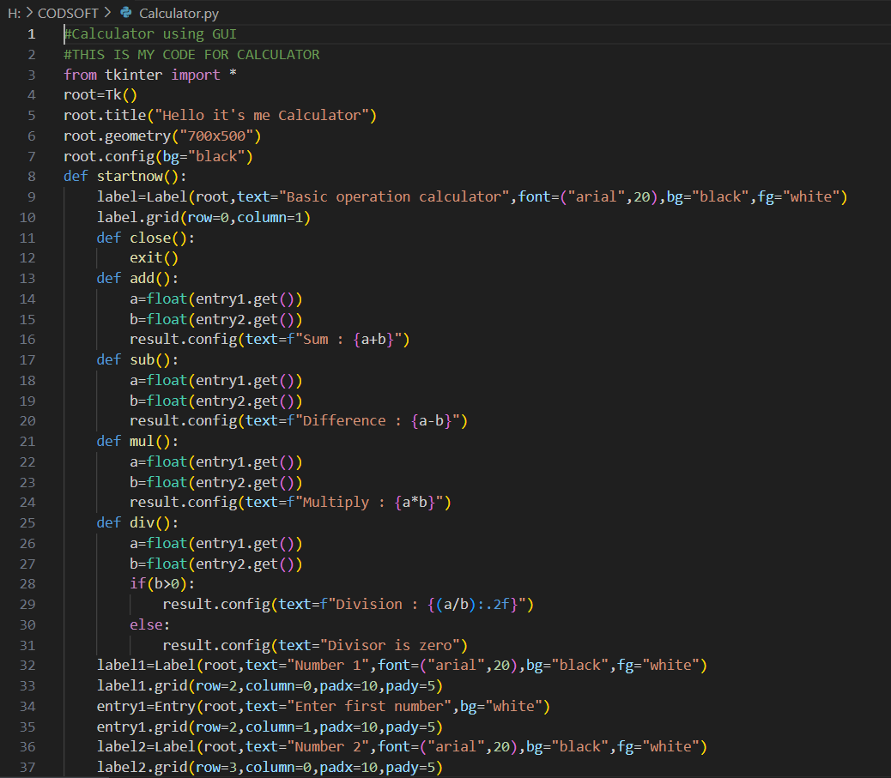
Project demo
CALCULATOR

Slide 16
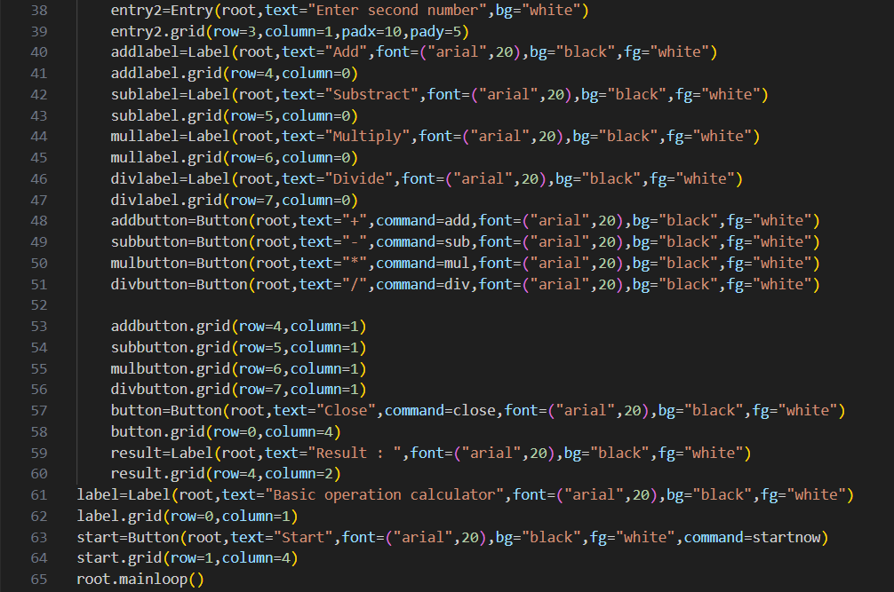

Slide 17
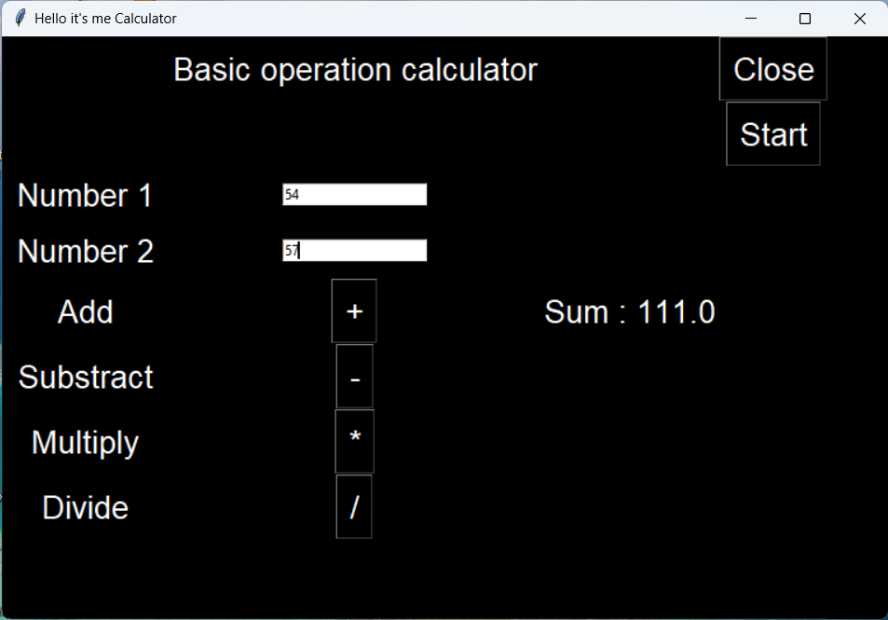
Output :

Slide 18
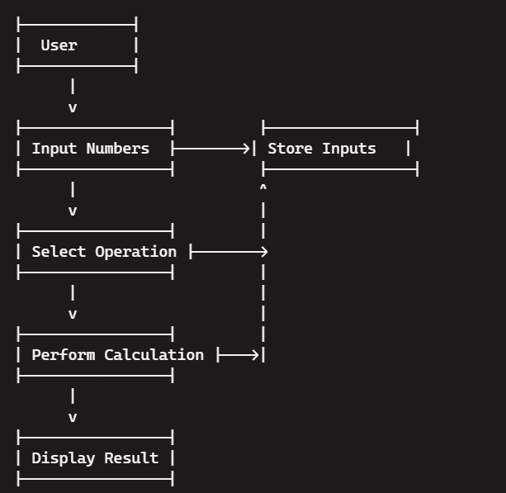
Data flow diagram

Slide 19
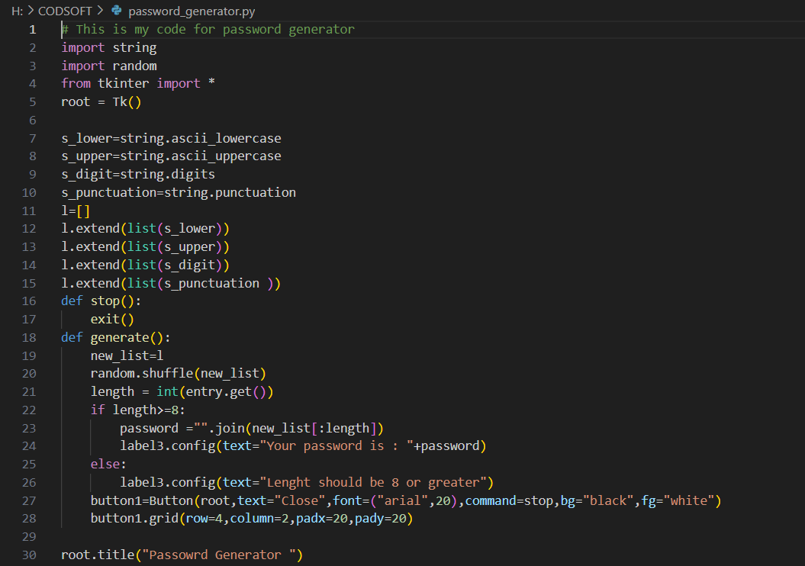
Password generator

Slide 20
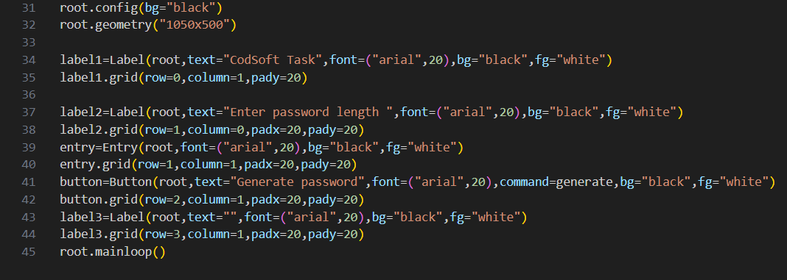

Slide 21
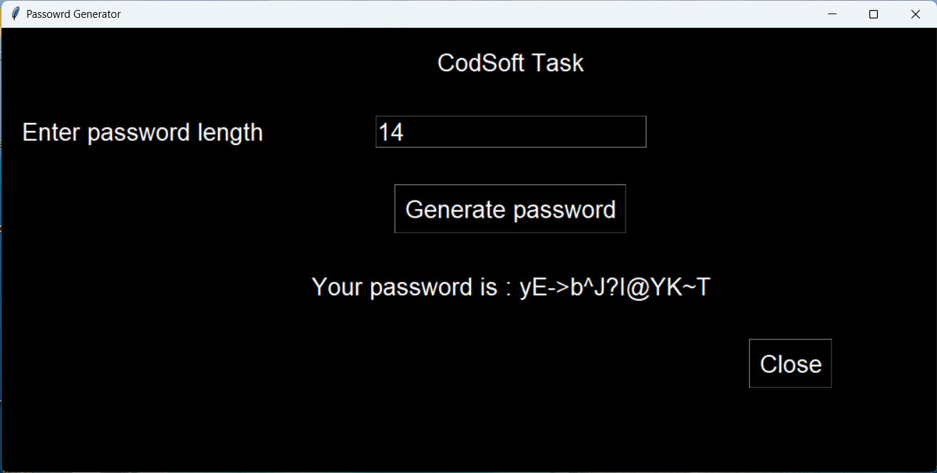
Output :

Slide 22
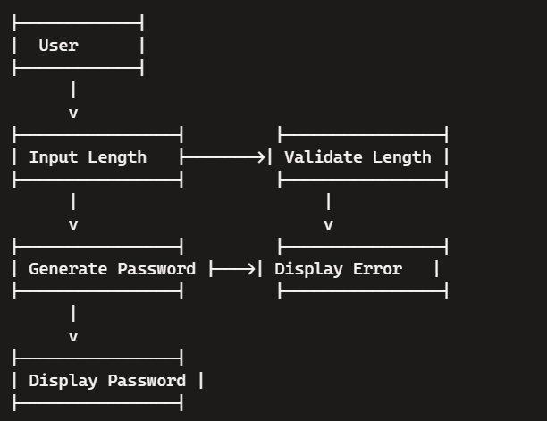
Data flow diagram

Slide 23
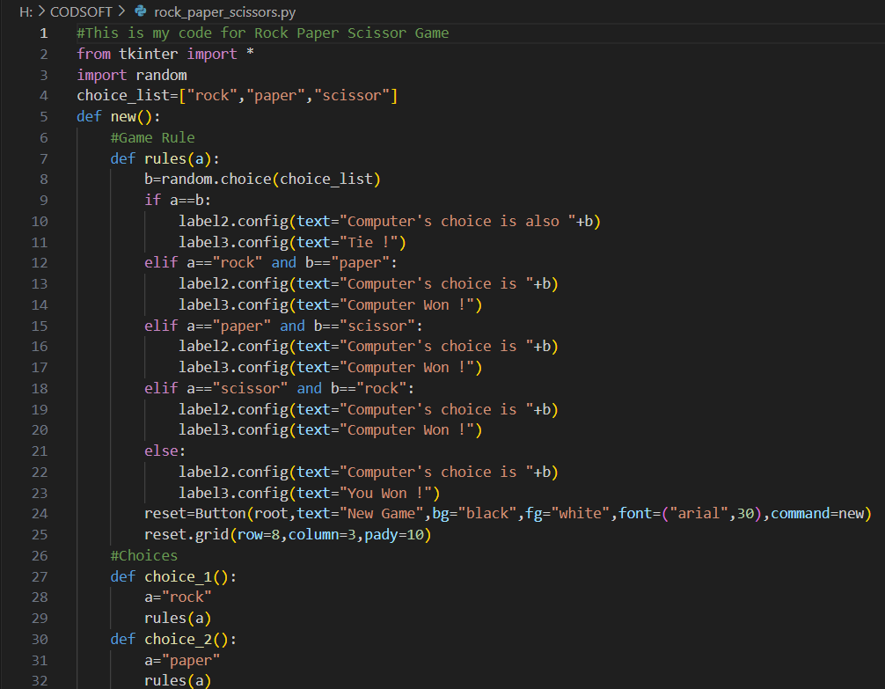
Rock-Paper-Scissors Game

Slide 24
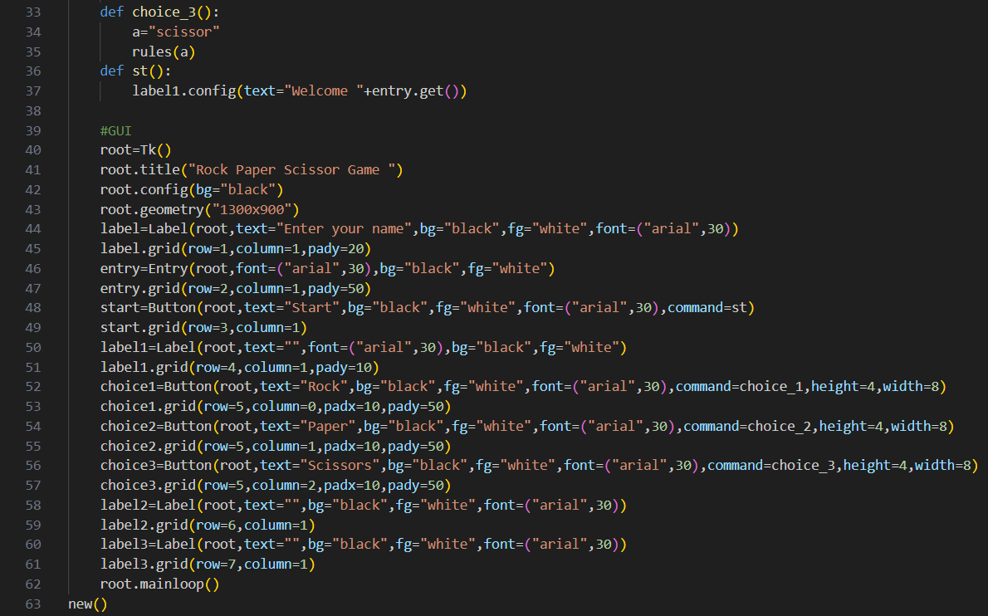

Slide 25
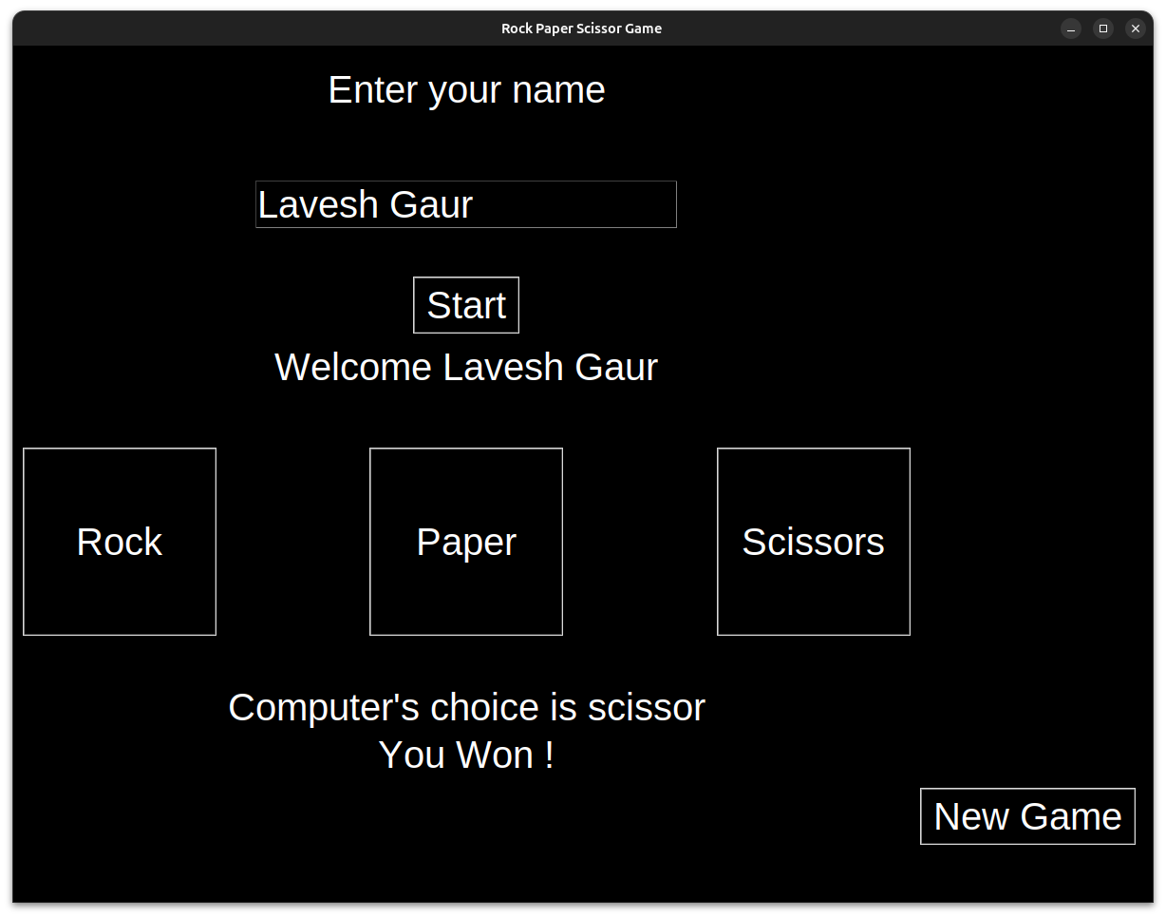
Output :

Slide 26
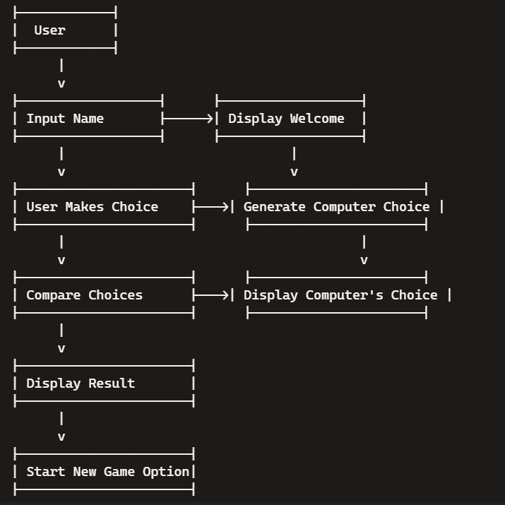
Data flow diagram

Slide 27
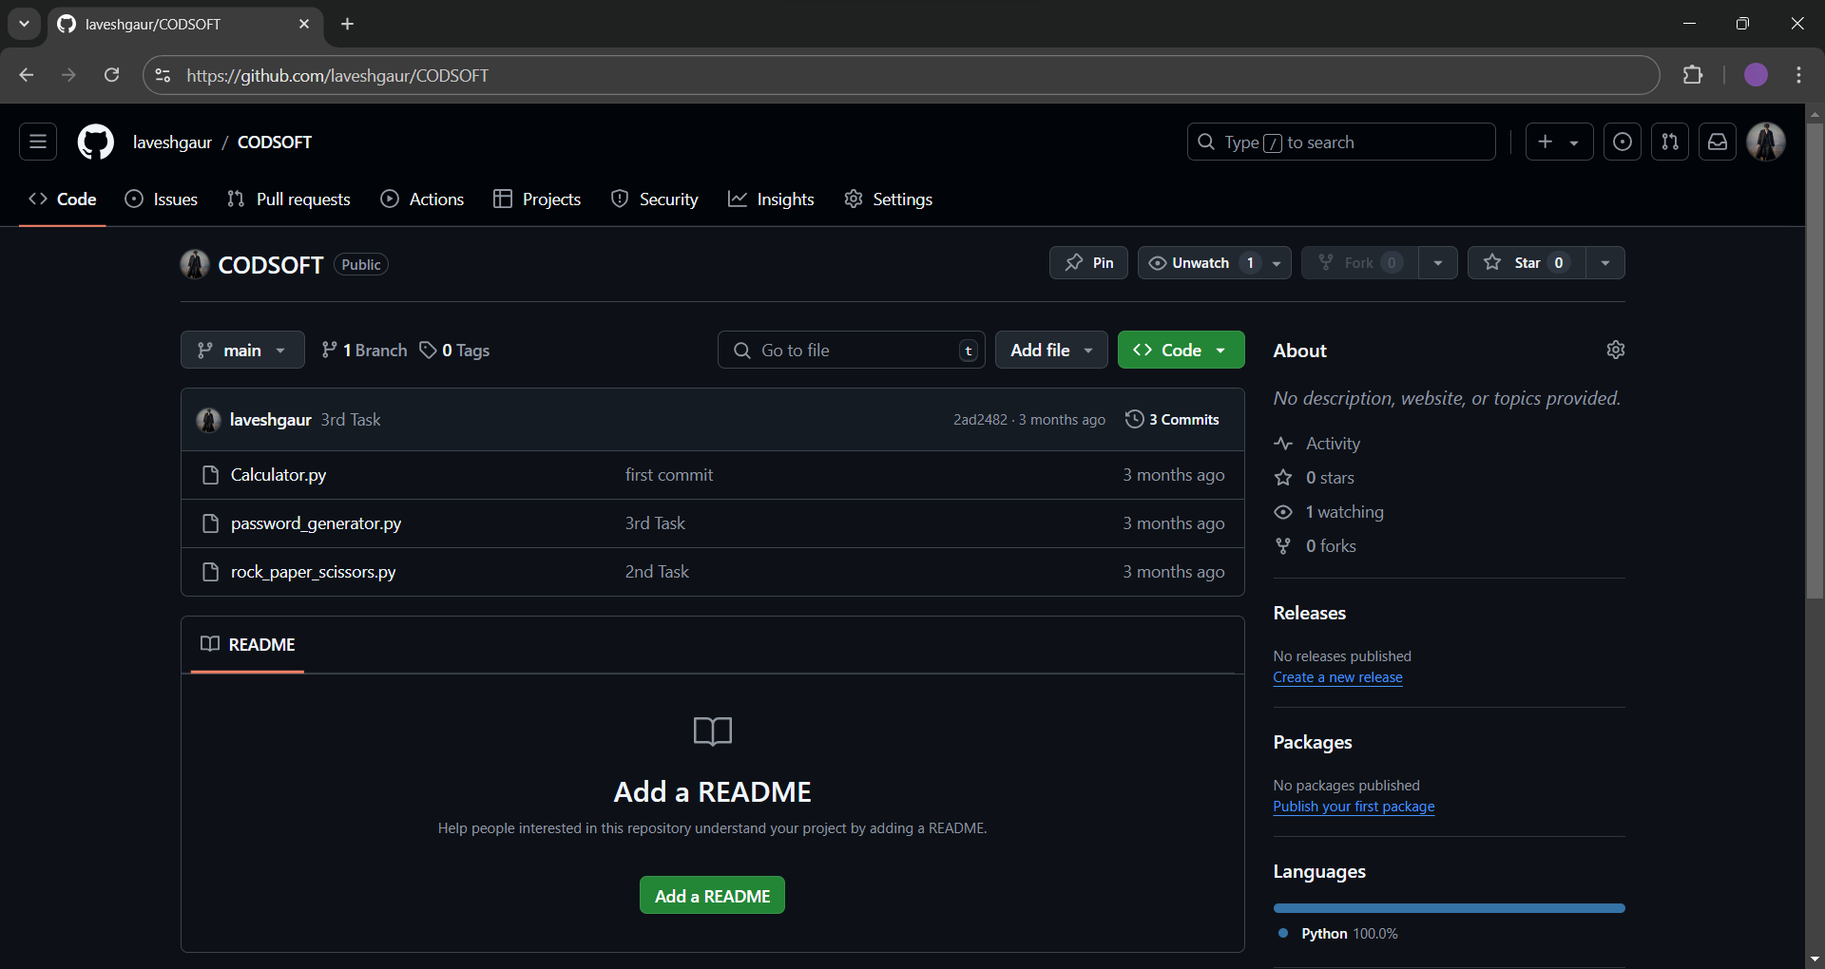
See my work
AT GITHUB : https://github.com/laveshgaur/CODSOFT

Slide 28
At linkedin
Calculator :
https://www.linkedin.com/posts/laveshgaur_this-is-my-first-project-in-python-which-activity-7216857531816587264-T-i9?utm_source=share&utm_medium=member_desktop
Password Generator :
https://www.linkedin.com/posts/laveshgaur_excited-to-share-my-latest-project-activity-7219993993349091328-RDdr?utm_source=share&utm_medium=member_desktop
Pock Paper Scissor :
https://www.linkedin.com/posts/laveshgaur_check-out-this-fun-python-rock-paper-scissors-activity-7219321013656768512-J995?utm_source=share&utm_medium=member_desktop

Slide 29
Skills Acquired /Career Growth
Python Proficiency: You'll deepen your understanding of Python syntax, libraries, and best practices.
Problem-Solving: Tackling real-world projects will hone your analytical and problem-solving skills.
Project Management: Handling tasks and deadlines will enhance your ability to
manage projects efficiently.
Critical Thinking: Evaluating and debugging code will strengthen your critical thinking.
Innovation: Applying creative solutions to coding challenges will boost your innovative thinking.

Slide 30
Thank You

