Slide 1


Multiple Entity Reconciliation
Samoila Lavinia

Slide 2
Table of contents
Introduction
Challenges
The reconciliation process
Experimental results
Conclusions and future work

Slide 3
What is reconciliation?
“the bringing together of two or more separately recorded pieces of information concerning a particular individual or family. “
– Newcombe et al.. 1959
ID
id?
TITLE
NAME
CAST
ACTORS
YEAR
YEAR
DESCR.
COMMENT
Notes:
TODO give actual example here

Slide 4
What is reconciliation?
id?
tt2096673
Insidan ut
Inside Out
Amy Poehler, Bill Hader, Richard Kind
Amy Poehler, Phyllis Smith, Richard Kind
2015
2015
Att växa upp kan vara knepigt, och för den unga flickan Jenny är det just så. Hennes pappa får ett nytt jobb och familjen flyttar från det trygga livet i en småstad till storstaden San Francisco. Precis som alla andra så styrs Jenny av sina känslor; Glädje, Rädsla, Ilska, Avsky och Vemod.
After young Riley is uprooted from her Midwest life and moved to San Francisco, her emotions - Joy, Fear, Anger, Disgust and Sadness...

Slide 5
Research questions
How effective are the machine learning techniques when applied to the movie reconciliation problem?
How to design an extensible reconciliation system that allows various data formats as input?

Slide 6

Challenges
ID
ID
ID
TITLE
TITLE
TITLE
CAST
CAST
YEAR
DESCR.
DESCR.
NAME
NAME
NAME
ACTORS
ACTORS
ACTORS
Dataset 1
YEAR
COMMENT
COMMENT
ID
ID
ID
Dataset 3
TITLE+YEAR
TITLE+YEAR
PEOPLE
PEOPLE
Data access
control classes
REVIEWS
REVIEWS
Dataset 2
Notes:
- incomplete info
- language
- ambiguity
- alternate names
- spelling and grammar mistakes

Slide 7
Experiment datasets
ID
TITLE
CAST
CREW
ID
NAME
CAST
Dataset 1 – 325k records
YEAR
DESCR.
ID
Dataset 3 – 178k records
TITLE
PEOPLE
YEAR
Dataset 2 – 86k records

Slide 8
Reconciliation process
Labelled
datasets
NAME
Unreconciled
record
ACTORS
YEAR
COMMENT
Obtain a list of match candidates
Compute similarities
Best labelled
record match
ID
ID
ID
Compute match probabilities
TITLE
TITLE
TITLE
CAST
CAST
CAST
CREW
CREW
CREW
YEAR

Slide 9
Filter component
Unreconciled record
Labelled datasets
NAME
ACTORS
Blocking
method
YEAR
COMMENT
ID
ID
ID
ID
ID
TITLE
TITLE
TITLE
TITLE
TITLE
CAST
CAST
CAST
CAST
CAST
CREW
CREW
CREW
Enrich
information
CREW
CREW
YEAR
Candidate list
Filter component

Slide 10
Similarities component
Candidate list
Unreconciled record
ID
TITLE
NAME
CAST
ACTORS
CREW
YEAR
YEAR
COMMENT
Compare string edit distance
Compare numerals
e.g. Saw V vs Saw 5
Compare language
Compare cast
Sim. values
Compare year
Compare proper nouns
Similarities component

Slide 11
Reconciliation component
Sim. values
Reconciliation algorithm
Rule, Bayes, Tree, SVM, NN
Match prob.
ID
Select best choice
TITLE
CAST
CREW
YEAR
Winner candidate
Reconciliation component

Slide 12
Experimental methodology
Training data: 500 (+) samples, 500 (-) samples
After filtering, 96% records with match in candidates list
Accuracy
Precision
Recall
False positive rate
Notes:
Equal sampling → no bias
As we have said, almost 180k samples with identifier, we use these for statistics

Slide 13
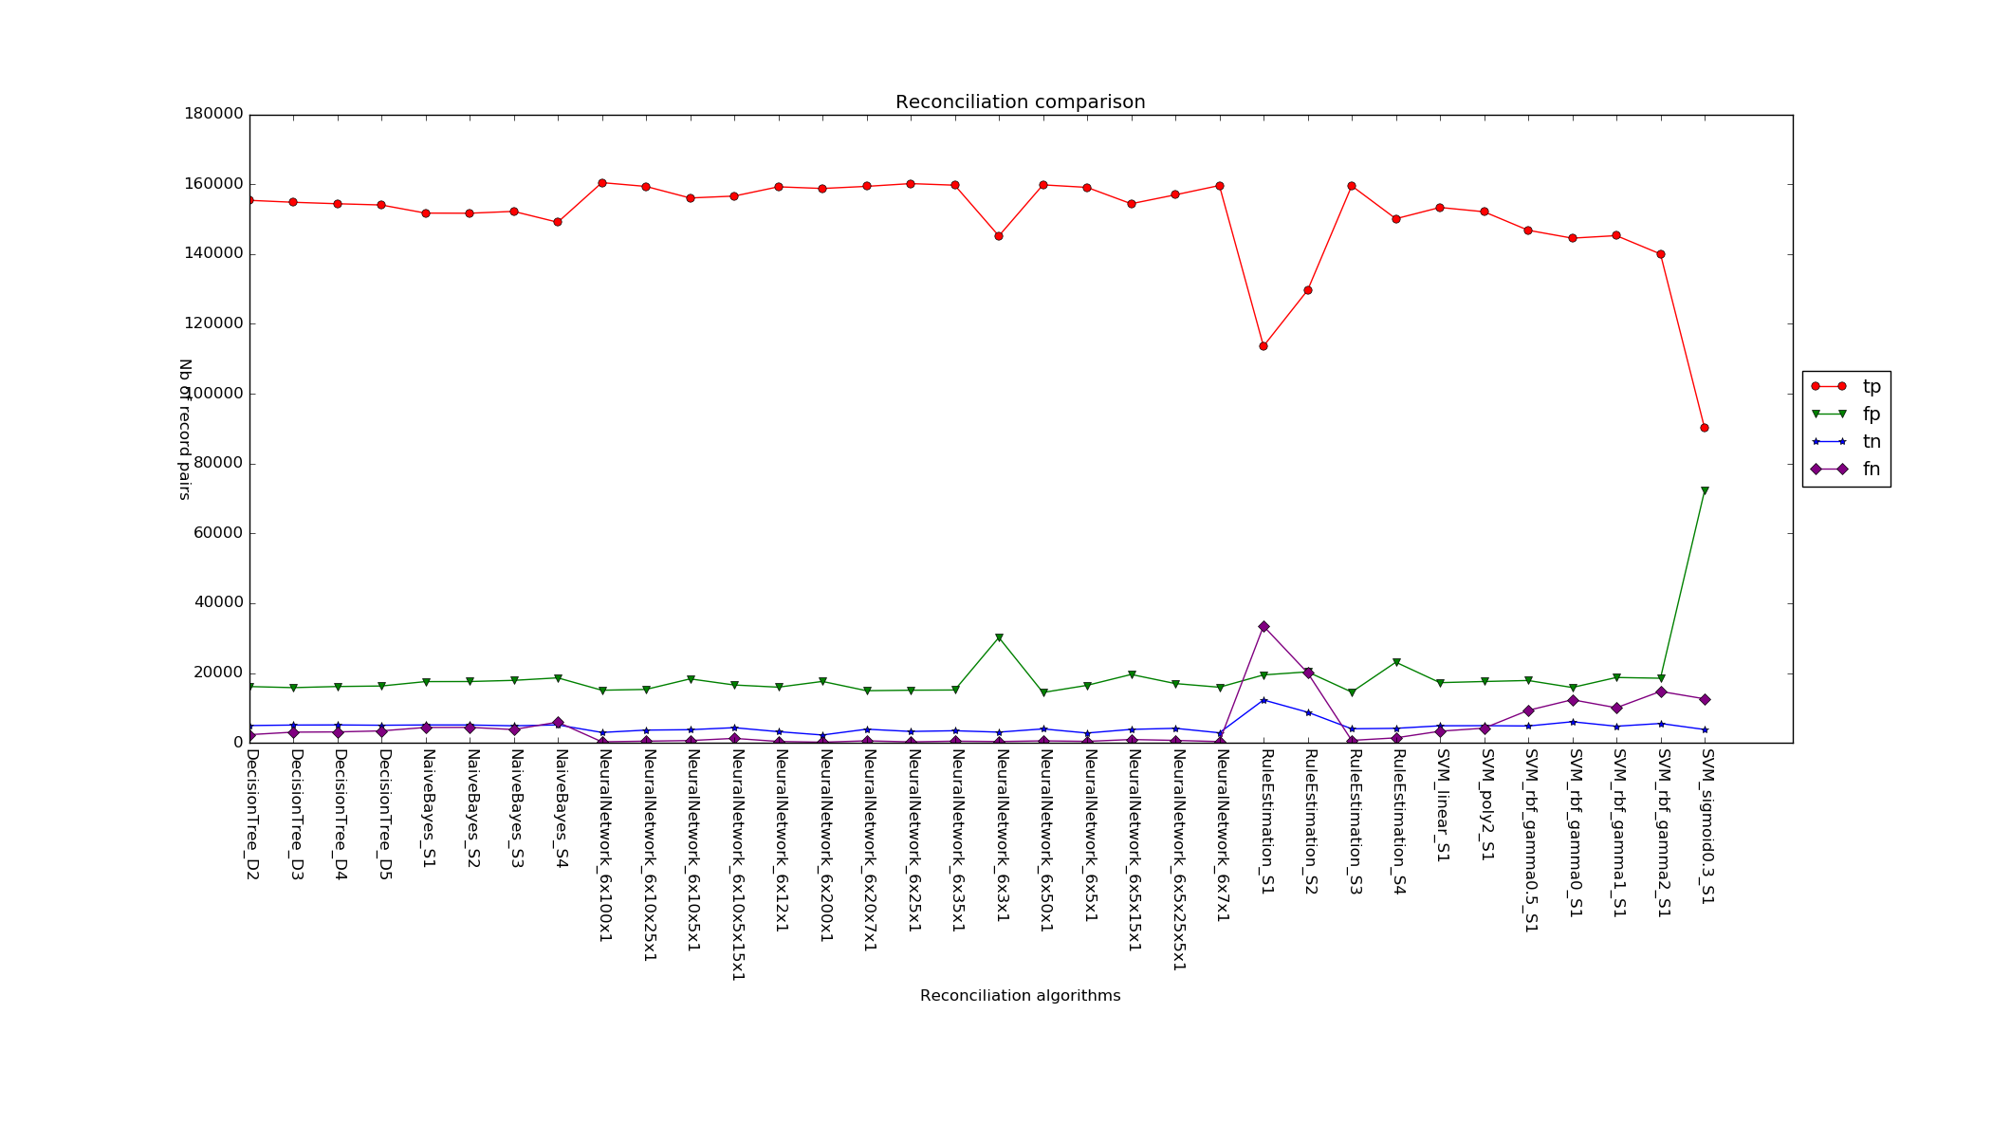
Results

Slide 14
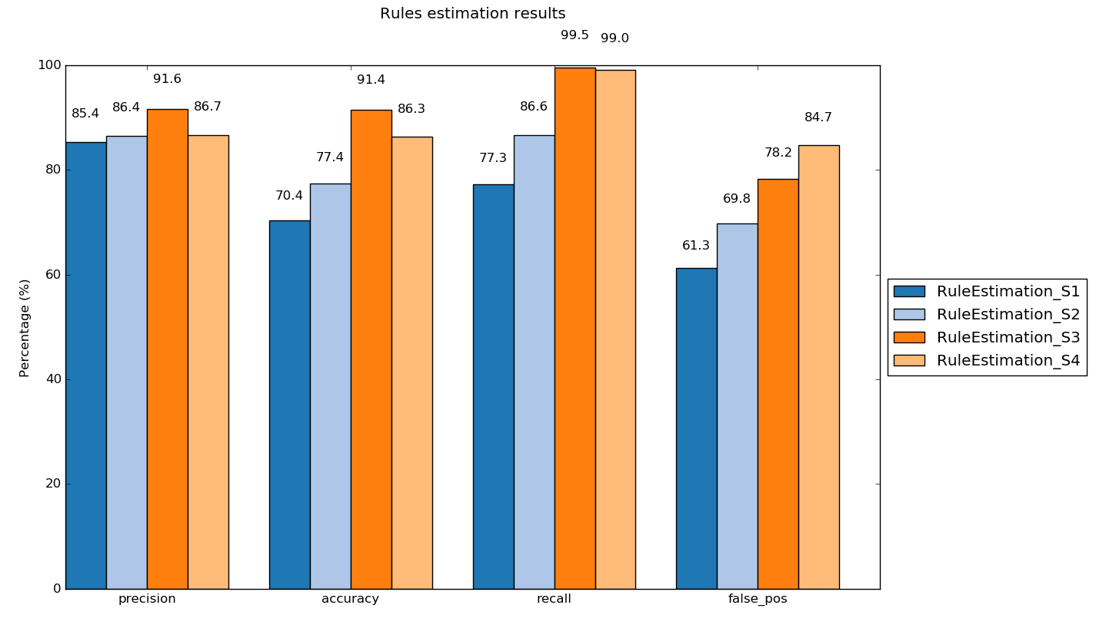
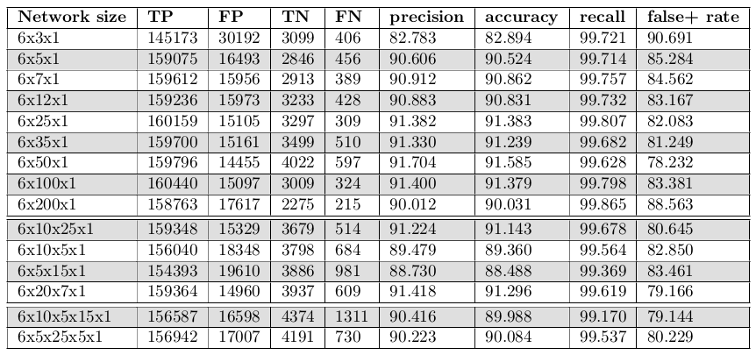
Results (2)
S1: all features; S2: title, cast, numerals, year; S3: title, cast; S4: title, year

Slide 15

Conclusions
Wise rules
Neural network
Similarity methods
Data access
control classes
Application
Filter method
Reconciliation algorithms

Slide 16
Future work
Paralellization
Evaluate results with different:
  filter method
  reconciliation alg. parameters
  training dataset
  similarity methods
GUI

Slide 17
Q & A
Questions, comments...
Thank you!

Slide 18
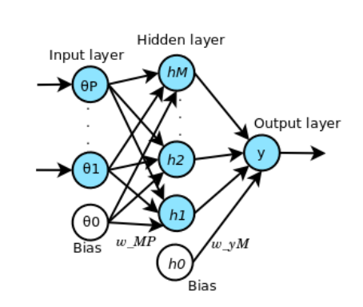

Neural network
Image adapted from Pattern recognition and machine learning, by Christopher M Bishop.

Slide 19
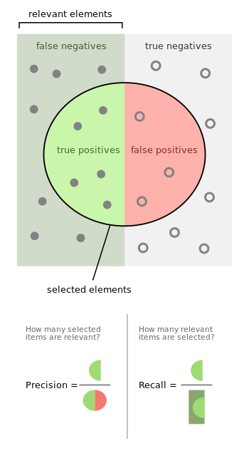




Metrics
Accuracy
Precision
Recall
False positive rate
Source: https://en.wikipedia.org/wiki/Precision_and_recall

Slide 20
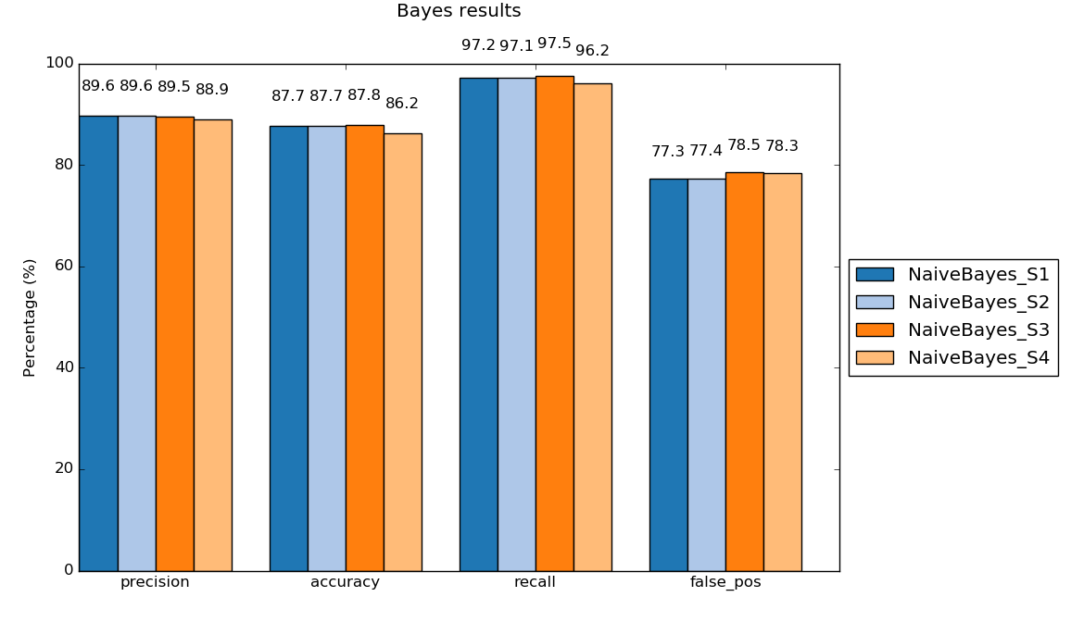
Bayes results

Slide 21
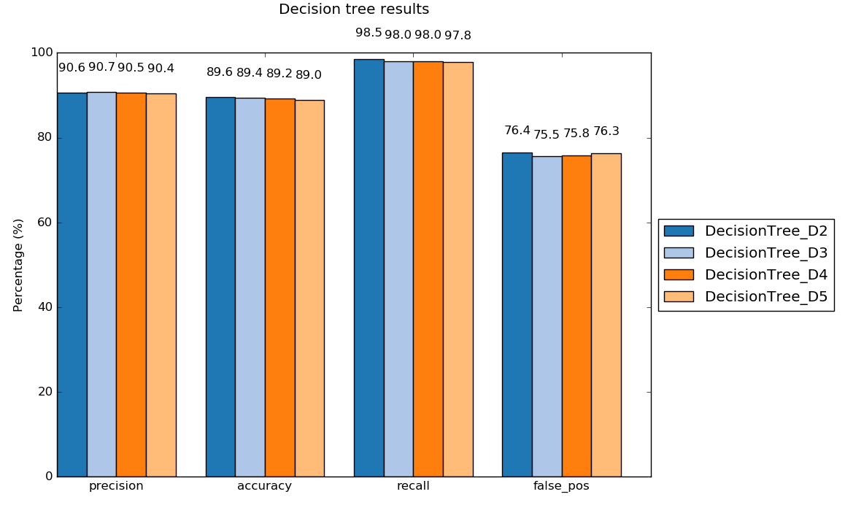
Tree results

Slide 22
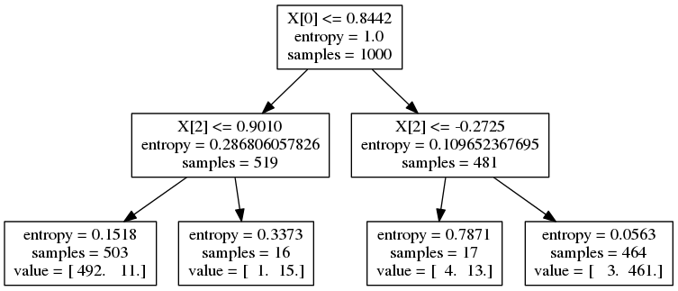
Tree results

Slide 23
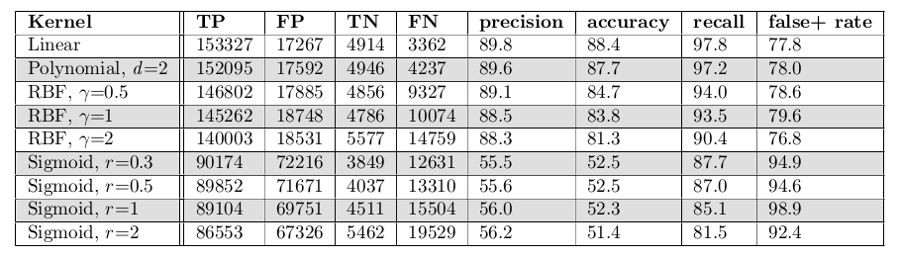
SVM results

Slide 24
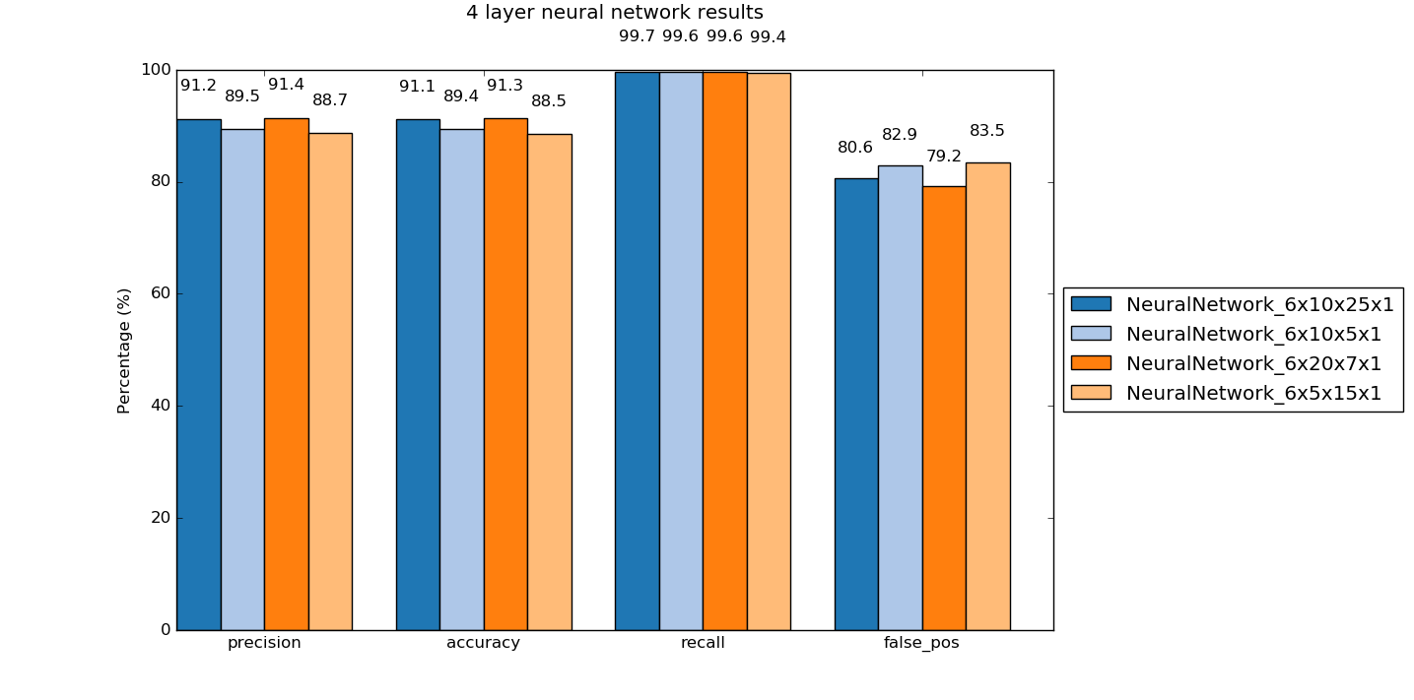
4NN results

