Slide 1
BENCHMARK OPTIMIZATION, ANALYSIS, AND HARDWARE ACCELERATION
Final Project
00460882 HWSW Co-Design
Lavie Lederman & Gal Michaeli

Slide 2
Profiling & Diagnostic Methodology
Step 1: Sample call stacks with
  perf record –F 999 –g -- python3-dbg –u run_benchmark.py
Step 2: Identify bottlenecks, e.g.
  Filler
Step 3: Optimize code
Step 4: Compare unoptimized vs optimized by
  Running both version with pyperf and recording output to JSON
  Inspecting improvement with pyperf compare_to with both JSONs
Step 5: If performance improvement is not satisfactory, go to step 1
Otherwise, inspect the flame graph⁽¹⁾ for visual confirmation
(1) Flame-graph representation can be misleading, since it normalizes total execution and interpreter-level optimizations shrink runtime uniformly.

Slide 3
BENCHMARK #1 - RAYTRACE

Slide 4
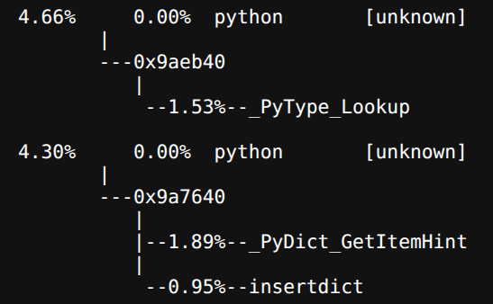
Overview
Target: Standard library raytracer evaluating 3D geometry and vector math
Discovered bottlenecks:
  Interpretation: C frame creation and deallocation during function calls along with temporary object creation are responsible for ~10% of runtime (top 3 lines). Moreover, object attribute and method lookup overhead during object property access contribute additional 3.5-9% of runtime

Slide 5
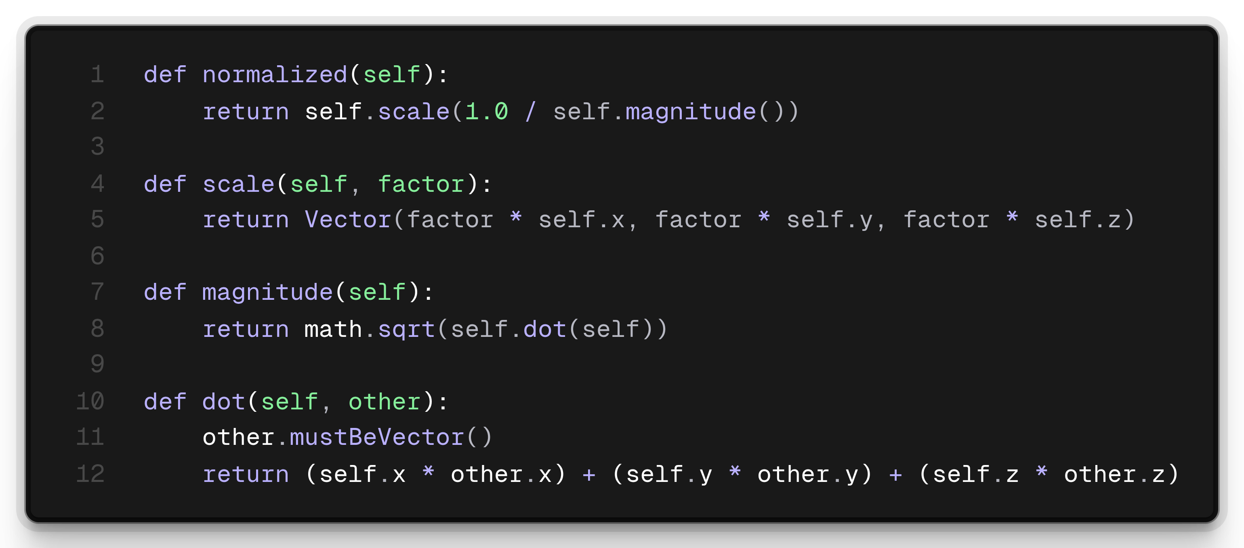
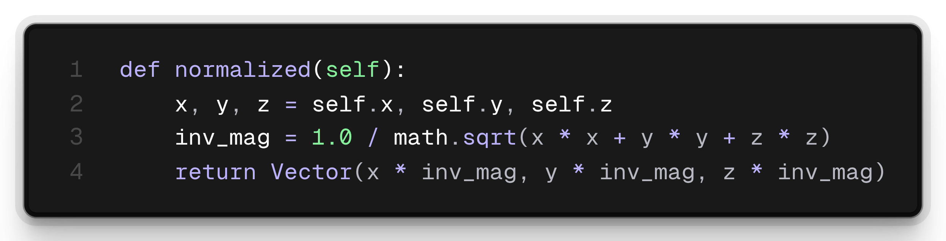
Refactoring Strategy & SW Optimizations
Inlining scalar math
  Replaced multi-step vector allocations with local scalar unpacking
  Before:
  After:

Slide 6
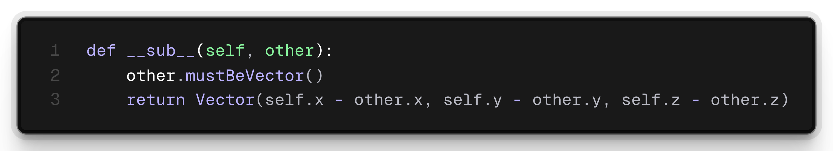
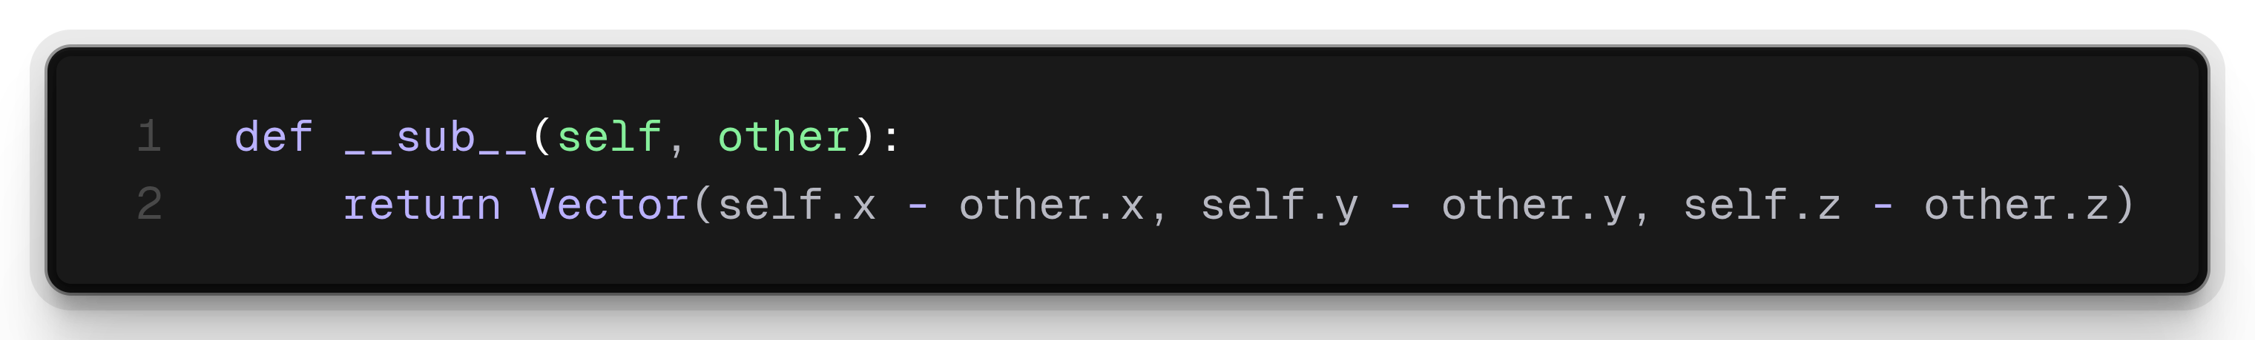
Refactoring Strategy & SW Optimizations (Cont.)
Removing type asserts
  Eliminated defensive assertions in tight loops
  Before:
  After:

Slide 7
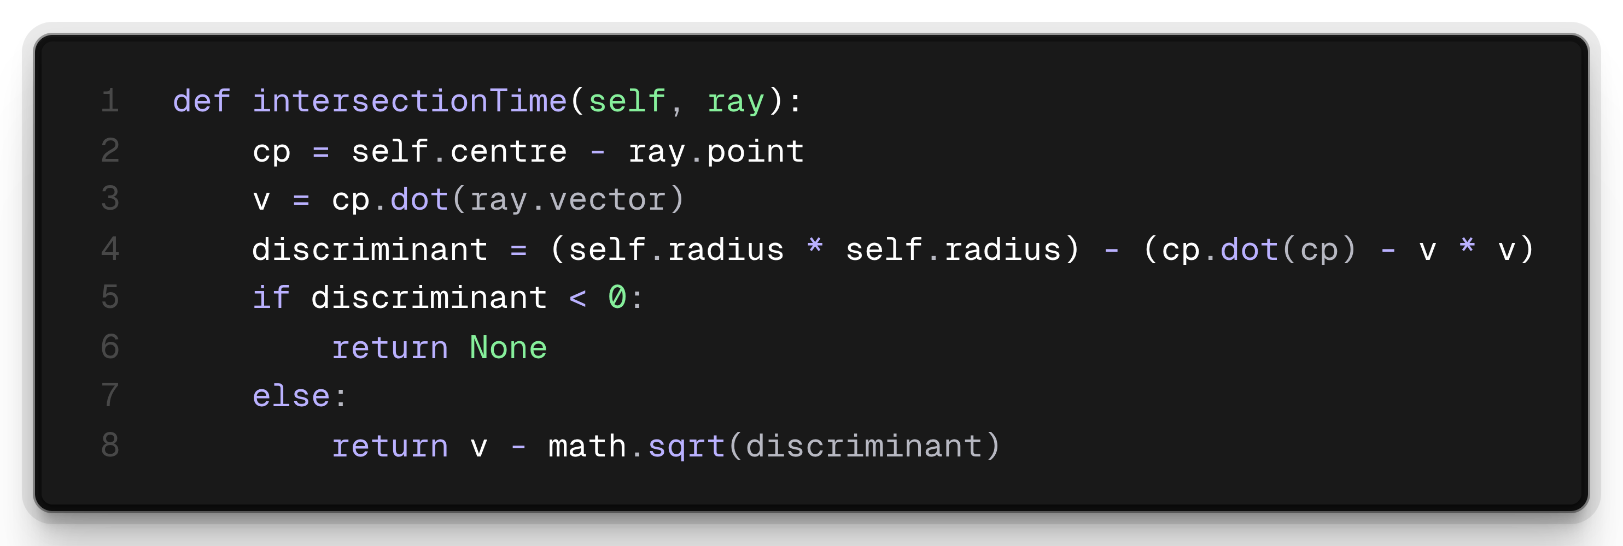
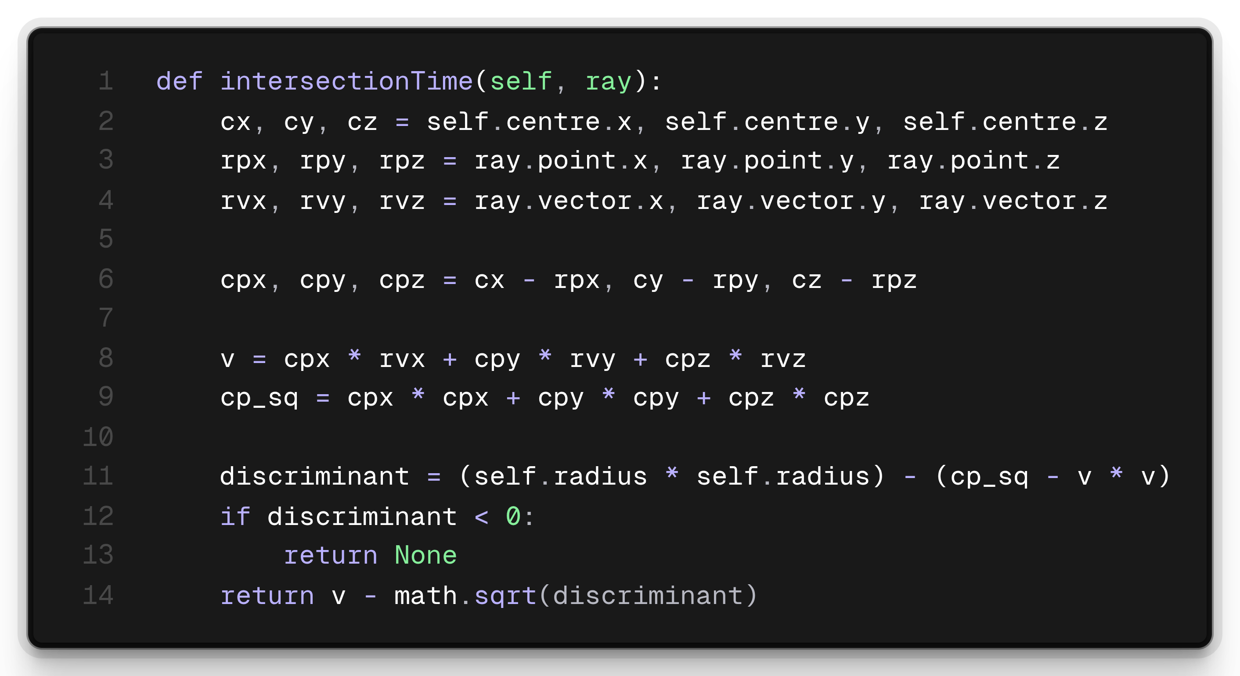
Refactoring Strategy & SW Optimizations (Cont.)
Direct Coordinates
  Computed ray-sphere quadratics directly in FP scalars, bypassing intermediate object creation
  Before:
  After:

Slide 8
Optimization Results
pyperf runtime results
33.15%
33.13%
23.62%

Slide 9
Optimization Results (Cont.)
perf record/report callchain results

Slide 10
Optimization Results (Cont.)
perf stat results
Metric | Original | Optimized
Cycles | 4.5e+11 | 3.05e+11
IPC | 2.056 | 2.113
L1 Load Misses / Cycle | 1.374e-2 | 1.422e-2
Branch Misses / Cycle | 4.384e-3 | 3.947e-3
Page Faults / Cycle | 2.011e-7 | 2.982e-7

Slide 11
BENCHMARK #2 - NBODY

Slide 12
Overview
Target: Standard library n-body (Sun + 4 planets) evaluating gravity kicks
Discovered bottlenecks:
  Almost all CPU time is interpreter scaffolding, not gravity
    FP ops (binary_op1, float_mul, float_add) are only ~4.6% on runtime
  Bytecode loop _PyEval_EvalFrameDefault is 24.27%, the single largest symbol
  Every add, multiply, and r^{-1.5} triggers
    Allocation: _PyFloat_FromDouble (4.62%)
    Deallocation: _Py_Dealloc (2.89%)
  The pair loop keeps positions and velocities in [x, y, z] lists, so we pay list_subscript and list_ass_subscript on every kick

Slide 13
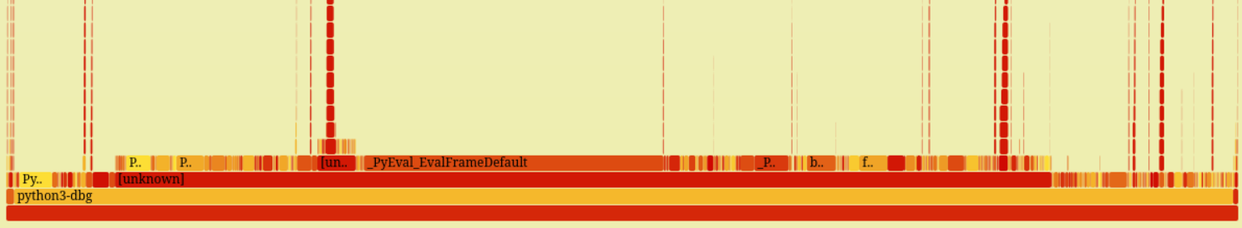
SW Optimizations
Initial attempts
  Transform body data arrays to SoA form to improve memory layout
  Compute ^(-1.5) with math.sqrt
Initial results
  ~3% improvement in runtime
Takeaway
  Not a Caching / FLOP issue – only 5 bodies and 3 coordinates
  CPython bytecode is the main culprit – float allocation and list indexing

Slide 14
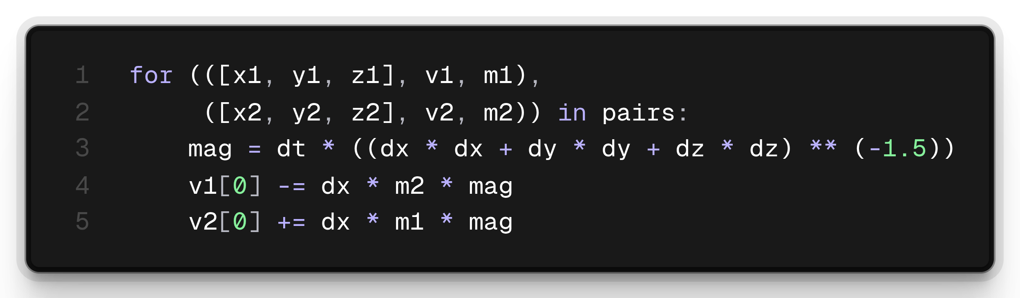
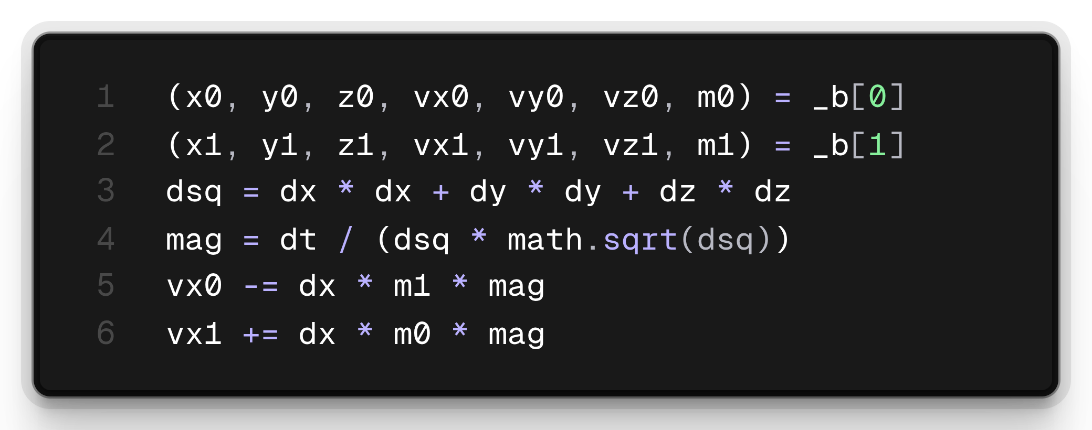
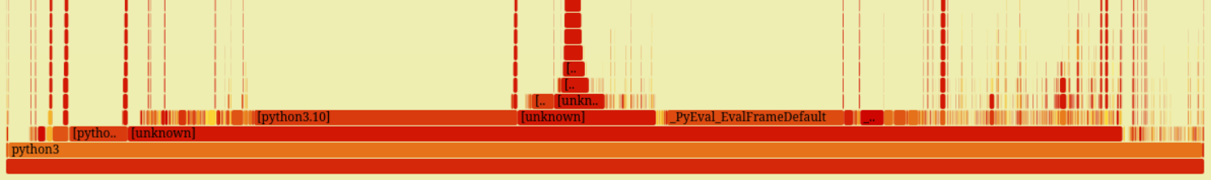
SW Optimizations (Cont.)
What worked
  Destructure the 10 pairs into local variables
  Keep them local throughout advance()
  Same physics, cheaper magnitude computation
    1 / (r * math.sqrt(r)) instead of r ** (-1.5)

Slide 15
SW Optimization Results
Speedup
  1.49x faster
  pyperf mean runtime: 3.71s —> 2.49s
  Std. Dev. mean: 0.22s —> 0.01s
    More stable without frequent float allocations and list manipulations
  ΔE ≈ 1e-16
    Acceptable for speedup gain
Results summary
Symbol | Benchmark | Optimized
_PyEval_EvalFrameDefault | 24.27% | 19.77%
list_subscript | 1.57% | 0.01%
list_ass_subscript | 1.31% | 0.01%
list_ass_item | 0.74% | ~0%

Slide 16
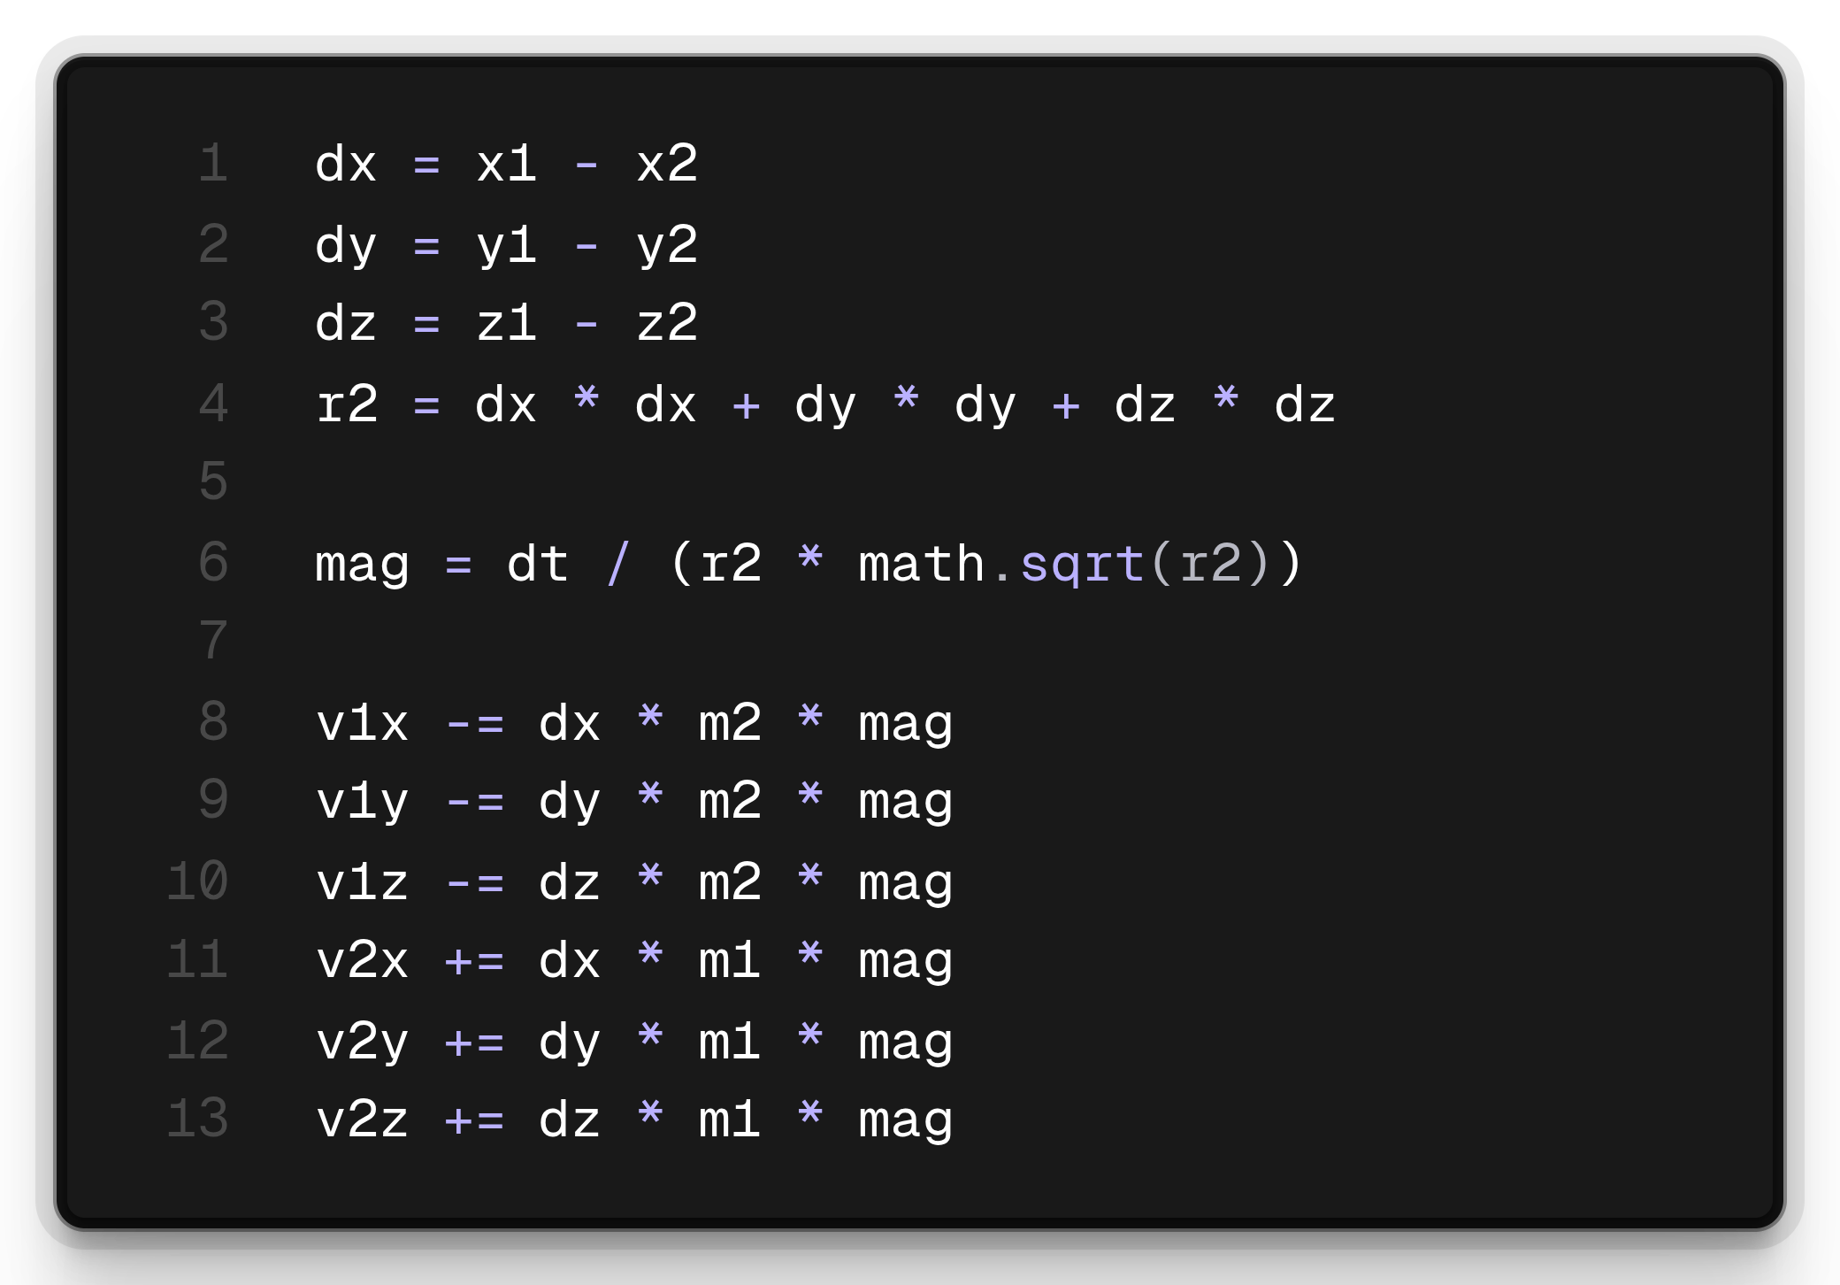
HW Acceleration - Motivation
This calculation is basically sqrt + FMA
General FP ops that are applicable in simulations and engines, not only n-body

Slide 17
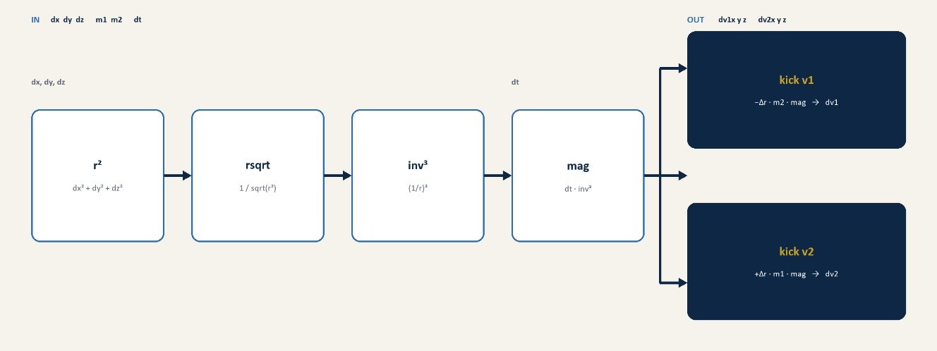
HW Acceleration – Proposed Architecture

Slide 18
QUESTIONS

