Slide 1
Practice Attempt #4
Create a 2-agent system that will create Python code where users enter a list of ticker symbols separated by commas in a string and the code returns the intrinsic value for each ticker using the user defined function provided (on the previous slide).
Upload a Word document containing the Python code that your AI team generates (not your prompts)

Slide 2
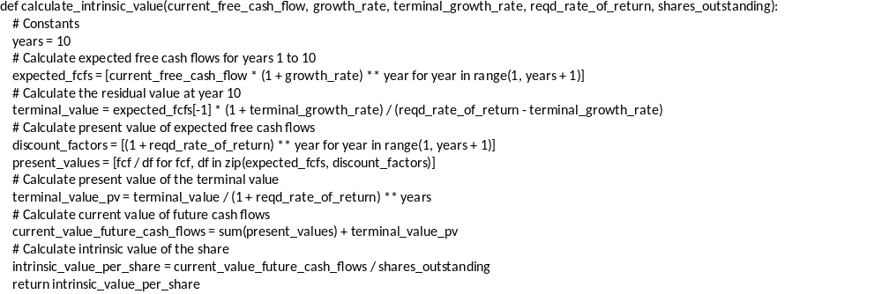
GPT generated the following Python function to compute intrinsic value

