Slide 1
CS 5187: Vision and Image Lecture 11 Motion and Optical Flow
Dr. Dapeng Oliver Wu
City University of Hong Kong
Department of Computer Science
Semester A, 2025/26

Slide 2
We live in a moving world
Perceiving, understanding and predicting motion is an important part of our daily lives

Slide 3
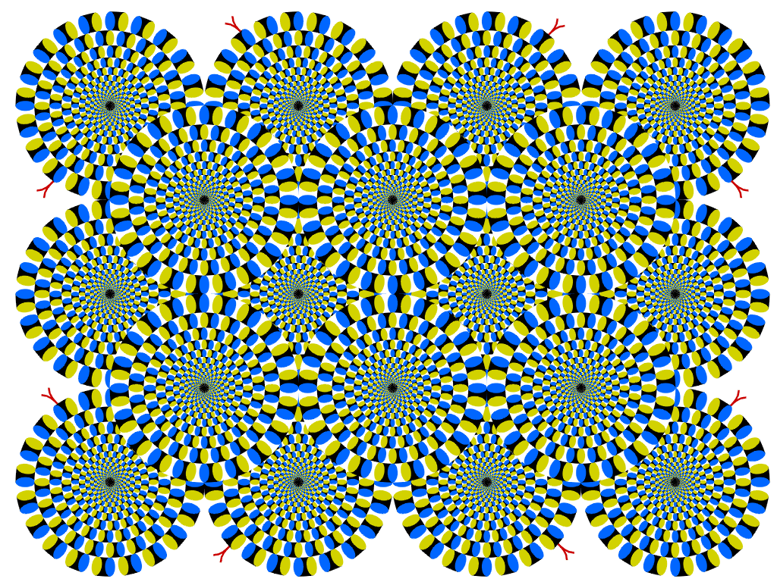
Seeing motion from a static picture?
http://www.ritsumei.ac.jp/~akitaoka/index-e.html

Slide 4

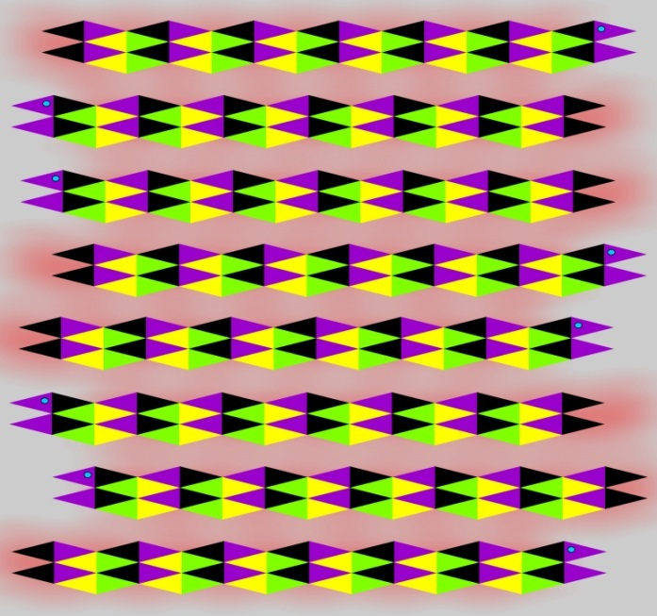
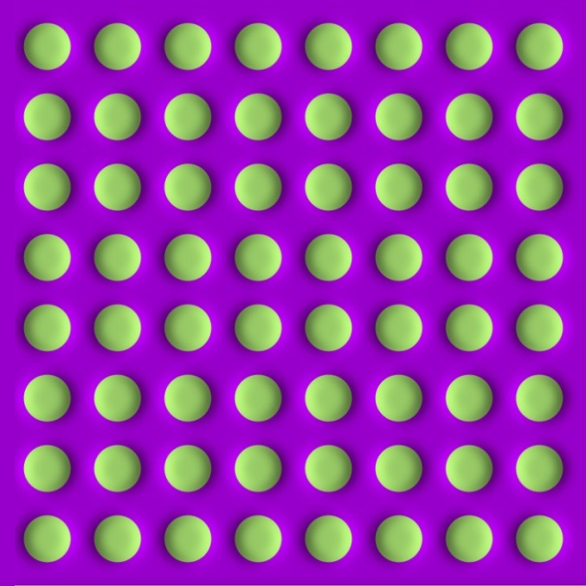
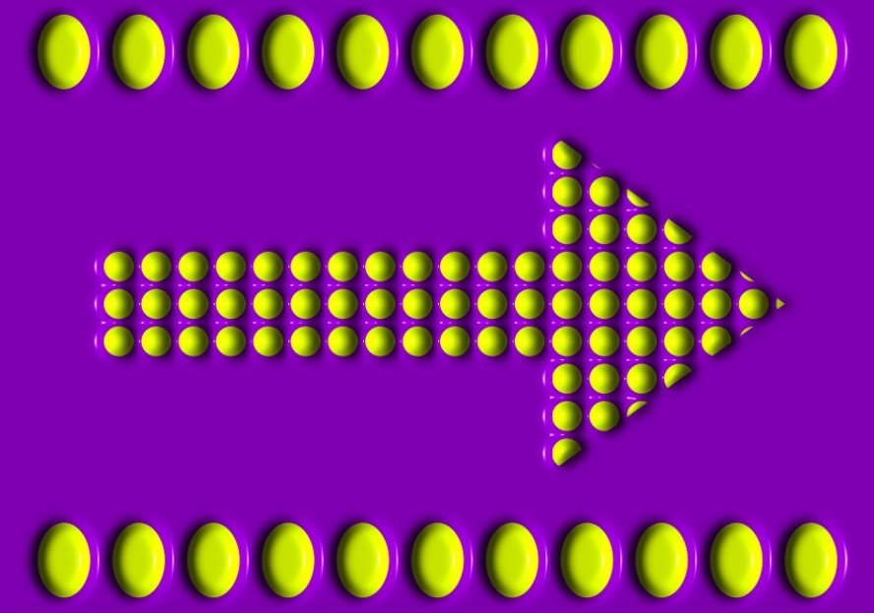
More examples

Slide 5
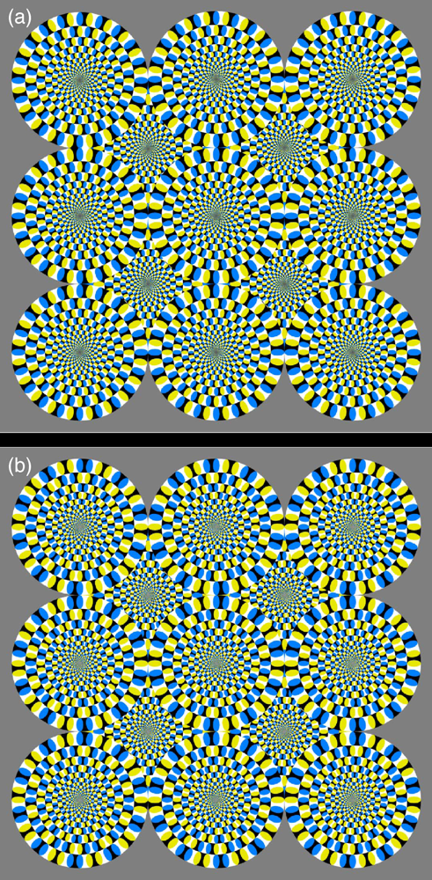
How is this possible?
The true mechanism is yet to be revealed
FMRI data suggest that illusion is related to some component of eye movements
We don’t expect computer vision to “see” motion from these patterns
Notes:
FMRI: Functional magnetic resonance imaging or functional MRI

Slide 6


The cause of motion
Three factors in imaging process
Light
Object
Camera
Varying any of them causes motion
Static camera, moving objects (surveillance)
Moving camera, static scene (3D capture)
Moving camera, moving scene (sports, movie)
Static camera, moving objects, moving light (time lapse)

Slide 7
Estimating motion
Feature-tracking
Extract visual features (corners, textured areas) and “track” them over multiple frames
Optical flow
Recover image motion at each pixel from spatio-temporal image brightness variations (optical flow)
B. Lucas and T. Kanade. An iterative image registration technique with an application to
stereo vision. In Proceedings of the International Joint Conference on Artificial Intelligence, pp. 674–679, 1981.

Slide 8
Feature tracking
Challenges
Figure out which features can be tracked
Efficiently track across frames
Some points may change appearance over time (e.g., due to rotation, moving into shadows, etc.)
Drift: small errors can accumulate since errors can propagate to future image frames
Points may appear or disappear: need to be able to add/delete tracked points
Notes:
Harris corner detection

Slide 9
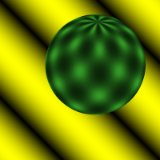
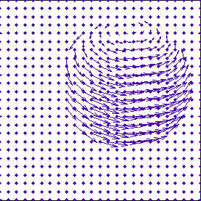
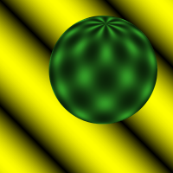
What is Optical Flow?
…
Notes:
explain: arrows and dots of flow field
Find a motion, where this pixel lies in the second frame

Slide 10
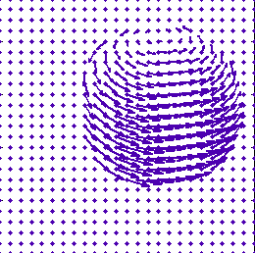
Definitions
The optical flow is a velocity field in the image which transforms one image into the next image in a sequence [ Horn & Schunck ]
+
=
frame #1
flow field
frame #2

Slide 11
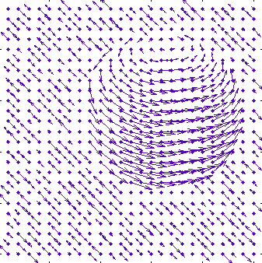
Ambiguity of optical flow
flow (2)
flow (1): true motion
Frame 1

Slide 12
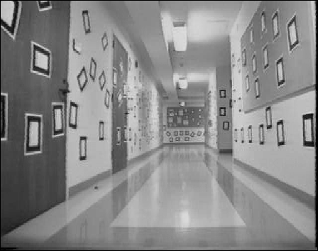
What is Optical Flow?
Optical Flow
Velocity vectors
Optical flow is the pattern of apparent motion of objects, surfaces, and edges in
a visual scene caused by the relative motion between an observer and a scene
-Wiki

Slide 13
Optical Flow Research: Timeline
Horn&Schunck
Lucas&Kanade
many methods
more methods
1981
1992
1998
now
Seminal papers
Benchmark: Barron et.al.
Benchmark: Galvin et.al.

Slide 14
Optical Flow
I(x,y,t)
I(x,y,t+1)
Given two subsequent frames, estimate the point translation
Key assumptions of Lucas-Kanade Tracker
Brightness constancy: projection of the same point looks the same in every frame
Small motion: points do not move very far
Spatial coherence: points move like their neighbors

Slide 15


The brightness constancy constraint
I(x,y,t)
I(x,y,t+1)
Brightness Constancy Equation:
Take Taylor expansion of I(x+u, y+v, t+1) at (x,y,t) to linearize the right side:
Image derivative along x
Difference over frames
So:
Notes:
Brightness constancy equation is equivalent to minimizing the squared error of I(t) and I(t+1)

Slide 16
The brightness constancy constraint
Can we use this equation to recover image motion (u,v) at each pixel?
How many equations and unknowns per pixel?
One equation, two unknowns (u,v)

Slide 17
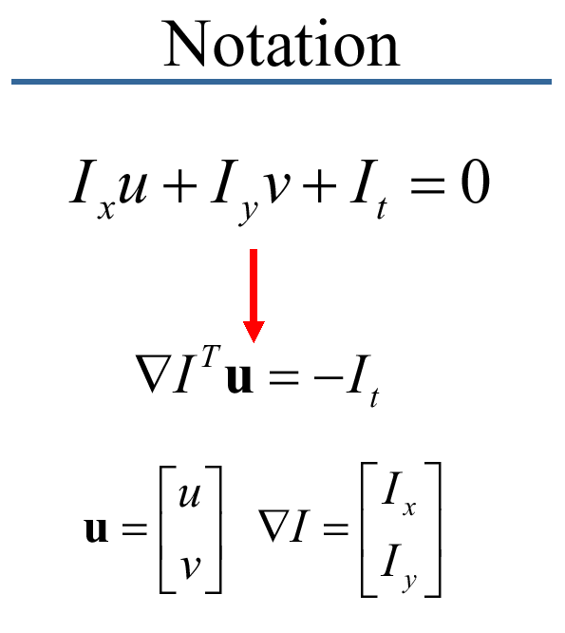
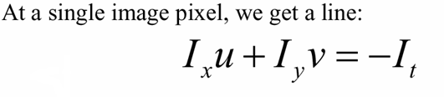
Optical Flow

Slide 18
How does this show up visually? Known as the “Aperture Problem”

Slide 19
Aperture Problem Exposed
Motion along just an edge is ambiguous

Slide 20
The aperture problem
Actual motion

Slide 21
The aperture problem
Perceived motion

Slide 22
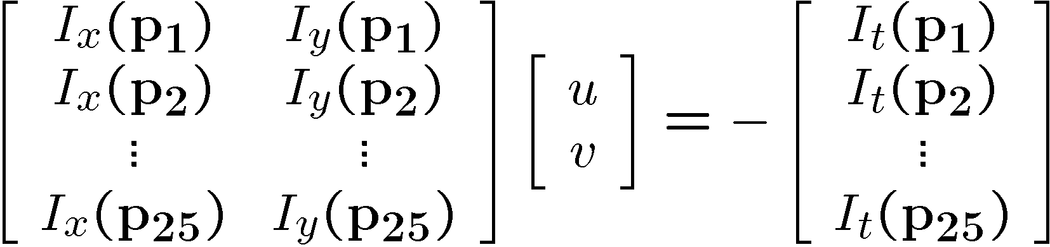
Lucas and Kanade
B. Lucas and T. Kanade. An iterative image registration technique with an application to stereo vision. In Proceedings of the International Joint Conference on Artificial Intelligence, pp. 674–679, 1981.
How to get more equations for a pixel?
Spatial coherence constraint
Assume the pixel’s neighbors have the same (u,v)
If we use a 5x5 window, that gives us 25 equations per pixel

Slide 23




Least squares problem
Least squares problem:

Slide 24

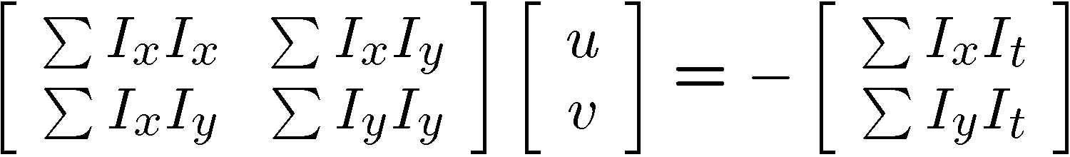


Matching patches across images
Overconstrained linear system
Least squares solution for d given by
The summations are over all pixels in the K x K window
Criteria for Harris corner detector

Slide 25





Aperture problem
Corners
Lines
Flat regions
Notes:
How computer sees the motion in flow estimation?

Slide 26
Errors in Lukas-Kanade
What are the potential causes of errors in this procedure?
Suppose A^{T}A is easily invertible
Suppose there is not much noise in the image
Our assumptions
Brightness constancy is not satisfied
The motion is not small
A point does not move like its neighbors
window size is too large
what is the ideal window size?

Slide 27
Improving accuracy
Recall our small motion assumption
I_{t-1}(x,y)
I_{t-1}(x,y)
This is not exact
To do better, we need to add higher order terms back in:
I_{t-1}(x,y)
Lukas-Kanade method does one iteration of Newton’s method
Better results are obtained via more iterations

Slide 28
Iterative Refinement
Iterative Lukas-Kanade Algorithm
Estimate velocity at each pixel by solving Lucas-Kanade equations
Warp I(t-1) towards I(t) using the estimated flow field
- use image warping techniques
Repeat until convergence

Slide 29
Tracking in the 1D case:
?

Slide 30
Tracking in the 1D case:
Temporal derivative
Spatial derivative
Assumptions:
Brightness constancy
Small motion

Slide 31
Tracking in the 1D case:
Iterating helps refining the velocity vector
Temporal derivative at 2nd iteration
Can keep the same estimate for spatial derivative
Converges in about 5 iterations

Slide 32
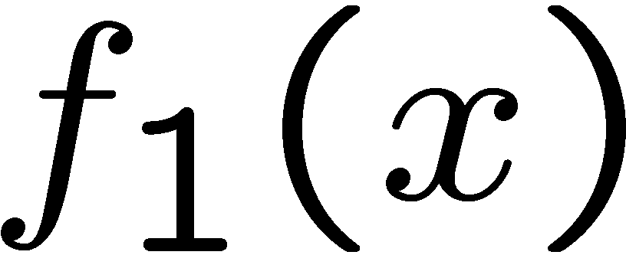
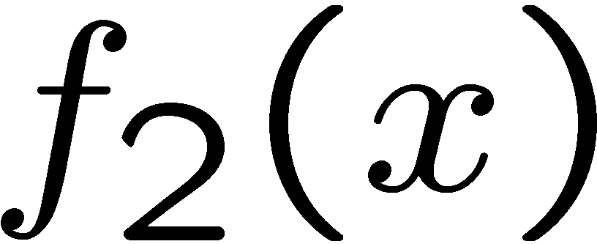
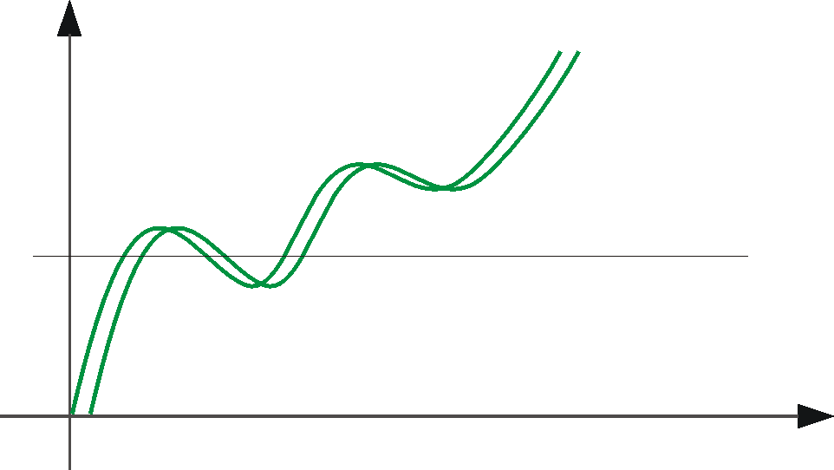
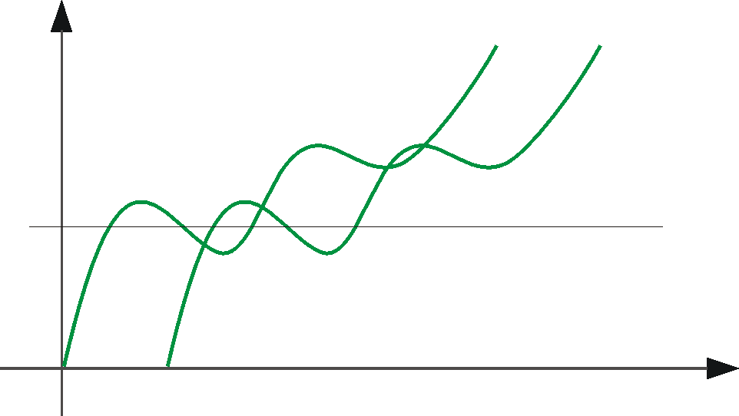
Optical Flow: Aliasing
Temporal aliasing causes ambiguities in optical flow because images can have many pixels with the same intensity.
I.e., how do we know which ‘correspondence’ is correct?
actual shift
estimated shift
nearest match is correct (no aliasing)
nearest match is incorrect (aliasing)
To overcome aliasing: coarse-to-fine estimation.

Slide 33
Revisiting the small motion assumption
Is this motion small enough?
Probably not—it’s much larger than one pixel
How might we solve this problem?

Slide 34
Reduce the resolution!

Slide 35
Coarse-to-fine optical flow estimation
run iterative L-K
warp & upsample
run iterative L-K
.
.
.
image J
image I
image 1
image 2
Gaussian pyramid of image 1 (t)
Gaussian pyramid of image 2 (t+1)

Slide 36
A Few Details
Top Level
Apply L-K to get a flow field representing the flow from the first frame to the second frame.
Apply this flow field to warp the first frame toward the second frame.
Return L-K on the new warped image to get a flow field from it to the second frame.
Repeat till convergence.
Next Level
Upsample the flow field to the next level as the first guess of the flow at that level.
Apply this flow field to warp the first frame toward the second frame.
Rerun L-K and warping till convergence as above.
Etc.

Slide 37
Coarse-to-fine optical flow estimation
u=1.25 pixels
u=2.5 pixels
u=5 pixels
image H
u=10 pixels
image I
image 1
image 2
Gaussian pyramid of image 1
Gaussian pyramid of image 2

Slide 38
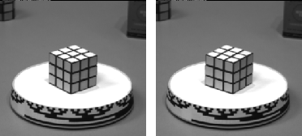
Optical flow result

Slide 39
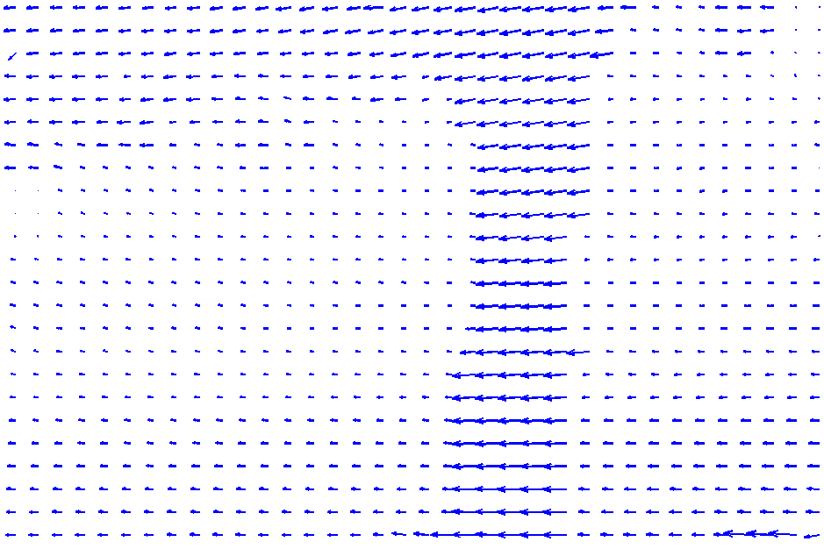
The Flower Garden Video
What should the
optical flow be?

Slide 40
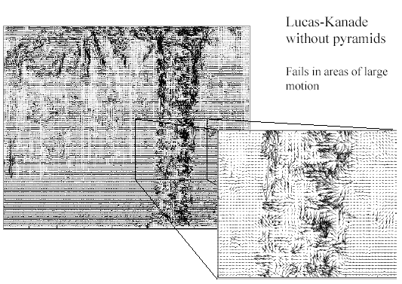
Optical Flow Results
* From Khurram Hassan-Shafique CAP5415 Computer Vision 2003
Notes:
The size of the window is a problem.
Big window: foreground and background, not the same motion, quite noisy

Slide 41
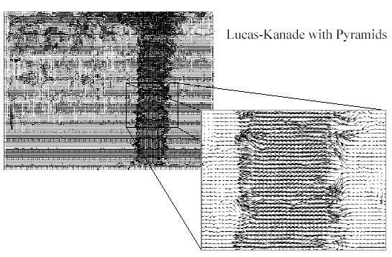
Optical Flow Results
* From Khurram Hassan-Shafique CAP5415 Computer Vision 2003

Slide 42
Summary
Major contributions from Lucas, Tomasi, Kanade
Tracking feature points
Optical flow
Key ideas
By assuming brightness constancy, truncated Taylor expansion leads to simple and fast patch matching across frames
Coarse-to-fine registration

