Slide 1
CS 5187: Vision and Image Lecture 3 Deep Learning
Dr. Dapeng Oliver Wu
City University of Hong Kong
Department of Computer Science
Semester A, 2025/26

Slide 2
Outline
Why deep learning?
Types of neural networks
DNN (or MLP)
Recursion principle for back-propagation algorithm
CNN
RNN, LSTM
Transformer

Slide 3
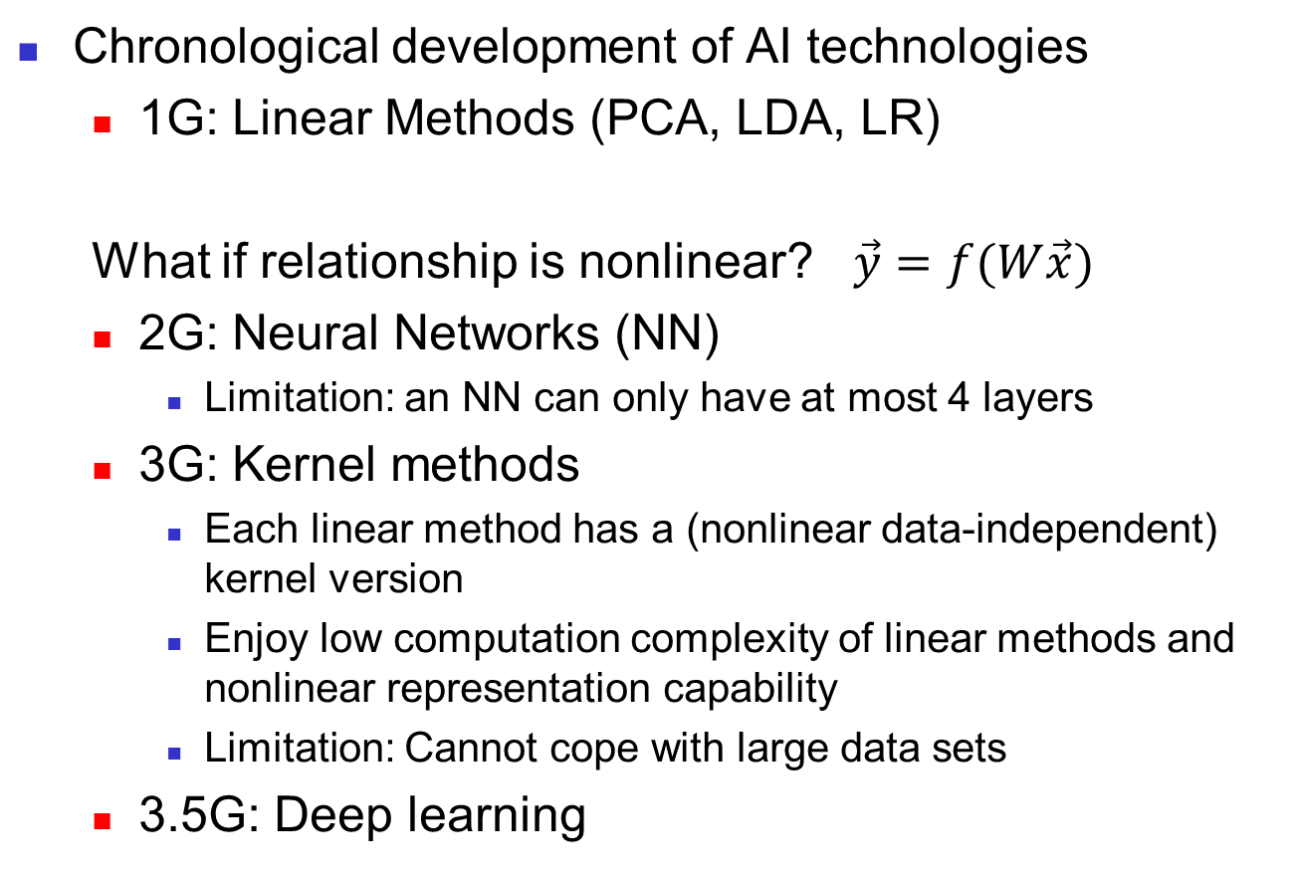

Why Deep Learning?
Chronological development of AI technologies
1G: Linear Methods (PCA, LDA, LR)
What if relationship is nonlinear? $\vec{y}=f(W\vec{x})$
2G: Neural Networks (NN)
Limitation: an NN can only have at most 4 layers
3G: Kernel methods
Each linear method has a (nonlinear data-independent) kernel version
Enjoy low computation complexity of linear methods and nonlinear representation capability
Limitation: Cannot cope with large data sets
3.5G: Deep learning
$$\vec{y}=W\vec{x}$$

Slide 4
Outline
Why deep learning?
Types of neural networks
DNN (or MLP)
Recursion principle for back-propagation algorithm
CNN
RNN, LSTM
Transformer

Slide 5
Deep Neural Networks (DNN)
Narrow-sense Deep Neural Network (DNN):
feedforward neural network (FFNN)
fully connected neural network (FCNN)
Multi-layer perceptron (MLP)
Broad-sense DNN includes FFNN, CNN, RNN

Slide 6
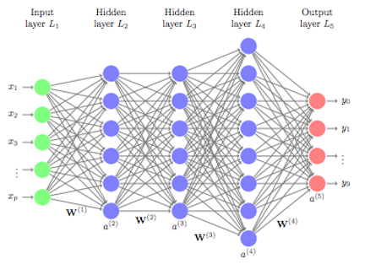




Structure of MLP
Recursion:
$$a^{(l)}=σ^{(l)}(W^{(l)}a^{(l−1)})$$
$$a^{(4)}$$
$$a^{(1)}$$
$$a^{(2)}$$
$$a^{(3)}$$
The overall network is a recursive operation of linear transformation and nonlinear activation:
$y={a^{(L)}=σ}^{(L)}(W^{(L)}σ^{(L−1)}(⋯σ^{(1)}(W^{(1)}x)⋯$))

Slide 7

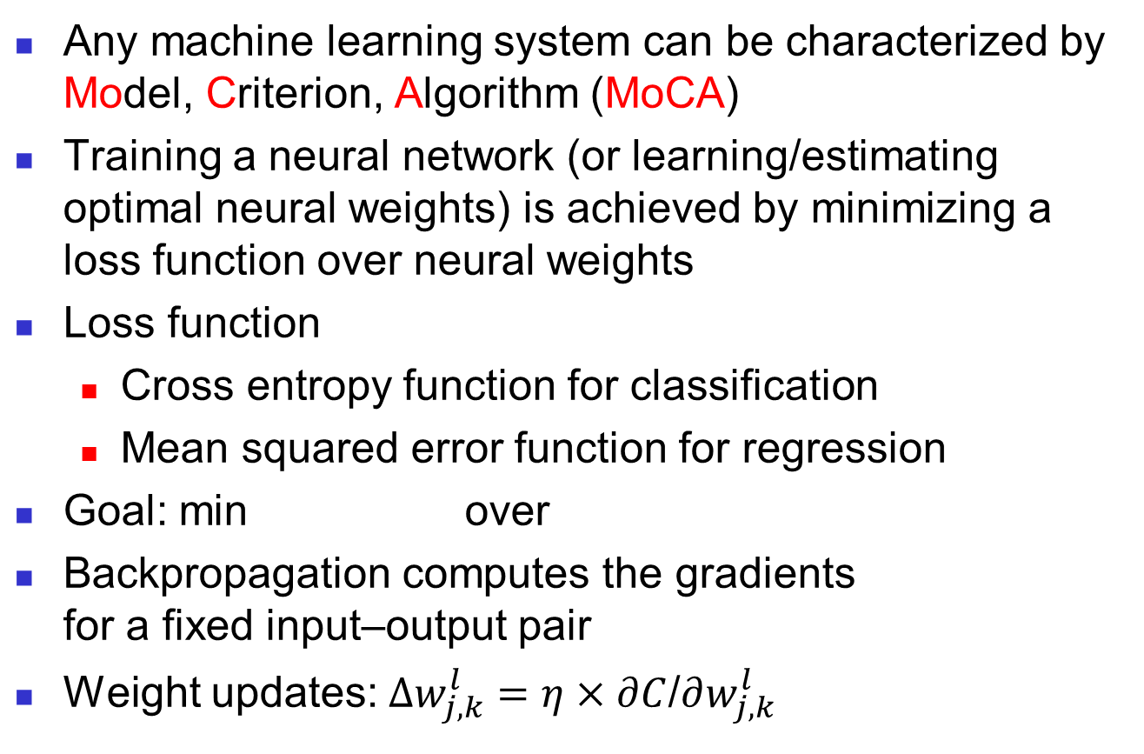

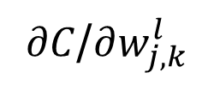


Back-propagation Algorithm (1)
Any machine learning system can be characterized by Model, Criterion, Algorithm (MoCA)
Training a neural network (or learning/estimating optimal neural weights) is achieved by minimizing a loss function over neural weights
Loss function
Cross entropy function for classification
Mean squared error function for regression
Goal: min over
Backpropagation computes the gradients for a fixed input–output pair
Weight updates:$∆w_{j,k}^{l}=η×∂C$/$∂w_{j,k}^{l}$
$$C(y_{d},y)$$
$$C(y_{d},y)$$
$$w_{j,k}^{l}$$
$∂C$/$∂w_{j,k}^{l}$
$$(x_{i}, y_{i,d})$$

Slide 8
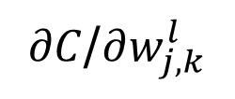
Back-propagation Algorithm (2)
$∂C$/$∂w_{j,k}^{l}$
Each gradient can be computed by the chain rule; however, doing this separately for each weight is inefficient.
What’s the trick here?
Backpropagation efficiently computes the gradient by avoiding duplicate calculations and not computing unnecessary intermediate values (similar to fast Fourier Transform (FFT) and dynamic programming), by computing the gradient of each layer from back to front recursively.

Slide 9
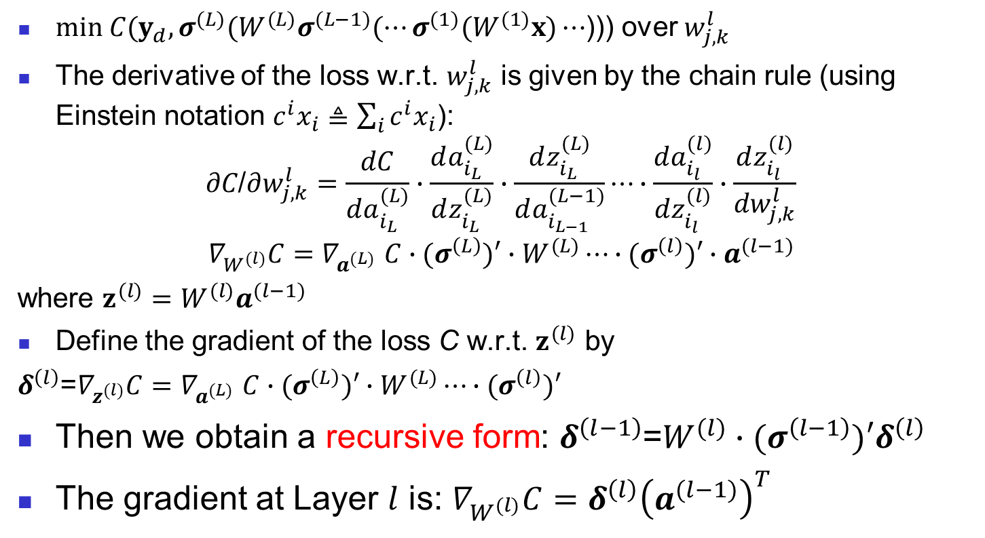
Back-propagation Algorithm (3)
$\text{min} C(y_{d},σ^{(L)}(W^{(L)}σ^{(L−1)}(⋯σ^{(1)}(W^{(1)}x)⋯$))) over $w_{j,k}^{l}$
The derivative of the loss w.r.t. $w_{j,k}^{l}$ is given by the chain rule (using Einstein notation $c^{i}x_{i}≜\sum_{i}{c^{i}x_{i}}$):
$$∂C\text{/}∂w_{j,k}^{l}=\frac{dC}{da_{i_{L}}^{(L)}}∙\frac{da_{i_{L}}^{(L)}}{dz_{i_{L}}^{(L)}}∙\frac{dz_{i_{L}}^{(L)}}{da_{i_{L−1}}^{(L−1)}}⋯∙\frac{da_{i_{l}}^{(l)}}{dz_{i_{l}}^{(l)}}∙\frac{dz_{i_{l}}^{(l)}}{{dw}_{j,k}^{l}}$$
$$∇_{W^{(l)}}C{=∇}_{a^{(L)}}C∙(σ^{\left(L\right)})′∙W^{(L)}⋯∙(σ^{\left(l\right)})′∙a^{(l−1)}$$
where $z^{(l)}=W^{(l)}a^{(l−1)}$
Define the gradient of the loss C w.r.t. $z^{(l)}$ by
$δ^{\left(l\right)}$=$∇_{z^{(l)}}C{=∇}_{a^{(L)}}C∙(σ^{\left(L\right)})′∙W^{(L)}⋯∙(σ^{\left(l\right)})′$
Then we obtain a recursive form: $δ^{\left(l−1\right)}$=${W^{(l)}∙(σ^{\left(l−1\right)})′δ}^{\left(l\right)}$
The gradient at Layer $l$ is: $∇_{W^{(l)}}C=δ^{\left(l\right)}{\left(a^{(l−1)}\right)}^{T}$

Slide 10
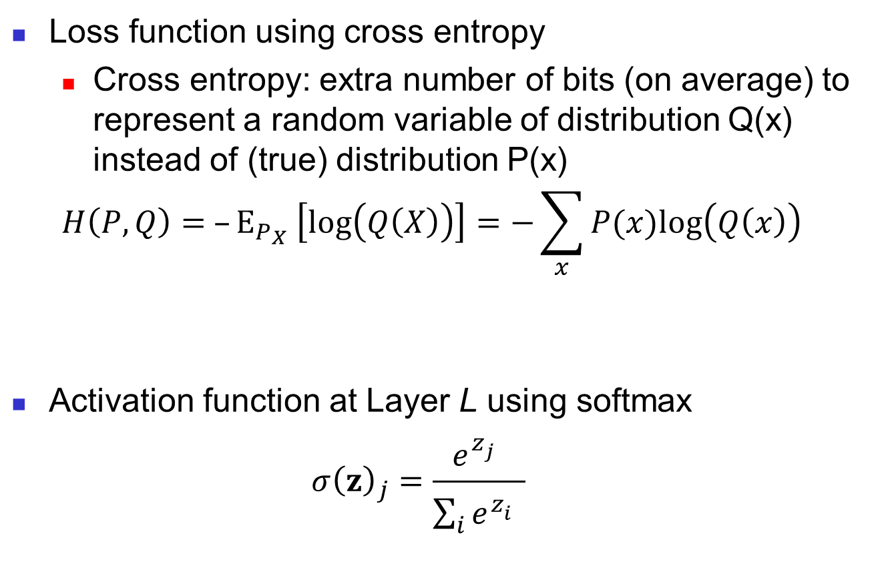
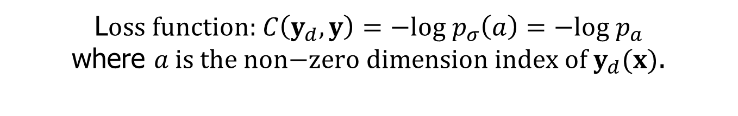
Example 1
Loss function using cross entropy
Cross entropy: extra number of bits (on average) to represent a random variable of distribution Q(x) instead of (true) distribution P(x)
$$H\left(P, Q\right)= –{\text{E}}_{P_{X}} \left[\text{log}\left(Q\left(X\right)\right)\right]=−\sum_{x}{P(x)\text{log}\left(Q\left(x\right)\right)}$$
Activation function at Layer L using softmax
$${σ\left(z\right)}_{j}=\frac{e^{z_{j}^{}}}{\sum_{i}{e^{z_{i}^{}}}}$$
L$\text{oss} \text{function}\text{:} C\left(y_{d},y\right)=−\text{log} p_{σ}\left(a\right)=−\text{log} p_{a}$
where $a \text{is} \text{the} \text{non}\text{−}\text{zero} \text{dimension} \text{index} \text{of} y_{d}(x)$.
Notes:
10

Slide 11
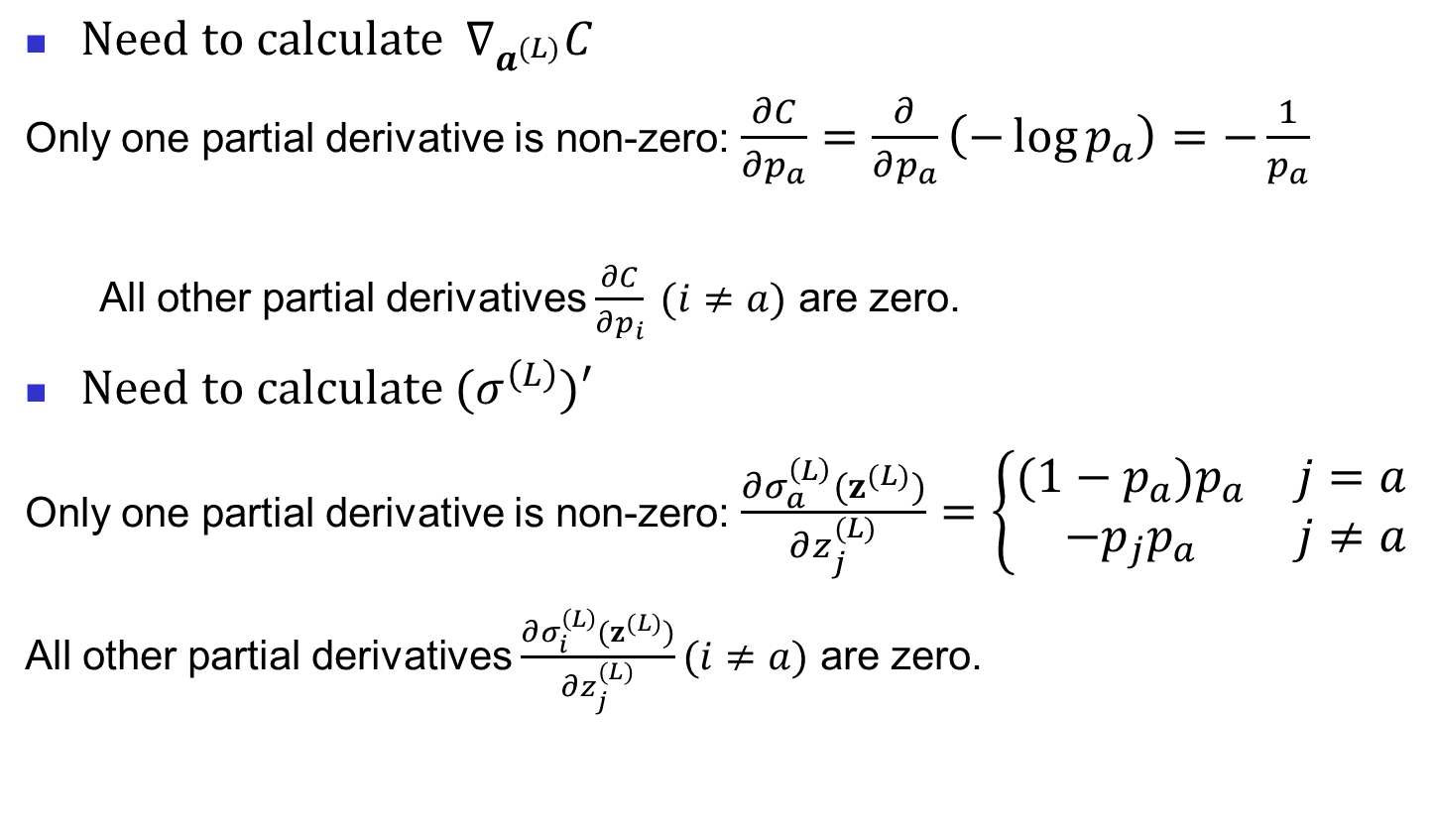
Example 1 (cont’d)
${\text{Need} \text{to} \text{calculate} ∇}_{a^{(L)}}C$
Only one partial derivative is non-zero: $\frac{∂C}{∂p_{a}}=\frac{∂}{∂p_{a}}\left(−\log{p_{a}}\right)=−\frac{1}{p_{a}}$
All other partial derivatives $\frac{∂C}{∂p_{i}} (i≠a)$ are zero.
$\text{Need} \text{to} \text{calculate} (σ^{\left(L\right)})′$
Only one partial derivative is non-zero: $\frac{∂σ_{a}^{\left(L\right)}(z^{(L)})}{∂z_{j}^{(L)}}=\left\{\begin{matrix}(1−p_{a})p_{a} & j=a \\ −{p_{j}p}_{a} & j≠a\end{matrix}\right.$
All other partial derivatives $\frac{∂σ_{i}^{\left(L\right)}(z^{(L)})}{∂z_{j}^{(L)}}(i≠a)$ are zero.
Notes:
11

Slide 12
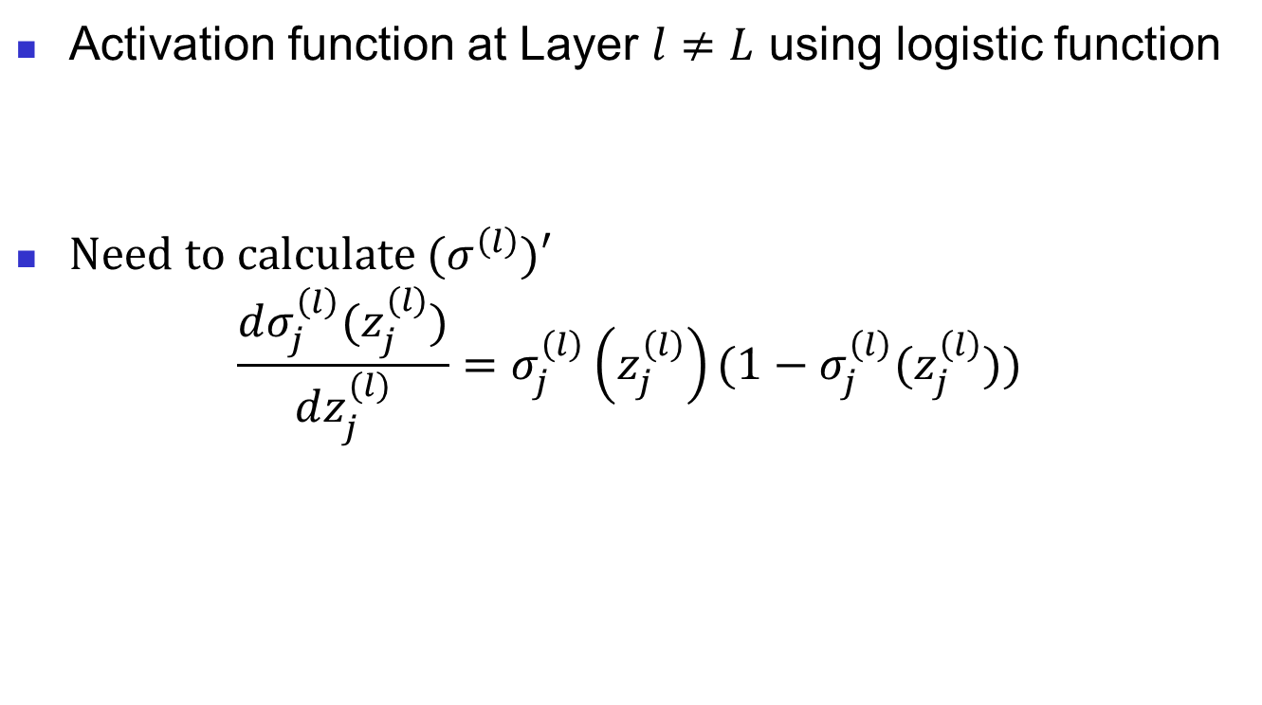

Example 1 (cont’d)
Activation function at Layer $l≠L$ using logistic function
$\text{Need} \text{to} \text{calculate} (σ^{\left(l\right)})′$
$$\frac{dσ_{j}^{\left(l\right)}(z_{j}^{(l)})}{dz_{j}^{(l)}}=σ_{j}^{\left(l\right)}\left(z_{j}^{\left(l\right)}\right)\text{(1}−σ_{j}^{\left(l\right)}(z_{j}^{\left(l\right)}))$$
$$σ\left(z\right)=\frac{1}{1+e^{−z}}$$
Notes:
12

Slide 13
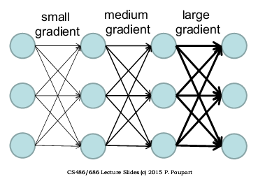
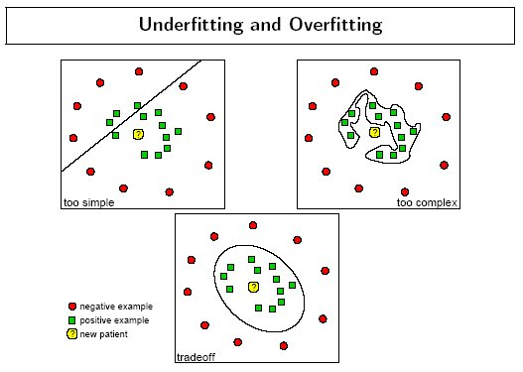
Challenges with MLP
Get stuck in poor local minima or plateaus due to random initialization.
Vanishing gradient: gradients become smaller at lower layers
Excellent training but poor in testing: overfitting
Notes:
13

Slide 14
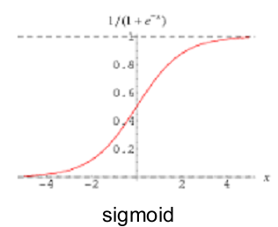
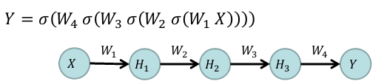
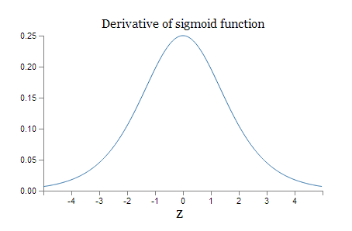
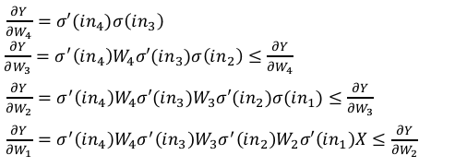
Why Vanishing Gradient?
Both sigmoid and its derivative < 1
Gradient calculated to train each layer:
Lower layers remain under-trained.
Notes:
14

Slide 15
Deep Learning – Early Phase
Unsupervised pre-training followed by traditional supervised back-propagation
Let the data speak for itself
Try to derive the inherent features of input
Why it clicks?
Pre-training helps create a data-dependent prior and hence better regularization
Gives a set of W’s that is better to start with
Lower layers are better optimized and hence vanishing gradients do not affect much
Restricted Boltzmann Machine (RBM) can achieve unsupervised pre-training.
Notes:
15

Slide 16
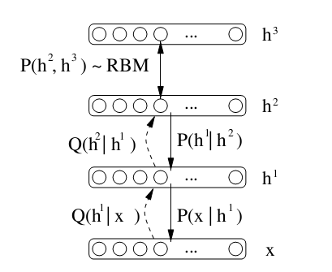
Deep Belief Network (DBN)
Each layer is initialized as an RBM
Characterized by conditional distributions and joint distributions
Training is done layer-by-layer greedily from bottom up.
It is then fed to a conventional NN
Notes:
16

Slide 17
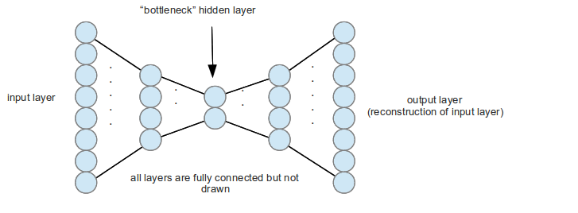
Deep Auto-Encoder (AE)
Code itself and then again reconstruct the output. Can be stacked to form DBNs
Training procedure is similar layer-by-layer
Except, in final step, may be supervised or unsupervised (just like backpropagation)
Denoising AE
Contractive AE
Regularized AE
Notes:
17

Slide 18
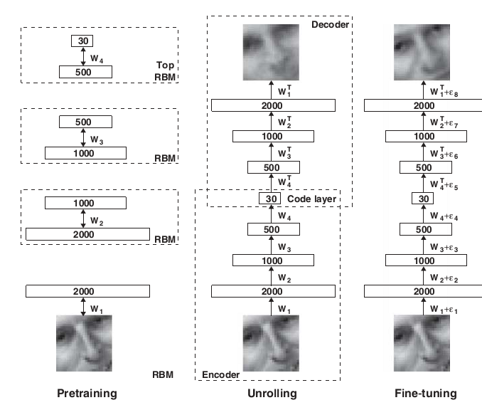
Dimension Reduction via AE
Notes:
18

Slide 19
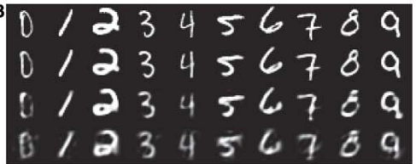
Performance of AE
Original
AE
Logistic PCA
Just PCA
Notes:
19

Slide 20
How to improve DNN?
Dropout
Batch normalization
Notes:
20

Slide 21
Dropout (a.k.a. Dilution)
Dropout is a regularization technique for mitigating overfitting in NN.
The term dilution refers to the thinning of the weights.
The term dropout refers to randomly "dropping out", or omitting, nodes (both hidden and visible) during the training process of a neural network.
Refer to:
Srivastava, Nitish, Geoffrey Hinton, Alex Krizhevsky, Ilya Sutskever, and Ruslan Salakhutdinov. "Dropout: a simple way to prevent neural networks from overfitting." The journal of machine learning research 15, no. 1 (2014): 1929-1958.
Notes:
21

Slide 22
Dropout Neural Network Model (1)
Notes:
22

Slide 23
Dropout Neural Network Model (2)
Notes:
23

Slide 24
Dropout Neural Network Model (3)
Notes:
24

Slide 25
Dropout Neural Network Model (4)
Insights:
Sparse networks can achieve better representation, similar to Occam's razor.
Statistical averaging is similar to mixed strategy in game theory, which is better than pure strategy.
Notes:
25

Slide 26
Batch Normalization (1)
Different sample sets may have different dynamic ranges. To achieve good performance, before applying the AI algorithm to a set of samples, we should align various batches of samples to the same dynamic range.
Such an alignment can be achieved by
centering (shifting the mean of the samples to zero),
and normalization (changing the variance to unit variance
Centering can be achieved by calculating the mean of all the samples in the batch, and subtracting the mean from each sample
Normalization can be achieved by calculating the standard deviation of the samples, and dividing each sample by the standard deviation.
Notes:
26

Slide 27
Batch Normalization (2)
Batch Normalization aims to accelerate the training of DNN.
Batch Normalization also has a beneficial effect on the gradient flow through the network, by reducing the dependence of gradients on the scale of the parameters or of their initial values. This allows for use of much higher learning rates without the risk of divergence.
Furthermore, batch normalization regularizes the model and reduces the need for Dropout.
Refer to:
Ioffe, Sergey, and Christian Szegedy. "Batch normalization: Accelerating deep network training by reducing internal covariate shift." In International conference on machine learning, pp. 448-456. PMLR, 2015.
Notes:
27

Slide 28
Batch Normalization (3)
Notes:
28

Slide 29
Batch Normalization (4)
During training, the gradient of loss ℓ needs to back-propagate through this BN module. Now, TensorFlow can automatically symbolically derive these formulas via end-to-end training.
Notes:
29

Slide 30
Training Batch Normalized Network
Notes:
30

Slide 31
Outline
Why deep learning?
Types of neural networks
DNN (or MLP)
Recursion principle for back-propagation algorithm
CNN
RNN, LSTM
Transformer

Slide 32
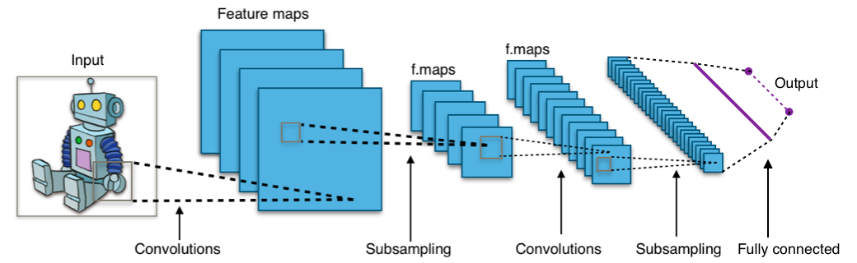
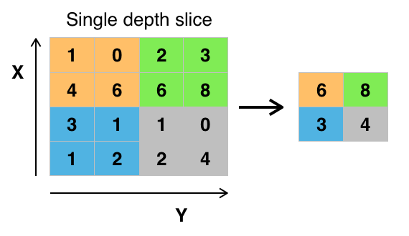
Convolutional Neural Network (CNN)
Max pooling with a 2x2 filter and stride = 2
Notes:
32

Slide 33
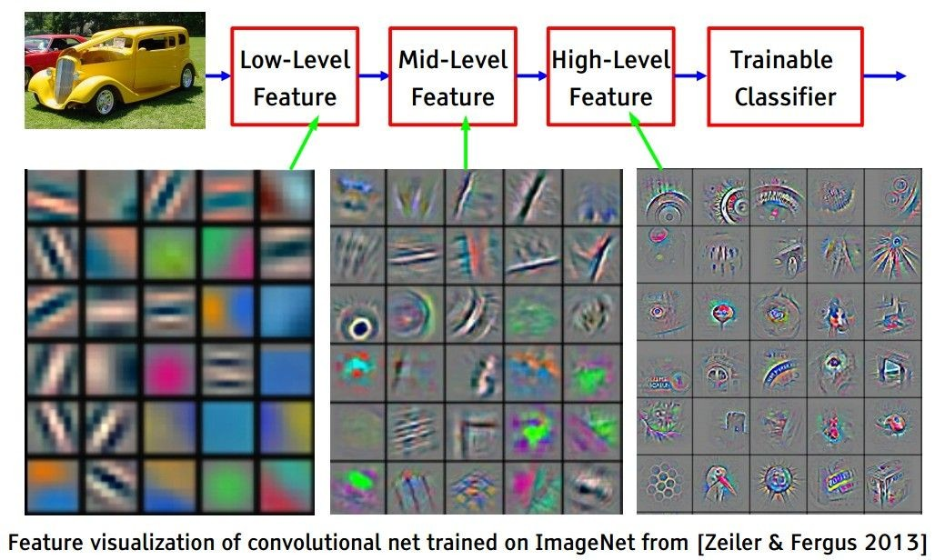
Visualization
[From Yann LeCun slides]
Andrej Karpathy

Slide 34
Examples of CNN
AlexNet
VGGNet
Inception
ResNet
DenseNet
Refer to:
https://towardsdatascience.com/architecture-comparison-of-alexnet-vggnet-resnet-inception-densenet-beb8b116866d
Notes:
34

Slide 35
Outline
Why deep learning?
Types of neural networks
DNN (or MLP)
Recursion principle for back-propagation algorithm
CNN
RNN, LSTM
Transformer

Slide 36
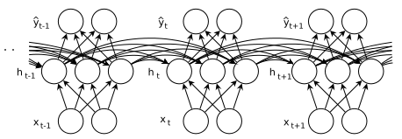
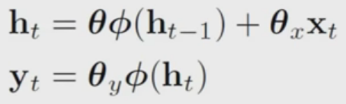
Recurrent Neural Network (RNN)
RNN is used to process time series data such as text, speech, video, weather data
RNN has memory so that it can process stochastic processes with short/long range dependence
Notes:
36

Slide 37
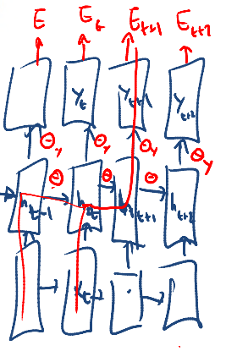
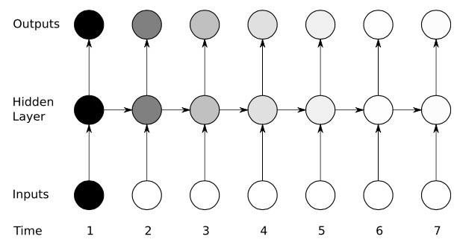
Vanishing/Exploding Gradient Both Temporally and Spatially
Multi-layered RNNs have their
lower layers undertrained
Information from previous input are
not properly carried- chained gradients
ALSO, cannot handle
long range dependency
Notes:
37

Slide 38
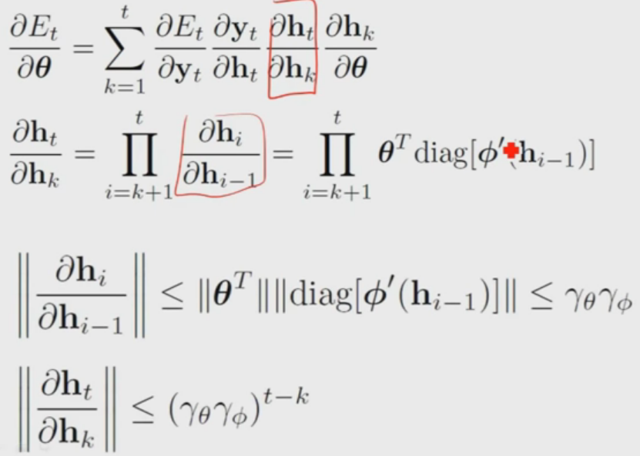
Why, again?
We cannot relate inputs from the distant past to the target output.
Notes:
38

Slide 39
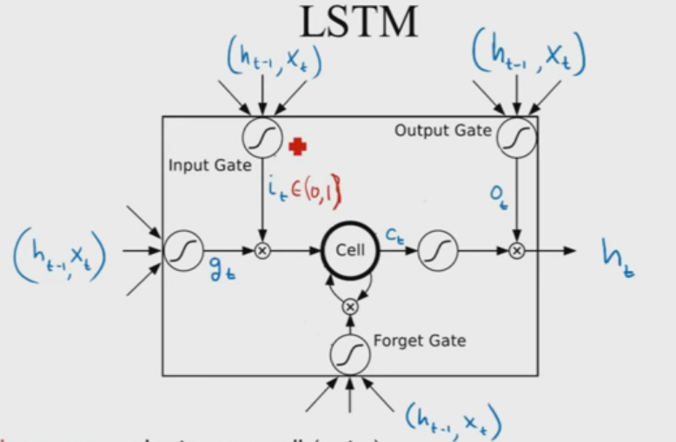
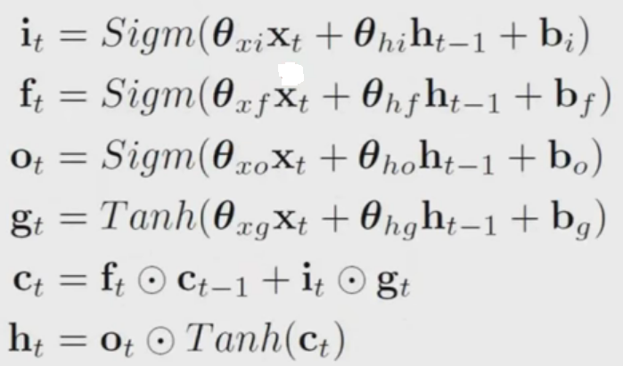
Long Short Term Memory
Error signals trapped within a memory cell cannot change.
Gates have to learn which error to trap and which ones to forget
Notes:
39

Slide 40
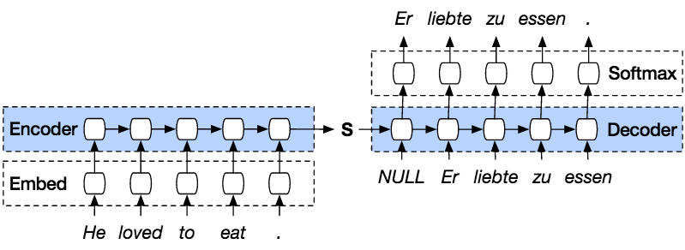
Sequence-to-sequence (Seq2seq)
Seq2seq is a general-purpose encoder-decoder framework; it converts one sequence into another sequence (sequence transformation). It is implemented by two cascading RNNs.
Notes:
40

Slide 41
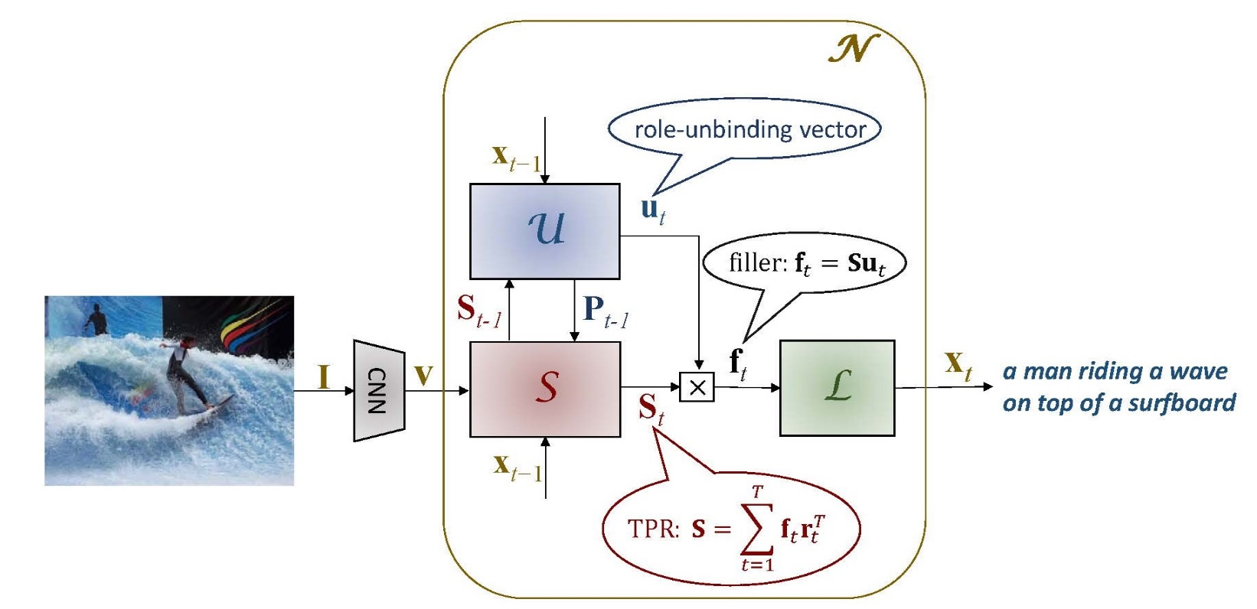
Seq2seq Applications
Applications of Seq2seq include language translation, image captioning, conversational models and text summarization.
Image captioning translates an image language into human language.
Notes:
41

Slide 42
End-to-end (E2E) Training
End-to-end training/learning refers to training a possibly complex learning system by applying gradient-based learning to the system as a whole, instead of training each component individually and then combining them.
End-to-end learning systems are specifically designed so that all modules are differentiable.
An example of E2E training:
https://github.com/suriyadeepan/rnn-from-scratch/blob/master/lstm.py
Notes:
42

Slide 43
An Example of E2E Training
The traditional approach for automatic speech recognition is to design the following pipeline structure:
Audio (input) -> feature extraction -> phoneme detection -> word composition -> text transcript (output).
A clear limitation of this pipelined architecture is that each module has to be optimized separately under different criteria.
The E2E approach uses the following single optimization criterion, achieving better performance:
Audio (input) → (NN) → transcript (output)
Notes:
43

Slide 44
Outline
Why deep learning?
Types of neural networks
DNN (or MLP)
Recursion principle for back-propagation algorithm
CNN
RNN, LSTM
Transformer

Slide 45
Attention Mechanism in AI
In NN, attention is a technique that mimics cognitive attention: focus on important parts of the input data and fades out the rest.
Which part of the data is more important than others depends on the context and is learned with training data.
Two main attention techniques:
dot-product attention, which uses the dot product between vectors to determine attention
multi-head attention, which combines several different attention mechanisms to direct the overall attention of a network or sub-network
Notes:
45

Slide 46
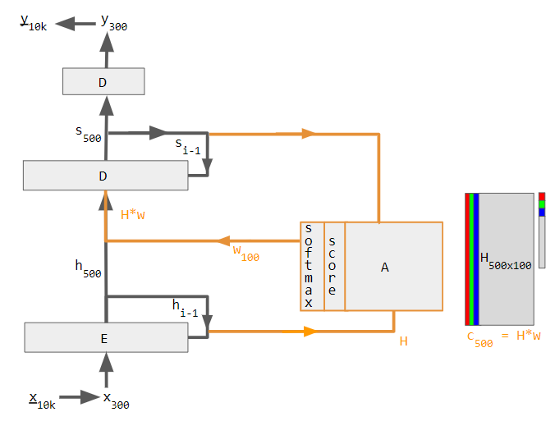
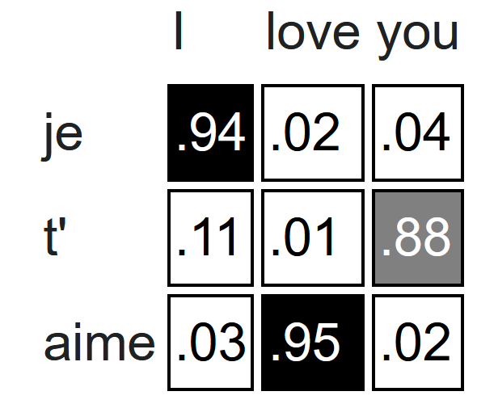
English-to-French Translation Example
Viewed as a matrix, the attention weights show how the network adjusts its focus according to context.
Notes:
46

Slide 47
Transformer (1)
A transformer is a deep learning model that adopts the mechanism of attention, differentially weighing the significance of each part of the input data.
It is used primarily in natural language processing (NLP) and in computer vision.
Before transformers, most state-of-the-art NLP systems relied on gated RNNs, such as LSTM and gated recurrent units (GRUs), with added attention mechanisms. Transformers built on these attention technologies without using an RNN structure, highlighting the fact that attention mechanisms alone can match the performance of RNNs with attention.
Notes:
47

Slide 48
Transformer (2)
Like seq2seq, the transformer adopts an encoder-decoder architecture. The encoder consists of multiple encoding layers that process the input iteratively one layer after another, while the decoder consists of multiple decoding layers that do the same thing to the encoder's output.
Each encoder/decoder layer makes use of an attention mechanism.
For each input, attention weighs the relevance of every other input and draws from them to produce the output.
Each decoder layer has an additional attention mechanism that draws information from the outputs of previous decoders, before the decoder layer draws information from the encodings.
Notes:
48

Slide 49
Transformer (3)
Both the encoder and decoder layers have a feed-forward NN for additional processing of the outputs, and contain residual connections and layer normalization steps.
Notes:
49

Slide 50
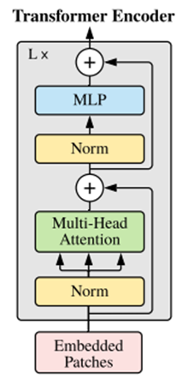
Transformer (4)
Transformer is based on scaled dot-product attention.
For each attention unit, the transformer model learns three weight matrices
query weights W_{Q}
key weights W_{K}
value weights W_{V}
For each token i, the input word embedding x_{i} is multiplied with each of the three weight matrices to produce a query (row) vector q_{i} = x_{i}W_{Q}, a key vector k_{i}= x_{i}W_{K}, and a value vector v_{i}= x_{i}W_{V}.
Notes:
50

Slide 51
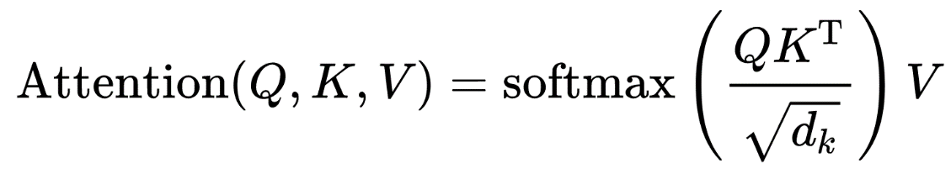
Transformer (5)
The attention weight a_{ij} from token i to token j is the dot product between q_{i} and k_{j}, divided by the square root of the dimension of a key vector, and passed through a softmax which normalizes the weights.
Define matrices Q, K and V as the matrices whose i-th rows are vectors q_{i}, k_{j}, and v_{i}, respectively.
Notes:
51

Slide 52
Multi-head Attention in Transformer
One set of (W_{Q}, W_{K}, W_{V}) matrices is called an attention head, and each layer in a transformer model has multiple attention heads.
While each attention head attends to the tokens that are relevant to each token, with multiple attention heads the model can do this for different definitions of "relevance".
For example, some attention heads can attend mostly to the next word, while others mainly attend from verbs to their direct objects.
The outputs for the attention layer are concatenated to pass into the feed-forward neural network layers.
Notes:
52

Slide 53
Encoder/Decoder in Transformer
Each encoder consists of two major components:
a self-attention mechanism
a feed-forward neural network
Each decoder consists of three major components:
a self-attention mechanism
an attention mechanism over the encodings
a feed-forward neural network.
Notes:
53

Slide 54
Transformer vs. RNN
In NLP, transformers achieve better performance than RNNs.
This is because parallelization allows training transformers on extremely large datasets. This led to the development of pretrained systems such as BERT (Bidirectional Encoder Representations from transformers) and GPT (Generative Pre-trained Transformer).
The pre-trained transformers can be fine-tuned for specific tasks.
Notes:
54

Slide 55
Reading Assignment
Magnus, Jan R., and Heinz Neudecker, “Matrix differential calculus with applications in statistics and econometrics,” John Wiley & Sons, 2019.
Xian-Da Zhang, “Matrix Analysis and Application,” Cambridge University Press, 2017
Notes:
55

