Slide 1
CS 5187: Vision and Image Lecture 6-1 Scale Invariant Feature Transform (SIFT)
Dr. Dapeng Oliver Wu
City University of Hong Kong
Department of Computer Science
Semester A, 2025/26

Slide 2
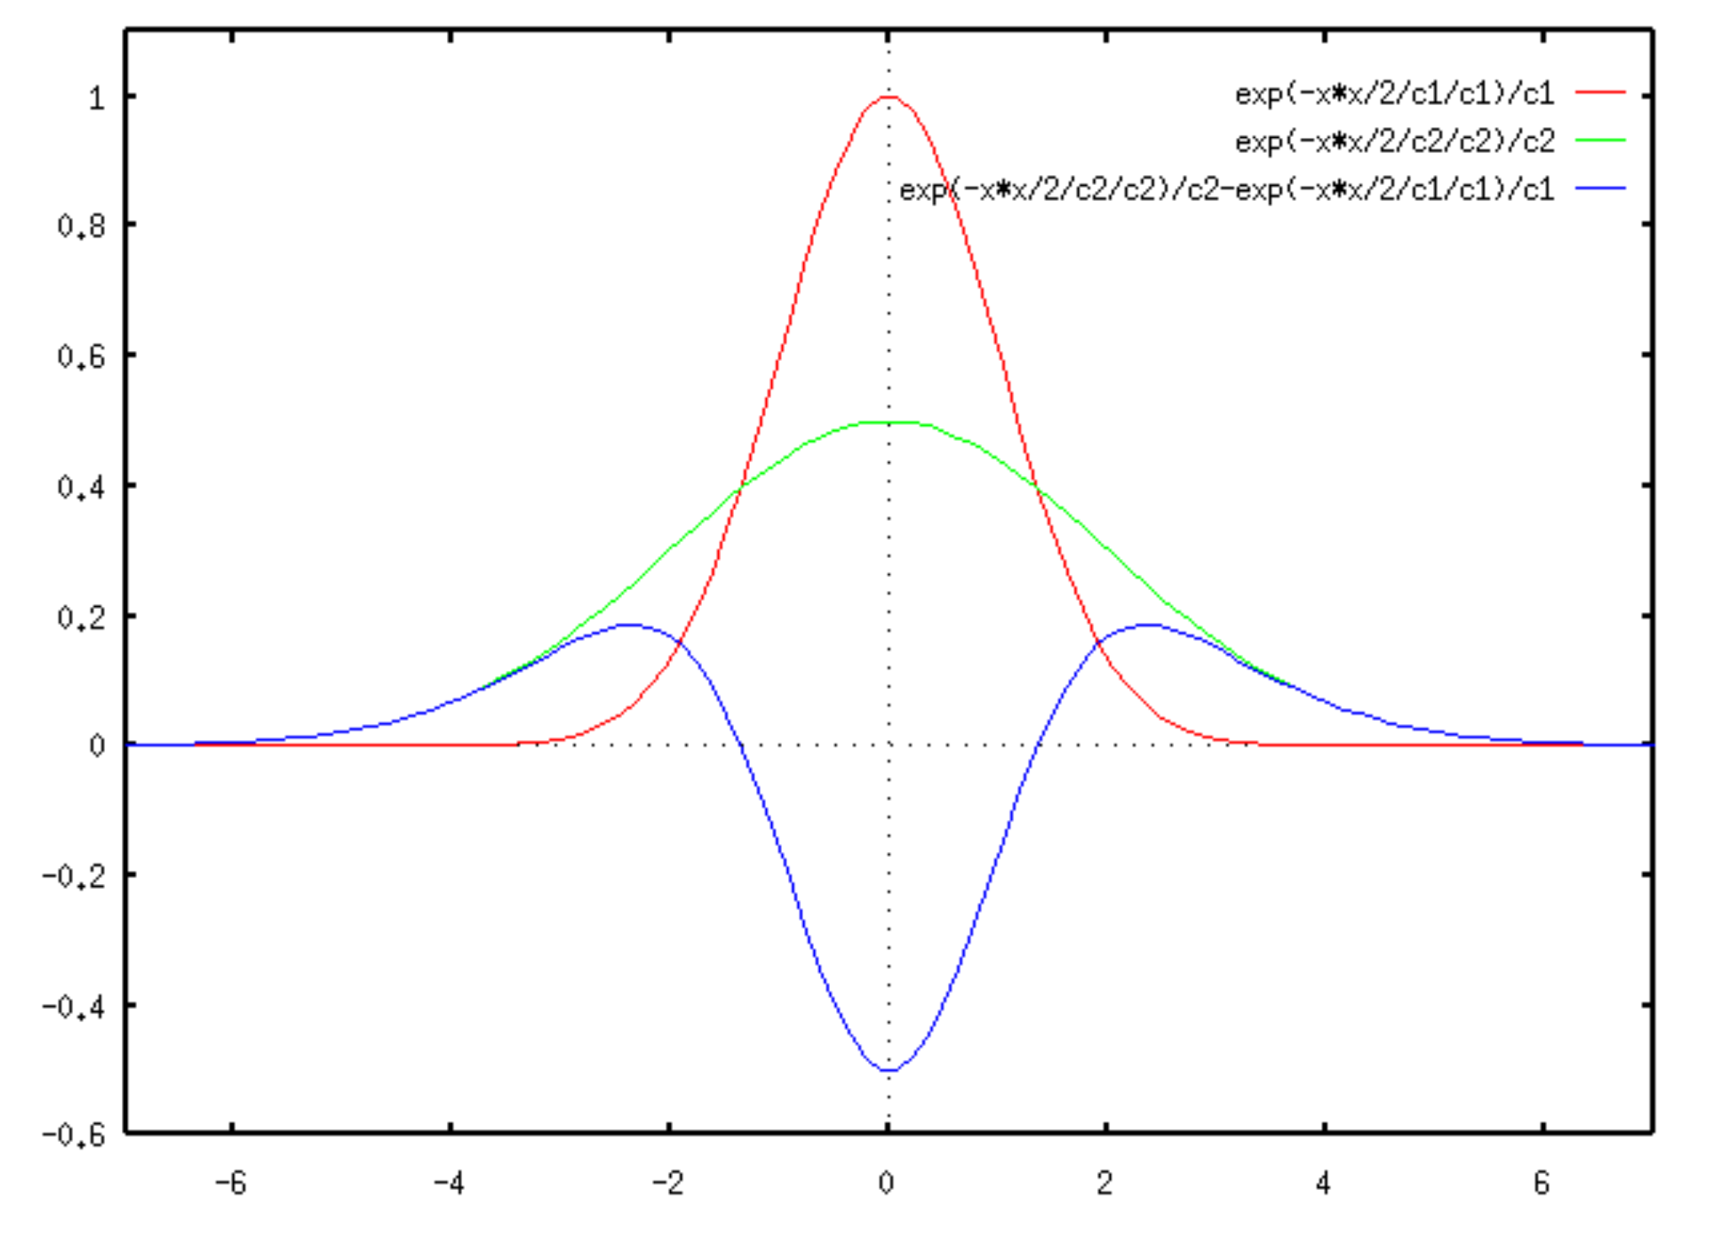
LoG-DoG (Difference of Gaussian)
LoG can be approximated by a difference of two Gaussians (DoG) at different scales
Adapted from Wiki

Slide 3
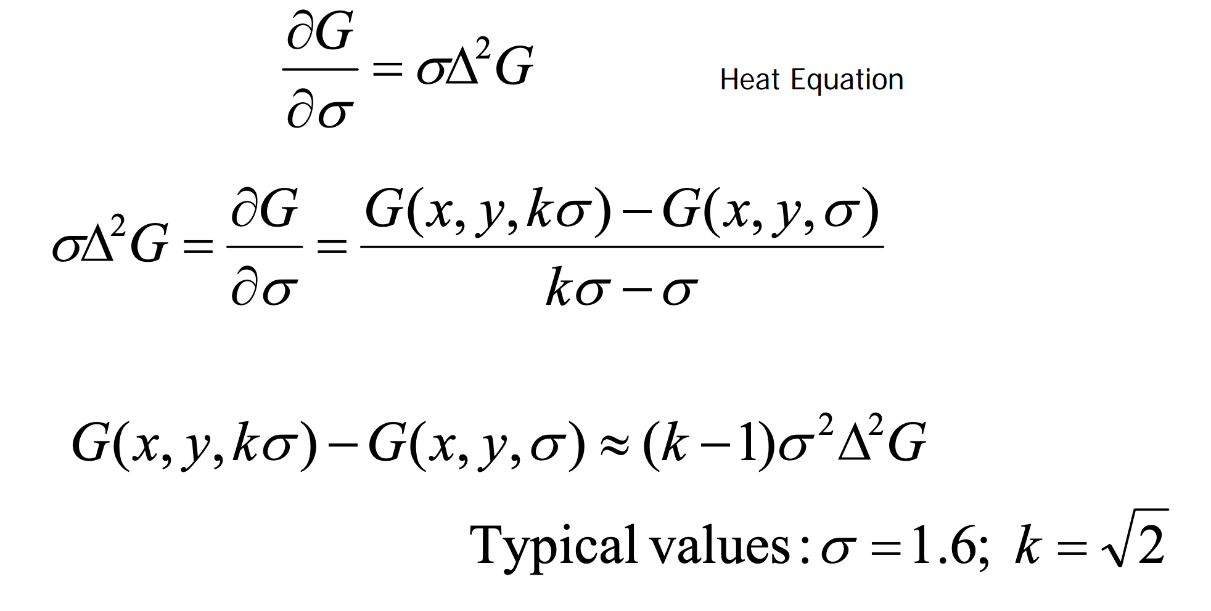
LoG-DoG (Difference of Gaussian)
Adapted from slide by Mubarak Shah

Slide 4
Scale Invariant Feature Transform
Build a scale space
Find a peak in the scale space => Localize a key point
Orientation assignment
Assign an orientation to the key point, based on the orientation histogram of its neighborhood.
Key point descriptor
Describe the key point by a high dimensional vector (128) (SIFT Descriptor)
Adapted from slide by Mubarak Shah

Slide 5
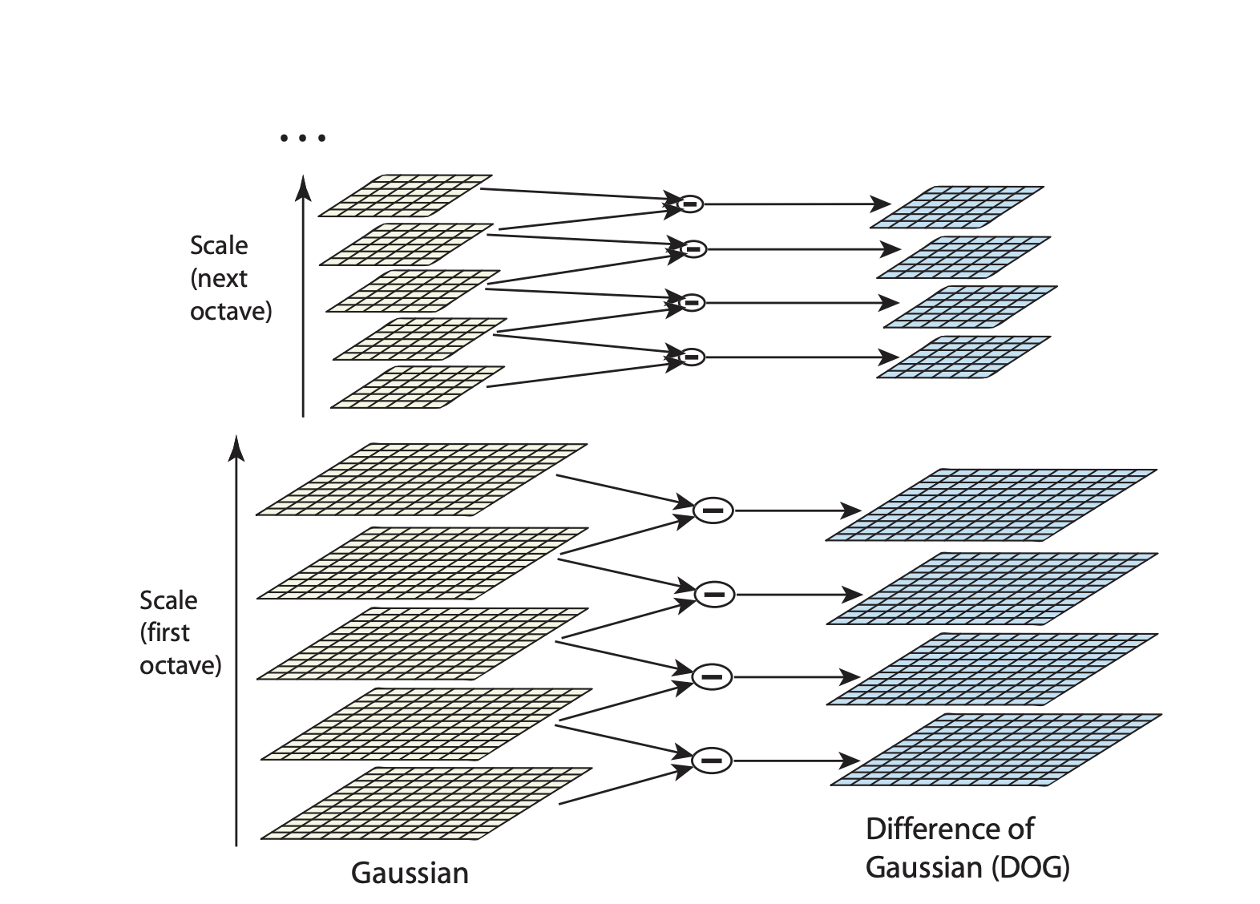






Building the Scale Space
$$k^{2}σ$$
$$k^{4}σ$$
$$k^{3}σ$$
$$k^{2}σ$$
$$kσ$$
$$σ$$
Adapted from IJCV 2004 by David Lowe
Notes:
K=1.4 impact of the filtering will be twice as much

Slide 6
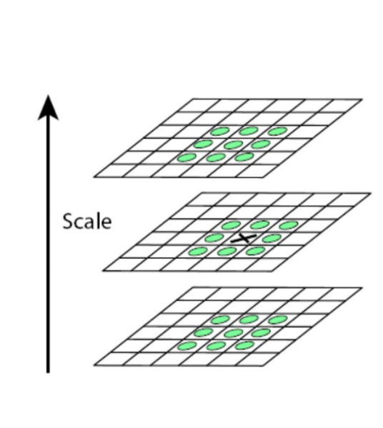
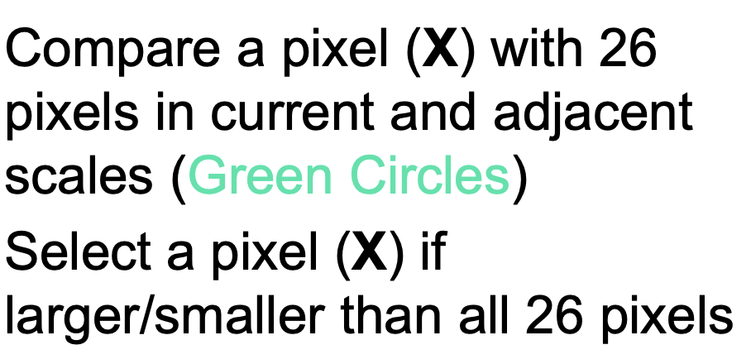
Peak Detection
Adapted from slide by Mubarak Shah
Notes:
Low contrast, poorly localized

Slide 7
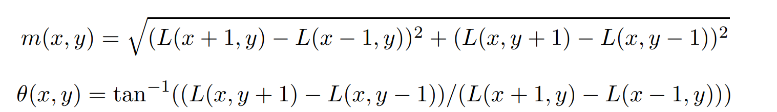
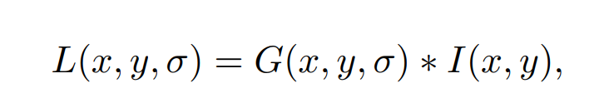
Assignment of the Orientation
Compute the gradient magnitude and direction of each pixel/point at the scale of the keypoint.
Adapted from IJCV 2004 by David Lowe
Notes:
Low contrast, poorly localized

Slide 8
Assignment of the Orientation
An orientation histogram is formed from the gradient orientations
of the points within a region around the keypoint.
The orientation histogram has 8 bins covering the 360 degree
range of orientations, i.e., the size of each bin is 45 degrees.
The samples added to the histogram is weighted by the
gradient magnitude.
The peak in the histogram represents the dominant direction.
Adapted from IJCV 2004 by David Lowe
Notes:
Low contrast, poorly localized

Slide 9
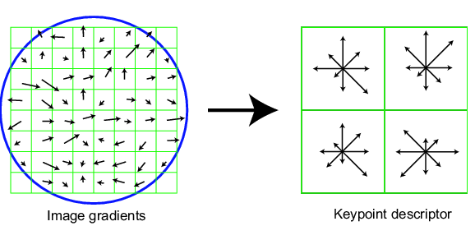
SIFT descriptor
A quarter version
Divide the 8x8 window into a 2x2 grid of cells; each cell contains 4x4=16 pixels
Compute
Compute an orientation histogram (8 bins) for each cell (weighted by the gradient magnitude)
4 cells * 8 bins = 32 dimensional descriptor
Adapted from slide by David Lowe

Slide 10
SIFT descriptor
Full version
Divide the 16x16 window into a 4x4 grid of cells; each cell contains 4x4=16 pixels
Compute an orientation histogram (8 bins) for each cell (weighted by the gradient magnitude)
16 cells * 8 bins = 128 dimensional descriptor
Adapted from slide by David Lowe

Slide 11
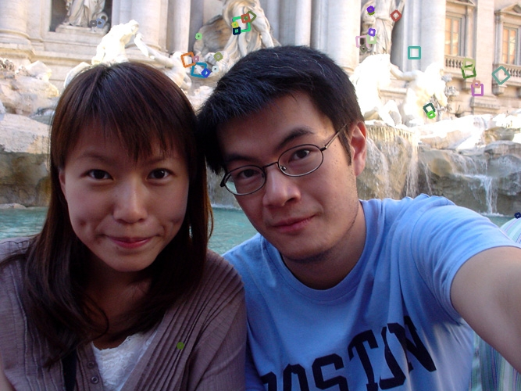
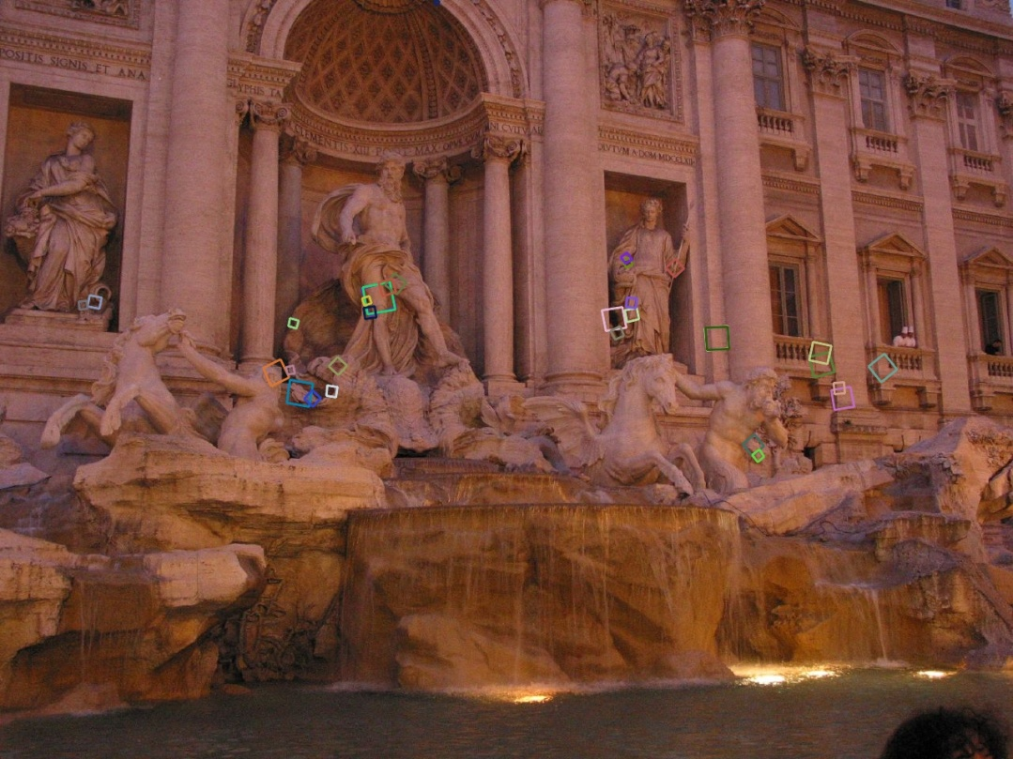
Properties of SIFT
Robust matching technique
Can handle changes in viewpoint
Can handle significant changes in illumination
Fast and efficient—can run in real time
Lots of code available

Slide 12
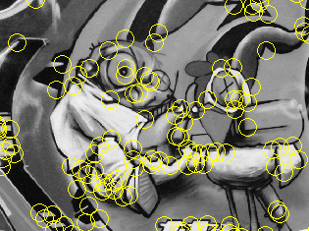
Summary
Keypoint detection:
Corners, blobs (stable regions)
Harris, LoG
Descriptors: robust and selective
histograms of orientation
SIFT and its variants are typically good for stitching and recognition

Slide 13
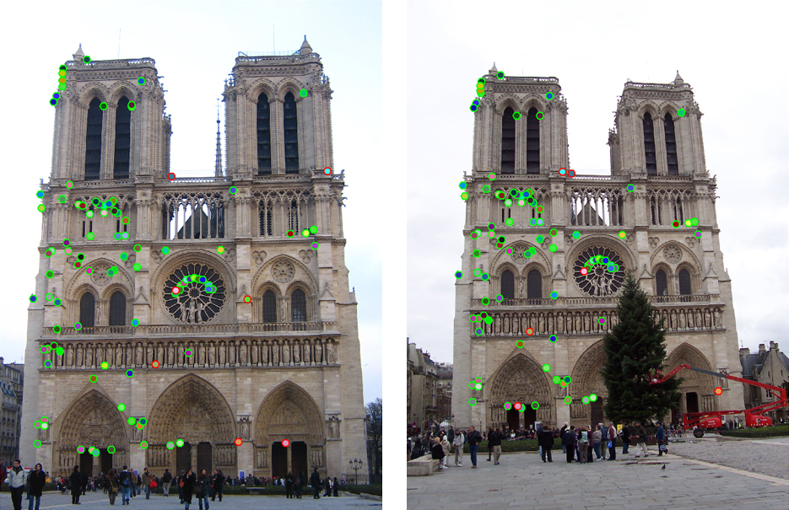
Which features match?

Slide 14
Feature matching
Given a feature in I₁, how to find the best match in I₂?
Define distance function that compares two descriptors
Test all the features in I₂, find the one with min distance

Slide 15
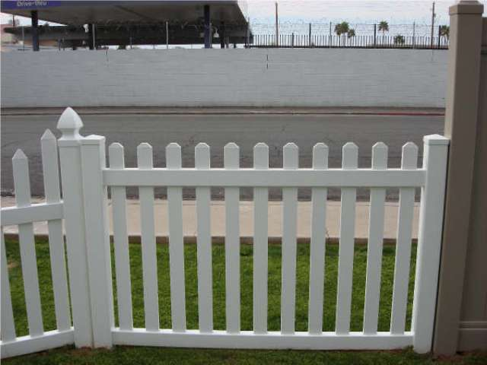
Feature distance
How to define the difference between two features f₁, f₂?
Simple approach: L₂ distance, ||f₁ - f₂ ||² (a.k.a. SSD)
can give good scores to ambiguous (incorrect) matches
f₁
f₂
I₁
I₂

Slide 16
Feature distance
How to define the difference between two features f₁, f₂?
Better approach: ratio distance = ||f₁ - f₂ ||² / || f₁ - f₂’ ||²
f₂ is best SSD match to f₁ in I₂
f₂’ is 2nd best SSD match to f₁ in I₂
gives small values for ambiguous matches (such matching pairs should not be considered and need to be dropped)
f₁
f₂'
f₂
I₁
I₂

Slide 17
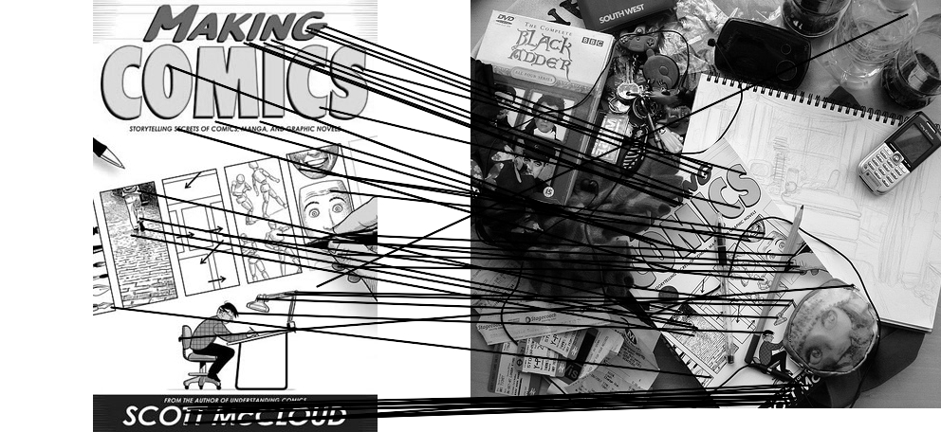
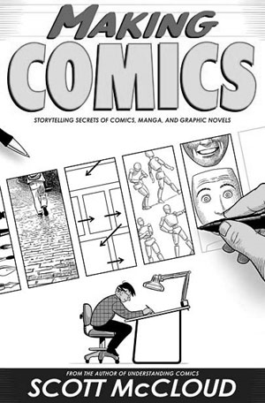

Feature matching example
51 matches (thresholded by ratio score)

Slide 18
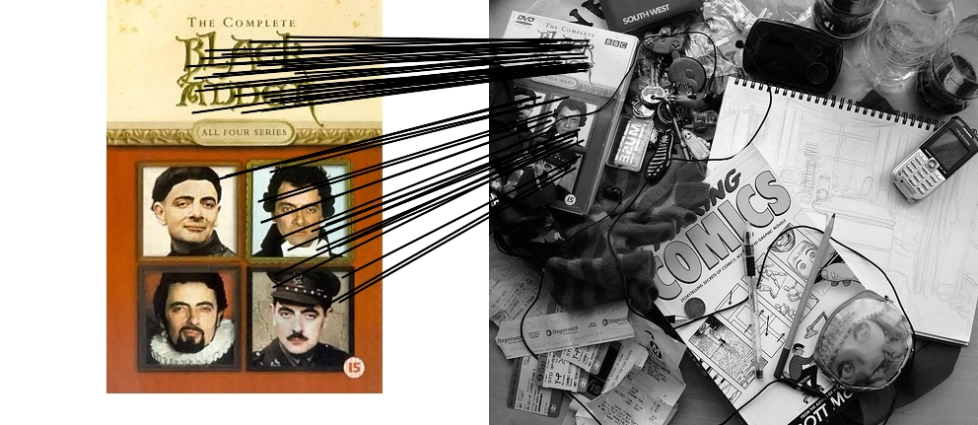
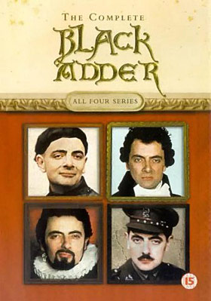
Feature matching example
58 matches (thresholded by ratio score)

